Slide 1
Fluid and Electrolytes for surgical patients in Emergency Department
Dr Abdulaziz Alrabiah, MD
Emergency Medicine, Trauma & EMS specialist

Slide 2
Objectives
IV Fluids
different types and classifications
indications
+/- contraindication
Electrolytes
Hyper / Hypo Na
Hyper / Hypo K
Hyper / Hypo Ca

Slide 3
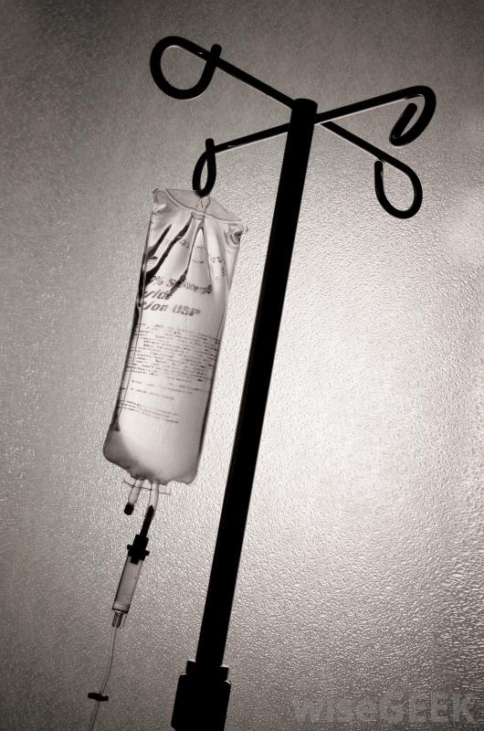
IV Fluid

Slide 4
Types of IV fluid
3 types ( tonicity / osmolarity )
Isotonic
Hypotonic
Hypertonic

Slide 5
Isotonic | Hypotonic | Hypertonic
Osmolality : 250-375 mOsm/L no fluid shifting only increase IV | Osmolarity < 250 mOsm/L shift of fluid from Intravascular to intracellular space hydrate the cell —> to cell | Osmolarity >375 mOsm/L shift fluid from IC to IV dehydrate the cell —> cell shrinkage

Slide 6
Classifications of IV fluid
Crystalloids
Colloids

Slide 7
Crystalloids
0.9 % Normal saline
Ringer lactate
0.45% Normal saline (1/2 NS)
5% Dextrose
5% dextrose + 0.45% NS
2.5% dextrose + 0.45% NS
4% dextrose + 018% NS
10% dextrose
3% normal saline

Slide 8
0.9% Normal saline
component
Na 150 mmol/L
CL 150 mmol/L
isotonic solution : 308 mOsm/L
PH 5.3
indications
replacement of fluid loss i.e. DKA, upper GI bleeding
therapy for hyponatremia
shock
contraindication
hypernatremia
hyperchloremia —> metabolic acidosis

Slide 9
lactated ringer (Ringer lactate)
components
Na 130 mmol/L
Cl 109 mmol/L
Lactate 28 mmol/L
K 4 mmol/L
Ca 1.5 mmol/L
isotonic solution : 275 mOsm/L
indications
preferred fluid for trauma patient
less hyperchloremic metabolic acidosis than 0.9 % NS

Slide 10
5% dextrose
component
Glucose 50g / L
isotonic solution : 260 mOsm/L
indication
Hypoglycaemia
hypernatremia
additional maintenance fluid
most effective fluid in establish urine flow in euvolaemic patient (i.e. patient going for pelvic ultrasound and needs full bladder)

Slide 11
0.45% (1/2) normal saline
component
Na 75 mmol/L
Cl 75 mmol/L
hypotonic solution : 154 mOsm/L
indication
DKA ( 2nd hour to avoid hyperchloemic metabolic acidosis)
therapy of hypernatermia

Slide 12
to make think more complicated!!!
3% NS = 0.9 % NS X 3
used in acute symptomatic hyponatremia
10% dextrose
Glucose 100 g/ L
5% dextrose + 0.45% NS
i.e. in DKA
2.5% dextrose + 0.45% NS
4% dextrose + 018% NS

Slide 13
Colloids
more expensive than crystalloid solution
not shown to have any benefit over crystalloid solution in initial resuscitation
Adverse effects
best avoided in the bleeding trauma patient due to potential anti-coagulant effects:
impair fibrin polymerisation
decrease clot elasticity
decrease clot weight
reduce von Willebrand factor levels
antiplatelet effects

Slide 14
4% albumin (Albumex4)
drives from human plasma
PH 7
albumin 40g/L
Na 140 mmol/L
Cl 128 mmol/L
K 0.12 mmo/L
octanoate 6.4 mmol/L
isotonic solution : 250 mosm/L

Slide 15
4% albumin (Albumex4)
indications
hypovolaemia associated with altered capillary permeability / hypoalbuminaemia
burns after 12 hours
shock and albumin < 20 g/L
possible role in enhancing binding of highly protein bound toxic agents (aspirin, TCADs)
complications
fluid over load ( t 1/2 5 days in blood )
infection
expensive
no mortality advantage over normal saline in volume expansion of critically ill patient

Slide 16
other colloid fluid
20% albumin ( Albumen 20 ) : 200 g / L
Gelofusine
Starch solution

Slide 17
Electrolytes disorders

Slide 18
Na
Major extracellur electrolytes
normal Na level in blood 135 mEq/L - 145mEq/L

Slide 19
Hyponatremia1
Na+ < 135mmol/L
Mild 125-134 : Asymptomatic
Moderate 120-124 : lethargy , confusion , anorexia, nausea, vomiting
Severe <120 : muscle cramp, weakness, convulsions, coma

Slide 20
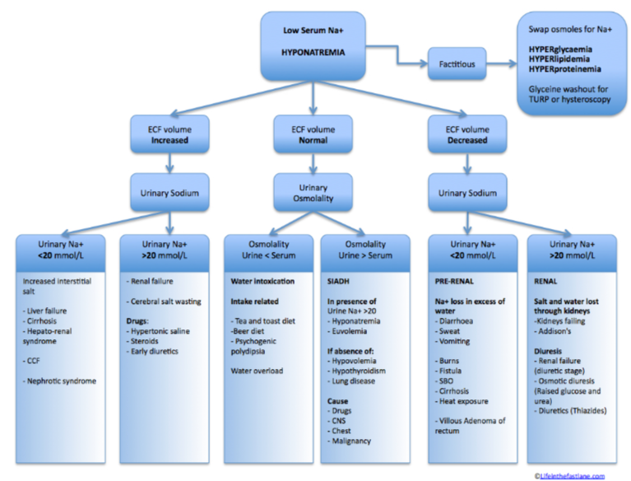
Hyponatremia2
causes and types

Slide 21
Hyponatremia3
HISTORY
speed of onset more important than level
most patients won’t be symptomatic until Na+ < 125mmol/L
fluid intake/output
nausea
vomiting
neuropsychiatric symptoms
muscular weakness
headache
lethargy
psychosis
raised ICP
seizures
coma
medications!
ROS to find precipitant and organ dysfunction
co-morbidities: adrenal disease, liver disease

Slide 22
Hyponatremia4
EXAMINATION
volume status
neurological complications (increased ICP, lateralizing signs)
INVESTIGATIONS
diagnostic
U+E (Na+, glucose, renal function)
plasma osmolality
plasma proteins and lipids
urinary Na+

Slide 23
Hyponatremia5
Management
calculate Na deficit
Na deficit= (desired Na-current Na) x (0.6 x body weight)
correction
In acute severe hyponatraemia, aim for 1-2mEq/hour correction
In chronic severe hyponatraemia aim for 0.5-1mEq/hour correction.
Hypertonic saline replacement
3% saline (513mEq/L) by giving (deficit/513) to the patient at the rate of 1mEq/hour over 4 hours

Slide 24
Hypernatremia
Na > 145mmol/L
causes
water loss:each1 L loss —> 3-5mEq rise in Na
sweat, burn, vomiting, diarrhoea, fistula, Diabetes insipidus.
decrease water intake i.e. hypothalamic lesion —> disorder thirst perception
increase salt intake
primary hyperaldosteronism
ectopic ACTH

Slide 25
Hypernatremia 2
clinically
dehydration
increase risk of IC bleed , due to brain shrinkage

Slide 26
Hypernatremia 3
correction
Stop ongoing losses
Correct water deficit
Correct sodium deficit if hypovolaemic
Treat the underlying cause
Complications of treatment
Intracerebral haemorrhage
Coma and seizures
Cerebral oedema (if correction too rapid)

Slide 27
Hypernatremia4
calculate water deficit
total body water X (serum Na -140) / (140)
0.5 X Kg X (serum Na -140) / (140)
Choice of fluid : oral free water or 5% dextrose over 24-48 hr with reduction rate of 0.5 - 1 mmol/L

Slide 28
K

Slide 29
Hyperkalemia
normal K 3.5 - 5.1 Hyperkalemia >5.1
causes
increase intake ( oral or IV )
endogenous K load
haemolysis
rhabdomyolysis
burns
TLS
increase activity
trauma

Slide 30
Hyperkalemia
decrease K excretion
renal failure
drugs i.e. k sparing diuretics
Pseudohyperkalemia ( Factitious )
hemolysis ( Venipuncture )
Thrombocytosis
Leukocytosis

Slide 31
Hyperkalemia
Clinical features are often non specific
Generalised muscle weakness
Flaccid paralysis and parathesia of the hands and feet
Lethargy, Confusion, Weakness and Palpitations

Slide 32
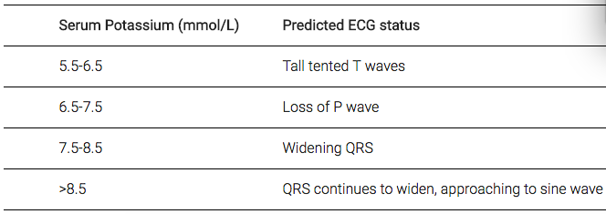
Hyperkalemia
ECG changes

Slide 33
Hyperkalemia
Management
Ca Cl 10%
Ca Gluconate 10%
Insulin and Glucose
10 Unit act rapid + 50 g Glucose ( 25 ml )
sodium bicarb : 100 ml , 8.4%
Salbutamol 10 mg Neb
Calcium resonium 15 gm orally or rectally
Dialysis
? Frusemide 20 - 80 mg
Normal saline

Slide 34
Hypokalemia
K < 3.5
causes
decrease intake
increase loss
GIT loss : vomit, NGT , Diarrhoea , fistula
renal loss
diuretics, mannitol
primary and secondary hyperaldosternism
cushing syndrome
renal artery stenosis

Slide 35
Hypokalemia
transcellular shift
alkalosis
dextrose, insulin infusion
Pernicious anaemia, AML

Slide 36
Hypokalemia
Clinical
Weakness
Fatigue
Paralysis and rhabdomyolysis
Respiratory difficulty
Constipation/ileus
Leg cramps

Slide 37
Hypokalemia
Correction
Minimise further K loss (commonest is GI loss and drugs)
Give potassium replacement
Correct magnesium and phosphate deficiencies
Oral K
Chlorvescent (K 14mmol, Cl 8mmol)
Span K (KCL 8 mmol) – nteric coated, delayed release
Intravenous
Maximum 20mEq/hr unless imminent cardiac arrest
CVL required if > 10mmol/hr
Requires ECG monitoring

Slide 38
Ca

Slide 39
Hypercalcemia
normal 2.2 - 2.6 mmol/L
causes
bone malignancy
hyperparathyroidism
addison’s , pheochromocytoma
dehydration
TB , sarcoidosis
drugs i.e. Lithium , thiazides, Vit D
Factitious
hyper-albumin
prolong cuff time

Slide 40
Hypercalcaemia
Clinical symptoms
Stones (Renal colic and hypercalcaemic stones)
Bones (Increased osteolysis and fractures)
Psychic moans (Depression, confusion, hallucinations and coma)
Abdominal groans (Anorexia, N, V, constipation, PUD, pancreatitis)
Other
Muscle weakness, malaise, hyporeflexia
Confusion, apathy, decreased memory
Nephrogenic diabetes insipidus (Polyuria and polydipsia)

Slide 41
Hypercalcaemia
Complication
Cardiac Arrhythmia and ECG changes
QT shortening (Prolonged with low K, Ca, Mg)
Prolonged PR
Widened QRS
Notched QRS with increased voltage
AV block…..CHB…..cardiac arrest

Slide 42
Hypercalcemia
Management
Fluid , fluid , fluid
Haemodialysis i.e. CVS or renal compromise
Calcitonin , Bisphosphonates i.e. reduce bone resorption & reduce GIT absorption

Slide 43
Hypocalcemia
Ca < 2.2 mmol/L
causes
Hypoparathyroidism
Vitamin D deficiency
Acute pancreatitis
Hyperphosphataemia
Hypomagnesaemia
Diuretics (frusemide)
Pseudohypoparathyroidism
Congenital disorders (e.g. DiGeorge syndrome)
Critical illness (e.g. sepsis)
Factitious (e.g. EDTA blood tube contamination)

Slide 44
Hypocalcaemia
Symptoms
Neuromuscular excitability
Carpopedal spasm
Tetany
Chvostek’s sign
Trousseau’s sign
Seizures

Slide 45
Hypocalcemia
ECGs Changes
Hypocalcaemia causes QTc prolongation primarily by prolonging the ST segment.
Dysrhythmias are uncommon, although atrial fibrillation has been reported.
Torsades de pointes may occur, but is much less common than with hypokalaemia or hypomagnesaemia.

Slide 46
Hypocalcaemia
Management
treat the cause
replace ca
Oral
IV Ca 10 ml Ca Gluconate , or Ca chloride
indication for IV Ca
symptomatic
Ca < 0.8
hyper kalmia
CCB overdose
after massive transfusion

Slide 47
Thank You
aalrabiah@ksu.edu.sa

