Slide 1
I regret now

Slide 2
Aim of the cession
To refresh your information regarding management of lung cancer by practical case scenario.

Slide 3
The case
Saud is a 56 years old male patient who works as a lawyer. He has recently discovered hypertension. He is a smoker for the last 30 years. He joined cigarette cessation programs many times but every time he smoke again. He claims that stress of the work is the cause.

Slide 4
He was in his usual health state till 3 months ago when he started to have more cough and excessive sputum. He sought medical care in a private clinic and received a short course of antibiotics. The condition improved to some extent but after few days the sputum became red. This is why he came to our hospital

Slide 5
Questions
What is the important information in this story?
What is the main complaint ?
What are the other questions you want to ask?
What is the next step?

Slide 6
Examination
The patient has an average built. He lies comfortable in bed but he is worried. His blood pressure is 130/90, pulse is regular, 80/min. and and his temperature is 37.1.

Slide 7
Questions
What are other signs you want to search for?
What is the organ you want to examine more thoroughly?
What is the differential diagnosis?
What is the next step?

Slide 8
Differential Diagnosis
?

Slide 9
Investigations
Diagnosis.
-radiological.
- pathological.
Staging.
Importance of mediastinal LN.

Slide 10
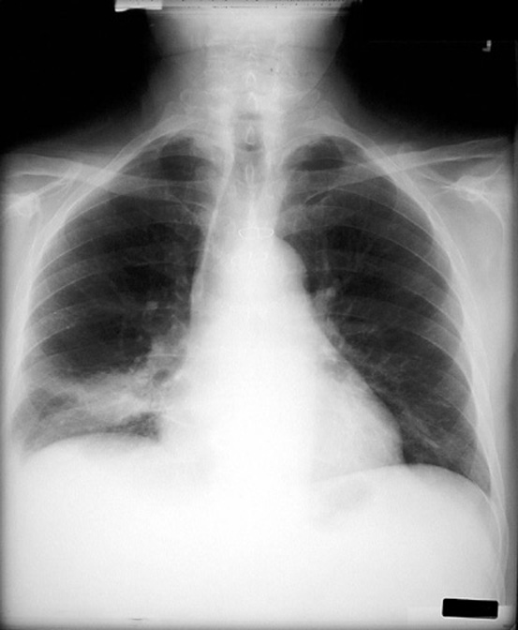
Chest x-ray

Slide 11
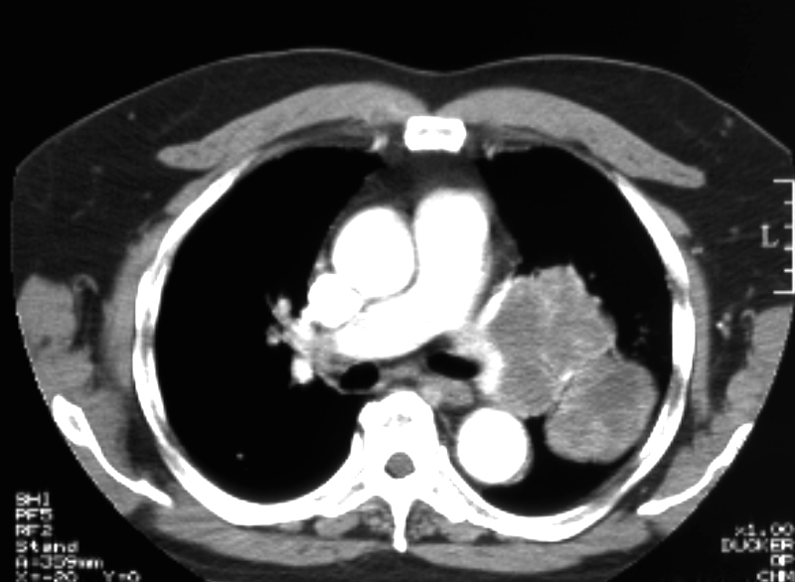
Ct lungs

Slide 12
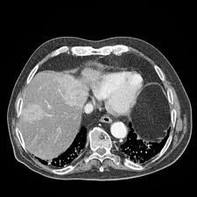
CT Abdomen & Pelvis

Slide 13
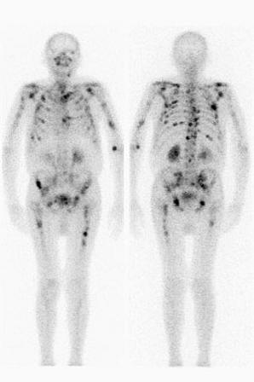
Bone Scan

Slide 14
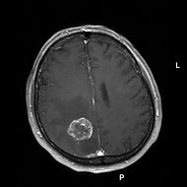
Brain MRI

Slide 15
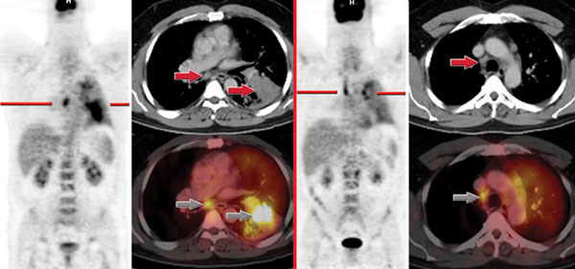
PET Scan

Slide 16
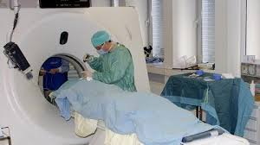
Biopsy

Slide 17
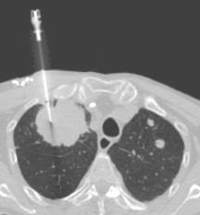
Ct-guided biopsy

Slide 18
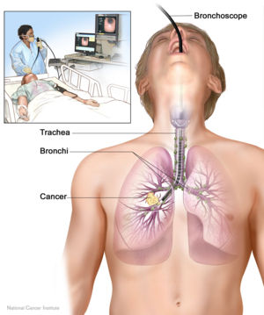
Bronchoscopy

Slide 19
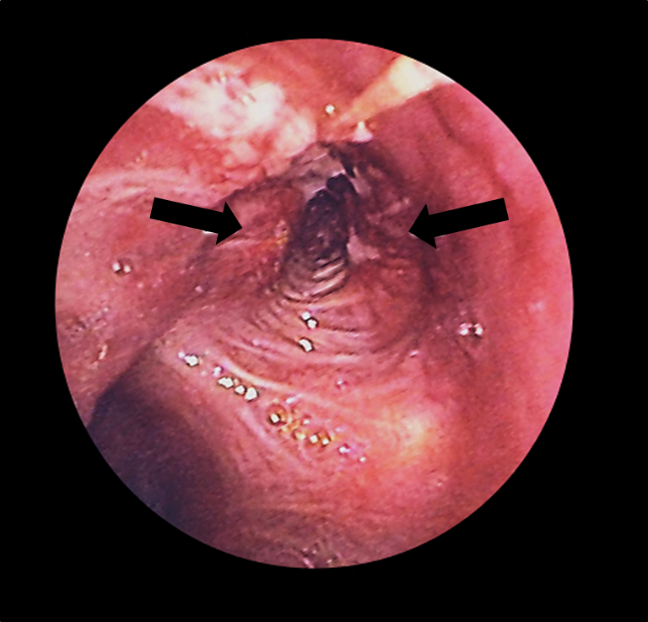
Bronchoscopy

Slide 20
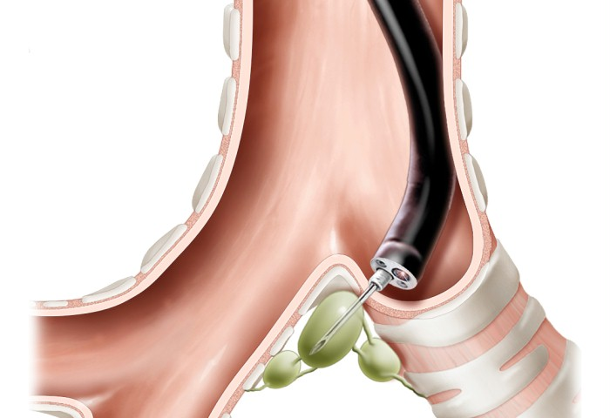
Transbronchial FNA

Slide 21
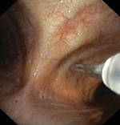

Slide 22
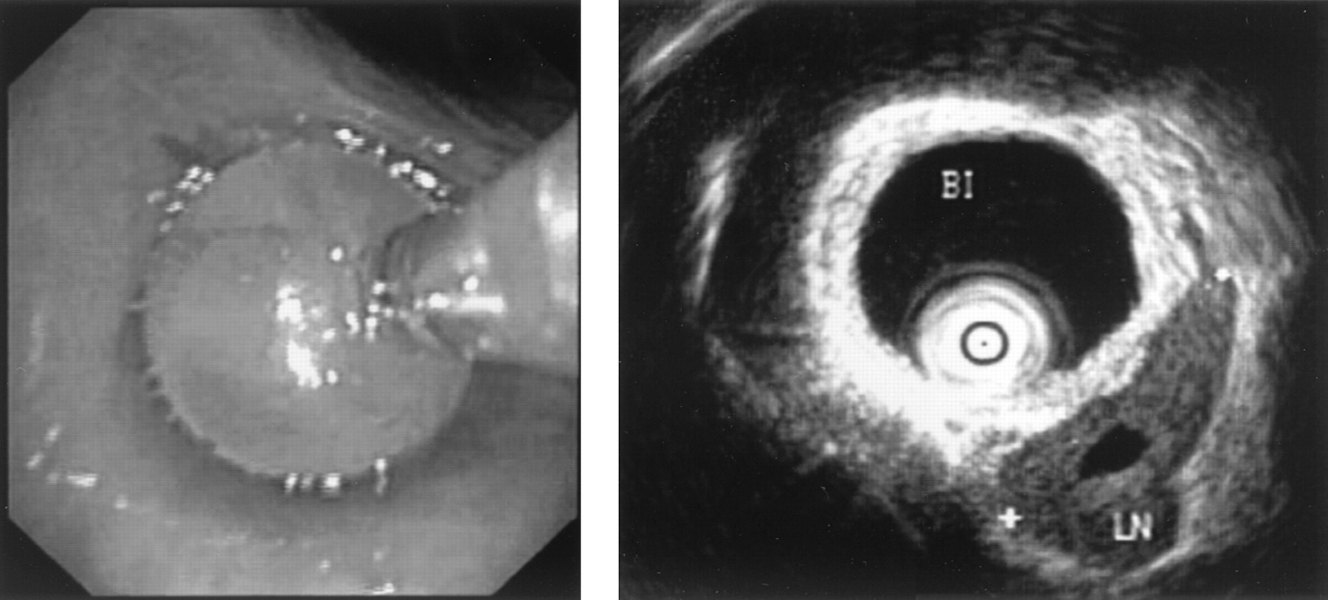
EBUS

Slide 23
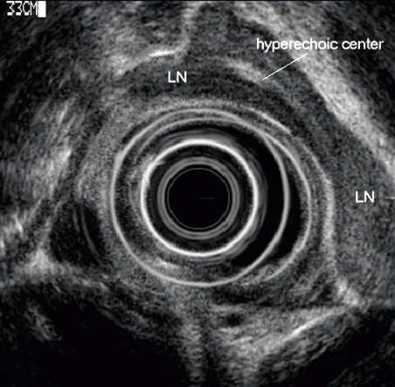
EUS

Slide 24
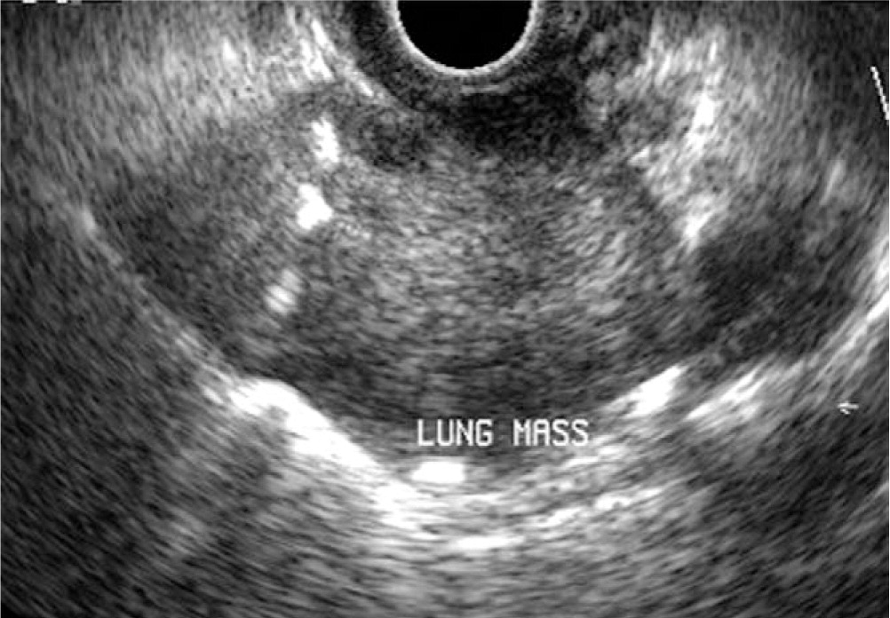
Trans-esophageal FNA

Slide 25
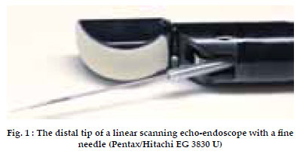

Slide 26
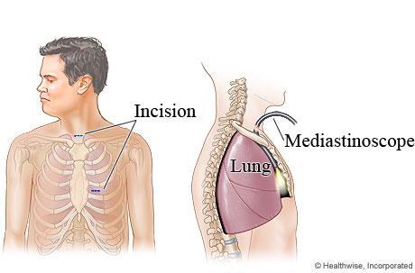
Mediastinoscopy

Slide 27
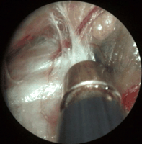

Slide 28
TREATMENT
TNM staging.
Multi-modality treatment.

Slide 29
Surgical Treatment
Preoperative assessment :
General health status.
- Arterial Blood gases
PFT
Ventilation perfusion scan.

Slide 30
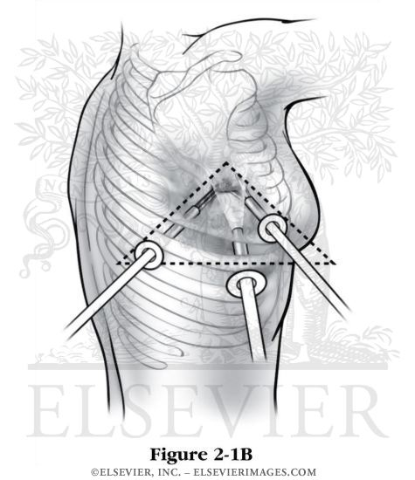
The incision

Slide 31
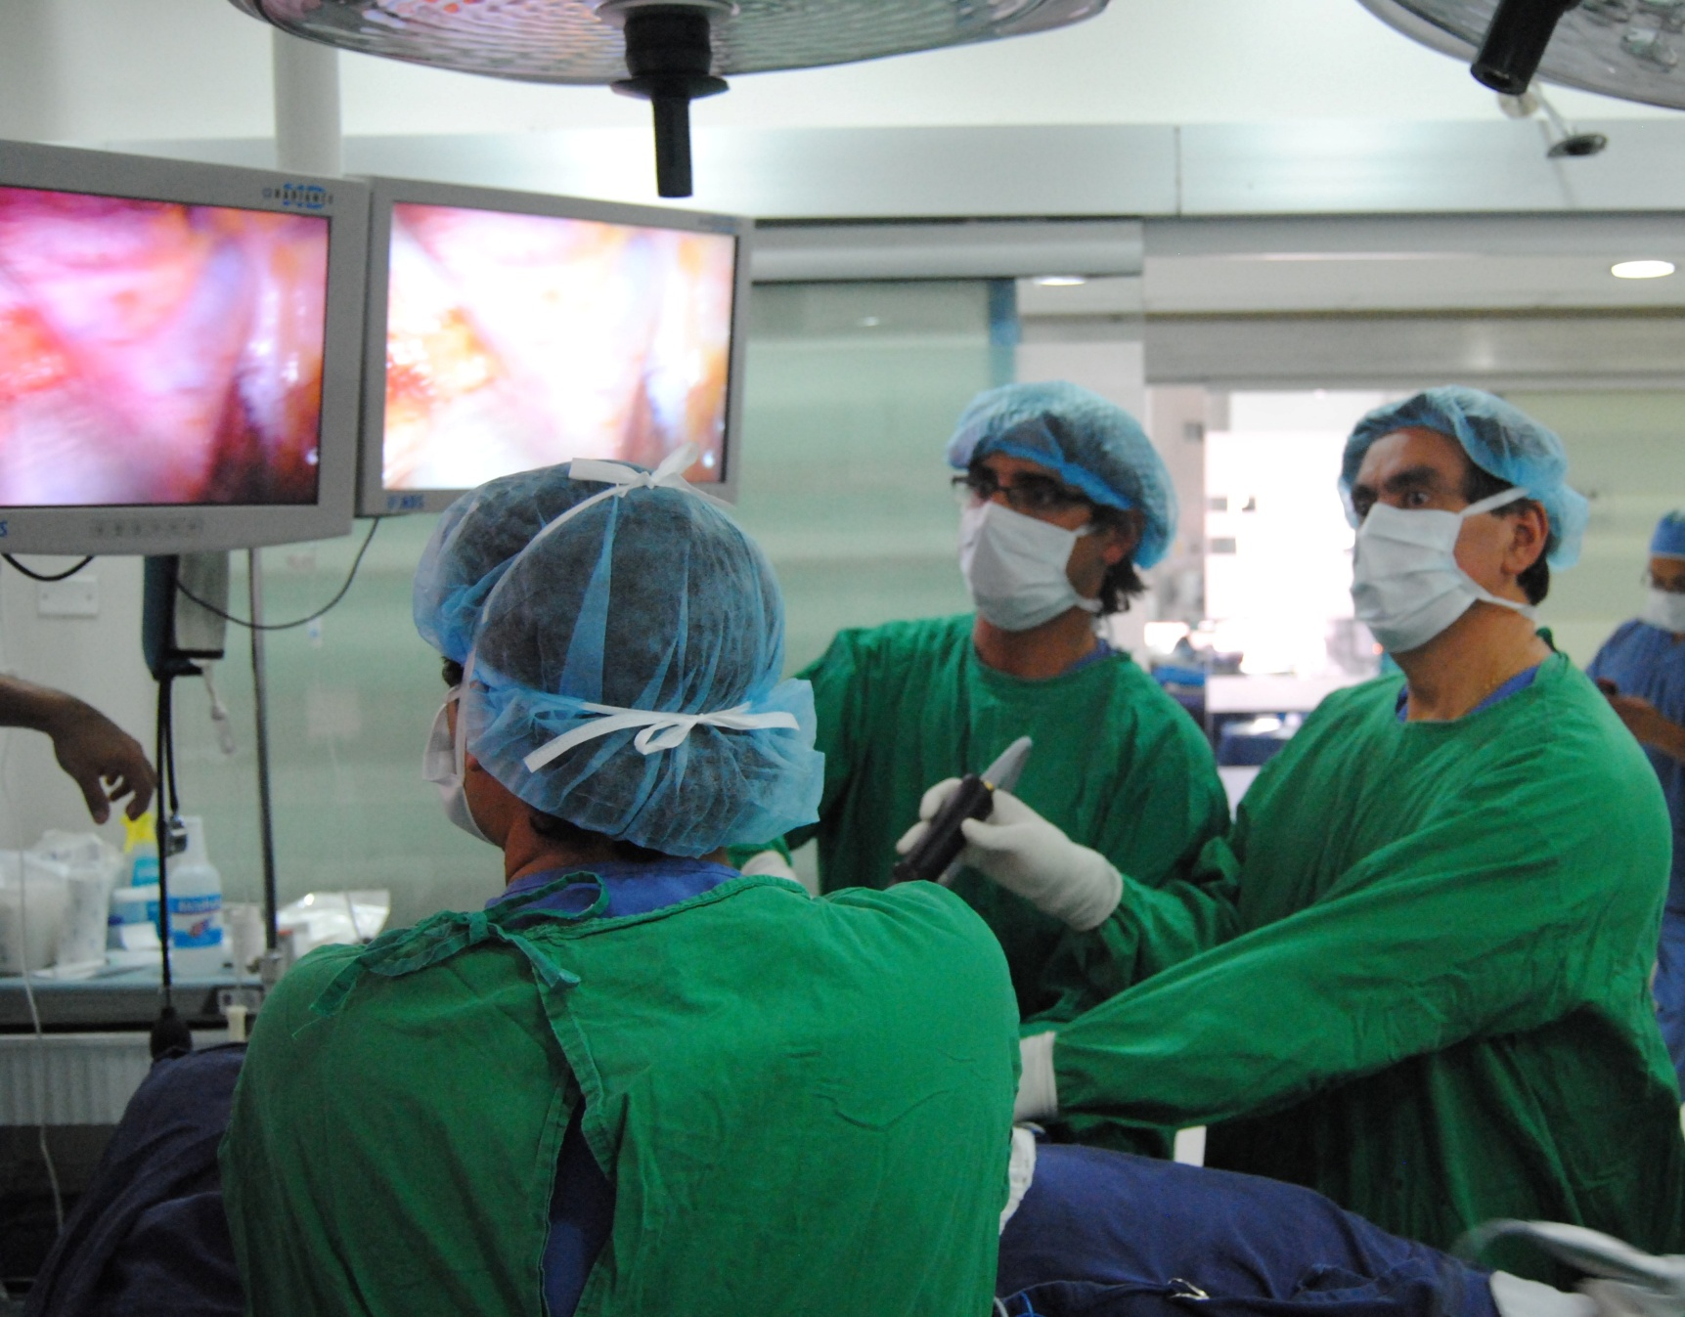
VATS

Slide 32
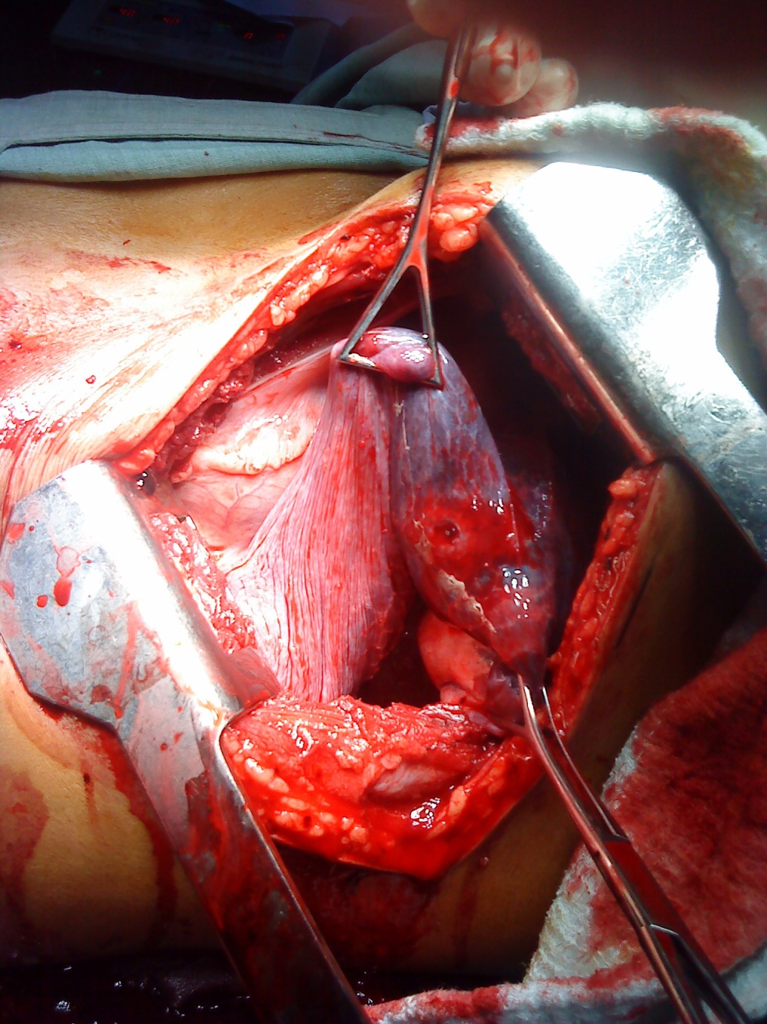
Thoracotomy

Slide 33
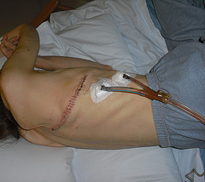

Slide 34
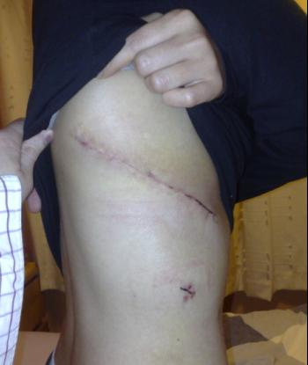

Slide 35
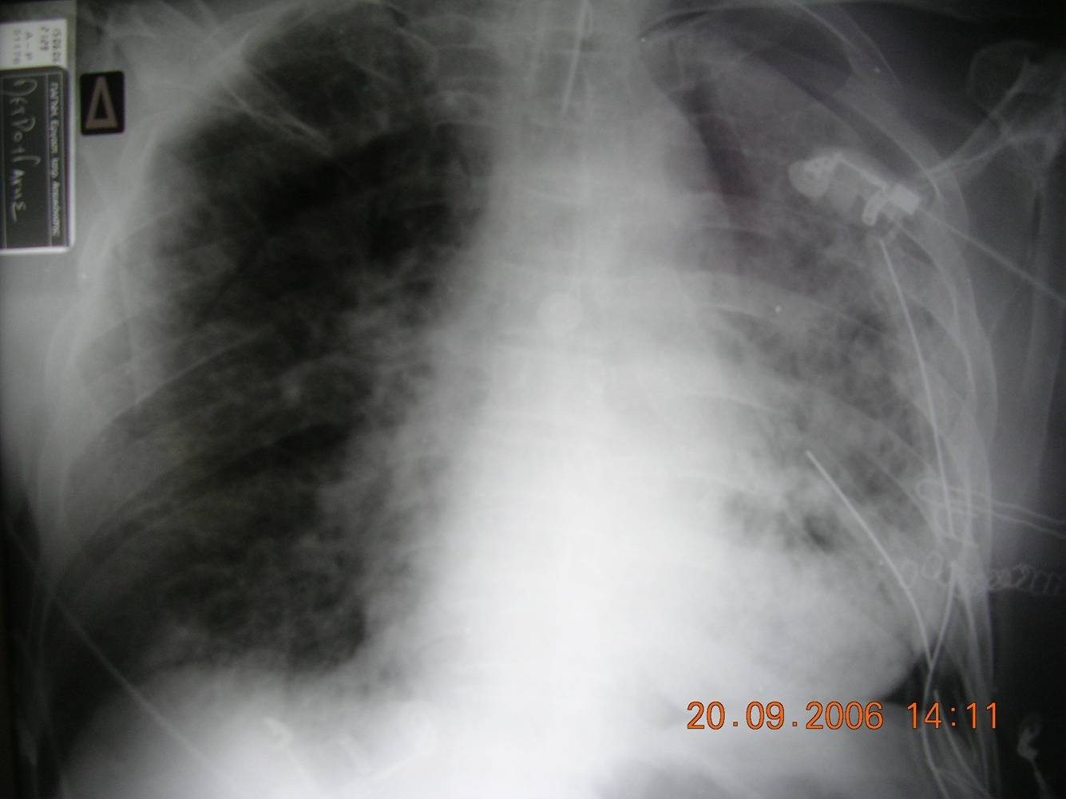
Lobectomy

Slide 36
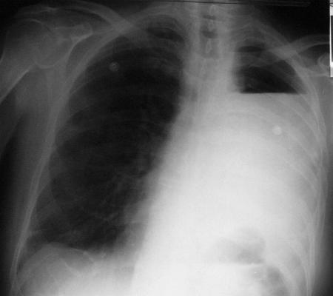
Pneumonectomy

Slide 37
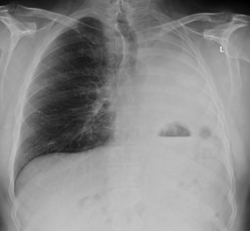

Slide 38
Outcome
complications,.
Results.

Slide 39
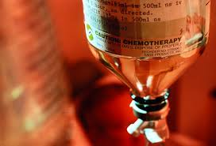
Chemotherapy

Slide 40
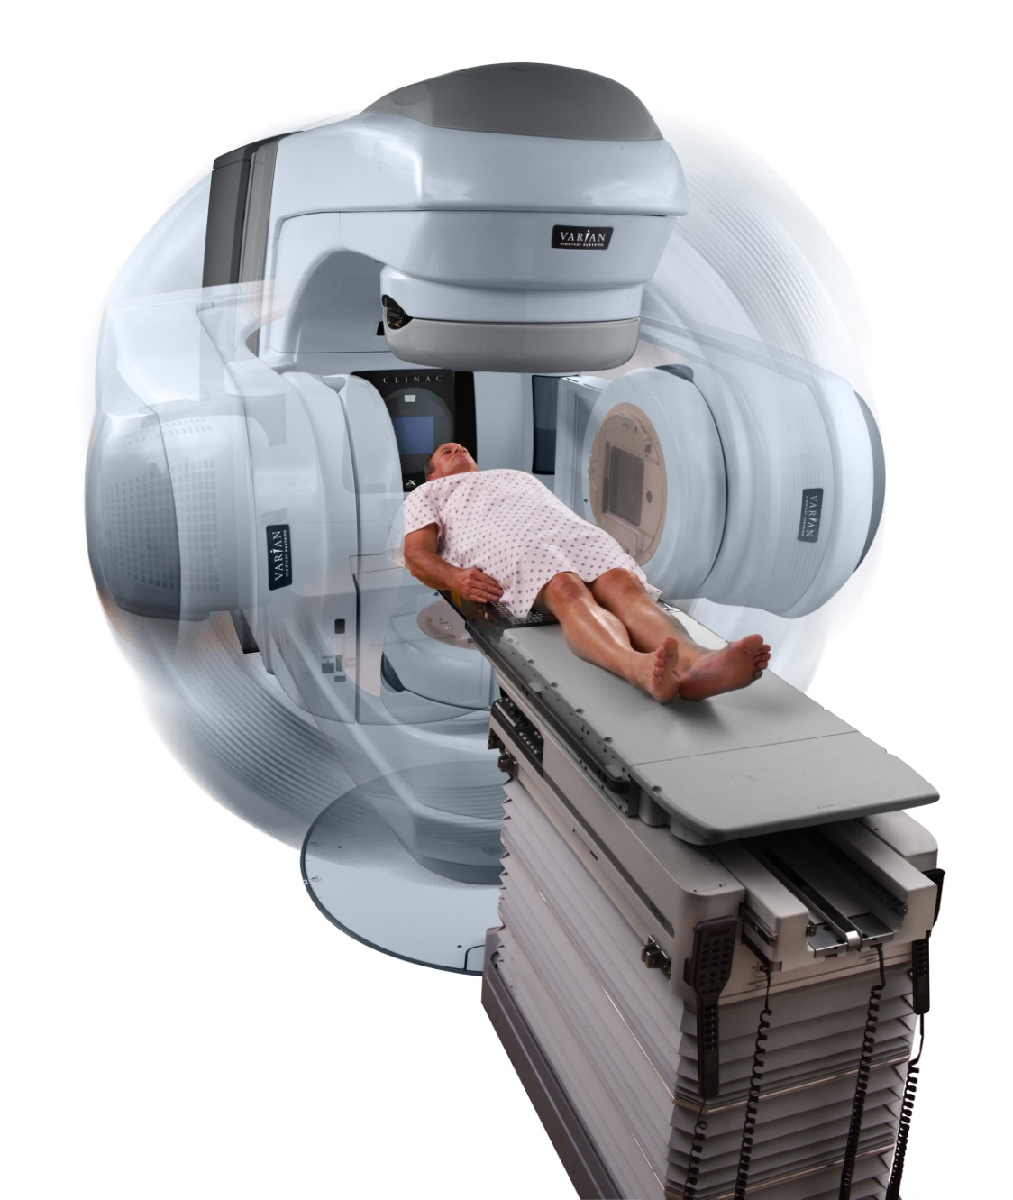
Radiotherapy

Slide 41
Palliative care
Pain
Pleural effusion
Hemoptysis.

Slide 42
End Of The Story
Saud did the surgery as the surgeon told him that the stage of the cancer is 2. he spent one day in surgical ICU the 5 days in hospital. During his follow up visits, sutures were removed. The postoperative pain became less and pain killer use less.

Slide 43
After 2 months of surgery, he started chemotherapy in KKUH. Every 3 months, he needs CAP CT for detection of any recurrence of metastasis.

Slide 44
Saud stopped smoking since diagnosis of lung cancer was established. He regret smoking. He said ; if time goes back, I would never smoke.

Slide 45
