Slide 1
Examination of The Newborn Infant
Khalid Altirkawi, MD, FAAP
Assistant Professor, Pediatrics
College of Medicine
King Saud University
2017

Slide 2
DISCLAIMER
This presentation is for helping medical students to get a quick start in the physical examination of the newborn infant. It is NOT a replacement of any recommended textbook Khalid Altirkawi, MD

Slide 3
Objectives
By the end of this presentation, student should be able to:
  Recognize the differences between the newborn infant and the older children.
  Recognize the importance of maternal factors in neonatal health.
  Recognize the most important components of exam and their proper interpretation

Slide 4
Features of uniqueness
Developmental considerations
  Children are NOT small adults
  Neonates are NOT small children
Maternal health issues and its effects on the newborn infant
  DM
  Hypertension

Slide 5
Purpose of the newborn exam
To discover abnormalities and problems
To explore the difficulties parents face in taking care of their baby.
To answer the parents’ questions

Slide 6
Before you start…
Remember to:
  Introduce yourself
  Wash your hands
  Explain to the caregiver the purpose of your visit and the procedure of examination

Slide 7
Examination steps
Review the newborn demographics (ID)
Review maternal history, pregnancy and perinatal details
Examine thoroughly from head to toe
Document your findings

Slide 8
Start with….
Nutritional status
  Hydration
  Adipose tissue
  Weight gain
  The cry

Slide 9
Anthropometric measurements
The Weight:
  Weigh infant directly on infant scale rather than indirectly by holding them.

Slide 10
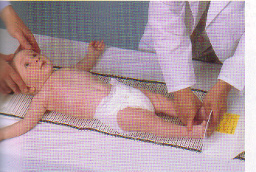
Anthropometric measurements
The Length:
  Place the baby supine on measuring board.
  Measure the distance between marks made on the exam table paper indicating the crown and heel.

Slide 11
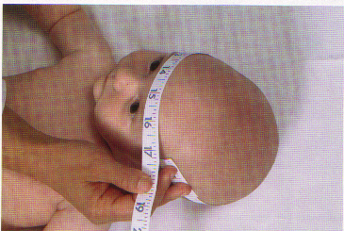
Anthropometric measurements
The Head circumference:
  Place the tape over occipital, parietal & frontal prominences to obtain the greatest circumference.

Slide 12
Skin
Observe for:
  Color: Plethora, Pallor, Cyanosis, Jaundice
  Mottling
  Bruises
  Rashes

Slide 13
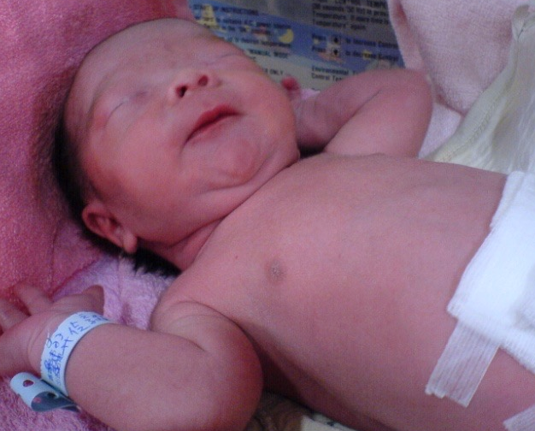
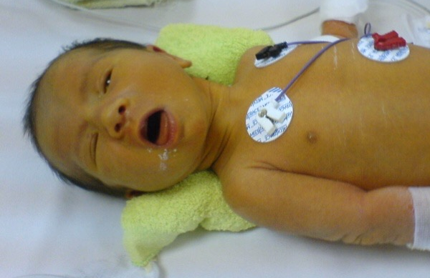
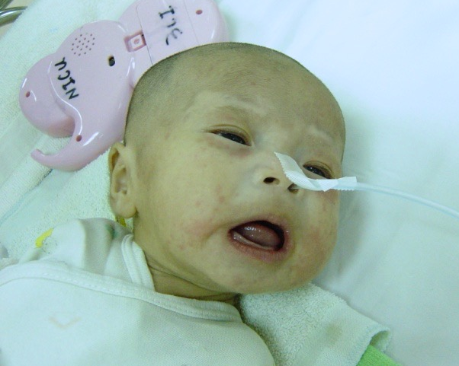
Skin colors

Slide 14
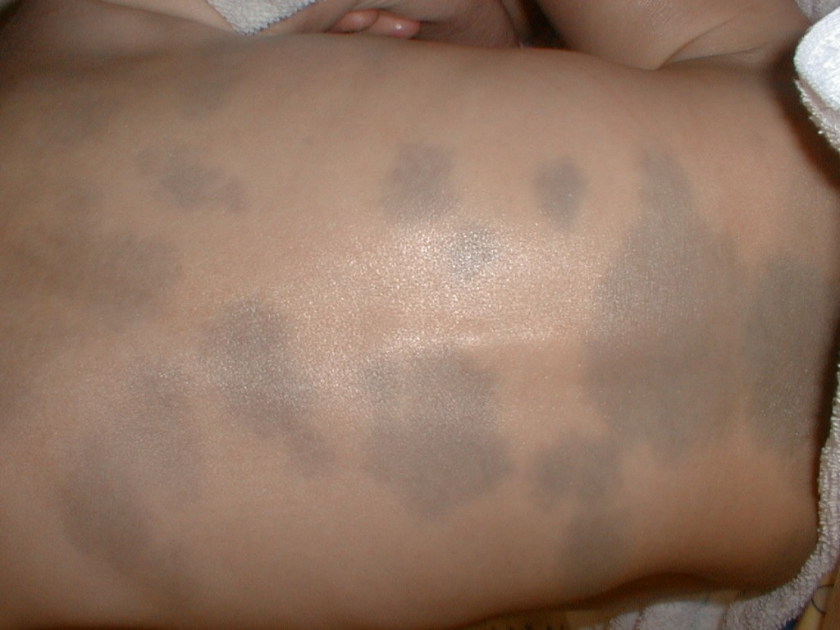
Selected
Skin Lesions
Mongolian spots
  Pigmented areas mostly over the lumbar region and buttocks.
  Become less prominent and may eventually disappear during childhood

Slide 15
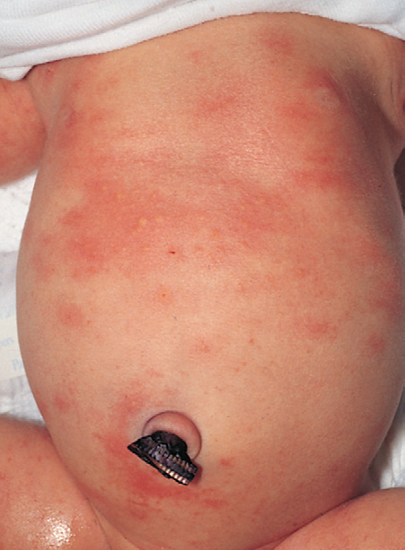
Selected
Skin Lesions
Erythema Toxicum
  Erythematous flares with central pin point vesicles or papules.
  May appear and disappear over several hours to days during the first week of life

Slide 16
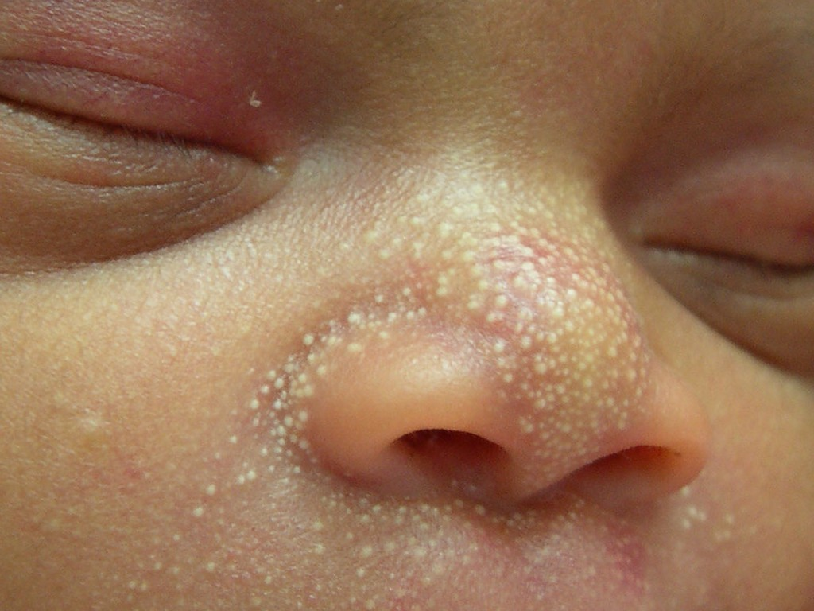
Selected
Skin Lesions
Milia
  Tiny white papules on the nose, cheeks, fore-head and occasionally the trunk, caused by plugging of sebaceous glands.

Slide 17
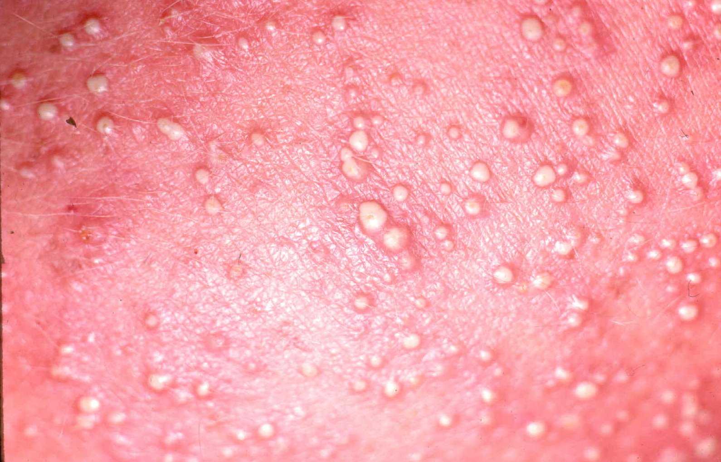
Selected
Skin Lesions
Miliaria (heat rash)
  Pin point vesicles with or without surrounding erythema caused by plugging of sweat glands

Slide 18
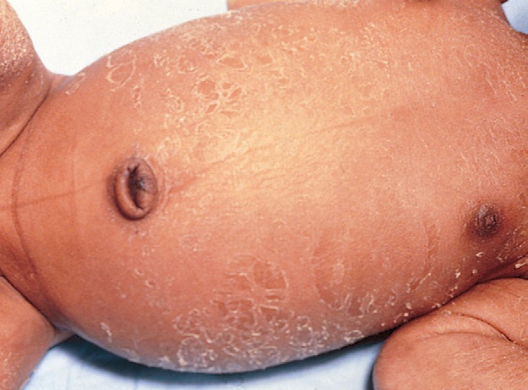
Selected
Skin Lesions
Peeling Skin
  Common in post mature babies.
  It does not denote skin disorder.

Slide 19
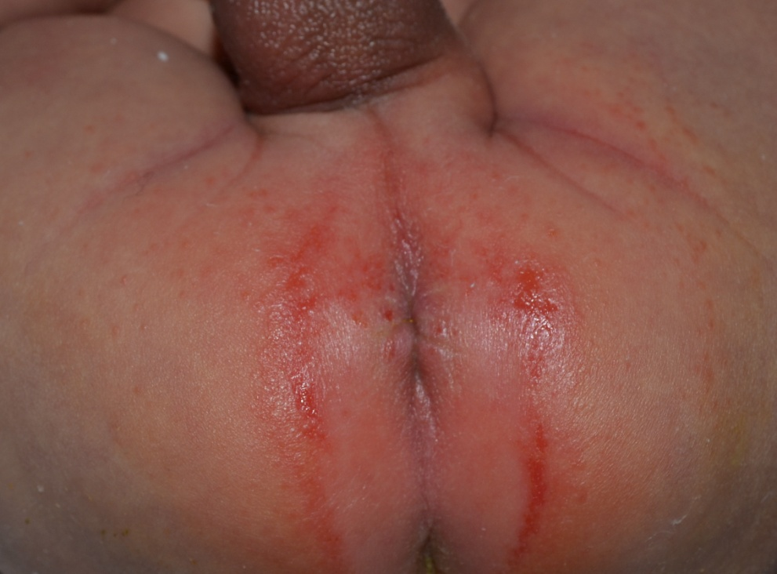
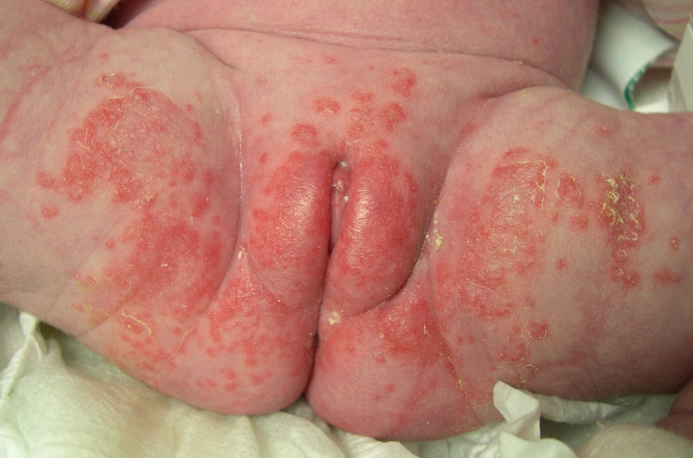
Selected
Skin Lesions
Diaper rash
  Mainly due to irritation by urinary urates.
  Maybe due to Candida skin infection

Slide 20
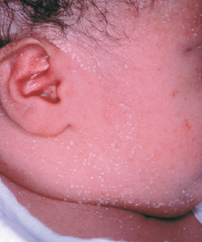
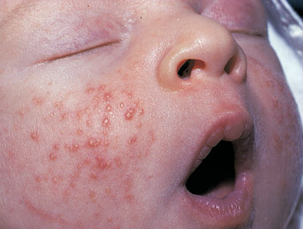
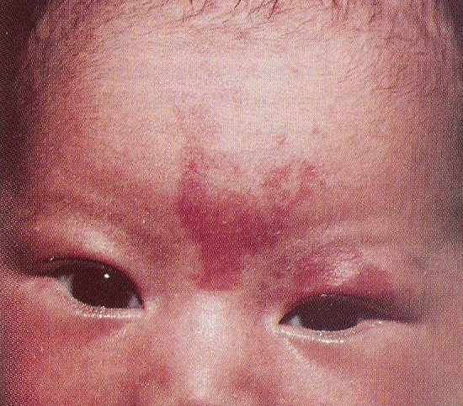
Selected
Skin Lesions

Slide 21
Selected skin lesions
Swollen Breasts
  Swollen breast occur in both sexes.
  Occasionally lactate under effect of the maternal hormones.
  It subsides gradually with no treatment

Slide 22
Head examination
Circumference
Fontanels
  ICP, Cranio-synostosis
Molding
Hematomas
Caput Succedaneum
  Edema under fetal skull due to prolonged labor
Cranial Tabes

Slide 23
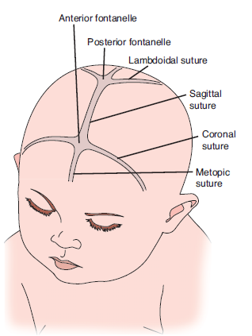
Fontanels
Diamond shaped ~1 inch across
Anterior one closes by 18 to 24 months
Posterior by birth to 2 months
If anterior Fontanel is
  Closed at birth → microcephaly or molding
  Tense/bulge → increased ICP
  Sunken → dehydration

Slide 24
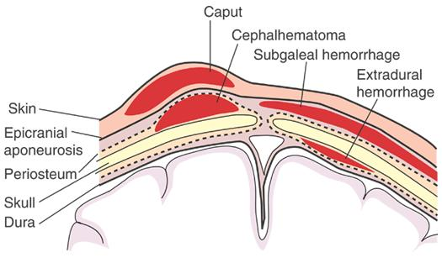
Caput Succedanum vs. Cephalhematoma

Slide 25
HEENT
Mouth
  Insert finger - intact palate, lips, mandible, gums, sucking, size of tongue
  Shut the mouth to test choanal atresia
Ears
  Shape and Position
  Low set (below the angle of eyes)
Nose
  Shape and size
Notes:
HEENT

Slide 26
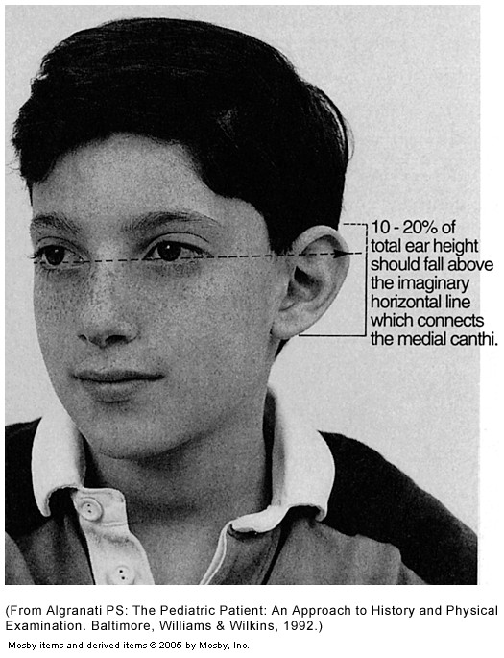
Low-set
Ears
10-20% of the total ear height should fall above the imaginary horizontal line which connects the medial canthi
Notes:
10-20% of the total ear height should fall above the imaginary horizontal line which connects the medial canthi

Slide 27
Eyes
Look for
  Red reflex
  Corneal opacities
  Conjunctivitis/discharge
  Hypertelorism(too far apart)/hypotelorism
  Microophthalmia
  Brushfield spots – Down’s
  Sticky eyes are common, mostly due to lacrimal duct stenosis

Slide 28
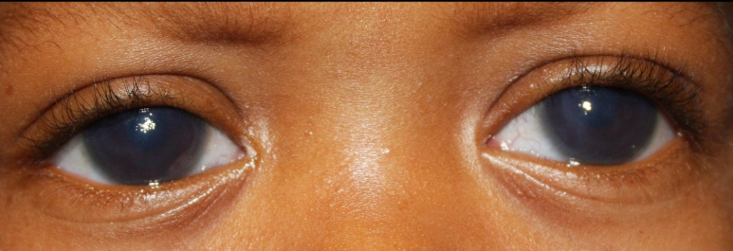
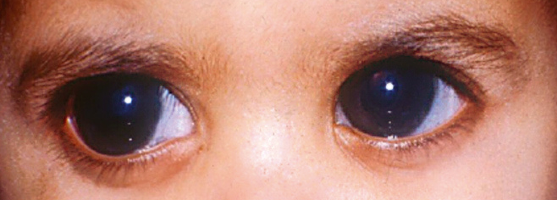
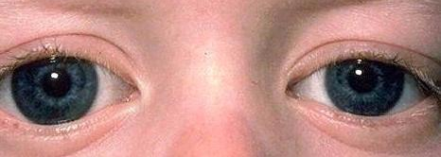
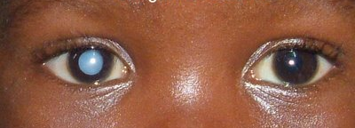
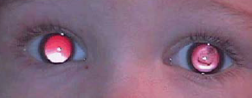
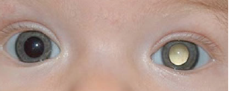
Eyes

Slide 29
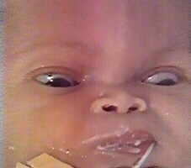
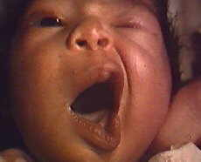
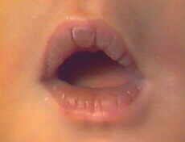
Selected
Facial
Anomalies

Slide 30
Thorax
Cardiovascular system
  Palpate precordium, apex beat
  Auscultate for the rate, rhythm and murmurs
  Normal HR at birth = 140 (90-175) bpm.
  Peripheral Pulses (Radio-femoral delay)
Lungs
  Respiratory movements, Rate, grunting or recessions
  Abnormal breath sounds
  Normal RR at birth = 40-60 bpm (count 1 full minute)

Slide 31
Abdomen and Perineum
Abdomen
  Normally feel liver, spleen and kidneys
Umbilical Cord
  Signs of infection: Odor/pus/redness/ tenderness
  Separates through a moist base at about day 7
Genitalia
  Identify gender, hypospadias, testes, orifice patency, bleeding
Anus
  Orifice’s patency, tone

Slide 32
Trunk and Extremities
Trunk & Spine
  Spina bifida/deformities
Extremities / Hip Joints
  Compare both upper and lower limbs
  Look for “dislocation”
  Number of fingers (polydactyly, syndactyly)
  Talipes
  Palmer creases (e.g. single palmer crease)

Slide 33
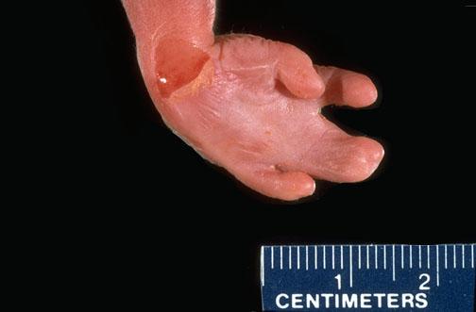
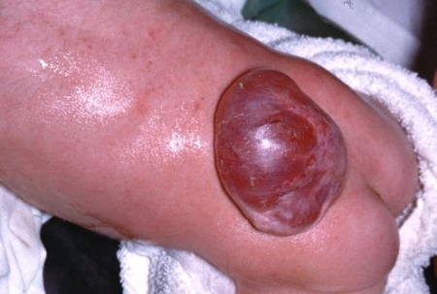
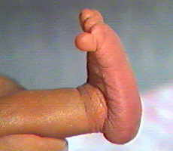
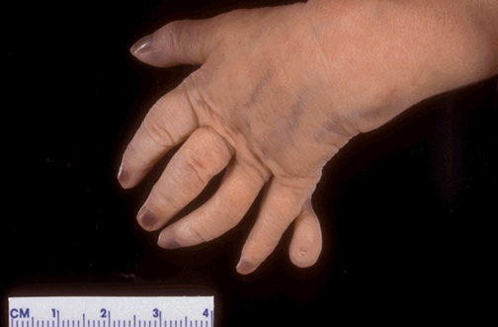
Selected Skeletal
Anomalies

Slide 34
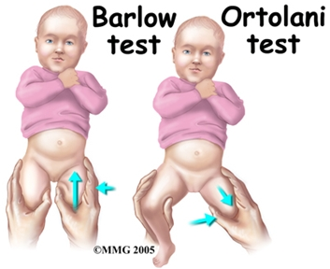
Testing Hip
Stability
Notes:
Hip dislocation is tested by Ortolani’s Test. The examiner tests for an unstable or actually dislocated femoral head by abducting one hip at a time and feeling for a click when the femoral head passes back into the acetabulum( Ortolani’s Sign).
Procedure
Place baby in supine, legs pointing towards examiner. Flex legs to right angles at hips and knees.
Note: Look for symmetry of the leg/thigh length. The thigh may appear short on affected side. Thigh skin folds may be asymmetric. Hip may have limited abduction on the affected side.
2. To detect an unstable hip by placing thumb medially over lesser trochanter and examiner middle/index finger laterally over greater trochanter. Abduct both hips simultaneously until lateral aspect of each knee touches examining table.The pelvis is steadied by the hand & the flexed thigh is abducted & adducted & any clunk or jerk is noted ( ortolani’s sign). With the hip abducted about 45 degree, the femur is gently rocked backwards & forwards on the pelvis & again any jerk or clunk(dull sound) is noted as the head of the femur slips out on to the posterior lip of the acetabulum.
3. with the help of index/middle finger, press greater trochanter forward and inward. Feel for a sudden movement of femoral head inward as it returns to hip socket.

Slide 35
Erb’s Palsy
C5-C6 Injury
Paralysis of deltoid, supraspinitus, biceps and teres major.
Loss of sensation over deltoid, lateral forearm and hand.
External rotation of arm is absent, biceps paralysis prevents flexion, & arm is held internally rotated. When adducted posteriorly it adopts – Porter’s Tip Position)

Slide 36
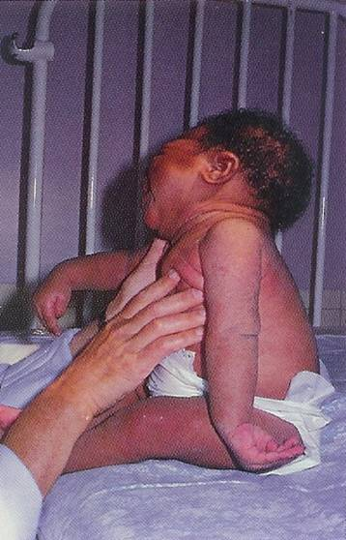
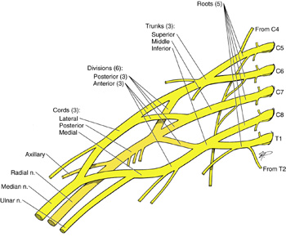
Erb’s Palsy

Slide 37
Neurological exam
General appearance
  CNS is under developed
  Functions at subcortical levels
  Normal subcortical functioning in early infancy does not mean an intact cortical system
Positioning
  Persistent asymmetries, predominant extension of extremities, constant turning of head to one side indicates severe intracranial disease (Opisthotunus).
Notes:
Opisthotunus (extension of head, stiffness of neck with extension of arms and legs) indicates meningeal or brainstem irritation due to infection or hemorrhage.

Slide 38
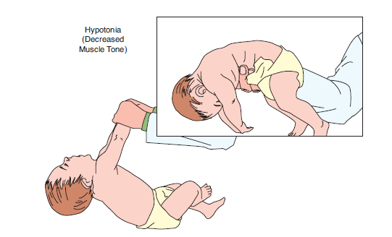
Testing for Hypotonia

Slide 39
Neurological exam
Activity
  Spontaneous and induced movement, cry and alertness
Motor Function
  Put each major joint through its range of motion
  Determine muscle tone – spasticity or flaccidity
Seizures
Unconsciousness

Slide 40
Primary Reflexes
Blinking (Dazzle Reflex)
  Disappears after first year. Eyelids close in response to bright light. Absence indicates blindness
Acoustic Blink (Chleco-palpebral reflex)
  Both eyes blink in response to a sharp loud noise. Disappearance variable.
Notes:
Note: Have prognostic value in CNS integrity. Absence of this in neonate or the persistence of some beyond their expected time indicate severe CNS dysfunction Eliciting anyone of them except rooting, grasp, tonic neck and moro should be attempted only when CNS function is questionable.
Note: All babies clinch their hand during first month of life. Persistence of clench hand beyond two months also suggests CNS/frontal lobe damage

Slide 41
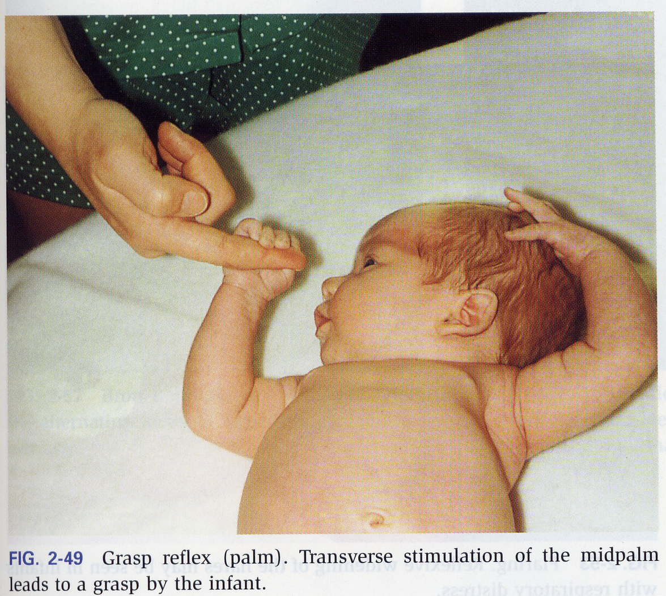
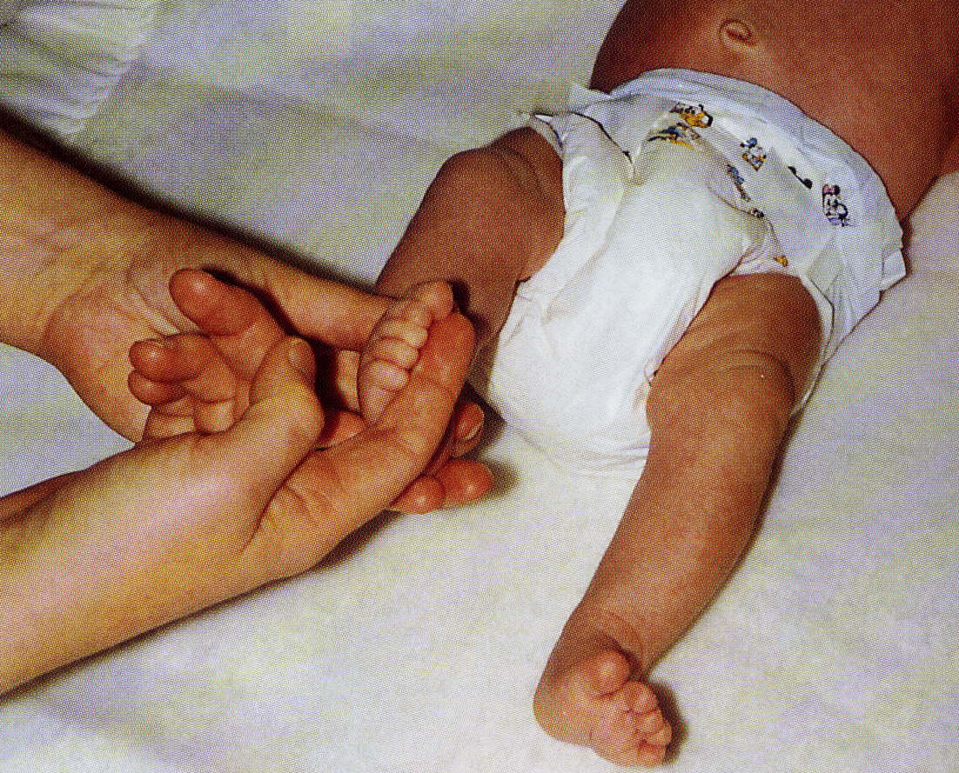
Grasp Reflex
  Head positioned in mid-line, arms semi-flexed, stroke ulnar side of baby’s palm or fingers with examiner index finger. Flexion of all fingers to grasp.
  Check for symmetry.
  Disappears within 3-4 months.

Slide 42
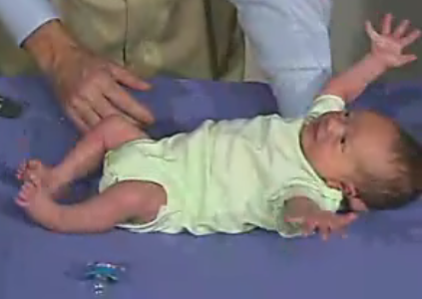
Moro’s Reflex
Hold baby in supine, support back and pelvis with one hand, and arm and head with other hand. Allow the head to drop several cm with a sudden rapid movement.
OR
Baby in supine, produce a large noise, by striking examination table with hands on both side of baby’s head.
Notes:
Response to reflex:
Arms briskly abduct, and extend with hands open, fingers are extended and legs flex slightly and abduct less than arms. Arms then return over the body in a clasping manoeuvre with a simultaneous cry
Persistence beyond four months indicate neurological disease.
An asymmetrical response in upper extremities suggest hemi-paresis, injury to brachial plexus, or fracture of clavicle or humerus.
Absence of response in one or both legs indicate lower spinal injury and congenital dislocation of hip

Slide 43
Rooting Reflex
Disappear at three to four months.
Absence indicates severe/generalized CNS disorder.
How to elicit:
  Baby’s head in midline, hands held against anterior chest, stroke with index finger the perioral skin at the corner of baby’s mouth and at the midline of upper and lower lips. Mouth will open and turn to simulated side
Notes:
How to elicit:
Baby’s head in midline, hands held against anterior chest, stroke with index finger the perioral skin at the corner of baby’s mouth and at the midline of upper and lower lips. Mouth will open and turn to simulated side.
When upper lip is stimulated, the head with extend and when the lower lip is stimulated the jaw will drop. Sometimes this reflex occurs when the infant’s cheek is stimulated some distance from corner of mouth.

Slide 44
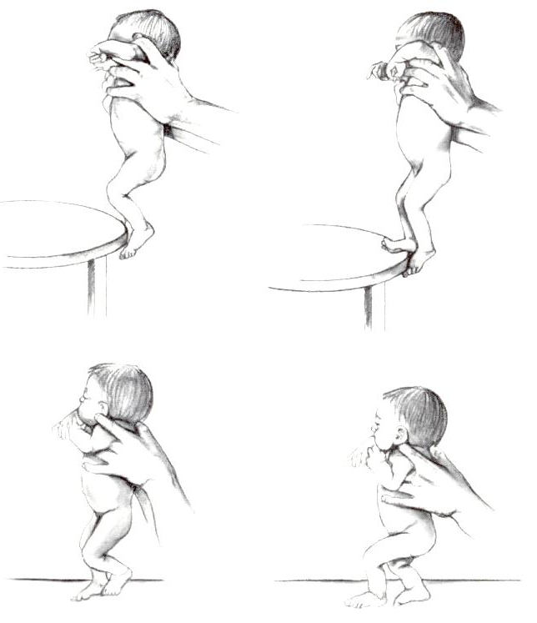
Placing
Reflex
Best elicited after first four days.
Disappears after one year.
Notes:
How to elicit:
Hold baby up right from behind by placing examiner’s hands under baby’s arm with your thumbs supporting the back of the head. Allow dorsal surface of one foot to touch or brush against the under surface of table top edge and is followed normally by simultaneous flexion of knees and hips and placement of foot on the table edge. The opposite leg steps forward and a series of alternate stepping movement occurs as you move the baby gently forward. This response is absent when paresis is present.

Slide 45
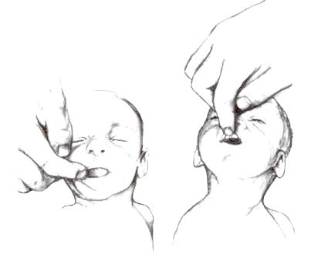
Sucking
Reflex

Slide 46
Non-primary Reflexes
Abdominal reflex
  Absent in newborn but appear within six months.
Anal reflex
  This is normally present in newborns
  Absent reflex strongly suggests loss of innervation to external sphincter muscle due to spinal cord injury, spina bifida or tumour at lower sacral segment
Notes:
How to elicit anal reflex: Baby supine, straighten and raise lower legs. Stroke perianal region with paper clip. Observe external anal sphincter contraction.

Slide 47
Non-primary Reflexes
Deep tendon reflex and planter response
These whether exaggerated or absent has little diagnostic significance as cortico-spinal pathways are not fully developed.

Slide 48
Sensory Examination
Sensory examination for neonate is rather limited
Threshold of touch, pain and temperature are higher in older children and reaction to these stimuli are relatively slow.
Notes:
.

Slide 49
Please send your feedback to:
kaltirkawi@ksu.edu.sa

