Slide 1
Dr. Turki M. AlKharfy Professor of Pediatrics Consultant Neonatologist
Normal Newborn & Common Neonatal problems

Slide 3
The aim of the lecture
To differentiate between normal and abnormal newborn.

Slide 4
Lecture headlines
History and examination.
Fetal maturation.
Neonatal physiology.
Normal variations in newborn.
Minor trauma in newborn.

Slide 5
History and examination
A) Maternal History:
Age
Medical / surgical history
Medications
Pregnancy history
Labour and delivery history
Family history
(B) Neonatal History:

Slide 6
History and examination
Physical examination:
Head large, face rounder, small mandible, prominent abdomen, mid point umbilicus, liver and spleen easily felt, kidneys palpable, flexion posture.
Other specific neonatal examinations:
Neonatal reflexes.
Gestational assessment.
Congenital malformations.

Slide 7
Fetal maturation
Second Trimester:
CVS attains Final Form 12 wk.
Respiratory movement as early as 18 wk.
Sufficient alveolar structures 24 wk.
Surfactant production by 20 wk, 34 wk.
Tidal flow of amniotic fluid, out of lungs.
Hemoglobin is fetal (HB A 30% at birth).
Coordinated suck 34 wk. (suck 26 – 28 wk).

Slide 8
Neonatal physiology
Respiratory system:
Established at delivery.
PR 50 - 60/min.
Wet lung syndrome.
CVS:
HR 120-160/min.
R ventricle predominant.
Transient murmur.
Fetal – neonatal circulation.

Slide 10
Neonatal physiology
Gastrointestinal system:
Activity usually addressed toward meeting nutritional needs (crying hungry, active reflexes).
End of first wk. feeds regular 2-5 hours.
First stool passed within the first 24 hours.

Slide 11
Neonatal physiology
Thermal regulation & metabolism:
At delivery same temp. as mother.
End of first wk. 110 kcal/kg/day.
Extra cellular fluid compartment 35%.
Body wt lost in the first 10 days.
End of first wk 120-150 m/kg/d.

Slide 12
Neonatal physiology
Renal System:
GFR and UOP law first day.
GFR adult standard end of first year.
Proteinuria common and urate crystals .
Urea clearance law and concentrating ability limited.

Slide 13
Neonatal physiology
Hematology:
Hb 17 – 19 g/dl.
WBC 10 – 30 x 10 ³ .
Plat. 150 – 750 x 10 ³.
Coagulation (acquisition of gut flora).

Slide 14
Neonatal physiology
Immunity:
High IgG levels (materno-fetal transfer).
IgM, IgE & IgA do not cross placenta.
Maternal IgG disappear by 3 months.

Slide 15
Neonatal physiology
Metabolic:
Placental transfer of maternal hormone.
Diminished capacity of liver to conjugate.

Slide 17
Normal newborn

Slide 18
Flat head

Slide 19
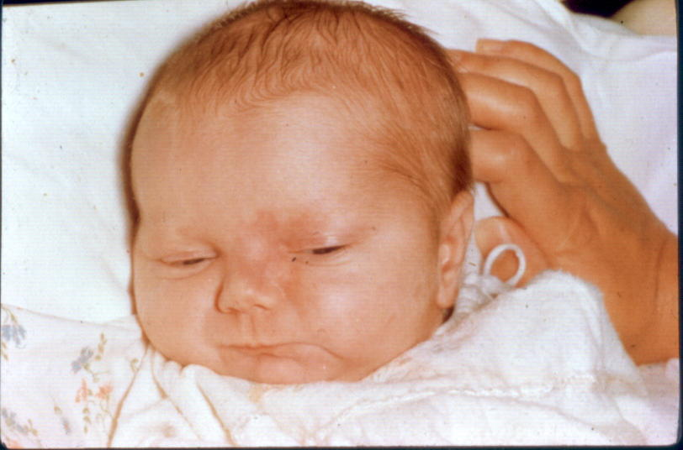
Salmon patches
Birthmarks that are caused by dilations of capillaries.
On the face, called an angel kiss, on the back of the neck, it is known as a stork bite.

Slide 20
Salmon patches
It is common.
It usually disappears within the first 3 years of life.

Slide 21
Port-wine stain (Nevus flammeus)
Early port-wine stains are usually flat and pink in appearance. May deepen to a dark red or purplish color with age.
They occur most often on the face.
Consisting of superficial and deep dilated capillaries in the skin

Slide 22
Strawberry hemangiomas
Also called, nevus vascularis, capillary hemangioma, hemangioma simplex).
Common type of vascular birthmark.
It is usually painless and harmless.
Unknown cause.
Consist of small, closely packed blood vessels.
May be absent at birth, and develop at several weeks.
They disappear by the time a child is 9 years old.

Slide 23
Mongollian spots
Congenital dermal melanocytosis.
Flat, blue, or blue-gray skin markings with wavy borders and irregular shape.
Near or around the buttocks.
Commonly appear at birth or shortly thereafter.
It disappears within 1-5 years from birth.

Slide 24
Harlequin phenomenon
Transient in approximately 10% of healthy newborns.
This presents as a well-demarcated colour change, with one half of the body displaying erythema and the other half pallor.
Usually occurring between two and five days of age, but can be seen as late as three weeks of age.
The condition is benign, and the change of colour fades away in 30 seconds to 20 minutes.

Slide 25
Cutis Marmorata
A reticulated mottling of the skin that symmetrically involves the trunk and extremities.
It is caused by a vascular response to cold and generally resolves when the skin is warmed.
A tendency to cutis marmorata may persist for several weeks or months, or sometimes into early childhood.
No treatment is indicated. It is also commonly found in babies with Down’s syndrome.

Slide 26
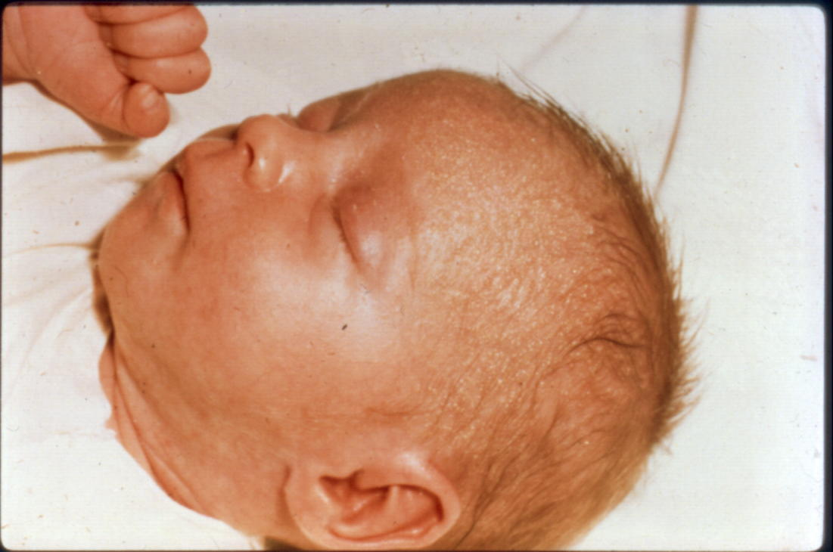
Miliaria crystallina
Superficial sweat ducts obstruction.
It consists of 1- to 2-mm vesicles without surrounding erythema.
Common on the head, neck, and trunk .
Rupture followed by desquamation.
Persist for hours to days.

Slide 27
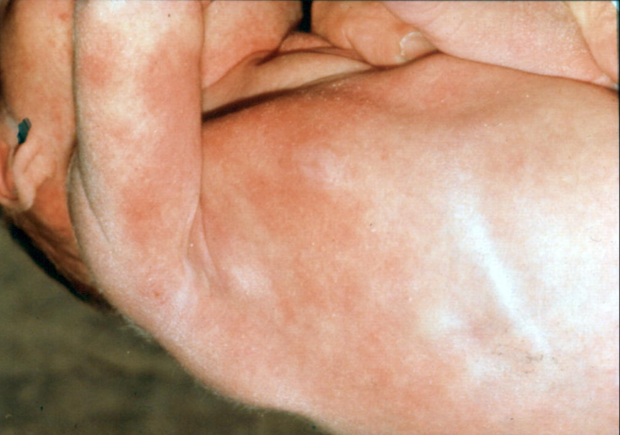
Erythema toxicum neonatorum
Common benign self-limited rash.
Usually appear between day 2-5 after birth.
Characterized by blotchy red spots on the skin with overlying white or yellow papules or pustules.
May be few or numerous that typically resolves within a few days.

Slide 28
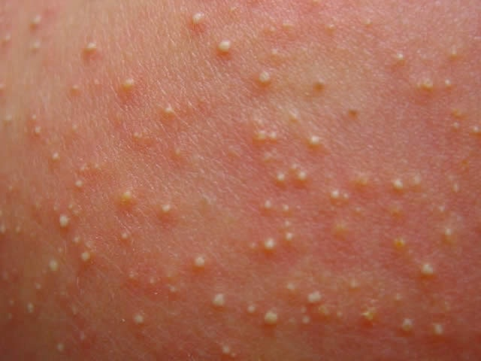
Neonatal pustular melanosis
Transient, a benign idiopathic skin condition.
Mainly seen in newborns with skin of color.
Distinctive features characterized by vesicles, superficial pustules, and pigmented macules.
The vesicles and pustules rupture easily and resolve within 48 hours.

Slide 29
Sucking blisters
Erosions, or calluses result from vigorous sucking by the infant during fetal life.
The lesions are present at birth and resolve without specific treatment within days to weeks.

Slide 30
Tonic neck reflex
The face is turned to one side, the arm and the leg on that side stretch out and the opposite arm and leg bend up.
It is called the "fencing" position.
The tonic neck reflex lasts about six to seven months.

Slide 31
Ranula
Cystic lesions in the floor of the mouth.
Retention cysts of the excretory duct of the sublingual gland.
Benign and causing no discomfort.
It has the tendency to rupture or resolve spontaneously within the first few months of life.

Slide 32
Natal - Neonatal teeth
Teeth that are already present at the time of birth.
Neonatal teeth, which grow in during the first 30 days after birth.
In both cases, once erupted, teeth has to be extracted due to the danger of getting aspirated or may cause discomfort.

Slide 33
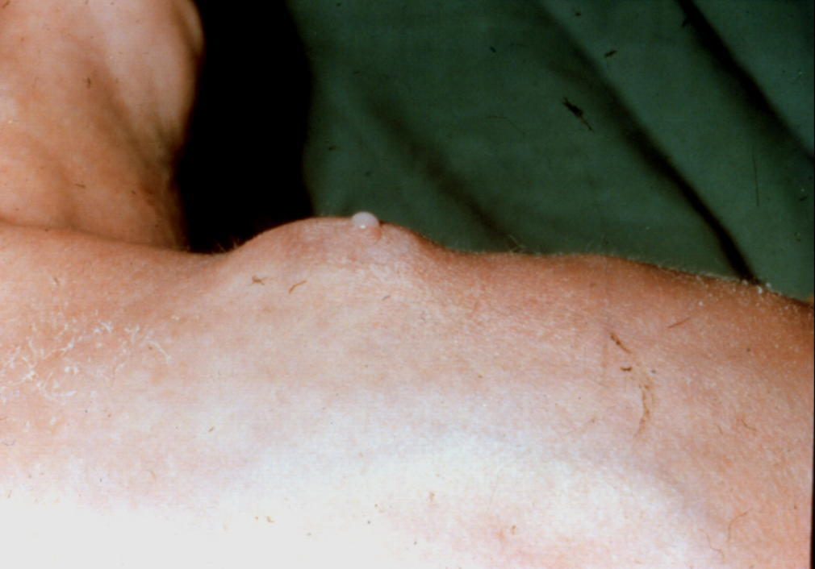
Neonatal gynecomastia
Is caused by the passage of maternal hormones across the placenta during pregnancy leading to the enlargement of the breasts.
Usually progressing over the first 2 months of life.
Breast discharge is also sometimes seen which is commonly called “witch’s milk”.

Slide 34
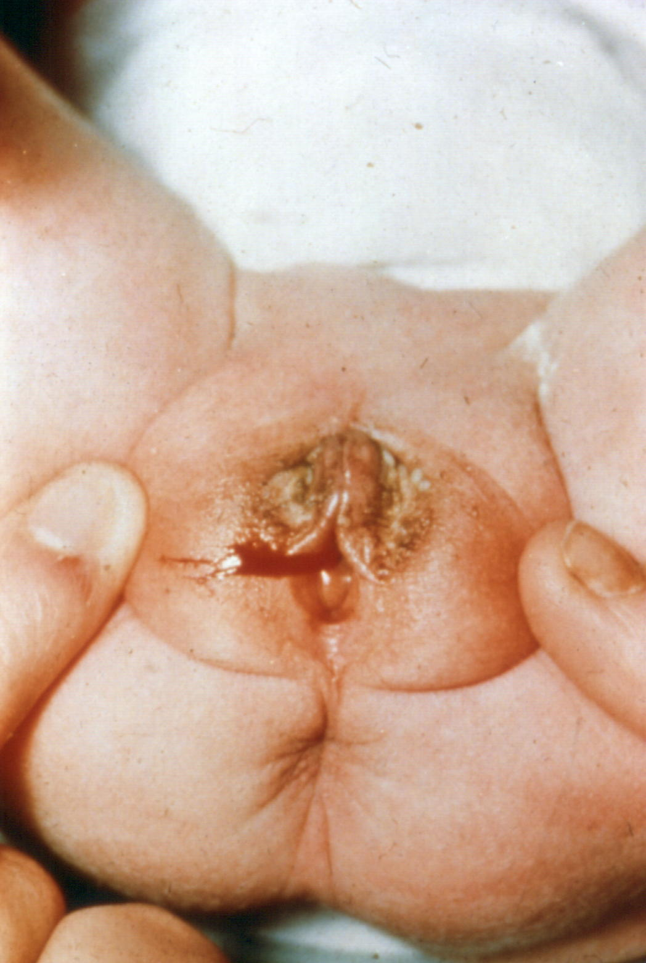
Neonatal Menstruation
Is caused by the passage of maternal hormones across the placenta during pregnancy.
Withdrawal bleeding takes place at the end of first week.
It is benign and needs no treatment.

Slide 36
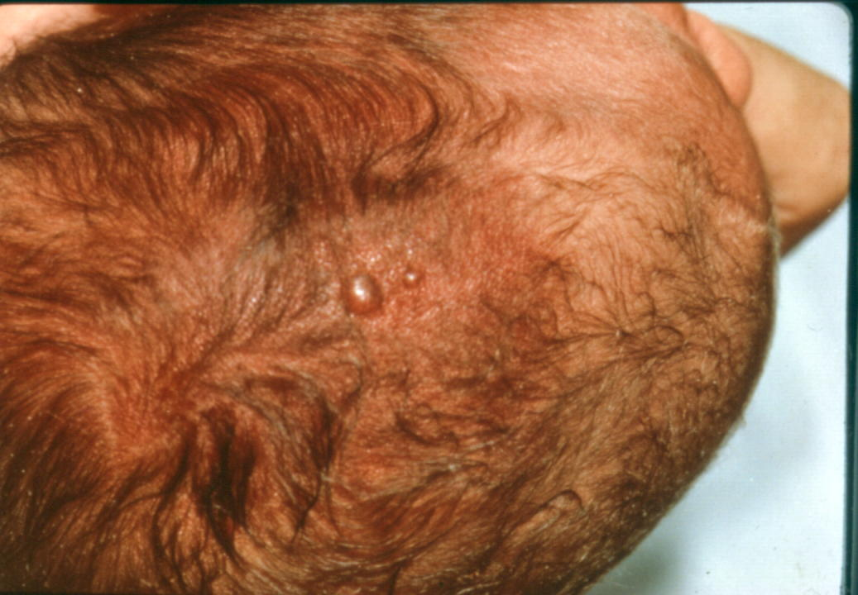
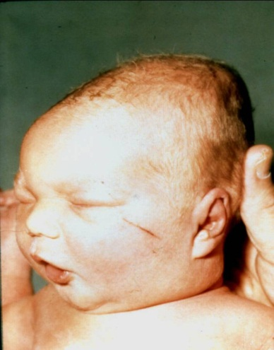
Birth trauma

Slide 37
Subconjunctival hemorrhage
Bleeding underneath the conjunctiva.
Appears as bright red patch in the sclera.
It is a painless and harmless.
As a consequence of elevated venous pressure in the head and neck.
It usually resolves within 1-2 weeks.

Slide 38
Caput succedaneum
Diffuse scalp swelling that extends across the midline and over suture lines.
It is commonly associated with head moulding.
Occurring due to pressure from uterine or vaginal wall during vertex vaginal delivery.
Does not usually cause complications and resolves over the first few days.

Slide 39
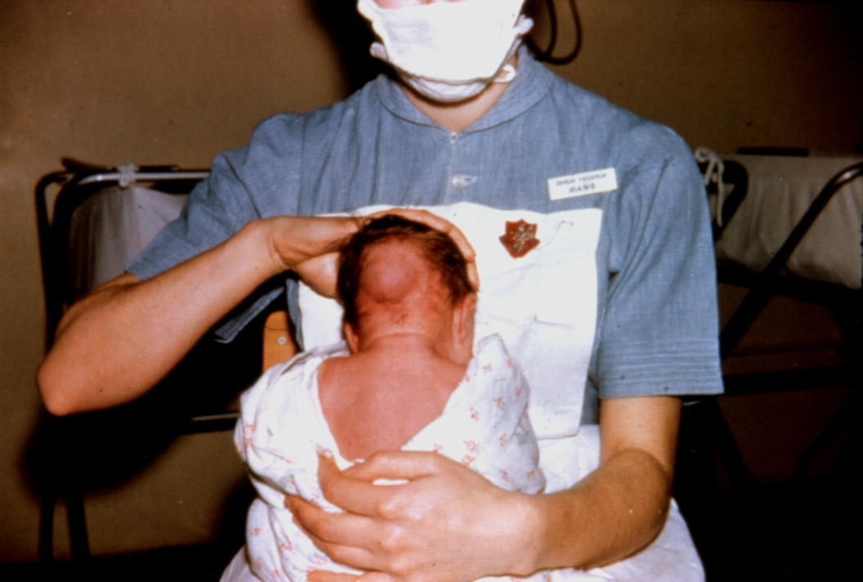
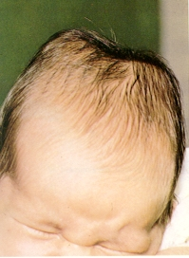
Cephalhematoma
A localized effusion of blood beneath the periosteum of the skull, due to disruption of the vessels during birth.
It does not cross cranial suture lines.
It is firmer to the touch than an edematous area.
It usually appears on the second or third day after birth and disappears within weeks or months.

Slide 40
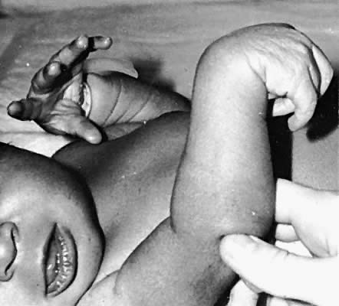
Erb’s palsy
A paralysis of the arm caused by injury to the upper group of the trunk, C5-C6 nerves.
The Moro reflex is absent but grasp reflex of the hand is present.
The elbow is extended and the forearm is pronated (the “waiter’s tip position).

Slide 41
Klumpke palsy
lower plexus injury to the lower roots of the brachial plexus.
Involving C8 and T1 roots.
There is loss of grasp reflex. The hand is supinated, the wrist extended, and the fingers clawed .

Slide 42
Facial palsy
Lower motor neuron lesion.
Both upper and lower parts are affected.
Conservative treatment.

Slide 43
Asymetric crying facies
A congenital deficiency or absence of the depressor anguli oris muscle which controls the downward motion of the lip.
The eye and forhead muscles are unaffected.

