Slide 1
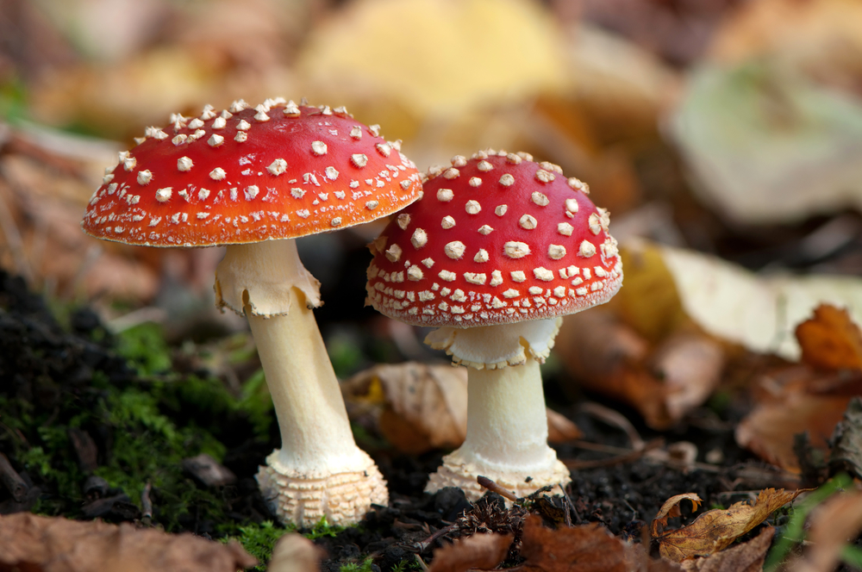

Slide 2
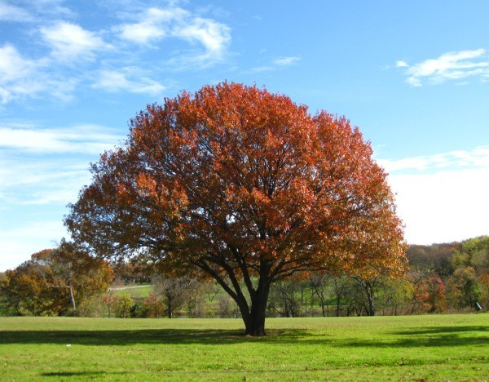

Slide 3
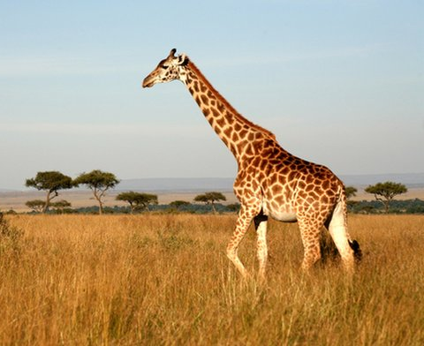

Slide 4
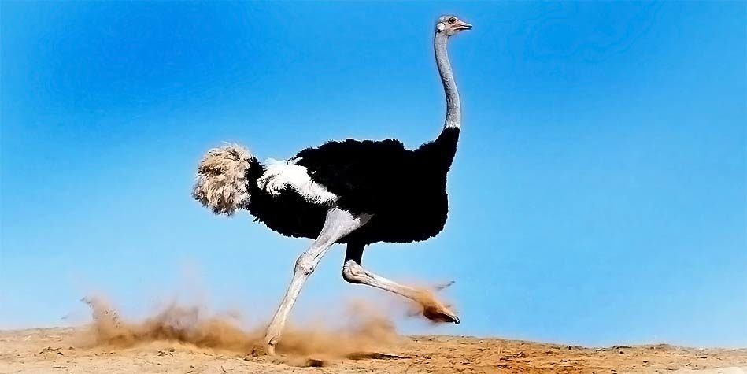

Slide 5


Slide 6
Living Organisms
Growth
Metabolism
Cellular Structure
Homeostasis
Cellular Structure
Reproduction
Heredity

Slide 7

Growth
(PED474)
Abdulmajeed AlSubaihin, MBBS, FAAP,FRCPC
Pediatric Endocrinologist

Slide 8
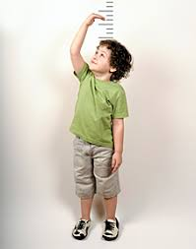
Growth

Slide 9
Objectives
How is Growth Hormone – IGF Axis regulated?
How is growth assessed in infants and children?
How to approach a child with short stature?

Slide 10
Objectives
How is Growth Hormone – IGF Axis regulated?
How is growth assessed in infants and children?
How to approach a child with short stature or growth failure?

Slide 11
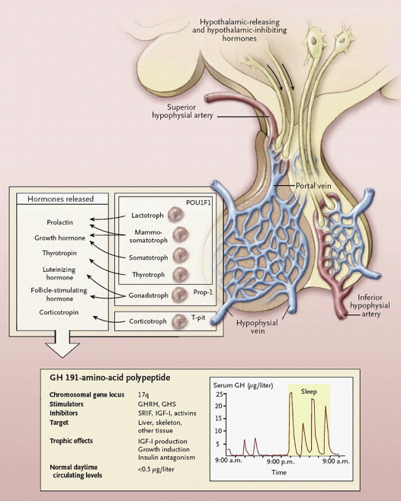
Hypothalamic–pituitary control of growth hormone (GH) secretion. Control of the secretion of GH is achieved by hypothalamic GH-releasing hormone (GHRH) and somatostatin, which traverse the portal vein, somatotroph-specific transcription factors, and negative feedback control of insulin-like growth factor I (IGF-I). Accurate measurement of pulsatile secretion of GH requires ultrasensitive assays. POU1F1 denotes POU domain, class 1, transcription factor 1; Prop-1 Prophet of Pit-1; GHS growth hormone secretagogues (e.g., ghrelin and GHRH, growth-hormone-releasing hormone); and SRIF somatostatin. Reproduced with permission from [272 ].
Growth Hormone
Herman-Bonert, Vivien S., Pituitary, The, Chapter 4, 83-117
Copyright © 2011 Copyright © 2011 Elsevier Inc. All rights reserved

Slide 12
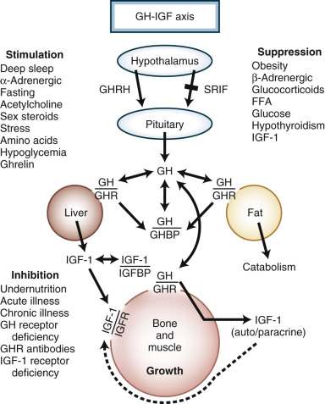
The growth hormone/insulin-like growth factor (GH-IGF) axis. Simplified diagram of GH axis involving hypophysiotropic hormones controlling pituitary GH release, circulating GH-binding protein (GHBP) and its GH receptor (GHR) source, IGF-1 and its largely GH-dependent binding proteins (IGFBP), and cellular responsiveness to GH and IGF-1 interacting with their specific receptors. GHRH, growth hormone–releasing hormone; IGFR, IGF-1 receptor; FFA, free fatty acids; SRIF, somatotropin release–inhibiting factor (somatostatin). (From Rosenbloom A. Growth hormone insensitivity: physiologic and genetic basis, phenotype and treatment. J Pediatr. 1999;135:280-289.)
Pituitary Physiology and Diagnostic Evaluation
Kaiser, Ursula, Williams Textbook of Endocrinology, Chapter 8, 176-231
Copyright © 2016 Copyright © 2016 by Elsevier, Inc. All rights reserved.

Slide 13
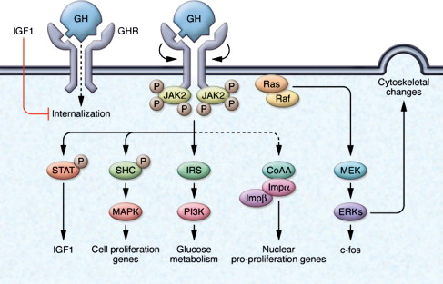
GH action. GH binds to the GHR dimer, which undergoes internal rotation, resulting in JAK2 phosphorylation (P) and subsequent signal transduction. GH signaling is mediated by JAK2 phosphorylation of depicted signaling molecules or by JAK2-independent signaling including Src/ERK pathways (S42). Ligand binding to a preformed GHR dimer results in internal rotation and subsequent phosphorylation cascades. GH targets include IGF-I, c-fos, cell proliferation genes, glucose metabolism and cystoskeletal proteins. GHR internalization and translocation (dotted lines) induce nuclear pro-proliferation genes via importin α/β (Impα/Impβ) coactivator (CoAA) signaling. IGF-I may also block GHR internalization, acting in a feedback loop. The GHR antagonist, pegvisomant, blocks GHR signaling; SRLs also attenuate GH binding and signaling (not shown). Reproduced with permission from [113 ].
Growth Hormone
Herman-Bonert, Vivien S., Pituitary, The, Chapter 4, 83-117
Copyright © 2011 Copyright © 2011 Elsevier Inc. All rights reserved

Slide 14
Growth Determinants
Factor | Disturbance
Nutrition | Decreased intake (famine, child neglect) Malabsorption (Celiac disease, Cystic fibrosis, liver disease) Metabolic defects (inborn errors of metabolism) Energy over expenditure (Tumors, Chronic infections, Hyperthyroidism, Heart failure
Environment | Poverty, neglect, maltreatment, stress
Hormonal signaling | GH deficiency, Hypothyroidism, Hypercortisolism, Adrenal insufficiency, gonadotropins
Genetic signaling | Turner syndrome, Silver-Russel Syndrome, Noonan Syndrome, SHOX gene insufficiency, Skeletal Dysplasias

Slide 15
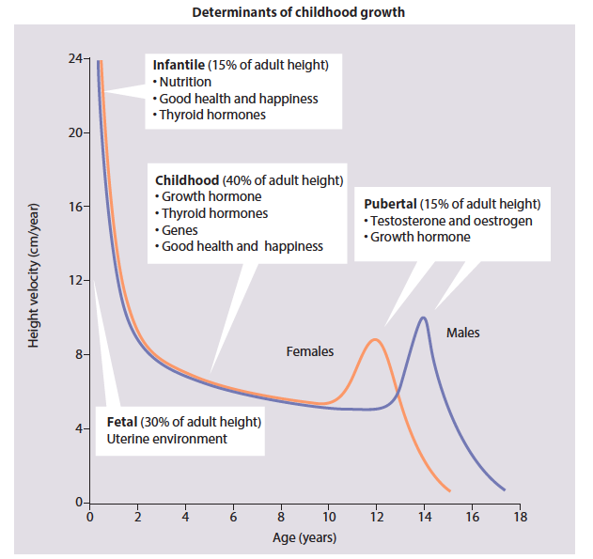
Growth determinants

Slide 16
Objectives
How is Growth Hormone – IGF Axis regulated?
How is growth assessed in infants and children?
How to approach a child with short stature or growth failure?

Slide 17
Infants( birth – 2 years)
Length
Weight
Head Circumference

Slide 18
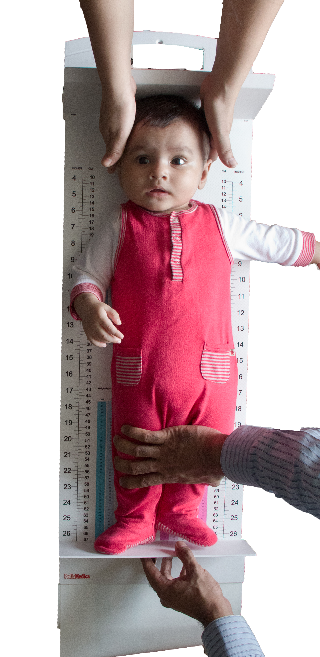
Length
Infantometer with 2 person technique
Recumbent position on a hard flat board
Head is touching the headboard
Legs are straight
Both heels are touching the measurement board

Slide 19
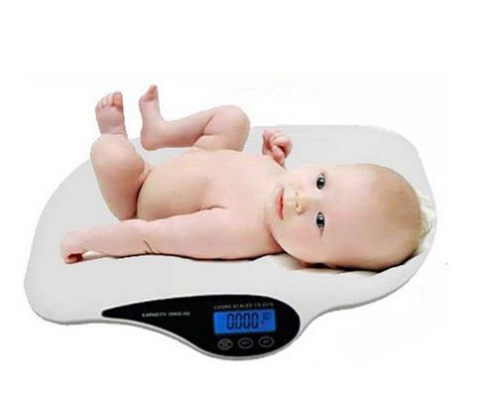
Weight
Calibrated scale
Digital output in grams or in Kg with 3 decimal points
Infants fully undressed and without diapers
Untouched and unsupported

Slide 20
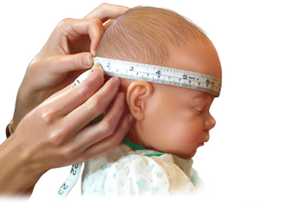
Head Circumference
Occiput
Glabella
The widest anterior posterior skull diameter

Slide 21
Children and Adolescents (2 -19 years)
Height
Weight
Body Mass Index (BMI)
Head Circumference (not routinely)

Slide 22
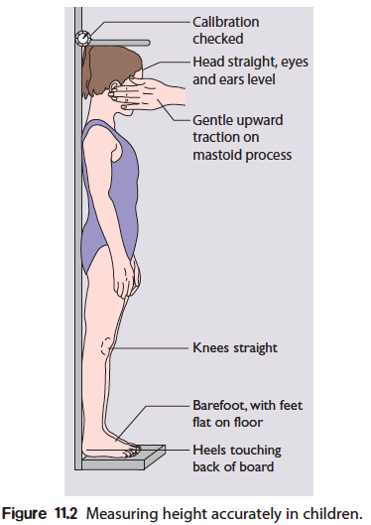
Height

Slide 23
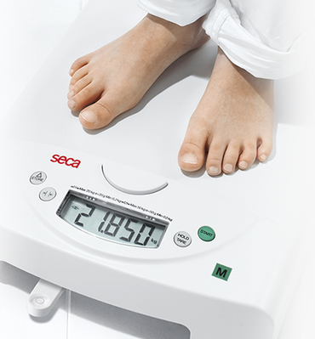
Weight
Calibrated scale
standing
Light clothing
Digital output in Kg with 2 or more decimal points

Slide 24
BMI
Indirect measure of adiposity
Calculated:
BMI = weight in Kg
(Height in meters)²
= Kg/m²

Slide 25
How do we decide whether a child’s growth is normal or not?

Slide 26
By comparing the child to normally growing children

Slide 27

WHO are normally growing children?

Slide 28
For children from birth to 5 years of age, a Multinational Growth Reference Study was conducted from 1997-2003
Included infants and children from Brazil, Ghana, India, Norway, Oman and USA.
N= 8440

Slide 29
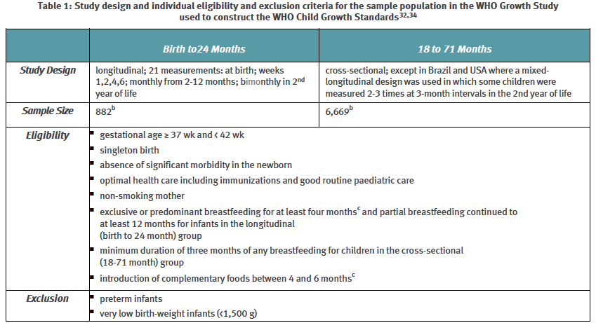

Slide 30
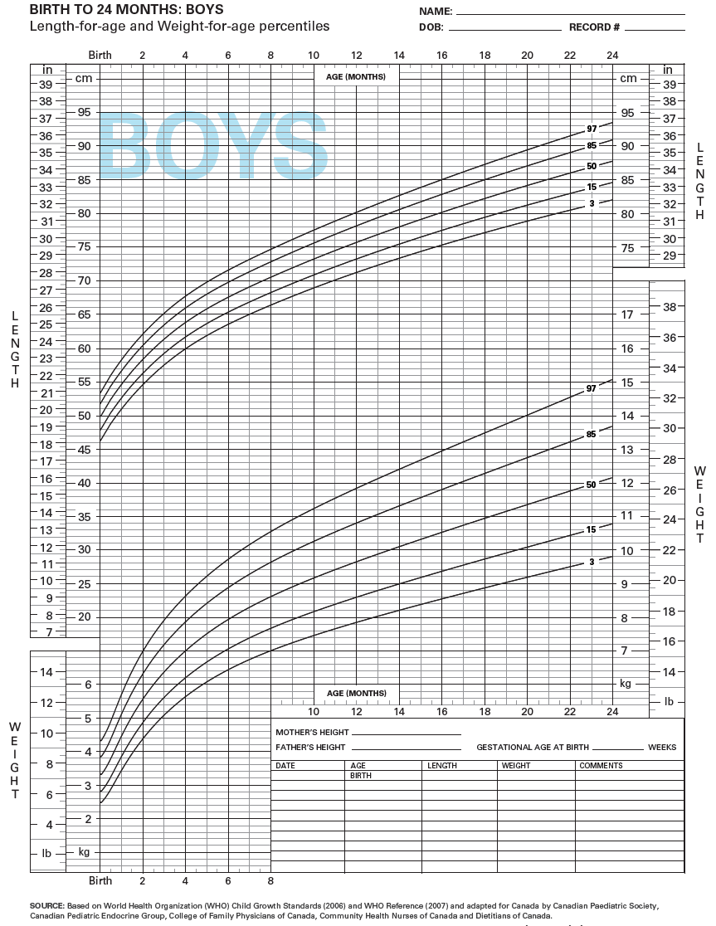
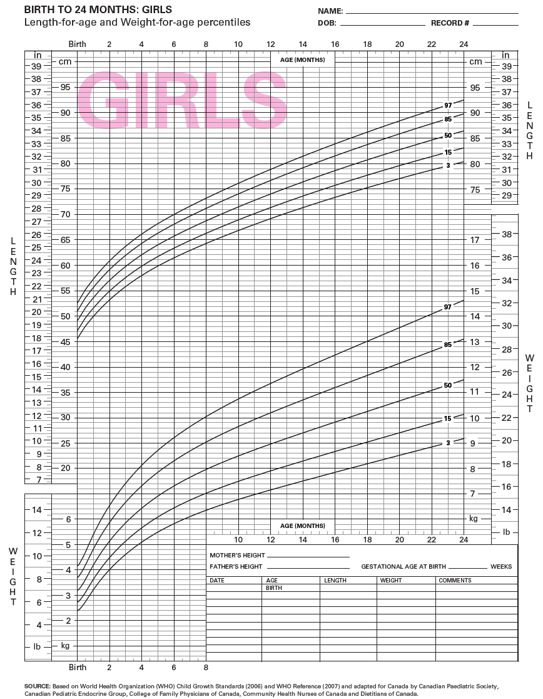
Growth charts birth-24 months

Slide 31
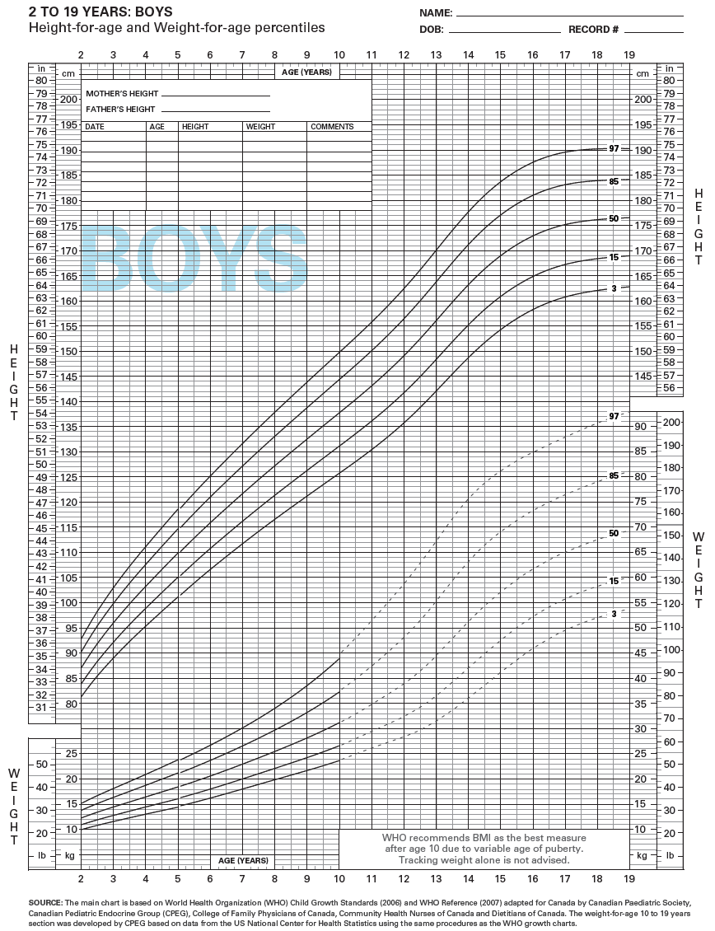
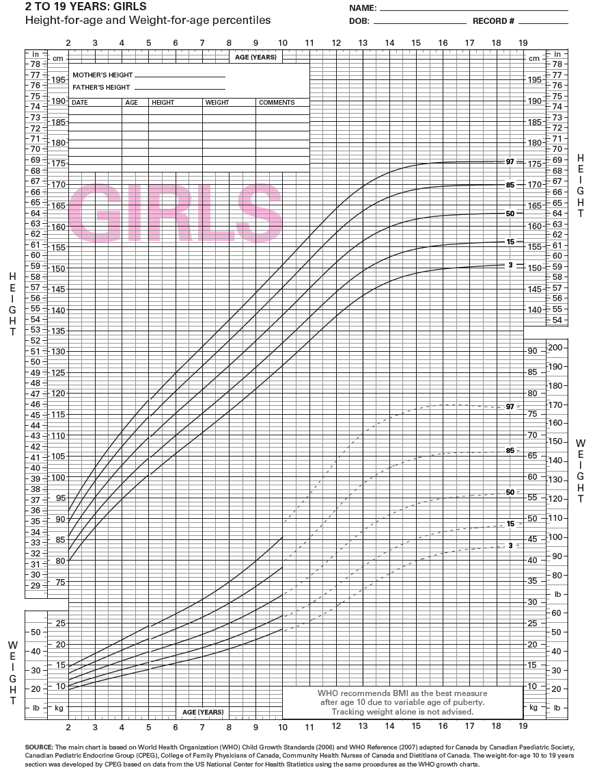
Growth charts
2-19 years

Slide 32
Who is this chart for
Age range
Child’s ID
Height in CM
Height in inches
Percentile lines
Weight in Kg
Weight in Pounds

Slide 33
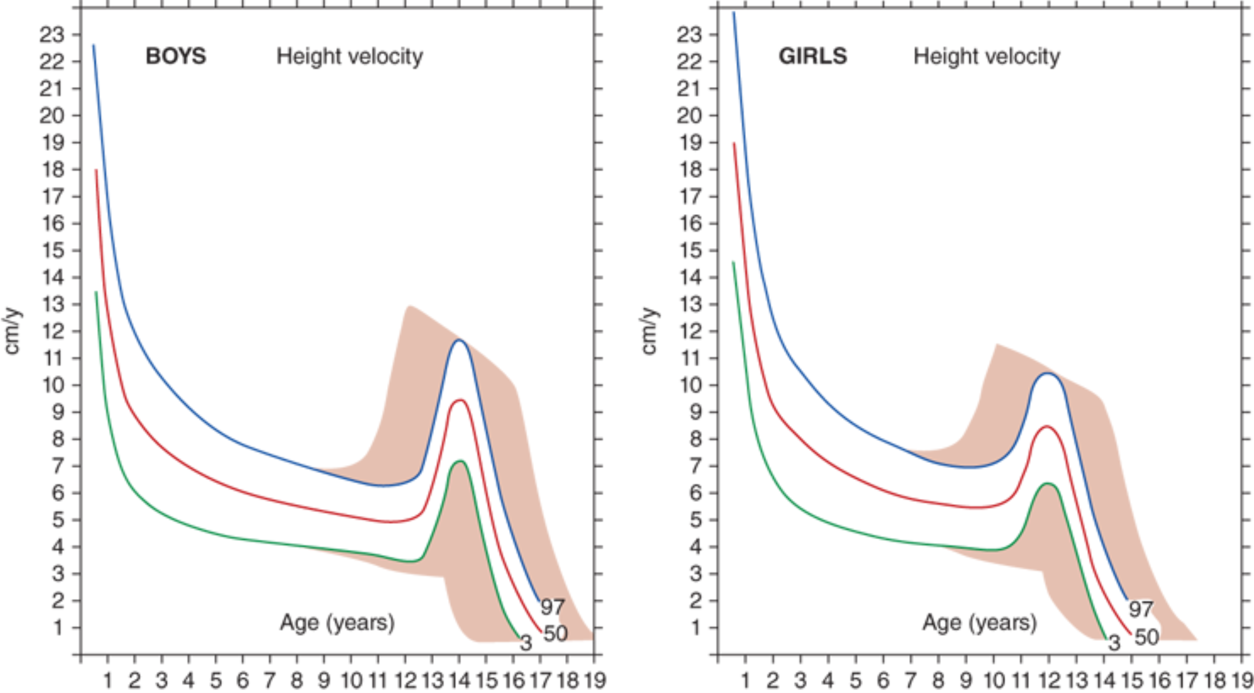
Growth velocity
The annual rate of growth in height (cm/year).

Slide 34
Rule of Thumb (Length and Height)
Average length at birth is 50 cm
Average Length at 1 year is 75 cm
At 4 years, birth length doubles.
Between 4 years and puberty, annual height increase by 5-8 cm/year

Slide 35
Rule of Thumb (weight)
Newborns lose 5-10% of body weight in the first few days after birth.
Newborns regain birth weight in 7-10 days.
Birth weight doubles at 4 months
Triples at 1 year
Quadruples at 2 years.

Slide 36
Example
Mohammed came today to the general pediatrics clinic for his annual health check up.
His date of birth is 7-3-2014. His mother states that he is 4 years old.
His height is today is 97 cm and his weight is 15 Kg
Mohammed’s mother asks: “ Is his growth normal?”

Slide 37
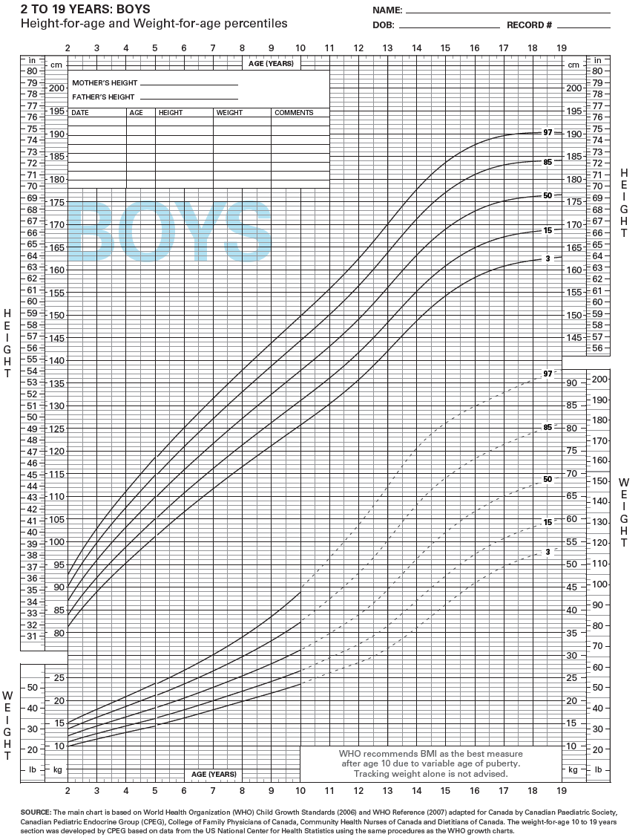

Slide 38
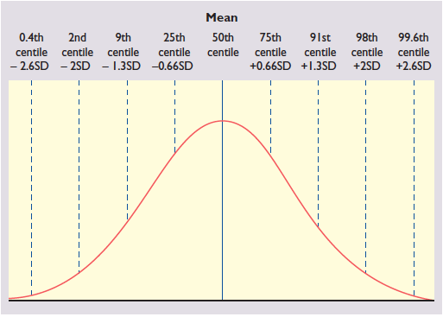
Normal distribution
Height
95%
2.5%
2.5%
2.5 % of population on both extreme sides (total 5%) are conventionally and arbitrarily labeled abnormal

Slide 40
Mohammed’s Height ( <2nd %ile)
X
3rd %ile
98 cm
50th %ile
107 cm
97th %ile
115 cm

Slide 41
Answer
Mohammed’s height is in the area below the < 3rd percentile at 4 ½ years of age.
Mohammed is shorter than (>97%) of Boys at his age.

Slide 42
Objectives
How is Growth Hormone – IGF Axis regulated?
How is growth assessed in infants and children?
How to approach a child with short stature or growth failure?

Slide 43
Definitions
Short stature:
Height > 2 SDS below mean of age and sex (≤2nd %ile).
Growth failure:
Height Velocity > 2 SDS below the mean for age and sex (<3rd %ile)

Slide 44
Short stature VS Growth failure

Slide 45
Short stature VS Growth failure

Slide 46
Short Stature VS Growth Failure

Slide 47
Differential Dx
Short Stature (Normal growth velocity) | Growth Failure
Constitutional Delay of Growth and Puberty (CDGP)/ Constitutional short stature | Nutritional deficiency
Familial Short stature | Endocrinopathy (GH deficiency, Hypothyroidism, hypogonadism, precocious puberty reaching final adult height and Cushing syndrome)
Genetic (Turner syndrome, Silver-Russell Syndrome, Noonan Syndrome, Prader-Willi syndrome, SHOX gene insufficiency, Pseudohypoparathyroidism Skeletal Dysplasias | GI disease
 | Chronic illness (Chronic infection, Heart failure, renal failure, liver disease)

Slide 48
Assessment
Midparental Height
For boys:
Father’s height (cm) + [Mother’s height + 13 cm]
2
For Girls:
[Father’s height(cm) – 13] + Mother’s height (cm)
2

Slide 49
Assessment
Body proportions
1- Arm span
(normal arm span = height)
2- lower body segment (Symphysis pubis to floor while standing), Upper segment = height – lower segment)
(normal = 1:1 by 10 years of age)

Slide 50
Assessment
Bone age:
Left hand and wrist x-ray compared to a standard.
(Used to assess skeletal maturity and to predict remaining growth and final adult height)

Slide 51
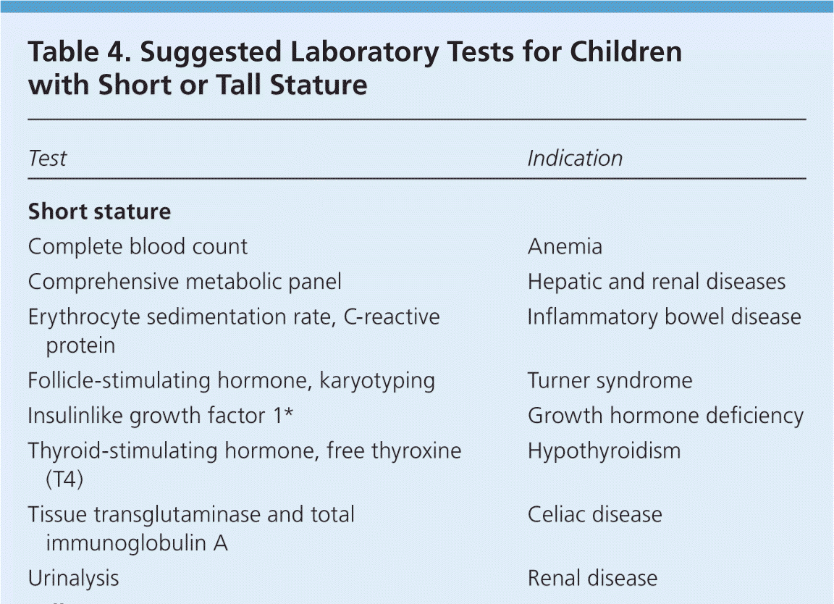
Assessment

Slide 52
DDx
Dx | Clinical features
Constitutional Short stature | Usually in a healthy boy with normal height early in life, associated with delayed puberty and delayed bone age, FHx of delayed puberty.
Familial short stature | Height within genetic target as per midparental height. Bone age = chronological age, no pubertal delay
Endocrinopathy | Growth failure (usually), weight is not affected, bone age is delayed.
Chronic illness | Growth failure, weight is also affected.
GI disease/ Malabsorption | Growth failure, weight is more affected than height
Genetic | Dysmorphic and / or disproportionate (Arm span < height, upper to lower segment ratio > 1.12)

Slide 53
Objectives
How is Growth Hormone – IGF Axis regulated?
How is growth assessed in infants and children?
How to approach a child with short stature?

Slide 54

Puberty (PED474)
Abdulmajeed AlSubaihin, MBBS, FAAP,FRCPC
Pediatric Endocrinologist

Slide 55
Objectives
How is Hypothalamic – Pituitary – Gonadal Axis regulated?
How is puberty assessed children?
How to approach a child a puberty disorder?

Slide 56
Objectives
How is Hypothalamic – Pituitary – Gonadal Axis regulated?
How is puberty assessed children?
How to approach a child a puberty disorder?

Slide 57
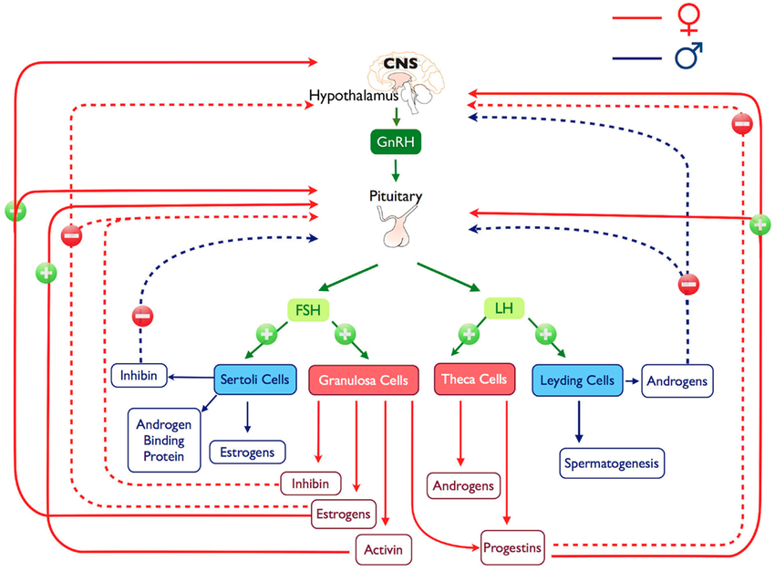

Slide 58
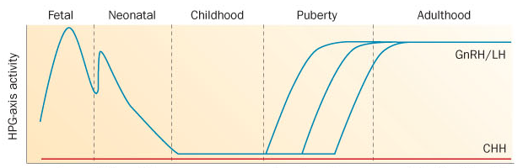
Mini-puberty phenomenon
Starts at 2 weeks of age
Peaks at 2 months of age
Ends by 6 months of age

Slide 59
HPG Axis remains dormant during childhood

Slide 60
Normal age of puberty onset:
8-13 years in girls
9-14 years in boys

Slide 61
Objectives
How is Hypothalamic – Pituitary – Gonadal Axis regulated?
How is puberty assessed children?
How to approach a child a puberty disorder?

Slide 62
Puberty Descriptions
Term | Signs | Result of
Gonadarche | Testicular enlargement | Testicular activation by FSH/ LH
Adrenarche | Body odor, skin oiliness, Pubic hair, Axillary hair and acne | Adrenal gland activation by ??
Thelarche | Breast development | Ovary activation by FSH/LH
Pubarche | Pubic hair growth | Adrenal, ovarian or testicular androgens
Menarche | First menses | Ovarian activation by FSH/LH
Spermarche | Appearance of sperms in morning void | Testicular activation by FSH/ LH

Slide 63
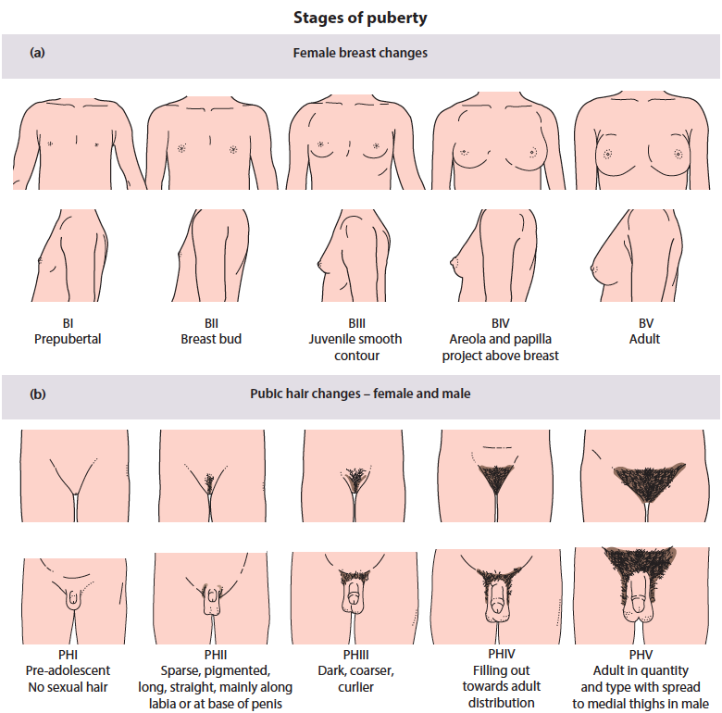
Pubertal Assessment
Tanner staging
Breast budding in girls (Tanner II) indicates onset of puberty

Slide 64
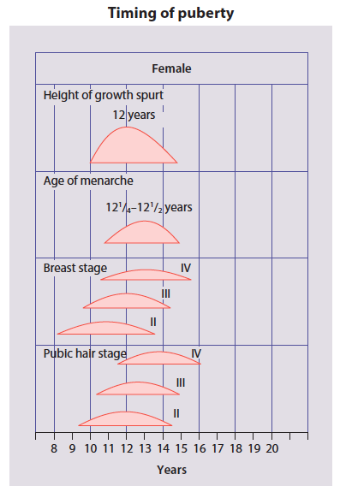
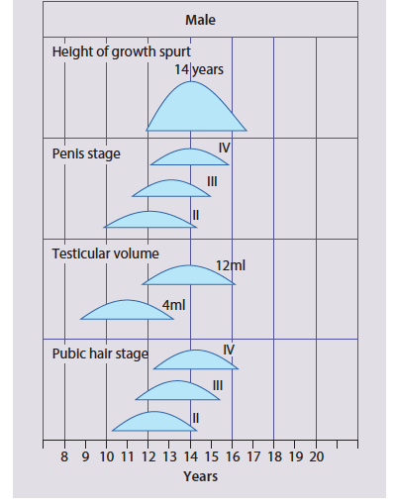
Pubertal Assessment

Slide 65
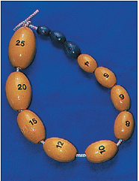
Pubertal Assessment
Orchidometer
Testicular volume in boys of 4 ml indicates the onset of puberty

Slide 66
Pubertal Assessment

Slide 67
Objectives
How is Hypothalamic – Pituitary – Gonadal Axis regulated?
How is puberty assessed children?
How to approach a child with a puberty disorder?

Slide 68
Delayed Puberty

Slide 69
Definitions
In boys:
Absence of pubertal signs by age 14.
In girls:
Absence of pubertal signs by age 13.

Slide 70
Approach
Constitutional delay of growth and puberty
Hypogonadotropic hypogonadism
Hypergonadotropic Hypogonadism
In an otherwise healthy child.
Family Hx of delayed puberty in a parent
Short stature, delayed bone age.
Spontaneous recovery at Bone age 12-13
FSH/LH and sex steroids in prepubertal range
Difficult to differentiate from CDGP
If congenital, could be associated with, cryptorchidism and/ or micropenis in boys.
Due to Pituitary/ Hypothalamic pathologies
No spontaneous recovery
FSH/LH and sex steroids in prepubertal range
Difficult to differentiate from Hypogonadtropic hypogonadism in prepubertal age range.
If congenital, could be associated with Ambigious genitalia, cryptorchidism and/or micropenis in boys.
Due to a gonadal pathology
FSH/LH are extremely elevated in pubertal age range.

Slide 71
Approach
Constitutional delay of growth and puberty
Hypogonadotropic hypogonadism
Hypergonadotropic Hypogonadism
DDx:
Pituitary hypoplasia (associated with other pituitary deficiencies, septo-optic dysplasia, CHARGE)
Isolated Gonadotropin Deficiency [Kallman syndrome] ( associated with anosmia/hyposmia).
Secondary (Trauma, Tumor, Radiation, Autoimmune , under nutrition, excessive exercising, hypothyroidism, hyperprolactinemia, cushing’s)
DDx:
Gonadal failure (congenital dysgenesis, Turner Syndrome, Klinefelter syndrome)
Secondary:
Trauma, Tumor, infection, radiation, Autoimmune, galactosemia.
A retrospective diagnosis.

Slide 72
Investigations
Bone age
FSH, LH levels
Testosterone (boys), estradiol (girls)
TSH, FT4 and prolactin
Karyotype
LHRH stimulation test in consultation with endocrinology
MRI Pituitary + Olfactory pulp, gonadal imaging

Slide 73
Precocious Puberty

Slide 74
Definition
Appearance of pubertal signs before age 8 in girls.
Appearance of pubertal signs before age 9 in boys.

Slide 75
Approach
What sex steroids are driving puberty?
Where are they coming from?

Slide 76
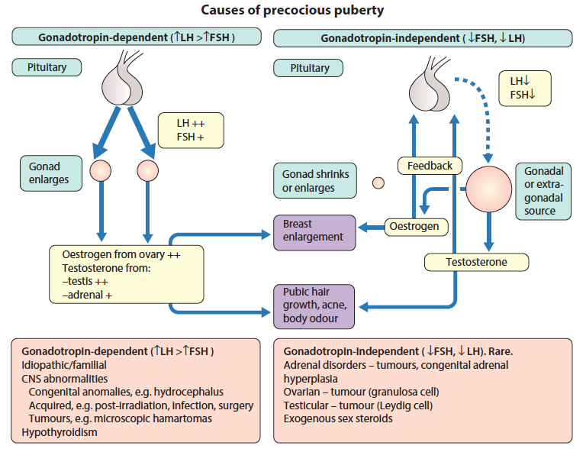
Assessment

Slide 77
Precocious Puberty and Café-au-lait macules (CALMs)
McCune- Albright Syndrome | Neurofibromatosis -1
Caused by auto activation of the gonadotropin receptor | Caused by optic gliomas adjacent to the pituitary gland
Gonadotropin independent precocious puberty (Suppressed FSH/LH) | Gonadotropin Dependent (Elevated FSH / LH)
CALMs respect midline and have rough borders | CALMs cross midline and have smooth borders.
Associated with fibrous dysplasia | Associated with Axillary freckling Plexiform Neurofibromas and Lisch nodules (Hamartomas).
Caused by somatic GNAS mutations | Caused by germline NF1 mutations (autosomal ddominant)

Slide 78
Investigations
Bone age
FSH, LH levels
Testosterone (boys), estradiol (girls)
Adrenal androgens for boys and girls.
TSH, FT4 and prolactin
LHRH stimulation test in consultation with endocrinology
MRI Pituitary (if gonadotropin dependent)
Gonadal/ Abdominal imaging to r/o tumors (if gonadotropin independent)

Slide 79
Objectives
How is Hypothalamic – Pituitary – Gonadal Axis regulated?
How is puberty assessed children?
How to approach a child with a puberty disorder?

Slide 80
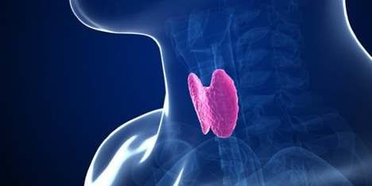
Thyroid Disorders (PED 474)
Abdulmajeed AlSubaihin MBBS, FAAP, FRCPC
Pediatric Endocrinologist

Slide 81
Objectives
How is the Hypothalamic- Pituitary- Thyroid Axis Regulated?
How to interpret Thyroid functions test?
Overview of common causes of hypothyroidism

Slide 82
Objectives
How is the Hypothalamic- Pituitary- Thyroid Axis Regulated?
How to interpret Thyroid functions test?
Overview of common causes of hypothyroidism

Slide 83
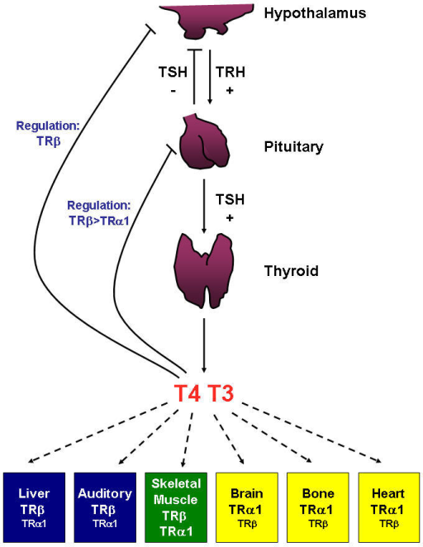

Slide 84
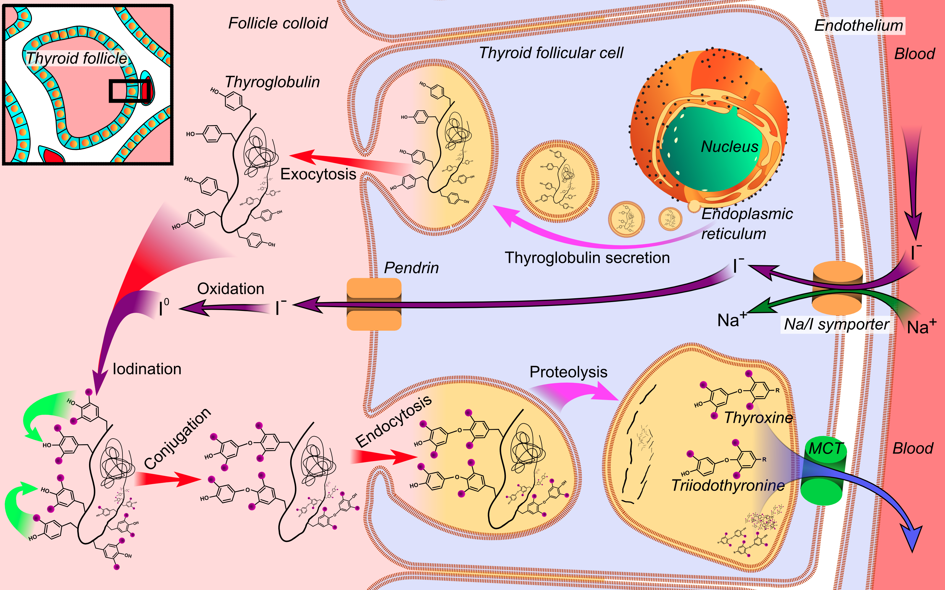

Slide 85
Objectives
How is the Hypothalamic- Pituitary- Thyroid Axis Regulated?
How to interpret Thyroid functions test?
Overview of common causes of hypothyroidism

Slide 86
TFTs
TSH | FT4 | FT3 | rT3 | Assessment
Normal | Normal | Normal | Low | Functional Thyroid axis
Elevated | Normal | Normal | Low | - Lab error - Primary hypothyroidism (subclinical) - TSH receptor resistance (Compensated)
Elevated | Low | Normal or Low | Low | Primary Hypothyroidism
Normal or slightly low | Low | Low | Elevated | Non-thyroidal illness (Sick Euthyroid)
Low or Normal | Low | Low | Low | Central hypothyroidism
Low | Elevated | Elevated | Low | Hyperthyroidism (Exogenous, Graves disease, Toxic nodule)

Slide 87
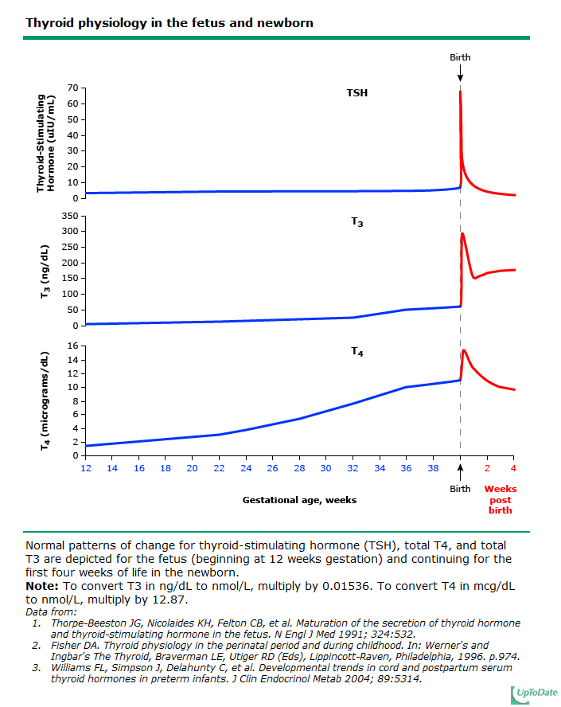
Normal TSH, FT4 and FT3 levels

Slide 88
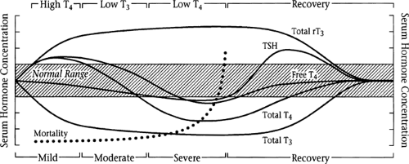
Non-thyroidal illness

Slide 89
Objectives
How is the Hypothalamic- Pituitary- Thyroid Axis Regulated?
How to interpret Thyroid functions test?
Overview of common causes of hypothyroidism

Slide 90
Presentation
Neonatal: positive newborn screening
Childhood: Poor growth, goiter, hypothyroid symptoms
Adolescence: Delayed puberty, goiter hypothyroid symptoms

Slide 91
Hypothyroidism by age
Neonate
Child and Adolescent
Etiology:
Thyroid dysgenesis
Dyshormonogenesis
Pituitary Hypothalmaic congenital malformation
Maternal blocking antibodies
Etiology
Autoimmune thyroiditis (Hashimoto)
Iodide deficiency or excess
Tumor
Trauma
Surgery
Iatrogenic (thyroid/ Pituitary irradiation) Thyroid blocking agents.

Slide 92
Hypothyroidism by age
Neonate/ Infantile
Child and Adolescent
Presentation
Positive newborn screen
Prolonged Jaundice
Hypotonia/ Tongue protrusion
Feeding intolerance
Constipation
Failure to thrive
Developmental delay
Presentation
Goiter
Growth failure
Delayed puberty
Hypothyroid symptoms: Fatigue, loss of memory/ concentration, poor school performance, excessive weight gain

Slide 93
Approach
Age range | Primary Hypothyroidism (High TSH) |  | Central Hypothyroidism (Low th low FT4)
Newborn | Hormonogenesis defect Maternal intake of goitrogens (Anti-thyroid drugs) | Goiter (+) | Nonthyroidal illness Hypothalamic/Pituitary disorder Hypoplasia (congenital) Autoimmune (Hypophysitis) Tumor Surgery Infiltrative (Histiocytosis/ Sarcoidosis) Iatrogenic Ischemic Infectious
 | Thyroid Dysgenesis Iodide exposure (contrast/ Anti-septic) Maternal blocking antibody | Goiter (-)
Child | Autoimmune (Hashimoto) Iodine deficiency | Goiter (+)
 | Thyroid dysgenesis Cystinosis Trauma/ Iatrogeneic (Radiation, Surgey) | Goiter(-)

Slide 94
Treatment
Treat the underlying cause if treatable
Thyroid hormone replacement in consultation with endocrinology.

Slide 96
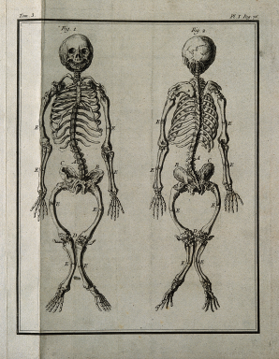
Rickets
Abdulmajeed AlSubaihin MBBS, FAAP, FRCPC
Pediatric Endocrinologist

Slide 97
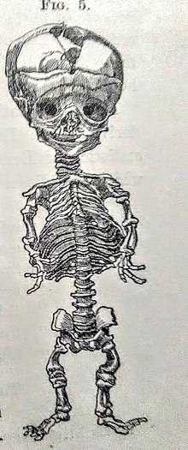
Rickets
Old English word Wrickken = to twist
Greek word Rachitis = in or of the spine
Skeleton of infant with rickets, 1881.

Slide 98
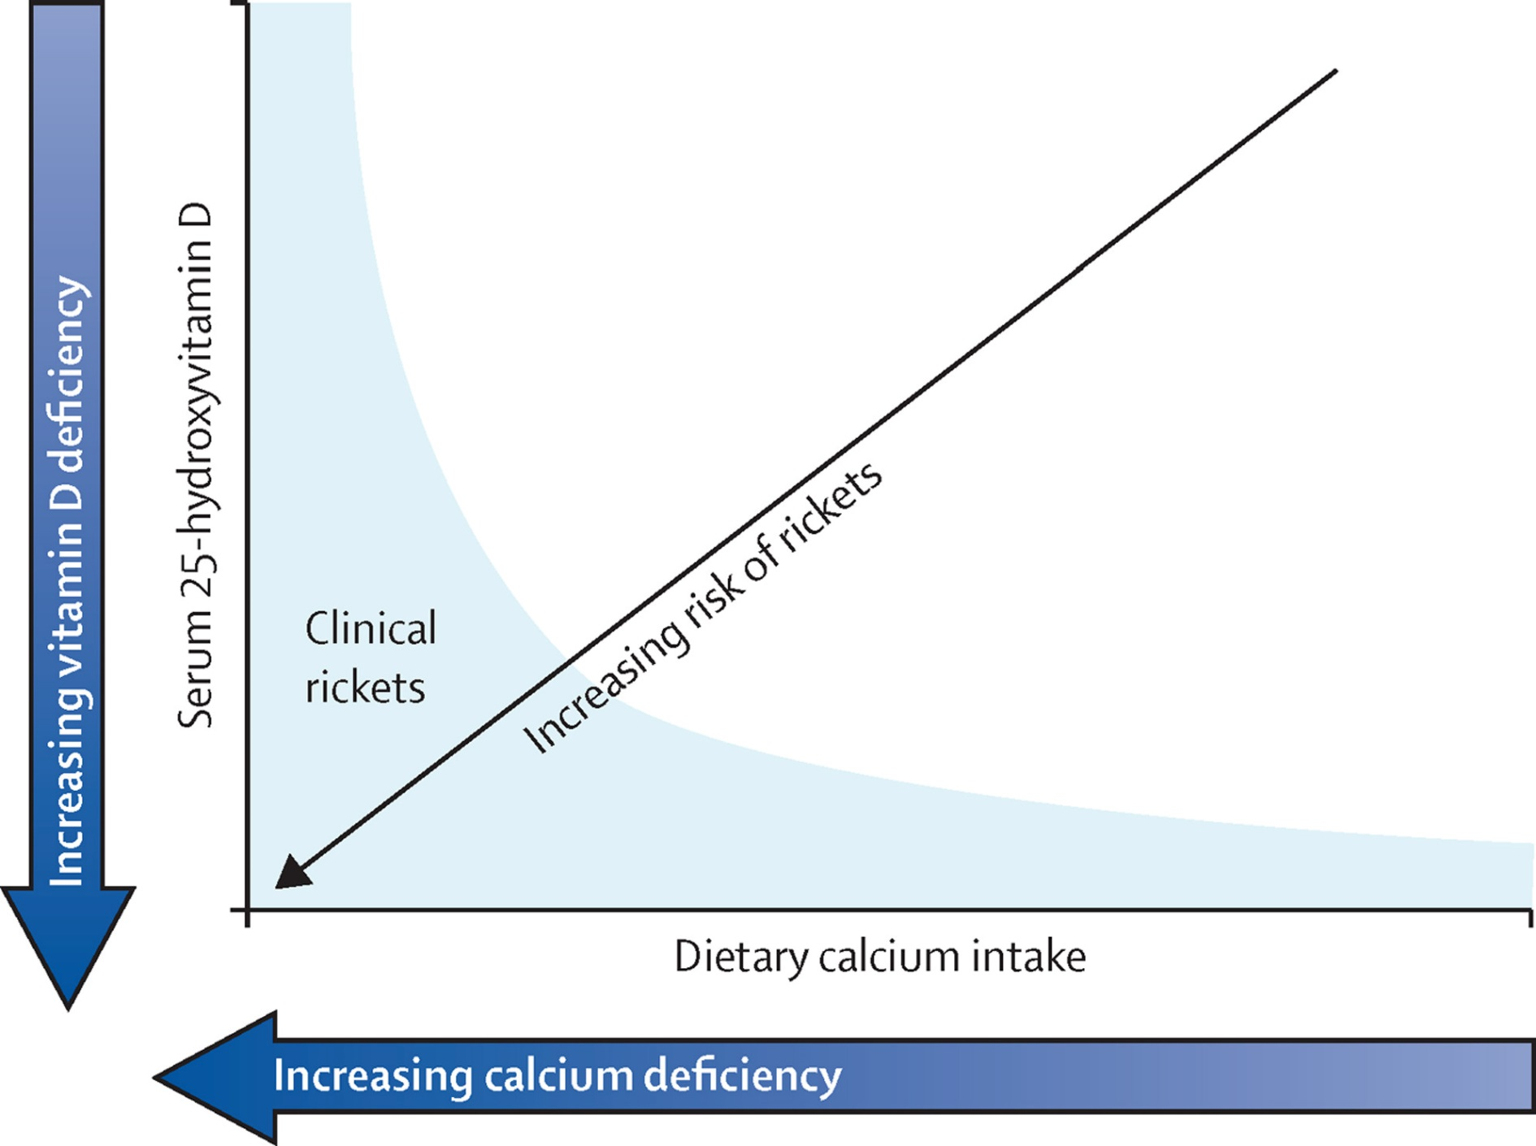

Figure
Copyright © 2016 Högler et al. Open Access article distributed under the terms of CC BY Terms and Conditions
The Lancet Global Health 2016 4, e229-e230DOI: (10.1016/S2214-109X(16)00061-9)
The Lancet Global Health 2016 4, e229-e230DOI: (10.1016/S2214-109X(16)00061-9)
Notes:
Vitamin D and dietary calcium deficiency—detrimental to bone in combination

Slide 99
Vitamin D vs Calcium Deficiency
Creo et al. Pediatric International Child Health. 2017 (4) 84-98

Slide 100
Carpenter, T. O. et al. (2017) Rickets
Nat. Rev. Dis. Primers doi:10.1038/nrdp.2017.101

Slide 101
Case 1
5 year old boy.
Non-consanguineous parents of African ancestry
Brought to ED for not being able to weight-bear following an unwitnessed fall.
Parents reported normal appetite and no dietary restrictions
On examination, his height, weight and head circumference were all below the 3rd percentile.
Also found to be globally delayed
Apprehensive and cries when touched for exam.
Had a palpable bone prominence on the right thigh, widened wrist joint bilaterally, bell shape chest with rachitic rosary

Slide 102
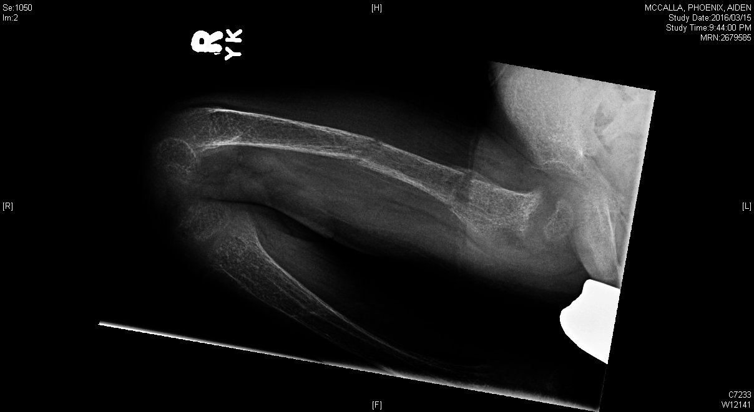
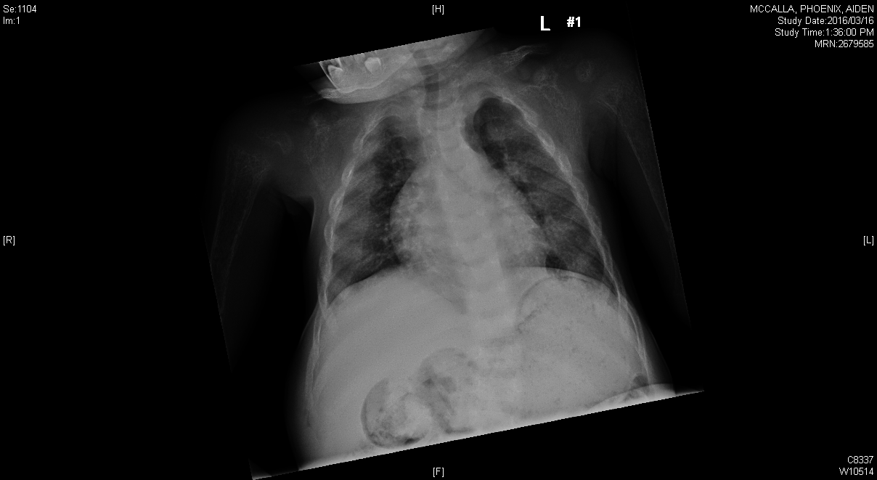
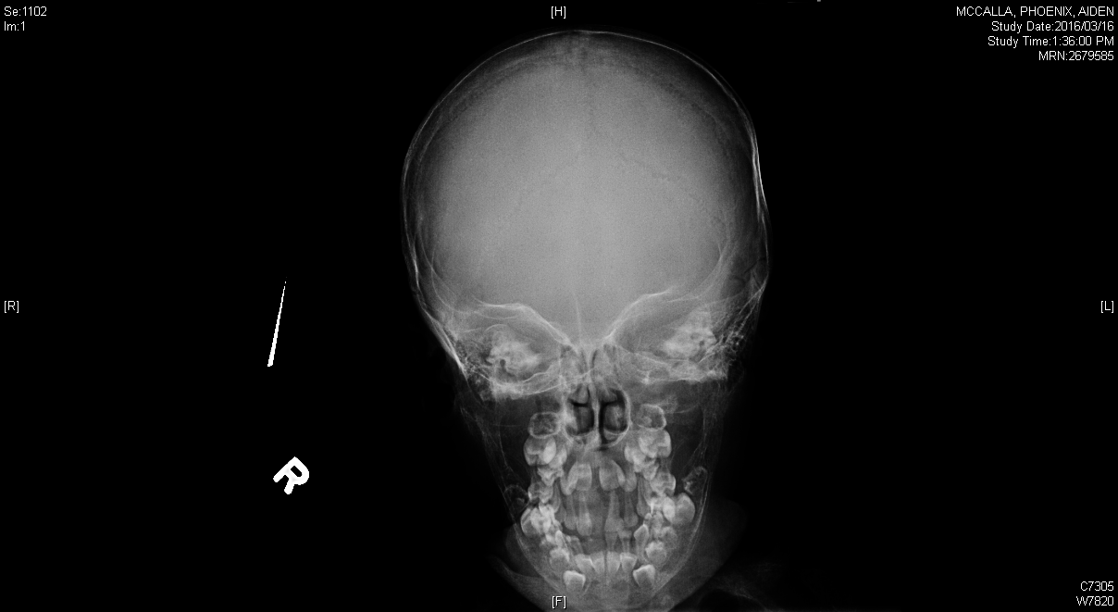
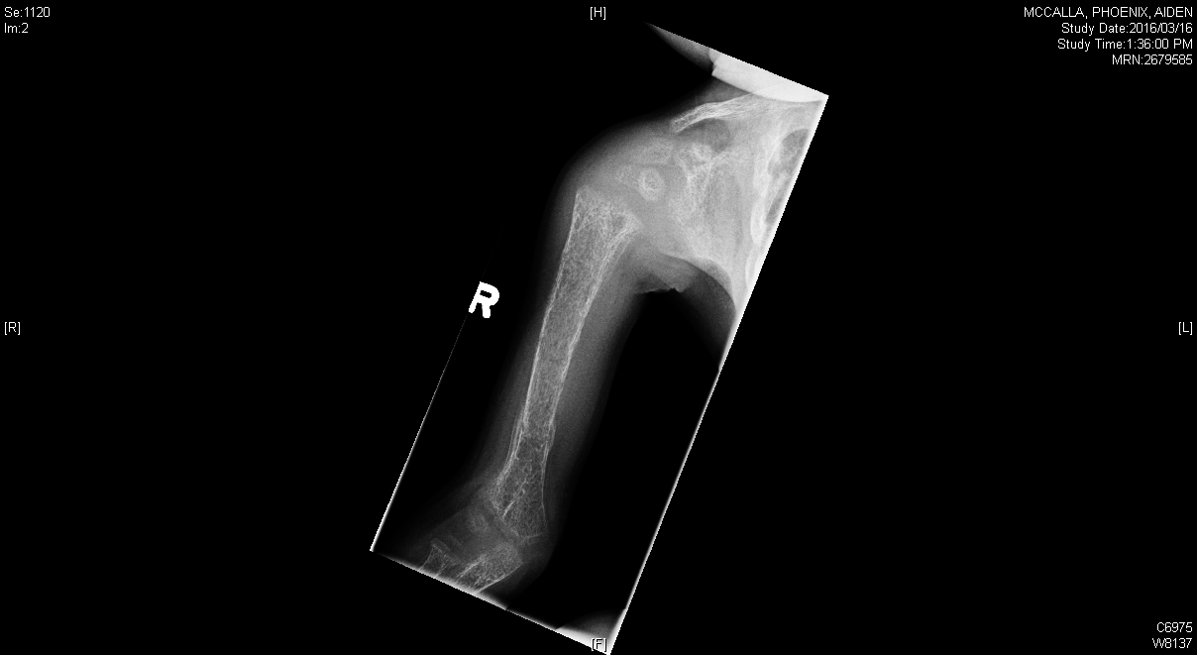
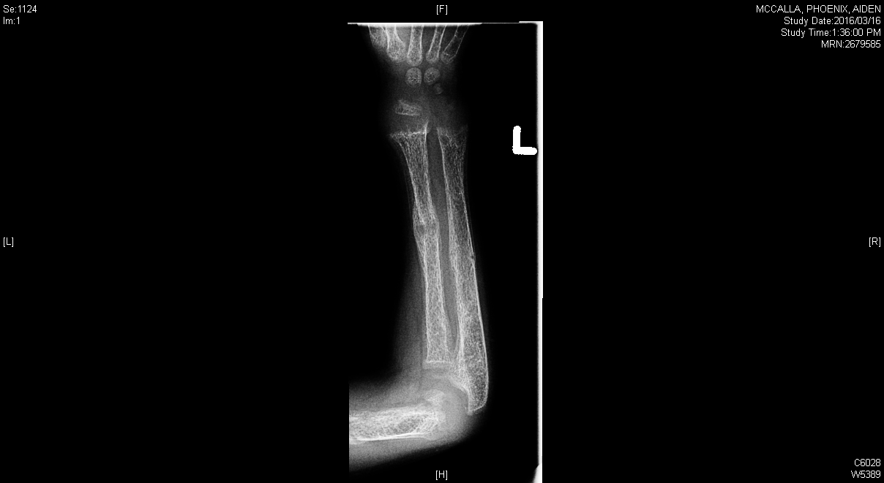
Case 1

Slide 103
Case 1
Labs:
Total 25-OH Vitamin D Undetectable
Ca (Total) 1.59 mmol/l (2.22-2.54)
Ca (Ionized) 0.84 mmol/l (1.22-1.37)
Phosphate 0.85 mmol/l (1.36-1.98)
ALP 1965 IU/l (151-342)
PTH 457 ng/l (12-78)
1,25-OH-Vitamin D Not done
CBC showed microcytic hypochromic anemia
Iron: Low
Transferrin: Low
Vitamin B12: Low

Slide 104
Case 1
Management:
IV Calcium infusion
Vitamin D 1000 IU daily
Alfacalcidiol 0.5 micrograms daily X 4months then stopped
Multivitamin supplements/Iron
CAS was involved and the child was discharged with a foster family.

Slide 105
Case 1
Labs:
Total 25-OH Vitamin D Undetectable 75 nmol/l
Ca (Total) 1.59 mmol/l (2.22-2.54) 2.44 mmol/l
Ca (Ionized) 0.84 mmol/l (1.22-1.37)
Phosphate 0.85 mmol/l (1.36-1.98) 1.91 mmo/l
ALP 1965 IU/l (151-342) 269 IU/l
PTH 457 ng/l (12-78) 39 ng/l
1,25-OH-Vitamin D Not done ( 48-191) 131 pmol/l

Slide 106
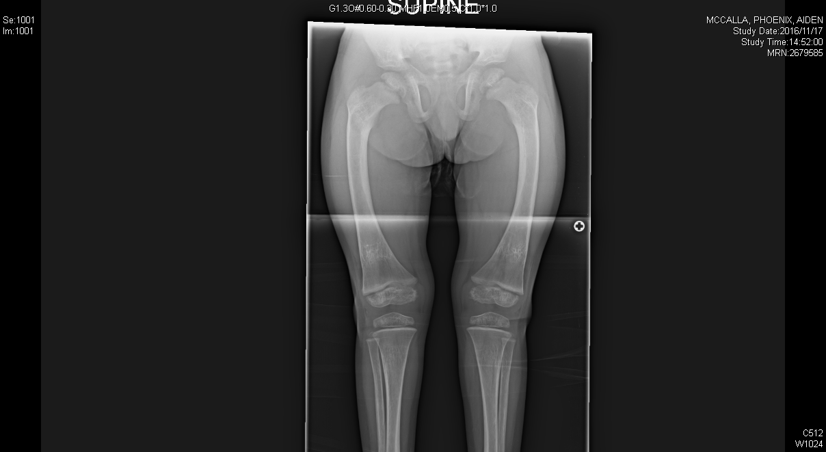
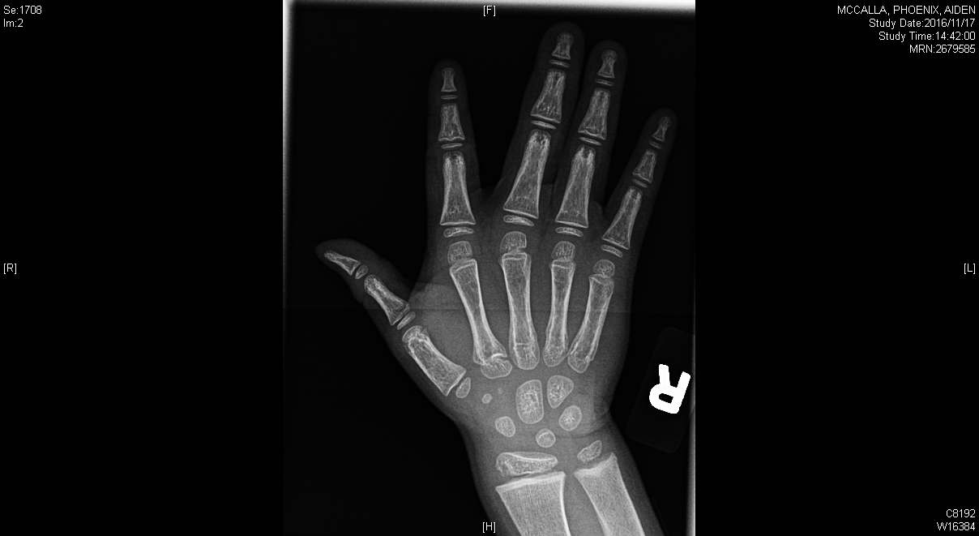
Case 1

Slide 107
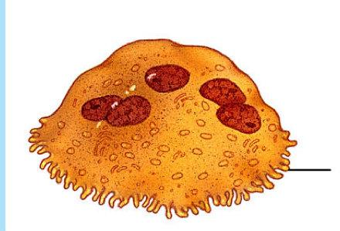
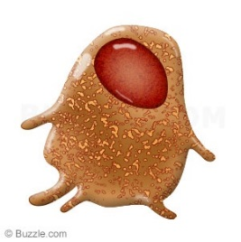
Case 1
Osteoclast
Adequate Vitamin D Calcium
Calcium sufficient State
PTH
Calcium
Phosphate
1-α-OHase CYP27B1
Osteoblast
Phosphaturia
1,25-OH Vitamin D
ALP

Slide 108
Case 1
Calcium insufficient State
Osteoclast
Inadequate Vitamin D Calcium
PTH
Calcium
Phosphate
1-α-OHase CYP27B1
Osteoblast
Phosphaturia
Phosphopenia
1,25-OH Vit D
ALP

Slide 109
Case 1
Hypocalcemia
Osteoclast
Inadequate Vitamin D Calcium
Calcium insufficient State
PTH
Calcium
Phosphate
1-α-OHase CYP27B1
Osteoblast
Phosphaturia
Phosphopenia
1,25-OH Vit D
ALP

Slide 110
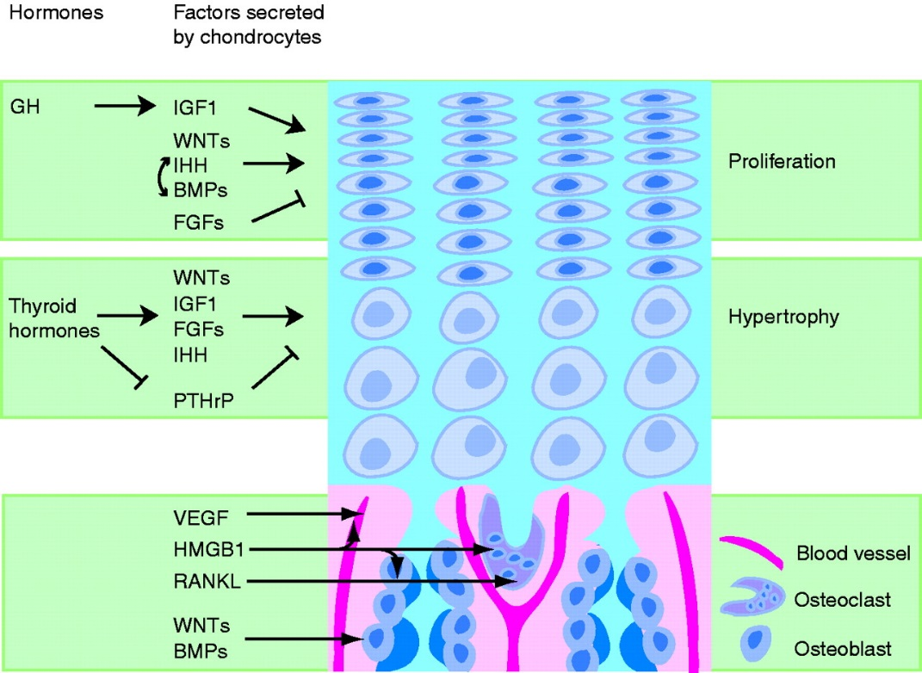
Case 1

Slide 111





Case 1
Expansion of Hypertrophy zone
Failure to activate apoptotic pathways
Metaphyseal flaring

Slide 112
Case 1
Labs:
Total 25-OH Vitamin D Undetectable 75 nmol/l
Ca (Total) 1.59 mmol/l (2.22-2.54) 2.44 mmol/l
Phosphate 0.85 mmol/l (1.36-1.98) 1.91 mmo/l
ALP 1965 IU/l (151-342) 269 IU/l
PTH 457 ng/l (12-78) 39 ng/l
1,25-OH-Vitamin D Not done ( 48-191) 131 pmol/l

Slide 113
Case 3
3 year old girl. Parents are non-consanguineous
Presented with lower limb deformity and waddling gait.
No diet restrictions
No family history of rickets
On examination: Height/Weight (10th %ile). No dysmorphic features. Bilateral lower limb bowing. No clinical features of rickets otherwise.

Slide 114
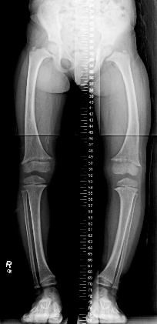
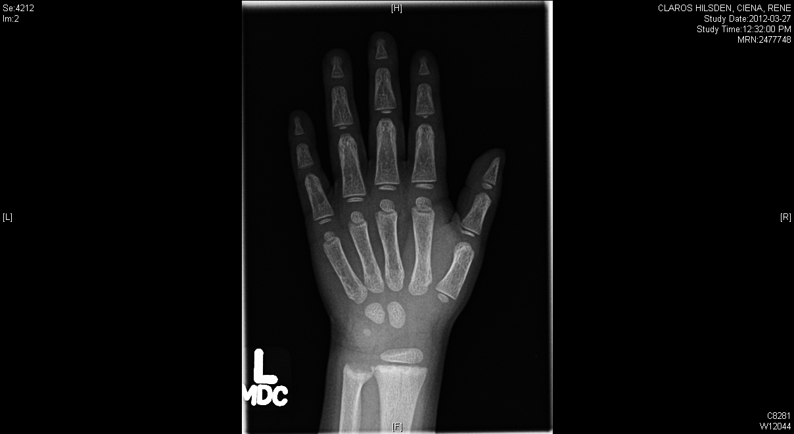
Case 3

Slide 115
Case 3
Labs:
Total 25-OH Vitamin D 71 nmol/l
Ca (Total) 2.42 mmol/l (2.22-2.54)
Ca (Ionized) not done (1.22-1.37)
Phosphate 0.92 mmol/l (1.16-2.1)
ALP 480 IU/l (151-382 )
PTH 35 ng/l (12-78)
1,25-OH-Vitamin D 86 pmol/l (39-193)
Urea 5.1 mmol/l (2.9-7.1)
Creat 20 umol (<36)

Slide 116

Case 3
Renal phosphate reabsorption measurements:
1- Tubular Reabsorption of Phosphate
= 84% ( > 80% in hypophosphatemia is appropriate)

Slide 117

Case 3
Renal phosphate reabsorption measurements:
2- TMP/GFR: 0.81 mmol/l

Slide 118
Case 3
Genetic testing showed a disease causing mutation in PHEX gene
(X-Linked Hypophosphatemic Rickets) MIM 307800

Slide 119
Case 3
Osteoclast
Adequate Vitamin D Calcium
Calcium Sufficient state
PTH
Calcium
Phosphate
1-α-OHase CYP27B1
Osteoblast
Phosphaturia
1,25-OH Vit D
ALP

Slide 120
Case 3
Osteoclast
Adequate Vitamin D Calcium
Calcium Sufficient State
PTH
Calcium
Phosphate
1-α-OHase CYP27B1
Osteoblast
Phosphaturia
Phosphopenia
1,25-OH Vitamin D
ALP

Slide 121
Case 3
Osteoclast
Inadequate Calcium and phosphate
Calcium Insufficient State
PTH
Calcium
Phosphate
1-α-OHase CYP27B1
Osteoblast
Phosphaturia
Phosphopenia
1,25-OH Vitamin D
ALP

Slide 122
Case 3
Is it Hypophosphatemic Rickets?
Labs:
Total 25-OH Vitamin D 71 nmol/l
Ca (Total) 2.42 mmol/l (2.22-2.54)
Ca (Ionized) not done (1.22-1.37)
Phosphate 0.92 mmol/l (1.16-2.1)
ALP 480 IU/l (151-382 )
PTH 35 ng/l (12-78)
1,25-OH-Vitamin D 86 pmol/l (39-193)
Urea 5.1 mmol/l (2.9-7.1)
Creat 20 umol (<36)

Slide 123
Take Home Messages
Carpenter, T. O. et al. (2017) Rickets. Nat. Rev. Dis. Primers doi:10.1038/nrdp.2017.101

Slide 124
Take Home messages
Rickets:
Radiological metaphyseal changes
Hypophosphatemia
Elevated ALP

Slide 125
PTH
Elevated
Not elevated
Very elevated 1,25 OH Vitamin D
Low, Normal slightly elevated 1,25OH Vit D
Low normal 1,25 OH Vitamin D
High normal, Elevated 1,25 OH-Vitamin D
FGF23 mediated Hypophosphatemic rickets:
PHEX, DMP1, ENPP1, FGF23 mutaions
TIO
Fibrous Dysplasia (MAS)
Epidermal Nevus syndrome
VDDR Type II
Calcium insufficiency
Nutritional Rickets
25-OHase deficiency
VDDR Type 1
Renal Rickets
Non-FGF23 mediated hypophosphatemic rickets:
-Insufficient
dietary phosphate
-HHRH (associated with hypercalciuria)
- Renal tubular defects (Fanconi)

Slide 126
The End

