Slide 1
Adrenal Disorders (PED474)
Abdulmajeed AlSubaihin MBBS, FAAP, FRCPC
Pediatric Endocrinologist

Slide 2
Objectives
Adrenal glands basic structure and function
Biochemical Patterns of adrenal disorders
Congenital Adrenal Hyperplasia
Addison’s disease
Cushing Syndrome

Slide 3
Objectives
Adrenal glands basic structure and function
Biochemical Patterns of adrenal disorders
Congenital Adrenal Hyperplasia
Addison’s disease
Cushing Syndrome

Slide 4
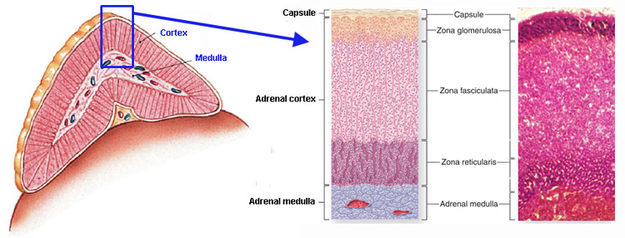
G → Salt (Mineralocroticoids)
F → Sugar (Glucocorticoids)
R → Sex (Androgens)

Slide 5
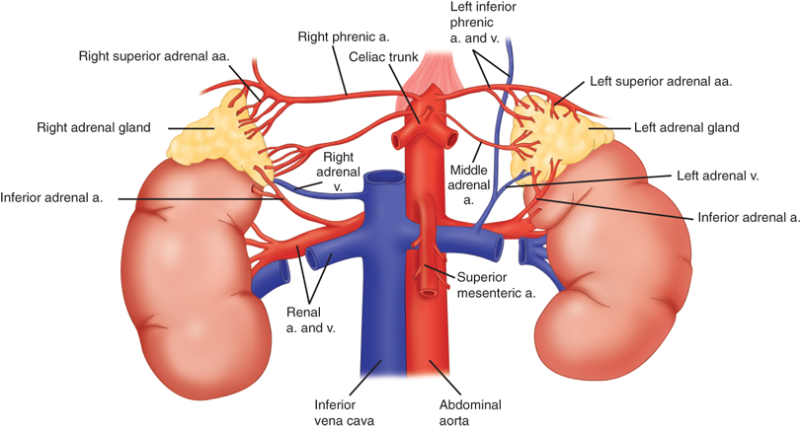

Slide 6
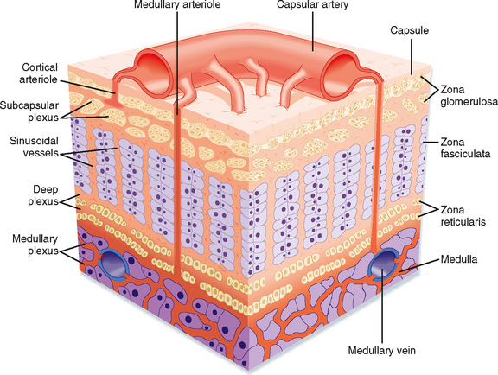

Slide 7
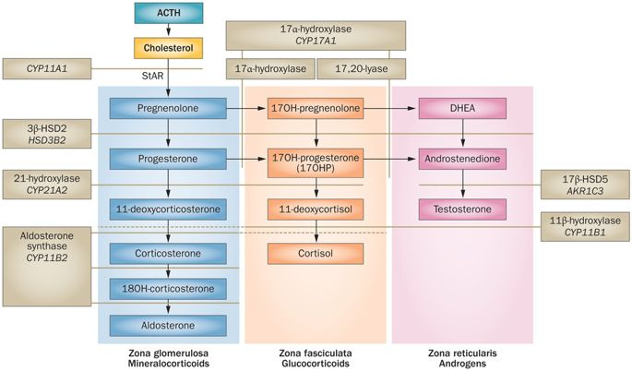

Slide 10
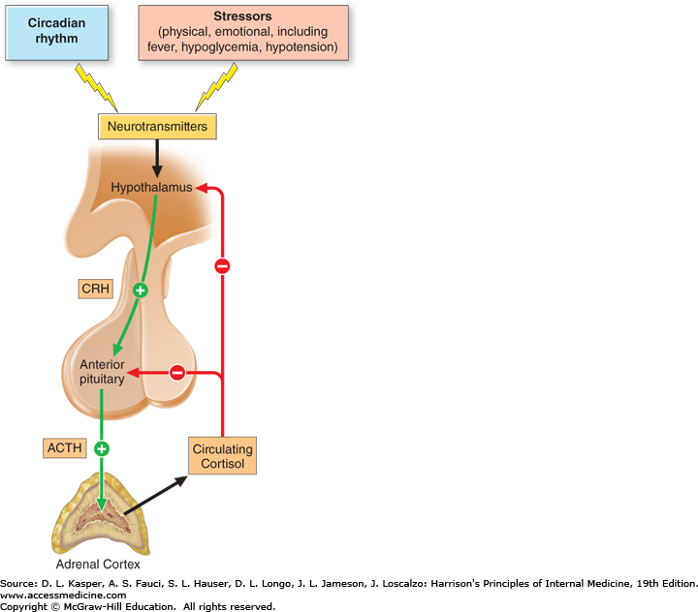
The Hypothalamic – Pituitary – Adrenal Axis

Slide 11
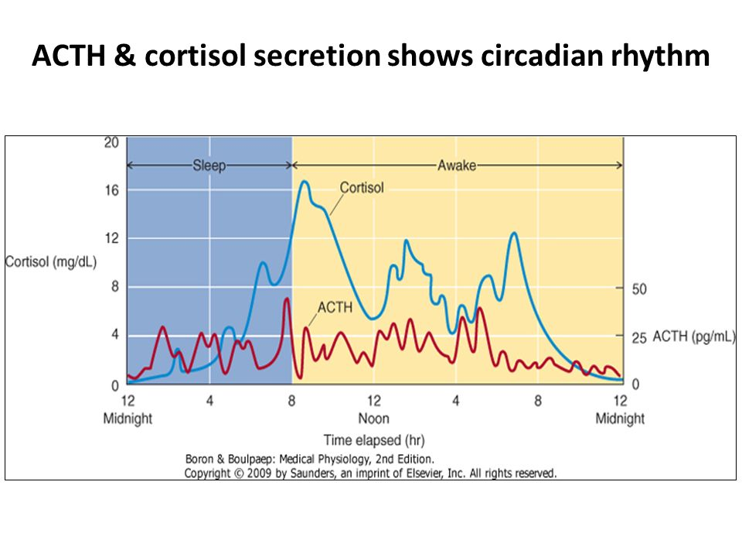

Slide 12
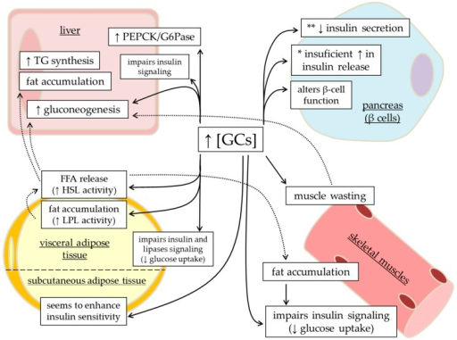

Slide 13
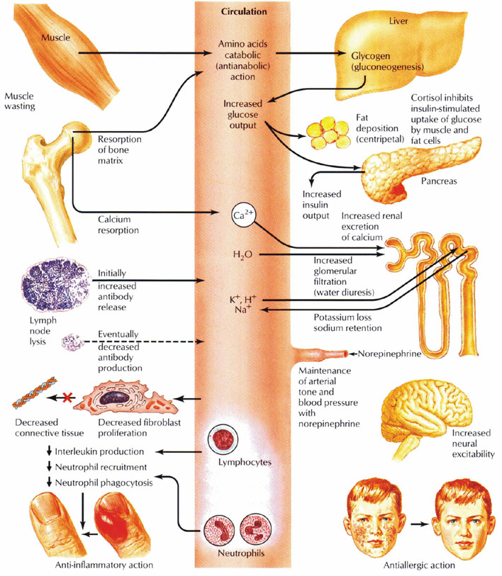
Cortisol Actions

Slide 14
Mineralocorticoid Axis
Zona Glomerlulosa
(Mineralocorticoids)
ACTH
Zona Fasiculata
(Cortisol)
Zona Reticularis
(Androgens)

Slide 15
Mineralocorticoid Axis
Zona Glomerlulosa
(Mineralocorticoids)
Angiotensin
Zona Fasiculata
(Cortisol)
Zona Reticularis
(Androgens)

Slide 16
Objectives
Adrenal glands basic structure and function
Biochemical Patterns of adrenal disorders
Congenital Adrenal Hyperplasia
Addison’s disease
Cushing Syndrome

Slide 17
Biochemical Patterns of Adrenal Disorders
Disorder | ACTH | Renin/ Aldosterone | Stimulated Cortisol | Adrenal Androgens
Pituitary Hypoplasia
Congenital Adrenal Hypoplasia
Classical Congenital Adrenal Hyperplasia (21- OHase def)
Cushing Disease (Pituitary Adenoma)
Addison’s disease

Slide 18
Biochemical Patterns of Adrenal Disorders
Disorder | ACTH | Renin/ Aldosterone | Stimulated Cortisol | Adrenal Androgens
Pituitary Hypoplasia | Low | Normal | Low/ Absent | N/A
Congenital Adrenal Hypoplasia
Classical Congenital Adrenal Hyperplasia (21- OHase def)
Cushing Disease (Pituitary Adenoma)
Addison’s disease

Slide 19
Biochemical Patterns of Adrenal Disorders
Disorder | ACTH | Renin/ Aldosterone | Stimulated Cortisol | Adrenal Androgens
Pituitary Hypoplasia | Low | Normal | Low/ Absent | N/A
Congenital Adrenal Hypoplasia | Elevated | Elevated Renin Normal/ Low aldosterone | Low/ Undetectable | N/A
Classical Congenital Adrenal Hyperplasia (21- OHase def)
Cushing Disease (Pituitary Adenoma)
Addison’s disease

Slide 20
Biochemical Patterns of Adrenal Disorders
Disorder | ACTH | Renin/ Aldosterone | Stimulated Cortisol | Adrenal Androgens
Pituitary Hypoplasia | Low | Normal | Low/ Absent | N/A
Congenital Adrenal Hypoplasia | Elevated | Elevated Renin Normal/ Low aldosterone | Low/ Undetectable | N/A
Classical Congenital Adrenal Hyperplasia (21- OHase def) | Elevated | Elevated Renin Normal/ Low aldosterone | Low/ Undetectable | Significantly elevated
Cushing Disease (Pituitary Adenoma)
Addison’s disease

Slide 21
Biochemical Patterns of Adrenal Disorders
Disorder | ACTH | Renin/ Aldosterone | Stimulated Cortisol | Adrenal Androgens
Pituitary Hypoplasia | Low | Normal | Low/ Absent | N/A
Congenital Adrenal Hypoplasia | Elevated | Elevated Renin Normal/ Low aldosterone | Low/ Undetectable | N/A
Classical Congenital Adrenal Hyperplasia (21- OHase def) | Elevated | Elevated Renin Normal/ Low aldosterone | Low/ Undetectable | Significantly elevated
Cushing Disease (Pituitary Adenoma) | Elevated | Suppressed | Elevated | Slightly elevated
Addison’s disease

Slide 22
Biochemical Patterns of Adrenal Disorders
Disorder | ACTH | Renin/ Aldosterone | Stimulated Cortisol | Adrenal Androgens
Pituitary Hypoplasia | Low | Normal | Low/ Absent | N/A
Congenital Adrenal Hypoplasia | Elevated | Elevated Renin Normal/ Low aldosterone | Low/ Undetectable | N/A
Classical Congenital Adrenal Hyperplasia (21- OHase def) | Elevated | Elevated Renin Normal/ Low aldosterone | Low/ Undetectable | Significantly elevated
Cushing Disease (Pituitary Adenoma) | Elevated | Suppressed | Elevated | Slightly elevated
Addison’s disease | Elevated | Elevated Renin/ Normal low aldosterone | Low | N/A

Slide 23
Objectives
Adrenal glands basic structure and function
Biochemical Patterns of adrenal disorders
Congenital Adrenal Hyperplasia
Addison’s disease
Cushing Syndrome

Slide 24
Congenital Adrenal Hyperplasia
A group of adrenal disorders due the deficiency of enzymes in the steroidogenesis pathway.
All are characterized by Cortisol deficiency.
May be associated with a varying degree of genital ambiguity
May be associated with mineralocorticoid EXCESS or Deficiency.

Slide 25
Pathophysiology
Pituitary
(ACTH)
Cortisol
Adrenals
Androgens
Mineralocorticoids

Slide 27
Pathophysiology
Pituitary
(ACTH)
Cortisol
Adrenals
Androgens
Mineralocorticoids

Slide 28
Pathophysiology
Pituitary
(ACTH)
Cortisol
Adrenals
Androgens
Mineralocorticoids

Slide 29
Pathophysiology
Pituitary
(ACTH)
Cortisol
Adrenals
Androgens
Mineralocorticoids

Slide 30
Pathophysiology
Pituitary
(ACTH)
Cortisol
Adrenals
Androgens
Mineralocorticoids

Slide 31
Pathophysiology
Pituitary
(ACTH)
Adrenals
Cortisol
Androgens
Mineralocorticoids

Slide 32
Pathophysiology
Pituitary
(ACTH)
Adrenal Hyperplasia
Cortisol
Androgens
Mineralocorticoids

Slide 33
Presentation
Early onset (Neonatal)
Positive newborn screen (21-OHase deficiency)
Ambiguous genitalia
Adrenal crisis (Vomiting and lethargy)
Hypoglycemia
Electrolyte disturbance
Hypo/ hypertension
Late onset (Childhood/ adolescence):
Prematrue Adrenarche
Precocious puberty
Growth acceleration
Hirsutism
PCOS

Slide 34
Types of CAH
Enzyme Deficient | Cortisol | 17-OH-Progesterone | 11-DOC | 17-OH-Pregnenolone DHEA | Renin | Clinical consequences
21-OHase
3-β-HSD
11-β-OHase
17-α-Ohase

Slide 36
Types of CAH
Enzyme Deficient | Cortisol | 17-OH-Progesterone | 11-DOC | 17-OH-Pregnenolone and DHEA | Renin | Clinical consequences
21-OHase | Low | High | Low | High | High | Adrenal insufficiency Salt wasting (Classical form) Ambiguous genitalia in a female
3-β-HSD
11-β-OHase
17-α-Ohase

Slide 38
Types of CAH
Enzyme Deficient | Cortisol | 17-OH-Progesterone | 11-DOC | 17-OH-Pregnenolone and DHEA | Renin | Clinical consequences
21-OHase | Low | High | Low | High | High | Adrenal insufficiency Salt wasting (Classical form) Ambiguous genitalia in a female
3-β-HSD | Low | Low | Low | High | High | Adrenal insufficiency Salt wasting Ambiguous genitalia Both males and females
11-β-OHase
17-α-Ohase

Slide 40
Types of CAH
Enzyme Deficient | Cortisol | 17-OH-Progesterone | 11-DOC | 17-OH-Pregnenolone and DHEA | renin | Clinical consequences
21-OHase | Low | High | Low | High | High | Adrenal insufficiency Salt wasting (Classical form) Ambiguous genitalia in a female
3-β-HSD | Low | Low | Low | High | High | Adrenal insufficiency Salt wasting Ambiguous genitalia Both males and females
11-β-OHase | Low | High | High | Normal/High | Low | Adrenal insufficiency Salt retention Hypertension Ambiguous genitalia in a female
17-α-Ohase

Slide 42
Types of CAH
Enzyme Deficient | Cortisol | 17-OH-Progesterone | 11-DOC | 17-OH-Pregnenolone and DHEA | renin | Clinical consequences
21-OHase | Low | High | Low | High | High | Adrenal insufficiency Salt wasting (Classical form) Ambiguous genitalia in a female
3-β-HSD | Low | Low | Low | High | High | Adrenal insufficiency Salt wasting Ambiguous genitalia Both males and females
11-β-OHase | Low | High | High | Normal/High | Low | Adrenal insufficiency Salt retention Hypertension Ambiguous genitalia in a female
17-α-Ohase | Low | Low | High | Low | suppressed | Adrenal insufficiency Salt retention Hypertensison Ambiguous Genitalia in Males

Slide 43
Management
Address ambiguous genitalia with a multidisciplinary biopsychosocial approach.
Confirm diagnosis (ACTH stim test, Karyotype electrolytes, renin, Androgens and adrenal metabolites)
Replace ( Hydrocortisone, Fludrocortisone and NaCl)
Teach (Adrenal crisis symptoms, Stress dosing)
Prevent (medical bracelet, ER letter)

Slide 44
Objectives
Adrenal glands basic structure and function
Biochemical Patterns of adrenal disorders
Congenital Adrenal Hyperplasia
Addison’s disease
Cushing Syndrome

Slide 45
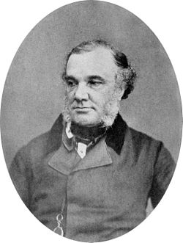
Addison’s disease
In 1855, Thomas Addison described the constellation of fatigue, weight loss hypotension and hyperpigmentation in a group of patients with adrenal insufficiency.
What was the cause of AI in those patients?

Slide 46
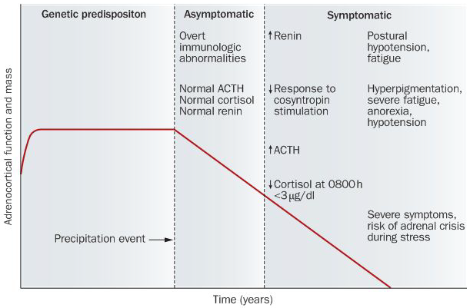
Addison’s Disease

Slide 47
Presentation
Chronic Fatigue/ Dizziness (postural hypotension)
Weight loss/ Anorexia
Recurrent Vomiting
Hypoglycemic episodes
Adrenal crisis (GI symptoms, Hypotension, relatively low heart rate, Hypothermia, Metabolic acidosis, Low Na/ High K, Hypoglycemia)

Slide 48
Adrenal Crisis
GI symptoms
Hypotension/ relatively low heart rate
Hypothermia
Metabolic acidosis, Low Na/ High K
Hypoglycemia

Slide 49
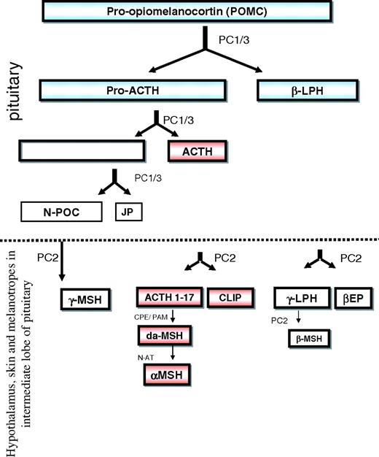
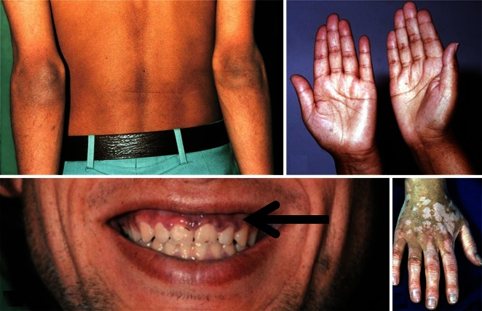
Hyperpigmentation

Slide 50
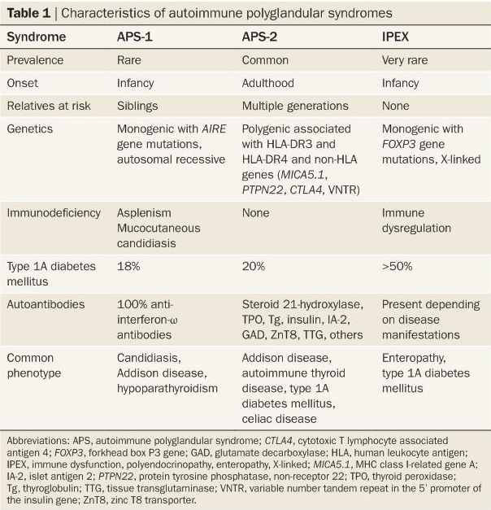
Autoimmune Polyendocrinopathies

Slide 51
Biochemical Assessment
ACTH stim test:
0 min→ Cosyntropin (15 mcg/kg) IV X1 (Max 250 mcg) + Baseline ACTH and Cortisol level
30 min → Cortisol level
60 min → Cortisol level
Cortisol peak of < 500 nmol/l is diagnostic for Adrenal insufficiency

Slide 52
Biochemical Assessment
Paired AM ACTH and Cortisol levels:
ACTH level of > 2-fold the upper limit of normal range
And
AM Cortisol level < 150 nmol/l

Slide 53
Other supportive biochemical features
Anti Adrenal antibodies (+)
Low sodium
High potassium
Normal anion gap metabolic acidosis (Type IV RTA)

Slide 54
Management
Find the etiology Screen for other co-autoimmunities
Oral Hydrocortisone (8-10 mg/m²/day divided into 3 doses)
Fludrocortisone (Mineralocorticoid) 0.1 mg 1-2 times per day.
Medicalert bracelet, ER letter
Stress dosing (sick days)

Slide 55
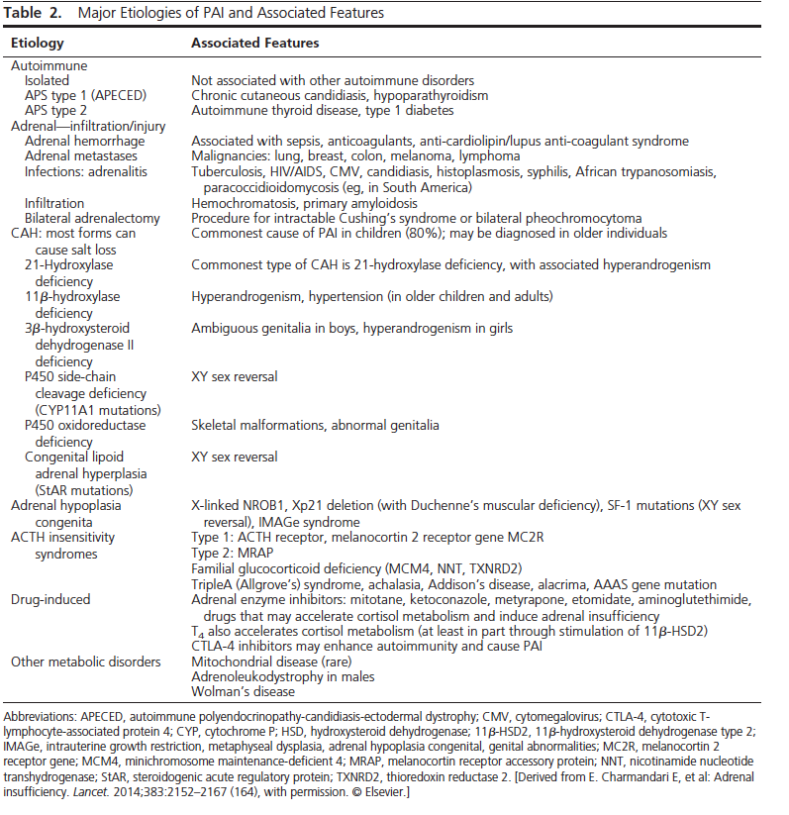
Causes of Primary Adrenal Insufficiency

Slide 56
Objectives
Adrenal glands basic structure and function
Biochemical Patterns of adrenal disorders
Congenital Adrenal Hyperplasia
Addison’s disease
Cushing Syndrome

Slide 57
Terminology
Cushing Syndrome
Cushing Disease
Pseudocushing

Slide 58
Presentation
progressive obesity
Growth failure
PCOS
Screening (MEN, McCune Albright Syndrome, Carney Complex)

Slide 59
Work-up
1- Establish hypercortisolism (Rule out pseudo cushing):
24h urine collection for free cortisol
Bedtime salivary cortisol level
2- Look for the source of excessive steroids
(Exogenous steroid exposure is the most common cause of cushing syndrome)

Slide 60
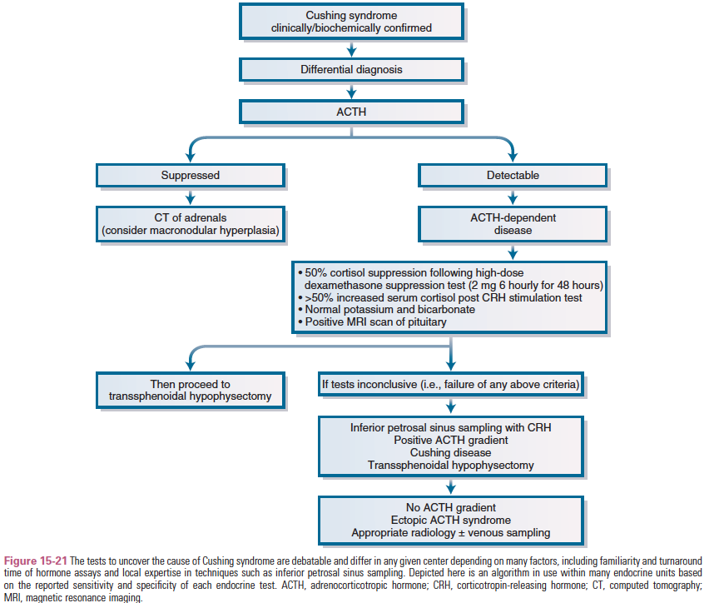

Slide 61
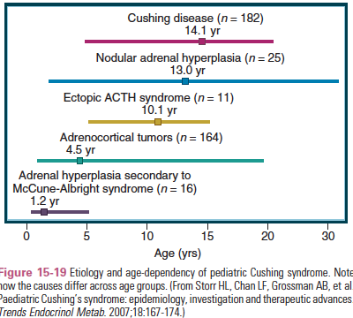
Etiologies in Children

Slide 62
Management
Surgical
Medical
Metyrapone: 11-beta hydroxylase inhibitor. Main side effect is nausea. Reduced by taking the drug with milk
Mitotane: Adrenolytic, mainly used in the management of adrenal tumors as both normal and malignant adrenal cells take it. It induces mineralocorticoid deficiency along with GC suppression. Side effects are common and include fatigue, skin rashes, neurotoxic­ity, and gastrointestinal disturbance
Ketoconazole: Anti-fungal . inhibits steroidogenic enzymes that are cytochrome P-450 dependant. Liver toxicity is the main side effect

Slide 63
Objectives
Adrenal glands basic structure and function
Biochemical Patterns of adrenal disorders
Congenital Adrenal Hyperplasia
Addison’s disease
Cushing Syndrome

