Slide 1
Poisoning
Mohammed Almazyad, MBBS, FRCPC, ABP
Assistant Professor –KSU

Slide 2
Objectives
Epidemiology
Approach to the poisoned child
Hx
Physical exam
Lab/Diagnostic tests
Toxidromes
Principles of management

Slide 3
Epidemiology
The number 1 cause of injury death in the United States.
Mostly unintentional.
CO and analgesics were the leading causes of poison-related fatalities in young children
50% occur in children younger than 6 yr old.
Poisoning exposures in children 6-12 yr old are much less common(2%)
A second peak in pediatric exposures occurs in adolescence (intentional)
Children younger than 6 yr account for <2% of all poisoning fatalities

Slide 4
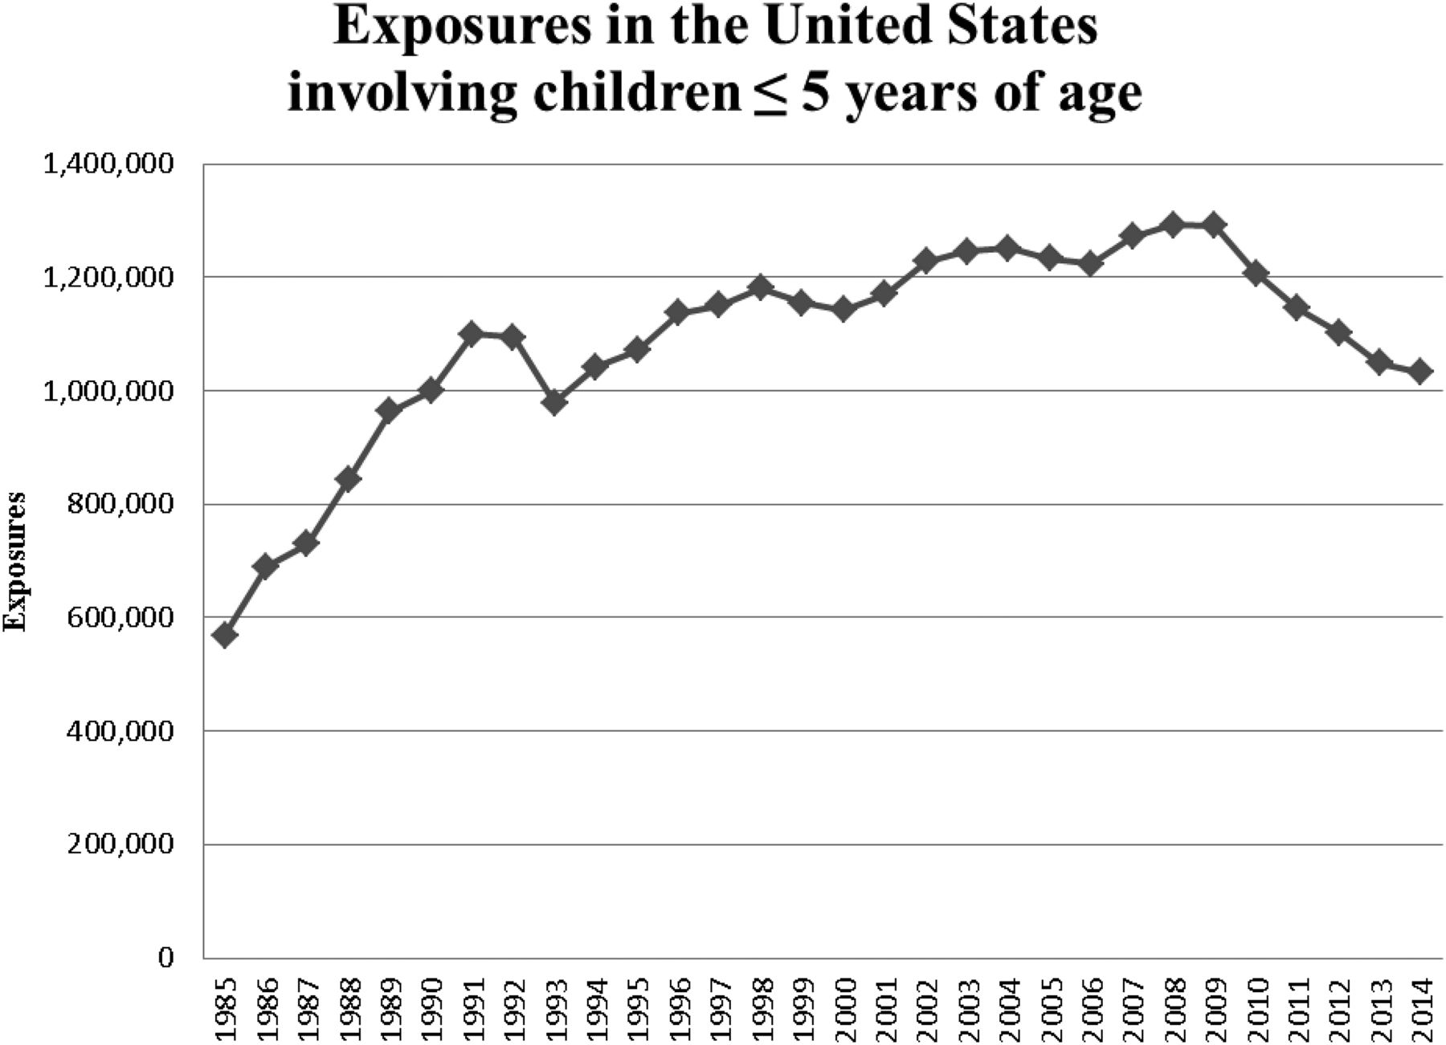
Epidemiology – Where/how/what
? Related to newly
designed safety packages
90% of toxic exposures in children occur in the home.
Most involve only a single substance
Ingestion most common rout
50% of cases involve are nondrug
Household cleaning products and
cosmetics represent the majority
of calls to poison centers

Slide 5
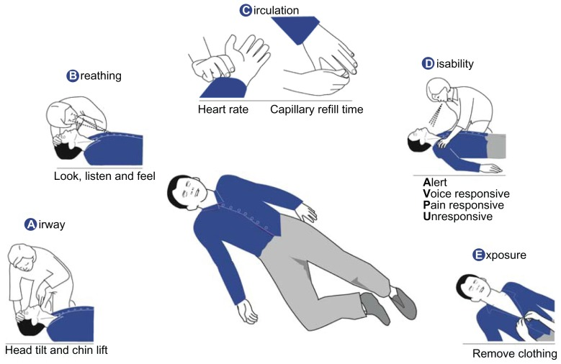
Approach
Should be no different than that in any other sick child.
Stabilization and ABCDEs
Targeted history and physical
examination

Slide 6
Approach – History
Very important
Some features may suggest poisoning
Acute onset
No prodrome
Sudden change in LOC
Multiorgan failure
Description of the exposure:
When, how much , where , why
What (household product vs medical)
List of meds in house
Did the family brought it the product with them?
immediate- versus extended-release preparation
Notes:
In the case of an unknown exposure, clarifying where the child was found (e.g., garage, kitchen, laundry room, bathroom, backyard, workplace) can help to generate a list of potential toxins.

Slide 7
Approach – History
Details of the symptoms
When did the symptom start in relation to time of ingestion
Progression
Past Medical History:
Underlying diseases can make a child susceptible to the effects of a toxin.
Current medication list (Drug-Drug interaction)
Psychiatric illness (more prone to substance abuse, misuse, intentional ingestions, and polypharmacy complications)
A developmental history (a report of a 6 mo old picking up a large container of laundry detergent and drinking it should raise a red flag)
Social History

Slide 8
Approach –Physical Exam
Targeted aiming to identify potential toxin and assess the severity.
Findings might suggest a toxidrome and help to build a DDx
Initial effort should be directed to ABCs
Key features of the physical exam:
V/S
LOC/GCS
Pupils
Nystagmus
Skin
Bowl sounds
Odor

Slide 9
Overview of some physical findings

Slide 10
ODOR
Bitter almonds | Cyanide
Acetone | Isopropyl alcohol, methanol, paraldehyde, salicylates
Alcohol | Ethanol
Wintergreen | Methyl salicylate
Garlic | Arsenic, thallium, organophosphates, selenium

Slide 11
OCULAR SIGNS
Miosis | Opioids (except propoxyphene, meperidine, and pentazocine), organophosphates and other cholinergics, clonidine, phenothiazines, sedative–hypnotics, olanzapine
Mydriasis | Anticholinergics (e.g., antihistamines, TCAs, atropine), sympathomimetics (cocaine, amphetamines, PCP) postanoxic encephalopathy, opiate withdrawal
Nystagmus | Anticonvulsants, sedative–hypnotics, alcohols, PCP, ketamine, dextromethorphan
Lacrimation | Organophosphates, irritant gas or vapors
Retinal hyperemia | Methanol

Slide 12
CUTANEOUS SIGNS
Diaphoresis | Cholinergics (organophosphates), sympathomimetics, withdrawal syndromes
Alopecia | Thallium, arsenic
Erythema | Boric acid, elemental mercury, cyanide, carbon monoxide, disulfiram, scombroid, anticholinergics, vancomycin
Cyanosis (unresponsive to oxygen) | Methemoglobinemia (e.g., benzocaine, dapsone, nitrites, phenazopyridine), amiodarone, silver

Slide 13
ORAL SIGNS
Salivation | Organophosphates, salicylates, corrosives, ketamine, PCP, strychnine
Oral burns | Corrosives, oxalate-containing plants
Gum lines | Lead, mercury, arsenic, bismuth
GASTROINTESTINAL SIGNS
Diarrhea | Antimicrobials, arsenic, iron, boric acid, cholinergics, colchicine, opioid withdrawal
Hematemesis | Arsenic, iron, caustics, NSAIDs, salicylates

Slide 14
CARDIAC SIGNS
Tachycardia | Sympathomimetics, anticholinergics, antidepressants, antipsychotics, methylxanthines (theophylline, caffeine), salicylates, cellular asphyxiants (cyanide, carbon monoxide, hydrogen sulfide), withdrawal (ethanol, sedatives, clonidine, opioids), serotonin syndrome, neuroleptic malignant syndrome
Bradycardia | β Blockers, calcium channel blockers, digoxin, clonidine, organophosphates, opioids, sedative–hypnotics
Hypertension | Sympathomimetics, anticholinergics, monoamine oxidase inhibitors, serotonin syndrome, neuroleptic malignant syndrome, clonidine withdrawal
Hypotension | β Blockers, calcium channel blockers, cyclic antidepressants, iron, antipsychotics, barbiturates, clonidine, opioids, arsenic, amatoxin mushrooms, cellular asphyxiants (cyanide, carbon monoxide, hydrogen sulfide), snake envenomation

Slide 15
RESPIRATORY SIGNS
Depressed respirations | Opioids, sedative-hypnotics, alcohol, clonidine, barbiturates
Tachypnea | Salicylates, sympathomimetics, caffeine, metabolic acidosis, carbon monoxide, hydrocarbon aspiration
CENTRAL NERVOUS SYSTEM SIGNS
Ataxia | Alcohols, anticonvulsants, sedative–hypnotics, lithium, dextromethorphan, carbon monoxide, inhalants
Coma | Opioids, sedative–hypnotics, anticonvulsants, antidepressants, antipsychotics, ethanol, anticholinergics, clonidine, GHB, alcohols, salicylates, barbiturates
Seizures | Sympathomimetics, anticholinergics, antidepressants (especially TCAs, bupropion, venlafaxine), cholinergics (organophosphates), isoniazid, camphor, lindane, salicylates, lead, nicotine, tramadol, water hemlock, withdrawal
Delirium/psychosis | Sympathomimetics, anticholinergics, LSD, PCP, hallucinogens, lithium, dextromethorphan, steroids, withdrawal
Peripheral neuropathy | Lead, arsenic, mercury, organophosphates

Slide 16
Toxidromes
Definition:
A group of signs and symptoms constituting the basis for a diagnosis of poisoning.

Slide 17
Sympathomimetic
TOXIDROME | SIGNS |  |  |  |  |  | POSSIBLE TOXINS
 | VITAL SIGNS | MENTAL STATUS | PUPILS | SKIN | BOWEL SOUNDS | OTHER
Sympathomimetic | Hypertension, tachycardia, hyperthermia | Agitation, psychosis, delirium, violence | Dilated | Diaphoretic | Normal to increased |  | Amphetamines, cocaine, PCP, bath salts (cathinones), ADHD medication

Slide 18
Anticholinergic
TOXIDROME | SIGNS |  |  |  |  |  | POSSIBLE TOXINS
 | VITAL SIGNS | MENTAL STATUS | PUPILS | SKIN | BOWEL SOUNDS | OTHER
Anticholinergic | Hypertension, tachycardia, hyperthermia | Agitated, delirium, coma, seizures | Dilated | Dry, hot | Diminished | Ileus urinary retention | Antihistamines, tricyclic antidepressants, atropine, jimson weed

Slide 19
Anticholinergic

Slide 20
Cholinergic
TOXIDROME | SIGNS |  |  |  |  |  | POSSIBLE TOXINS
 | VITAL SIGNS | MENTAL STATUS | PUPILS | SKIN | BOWEL SOUNDS | OTHER
Cholinergic | Bradycardia BP and temp typically normal | Confusion, coma, fasciculations | Small | Diaphoretic | Hyperactive | Diarrhea, urination, bronchorrhea, bronchospasm, emesis, lacrimation, salivation | Organophosphates (insecticides, nerve agents), carbamates (physostigmine, neostigmine, pyridostigmine)

Slide 21
Cholinergic

Slide 22
Opioids
TOXIDROME | SIGNS |  |  |  |  |  | POSSIBLE TOXINS
 | VITAL SIGNS | MENTAL STATUS | PUPILS | SKIN | BOWEL SOUNDS | OTHER
Opioids | Respiratory depression bradycardia, hypotension, hypothermia | Depression, coma, euphoria | Pinpoint | Normal | Normal to decreased |  | Methadone, buprenorphine, morphine, oxycodone, heroin, etc.

Slide 23
Opioids Withdrawal
TOXIDROME | SIGNS |  |  |  |  |  | POSSIBLE TOXINS
 | VITAL SIGNS | MENTAL STATUS | PUPILS | SKIN | BOWEL SOUNDS | OTHER
Withdrawal (opioid) | Tachycardia | Restlessness, anxiety | Dilated | diaphoretic | Hyperactive | Nausea, vomiting, diarrhea | Lack of access to opioids or excessive use of naloxone

Slide 24
Opioids Withdrawal

Slide 25
Serotonin Syndrome
TOXIDROME | SIGNS |  |  |  |  |  | POSSIBLE TOXINS
 | VITAL SIGNS | MENTAL STATUS | PUPILS | SKIN | BOWEL SOUNDS | OTHER
Serotonin syndrome | Hyperthermia, tachycardia, hypertension or hypotension (autonomic instability) | Agitation, confusion, coma | Dilated | Diaphoretic | Increased | Neuromuscular hyperexcitability: clonus, hyperreflexia (lower extremities > upper extremities) | SSRIs, lithium, MAOIs, linezolid, tramadol, meperidine, dextromethorphan

Slide 26
Serotonin Syndrome

Slide 27
Lab/Diagnostic Testing
Drug Levels
Tox-Screen
U&E
Blood Gas
LFTs (Acetaminophen)
Serum Osmolality (Alcohol)
CK (prolonged down time)
ECG (Dig, Amiodaron, SSRI)

Slide 28
Drug levels
For some drugs quantitative blood concentrations are integral to confirming the diagnosis and formulating a treatment plan.
SAS, Acetaminophen, dig, iron and methanol.
For most exposures, quantitative measurement is not readily available and is not likely to alter management.
All intoxicant levels must be interpreted in conjunction with the history.
Chronic vs acute use
Time of ingestion
Co-ongestion

Slide 29
Acetaminophen Level
Very helpful.
Acetaminophen is a widely available medication and a commonly detected co-ingestant with the potential for severe toxicity.
There is an effective antidote to acetaminophen poisoning that is time-dependent.
Patients might initially be asymptomatic and might not report acetaminophen as a coingestant, an acetaminophen level should be checked in all patients who present after an intentional exposure or ingestion

Slide 30
Tox-Screen
Varey from lab to lab :
What it tests for?
Cutoff for +
False + /Fales –
Eg Synthetic opioid are not detected with urine tox-screen
Helpful in patients with altered mental status of unknown etiology, persistent, unexplained tachycardia, acute myocardial ischemia or stroke at a young age

Slide 31
KUB
RADIOPAQUE SUBSTANCE ON KUB (MNEMONIC = CHIPPED)
C hloral hydrate, calcium carbonate H eavy metals (lead, zinc, barium, arsenic, lithium, bismuth) I ron P henothiazines P lay-Doh, potassium chloride E nteric-coated pills D ental amalgam, drug packets

Slide 32
Principles of Management
ABCDs (supportive care)
Antidots
Decontamination
Enhanced elimination

Slide 33
ABCDs (supportive care)
Airway: Patent and maintainable
Breathing: Spontaneous with GABL ,RR, SpO2 and WOB
Circulation: HR, BP, Cap refill, Rhythm and Liver edge in infants
Disability: Pupils ?equal and reactive . GCS Glucocheck
Exposure , check the skin for any contamination

Slide 34
Antidots
Definition = a medicine taken or given to counteract a particular poison.
Only a small proportion of poisoned patients are amenable to antidotal therapy
Only a few poisoning is antidotal therapy urgent (e.g., CO, cyanide, organophosphate and opioid intoxication)

Slide 35
POISON | ANTIDOTE | DOSAGE | ROUTE | ADVERSE EFFECTS, WARNINGS, COMMENTS
Acetaminophen | N -Acetylcysteine (Mucomyst) | 140 mg/kg loading, followed by 70 mg/kg q4h | PO | Vomiting (patient-tailored regimens are the norm)
 | N -Acetylcysteine (Acetadote) | 150 mg/kg over 1 hr, followed by 50 mg/kg over 4 hr, followed by 100 mg/kg over 16 hr | IV | Anaphylactoid reactions (most commonly seen with loading dose) (Higher doses of the infusion are often recommended depending upon the acetaminophen level and the degree of injury)
Anticholinergics | Physostigmine | 0.02 mg/kg over 5 min; may repeat q5-10min to 2 mg max | IV/IM | Bradycardia, seizures, bronchospasm Note: Do not use if conduction delays on ECG
Benzodiazepines | Flumazenil | 0.2 mg over 30 sec; if response is inadequate, repeat q1min to 1 mg max | IV | Agitation, seizures; do not use for unknown ingestions
β Blockers | Glucagon | 0.15 mg/kg bolus followed by infusion of 0.05-0.15 mg/kg/hr | IV | Hyperglycemia, vomiting

Slide 36
POISON | ANTIDOTE | DOSAGE | ROUTE | ADVERSE EFFECTS, WARNINGS, COMMENTS
Carbon monoxide | Oxygen | 100% F io ₂ via non–rebreather mask (or ET if intubated) | Inhalational | Some patients may benefit from hyperbaric oxygen (see text)
Cyanide | Cyanide kit:
 | Amyl nitrate | 1 crushable ampule; inhale 30 sec of each min | Inhalation | Methemoglobinemia
 | Sodium nitrate | 0.33 mL/kg of 3% solution if hemoglobin level is not known; otherwise, based on tables with product | IV | Methemoglobinemia Hypotension
 | Sodium thiosulfate | 1.6 mL/kg of 25% solution; may be repeated q30-60min to max of 50 mL | IV | If inducing methemoglobinemia is contraindicated; consider only using the thiosulfate component of the kit
 | Hydroxocobalamin (Cyanokit) | 70 mg/kg (adults: 5 g) given over 15 min | IV | Flushing/erythema, nausea, rash, chromaturia, hypertension, headache
Digitalis | Digoxin-specific Fab antibodies (Digibind; DigiFab) | 1 vial binds 0.6 mg of digitalis glycoside; #vials = digitalis level × weight in kg/100 | IV | Allergic reactions (rare), return of condition being treated with digitalis glycoside

Slide 37
POISON | ANTIDOTE | DOSAGE | ROUTE | ADVERSE EFFECTS, WARNINGS, COMMENTS
Opioids | Naloxone | 0.01-0.1 mg/kg; adolescents/adults: 0.04-2 mg, repeated as needed; may give continuous infusion | IV | Acute withdrawal symptoms if given to addicted patients May also be useful for clonidine ingestions (inconsistent response)
Organophosphates | Atropine | 0.05-0.1 mg/kg repeated q5-10min as needed | IV/ET | Tachycardia, dry mouth, blurred vision, urinary retention
 | Pralidoxime (2-PAM) | 25-50 mg/kg over 5-10 min (max: 200 mg/min); can be repeated after 1-2 hr, then q10-12hr as needed | IV/IM | Nausea, dizziness, headache, tachycardia, muscle rigidity, bronchospasm (rapid administration)

Slide 38
POISON | ANTIDOTE | DOSAGE | ROUTE | ADVERSE EFFECTS, WARNINGS, COMMENTS
Ethylene glycol, methanol | Fomepizole | 15 mg/kg load; 10 mg/kg q12h × 4 doses; 15 mg/kg q12h until EG level is <20 mg/dL | IV | Infuse slowly over 30 min; If fomepizole is not available, can treat with oral ethanol (80 proof)
Iron | Deferoxamine | Infusion of 5-15 mg/kg/hr (max: 6 g/24 hr) | IV | Hypotension (minimized by avoiding rapid infusion rates)
Isoniazid (INH) | Pyridoxine | Empirical dosing: 70 mg/kg (max dose = 5 g) If ingested dose is known: 1 g per gram of INH | IV | May also be used for Gyromitra mushroom ingestions

Slide 39
Decontamination
The goal of decontamination is to minimize absorption of the toxic substance.
Decontamination should not be routinely employed for every poisoned patient.
Dermal and ocular decontamination remove any contaminated clothing and particulate matter, followed by flushing of the affected area with tepid water or normal saline.
10-20 min of washing is recommended for most exposures.
Dermal decontamination, especially after exposure to adherent or lipophilic (e.g., organophosphates) agents, should include thorough cleansing with soap and water .
Avoid water with highly reactive agents.

Slide 40
GI Decontamination:
GI decontamination strategies are most likely to be effective in the 1st hour after an acute ingestion.
GI decontamination at more than 1 hr after ingestion may be considered in patients who ingest toxic substances with these properties:
GI absorption may be delayed after ingestion of agents that slow GI motility (anticholinergic medications, opioids or TCA).
massive pill ingestions.
sustained-release preparations.
ingestions of agents that can form pharmacologic bezoars (e.g., enteric-coated salicylates).

Slide 41
Methods of GI Decontamination:
Syrup Ipecac:
Risk is more than benefit (no evidence)
Gastric Lavage:
in most clinical scenarios, the use of gastric lavage is no longer recommended.

Slide 42
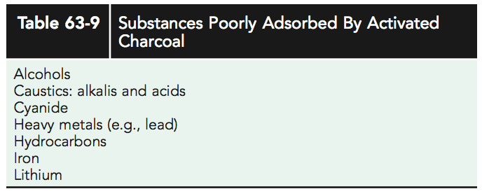
Single dose Activated Charcoal:
It has an extensive network of pores that provides a very large adsorptive surface area.
1g/kg or 50-100 g in adolescents and adults
A repeat dose of activated charcoal may be warranted in the cases of ingestion of an extended release product or, more commonly, with a significant salicylate poisoning as a result of its delayed and erratic absorption pattern.
Not effective in :
Charged molecules (i.e., heavy metals
lithium, iron)
liquids do not bind well to activated
charcoal
Caustic agents

Slide 43
Single dose Activated Charcoal:
20% of pt will vomit → must ensure that the patient’s airway is intact or protected and that the patient has a benign abdominal exam.
In the awake, uncooperative adolescent or child who refuses to drink the activated charcoal, there is relatively little utility and potential morbidity associated with forcing activated charcoal down a nasogastric tube, and such practice should be avoided.
Constipation is a common side effect. ( consider lactulose)

Slide 44
Enhanced Elimination:
Urinary Alkalinization
Hemodialysis
Multiple-Dose Activated Charcoal
Intralipid Emulsion Therapy

Slide 45
Urinary Alkalinization
Making a molecule charged and hydrophilic → difficult to be absorbed through fat membrane Thus, the molecule is trapped within the renal tubules
Accomplished via a continuous infusion of sodium bicarbonate–containing intravenous fluids, with a goal urine pH of 7.5-8.
Alkalinization of the urine is most useful in managing salicylate and methotrexate toxicity.

Slide 46
Hemodialysis
Enhance the elimination of the toxin itself
Also be useful to correct severe electrolyte disturbances and acid–base derangement
Toxins that are amenable to dialysis have the following properties:
low volume of distribution (<1 L/kg).
low molecular weight.
low degree of protein binding.
high degree of water solubility.
eg methanol, ethylene glycol, salicylates, theophylline, bromide, lithium, and, potentially, valproic acid.

Slide 47
Acetaminophen
The most common cause of acute liver failure in USA
The single acute toxic dose of acetaminophen is generally considered to be >200 mg/kg in children and >7.5-10 g in adolescents and adults.

Slide 48
Classical signs and symptoms
STAGE | T after Ingestion | CHARACTERISTICS
I | 0.5–24 hr | Anorexia, nausea, vomiting, malaise, pallor, diaphoresis
II | 24–48 hr | Resolution of earlier symptoms; right upper quadrant abdominal pain and tenderness; elevated bilirubin, prothrombin time, hepatic enzymes; oliguria
III | 72–96 hr | Peak liver fxn abnormalities; anorexia, nausea, vomiting, and malaise may reappear
IV | 4 days–2 wk | Resolution of hepatic dysfunction or complete liver failure

Slide 49
Acetaminophen

Slide 50
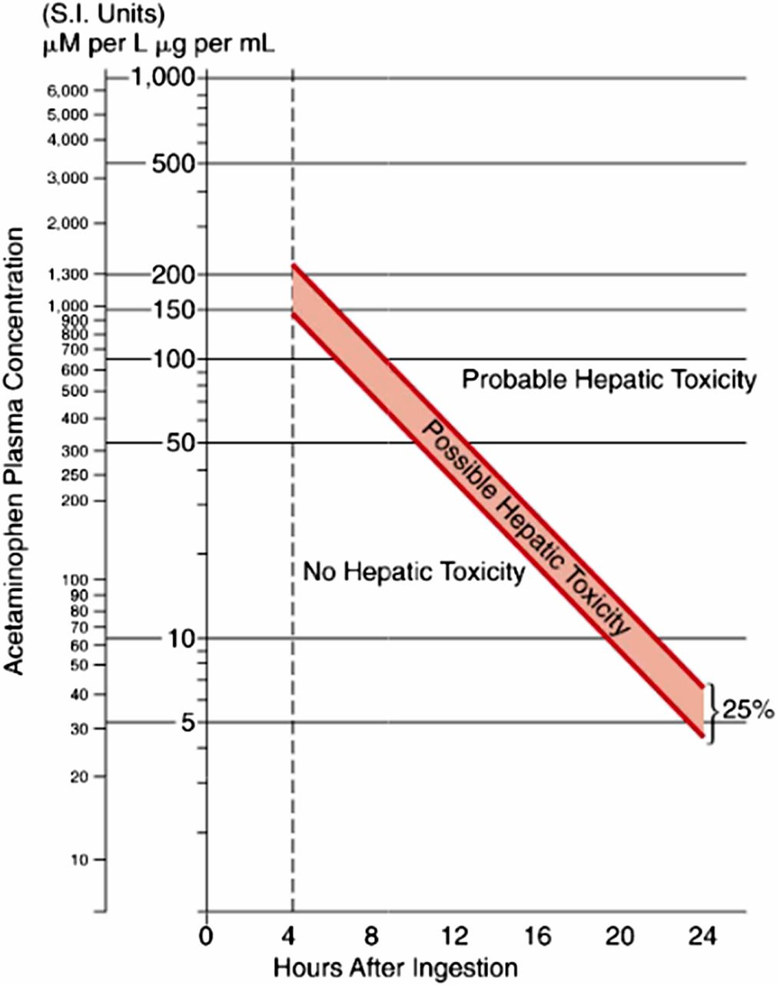
Acetaminophen overdose Rx
After ABCs
Hx
Time
Quantity
Regular vs extended rlease
Intetion
LFTs, Lytes, renal function
Obtain a level 4 hours after ingestion
Use Rumack-Matthew nomogram
Only for single ingestion

