Slide 1
Approach to Anemia
Abdulrahman Alsultan, MBBS FAAP

Slide 2
Definition of Anemia
Hemoglobin concentration is at least 2 standard deviations below mean for age, gender, and race

Slide 3
Approach to Anemia
History
Physical examination
CBC, differential
Reticulocytes
Peripheral blood smear
Other labs as indicated

Slide 4
Classification of Anemias
Physiological classification:
  ⬇ Production of RBCs:
    Absolute failure of erythropoiesis e.g.
      Inherited or acquired aplastic anemia
      Pure red cell aplasia
      Impaired erythropoietin production (e.g. chronic renal failure)
    Erythrocyte maturation disorders (ineffective erythropoiesis)
      e.g. Thalassemia, Vit B12 or folate deficiency.
  ⬆ Destruction of RBCs:
    Defects in hemoglobin (e.g. thalassemia)
    Defects in RBC membrane
    Defects in RBC metabolism
    Immune mediated/drug induced
    others

Slide 5
Classification of Anemias
Morphological classification (based on MCV):
  Microcytic:
      Iron deficiency anemia
      Lead poisoning
      Thalassemia syndromes
      Sideroblastic anemia
      Chronic inflammation
  Macrocytic:
      Vitamin B12 or folic acid deficiency
      Orotic aciduria
      Inherited or acquired aplastic anemia
      Hypothyroidism
      Liver disease
  Normocytic:
      Congenital or acquired hemolytic anemias
      Acute blood loss
      Chronic inflammation

Slide 6
History
Age
Gender
Race/Ethnicity
Diet
Diarrhea (malabsorption?)
Drugs
Infections
Family history
Notes:
Age: Iron def is never responsible <6 month esp the neonatal period, rarely premature infants. Neonatal onset: think about blood loss, isoimmunization, congenital hemolytic anemia (e.g. G6PD or HS), or congenital infection. Beta globin disorders start 3-6 months
Gender: G6PD is X-linked
Diet: Sources of iron, VitB12, folic acid, and Vit E
Drugs: e.g. phenytoin induced megaloblstic anemia, Oxidants, drug-induxed aplastic anemia
Infections: Hepatitis induced aplastic anemia, parvovirus
Family history: of anemia, gallstones, or splenomegaly
Diarhea: short bowel disease (folate or Vit B12 def) or IBD or blood loss

Slide 7
Physical Examination
Skin:
    hyperpigmentation (Fanconi)
    Petechiae/purpura (thrombocytopenia)
    Cavernous hemangioma (MAHA)
Face:
    Frontal bossing (B-thalassemia major)
Mouth:
    Glossitis (Vit B12 or iron def)
Hands:
    Abnormal thumbs (Fanconi)
    Spoon nails (iron def)
Spleen/Liver/lymph nodes
Notes:
Pale + Jaundice

Slide 8
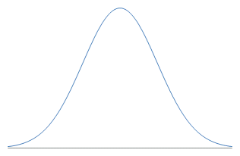
Initial Workup
CBC:
  First: WBC, Hb, Platelets, differential
  Second: Reticulocytes
  MCV/MCHC
  RDW
Peripheral blood smear
 | Normal RDW | High RDW
Low MCV | Thalassemia trait | Iron Deficiency
Normal MCV | Normal | Sickle Cell
High MCV | Aplastic anemia | Vitamin B12 or folate deficiency

Slide 9
Case 1
History: An 18 months old boy was noticed to be pale during his routine health visit. His mother mentioned that his diet is mainly cow milk and he hardly eat any thing else. No family history of anemia.
Physical exam: was unremarkable except for a pale child.
CBC: Hb 7.5 (microcytic and hypochromic), RDW high. Low reticulocytes. Normal WBC and platelets.

Slide 10
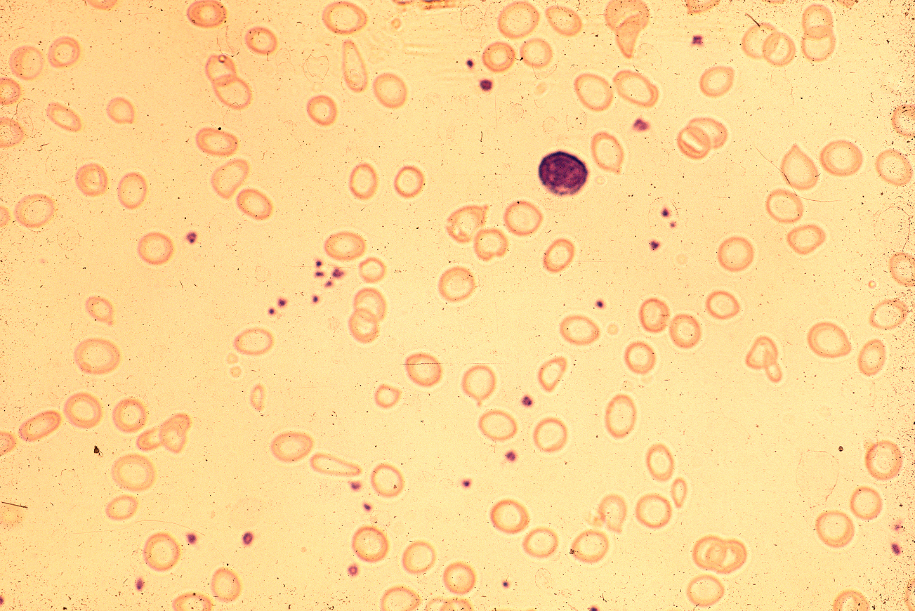
Ferritin is low and normal hemoglobin electrophoresis
Dx: Iron deficiency anemia

Slide 11
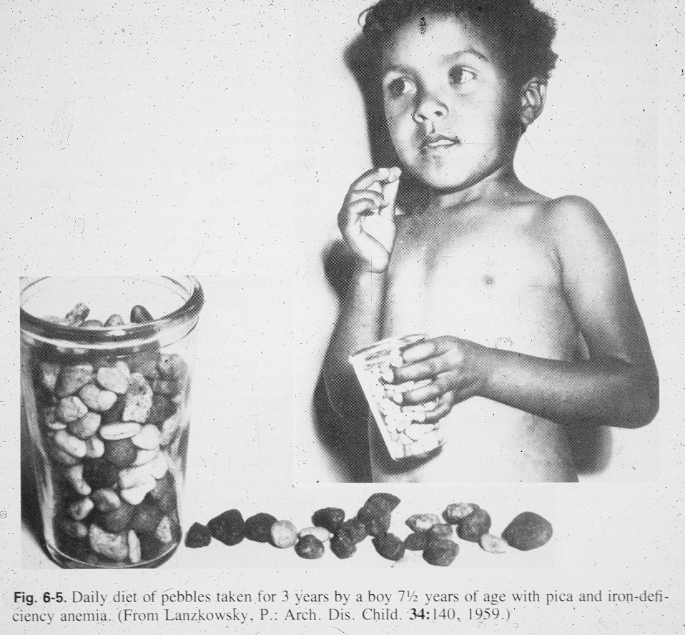
G.Buchanan

Slide 12
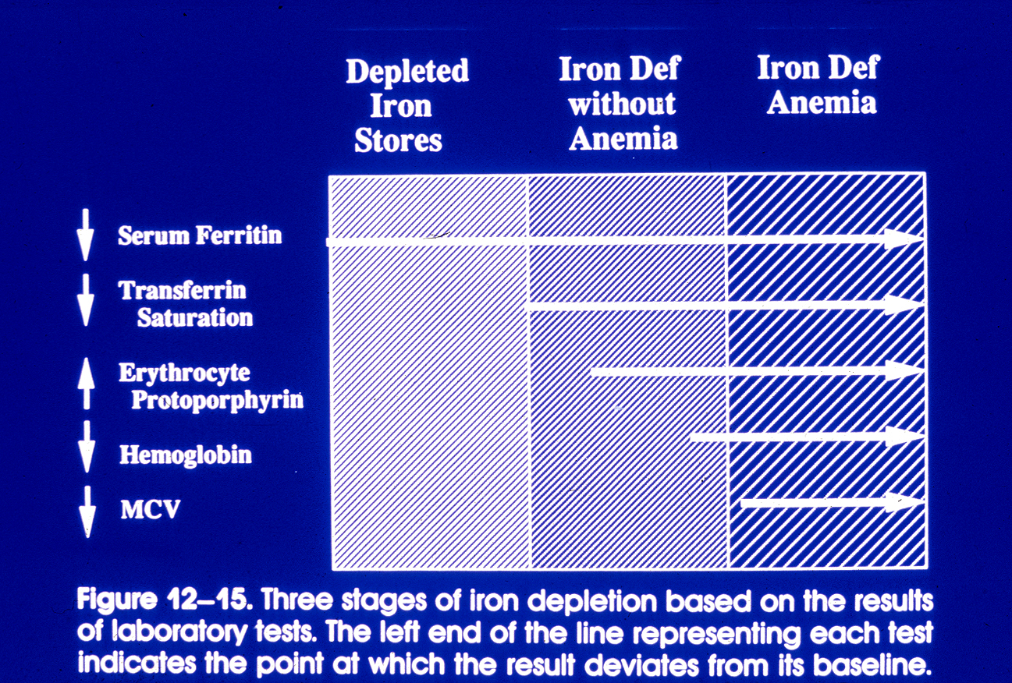
From Dallman et al, Nathan & Oski, 4th Edition 1993

Slide 13
 | Fe deficiency | Thalassemia trait
RBC count | ↓ | NI to ↑
Mentzer index (MCV/RBC) | > 13 | < 13
RDW | ↑ | NI
Serum ferritin | ↓ | NI
Hgb A2 | ↓ to NI | ↑ in B-thal trait
Notes:
PICA in severe IDA
Treatment of IDA- treat the cause + IRon

Slide 14
Case 2
History: 12-month-old boy was noted to be pale during a routine health visit. He was a full term infant and is exclusively breastfed on iron supplement, and his mother adheres to a strict vegan diet. No family history of anemia.
Exam remarkable for a pale child.
CBC: Hb 8 g/dl with high MCV and RDW. Normal WBC and platelets.

Slide 15
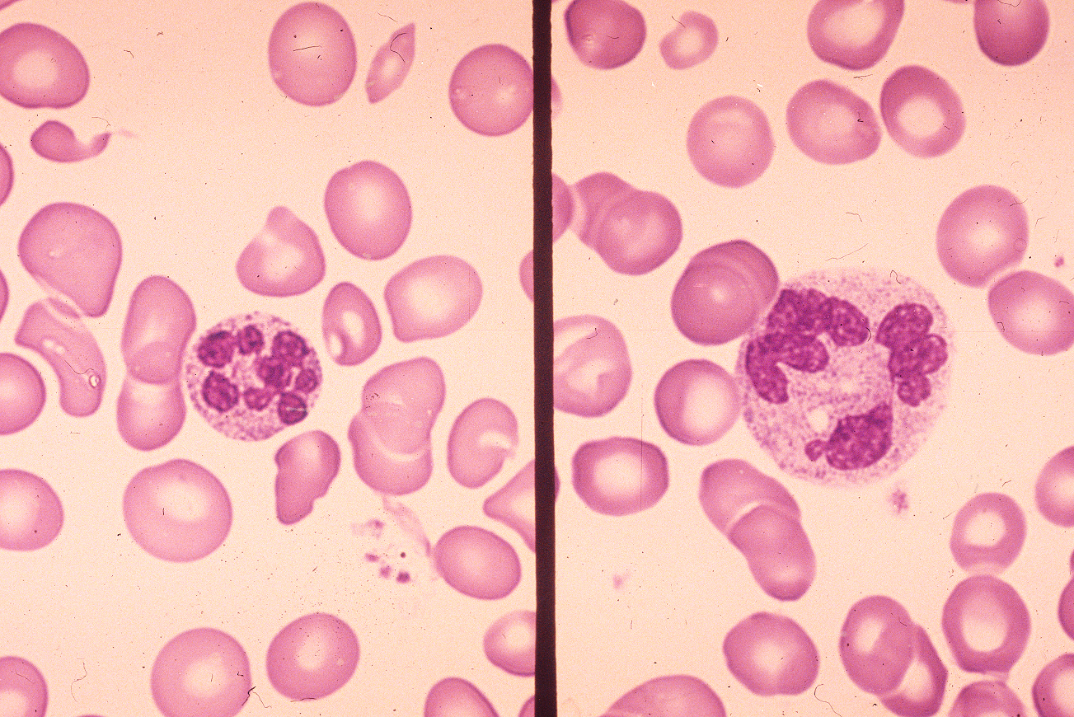

Slide 16
Diagnosis of folate or Vitamin B12 deficiency
Serum folate level (reflects current status)
RBC folate level (reflects tissue levels)
Serum Vitamin B₁₂ (cobalamin) level
Urinary methylmalonic acid excretion
Plasma homocysteine level
Notes:
Treatment Folic acid/Vit B12

Slide 17
Case 3
History: 12 year old boy was referred to our hospital because of anemia. Strong family history of similar illness.
Exam was remarkable for short stature, hyper pigmentation, and abnormal thumbs.
CBC: Low WBC (neutropenia), Hb 7 g/dl, mild thrombocytopenia. High MCV. Reticulocytes is low.
Vitamin B12 and folate levels are normal
Bone marrow was performed which showed hypocellular marrow (<10%) and no evidence of leukemia.
Chromosomal fragility test: Abnormal

Slide 18
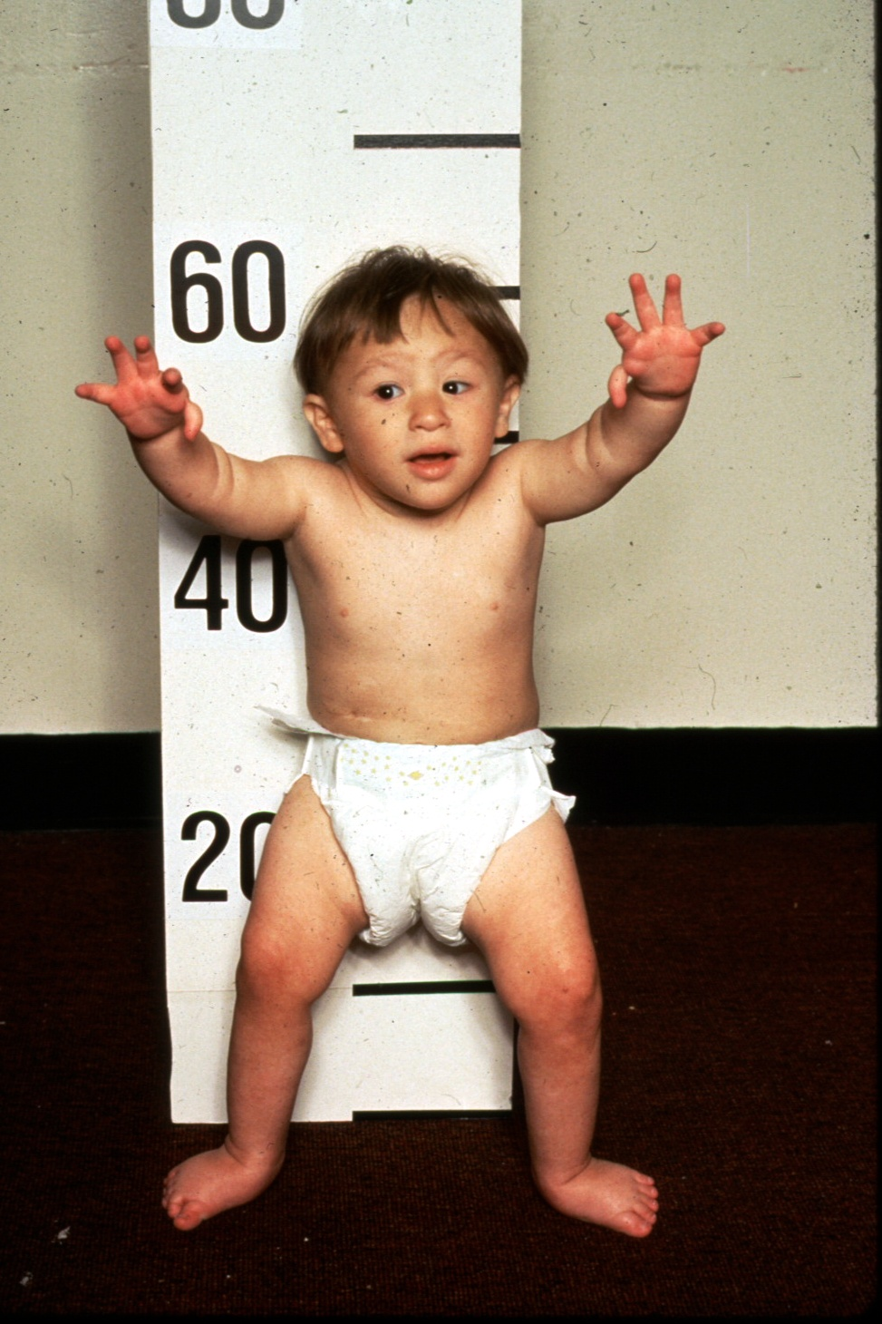
Congenital Anomalies
Fanconi Anemia
Microcephaly
Hypertelorism
Webbed neck
Abnormal thumbs
Dislocated hips
J. Lipton

Slide 19
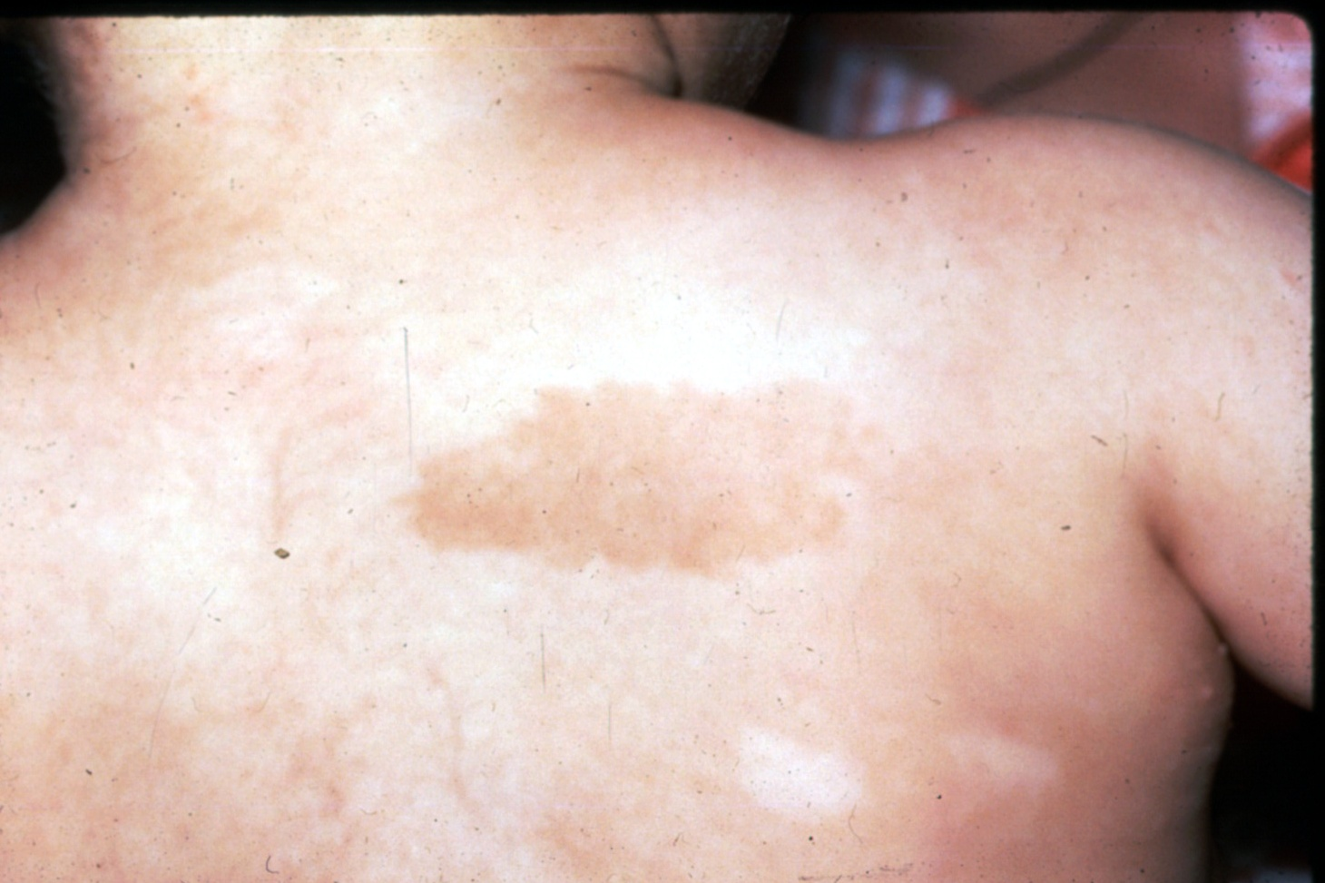
Congenital Anomalies
Fanconi Anemia
Café au lait spot
Hypopigmentation
J. Lipton

Slide 20
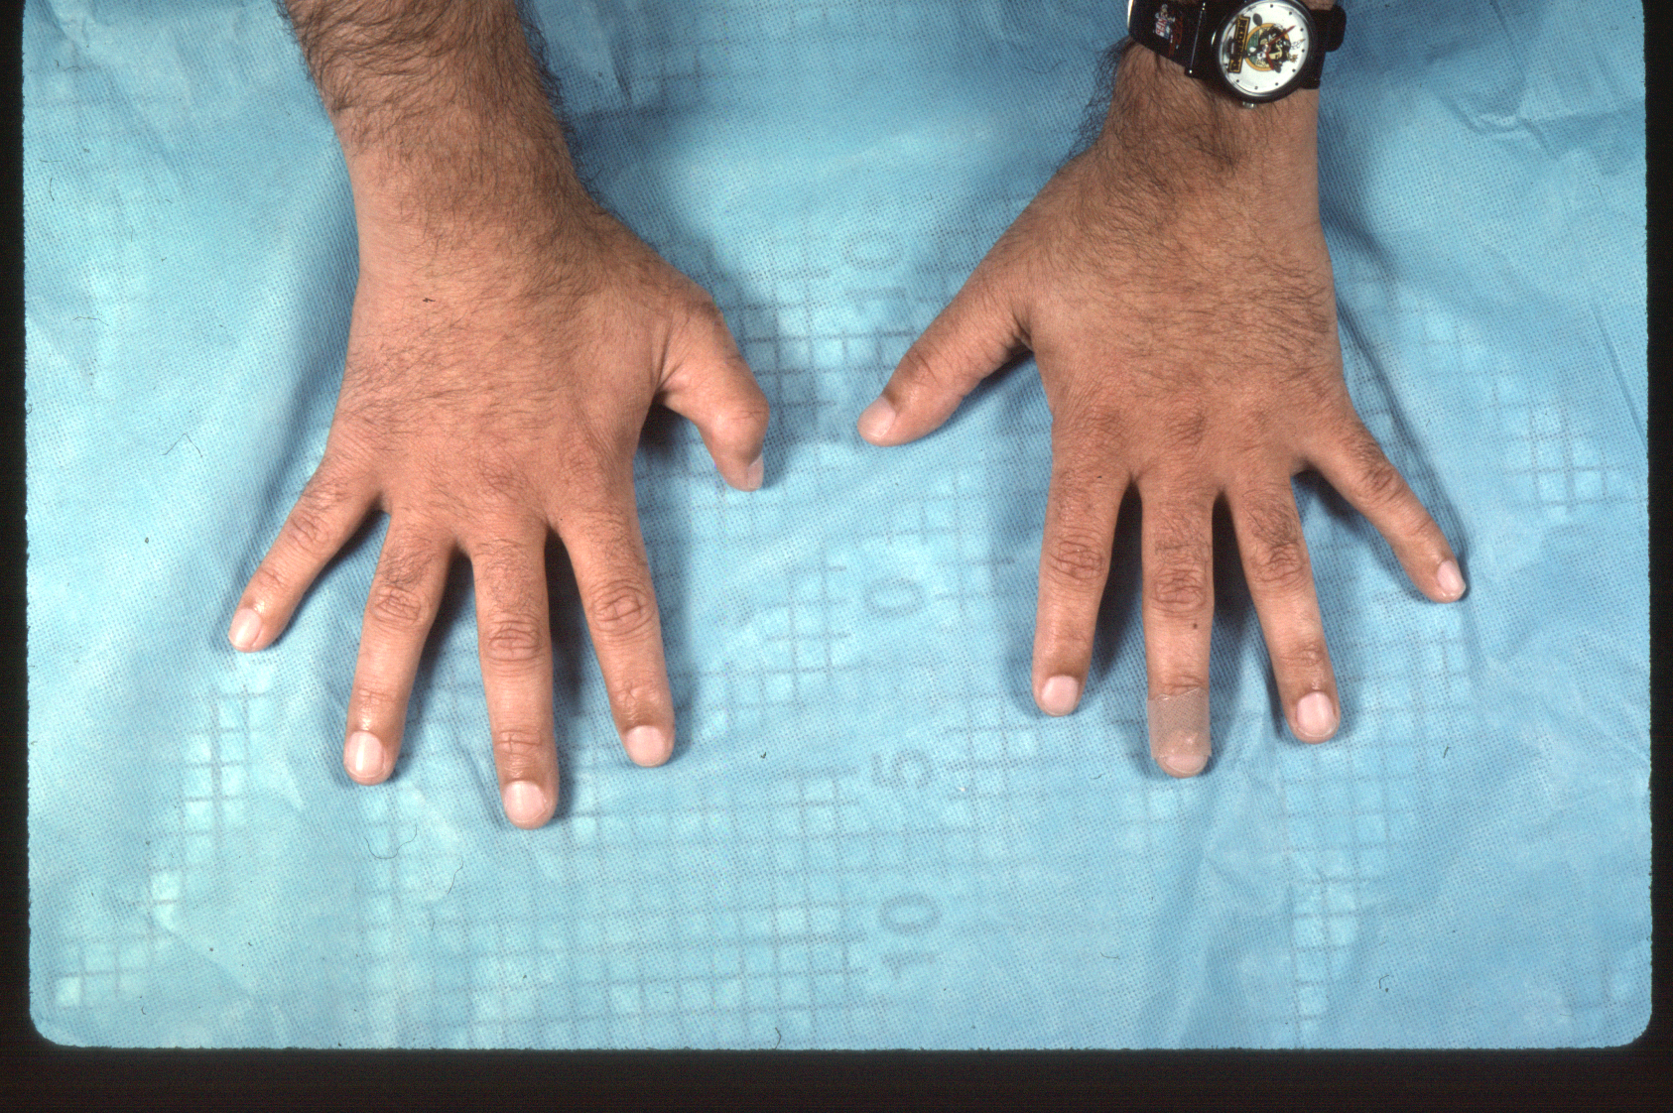
Fanconi Anemia
Subtle Anomalies
J. Lipton

Slide 21
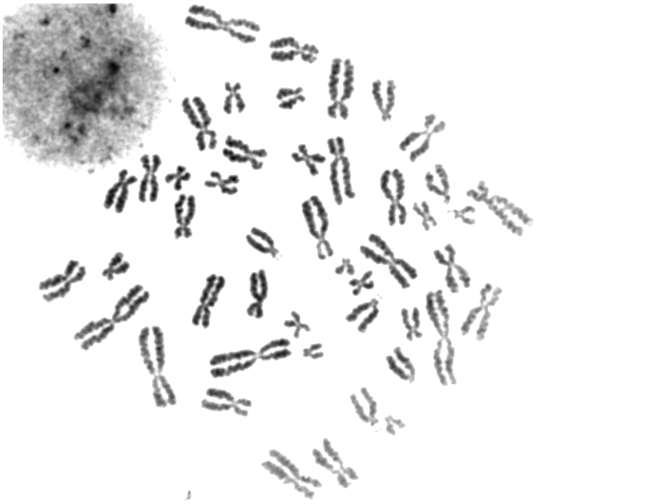
FA Cells Incubated without DEB or MMC

Slide 22
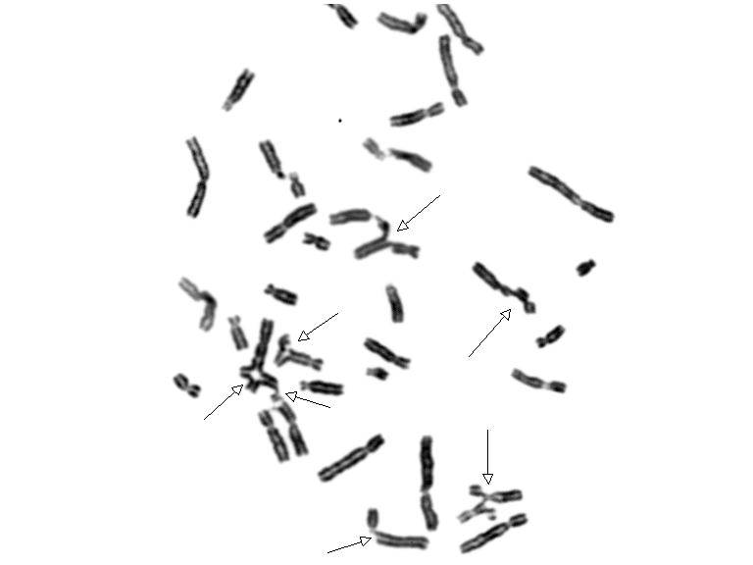
FA Cells Incubated with DEB
Notes:
FA1073 DEB

Slide 23
Fanconi Anemia
Differential Diagnosis: (Inherited BM failure syndromes)
Diamond-Blackfan anemia
Dyskeratosis congenita
Shwachman-Diamond Syndrome
Amegakaryocytic thrombocytopenia.
Notes:
If all negative---acquired aplastic anemia

Slide 24
Case 4
History: Faisal is a 6-year-old boy who is admitted to the hospital because of acute onset of dark urine and anemia after eating fava beans. Exam was remarkable for jaundice.
CBC: Hb 5 g/dl (normal MCV), high reticulocytes, normal WBC and platelets.

Slide 25
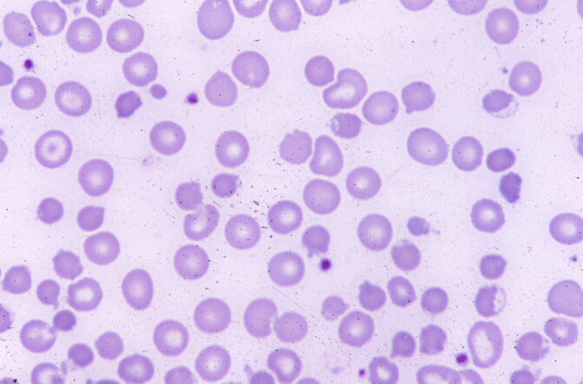
Case 4
Notes:
Blister cells

Slide 26
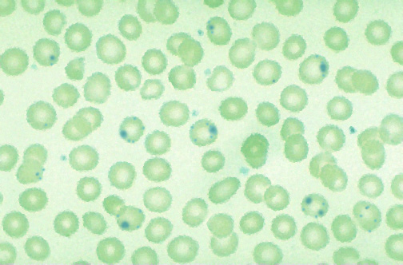
Case 4
Crystal violet staining
DAT : negative
G6PD level: deficient
Notes:
When do you check G6PD level

Slide 27
G6PD Deficiency
Most common red cell enzymopathy
X linked inheritance
Decreased production of NADPH with inability to maintain reduced glutathione levels
Hemolysis occurs in response to oxidative stresses such as infections, drugs, fava beans (“favism”), naphthalene (moth balls)
Anemia may be low grade and chronic (CNSHA) or acute after exposure to oxidant

Slide 28
Case 5
History: Sarah is 2 month-old infant who you are seeing in your clinic for the first time for a well-child check. According to her mother, the neonatal period was complicated by prolonged hyperbilirubinemia requiring several days of phototherapy. Otherwise, she has done well and has been growing and thriving. Her mother has history of splenectomy and GB removal.
Exam is remarkable for mild jaundice and spleen is 4 cm below costal margin.

Slide 29
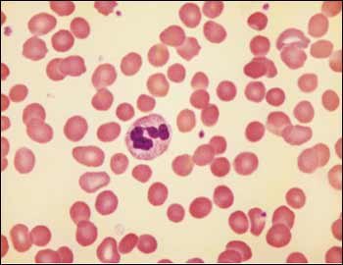
Case 5
CBC showed : Hgb 6.5 g/dl (normochromic normocytic), high MCHC, Retics 11%. DAT is negative.

Slide 30
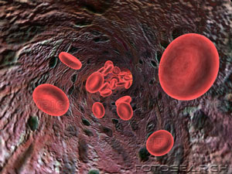
Red Cells
Biconcave disc with diameter of 7.5 μm
Efficient transport vehicle for oxygen exchange
Shape also allows deformability as the erythrocytes move through capillaries
Normal life span 120 days

Slide 31
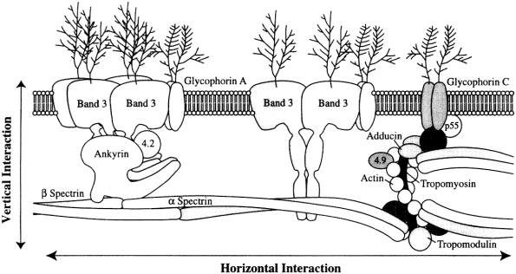
Red Cell Membrane Structure
Used with permission and originally published in “Red Blood Cell Membrane Disorders“ by WT Tse and SE Lux, British Journal of Haematology, Volume 104(1), January 1999, pages 2-13, Blackwell Publishing.

Slide 32
Hereditary Spherocytosis
Most common cause of non-immune hemolytic anemia
Autosomal dominant transmission
  25-30% sporadic mutations
Loss of membrane surface area relative to intracellular volume  spheres and decreased deformability
Abnormalities of spectrin and/or ankyrin, and less commonly Protein 4.2 or Band 3

Slide 33
Clinical Manifestions of HS
Hemolytic anemia
  Degree of anemia varies with different mutations
  25% with compensated hemolysis and no anemia
Pallor, fatigue
Jaundice
  Neonatal jaundice in first 24 hours of life
Splenomegaly
Gallstones
Positive family history
May present with parvovirus associated aplasia

Slide 34
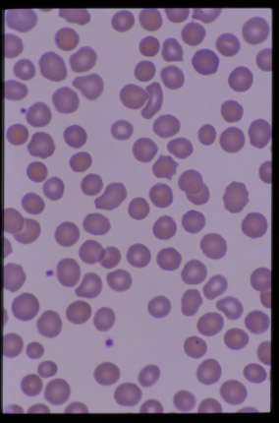
Laboratory Manifestations of HS
Spherocytes on peripheral blood smear
Reticulocytosis
Increased incubated osmotic fragility
Negative DAT
Increased MCHC > 36% due to relative cellular dehydration
Increased bilirubin, LDH

Slide 35
Case 6
History: Abdullah is 12 year old boy who was referred to our hospital because of acute onset of pallor, jaundice, dark urine. Exam: spleen is 2 cm BCM.
CBC showed normochromic normocytic anemia (Hb 8 g/dl), high reticulocytes. LFT is normal.

Slide 36
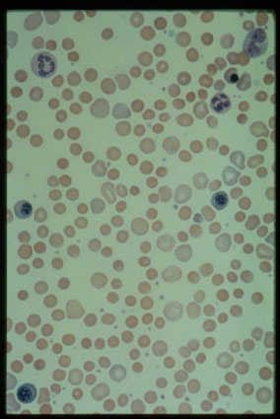
Case 6
DAT:
IgG negative
Complement +ve

Slide 37
Extravascular vs Intravascular Hemolysis
 | Intravascular | Extravascular
Location of RBC Clearance | Inside vessels | In spleen and or liver (RES)
Antibody Type* | IgM (occ. IgG) | IgG
Mechanism of Hemolysis | Complement mediated | Macrophages digest RBCs
Example | Cold Agglutinin Disease | Warm AIHA, HDN, HS

Slide 38
Warm Autoimmune Hemolytic Anemia
May be idiopathic or associated with SLE, lymphoid malignancies, immunodeficiency
Antibodies usually against “common” (Rh) antigens
DAT positive (IgG + C3)
Treatment: Steroids, splenectomy, other immunosuppressive drugs, + IVIG, transfusion with least incompatible blood

Slide 39
Cold Agglutinin Disease
IgM mediated
  IgM-RBC immune complex forms at 4°C
  Often react with I/i blood group system
Can be associated with Mycoplasma, EBV
DAT + for C3, thus intravascular lysis
Treatment: Keep patient warm, supportive therapy, plasmapheresis for severe disease. Steroids, IVIG, and splenectomy not usually helpful since intravascular, complement mediated lysis.

Slide 40
Case 7
Anas is 8 week-old male infant who is a former 30 wks premie and came to your clinic for routine check. He has been doing well and his exam was unremarkable. CBC showed Hgb 8 g/dl (normochromic and normocytic) and CBC otherwise unremarkable.

Slide 41
Case 7
What will you do next?
  Urgent PRBC transfusion.
  Obtain iron studies and start iron Rx.
  Start folic acid.
  Reassure parents.

Slide 42
Physiologic anemia
Nadir of Hemoglobin Value
Age (wk)
Lower Limit of Normal
Term infant 12 9.5 gm/dl
Premature infant 6 - 8 7.0 gm/dl
(The smaller the premie, the earlier and lower the hemoglobin nadir)

Slide 43
Case 8
A six month old male infant was brought by his parents to ED because of increased irritability and swelling in both wrists and ankles for two days. CBC showed slight increase in total WBC count and Hb of 8 g/dl.

Slide 44
Case 8
What is the most likely diagnosis?
  Septic arthritis
  Juvenile rheumatic arthritis
  Sickle cell disease
  Thalassemia
  G6PD deficiency

Slide 45
Case 8
What is the most important diagnostic investigation in SCA apart from molecular study?
  Sickling test
  Hemoglobin electrophoresis
  Peripheral blood smear

Slide 46
Case 8
How can you differentiate between SA, SS, SB⁺, and SB⁰ on Hb electrophoresis?
  Hb A Hb S HbF HbA₂

