Slide 1
CHRONIC DIARRHEA IN CHILDREN
Asaad M. A. Abdullah Assiri
Professor of Pediatrics &
Consultant Pediatric Gastroenterologist
Department of Pediatrics
King Khalid University Hospital

Slide 2
OBJECTIVES
Know how to evaluate a child who has chronic diarrhea, including appropriate elements of history, physical examination, stool analysis, and blood testing.
Be familiar with the many disorders that cause chronic diarrhea, both with and without failure to thrive.
Know the therapies for the many causes of chronic diarrhea.

Slide 3
Introduction
Recurrent, chronic, infantile diarrhea with malnutrition, causes the death of 4.6 million children globally each year. In the last 25 years, the following specific preventive measures have reduced further the number of infants who have this condition.

Slide 4
Introduction (cont.)
renewed emphasis on breastfeeding
reduction in the use of partial starvation regimens during diarrheal episodes and
increased availability of age-appropriate infant food for children living in poverty

Slide 5
PATHOPHYSIOLOGY
Osmotic diarrhea is caused by a failure to absorb a luminal solute, resulting in secretion of fluids and net water retention across an osmotic gradient.
Secretory diarrhea occurs when there is a net secretion of electrolyte and fluid from the intestine without compensatory absorption.

Slide 6
PATHOPHYSIOLOGY
Intestinal dysmotility typically occurs in the setting of intact absorptive abilities. Intestinal Transit time is decreased, the time allowed for absorption is minimized, and fluid is retained within the lumen.
Inflammatory diarrhea may encompass all of the above pathophysiologic mechanisms.

Slide 7
My baby whom I just deliver developed diarrhea from day 1 after birth, what is the cause?

Slide 8
Congenital Chloride Diarrhea A Study in Arab Children
J Clin Gastroenterol 1994; 19(1):36-40
Maternal polyhydrammics
Prematurity

Slide 11
Abdominal Distention
Diarrhea

Slide 12
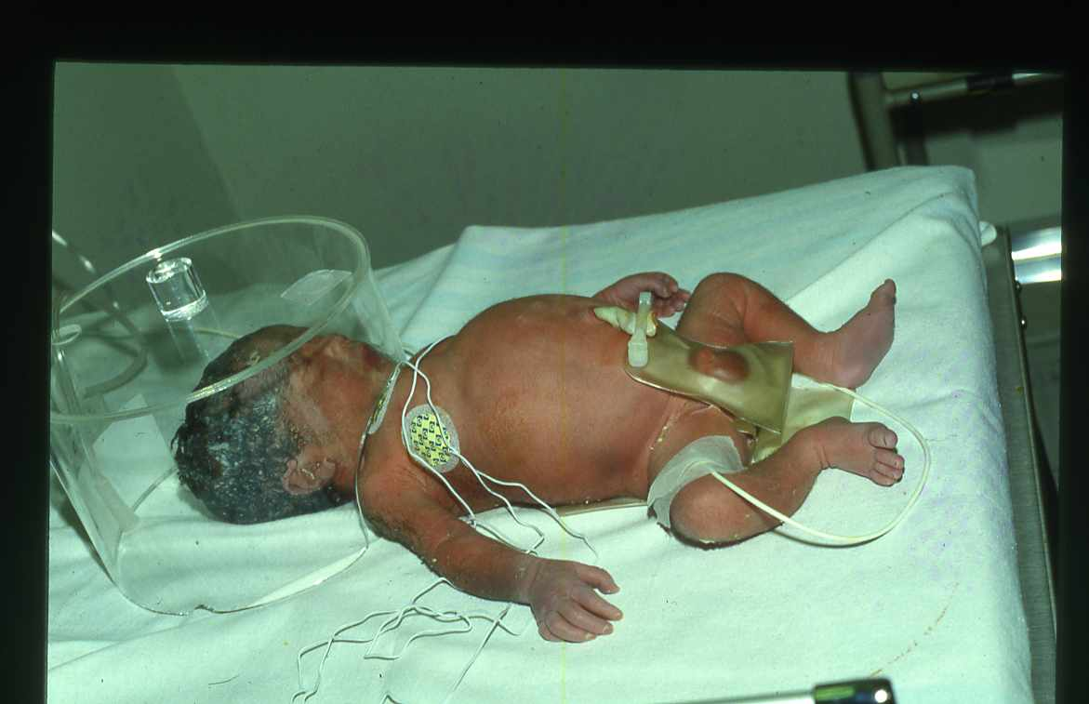

Slide 14
Congenital Chloride Diarrhea
Hypokalemia, hypochloremic
Metabolic alkalosis
Fecal chloride greater than
Fecal sodium and potassium

Slide 15
TREATMENT
Na + Kcl supplement

Slide 16
Congenital Sodium Diarrhea
It is caused by a defect in a jejunal sodium/proton exchange that results in severe watery diarrhea.
Polyhydramnios – first manifestation of CSD
Hyponatremia
Metabolic Acidosis
An autosomal recessive disease.

Slide 17
Congenital Sodium Diarrhea
DISEASE | GENE | LOCATION | FUNCTION
Congenital Sodium Diarrhea | SPINT2* | 19q13.1 | Serine – protease inhibitor

Slide 18
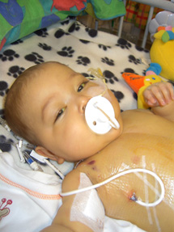
Microvillous Atrophy-Inclusion Disease (Familial Microvillous Atrophy)
Watery diarrhea despite patients NPO
Clinical forms are:
Congenital the onset of the diarrhea in the first week of life
Late onset when diarrhea start after neonatal period

Slide 19
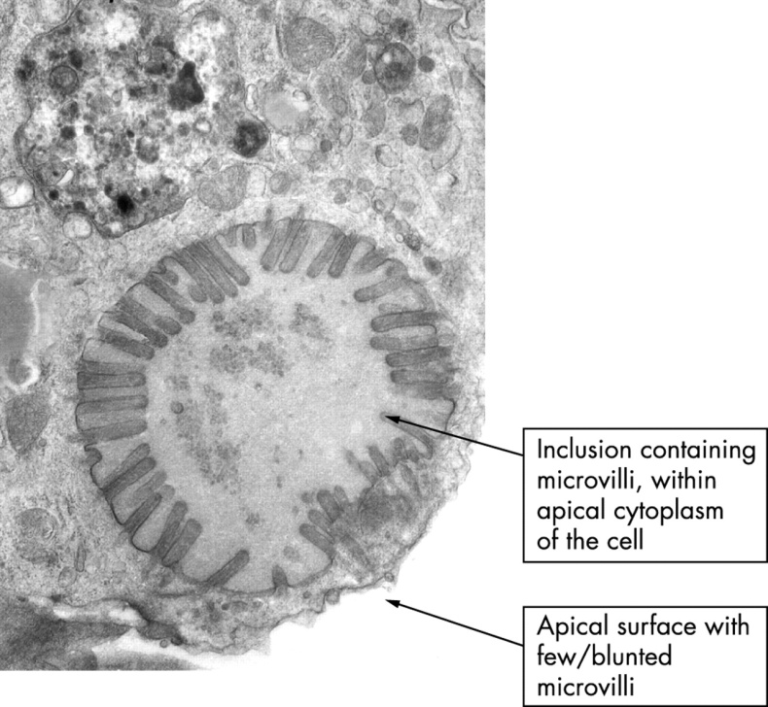
Microvillous Atrophy-Inclusion Disease (Familial Microvillous Atrophy)
Diagnosis is based on the finding of villus atrophy and intracytoplasmic inclusions lined by intact microvilli in intestinal biopsy material

Slide 20
Microvillus Inclusion Disease
Rx: TPN + intestinal transplant

Slide 21
Intestinal Epithelial Dysplasia (Tufting Enteropathy)

Slide 22
Definition
Intestinal epithelial dysplasia (IED), is also known as tufting enteropathy.
A congenital enteropathy presenting with early-onset severe intractable diarrhea and persistent villous atrophy.

Slide 23
Clinical description, associated disorders and diagnostic criteria
Watery diarrhea within the first days after birth.
Growth is impaired.
No past history of hydramnios suggesting congenital chloride diarrhea or sodium malabsorption.
Affected children are reported to have dysmorphic features.

Slide 25
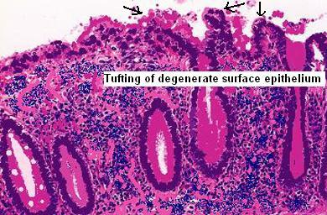
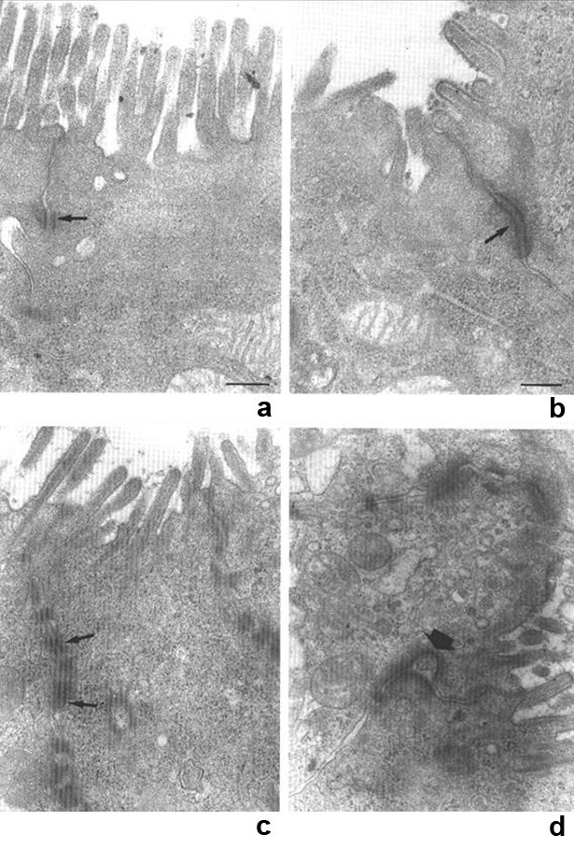
Histological presentation
Villous atrophy
Epithelium
Abnormalities are localized mainly in the epithelium, includes disorganization of surface enterocytes with focal crowding.
Specific features
Focal enterocyte crowding observed in crypt epithelium.
Crypts are dilated with features of pseudo cysts.

Slide 26
TREATMENT
- Total parenteral nutrition
- Intestinal transplantation

Slide 27
Autoimmune Enteropathy
Severe protracted watery diarrhea during infancy or toddlerhood.
Diarrhea may be isolated or may occur in, association with diabetes mellitus as part of the IPEX syndrome (Immune dysregulation, Polyendocrinopathy and Enteropathy, X-linked), associated with mutations in the FOXP3 gene.
Circulating antibodies to enterocytes anti-smooth, antithyroid and islet-cell antibodies.

Slide 28
TREATMENT
Total parenteral nutrition
Prednisone
Cyclosporine
Azathioprine
Intestinal transplant

Slide 29
I delivered this baby and I start to feed him/ her my breast milk and/ or bottle milk, since I start feeding the baby developed diarrhea. What is the cause?

Slide 31
Early onset
Watery diarrhea
Dehydration and metabolic acidosis
The diarrhoea ceases within one hour of removing the oral intake of lactose, glucose, and galactose.
The diarrhoea returns with introduction of lactose, glucose and galactose.
Fructose is mandatory

Slide 33
Developmental Lactase Deficiency
The relative lactase deficiency observed among preterm infants of less than 34 weeks gestation.
The immature gastrointestinal tract, lactase and other disacharidases are deficient until at least 34 weeks gestation.

Slide 34
Primary Lactase Deficiency
Relative or absolute absence of lactase.
Develops in childhood at various ages in different racial groups.
The most common cause of lactose malabsorption and lactose intolerance.

Slide 37
Secondary Lactase Deficiency
Results from small bowel injury such as:
Acute gastroenteritis
Persistent diarrhea
Small bowel overgrowth
Cancer chemotherapy
Other causes of injury to the small intestinal mucosa
Present at any age but is more common in infancy.

Slide 38
Treatment
is relatively simple and aimed at reducing or eliminating lactose, by eliminating it from the diet or by “predigesting” it with supplemental lactase-enzyme replacement. Calcium must be provided by alternate nondairy dietary sources or as a dietary supplement to individuals who avoid milk intake.

Slide 40
I am feeding my baby milk feed and I start to feed him fruit juices, since I start the fruit juice my infant start to have diarrhea. What is the cause?

Slide 41
Congenital Sucrase - Isomaltase Deficiency

Slide 44
Congenital Sucrase - Isomaltase Deficiency
Watery diarrhea
Abdominal distension
Older children irritability
Growth may be normal

Slide 45
TREATMENT
Avoid sucrose or fructose- containing diet or supplement with:
SACROSIDASE

Slide 46
My infant developed vomiting and diarrhea and then I took him to the ER and the doctor diagnosed him as Acute Gastroenteritis. He gave me different medications and/ or fluid and then sent me back home. Since that time, my infant continue to have diarrhea. What is the cause?

Slide 49
Bacterial Causes of Chronic Diarrhea
Organism | Sources | Duration
Aeromonas sp | Untreated water | 1 wk to 1 yr
Campylobacter sp | Raw poultry, diarrheic animals, unpasteurized milk, birds, water, ferrets | 5 days to chronic
Clostridium difficile | Antibiotic use; can be nosocomial | 10% have relapses
Plesiomonas shigelloides | Untreated water, shellfish | 2 wks to mos
Salmonella sp | Poultry, fecal-oral, water | 5 d to mos in infants
Yersinia enterocolitica | Handling of raw pig intestines (chitterlings) | 3 wk to 3 mos

Slide 50
Bacterial Diarrheas
Non-typhoidal Salmonella infection
Aeromonas and Plesiomonas
Yersinia

Slide 51
Bacterial Diarrheas
Escherichia Coli (E-Coli)
Enteric pathotypes of E-Coli diarrhea may evolve to a chronic course due to persistent injury to the bowel.
Enterotoxic and mucosa-adherent E-Coli cause a watery diarrhea. May lead to prolonged diarrhea due to mucosal damage of persistence of the primary infection.
Enterohemorrhagic pathotype that produces toxin causes acute colitis and the hemolytic-uremic syndrome.

Slide 52
Parasitic Causes of Chronic Diarrhea
Organism | Sources | Duration
Giardia lamblia | Diapered infants, fecal-oral, water supplies | 2 wks to yrs
Cryptosporidium parvum | Child care, petting zoos, swimming pools | 1 to 2 wk w/ occasional reports of 6 wk
Cyclospora cayetanensis | Raspberries from Central America, water, unpasteurized apple cider | 1 wk to 1 mo or more
Entamoeba histolytica | Fecal-oral, water | Weeks
Isospora belli | Fecal-oral, water | Chronic
Strongyloides stercoralis | Developing countries, Appalachia,fecal-oral | Chronic
Blastocystis hominis | Uncertain if a pathogen

Slide 53
Signs and Symptoms of Giardiasis
Diarrhea (64 to 100%)
Malaise, weakness (72 to 97%)
Abdominal distention (42 to 97%)
Flatulence (35 to 97%)
Abdominal cramps (44 to 81%)
Nausea (14 to 79%)
Foul-smelling, greasy stools (15 to 79%)
Anorexia (41 to 73%)
Weight loss (53 to 73%)
Vomiting (14 to 35%)
Walterspiel JN, et al. Giardia and giardiasis Prog Clin Parasitol 1994;4:1-26.

Slide 54
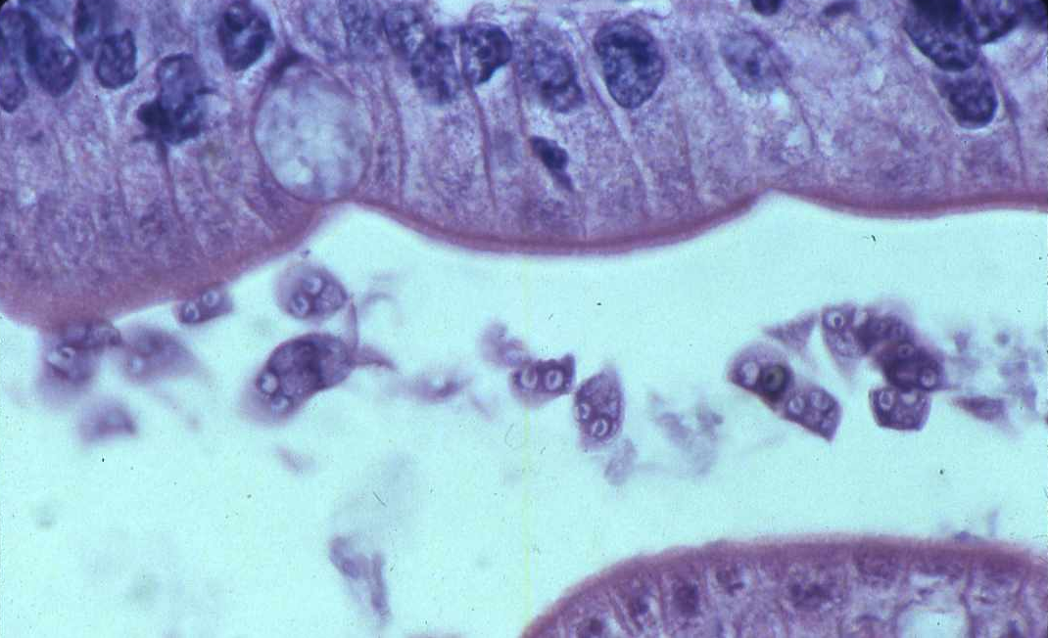
Giardia Lamblia
Rare presentations of Giardiasis include anasarca (protein-losing enteropathy).
Diagnosis can be done by miscroscopic examination of feces.
Organism sometimes is seen in intestinal biopsies.

Slide 55
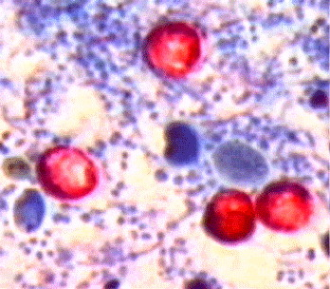
Cryptosporidium Parvum
The infection results from ingestion of the organism from fecal contamination of the hands.
Giardia-Cryptosporidium antigen tests have better sensitivity.

Slide 56
Intractable Diarrhea of Infancy (IDI)
IDI is also known as:
Postenteritis enteropathy
Protracted diarrhea of infancy
Secondary disaccharidase deficiency
Enteric infection and associated compromise of intake and absorption lead to variable loss of digestive and absorptive capacity in infants.

Slide 57
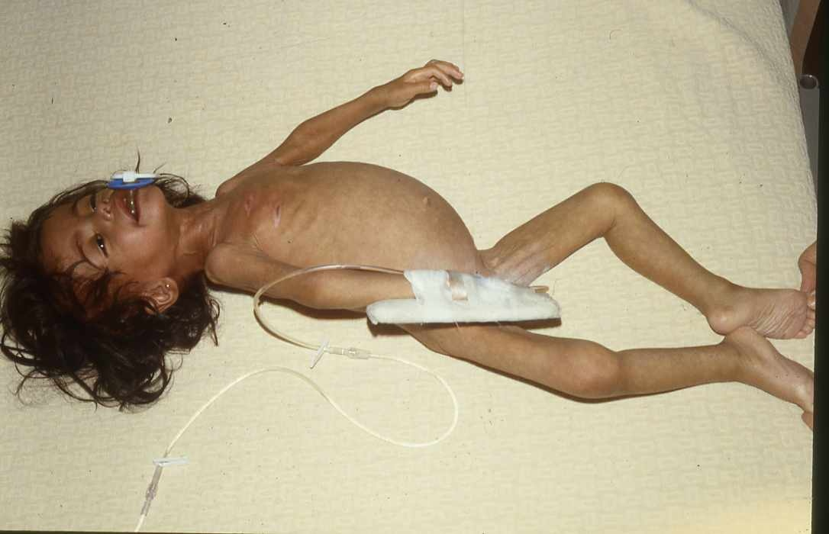
Intractable Diarrhea of Infancy (IDI)
Recurrent episodes of diarrhea and failure to regain weight in an infant.

Slide 58
Suspicion should be raised further by the
1. absence of breastfeeding
2. administration of diluted or clear liquid feedings
3. restriction of intake in a misguided effort to reduce diarrhea or vomiting.

Slide 59
Treatment
Lactose free-sucrose free formula
IV hydration for short period
If no improvement total parenteral nutrition

Slide 60
A 6 – month old infant with diarrhea for few weeks and chronic cough and recurrent skin abscesses. What is the cause of the diarrhea?

Slide 61
Immune deficiency diseases (IDD)
Chronic diarrhea is a common complication of IDD
Evaluation should include examination of lymph nodes, spleen, skin and peripheral blood smear.

Slide 62
Diarrhea in Immunodeficiency Diseases
Condition | Condition
Human immunodeficiency virus infection | Common variable immunodeficiency
Severe combined immunodeficiency syndrome (Raq1, Raq2, JAK3, ZAP-70, Omenn S) | Chronic Granulomatous disease
X-linked agammaglobulinemia | Wiskott-Aldrich syndrome
Hyper lgM immunodeficiency | Major histocompatibility complex class II deficiency
Condition
Selective lgA deficiency
Immunodysregulation, polyendocrinopathy, enteropathy, X-linked syndrome

Slide 63
I have a 6 – month old infant who was well then I started to give him some milk formula and fruits, since that time he start to have diarrhea with skin rashes and recurrent wheezes. What is the cause of his diarrhea?

Slide 64
Dietary Protein Enteropathy
Age at onset | Dependent on age of exposure to antigen Cow’s milk and soy: up to 2 years failure to thrive
Proteins implicated | Cow’s milk, soy, cereal, egg, fish
Pathology | Variable small bowel villous injury and increased crypt length; often patchy, sub-total intraepithelial lymphocytes; few eosinophils

Slide 65
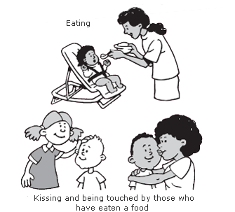
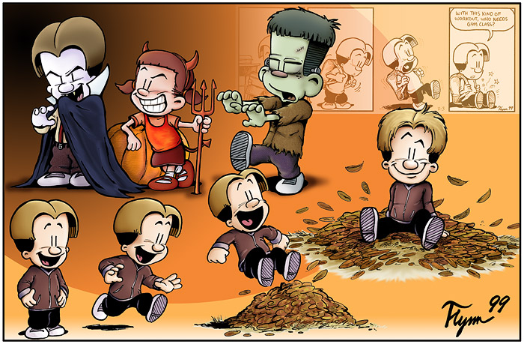
Dietary Protein Enteropathy
Manifestations | Diarrhea Malabsorption Failure to thrive Emesis Abdominal distensions Anemia Edema Hypoproteinemia Protein-losing enteropathy Anti-endomysium antibody negative Radiographic: small bowel edema Food challenge: vomiting and/or diarrhea in 40 to 72 hours

Slide 66
Treatment | Strict elimination of offending antigen
Natural History | Most cases resolve in 2 to 3 years

Slide 67
My 8 – month old infant was well up to 6 – month of age when I start to introduce cereals and baby biscuits then he started to have diarrhea since that time. What is the cause of the diarrhea?

Slide 68
Celiac Disease
Age of onset | Dependent on timing of gluten introduction typically more than 6 months
Proteins implicated | Wheat, rye, barley, possibly oats
Pathology | Extensive villous atrophy Elongated crypt length Increased intraepithelial lymphocytes
Genetics | HLA-DQ2 (and DQ8) associated
Natural History | Illness is life-long

Slide 69
Celiac Disease (cont.)
Manifestations | Chronic diarrhea Abdominal distension Failure to thrive / growth failure Complications of malabsorption Abdominal pain Associated diseases: dermatitis herpetiformis, diabetes mellitus, thyroid disease, Down syndrome, IgA deficiency
Treatment | Gluten elimination

Slide 70
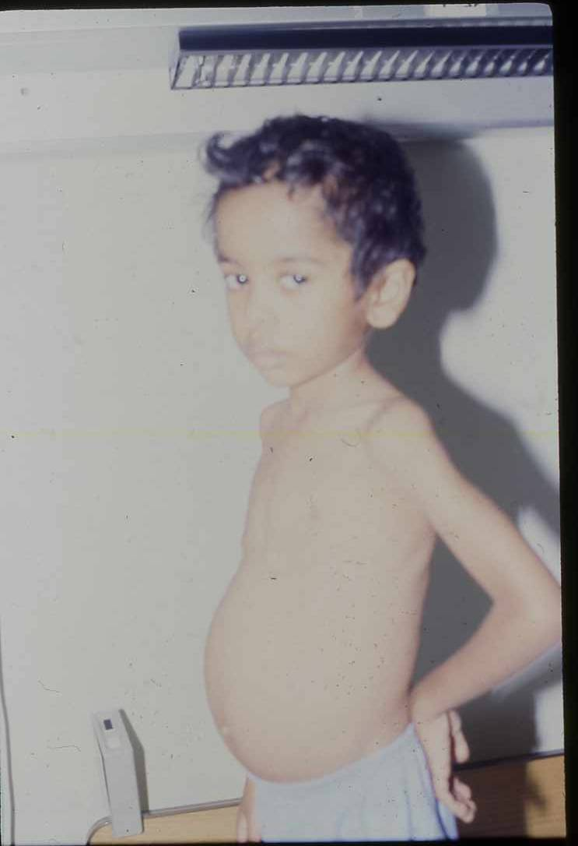

Slide 71
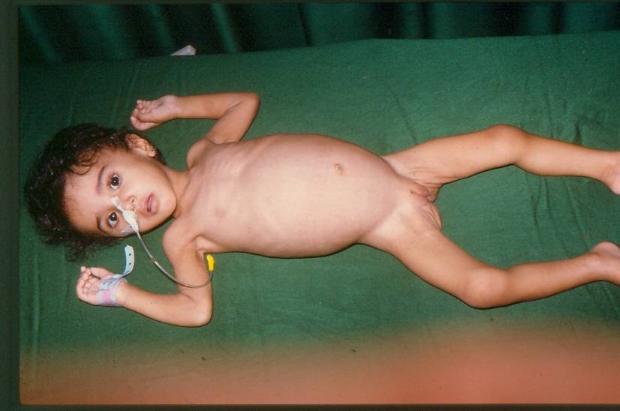

Slide 72
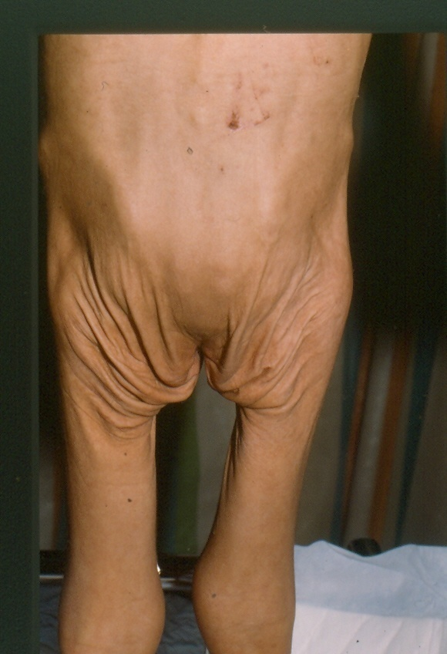

Slide 73
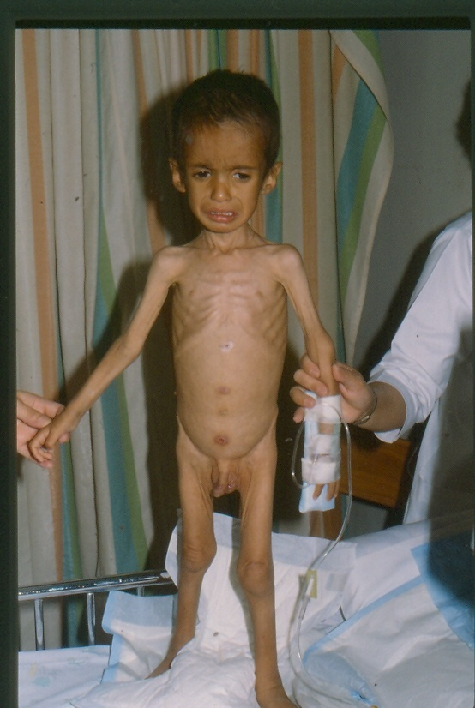

Slide 75
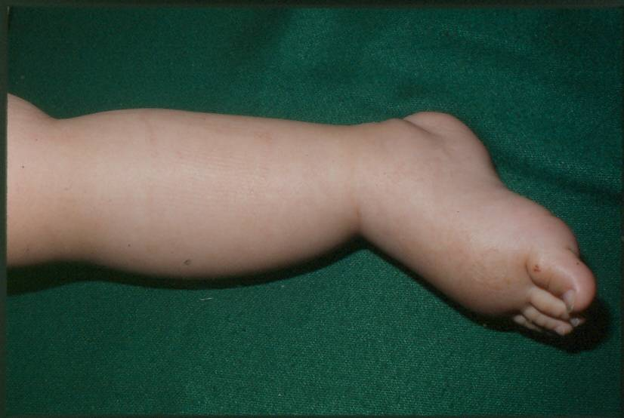

Slide 76
Diagnosis of Celiac Disease (New criteria)
1) Positive anti-issue transglutaminase or endomysium antibodies.
2) Villous atrophy on small bowel biopsy.

Slide 77
Diagnosis of Celiac Disease (Old criteria)
Biopsy | Histologic findings | Management
First | Compatible with diagnosis | Gluten-free diet initiated on trial basis, and clinical response observed
Second | Recovery documented | Gluten challenge subsequently administered
Third | Relapse documented | Lifelong gluten-free diet recommended
77

Slide 78
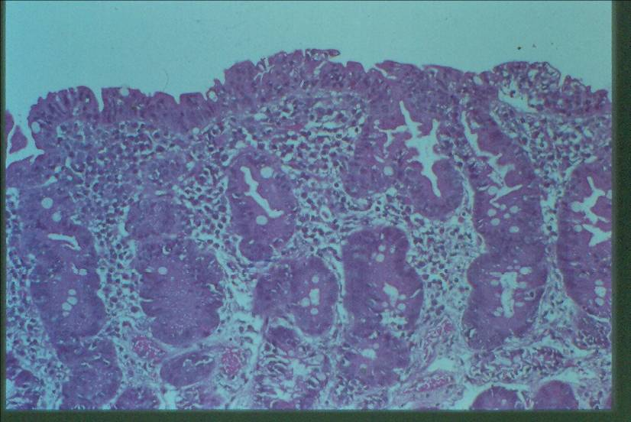

Slide 79
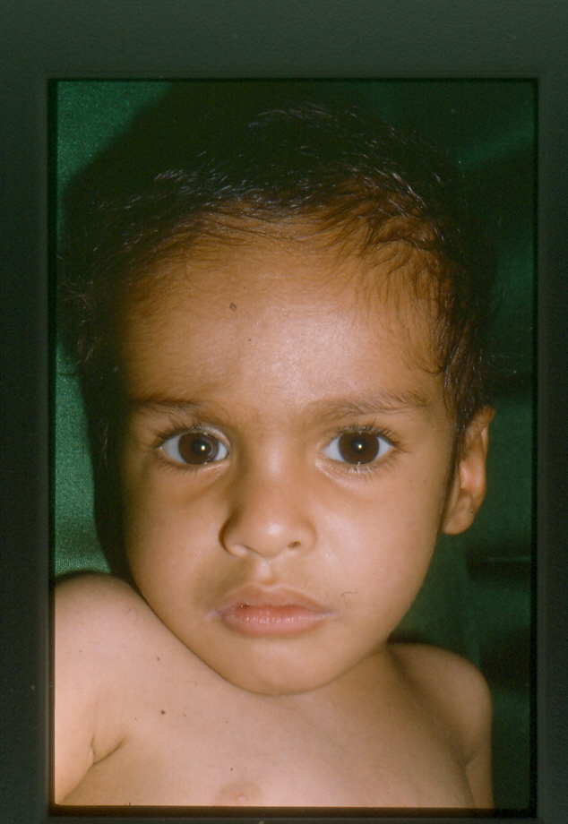

Slide 80
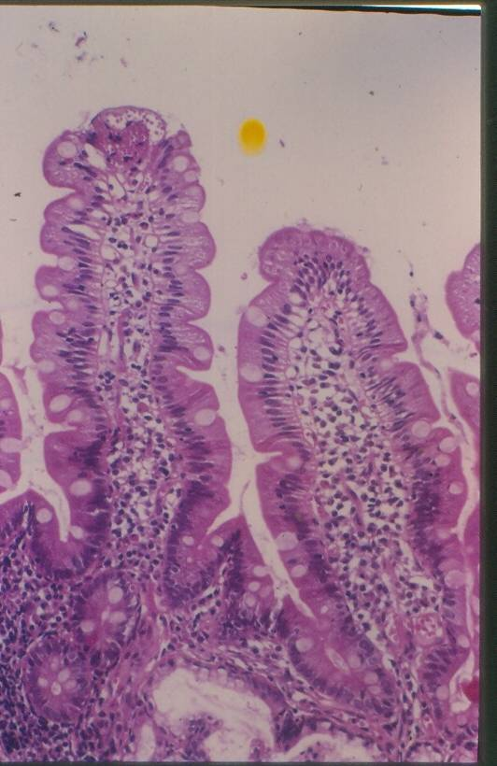

Slide 81
A 2 – year old child with chronic diarrhea which is associated with lymphedema or ataxia. What is the cause?

Slide 82
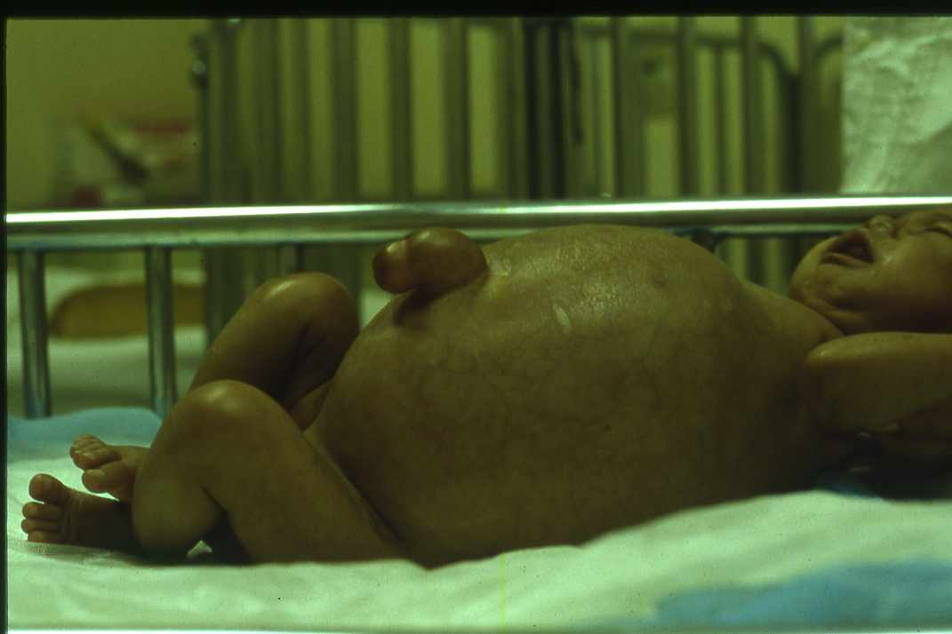
Intestinal Lymphangiectasia
Disorder of the intestinal lymphatics Impaired fat absorption Protein-losing enteropathy Primary (familial) Secondary to fibrosis Hypo-albuminemia Hypogammaglobulinemia Low lymphocyte count | Chylous ascites Systemic infections Generalized lymphatic abnormalities

Slide 83
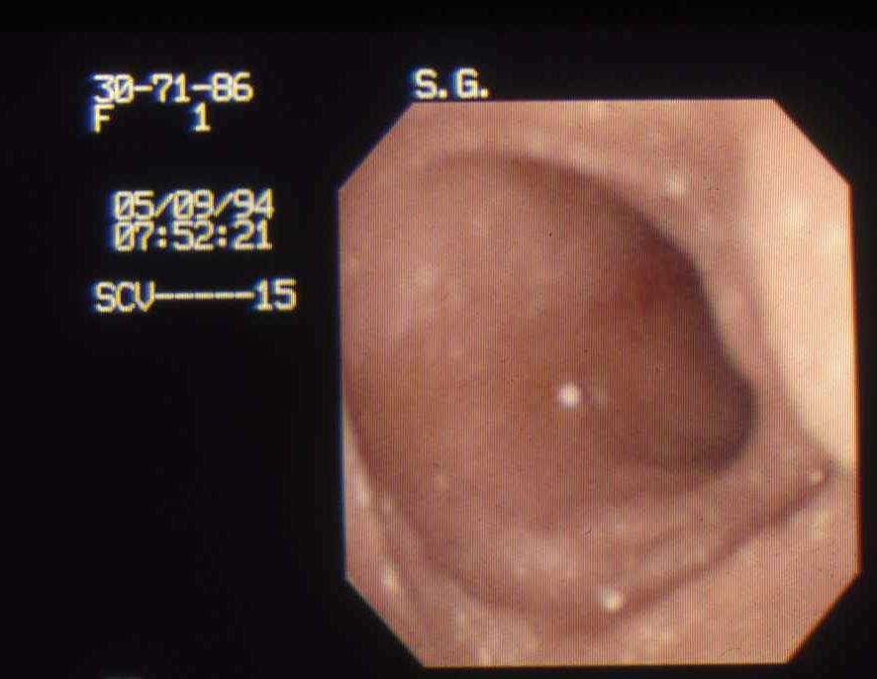
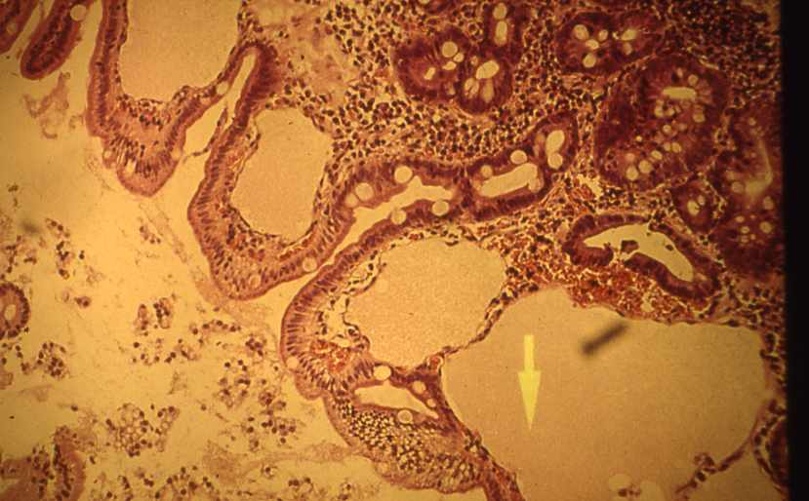
Intestinal Lymphangiectasia
Biopsy confirms lymphangiectasia Characteristic lymphatic dilatation Follow-through demonstrate oedema of the intestine Protein loss by Cr-labeled albumin

Slide 84
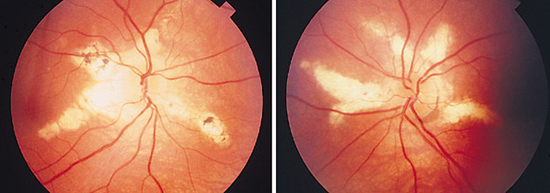
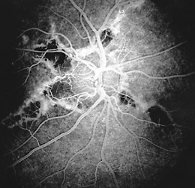
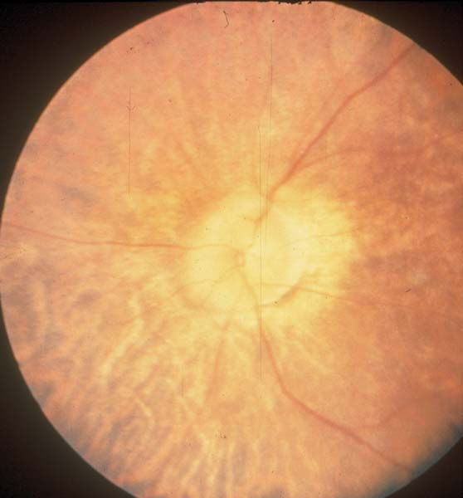
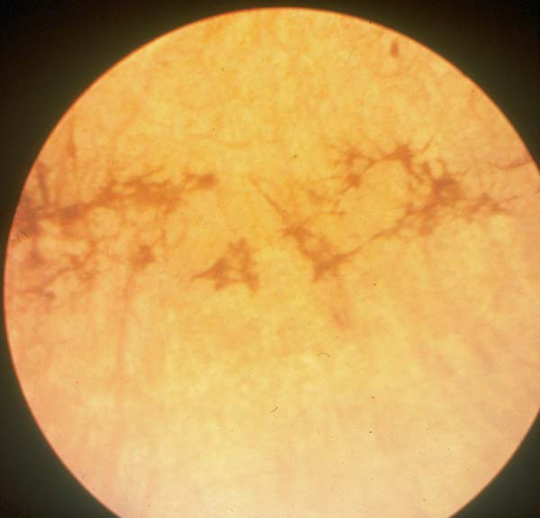
Abetalipoproteinemia
DISEASE | GENE | LOCATION | FUNCTION
Abetalipoproteinemia | MTP | 4q22 | Transfer lipids to apolipoprotein B
Autosomal recessive trait Fat malabsorption failure to thrive Ataxia and retinitis pigmentosa Markedly decreased plasma levels of cholesterol triglycerides and phospholipids

Slide 85
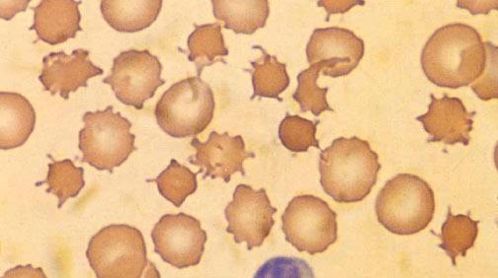
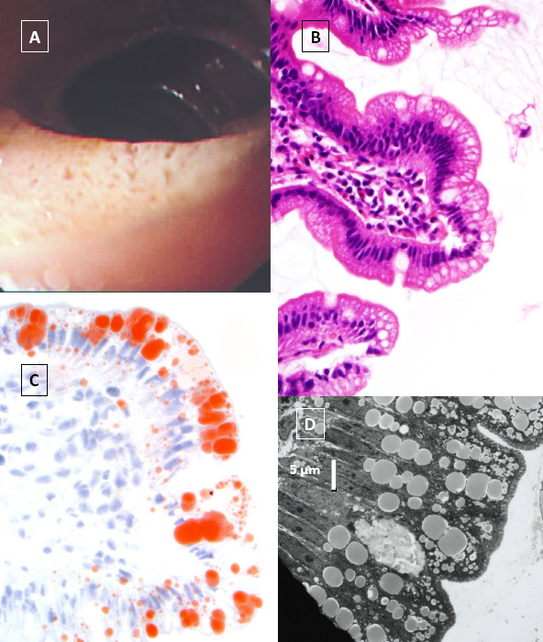
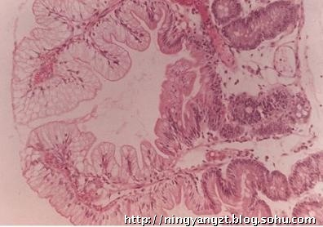
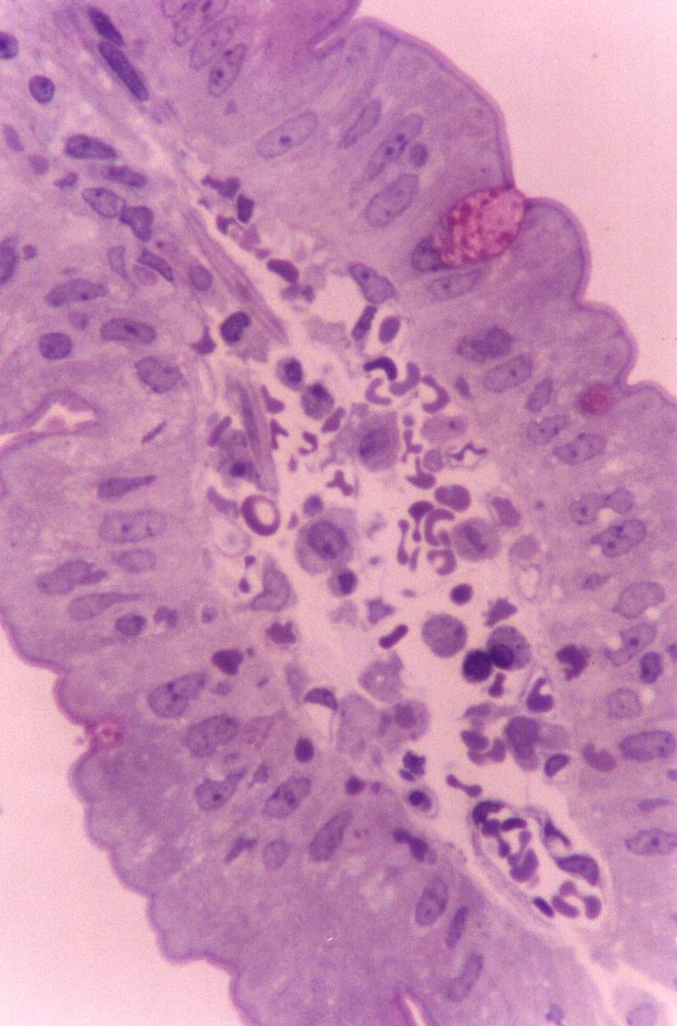
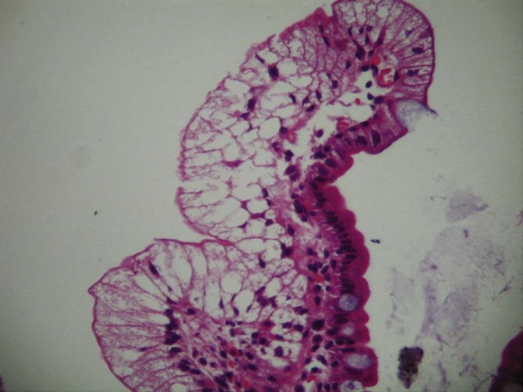
Abetalipoproteinemia
Acanthocytosis Small intestinal biopsy Normal villous architecture Fat droplets in the enterocytes Low-fat diet with medium-chain triglycerides Vitamins A, D, E and K

Slide 86
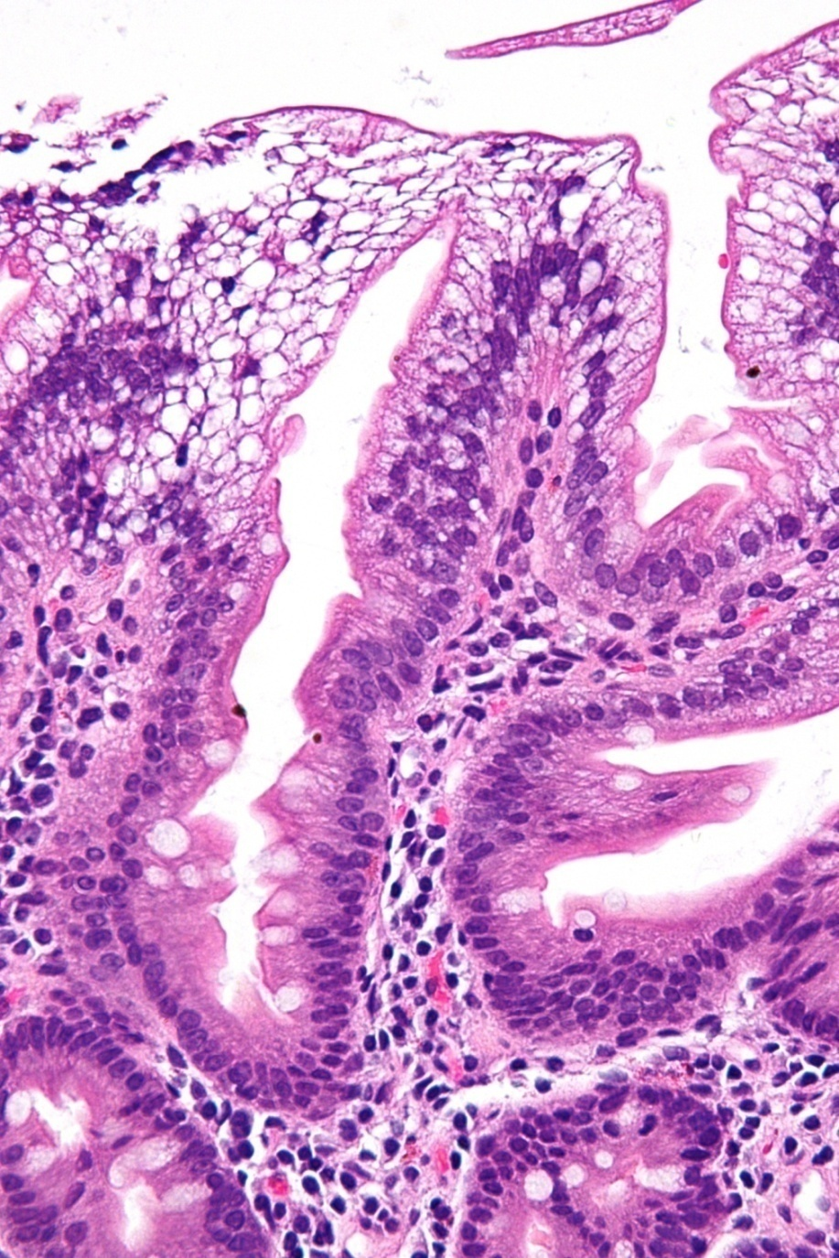
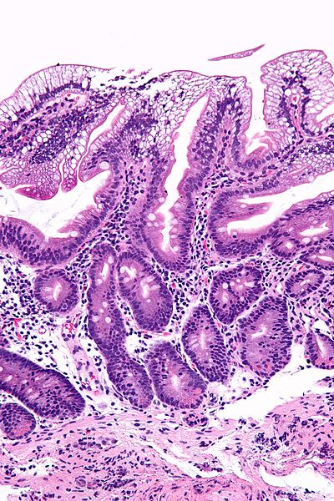

Slide 87
A 1 – year old child with chronic diarrhea and skin rashes around the orifices and hair loss. What is the cause?

Slide 88
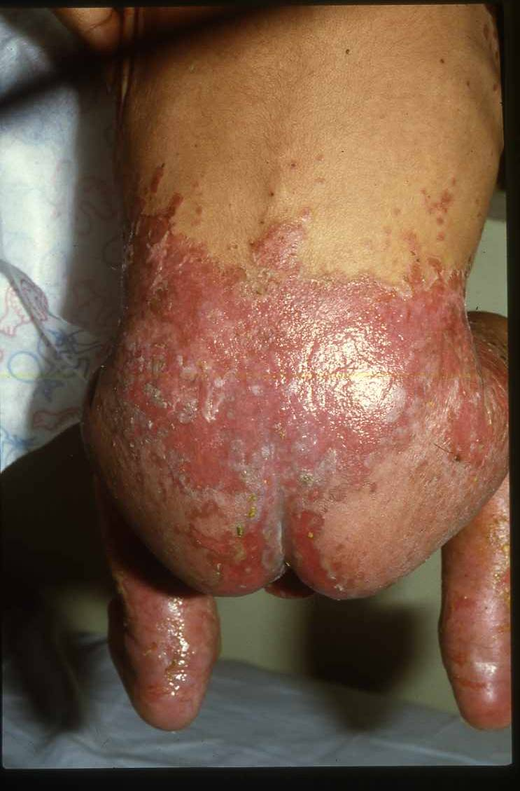
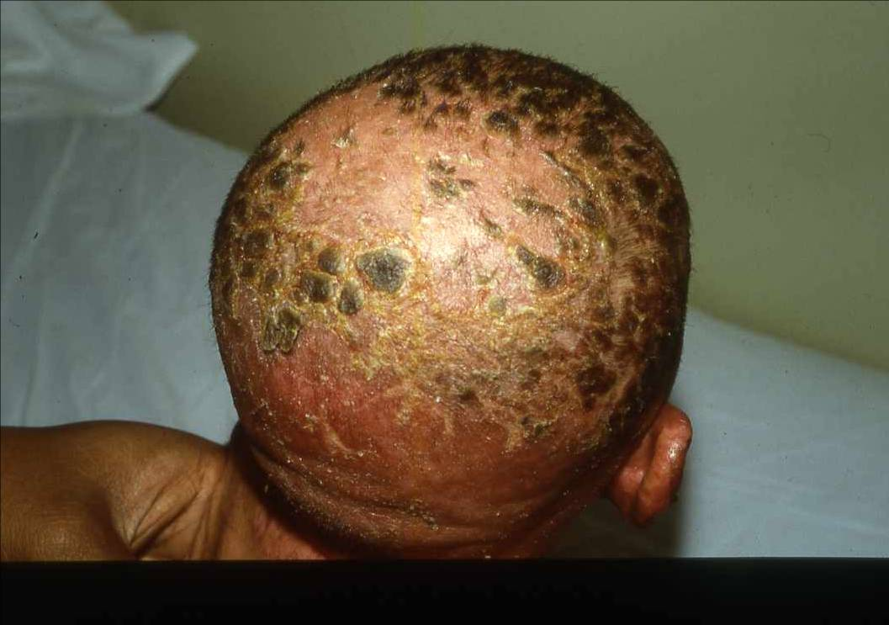
Acrodermatitis Enteropathica
DISEASE | GENE | LOCATION | FUNCTION
Acrodermatitis Enteropathica | SLC39A4 | 8q24.3 | Zn²⁺ transporter
Recessive
Chronic diarrhea and failure to thrive
Dermatitis involving perioral and perianal regions
Alopecia
Low plasma zinc levels
Alkaline phosphatase is low

Slide 89
Treatment
zinc sulfate 150 mg/d orally

Slide 90
A 3 – year old child with chronic diarrhea and growth failure and recurrent chest infection. What is the cause?

Slide 93
In the neonatal period, with intestinal obstruction; meconium ileus
With recurrent or persisting cough often associated with wheeze
Malabsorption; large, pale, bulky and offensive stools
Failure to thrive
Rectal prolapse
Rarely, heat stroke
Sweat chloride concentration is ↑
Staphylococcus + pseudomonas aeruginosa
Physiotherapy
Enzyme replacement
Hot weather
↑ fluid and salt intake
93

Slide 94
Short Gut Syndrome
Surgical resection of the small intestine
Volvulus
Adhesions

Slide 95
Vasoactive Intestinal Polypeptide- Secreting Tumors
Pediatric:
Ganglioneuroma
Ganglioneuroblastoma
Pheochromocytoma
Mastocytoma
Non-beta cell hyperplasia
Medullary thyroid carcinoma

Slide 96
VIPoma and WDHA
Vasoactive intestinal polypeptide (VIP)
Chronic, high-volume, watery diarrhea, hypokalemia, and alkalosis (WDHA).
Age range from 1 to 3 year olds.
VIP is strikingly elevated, or imaging studies that show a mass in the adrenal gland or along sympathetic ganglia in abdomen or thorax

Slide 97
A 1 ½ year old child with chronic diarrhea and food particles in the stool with normal growth. What is the cause of the diarrhea?

Slide 98
Chronic Nonspecific Diarrhea (CNSD)/ Irritable Bowel Syndrome (IBS)
Symptoms
Onset: 6 to 18 months of age
Loose, explosive bowel movement containing food particles
Bowel movement frequency: 6 to 12/d
Growth: Normal (if not on restrictive diet)
Red Flags (Not Compatible with CNSD/IBS)
Hematochezia or melena
Persistent fever
Weight loss or growth arrest
Anemia

Slide 99
Chronic Nonspecific Diarrhea (CNSD)/ Irritable Bowel Syndrome (IBS)
Diet:
Restrict apple juice (trial only)
Restrict lactose (trial only)
Laboratory Studies:
tTg or EMA
Fecal Giardia antigen
Therapy:
Reassurance
Lifestyle modifications
Avoidance of restrictive diets

Slide 100
A 5 – year old child with chronic bloody diarrhea and growth failure. What is the cause?

Slide 101
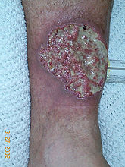

Slide 102
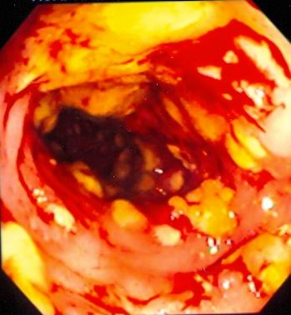
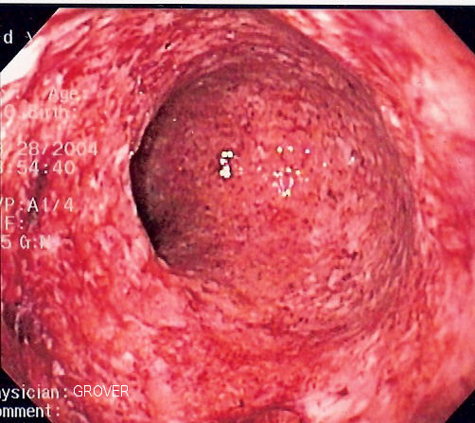
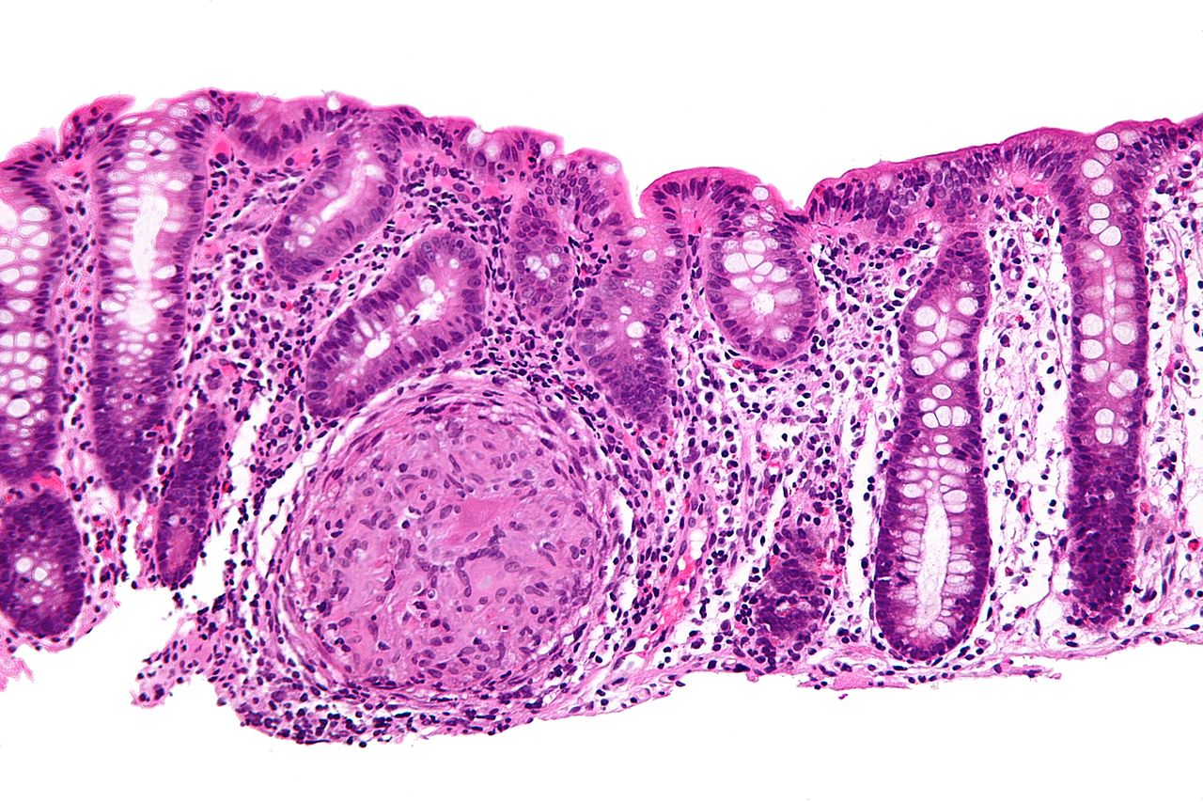

Slide 103
Differential Diagnosis Between Ulcerative Colitis and Crohn’s Disease
Feature Relative incidence of symptoms Rectal bleeding (gross) Diarrhea Pain Anorexia Weight loss Growth retardation Extraintestinal manifestations | Ulcerative colitis Common Often severe Less frequent Mild or moderate Moderate Usually mild Common | Crohn’s disease Rare Moderate or even absent Almost always Can be severe Severe Often pronounced Common

Slide 104
Plan of Investigation in Children with Chronic Diarrhea
Investigation | Clinical Diagnosis for which indicated
Identification of bacterial, viral and protozoal agent in stool | Infectious enteritis
Stool PH and reducing substances; breath H2 excretion; oral sugar tolerance tests | Carbohydrate malabsorption
Stool electrolyte | Chloride losing diarrhea
Lymphocyte count & immunoglobulin, profile; macrophage function, serum opsonic activity | Immunodeficiency, intestinal lymphangiectasia
Celiac Serology | Celiac Disease
Sweat chlorides; pancreatic function tests | Cystic fibrosis and other pancreatic deficiency disorders
Duodenal intubation | Bacterial overgrowth, excess deconjugated bile salts, enteric infections

Slide 105
Plan of Investigation in Children with Chronic Diarrhea (cont.)
Investigation | Clinical Diagnosis for which indicated
Intestinal Biopsy | Milk protein allergy by pre and post milk challenge histology Celiac disease, lymphangiectasia
Urinary catecholamines; immunoassay for VIP | Secretory tumors
Serum zinc | A crodermatitis enteropathica
Lipid profile | A beta liproteinemia
PT, PTT | Vitamin K malabsorption
Stool fat | Fat malabsorption
Alpha-1-antitrypsin in stool | Protein loosing enteropathy
Barium studies | Surgical disorders, inflammatory bowel disease
Colonoscopy | Inflammatory bowel disease

Slide 106
Differential Diagnosis of Prolonged Diarrhea of Infancy
Congenital chloride diarrhea
Congenital Sodium Diarrhea
Microvillus inclusion disease
Tufte enteropathy
Autoimmune enteropathy
Carbohydrate malabsorption
Cow milk protein allergy
Celiac disease
Intractable diarrhea in infancy
Enteric infection
Immunodeficiency disease
Intestinal Lymphangectasia
A-beta-lipoproteinemia
Congenital short gut (malrotation)
VIPoma
Acrodermatitis enteropathica
Cystic Fibrosis
Chronic Non-Specific Diarrhea
IBD

Slide 107
TREATMENT CONSIDERATION
I. MALNUTRITION
Sufficient calories should be provided to allow for catch-up weight gain. When oral intake is inadequate or malabsorption precludes adequate intake, continuous enteral feedings or parenteral nutrition maybe necessary.
Micronutrient and Vitamin supplementation are part of nutritional rehabilitation:
Vitamin A
Zinc
Folic Acid
Copper
Selenium
Deficiencies in these micronutrients can impair the function of the immune system.

Slide 108
II. MEDICATIONS
1. PROBIOTICS
Administration of probiotic bacteria and the administration if antibiotics
The utility if treatment with antibiotics is unclear.
2. ANTIDIARRHEAL DRUGS
Children with protracted diearrhea
Important side effects: sedation and risk for toxic megacolon
Prolong excretion of the organism or promote the development of hemolytic-uremic syndrome in patients infected with enterohemorrhagic E. coli.

Slide 109
3. SOMATOSTATIN
Treatment may be directed at modifying specific pathophysiologic processes.
In severe secretory diarrheas for instance: neuroendocrine tumors microvillous inclusion disease and enterotoxin-induced severe diarrhea

Slide 110
Summary
The differential diagnosis for chronic diarrhea in children is broad. Pediatric clinicians can narrow these possible diagnoses beginning with a detailed history and physical examination.
Particular attention should be paid to growth measurements to distinguish between chronic diarrhea with and without associated growth failure.

Slide 111
Summary
Understanding the four basic pathophysiologic mechanisms of diarrhea also may aid in making a diagnosis. The four categories are osmotic, secretory , dysmotility associated, and inflammatory.
Although specific therapies vary for each disease, the importance of maintaining nutrition demands particular emphasis. Whatever the cause of the diarrhea, each patient requires adequate caloric intake to allow healing of the initial insult, or at least take to support the child while pursuing diagnostic and therapeutic interventions.

Slide 113
Thank You!!!

