Slide 1
SOB
Khalid Al-Mobaireek

Slide 2
Introduction and Definition
Pathophysiology
Causes
Approach
cases

Slide 3
Dyspnea
common symptom
may be the primary manifestation of lung disease, cardiac, anemia, obesity, or deconditioning.

Slide 4
What is Dyspnea?
Dyspnea: breathing discomfort
“Subjective experience of breathing discomfort that consists of qualitatively distinct sensations that vary in intensity” – ATS Consensus Statement 2012
“Uncomfortable awareness of breathing”
Major problem: Lack of a valid, reliable measure of the degree of Dyspnea
Physical symptoms define ‘dyspnea intensity’
Emotional response determines ‘degree of distress’
Dyspnea is complex multidimensional symptom

Slide 5
Dyspnea can be:
acute develops over hours to
chronic > 4-8 weeks.
acute worsening of chronic breathlessness (eg, CF, heart failure).

Slide 6
Introduction and Definition
Pathophysiology
Causes
Approach
cases

Slide 7
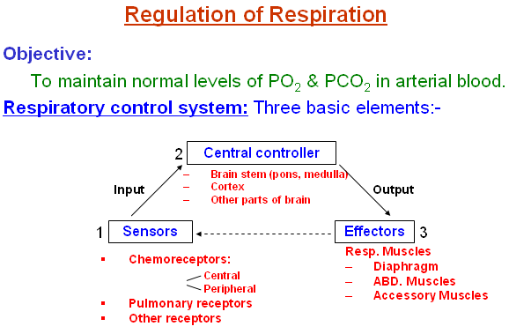

Slide 8
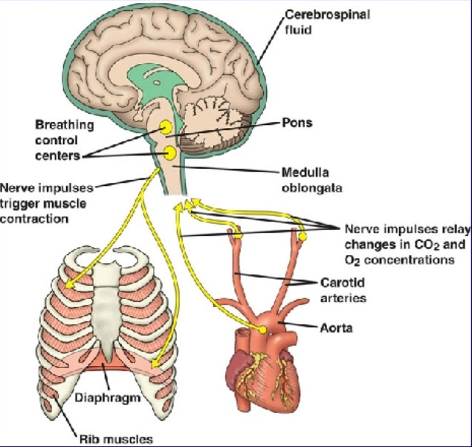
Regulation of the respiratory system

Slide 9
receptors
Chemoreceptors (peripherally and centrally located)
mechanoreceptors (located in the airways, lungs and chest wall)

Slide 10
Chemoreceptors
stimulated by changes in PCO 2 and PO 2 levels.
Central chemorecepters are in the medulla.
Peripheral chemoreceptors are in the aortic arch and carotid bodies
Notes:
increase of PCO 2 as sensed by the chemoreceptors can lead to subjective perception of dyspnea. Similarly, research suggests hypoxia can stimulate dyspnea,presumably by chemoreceptor stimulation

Slide 12
Mechanoreceptors
located in the airways, lungs and the chest wall.
Lungs: three main types:
pulmonary stretch receptors: increased airway tension and lung volume (asthma related dyspnea)
Irritant receptors: bronchial walls
C-fibers: near alveoli in the pulmonary parenchyma,
Chest wall receptors: respond to restricted chest wall movements.

Slide 13
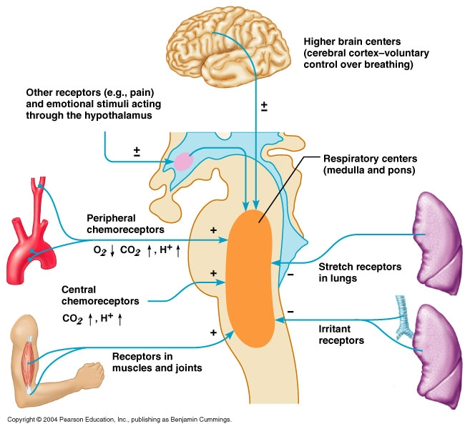

Slide 14
PATHOPHYSIOLOGICAL FEATURES
In normal:respiratory muscles work only during inspiration
the diaphragm does most of the work.
The work of inspiration is the sum of the work necessary to overcome:
the elastic forces of the lung
the tissue viscosity of the lung and chest wall
airway resistance.

Slide 15
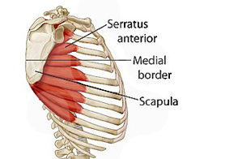
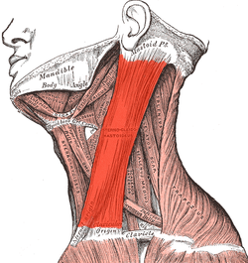
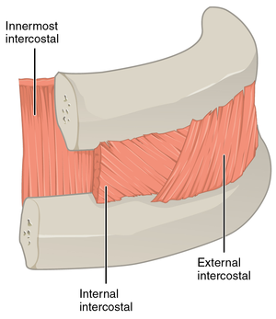
classic sign of dyspnea
The accessory muscles of inspiration:
the sternocleidomastoid
anterior serratus
external intercostal muscles
Contraction of these muscles increases the –ve intrathoracic pressure.
The negative pressure draws in the soft tissues of the chest wall (retractions:suprasternal, infrasternal, intercostal, subcostal, and supraclavicular).
Other way to maintain an adequate MV is to increase the RR(tachypnea).
Nasal flaring
MV= TV X RR

Slide 16
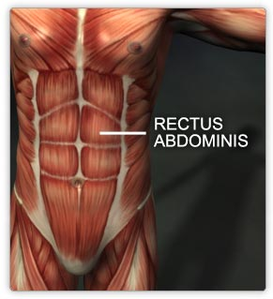
Expiration
Little energy is expended during normal expiration.
Relaxation of the diaphragm, elastic recoil of the lungs and chest wall, and compression of the lungs by the intraabdominal organs.
In obstructive airway disease: more force is needed.
In tachypnea: no time for elastic recoil to allow adequate exhalation between breaths.
In either instance the accessory muscles of expiration are used:
The abdominal recti muscles: force the abdominal contents against the diaphragm to compress the lungs
the internal intercostal muscles contract to pull the ribs downward.

Slide 17
Respiratory | cardiovascular | neuromuscular | systemic | psychogenic
Asthma/ CF/PCD/ bronchiectasis | CHF/pul edema | Rib #/ chest trauma | anemia | Hyperventilation syndrome
Pneumonia/ Bronchiolitis | arrhythmias | Flail chest | ARF | Psychogenic dyspnea
Pneumothorax | Cyanotic spells | Massive obesity | Metabolic acidosis | Vocal cord dysfunction
Foreign Body | Pul HPN | kyphoscoliosis | sepsis
aspiration | Valvular heart dis | CNS/spinal cord disordes | cirrohsis
embolism |  | Phrenic nerve palsy | anaphylaxis
Upper aw obs * |  | Myopathy/ neuropathy | fever
* Foreign body (airway or esophagus), Croup, Epiglottitis, Retropharyngeal abscess, Enlarged tonsils or adenoids, tumors (vc, larynx, trachea, Mediastinum), Diphtheria, Bacterial tracheitis, Ingestion of caustic substance, Vascular ring, Tracheal laryngeal web, Bronchomalacia, choanal atresia

Slide 18
Introduction and Definition
Pathophysiology
Causes
Approach
cases

Slide 19
Approach
Step 1: ABC (i.e is the patient stable?)
a patient presenting with dyspnea must be evaluated for life threatening causes.
acute in onset.
FB, pneumothorax, tamponade.
After these causes are ruled out, further evaluation can proceed.

Slide 20
History
complete description of the dyspnea:
Onset:
sudden (eg, inhaled FB, pneumothorax)
evolved over several hours (eg, asthma, diabetic ketoacidosis).
duration
the frequency of attacks of dyspnea
Triggers
severity (daily activities restriction. However, dyspnea sensation can be affected by the patient's anxiety level, previous experiences.
Aggrivating factors: patient's position
associated symptoms such as cough, wheezing, sputum, and pleuritic pain.

Slide 21
history of other known illnesses, allergies, illnesses in the family.
social history: Deconditioning can be present in sedentary life style, smoking and environmental exposure.
Medication effect can directly cause a sensation of dyspnea (e.g opioids) not compliant or recently stopped taking medications (such as lasix for fluid overload, or brochodilators).

Slide 22
Physical exam
While taking the history you can also begin the inspection.
vital signs including O2 sat. Does the patient have fever?
Growth parameters
Finger clubbing
inspection of the upper airways
What position is the patient in? (sitting forward, etc)
Does the patient have stridor? Tracheal tug?

Slide 23
extrathoracic obstruction:
Hoarsness (larynx)?
Cough sound?
Does the patient have signs of increased WOB (inter/subcostal retractions)?
Consider intrathoracic respiratory causes.
Does the patient have a wheeze?
Does the wheeze respond to bronchodilators?
Full cardiac and pulmonary exams.

Slide 24
Cardiac
Does the child develop SOB during feeds or activity? Have poor weight gain?
Does the anterior left hemithorax look more prominent?
Does the patient have periorbitalema? Hepatomegaly?
Does the patient have tachychardea more than tachypnea.

Slide 25
Important clinical clues
Hypoxia:
most worrisome endpoint of SOB.
Central Cyanosis:
Deoxygenated hemoglobin is at least 5g/100mL of blood, or that O2 sats have dropped below 85%.
either severe respiratory disease or cyanotic CHD.
Peripheral cyanosis: if without central cyanosis, is a sign of decreased peripheral (not necessarily hypoxia).

Slide 26
After basic evaluation, formulating a hypothesis: there is primary cardiac, pulmonary, or neurologic pathology
multiple systems may be impacted simultaneously.

Slide 27
Lab
ABG: can indicate the elevated CO 2 levels, acidosis
Electrolyte abnormalities.
complete blood count: anemia.
EKG: heart rhythmsCXR: pneumonia, pulmonary edema, FB.
CT scan of the chest: pulmonary embolism and a multitude of pulmonary and vascular diseases.

Slide 28
Echocardiography: strucure, pulmonary pressures, assessing systolic function
Troponin testing to evaluate for myocardial ischemia
BNP and nt-pro-BNP separate dyspnea due to CHF versus pulmonary causes.
Cardiopulmonary exercise testing: in cases of exertional dyspnea, when cardiac or pulmonary disease is at early stages.
Notes:
In this form of testing, patients are monitored
and breathing and ventilatory patterns are studied during
incremental exercise. The difference in adaptation to
exercise can determine whether dyspnea is caused by primary
cardiac or pulmonary process

