Slide 1
NeuroExam
General: vitals & appearance
Consciousness, orientation, Cognition
Memory
Speech
Meningeal irritation
Cranial Nerves
Motor (Power, Tone, Reflexes)
Sensory
Cerebellar examination
Gait

Slide 2
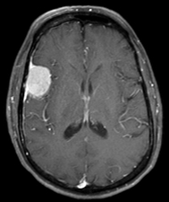
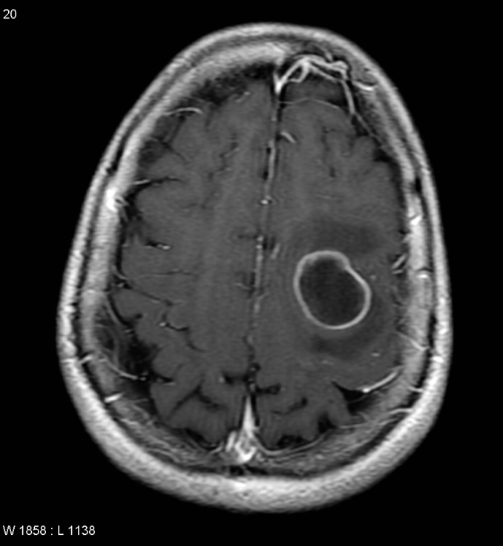
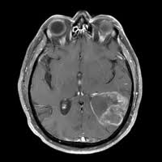
Brain Tumors 101
Abdulrazag Ajlan MBBS, MSc, FRCSC
Consultant Neurosurgery, KSU
Adjunct Teaching Faculty, Stanford

Slide 3
Key Points
Increased ICP (signs/symptoms/treatment)
CT & MRI 101
Most common brain tumors
Treatment Options
Do you want to be a neurosurgeon!

Slide 5
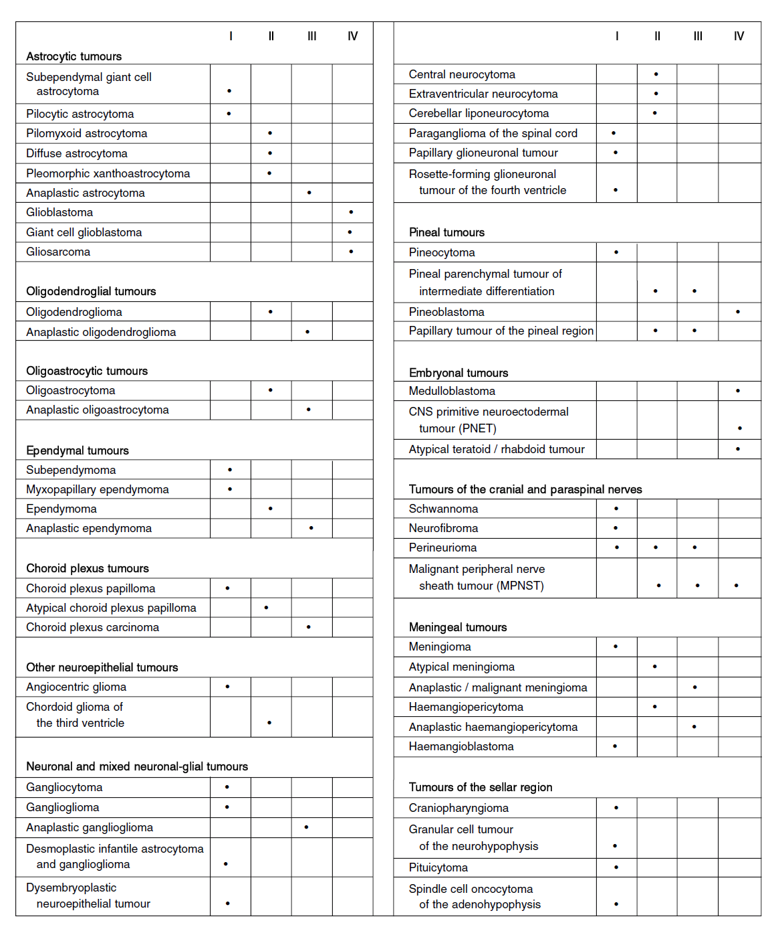

Slide 6
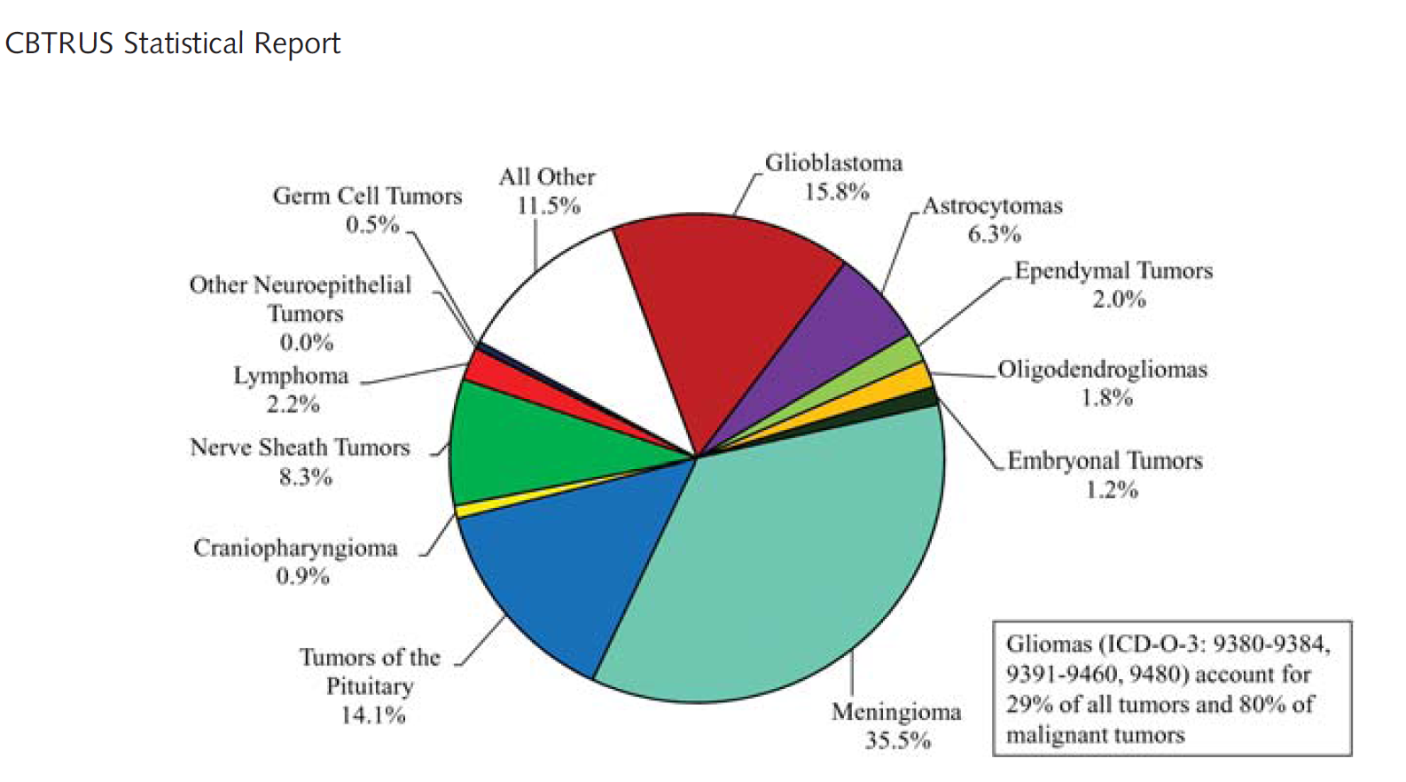
# 1
2ry
Metastasis
1ry
Therese A. Dolecek, Jennifer M. Propp, Nancy E. Stroup, and Carol Kruchko CBTRUS Statistical Report: Primary Brain and Central Nervous System Tumors Diagnosed in the United States in 2005–2009 Neuro Oncol (2012) 14 (suppl 5): v1 v49 doi:10.1093/neuonc/nos218
http://neuro-oncology.oxfordjournals.org/content/14/suppl_5/v1.full.pdf+html

Slide 7
Radiology 101
#2
Meningioma Metastasis Glioma

Slide 8
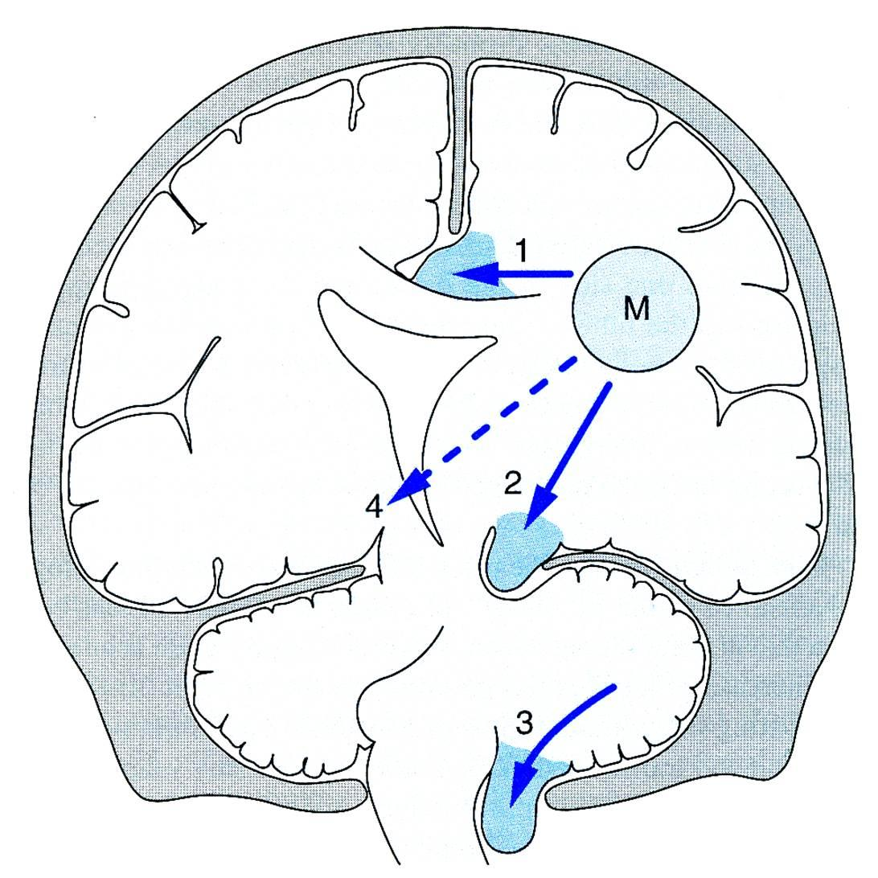
1- Local compression 2- Mass effect & Herniation 3- High ICP
# 3

Slide 9
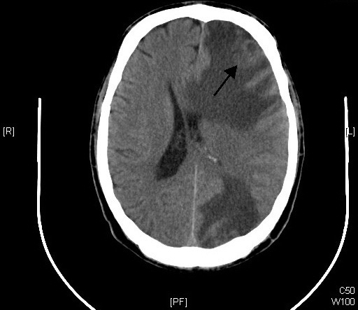
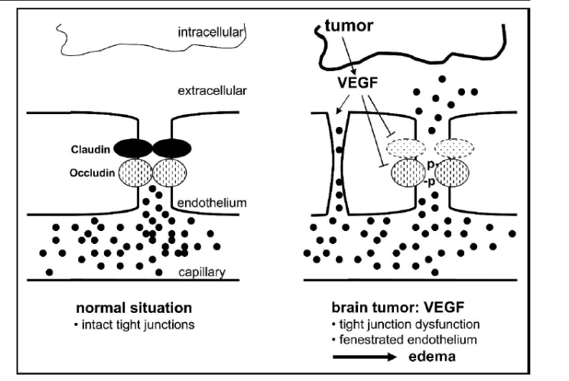
# 4
http://pzwvl.be/upload/fckeditor/file/De%20Mantel/literatuur/kaal.pdf

Slide 10
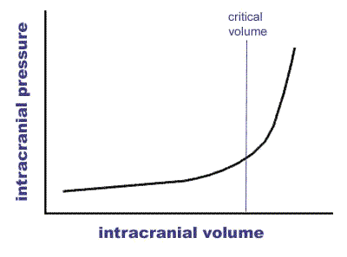
“compliance reflects the ability of the intracranial system to compensate for increases in volume without subsequent increases in ICP.
C.J Kirknesse t. al, 2000, 32,5 271

Slide 11
Not the same!
#5
Meningioma Metastasis Glioma

Slide 12
# 5
Tx
Observation
Radiation
Medical Therapy
Surgery

Slide 13
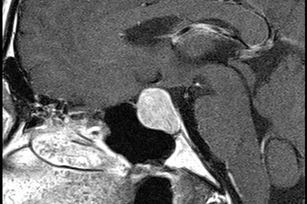
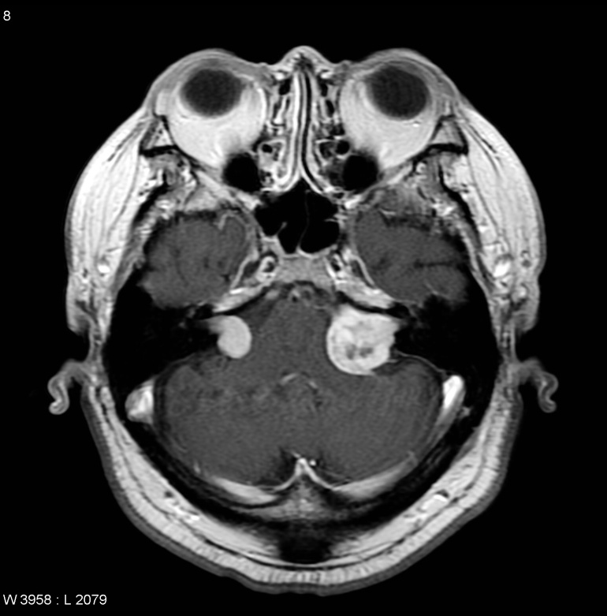
Surgery?
# 6
Improve functional status
→ Pressure
→ High ICP
Obstructive hydrocephalus
Seizures
Hormonally active
Prevention
Improve survival
Diagnostic

Slide 14
Illustrative Cases

Slide 15
84 year-old lady CC One week progressive speech difficulty & confusion PMH Hypercholesterolemia on Lipitor Exam -Expressive Dysphasia -Right-sided facial droop
Case # 1
D.P 00578799

Slide 18
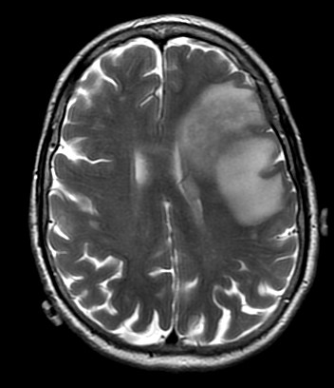
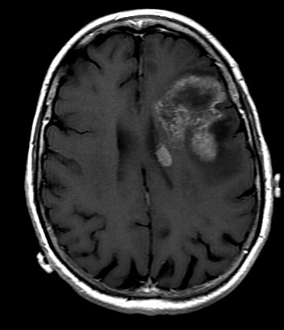

Slide 19
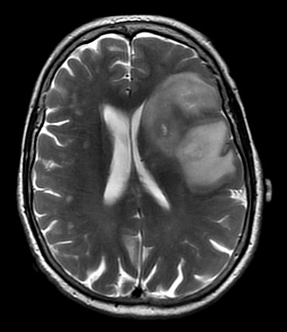
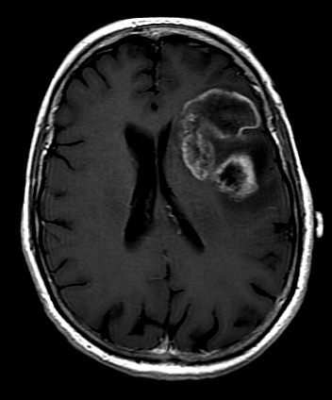

Slide 20
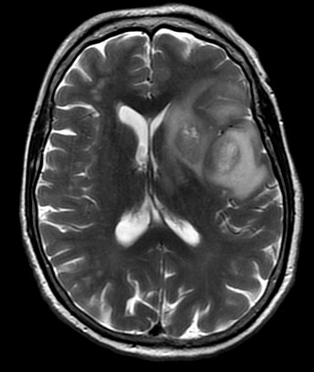
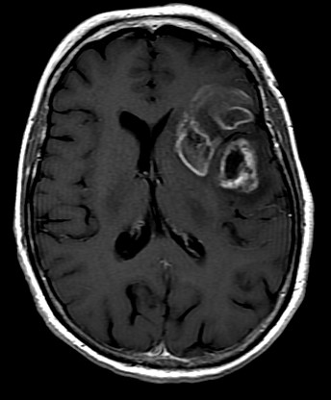

Slide 21
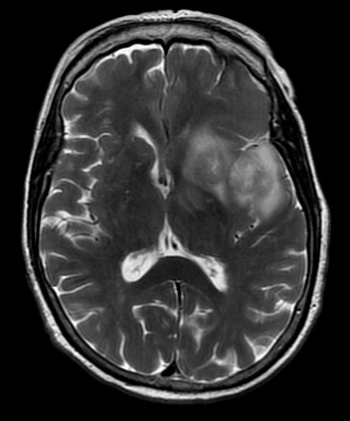
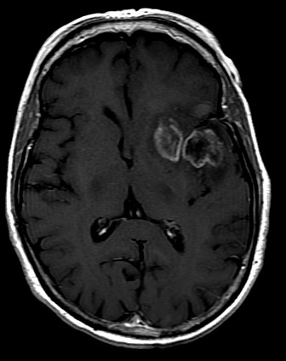

Slide 22
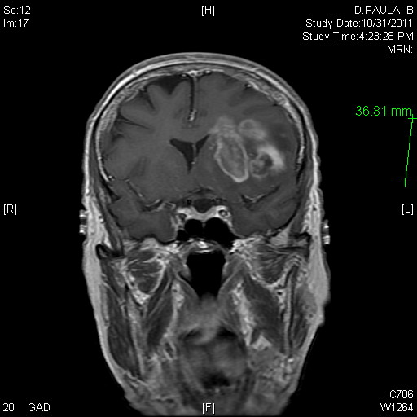
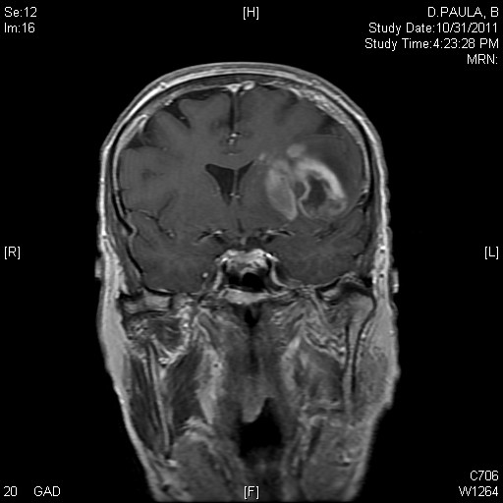

Slide 23
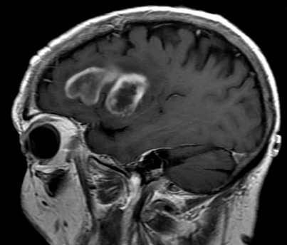

Slide 24
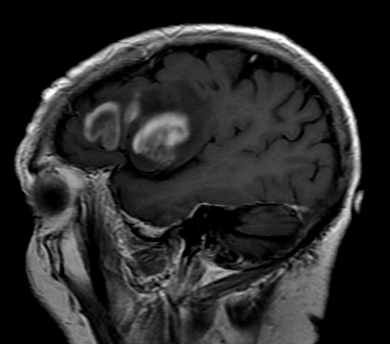
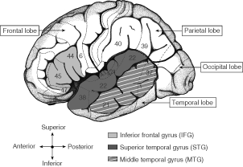
This Pt presented with expressive dysphasia, family thought she is depressed for a week.
Broca’s area located around pars opercularis (44) and pars triangularis (45)

Slide 25
What do you want to do?
Nothing
Biopsy
Biopsy/radiation
Biopsy/radio-chemotherapy
Partial debulking /radio-chemotherapy
Awake ( more aggressive)/radio-chemotherapy

Slide 26
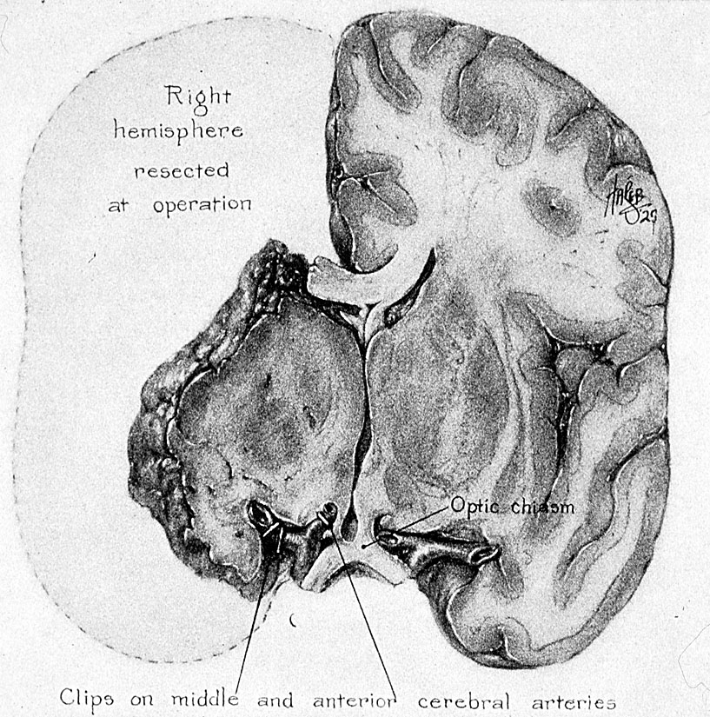
80 years ago
→Surgical inspection, Dandy could not find all the neoplasm to be "extirpated"
JAMA 1928;90:823-825

Slide 27
Lancet Oncol 2009; 10: 459–66
Progression-free survival rates (radiotherapy and temozolomide)
11·2% at 2 years
4.1% at 5 years

Slide 28
Surgery→ DO NO HARM

Slide 29
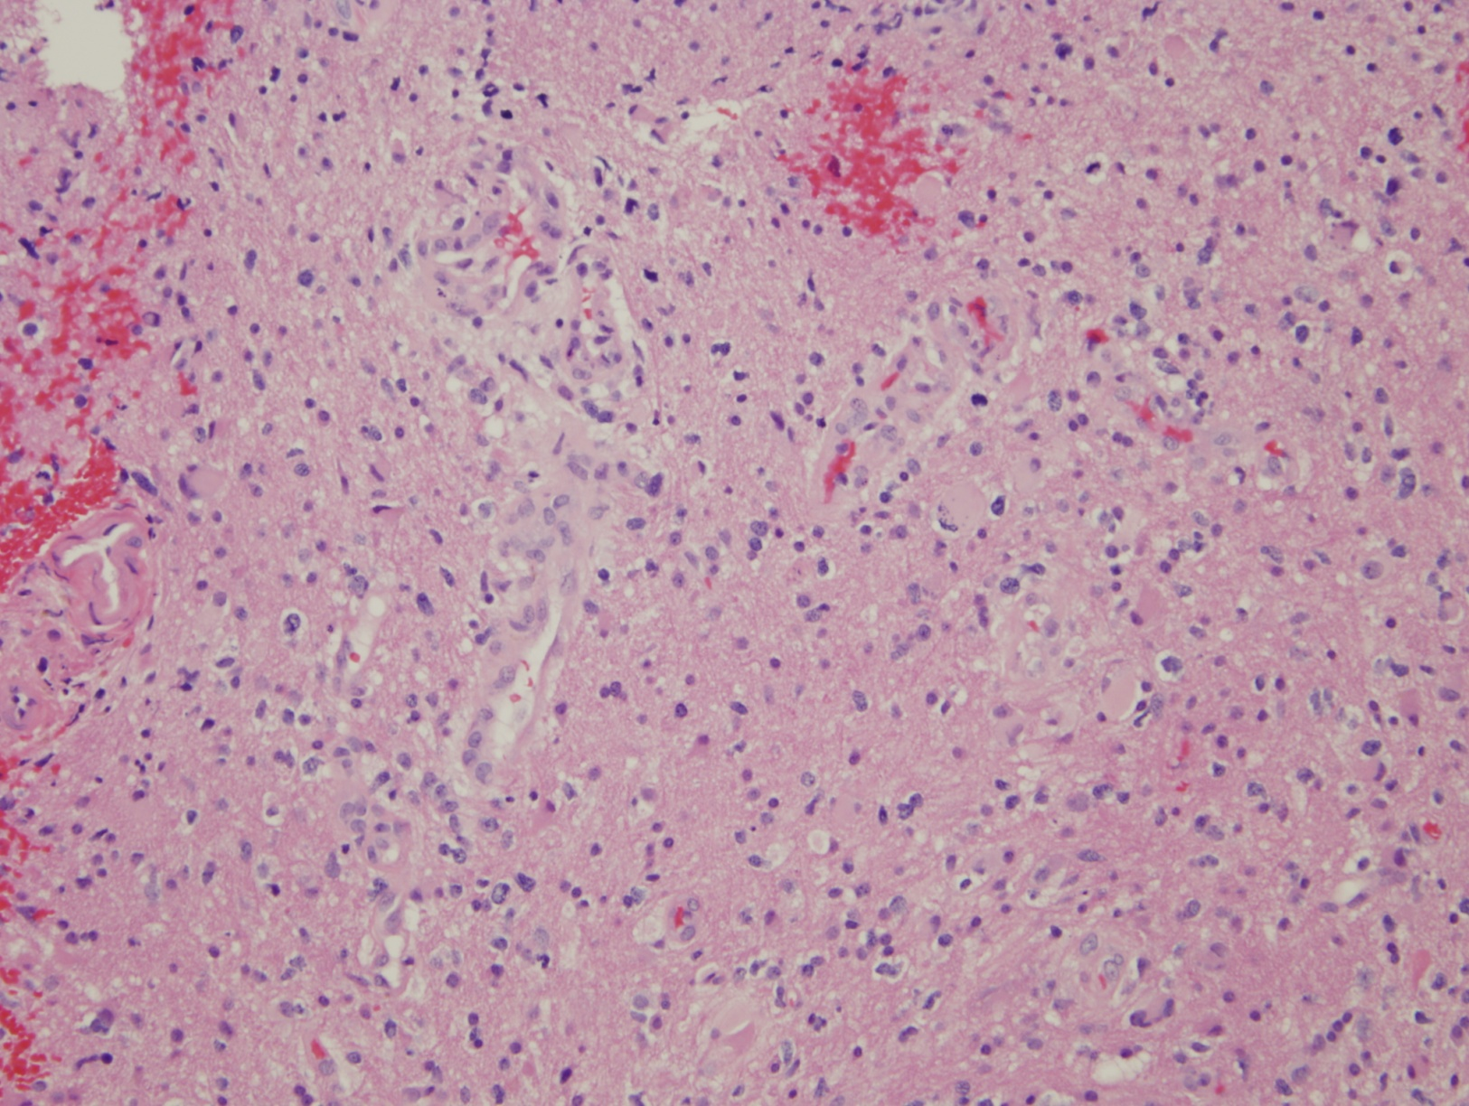

Slide 31
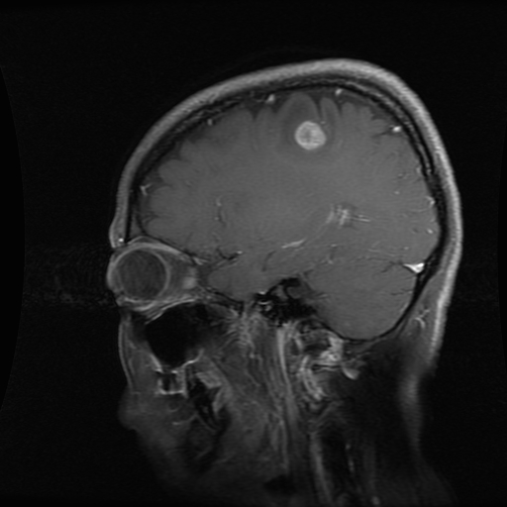
Metastasis

Slide 32
Tx
Observation
Radiation
Medical Therapy
Surgery

Slide 33
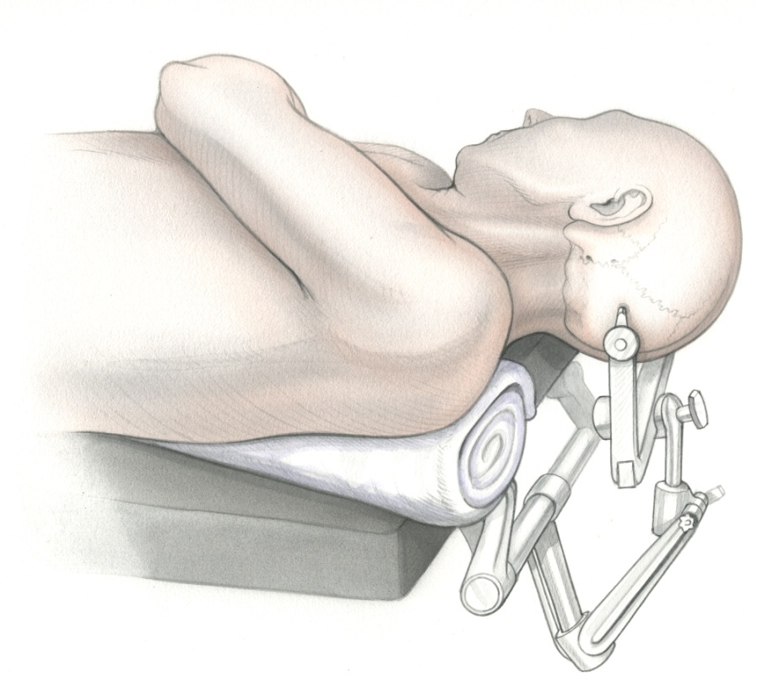
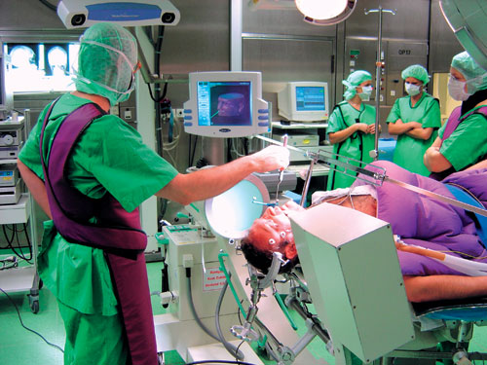
Operative Room
Case # 6
- Intubation
- Position
Neuronavigation
Plan the incision
Monitoring
Skin→ Bone → Dura

Slide 34
Operative Room
Case # 6
- Intubation
- Position
Neuronavigation
Plan the incision
Monitoring
Skin→ Bone → Dura

Slide 35
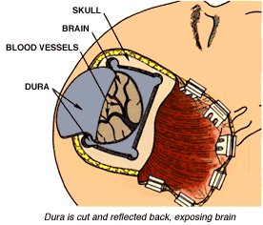
Operative Room
Case # 6
- Intubation
- Position
Neuronavigation
Plan the incision
Monitoring
Skin→ Bone → Dura

Slide 36
http://www.youtube.com/watch?v=O9UzGLVUKmk

Slide 38
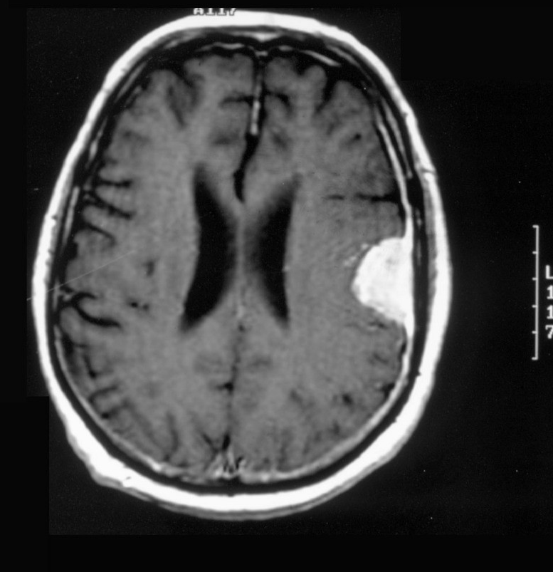
Meningioma

Slide 39
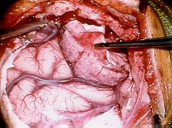
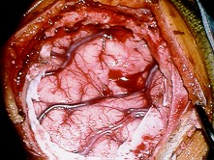
http://www.mashpedia.com/videoplayer.php?q=m7Ksx08OjHI

Slide 40
Key Points
Increased ICP (signs/symptoms/treatment)
CT & MRI 101
Most common brain tumors
Treatment Options
Do you want to be a neurosurgeon!

