Slide 1
Cleft Lip & Palate
Dr. Abdullah E. Kattan
Date

Slide 2
Outline
Cleft lip
Unilateral
Bilateral
Cleft palate

Slide 3
Causes
Unknown
Advanced parental age
Family history (genetic)
Smoking
Medications
Associated syndromes

Slide 4
Cleft Lip
Unilateral/Bilateral
Complete/Incomplete

Slide 5
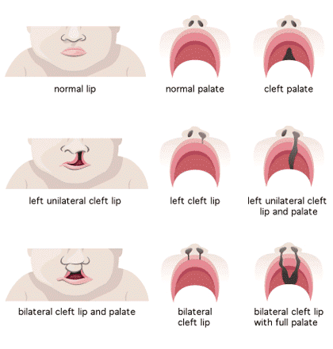

Slide 6
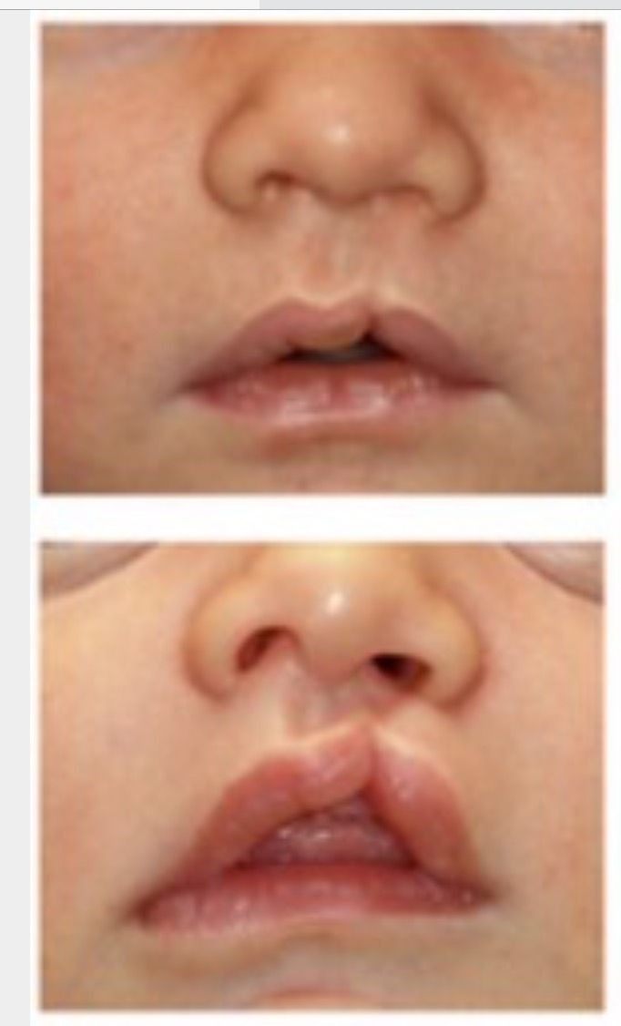
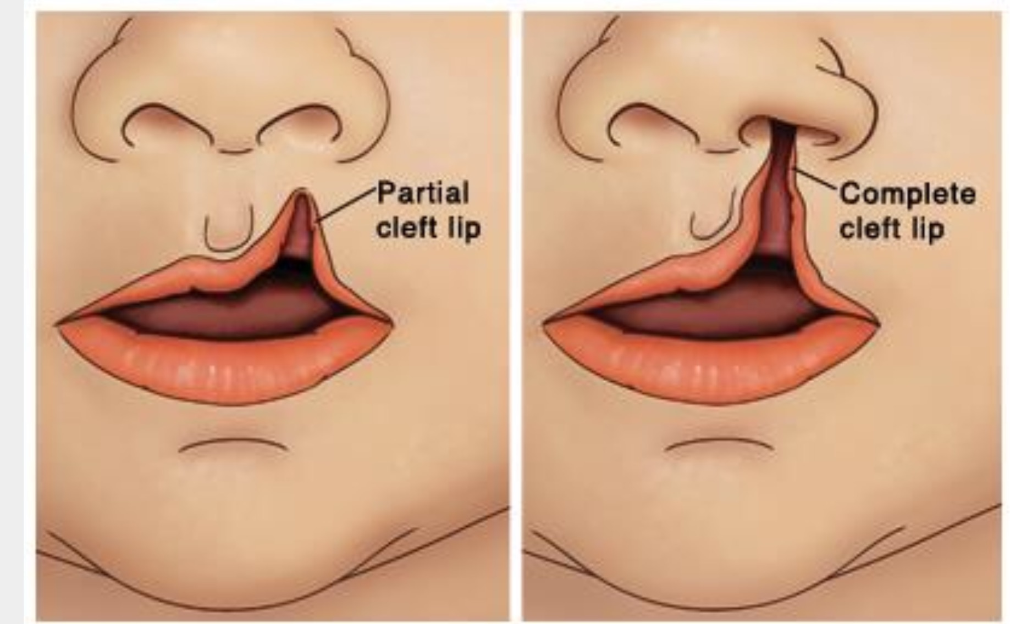

Slide 8
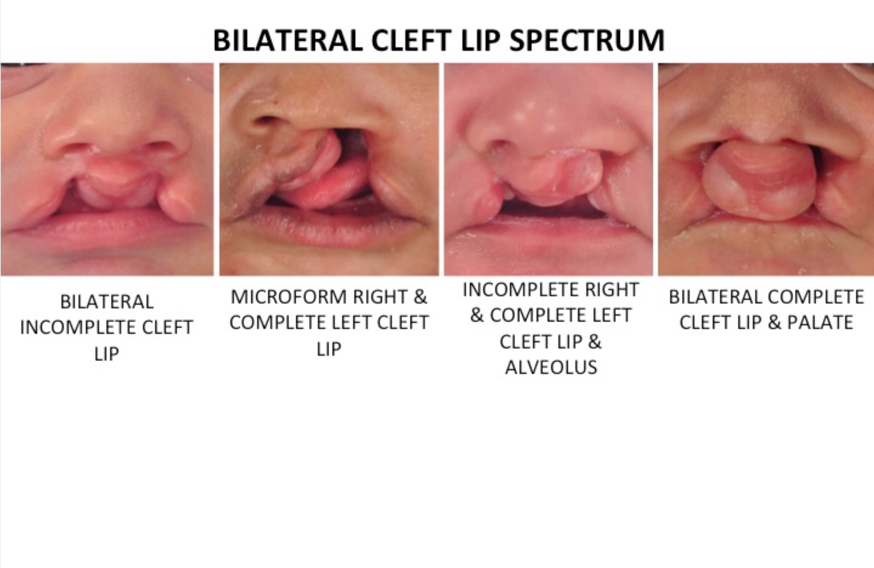

Slide 9
Defect
Lip skin
Lip Mucosa
Orbicularis oris muscle
Nasal cartilage

Slide 10
Impact
Feeding (unable to get proper seal)
Psychosocial

Slide 11
Management
Parent education of proper feeding
Between the ages of 3-6 months
Rule of 10s
Hb of 10
Wt of 10 lbs
Age of 10 wks

Slide 12
Cleft Palate
Bifid uvula
Soft palate only
Soft and hard palate
Combined cleft lip and palate

Slide 13
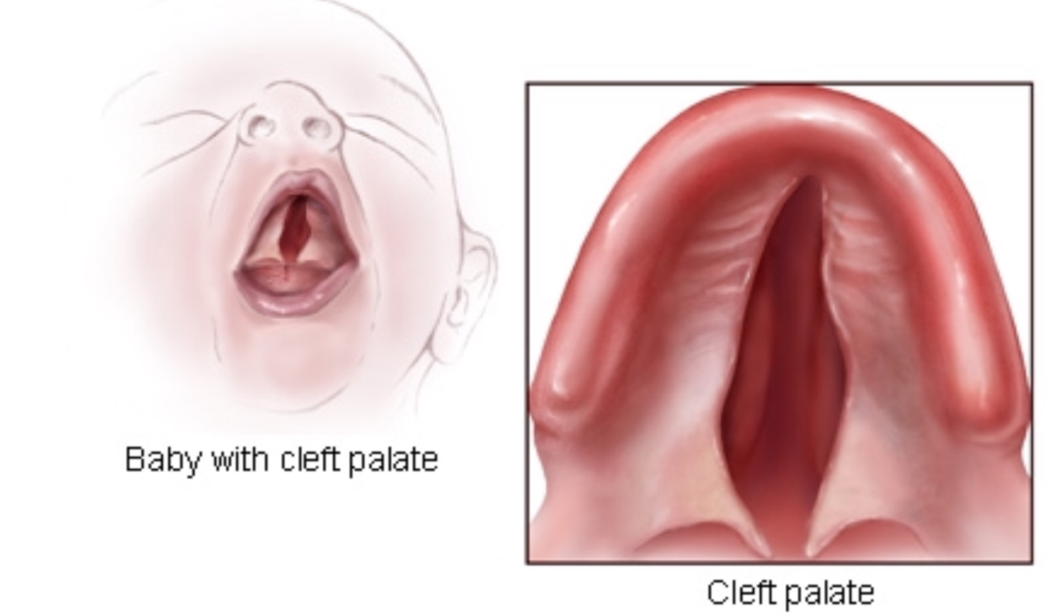

Slide 14
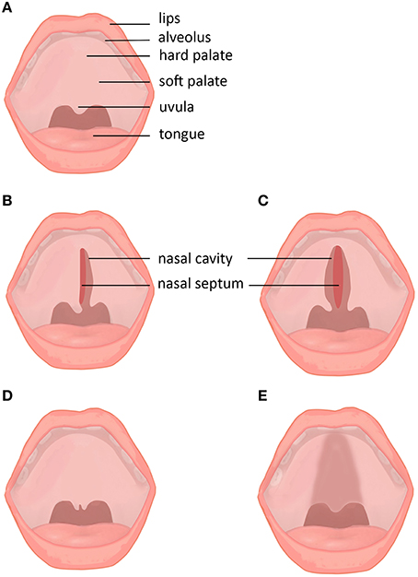

Slide 15
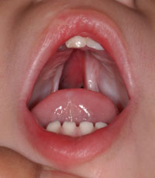

Slide 16
Impact
Feeding (unable to make proper seal, weak swallowing, nasal regurgitation)
Speech abnormalities
Repeated ear infection
Dental
Facial growth

Slide 17
Repair
Between the ages of 9-18 months

