Slide 1
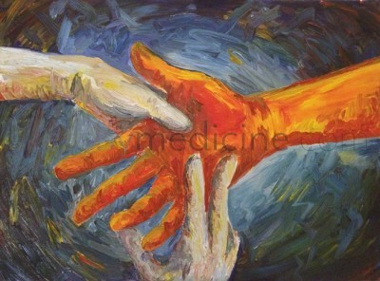
Hand Examination
Dr. Abdullah E. Kattan
Division of Plastic Surgery

Slide 2
Objective
Take proper history of patients presenting with hand pathologies
Perform a comprehensive hand exam
Formulate a differential diagnosis based on history and clinical exam

Slide 3
Outline
History taking
Physical Exam
Examples

Slide 4
History
Age & and dominance
Occupation & hobbies
Previous hand injuries/surgeries
PMH (RA, OA, DM ...)
Medications & allergies
Tetanus

Slide 5
Exam
Inspection
Palpation
Motor
Sensory
Vascular

Slide 6
Inspection
Posture / cascade
Deformity
Rotation or scissoring
Wasting or swelling
Color

Slide 7
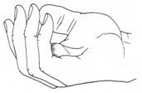
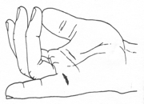
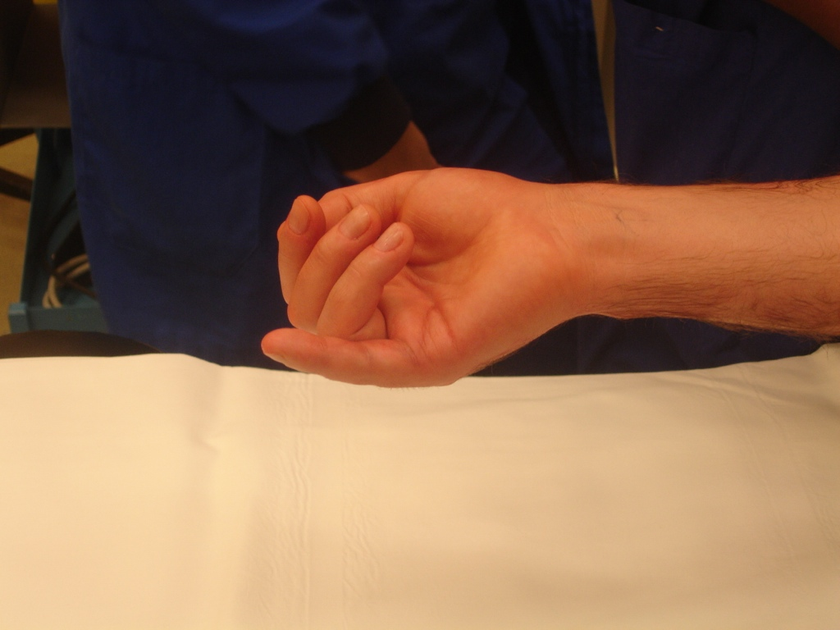

Slide 8
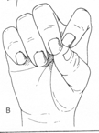

Slide 9
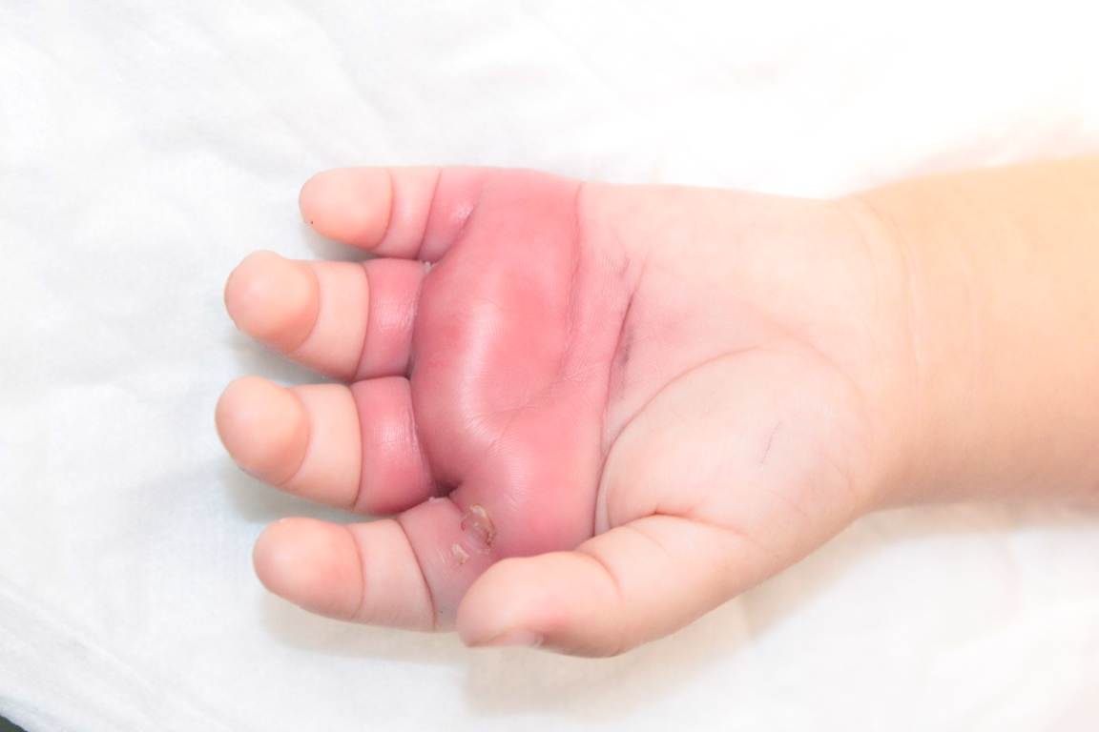

Slide 10
Palpation
Tenderness
Temperature (warm or cold)
Thrill
Range of motion (ROM)
Active
Passive

Slide 11
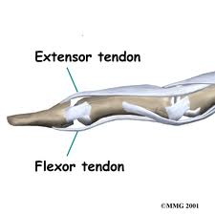
ROM
For full & normal AROM you need
Normal skin
Normal nerves
Normal tendons
Normal joints

Slide 12
ROM
If pt. is unable to actively move the finger
you put it through passive ROM (PROM)
FULL PROM = problem in tendon or nerve --> tenodesis
Incomplete PROM = problem in joint or scarring (skin or tendon) --> X-ray

Slide 13
Tenodesis

Slide 15
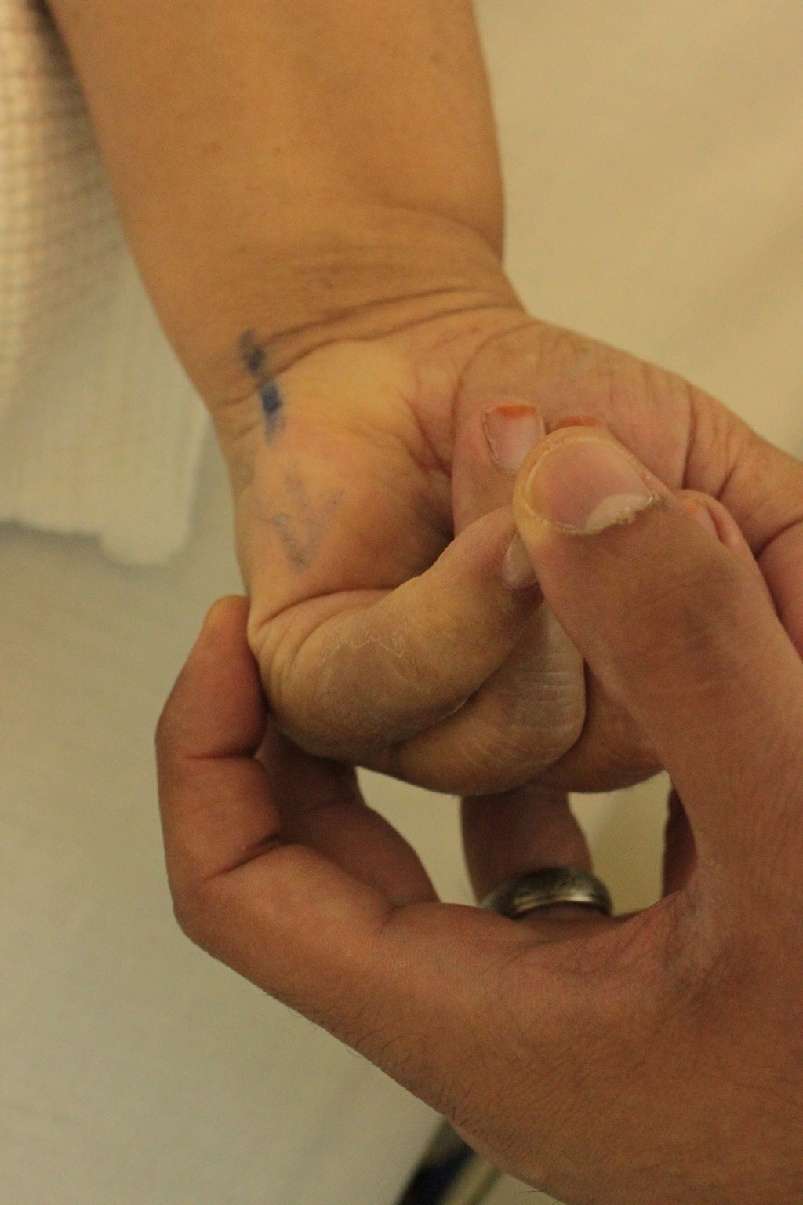
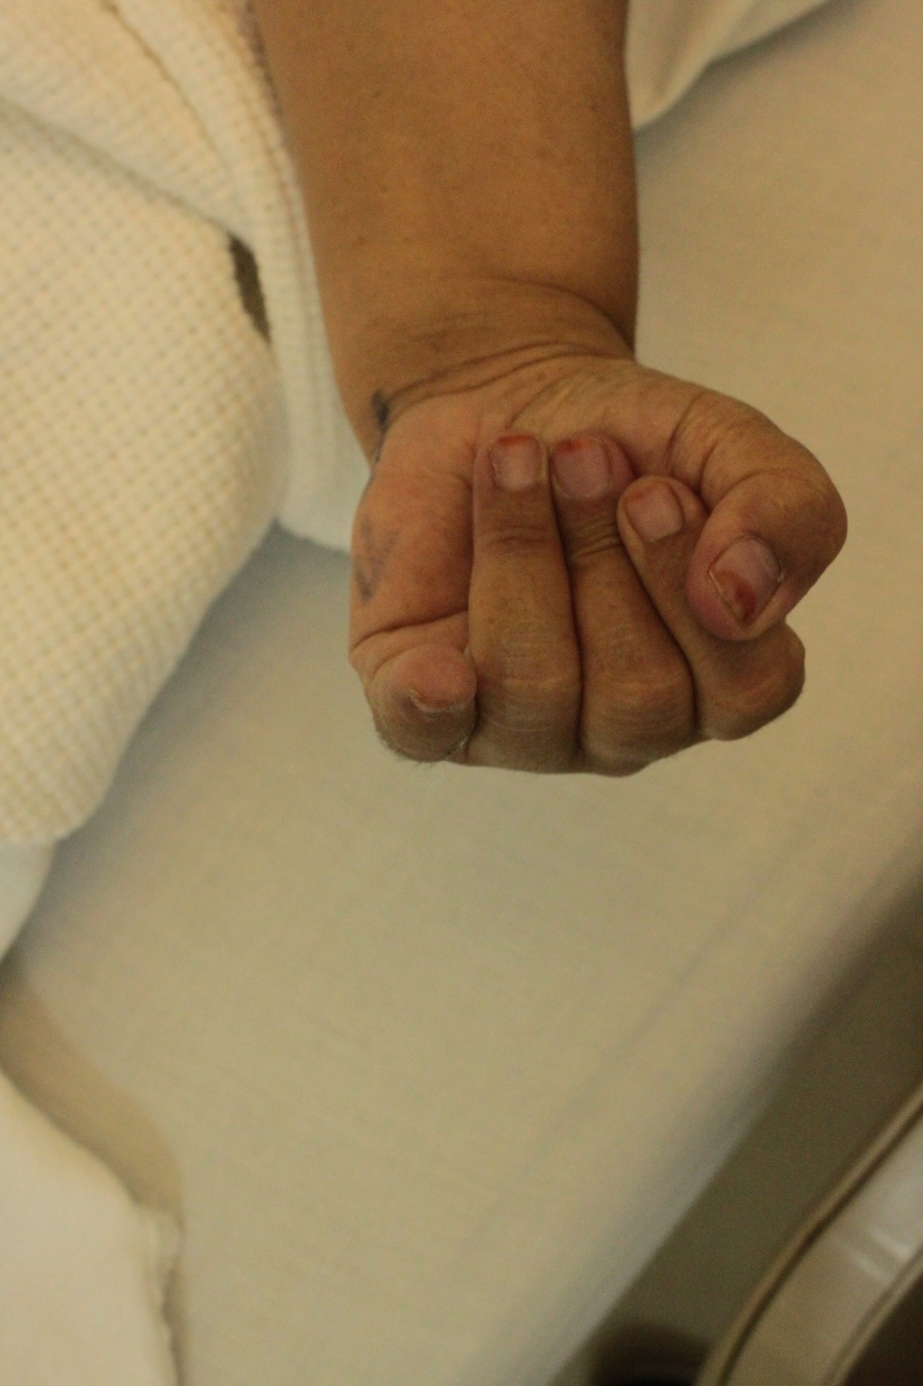
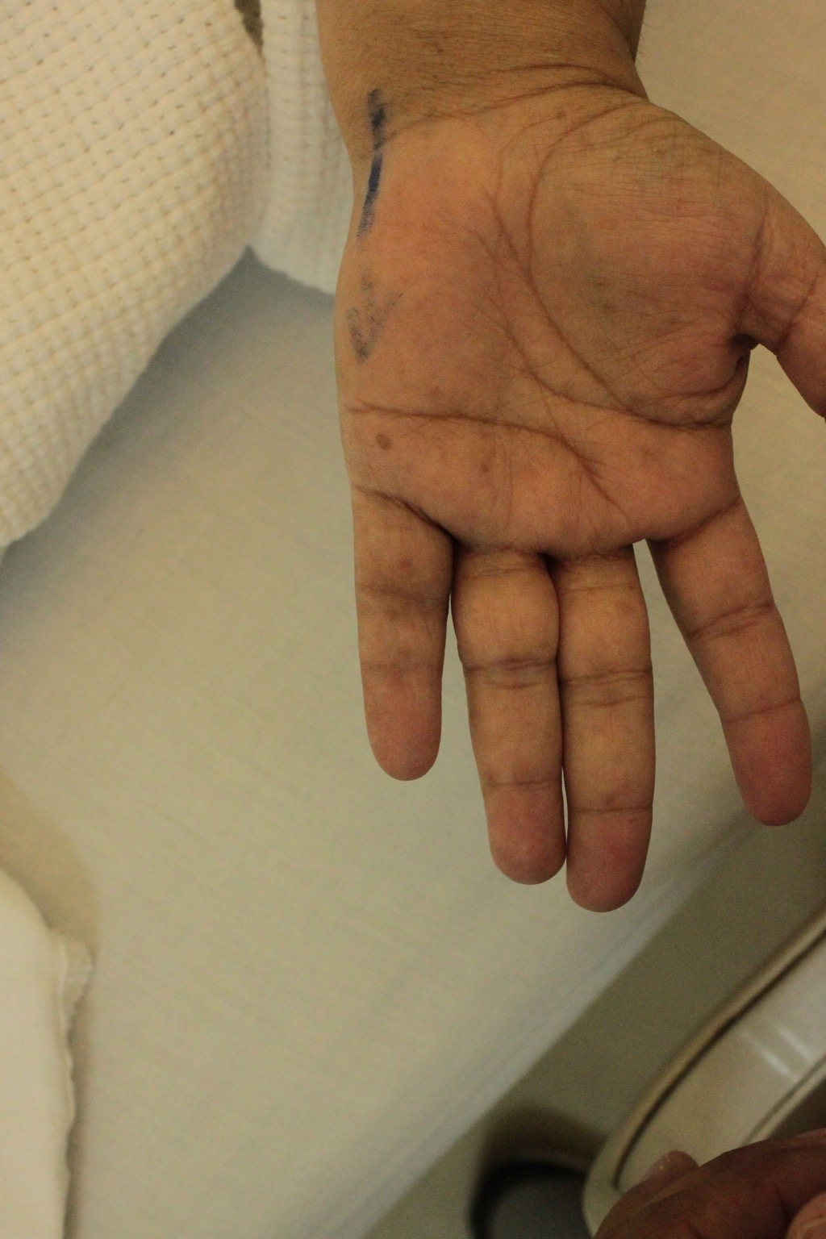

Slide 16
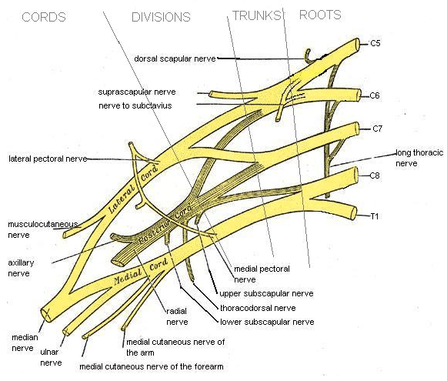

Slide 17
Motor
Cervical Nerve Root (Brachial Plexus)
C5 --> Deltoid
C6 --> Biceps
C7 --> Triceps
C8 --> Finger Flexors
T1 --> Interossei

Slide 18
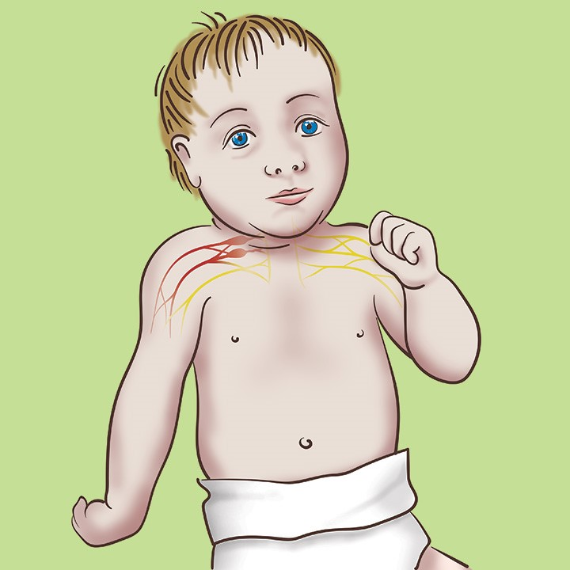
Erb’s Palsy (C5,6 +/- 7)

Slide 19
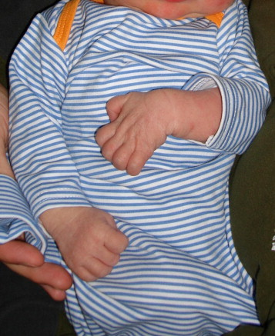
Klumpk’e Palsy (C8, T1)

Slide 20
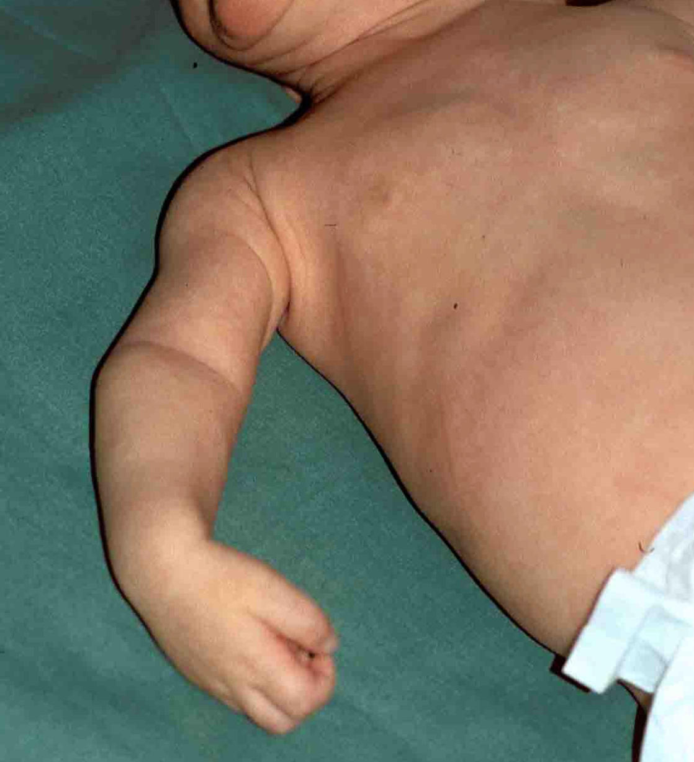
Total Palsy

Slide 21
Nerves
Shoulder and Arm
Axillary (Deltoid and Teres minor)
Musculocutaneous (Biceps)
Radial

Slide 22
Nerves
Forearm & Hand
Peripheral Nerves:
Radial:
wrist, finger and thumb extensors
Median:
FCR, PL, FDS, FDP(2,3), FPL, thenar muscles (APB), 2 lumbricals
Ulnar:
FCU, FDP(4,5), hypothenar muscle, adductor pollicis, 2 lubmricals, interossie (1st DI)

Slide 23
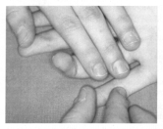
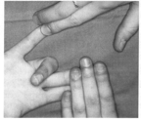
dfdfdfdfdfdfdfd
Flex Dig Prof (FDP) Flex Dig Sup (FSD)

Slide 24
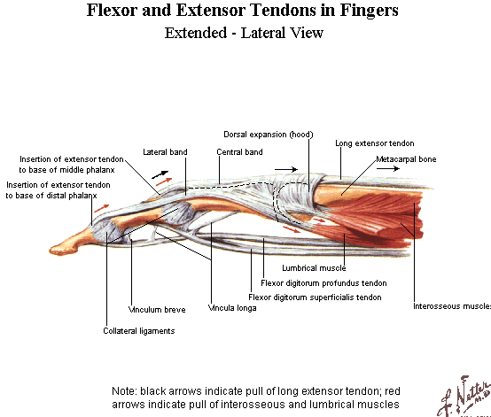

Slide 25
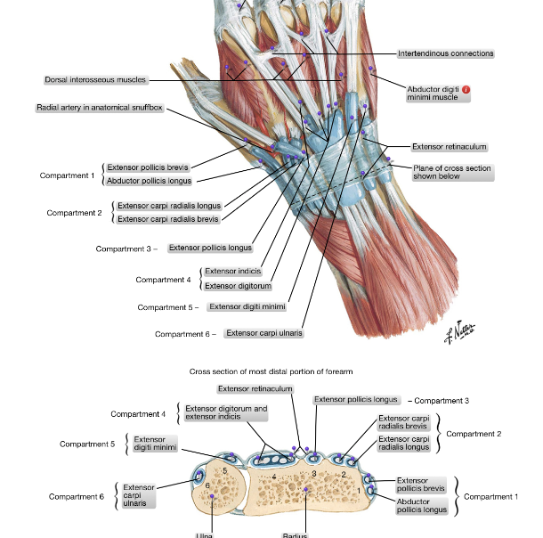

Slide 26
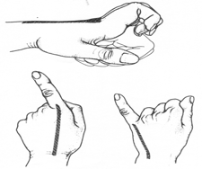
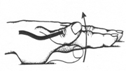
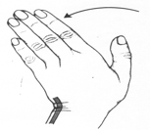
APL/EPB
ECRL/ECRB
EDC/EIP/EDM
EPL
ECU

Slide 27
Sensory Exam
Types of sensation:
Pain
Pressure
Light touch
Vibration
Moving 2 point discrimination (M2PD)
3-5 mm N

Slide 28
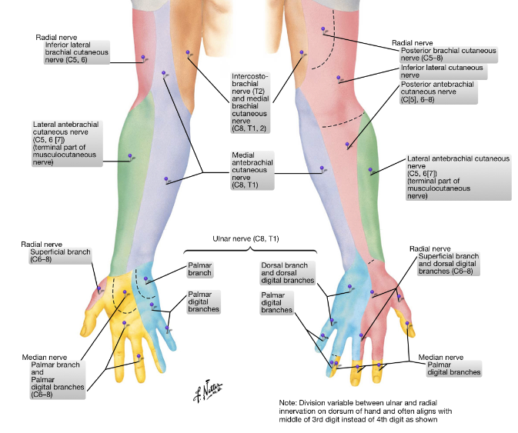

Slide 29
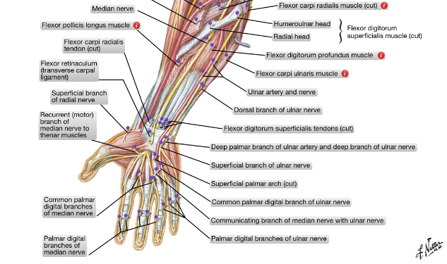

Slide 31
Vascularity
Color:
White --> ischemic (arterial compromise)
Blue --> venous congestion
Black --> Gangrene
Temperature
Allen’s test
Capillary refill

Slide 32
Allen’s Test
Two main arteries in the hand
Radial
Ulnar
Two arteries in each digit
Radial digital artery
Ulnar digital artery

Slide 33
