Slide 1
Dr Mohammad Al Akeely Associate professor& consultant general surgeon
UPPER & Lower GI Bleeding

Slide 2
REFERENCE:
MacLeod's clinical examination 12th edition
Davidson’s principle and practice of medicine th21 edition
Oxford handbook of emergency medicine
Upper GIT bleeding http://www.patient.co.uk/doctor
www.medscape.com

Slide 3
Definition
Hemorrhage can originate from any region of the GI tract and is typically classified based on its location relative to the ligament of Treitz.

Slide 4
INTRODUCTION
′ Acute gastrointestinal bleeding is a potentially life-threatening abdominal emergency that remains a common cause of hospitalization.
′ Upper gastrointestinal bleeding (UGIB) is defined as bleeding derived from a source proximal to the ligament of Treitz.
Can be categorized as either variceal or non-variceal. Variceal is usually
acomplication of liver cirrhosis or fibrosis
While non variceal bleeding is usually associated with peptic ulcer disease or other causes of UGIB
′
UGIB is more common than lower GIT, with a higher incidence in male.

Slide 6
′ Esophageal causes:
CAUSES
Esophageal varices
Esophagitis
Esophageal cancer
Esophageal ulcers
Mallory-Weiss tear
′ Gastric causes:
Gastric ulcer
Gastric cancer
Gastritis
Gastric varices
Dieulafoy's lesions

Slide 7
′ Duodenal causes:
Duodenal ulcer
Vascular malformation including aorto-enteric fistulae
Hematobilia, or bleeding from the biliary tree

Slide 9
:PRESENTATION
Hematemesis: vomiting of blood in the stomach.
coffee-ground emesis that indicate slower rate of bleeding or fresh bright red blood (may be with clots) that indicates faster rate of bleeding.
Melena: stool consisting of partially digested blood (black tarry, semi solid, shiny and has a distinctive odor, when its present it indicates that blood has been present in the GI tract for at least 14 h. The more proximal the bleeding site, the more likely melena will occur.
Hematochezia usually represents a lower GI source of bleeding, although an upper GI lesion may bleed so briskly that blood does not remain in the bowel long enough for melena to develop.

Slide 10
:SIGNS AND SYMPTOMS
¬
¬
¬
¬
¬
¬
¬
¬
¬
¬
¬
Hematemesis Melena Hematochezia Syncope Dyspepsia Epigastric pain Heartburn
Diffuse abdominal pain Dysphagia
Weight loss Jaundice

Slide 11
APPROACH:
History:
Abdominal pain
Haematemsis
Haematochezia
Melaena
Features of blood loss: shock, syncope, anemia
Features of underlying cause: dyspepsia, jaundice, weight loss

Slide 12
/ alcohol , bilharziasis H/O hepatitis B or C. Drug history: NSAIDs, Aspirin, corticosteroids, anticoagulants.
History of epistaxis or hemoptysis to rule out the GI source of bleeding.
Past medical: previous episodes of upper gastrointestinal bleeding, diabetes mellitus; coronary artery disease; chronic renal or liver disease; or chronic obstructive pulmonary disease.
Past surgical: previous abdominal surgery

Slide 13
APPROACH CONT,
Examination :
General examination and systemic examinations
VITALS:
Pulse = Thready pulse
BP= Orthostatic Hypotension
SIGNS of shock:
Cold extremeties, Tachycardia, Hypotension
Chest pain, Confusion, Delirium, Oliguria, and etc.

Slide 14
SKIN changes:
•
Cirrhosis – Palmer erythema, spider nevi Bleeding disorders – Purpura /Echymosis
Coagulation disorders – Haemarthrosis, Muscle hematoma.
•
Signs of dehydration:
dry mucosa, sunken eyes, skin turgor reduce.
•
Signs of a tumour may be present: (nodular liver, abdominal mass, lymphadenopathy, and etc(.
•
fresh blood, occult blood, bloody diarrhea: Respiratory, CVS, CNS for comorbid diseases

Slide 15
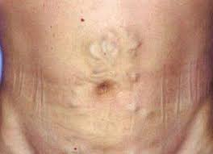
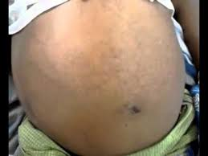

Slide 16
:LAB DIAGNOSIS
•
CBC with Platelet Count, and Differential
A complete blood count (CBC) is necessary to assess the level of blood loss. CBC should be checked frequently(q4-6h) during the first day.
•
Hemoglobin Value, Type and Crossmatch Blood
The patient should be crossmatched for 2-6 units, based on the rate of active bleeding.The hemoglobin level should be monitored serially in order to follow the trend. An unstable Hb level may signify ongoing hemorrhage requiring further intervention.

Slide 17
LFT- to detect underlying liver disease
•
•
RFT- to detect underlying renal disease
•
Calcium level- to detect hyperparathyroidism and in monitoring calcium in patients receiving multiple transfusions of citrated blood
•
Gastrin level

Slide 18
The BUN-to- creatinine ratio increases with upper
•
gastrointestinal bleeding (UGIB). A ratio of greater than 36 in a patient without renal insufficiency is suggestive of UGIB .High serum ammonia may lead to encephalopathy in cirrhotic patients.
The patient's prothrombin time (PT), activated partial
•
thromboplastin time)PTT),and International Normalized Ratio (INR) should be checked to document the presence of a coagulopathy.

Slide 19
Prolongation of the PT based on an INR of more than
•
1.5 may indicate moderate liver impairment.
•
A fibrinogen level of less than 100 mg/dL also indicates advanced liver disease with extremely poor synthetic function

Slide 20
:ENDOSCOPY
•
Initial diagnostic examination for all patients presumed to have UGIB
•
Endoscopy should be performed immediately after hemodynamic stabilization, and adequate monitoring

Slide 22
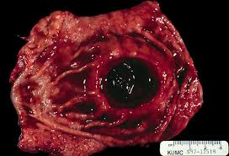
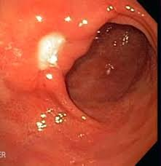
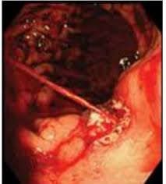
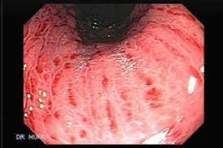
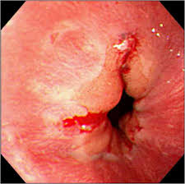

Slide 23
:IMAGING
•
CHEST X-RAY-Chest radiographs should be ordered to exclude aspiration pneumonia, effusion, and esophageal perforation.
•
Abdominal X-RAY- erect and supine films should be ordered to exclude perforated viscous and ileus.

Slide 24
•
Computed tomography (CT) scanning and ultrasonography may be indicated for the evaluation of liver disease with cirrhosis, tumours, aortoenteric fistula, and other unusual causes of upper GI hemorrhage.
•
Nuclear medicine scans may be useful in determining the area of active hemorrhage

Slide 25
ANGIOGRAPHY:
′ Angiography may be useful if bleeding persists and endoscopy fails to identify a bleeding site.
′ Angiography along with transcatheter arterial embolization (TAE) should be considered for all patients with a known source of arterial UGIB that does not respond to endoscopic management, with active bleeding and a negative endoscopy.
′ In cases of aortoenteric fistula, angiography requires active bleeding (1 mL/min) to be diagnostic.

Slide 26
NASOGASTRIC LAVAGE
′A nasogastric tube is an important diagnostic tool.
′This procedure may confirm recent bleeding or exclude an upper GI lesion(.

Slide 27
BENEFITS OF LAVAGE :
Better visualization during endoscopy
Give crude estimation of rapidity of bleeding
Prevent the development of Porto systemic encephalopathy in cirrhosis
Tube placement can reduce the patient's need to vomit
During gastric lavage use saline and not use large volume of to avoid water intoxication.
Gastric lavage should be done in alert and cooperative patient to avoid bronco-pulmonary aspiration

Slide 28
SEVERITY
ROCKALL SCORE

Slide 29
RISK CATEGORY
′ Rockall’s score >8 = High risk of death
′ Rockall’s score <3= excellent prognosis

Slide 30
MANAGEMENT
Priorities are:
Stabilize the patient: protect airway, restore circulation.
Identify the source of bleeding.
Definitive treatment of the cause.
Resuscitation and initial management
′ Protect airway: position the patient on side
′ IV access: use 1-2 large bore cannula
′ Take blood for: Hb, PCV, PT and cross match
′ Restore the circulation: if pts haemodynamically stable give N.S. infusion, if not give colloid 500ml/1hr and then crystalloid and continue until blood is available.

Slide 31
o
Transfuse blood for:
o
o o
Obvious massive blood loss Hematocrit < 25% with active bleeding
Symptoms due to low hematocrit and hemoglobin
Platelet transfusions should be offered to patients who are actively bleeding and have a platelet count less than 50000
Fresh frozen plasma should be used for patients who have either a fibrinogen level of less than 1 g/litre, or (INR) greater than 1.5 times normal.
Over-transfusion may be as damaging as under- transfusion.

Slide 32
Monitor urine output.
Watch for signs of fluid overload (raised JVP, pul. edema, peripheral edema)
Commence IV PPI, omeprazole 80 mg iv followed by 8mg/hr for 72 hrs.
Keep the pt nill by mouth for the endoscopy

Slide 33
TREATMENT OF VARICEAL BLEEDING
′ Terlipressin, Prophylactic antibiotic therapy
Endoscopic banding
Stent insertion is effective for selected patients
′ Balloon tamponade should be considered as a temporary salvage treatment for uncontrolled variceal haemorrhage
TIPS should be offered if bleeding from gastric varices is not controlled by endoscopic injection of N-butyl-2- cyanoacrylate

Slide 34
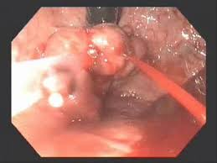

Slide 35
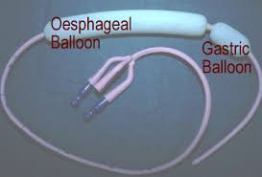

Slide 37
TREATMENT OF NON-VARICEAL BLEEDING
′ Endoscopy is now the method of choice for controlling active peptic-ulcer related UGIB.
′ Endoscopic therapy should only be delivered to actively bleeding lesions, non-bleeding visible vessels and, when technically possible, to ulcers with an adherent blood clot.
′ Black or red spots or a clean ulcer base with oozing do not merit endoscopic intervention since these lesions have an excellent prognosis without intervention.
′ A n endoscopic dual therapy( rather than adrenaline monotherapy is preferred for treatment of non-variceal UGIB

Slide 38
For the endoscopic treatment of non-variceal UGIB, one of the following should be used:
A mechanical method(clips) with or without adrenaline (epinephrine(
Thermal coagulation with adrenaline (epinephrine(
Fibrin or thrombin with adrenaline (epinephrin(
′ Interventional radiology should be offered to unstable patients who re-bleed after endoscopic treatment. Refer urgently for surgery if interventional radiology is not immediately available.

Slide 40
SURGERY INDICATIONS :
Persistent hypotension
Failure of medical treatment or endoscopic homeostasis
Coexisting condition ( perforation, obstruction, malignancy(
Transfusion requirement ) 4 units in 24 hr(
Recurrent hospitalizations

Slide 41
TYPES OF OPERATIONS:
The choice of operation depends on the site and the bleeding lesions:
Duodenal ulcers are treated by under-running with or without pyloro-plasty.
Gastric ulcers treated by under-running (take a biopsy to exclude carcinoma(.
Local excision or partial gastrectomy will be required for tumours.

Slide 42
COMPLICATIONS
Can arise from treatments administered for example:
′ Endoscopy:
Aspiration pneumonia
Perforation
Complications from coagulation, laser treatments
′ Surgery:
Ileus
Sepsis
Wound problems

Slide 43
PREVENTION
′ The most important factor to consider is treatment for H. pylori infection.
′ 1st line therapy:
PPI )omeprazole, lansoprazole, pantoprazole) + two of these three AB
) clarithromycin, amoxicillin, metronidazole(
′ 2nd line therapy:
PPT
bismuth
metronidazole
tetracycline

Slide 44
LOWER GI BLEED

Slide 45
Upto 80% of acute GI bleed occurs in Upper GIT, of which Peptic Ulcer Disease & Variceal Haemorrhage are most common causes.
Obscure bleeding - hemorrhage that persists or recurs after normal endoscopy
The Lower GI bleed occurs mostly from COLON (95%) of which Diverticula and Angiodysplasias are most common causes.
Occult bleeding - not apparent to patients until they present with symptoms related to anaemia.

Slide 46
Incidence of LGI-Bleed, increases with Age, slightly more common in women, with an overall mortality of <5%
•
•
Intussusception in most common in paediatric age group, while Meckel’s diverticulum must be considered in a young adult.
•
Vascular lesions and Diverticular disease affects all age groups, with increased incidence in middle aged & older adults

Slide 47
DIAGNOSIS
Classical Signs & Symptoms
Hematochezia (usually painless)
Malena (mostly UGI-B)
Occult blood in stool
Anaemia
Nasogastric aspirate usually clear

Slide 48
Source for severe Hematochezia

Slide 49
RISK FACTORS
Aspirin use, more than 2 comorbid illnesses, heart rate > 100bpm, non-tender abdominal examination, rectal bleeding within first 4 hrs of evaluation, syncope, systolic BP < 115mmHg
•

Slide 50
Diagnostic Intervensions
Resuscitate
•
PR, Anoscopy or Sigmoidoscopy
•
NGT aspirate & UGI-Endoscopy
•
Colonoscopy
•
Radionucleotide Scanning
•
•
Mesenteric Angiography (selective(
•
Emergency operative interventions
Algoritm for diagnosis and mng of LGI-B
•

Slide 52
DD for a Lower Gastrointestinal Haemorrhage

Slide 53
Brief on Investigations before going to specific diseases

Slide 54
Digital Rectal Examination

Slide 55
Flexible Sigmoidoscopy
~50 to 60 cms

Slide 56
Colonoscopy
•
Most appropriate in the setting of mild to moderate bleeding, with patient in stable condition
•
Preparation with Polyethylene Glycol (PEG) orally or via NG tube[4-8L] for 4-6 hrs, with metaclopramide IV improves visualisation

Slide 57
~Distance markings for Colonoscope in an Adult
in cms

Slide 59
Findings may include an actively bleeding site, clot adherence to a focus of mucosa or diverticular orifice, other than Polyps, Cancers and Inflammatory conditions.
•
•
Angiodysplasias are difficult to visualise, specially in unstable patients with mesenteric vascular constriction.
•
Some studies reported that Colonoscopy is successful in identifying the bleeding source in 95% of cases, mostly secondary to Diverticuli or Angiodysplasias

Slide 61
Radionuclide Scanning
•
Technician-99m [ ^{99m}Tc-labelled RBC ]
Most sensitive, but least accurate for localising bleed
•
Patients own blood is labelled and reinjected, which is extravasated into GI tract lumen, creating a focus that can be detected scintigraphically, Initially images obtained serially, then at 4 hour intervals, upto 24hrs.
•
can detect bleed as slow as 0.1mL/min
•
Unfortunately, spatial resolution is low with reported accuracy of 40 - 60 %

Slide 63
Mesenteric Angiography
•
Selective angiography, using SMA / IMA can detect haemorrhage upto 0.5 to 1.0 mL/min
•
Used in diagnosis of ongoing haemorrhage, particularly in identifying vascular patterns of Angiodysplasias
•
Therapeutic capabilities like Embolisation & Catheter- directed vasopressin infusion to provide temporary control of bleeding. (50% rebelled when it is discontinued) -Bridging(temporary) procedure
Complications include hematoma, arterial thrombosis, contrast reaction and ARF.
•

Slide 64
Small Bowel Endoscopy
•
PUSH endoscopy ( 40% success rate)
•
Performed in hemodynamically stable patients, usually with a paediatric colonoscope, which can reach upto 50-70cms past the lig of trietz.
•
SONDE PULL endoscopy - enteroscope that passes passively into very distal small bowel with a balloon at its end which is moved down by peristalsis. mucosa visualised as scope is removed
Double-Balloon endoscopy
•

Slide 65
Capsule endoscopy
•
Visualisation of entire GIT, but no interventional capacity and time consuming
•
Excellent tool in a hemodynamically stable patient who continues to bleed, with success rate as high as 90%
•
Contraindicated in patients with obstruction or motility disorders.

Slide 66
Specific causes for Colonic Bleeding

Slide 67
Diverticular Disease
•
responsible for upto 55% of cases of LGI-B
•
affects more than two-thirds of western population in their 80’s and can be rarely seen in patients younger than 40yrs
•
Only 3-15% individuals with diverticulosis experience bleeding
•
In bleeding diverticuli, More than 75% stop spontaneously, of which about 10% will rebelled in an year and almost 50% within 10yrs.
•
Although diverticular disease is more common on left side, right sided disease is responsible for more than 50% of bleed.

Slide 68
Bleed generally occurs at neck of diverticulum and is believed to be secondary to bleeding from vasa recti as they penetrate through the submucosa.
•

Slide 69
COLONOSCOPY - Best method of diagnosis and treatment (limited in severe bleed)
•
•
Bleeding diverticulum can be controlled by Epinephrine injection, use of Electrocautery, and with Endoscopic clips.
•
Angiography with Superselective embolisation can be considered if all the above fail, with high success rates(>90%), but with risk of ischemic complications
•
Lastly, Surgical intervention with colonic resection, or blind hemicolectomy done in unsure patients (50%)
•
Subtotal colectomy does not eliminate risk of recurrent hemorrhage compared to segmental resection, and is accompanied by significant increase in morbidity, particularly older patients in whom rectum never adapts.
Mortality is almost 30% in the Emergent subtotal colectomy for bleed

Slide 70
Angiodysplasia
•
Some reports state vascular lesions account upto 40% of LGI-B, However, recent reports state much low incidence
•
also called Arteriovenous Malformations [AVM’(]
•
They are acquired degenerative lesions secondary to progressive dilatation of normal blood vessels within the submucosa of the intestine
•
Age of incidence > 50 yrs with M=F, usually associated with aortic stenosis and renal failure, esp in older patients
•
Haemorrhage tends to arise from right side of colon, with CECUM being most common location

Slide 71
COLONOSCOPY:
Red stellate lesions with a surrounding rim of pale mucosa, can be treated by sclerotherapy or electrocautery
ANGIOGRAPHY:
dilated, slowly emptying veins, and sometimes early venous filling

Slide 72
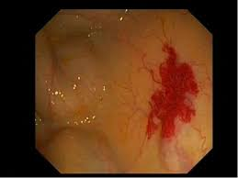
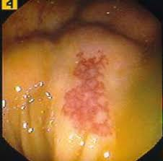
Treatment with intra-arterial vasopressin, selective gel-foam embolisation, endoscopic coagulation, injection with sclerosing agents, lastly Segmental resection most commonly a right colectomy is effective.
•
•
•

Slide 73
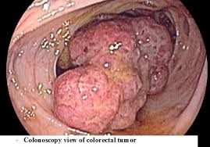
Neoplasia
•
Uncommon cause of significant lower GI bleed
•
Bleeding is usually painless, intermittent and slow in nature, frequently assoc with IDA
•
Polyps also bleed, but usually occurs after a polypectomy
•
Juvenile polyps are second most common cause of bleeding in pts younger than 20yrs
•
Occasionally, GIST’s are assoc with massive hemorrhage

Slide 74
COLITIS
•
Inflammation of the Colon is caused by number of disease processes, including..
Inflammatory bowel disease (Crohn’s disease, UC, indeterminate colitis)
Infectious colitis (E coli, CMV, salmonella, shigella, campylobacter spp. & Clostridium difficale)
Radiation proctitis and Ischemia.

Slide 75
ULCERATIVE COLITIS :
mucosal disease starting at distal rectum and progress proximally to involve the entire colon.
Pts present with upto 20 bloody bowel movements daily, accompanied by crampy abdominal pain & tenesmus
Diagnosis by careful history and colonoscopic biopsy
Medical treatment with steroids, 5-aminosalicylic acid (ASA), immunomodulatory agents and supportive care
Surgery is rarely indicated

Slide 76
Crohn’s Disease :
assoc with guaiac-positive diarrhoea and mucus filled bowel movements, but not with bright red colour
Characterised by skip lesions, transmural thickening of bowel wall and granuloma formation. Can affect entire GIT
Diagnosed with Endoscopy and Contrast studies
Medical management consists of steroids, antibiotics, immunomodulators and ASA compounds

Slide 77
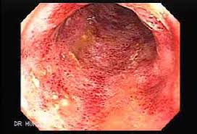
INFECTIOUS COLITIS:
causes bloody diarrhoea, Diagnoses from history and stool cultures
C.difficile colitis presents with explosive, foul smelling diarrhoea in a patient with prior antibiotic use., Treatment consists of stopping antibiotics, supportive care and oral/IV metronidazole or oral vancomycin
CMV colitis suspected in immunocompromised pts presenting with bloody diarrhoea & endoscopic biopsy confirms diagnosis
Treatment is IV ganciclovir

Slide 78
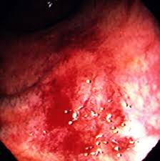
RADIATION PROCTITIS :
became more common in last 30 - 40 yrs as the use of radiation to treat rectal CA, prostate CA & gynecologic malignancies have increased.
presents with bright red blood per rectum, diarrhoea, tenesmus & crampy pelvic pain.
Treatment consists of antidiarrheals, hydrocortisone enemas and endoscopic APC
In persistant bleeding cases, ablation with 4% formalin solution works well

Slide 79
Anorectal Disease
•
Internal haemorrhoids, Anal fissures and Colorectal neoplasia
•
account for 5-10% of all acute lower GI bleeding
•
Most hemorrhoidal bleed occurs from internal haemorrhoids, which are painless and accompanied by prolapsed tissue that reduces by itself or has to be reduced manually.
•
Internal haemorrhoids should be treated with bulking agents, increased dietary fibre, adequate hydration.

Slide 80
Office-based interventions, including rubber band ligation, injectable sclerosing agents and infrared coagulation can be done, Surgical hemorrhoidectomy as a last resort
•
•
Anal fissure, produces painful bleeding after a bowel most, with bleeding as their main symptom
•
Treated medically by stool-bulking agents (psyllium), increased water intake, stool softeners and topical nitroglycerin ointment or diltiazem to relieve sphincter spasm and promote healing.

Slide 82
Mesenteric Ischemia
•
Secondary to acute or chronic arterial or venous insufficiency
•
Presents with Abdominal pain & bloody diarrhoea
•
Predisposing factors - Cardiovascular disease, recent abdominal vascular surgery, hyper coagulable states, medications (vasopressin, digoxin) and vasculitis
•
Acute Colonic Ischemia - most common form, occurring in watershed areas of splenic flexure and rectosigmoin junction, but can be right sided in upto 40% of cases

Slide 83
CT shows a thickened bowel wall and diagnosis confirmed with flexible endoscopy, which reveals edema, hemorrhage and demarcation between normal and abnormal mucosa
•
•
Treatment - bowel rest, IV antibiotics, CVS support & correction of the low flow state.
•
In 85% cases schema resolves by itself, occasionally causing colonic stricture. In rest 15% cases, Surgery is indicated due to progressive ischemia and gangrene.
•
Marked leucocytosis, fever, fluid requirement, tachycardia, acidosis, peritonitis - require Sx, in which resection of the ischemic intestine and creation of an end ostomy is indicated.

Slide 85
Specific causes of Small Bowel Bleeding

Slide 86
Angiodyspalsias
•
Small Intestinal Vascular Ectasias
•
Most common cause of small intestinal bleed with upto 40% cases in older patients and 10% in younger patients
•
common site : Jejunum > Ileum > Duodenum
Enteroscopy or Capsule endoscopy for diagnosis
•

Slide 87
Meckel’s Diverticulum
•
True diverticulum, which is a congenital remnant of the omphalomesentric duct [2% of ppl]
•
Bleeding is usually from an ulcerative lesion on the ideal wall opposite the diverticulum, resulting from the acid production by ectopic gastric mucosa
•
Surgical management includes Segmental resection to incorporate the opposing ill mucosa, which is typically the site for bleeding.

Slide 88
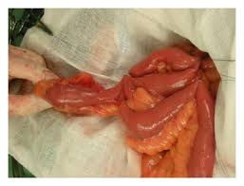
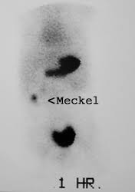
occur in 2% of population
•
•
found within 2 feet from IC valve
•
complications in 2% of cases
•
have 2 types of ectopic tissue (Gastric & Pancreatic)
•
clinically most common at 2 yrs of age
•
Male to Female ratio of 2:1
Best diagnostic test is a ^{99m}Tc-pertechnetate scan
also called Meckel’s scan

Slide 89
NEOPLASIA :
Not common, GIST’s have greatest propensity for bleeding, can be diagnosed by small bowel contrast series or a spiral CT. Wide surgical resection is treatment of choice
CROHN’S DISEASE :
may present with small bowel bleeding in assoc with terminal ileitis, which will not be the only symptom.
Diagnosed by small bowel contrast series
DIVERTICULA

Slide 90
OBSCURE CAUSES of Acute GI Hemorrhage
•
Bleeding that persists after an initial negative evaluation with an EGD and Colonoscopy
•
Divided into Obscure-occult & Obscure-overt bleeding, first characterised by IDA or guaiac positive stools without visible bleeding, other by recurrent or persistent visible bleeding.

Slide 91
Differential Diagnosis for an Obscure Lower Gi Bleed
•
Obscure bleeding can be frustrating for the patient and physician and is especially true for obscure-overt bleeding ,which cannot be localised despite aggressive diagnostic measures.
Fortunately, obscure-overt bleeding is only responsible for about 1% of all cases of GI bleeding. The differential diagnosis of obscure- overt bleeding is long and varied.
•

