Slide 1
Diagnosis and Management of shock
Dr.Hossam Hassan
Consultant and Assistant prof D.E.M
Dr Abdulaziz Alrabiah
Assistant Professor of Emergency Medicine

Slide 2
Objectives
Identify the 4 main categories of shock
Discuss the goals of resuscitation in shock
Summarise the general principles of shock management
Describe the physiologic effects of vasopressors and inotropic agents

Slide 3
CASE STUDY
A25 Years old lady with no prior history of any chronic disease presented to the emergency department complaining of a productive cough of greenish yellow sputum.

Slide 4
VITAL SIGNS
Temp.38.8
Ht.Rate 129/Min
R.R 27/Min
BP 112/68

Slide 5
Where do you triage this Pt.?
What information do you need to determine if this Pt. is in shock?
What initial interventions are needed to stabilise this Pt.?

Slide 6
Shock is a syndrome of impaired tissue oxygenation and perfusion due to a variety of causes
If it left untreated:
Irreversible injury ,Organ dysfunction And finally death

Slide 7
Clinical alterations in shock
The presentation of patients with shock may be Subtle(mild confusion, tachycardia)
Or easily identifiable(profound hypotension, anuria)

Slide 8
The clinical manifestation of shock result from:
1- inadequate tissue perfusion and oxygenation
2- Compensatory responses
3- The specific aetiology

Slide 9
Classification of shock
1-hypovolemic
Hemorrhagic
nonhemorrhagic
2-Cardiogenic
Ischemic
Myopathy
Mechanical
Arrhythmia

Slide 10
3- Distributive
Septic
Adrenal crises
Neurogenic (spinal shock)
Anaphylactic

Slide 11
4- Obstructive
Massive Pulmonary embolism
Tension pneumothorax
Cardiac tamponade
Constrictive pericarditis

Slide 12
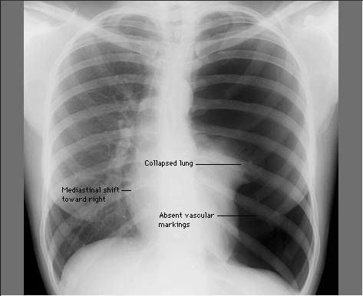

Slide 13
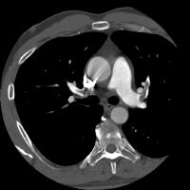

Slide 14
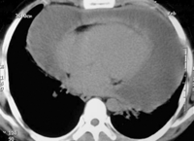

Slide 15
HYPOVOLEMIC SHOCK
It occurs when the intra vascular volume is depleted relative to the vascular capacity as a result of:
1- bleeding
2- G.I.T loss
3-urinary loss
4-dehydration

Slide 16
HYPOVOLEMIC SHOCK
Management:
The goal is to restore the fluid loss
Vasopressors are used only as a temporary method to restore B.P until fluid resuscitation take place
Permissive hypotension I.e. SBP 90 mmHg
Trauma patient with active bleeding: early blood transfusion

Slide 17
Distributive shock
It is characterised by loss of vascular tone
The most common form of distributive shock is septic shock
The hemodynamic profile of septic shock include

Slide 18
Cardiac output normal or increased
Ventricular filing pressure normal or low
SVR low
Diastolic pressure low
Pulse pressure wide

Slide 19
Management of septic shock
The initial approach to the patient with septic shock is the restoration and maintenance of adequate intravascular volume
Prompt institution of appropriate antibiotic

Slide 20
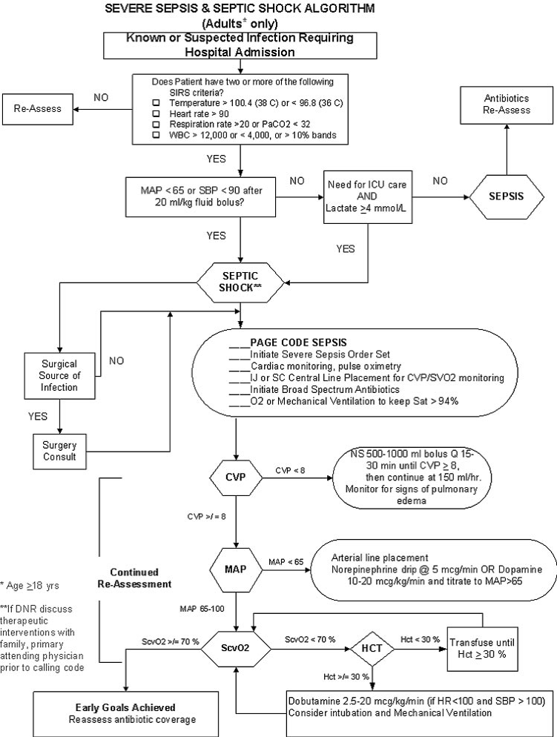

Slide 21
CARDIOGENIC SHOCK
Forward flow of blood is inadequate due to pump failure I.e.loss of functional myocardium
It is the most severe form of heart failure and it is distinguished from chronic heart failure by the presence of hypotension, hypo-perfusion and the need for different therapeutic interventions

Slide 22
Hemodynamic characteristics
Cardiac output low
Ventricular filing pressure high
SVR High
Mixed venous o2 sat low

Slide 23
MANAGEMENT OF CARDIOGENIC SHOCK
The main goal is to improve myocardial function
Arrhythmia should be treated
Reperfusion PCI is the treatment of choice in ACS
Inotropes and vasopresor

Slide 24
Obstructive shock
Obstruction to the outflow due to impaired cardiac filling and excessive after load
Cardiac tamponade and constrictive pericarditis impair diastolic filling of the Rt.ventricle
Tension pneumothorax limit Rt.ventricular filing by obstruction of venous return
Massive pulmonary embolism increase Rt.ventricular afterload

Slide 25
Hemodynamic profile in obst. Shock
Cardiac output low
Afterload high
Lt.Vent.filling pressure variable
Pulsus paradoxicus in Tamponade
Distended Jugular viens

Slide 26
Management Of Obstructive Shock
Treat the cause !!

Slide 27
GENERAL Principles of shock management
The overall goal of shock management is to improve oxygen delivery or utilisation in order to prevent cellular and organ injury
Effective therapy requires treatment of the underlying aetiology

Slide 28
Restoration of adequate perfusion, monitoring and comprehensive supportive care
Interventions to restore perfusion:
achieving an adequate B.P
increasing cardiac output
optimising oxygen content of the blood

Slide 29
In Summery
Management of shock
1- Monitoring
2- Fluid Therapy
3- Vasoactive agents
4- Treat the cause

Slide 30
Email: aalrabiah@ksu.edu.sa
Twitter: @azizalrabiah

