Slide 1
Approach to trauma patient
Dr. Abdulaziz Alrabiah, MD
Emergency Medicine, Trauma & EMS specialist

Slide 2
Objective
Fun part of EM
Primary Survey
Secondary survey
Investigations in each survey

Slide 3
Fun part why?!
Every one try to participate
Well structured approach
Courses available ( EMST, ATLS)

Slide 4
Primary survey
A : Airway and C-spine immobilisation
B : Breathing
C : Circulation and Bleeding control
D : Disability
E : Exposure

Slide 5
A : Airway + C-spine immobilisation
evaluate for patent airway
if patient is able to talk clearly —> patent airway i.e. clear from obstruction
C-spine : must be immobilised
i.e. application of c-collar, foam pads taped to forehead or ask the patient to keep still !!

Slide 6
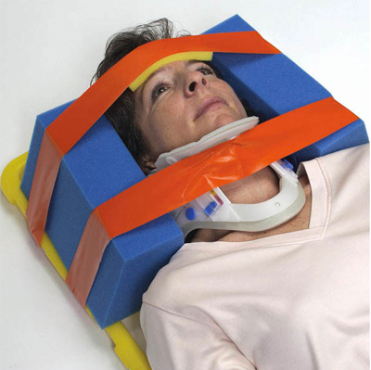
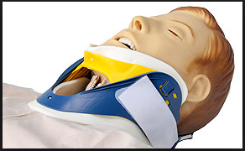
A : Airway + C-spine immobilisation

Slide 7
B : Breathing
check:
paradoxical movement of chest wall segment
tracheal deviation
chest wall tenderness
equal air entry bilateral

Slide 8
C : Circulation and bleeding control
vital signs i.e. pulse, BP
skin colour
presence or absence of peripheral pulse i.e. U & L limbs
control bleeding
direct pressure ( the best )
application of tourniquet
limb elevation
vessels clamp ( vascular clamp)
place two large IV access ( 14G , 16G , 18G)
if failed , do IO access i.e. proximal tibia, humorous
no central line

Slide 9
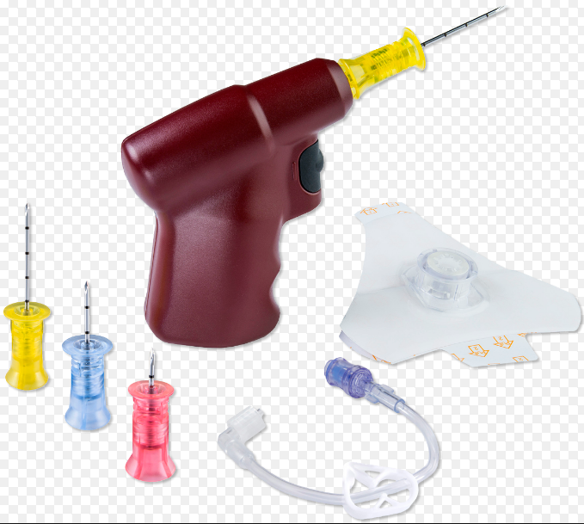
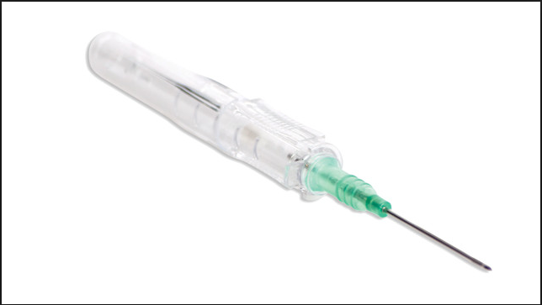

Slide 10
D : Disability
two parts exam
GCS : level of consciousness
mild 15-14 moderate 13-9 sever <8
Pupil exam : normal 3 mm equal and reactive to light

Slide 11
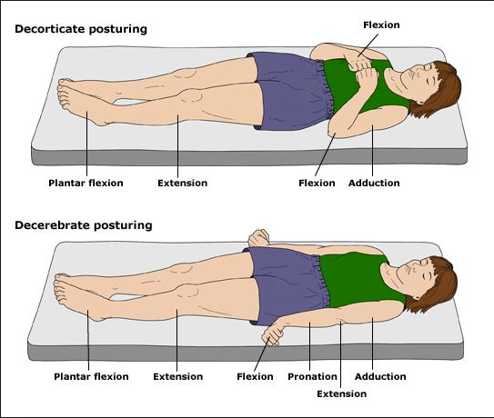
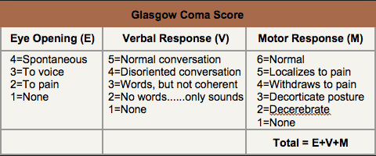
GCS

Slide 12
E : Exposure
Expose the patient ( cut the cloths ) and look for any injury
prevent hypothermia i.e. immediately cover the patient

Slide 13
How should I proceed?
if you find a pathology at any above step, don't proceed to the next step unless your correct the pathology

Slide 14
A : Airway + C-spine immobilisation
A : Airway pathology
visible FB
bleeding
stridor i.e. expanding neck heamtoma
Rx : remove visible FB , suction blood , Intubation if stridor present
if C-spine fractured, neck already immobilised

Slide 15
B : Breathing
looking for tension pneumothorax
it is clinical diagnosis
signs: tachycardia, hypotension, tracheal deviation to opposite site, decrease air entry in same site and hyper resonant to percussion.
treatment :
needle decompression ( 2nd intercostal space, mid clavicular line )
then insertion of chest drain ( 5th intercostal space, between anterior and mid axillae line )

Slide 16
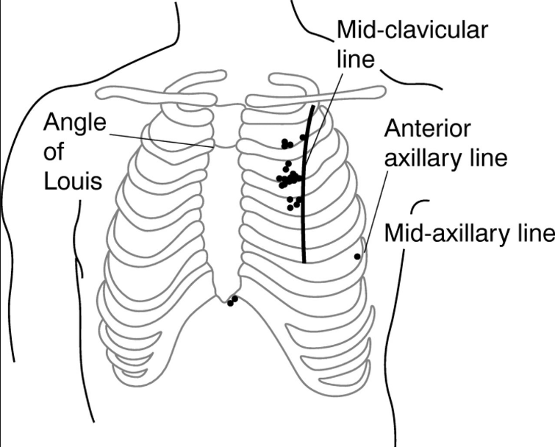

Slide 17
C : Circulation and bleeding control
control external bleeding
fluid replacement
ringer lactate > normal saline , due to less hyperchloremic metabolic acidosis
give 2 L max. if no response
start blood transfusion
RBC, PLT , FFP at ratio of 1:1:1

Slide 18
D : Disability
if GCS less than or equal 8 —> intubate the patient using rapid sequence intubation “RSI”

Slide 19
E : Exposure
expose the patient
present hypothermia
look for any bruise, deformity
correct the correctable pathology i.e. deformed limb reduction.

Slide 20
Adjunct to Primary survey

Slide 21
BGL test
do not ever forget glucose !!

Slide 22
X-ray
C-spine X-ray ( 3 views )
lateral
anterior - posterior
open mouth
chest x-ray
pelvic X-ray

Slide 23
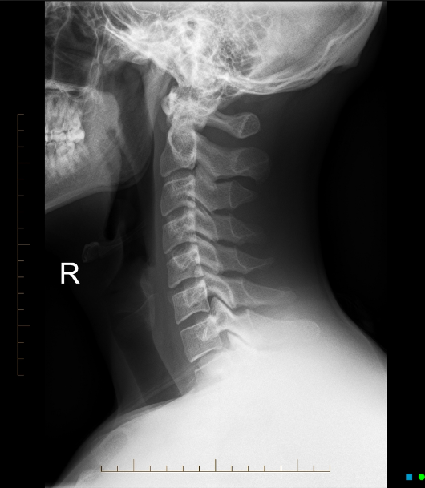

Slide 24
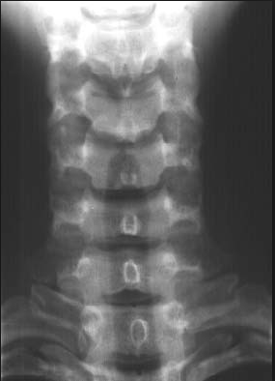

Slide 25
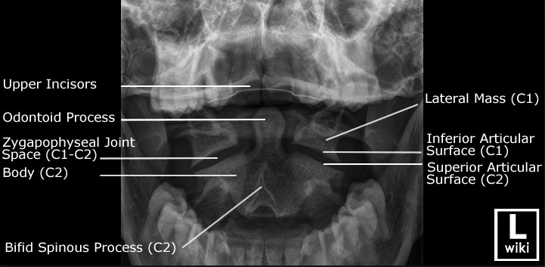

Slide 26
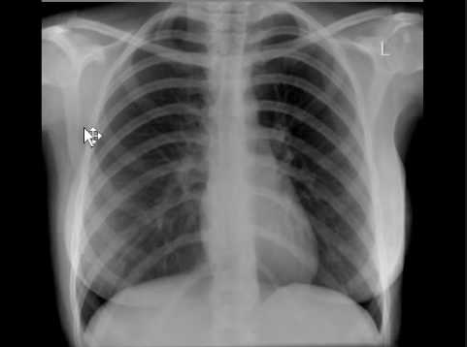

Slide 27
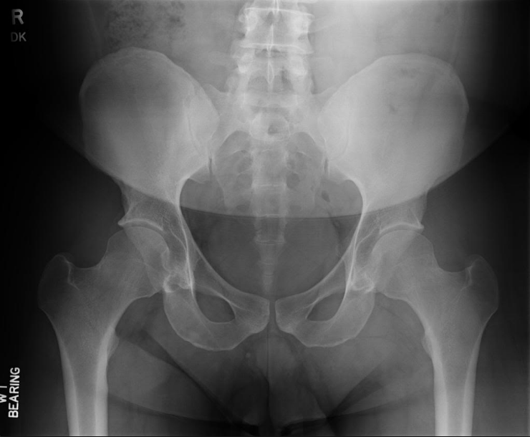

Slide 28
eFAST scan
ultrasound of the chest and abdomen
aim to
detect pneumothorax
detect intor-peritoneal bleed and pericardial effusion

Slide 29
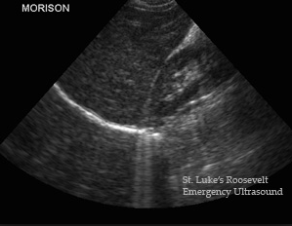
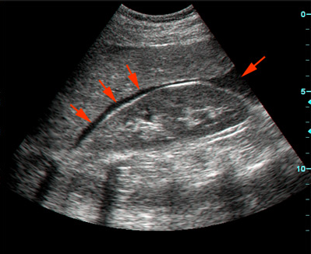
RUQ scan

Slide 30
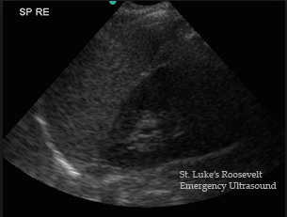
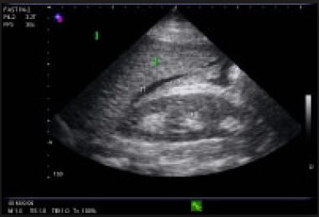
LUQ scan

Slide 31
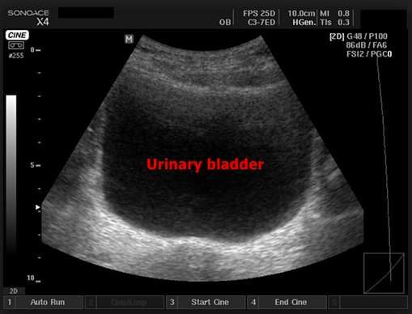
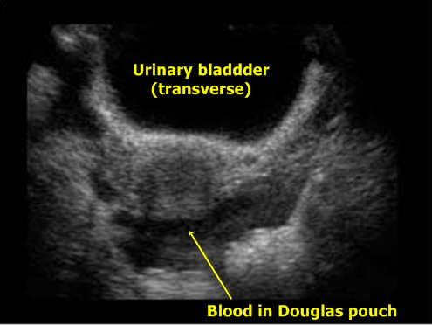
Bladder scan

Slide 32
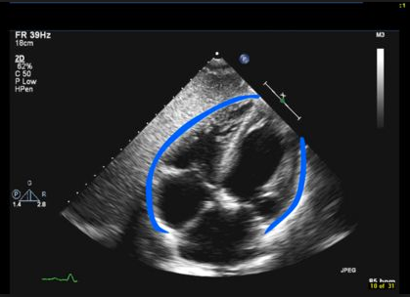
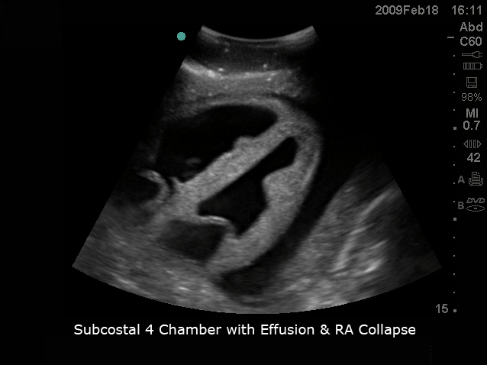
Pericardial scan

Slide 33
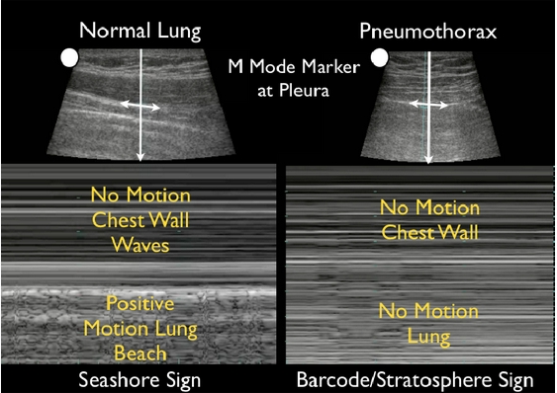
Lung Scan

Slide 34
Secondary Survey

Slide 35
Secondary Survey
AMPLE history
head to Toe exam

Slide 36
Secondary Survey
A : Allergy
M : Medications
P : past medical/Surgical History , Pregnancy
L : last meal and drink
E : event = mechanism of injury

Slide 37
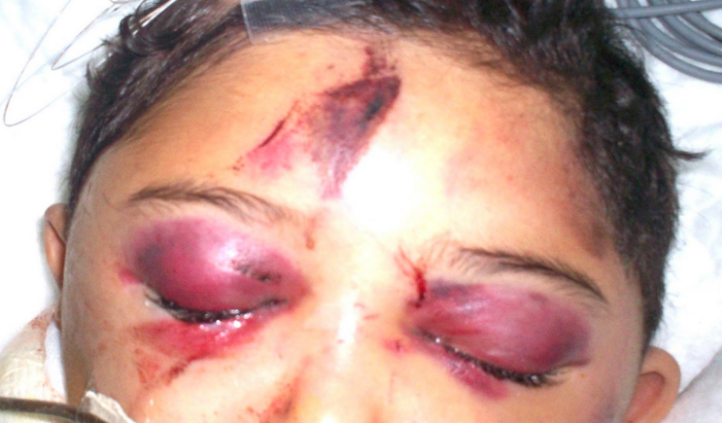
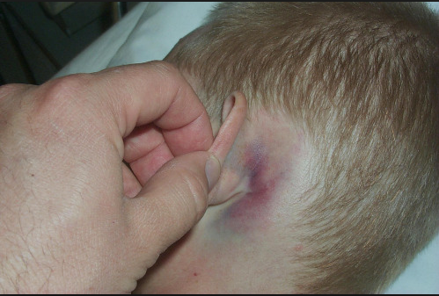
head & face exam
laceration
bleeding
deformity
missed teeth
CSF leakage
raccoon’s eye
Battle sign

Slide 38
Neck
bruise
wound
bleeding
haematoma i.e. expanding

Slide 39
chest
like primary survey
cardio exam
chest wall tenderness

Slide 40
Abdomen
bruise
wounds
distension
tenderness

Slide 41
Pelvis
lateral compression of pelvis —> to check for instability

Slide 42
Genital exam
blood at urethral meatus i.e. urethral injury
cation in putting urinary catheter
perform retrograde urethrogram before insertion

Slide 43
upper and lower limb exam
deformity
loss of pulse
loss of motor and sensory function

Slide 44
back exam
log roll!
spine exam top to bottom, looking for spinal tenderness , deformity
wound , laceration
bruise
do rectal exam

Slide 45
Adjunct to secondary survey
X-rays limbs
CT scan
blood tests
group and safe blood
urine test : for blood and pregnancy

Slide 46
Thank you

