Slide 1
Preoperative evaluation how much is enough?
(An evaluation that is considered a basic element of anesthesia care)
Dr Mohamed Bilal Delvi MD.
Associate Professor
Department of Anesthesia
College Of Medicine
KSU.

Slide 3
Patient Evaluation before surgery
In the Past
Present Literature
Believed that it is best for every patient to be seen by anesthesiologist with routine, protocolized preoperative tests and preparations to save time, money and to improve patient care.
Supports a visit
that focuses on individual patient’s surgical & anesthesia evaluations
and
patient directed effective interventions.
The challenge for anesthesiologists lies in understanding both surgery-specific and patient specific risk factors, and targeting interventions to optimize the outcomes.
Now called
PASS CLINIC
PRE ANESTHESIA & SURGICAL SCREENING CLINIC

Slide 4
Preoperative evaluation
American Society of Anesthesiologists Task Force on Preanesthesia Evaluation
A Process of clinical assessment that precedes anesthesia care for surgical or for nonsurgical procedures for best possible perioperative anesthetic care.
1. Assess and optimize existing conditions that may affect perioperative care
2. Identify if any other conditions that may affect perioperative care
3. Come up with specific plans for perioperative care
Clinical
4. Educate the patient & obtain informed consents
5. Organize resources for intraoperative, postoperative recovery, and perioperative pain management.
Non Clinical
This involves:
All these costs money, time and demands resources and manpower for healthcare system as well as patients
Review of patient’s medical records,
Interview and conduct Physical examination & Investigations (patient specific)
Findings from medical tests and evaluations

Slide 5
Our goals included: (other than clinical evaluation & optimization)
When we did redesign of our Anaesthesia Clinic
Coordinated, efficient, streamlined approach (Elective)
Individual plan for each elective surgery patient
Minimise delays and cancellations on the day of Surgery
Maximise the use of theatre time and beds
Medical/ Surgical Optimization
Improve discharge process by identifying and addressing post discharge requirements.
Patient education and instruction with opportunity for questions and answers.
Efficient use of human and material resources.
Minimise avoidable complications and extended postoperative admissions.
Optimize Patient Experience, Documentation, Theatre Efficiency & Save Money

Slide 6
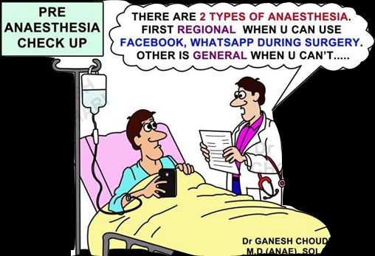
Individual Patient Plan
Patient co morbidities
Complexity of surgery
Type of anaesthesia planned
Suitability and fitness for anaesthesia
Optimisation of the patient
Investigations
Referral to other specialists
Discharge planning

Slide 7
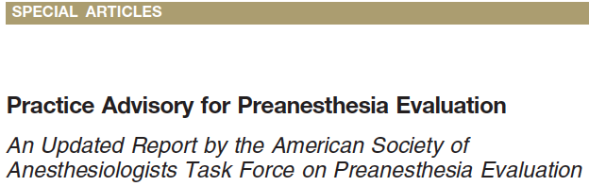
The update consists of an evaluation of literature published after completion of the original Advisory in 2009. This updated document was made available for review on the ASA Web site.
Any evaluations, tests, and consultations required for a patient are done with the reasonable expectation that such activities will result in benefits that exceed the potential adverse effects.
Potential benefits may include:
Effective use of perioperative resources
Improve the safety and effectiveness of anesthetic processes.
Potential adverse effects may include:
Interventions that result in injury, discomfort, inconvenience, delays, or costs that are not commensurate with the anticipated benefits
Prof. Krishna Boddu
+61416030020
Krishna.boddu@health.wa.gov.au
7

Slide 8
My Case Last Week
53 Year Old Lady for Right Inguinal Hernia on Saturday
Family history: Father, Brother and grand mother died of heart attacks at around 50 years of age.
History: Depression, Anxiety, Hypertension Medically Well Controlled. Good Exercise tolerance (>4mets)
Last year admitted to hospital with crushing chest pain – fully investigated – everything OK. ECG WNL
Just before going to theatre, in pre anaesthesia evaluation, system review questions were normal except depression & anxiety.
I was listening her chest: She asked did you find anything wrong?
I said: No. Lungs are clear, HR is a bit fast (96/min). I asked if she is worried of anything.
She said that she is internally jittery and very anxious about surgery. She said that the hospital air-conditioning is making her chest feel tight but no difficulty in breathing.
Took her to theatre: Gave 100 mcg Fentanyl – she said that tightness in the chest gone.
ECG: Wide Complex – LBBB, HR 96/min, BP 159/80 (Last year ECG Normal)
Surgeon said that the surgical condition is not that bad and she can wait if required.
Would you proceed or postpone?

Slide 9
Emergency angiogram performed
90% Circumflex Block – Old changes
Beta Blockers, Aspirin Started
Surgery rescheduled after 4 days
Did we subject her for unnecessary invasive investigations?

Slide 10
Case 2
50 year old fit and well man for elective carpel tunnel release.
Preop Clinic: Routine bloods, EKG and Chest Xray ordered
On the day of surgery: Anaesthetist happy to give propofol sedation and local anaesthetic by surgeon for procedure.
Procedure uneventful, Patient discharged as planned.
Two years later, patient was diagnosed with symptomatic pulmonary nodule. Review of records showed that nodule was reported in preop X Ray performed for carpel tunnel release (anaesthetist never reviewed X-Ray as pt was fit and well)
Is the anaesthetist liable for not reviewing chest x ray report that was ordered as a part of pre anaesthesia evaluation?

Slide 11
Preoperative evaluation how much is enough?
Preanesthesia History and Physical Examination
Selection and Timing of Preoperative Tests
Electrocardiogram (ECG)
Other Cardiac Evaluation
Pulmonary Evaluation (i.e., Pulmonary Function Tests, Spirometry)
Hemoglobin/Hematocrit Measurement.
Coagulation Studies
Serum Chemistries
Urine Testing
Pregnancy Testing

Slide 12
Preoperative Testing Guidelines
Tests Should not be ordered routinely.
Tests may be ordered on a selective basis for purposes of guiding or optimizing perioperative management.
Insufficient evidence to identify explicit decision parameters or rules for ordering tests based on specific clinical characteristics
Clinical characteristics may assist in deciding preoperative tests
The indications, justifications and rationale for such testing should be documented along with type and invasiveness of the planned procedure.

Slide 13
Grading of surgical procedures by severity (Examples)
Grade 1
Release of peripheral nerve entrapment at wrist.
Drainage of middle ear.
Tooth extraction.
Grade 2
Electroconvulsive therapy.
Partial excision of breast.
Extraction of lens.
Haemorrhoid operations.
Evacuation of retained products of conception.
Grade 3
Thyroidectomy.
Open operation on bladder.
Total mastectomy.
Vaginal repair or hysterectomy.
Grade 4
Operations on the lung.
Excision of the colon/stomach/rectum.
Kidney transplant.
Total hip replacement.

Slide 14
Preanesthesia History and Physical Examination
At a minimum, a focused preanesthetic physical exam
should include an assessment of
airway, lungs, and heart, with documentation of vital signs
Obligation of the healthcare system
provide pertinent information to the anesthesiologist for the appropriate assessment of the severity of medical condition of the patient and invasiveness of the proposed surgical procedure
well in advance of the anticipated day of procedure for all elective patients

Slide 15
Selection and Timing of Preoperative Tests
The timing is guided by such factors as patient demographics, clinical conditions, type and invasiveness of procedure, and the nature of the healthcare system.
Three options that practices use for the timing of an initial preanesthetic evaluation are:
Always before the day of surgery (High severity of disease & high invasive)
Either on or before the day of surgery, and
Only on the day of surgery (Low severity of disease & less invasive)

Slide 16
Electrocardiogram (ECG)
Age – Not an indication any more. Advanced Age?
Known Cardiocirculatory disease
Known Respiratory disease
Other Cardiac Evaluation (Other than ECG)
May include consulting specialists and tests that range from
Noninvasive passive or provocative screening tests (e.g., stress testing)
Tests for cardiac structure, function, and vascularity (e.g., echocardiogram, radionucleotide imaging, cardiac catheterization).
Anesthesiologists should balance the risks and costs of these evaluations against their benefits.
Clinical characteristics to consider include cardiovascular
risk factors and type of surgery

Slide 17
Pulmonary Evaluation (Chest X-Ray)
Routine Chest X-Ray not indicated any more even in patients with
History of Ashma, Smoking, COPD
Preanesthesia Chest Radiographs: Clinical characteristics to consider include smoking, recent upper respiratory infection, COPD, and cardiac disease stability
The Task Force recognizes possible higher x-ray abnormalities in such patients but does not believe that extremes of age, smoking, stable COPD, stable cardiac disease, or resolved recent upper
respiratory infection should be considered unequivocal
indications for chest radiography.

Slide 18
Pulmonary Evaluation (i.e., Pulmonary Function Tests, Spirometry)
Should not be ordered routinely
May include specialist consultation and tests that range from
noninvasive passive or provocative screening tests (e.g., pulmonary function tests, spirometry, pulse oximetry) to invasive assessment of pulmonary function (e.g., arterial blood gas).
Clinical characteristics to consider include type and invasiveness
of the surgical procedure, interval from previous
evaluation, treated or symptomatic asthma, symptomatic
COPD, and scoliosis with restrictive function.
Anesthesiologists should balance the risks and costs of these
evaluations against their benefits.

Slide 19
Hemoglobin/Hematocrit Measurement.
Routine hemoglobin or hematocrit is not indicated.
Clinical characteristics to consider: type and invasiveness of
procedure, patients with liver disease, extremes of age, and history
of anemia, bleeding, and other hematologic disorders.
Coagulation Studies
Routine Coagulation Studies are not indicated.
Clinical characteristics to consider: bleeding disorders, renal, liver dysfunction, and type and invasiveness of procedure
Anticoagulants and alternative therapies may present an additional risk but not enough data to comment on the advisability of coagulation tests before regional anesthesia.

Slide 21
Serum Chemistries
i.e., Potassium, Glucose, Sodium, Renal and Liver Function Studies)
▪ Clinical characteristics to consider: Endocrine disorders, risk of renal and liver dysfunction, and use of certain medications or alternative therapies. The Task Force recognizes that laboratory values may differ from normal values at extremes of age.
Urine Testing
Routine Urinalysis: not indicated except for specific procedures
(e.g., prosthesis implantation, urologic procedures) or when symptoms are present.

Slide 22
Pregnancy Testing
Patients may present for anesthesia with early undetected
Pregnancy but the literature is inadequate to inform patients or physicians on whether anesthesia causes harmful effects on early pregnancy.
Pregnancy testing may be offered to reproductive age female patients and for whom the result would alter the patient’s management.

Slide 23
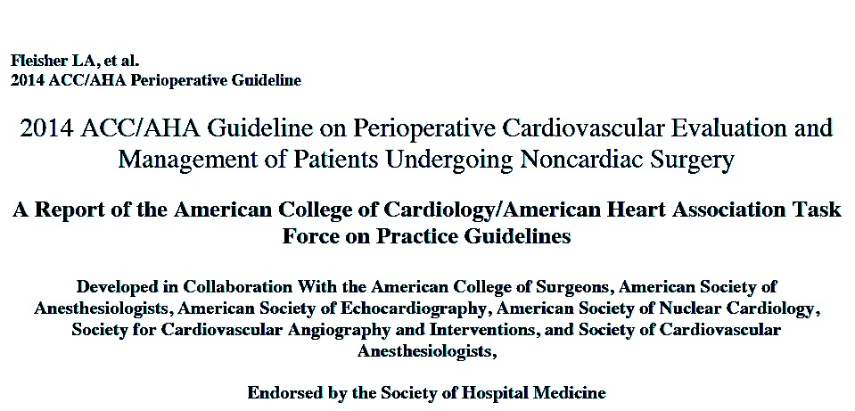
Preoperative Cardiac Evaluation
& Management of Patients Undergoing Noncardiac Surgery

Slide 24
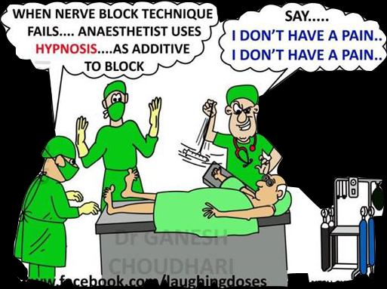
Thank you
Original Anaesthesia

