Slide 1
ABO & Rh(D) Blood Groups
Anatomy & Physiology
Unit 9 – Circulatory System

Slide 2
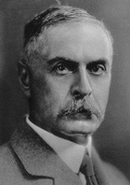
The ABO System
Discovered in 1901 by Dr. Karl Landsteiner
4 Main Phenotypes (A, B, AB, O)
ABO gene located on long arm of chromosome 9

Slide 3
The ABO Antigens
Added to Proteins or Lipids in Red Cells
Substrate Molecule is H (fucose)
A antigen is N-acetyl-galactosamine (GalNAc)
B antigen is Galactose (Gal)
A and B genes code for transferase enzymes

Slide 4
ABO Antibodies
A and B substances very common
Antibodies produced to “non-self”
Produced after first few months of life
A & B people have mainly IgM
O people have IgG
May fade in old age

Slide 5
Antigens & Antibodies
Blood Group
Antigens on RBCs
Antibodies in Serum
Genotypes
A
A
Anti-B
AA or AO
B
B
Anti-A
BB or BO
AB
A and B
Neither
AB
O
Neither
Anti-A and anti-B
OO

Slide 6
Inheritance of ABO Groups
Allele from the mother
Allele from the father
Genotype of offspring
Blood types of offspring
A
A
AA
A
A
B
AB
AB
A
O
AO
A
B
A
AB
AB
B
B
BB
B
B
O
BO
B
O
O
OO
O

Slide 7
ABO Typing
Cell Group
Test Washed Cells With:
Monoclonal Anti-A
Monoclonal Anti-B
Inert control
Agglutination is a positive result
Reverse Group
Test plasma/serum with:
Known A₁ cells
Known B cells
Known O cells
? Known A₂ cells
Reactions may be weaker than cell group

Slide 8
Distribution of ABO Groups
Population
O
A
B
AB
Aborigines
61
39
0
0
Basques
51
44
4
1
Blackfoot (N. Am. Indian)
17
82
0
1
Bororo
100
0
0
0
Chinese-Canton
46
23
25
6
Chinese-Peking
29
27
32
13
English
47
42
8
3
Hawaiians
37
61
2
1
Irish
52
35
10
3
Mayas
98
1
1
1
Navajo (N. Am. Indian)
73
27
0
0
Peru (Indians)
100
0
0
0
United Kingdom (GB)
47
42
8
3
USA (blacks)
49
27
20
4
USA (whites)
45
40
11
4

Slide 9
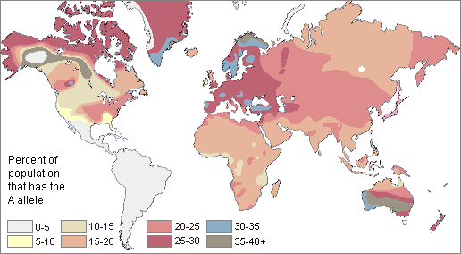
Distribution of the A allele

Slide 10
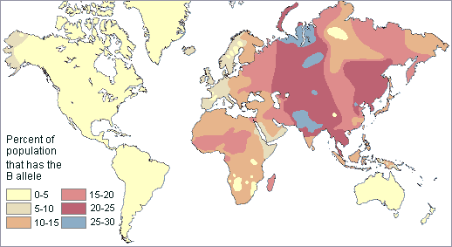
Distribution of the B Allele

Slide 11
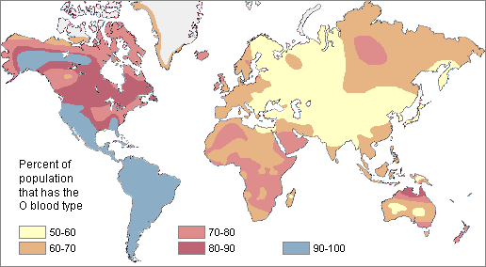
Distribution of the O Allele

Slide 12
Significance of ABO Group
ABO mismatched transfusions:
Rare
May be life threatening
Can be caused by technical or clerical error
Intravascular haemolysis
More severe in group O patients

Slide 13
Universal Donor and Recipient
Universal Donor
Group O
Carries no A or B antigens
Packed and processed units have little antibody
Universal Recipient
Group AB
Patient has no anti-A or anti-B present
Cannot lyse any transfused cells
Beware: other
antibodies may be present
Using the patient’s own group ASAP will conserve resources

Slide 14
The Rh(D) Antigen
RH is the most complex system, with over 45 antigens
Discovered in 1940 after work on Rhesus monkeys
Subsequently discovered to be unrelated to monkeys
RH gene located on short arm of chromosome 1

Slide 15
Simple Genetics of Rh(D)
86% of caucasians are Rh(D) pos
The antithetical antigen d has not been found
The d gene is recessive:
Dd, dD, DD, persons are Rh(D) pos
Only dd persons are Rh(D) neg

Slide 16
Distribution of Rh(D) Types
Population | Rh(D) pos | Rh(D) neg
Caucasian | 86% | 14%
African-American | 95% | 5%
Oriental | >99% | <1%

Slide 17
Significance of Rh(D)
80% of Rh(D) neg persons exposed to Rh(D) pos blood will develop anti-D
Anti-D can also be stimulated by pregnancy with an Rh(D) positive baby
Sensitisation can be prevented by the use of anti-D immunoglobulin, antenatally and post natally
Rh(D) neg females of childbearing potential should never be given Rh(D) positive blood products

Slide 18
Inheritance
ABO & RH genes are not linked
ABO & Rh(D) type are inherited independently
For example:
An A Rh(D) pos mother
and a B Rh(D) pos father
could have an O Rh(D) neg child

Slide 19
Inheritance of ABO and Rh(D)
Mother
Group A AO
Rh(D) pos Dd
Father
Group B BO
Rh(D) pos Dd
Group A AO
Rh(D) pos Dd
Group B BO
Rh(D) pos Dd
Group O OO
Rh(D) neg dd

