Slide 1
Ped Urology Review
ANH and GU anomalies
Surgery 453
Dr. Fahad Alyami
Dr Hamdan Alhazmi

Slide 2
Antenatal Hydronephrosis
Def of hydronephrosis?
Antenatal ?

Slide 3
Normal Antenatal Renal US

Slide 5
You have 2 days old boy diagnosed bilateral hydronephrosis on antenatal US, what the possible causes?
If this was unilateral , what are the possible causes?

Slide 6
POSTNATAL EVALUATION AND MANAGEMENT
History
Maternal health
Maternal PMHx & FmHx: GU anomalies, course of pregnancy, DM, Meds
Previous pregnancies: siblings w/ VUR, hydro
Gender of the child
Voiding ( 1st void , straining, wetting the diaper)
EtOH, drug use

Slide 7
Pre-natal U/S
Gender of fetus
Single vs. multiple
AF volume
Kidneys: degree of hydro, variation in hydro b/w exams, unilateral/bilateral hydro.
Ureters: hydroureter
Bladder: presence, fullness, size, thickness, emptying
Urethra: dilated posterior urethra
Other abnormalities
Overall growth and development

Slide 8
Oligohydramnios
OLIGOHYDRAMNIOS = amniotic fluid <500cc (pocket <2cm)
Before 16-18 wks, most of AF is a placental transudate
By 20-22 wks, most of AF is fetal urine (urine production starts at ~12 wks)
oligohydramnios that develops only after 18-20 weeks likely represents GU tract obstruction or abnormal renal development.
Notes:
Why do we care about oligohydromnios in history

Slide 9
Investigations
US
VCUG
Nuclear scan
No IVP
Notes:
Add pictures
NORMAL IMAGING

Slide 10
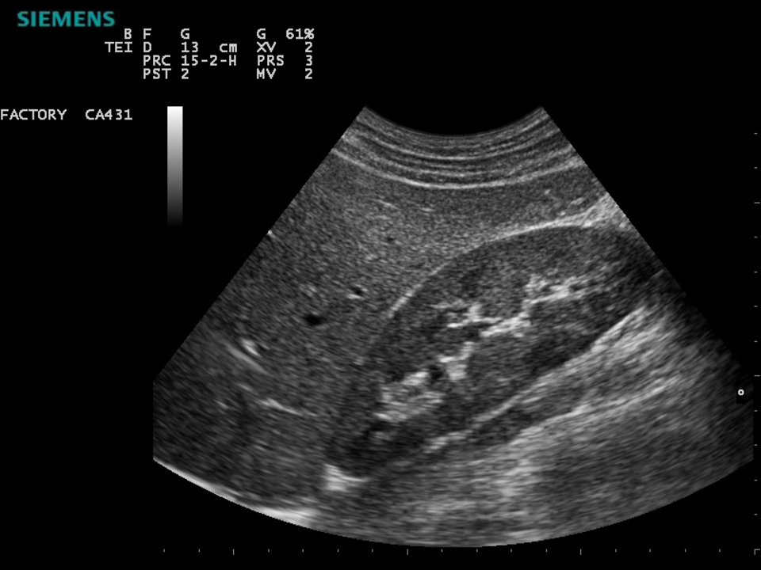
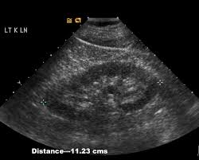
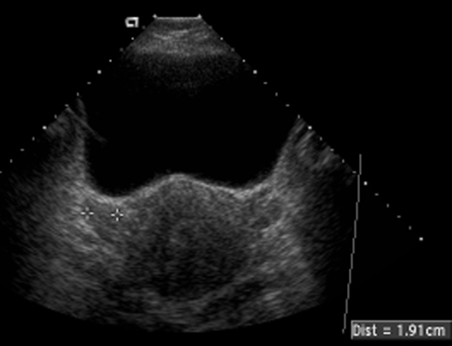
Normal Renal & Bladder US

Slide 11
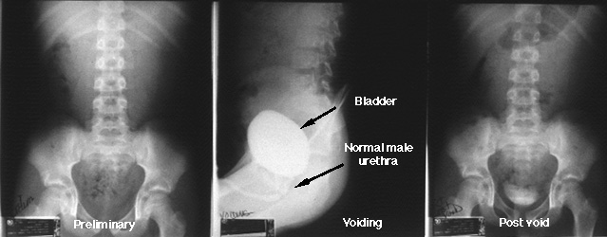
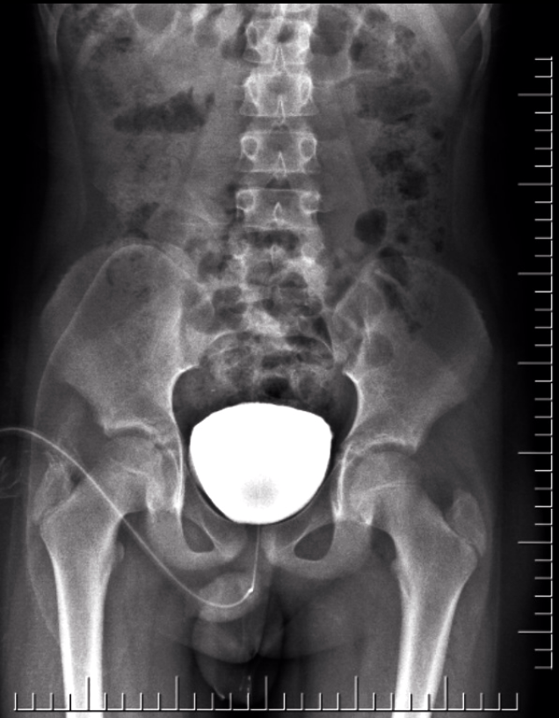
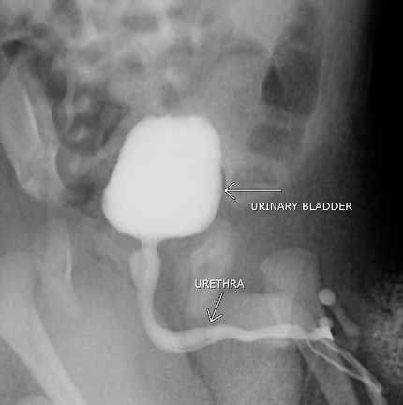
Voiding cystourethrogram
(VCUG)

Slide 12
Diuretic renal scan

Slide 13
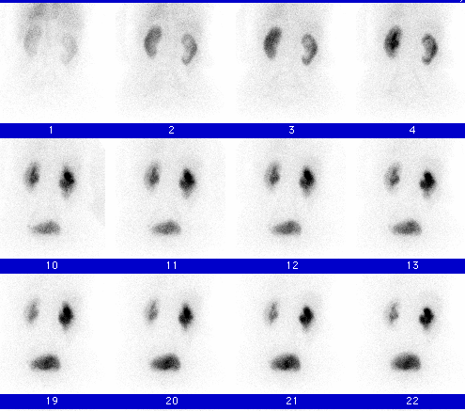
pre-Lasix

Slide 14
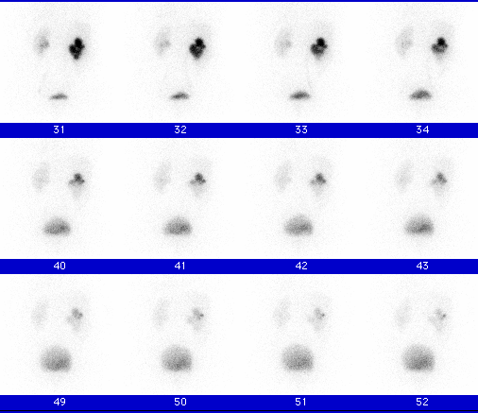
post-Lasix

Slide 15
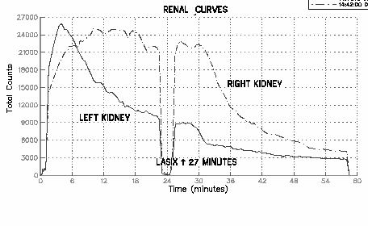
No UPJ obstruction
T1/2
R = 6’
L = 2’

Slide 17
Post natal workup
Post-natal
Observe child voiding.
Serum Cr. (When and why?)
Prophylactic antibiotic.
Repeat US +/- VCUG or nuclear scan .
Notes:
Us finding ( anantomy)
IVP xxxx
Nuclear

Slide 18
Divide your self in 3 teams , each team will be responsible for a case scenario.

Slide 19
Case 1
2 days old term boy (SVD), found to have bilateral hydronephrosis on antenatal US?
What are the possible causes ?
How would you manage this case?

Slide 20
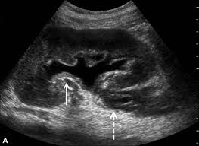
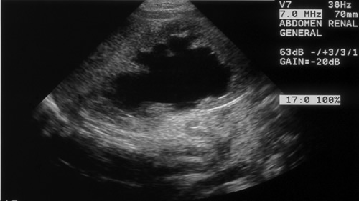
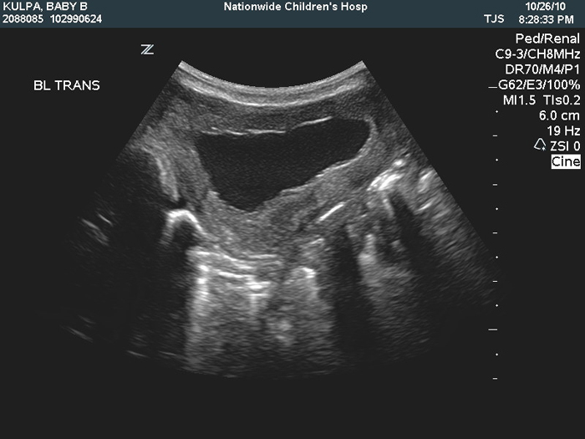

Slide 21
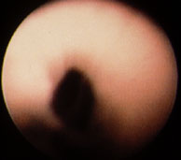
Posterior urethral valve (PUV)
congenital obstructive membrane in posterior urethra that impedes antegrade flow of urine.
occurs in 1 in 8,000-25,000 live male births.

Slide 23
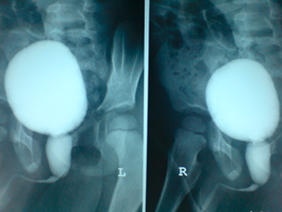
Notes:
Need better imaging
US and VCUG

Slide 24
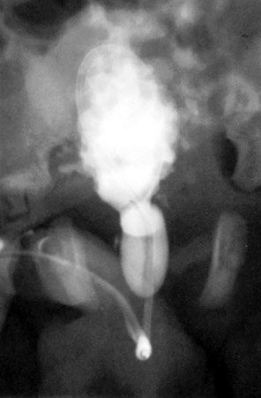
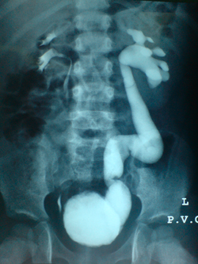

Slide 25
Initial Management of PUV
1ST step of management : Bladder drainage (permits medical stabilization)
Effective NICU support for issues with pulmonary hypoplasia & renal insufficiency
Lab investigations
- Electrolyte, creatinine , BUN: may take 48hrs to be accurate.
Prophlactic Abx.
Cystoscopy and Valve ablation. (Definitive treatment)

Slide 26
Case 2
5 days old boy with unilateral hydronephrosis diagnosed on antenatal US.
What is the possible causes ?
How would you approach this case?
Notes:
Add images US
NORMAL VCUG
MAG3 pictures

Slide 27
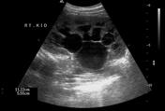
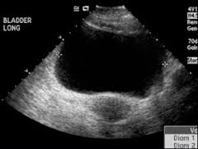
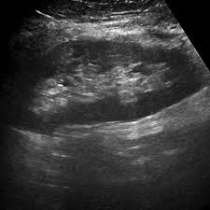
RT
LT

Slide 28
WHAT IS NEXT?

Slide 29
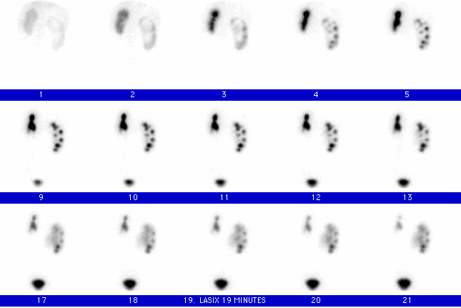
Pre-Lasix

Slide 30
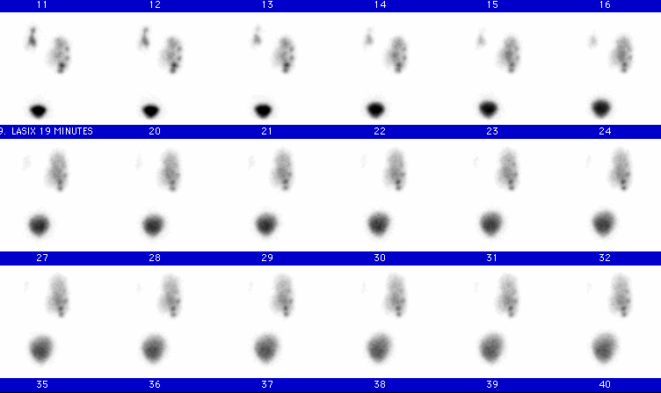
Post-Lasix

Slide 31
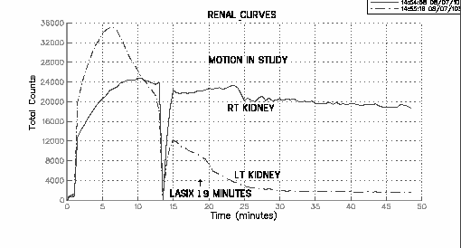
Rt UPJ obstruction
T1/2
R = N/A

Slide 32
Ureteropelvic Junction Obstruction
Most common cause of UNILATERAL hydro in fetal kidney (~50%)
More common in Males, Lt> Rt.

Slide 33

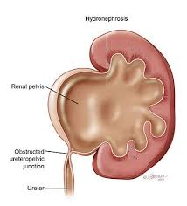

Slide 34
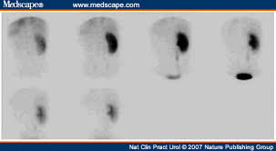
Work-up
No need for urgent intervention unless baby develops pyelonephritis (nephrostomy tube or stent).
Repeat US.
Diuretic renal scan
( MAG3 or DTPA)
Notes:
More pictures

Slide 35
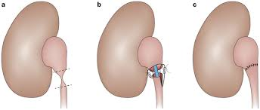
Pyeloplasty
Open/laparoscopic/Robotic

Slide 36
Case 3
5 days old girl fond to have bilateral hydronepohrosis on antenatal US?
What are the possible causes?
How would you approach this case?
Notes:
VCUG ( 1RY AND 2RY)
NORMAL US

Slide 37
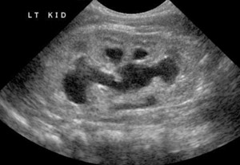
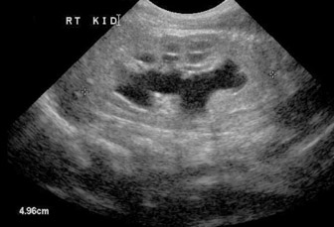
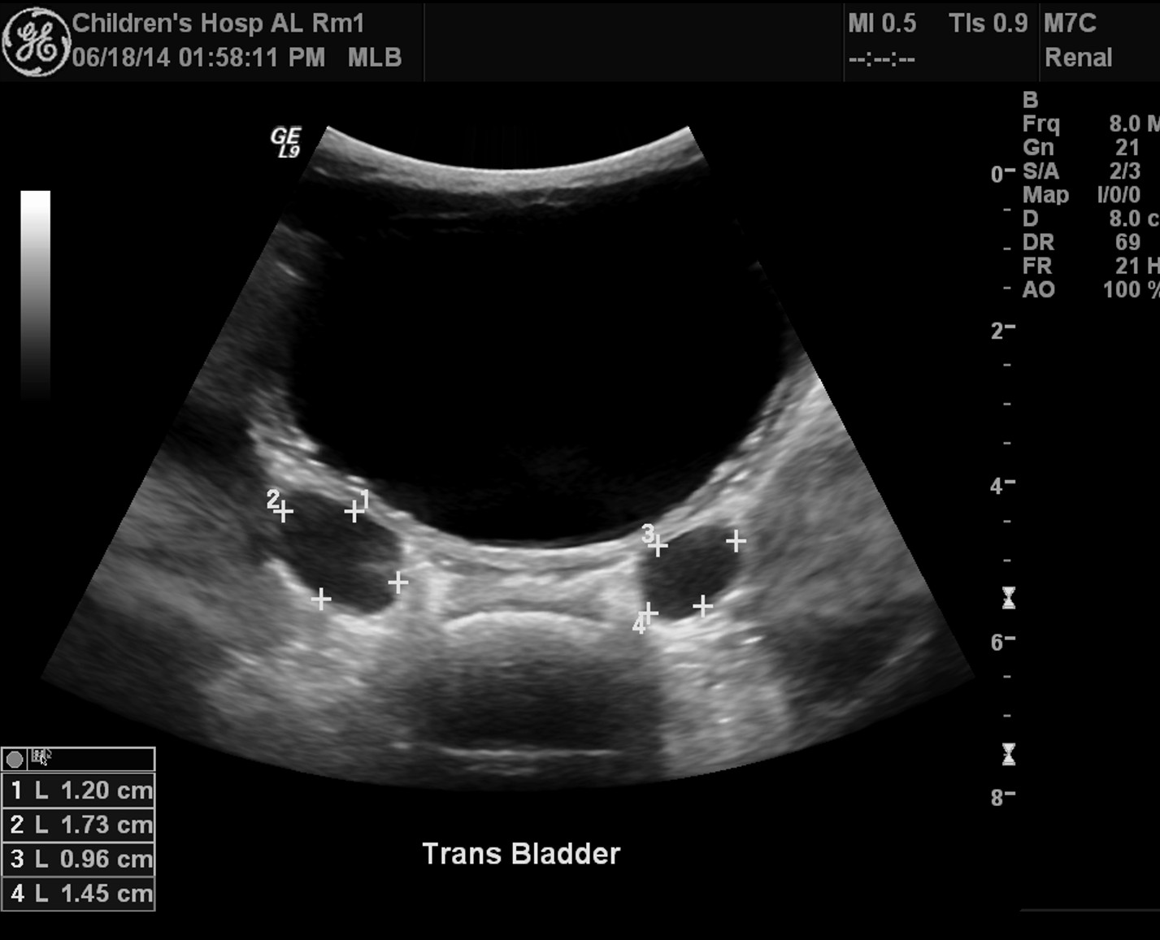

Slide 38
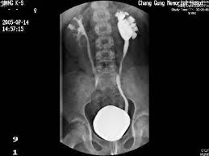

Slide 39
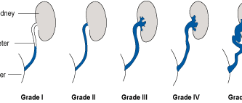
Vesicoureteral Reflux (VUR)

Slide 40
Vesicoureteral Reflux (VUR)
30-40% of ANH is due to VUR.
Presentation : ANH or UTIs.
Family Hx (30%) .

Slide 41

Work-up for vur
US
VCUG.
Notes:
Neurogenic .. 2ry
Add US picture

Slide 42
Treatment options
Observation
Prophylactic antibiotics.
Surgical:
- Deflux injection
- Ureteric reimplantation

Slide 43
Principles of Management of VUR
Spontaneous resolution is very common
High-grade VUR is less likely to resolve spontaneously
Extended use of prophylactic ABx is benign
Success rate with surgical correction is very high

Slide 44
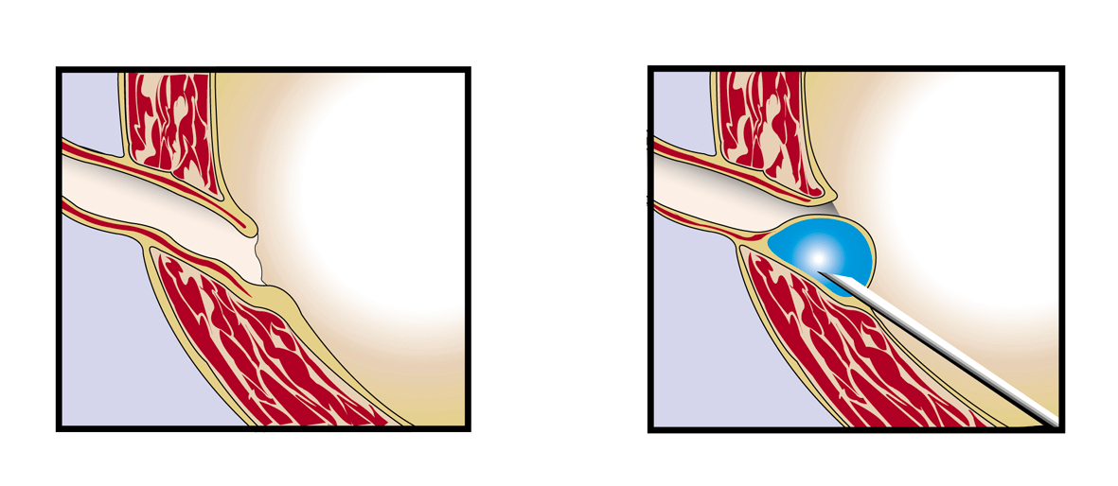
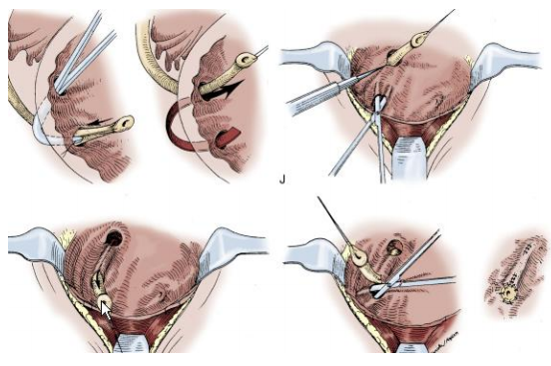
Notes:
UVJO
MCDK

Slide 45
Hypospadias
What is hypospadias?
Association of 3 anomalies of the penis
Abnormal ventral opening of urethral meatus (glans to perineum)
2) Abnormal ventral curvture.
3) Abnormal distribution of foreskin with a dorsal “hood” and deficient ventral foreskin

Slide 46
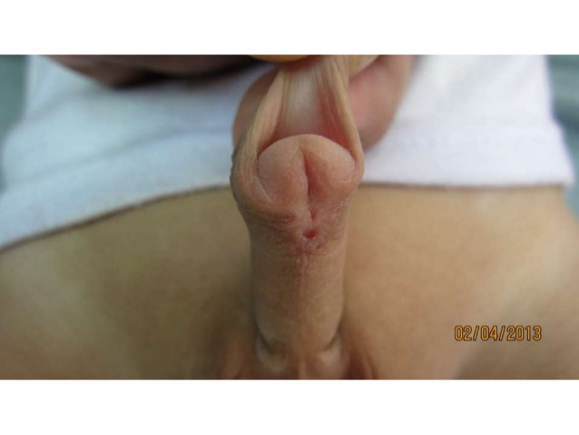
Hypospadias
What is hypospadias?
Association of 3 anomalies of the penis
Abnormal ventral opening of urethral meatus (glans to perineum)
2) Abnormal ventral curvture.
3) Abnormal distribution of foreskin with a dorsal “hood” and deficient ventral foreskin

Slide 47
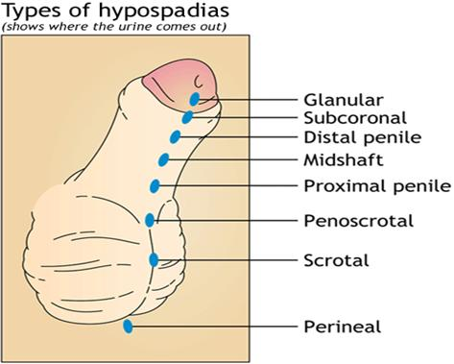

Slide 48
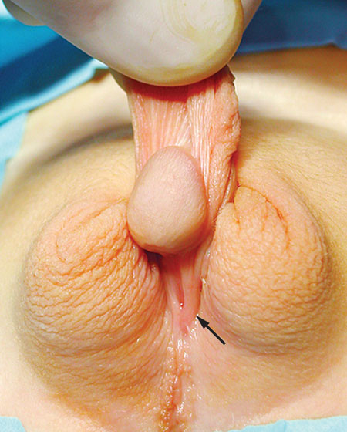

Slide 49
Epidemiology
Approximately 1 in 250 live male birth
The majority are distal hypospadias.
It can be familial.
More in twins.

Slide 50
Diagnosis
Most found at newborn P/E.
Some cases are diagnosed at later age or after circumscion.
Look for associated anomalies like UDT or intersex
No routine imaging for isolated hypospadias.

Slide 51
Physical exam
Abdominal exam: masses, SP/flank tenderness, full bladder.
External genitalia:
micropenis, meatal location, deficiency of spongiosum, hernia, hydrocele, and UDT
In cases of non palpable UDT and hypospadias what you should think about?
Notes:
UDT = HYPO : THINK OF DSD

Slide 52


Slide 53
Reasons of Hypospadias Repair
To allow micturition in standing position.
To allow sexual intercourse.
To allow effective insemination.
Cosmesis.
→ most males with distal hypospadias have no medical indications for repair other than cosmesis

Slide 54
Surgical Repair
Idealy it should be done after the age of 6 months (6-12months)
It can be done in 1 or 2 stages.

Slide 55
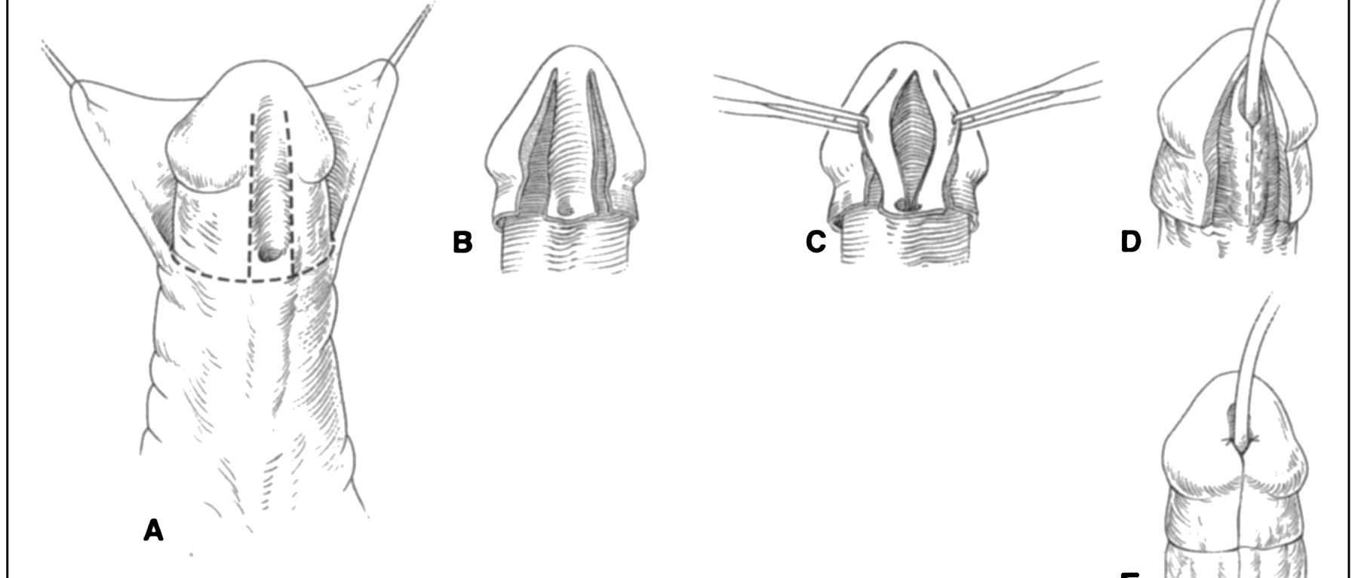
One Stage Repair

Slide 56
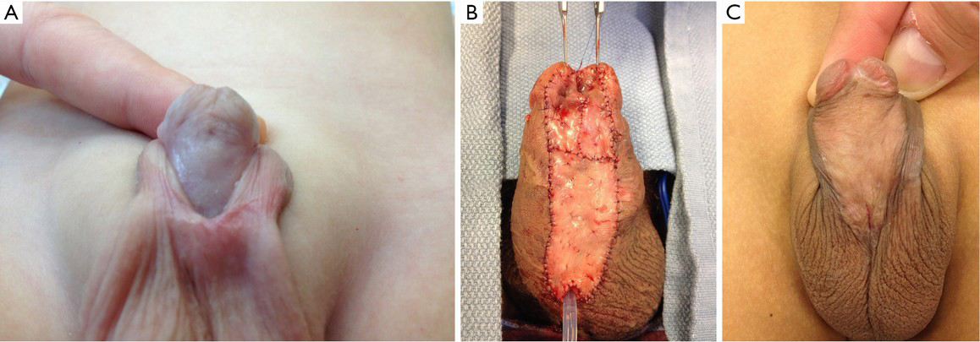
Staged repair

Slide 57
EXSTROPHY-EPISPADIAS COMPLEX
3 main variants
Epispadias
bladder exstrophy } accounts for >50% of kids born with this complex
cloacal exstrophy } much more GI involvement

Slide 58
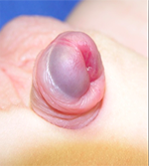
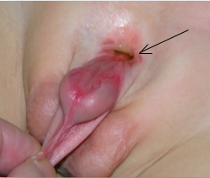
Epispadias

Slide 59
Epispadias
Males >Females X 3-5 times.
Males : 1 in 150,000
It require surgical repair after the age of 1 year.
Some patients will have issues with incontinence

Slide 60
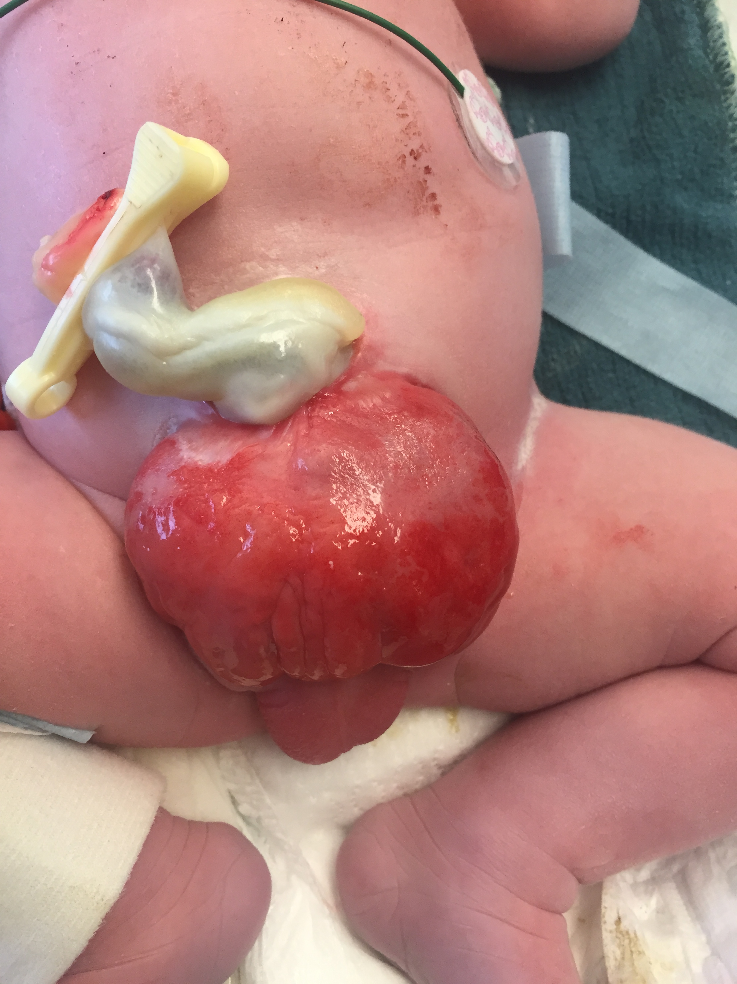
CLASSIC BLADDER EXSTROPHY

Slide 61
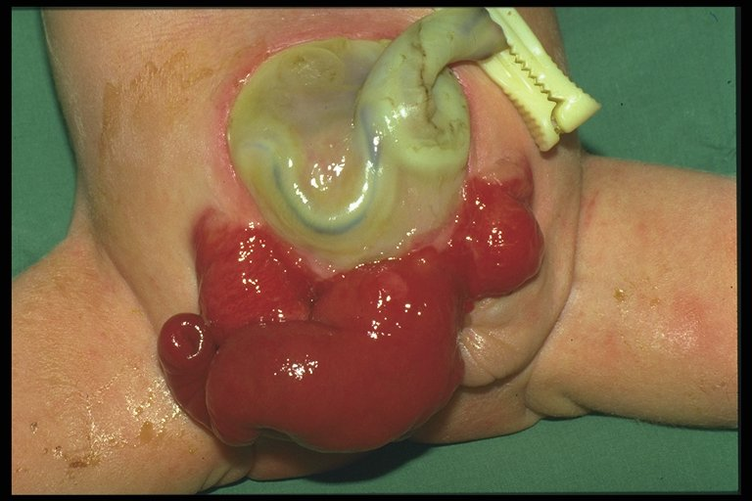
CLOACAL EXSTROPHY

Slide 62
Prune Belly Syndrome
It affects 1 per 30,000-40,000 live births. (Boys>Girls)
Usually patients will have the triad
Weak/absent abdominal muscles.
Bil UDT.
Weak and dilated GU organs ( Bladder, ureters, urethra).\
+/- Cardiac anomalies : tetralogy of Fallot (TF) and ventriculoseptal defects (VSD)
- The mortality rate can reach up to 20% in this syndrome.

Slide 63
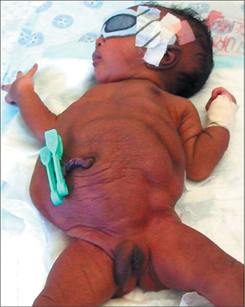
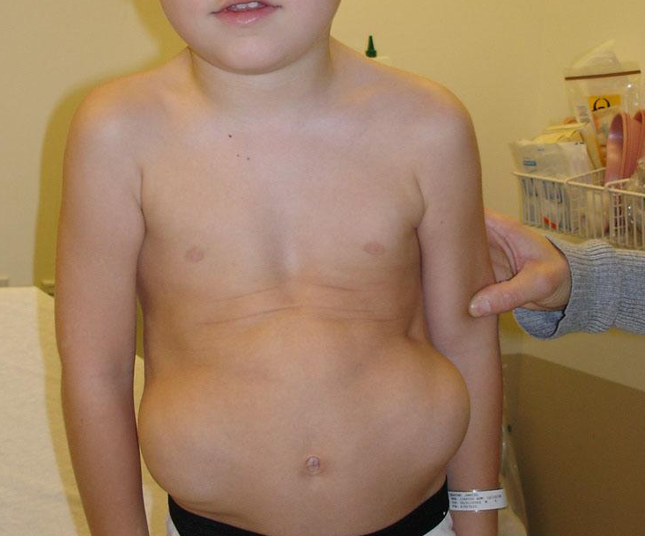

Slide 64

Questions

