Slide 1
Patient safety
Dr Jumana Baaj
Consultant Anesthesia
Assistant Professor
KSU-KKUH

Slide 2

Safe Anaesthesia practice- Current Trends

Slide 3


Safety? Whose safety?
Anesthesia is an area in which very impressive improvements in
safety have been made.

Slide 4
Objectives
Patient safety during anaesthesia
Causes of Mortality in anesthesia
Factors influence the anesthesia safety and patient outcome
mandatory standard for safe anaesthesia techniques
Post crisis recommendation

Slide 5
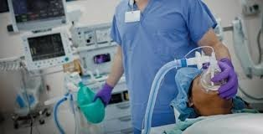
Anaesthesiology: A High risk Speciality
Anaesthesiology is a high-risk speciality as compared with other
_{specialities in medicine}

Slide 6
How safe is surgery and anesthesia?
λ
1 death per 5,000 anesthetics administered during
_{1 death per 100,000 in 2015.}
the 1970s,
to
λ
Today’s surgical patients are sicker and
aged than
ever.
λ
5% of all surgical patients die within one year of surgery.
λ
Surgical Patients over
_{surgery.}
65 years, 10%
die within one year
of

Slide 7
Dr. Jeana Havidich; 2014 ASA Convention:
λ
3.2 million anaesthesia case data: 2010-2013.
λ
Complication rate: decreased from 11.8 percent to 4.8 percent
λ
Evening or holiday procedures: no increase in complications
λ
Healthier patients having elective daytime surgery: highest minor
complications
λ
Serious complications highest in pt >50 years

Slide 8
Complication of anesthesia
Major Complications
  cardiac arrest
  Perioperative MI
  Aspiration
  Anaphylaxis
  Drug overdose
  Convulsion
  nerve pulses
  Organ injury
  Malignant hyperthermia
Minor complications
  Airway obstruction
  Postop nausea, vomiting
  Sore throat
  Hemodynamic instability
  Pneumonia
  Delirium
  Shivering
  Cognitive defect

Slide 9
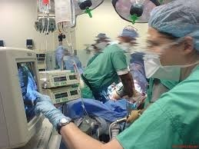
10 common causes of cardiac arrest under anaesthesia
1.
2.
3.
4.
5.
6.
7.
8.
9.
Drug overdose/ adverse
Rhythm disturbances
Peri-op MI
Airway obstruction
High spinal
Lack of vigilance
Bleeding
reaction
Over-dosage of inhalation
Aspiration
agent
10.Technical problem in anaesthesia
system

Slide 10
Anaesthesia Vs Aviation industry
λ
The safety of airline travel-highest:
λ
Increased in air traffic density; More take-offs and landings
less separation between aircraft.
with
λ
Practice of anesthesiology similar like aviation
λ
Take off and landing: similar to induction and recovery
λ
Increased No of Surgical patient; diverse age group;
λ
Increasing co-morbidities; complex surgical procedure.
λ
Fatal accident complications still happened.

Slide 11
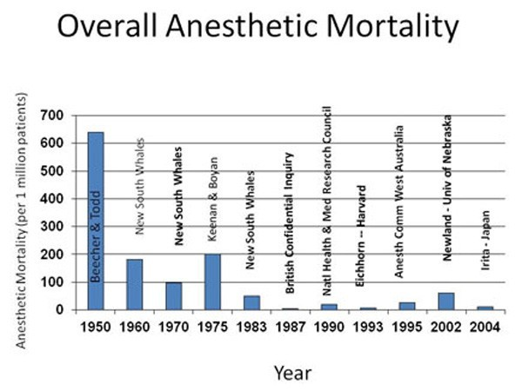
Lets look at the mortality from Anaesthesia
λ
In 1950: 3.7 in 1000 anaesthetics
1980: 1 in 10,000 anaesthetics
2015: 1 in 100,000- anaesthetics
λ
λ

Slide 12
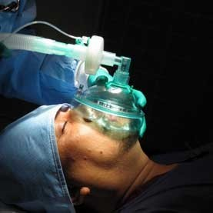
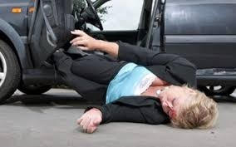
Mortality: GA Vs RTA
λ
Now Lets Compare the Mortality from GA with an
event that anyone, anywhere on this Mother earth can face

Slide 13
GA Vs RTA
2013: WHO released “Global Status report
on
road
safety;
λ
RTA mortality 18 per 100,000 people/year
λ
Mortality From GA: 1 in 100,000
So, A patients has
HIGHER chances of dying
from RTA than
from exposure to General Anaesthesia.

Slide 14

What
makes
anaesthesia
safe
?

Slide 15
What makes anesthesia safe
Pre operative assessments
Monitors and anesthesia machines
Safe drug equipment
Anesthesia skills and knowledge’s
Guidelines and protocol
Surgical skills

Slide 16
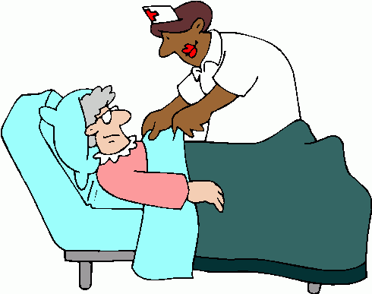
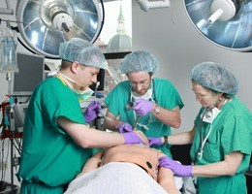
Factors influencing risk of Anaesthesia?
λ
Patient status: age, co-morbidities
λ
Procedure –: urgency, invasive
λ
Facility: resources, equipment, monitoring
λ
Skill/ expertise- anaesthetist, surgeon
λ
Readiness, fatigue of the physicians

Slide 17


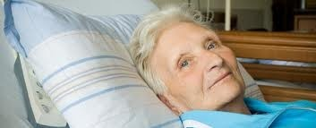
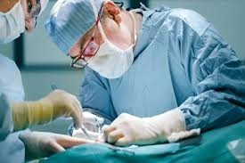
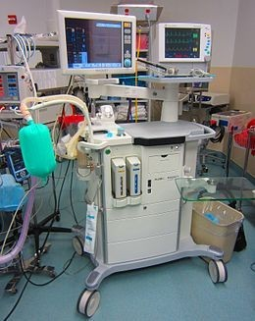
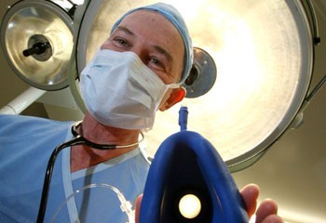
Where Safety Starts ?
^{Patient}
^{Surgeon’s Skill}
Facilities, Equipment, and Medications
Anaesthetist’s Skill

Slide 18

.......Survival Depends
Referal
10%
^{HELP}
^{10%}
^{20%}
Anaesthetist
^{Skill}
^{60%}
Facilities, resources; Equipment,
and Medications Quantity and Quality

Slide 19
Safe anesthesia practice
Protocole
Crisis managements and guidelines
Training /skills developemnets /updation , simulation based learning
Evidence based medicine transferred into practical skills

Slide 20

The goal is to provide highest standard of care and safety
_{any setting}
International Task Force on Anaesthesia Safety
Approved by:
in
World Federation of Societies of Anaesthesiologists
_{(WFSA)}

Slide 21
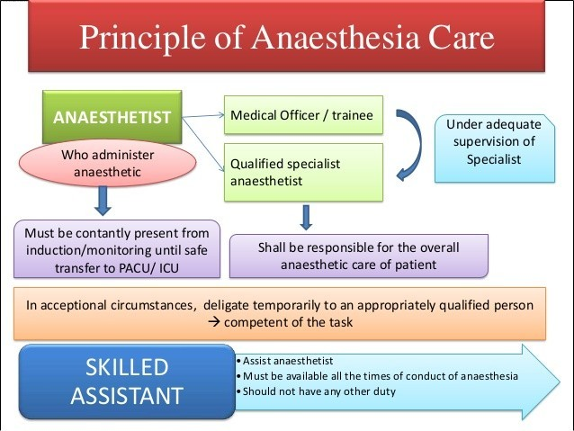

Slide 22
STANDARD OF ANESTHESIA(in order of adoption ) | SITTING | INFRASTRUCTURE
highly recommended | Level 1 Small hospital/ health center | Basic
highly recommended+ recommended | Level 2 Small hospital/ health center | Intermediate
highly recommended + recommended + suggested | Level 3 Referral hospital | Optimal

Slide 23
Minimum infrastructure requirements for general anesthesia include:
  a well-lit space of adequate size
  a source of pressurized oxygen (most commonly piped in);
  an effective suction device;
  standard ASA monitors.
    heart rate, blood pressure, ECG, pulse oximetry, capnography, temperature; and inspired and exhaled concentrations of oxygen and applicable anesthetic agents

Slide 24
HIGHLY RECOMMENDED
λ
Minimum standards that would be expected
  all anaesthesia care for elective surgical procedures
in
λ
“Mandatory" standards

Slide 25
Mandatory standard
λ
Pre-anaesthesia
checks/ Care
λ
Safe Conduct of
anaesthesia
λ
Monitoring during anaesthesia
λ
Post Anaesthesia Care

Slide 26

Pre Anesthesia Check
check patient risk factor
  ASA 1,2,3,4,5, e in case of emergency
  Airway assessment
  Aspiration risk
  Allergies
  Abnormal investigation
  Comorbidity
  Medication
  Formulate anesthesia plan

Slide 27
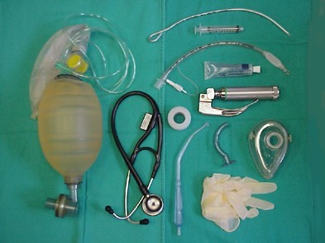
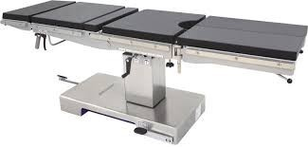
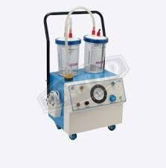
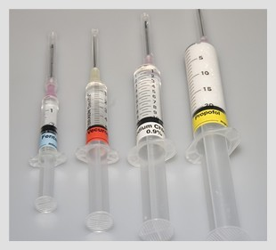
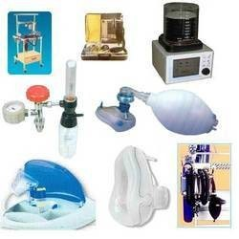
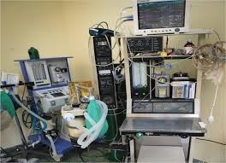
Check resources? Before starting Anaesthesia

Slide 28


Choice of Anaesthesia
λ
Judged by type of patient / procedure/ facility
λ
Chose the Simplest and safest
Variety of options available
- LA
-LA + Sedation
-Regional +/- sedation
- GA with LMA/i-gel
- GA with ETT
technique
λ
- GA + Regional combination
Try to minimise the multiple combinations
λ

Slide 29
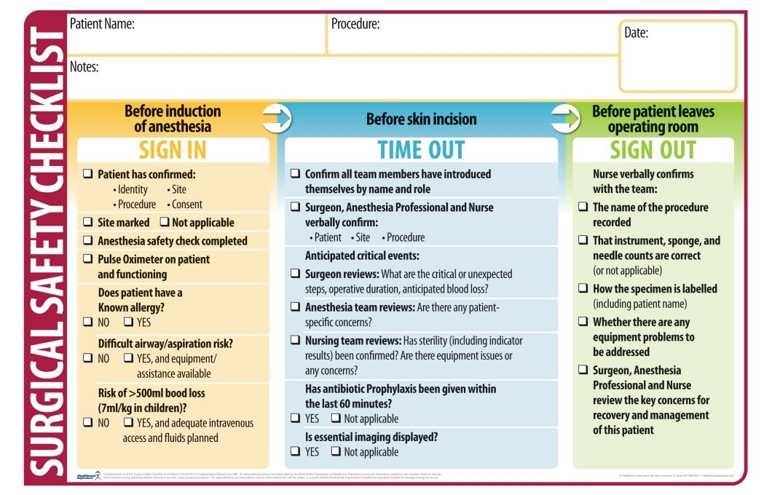

Slide 30
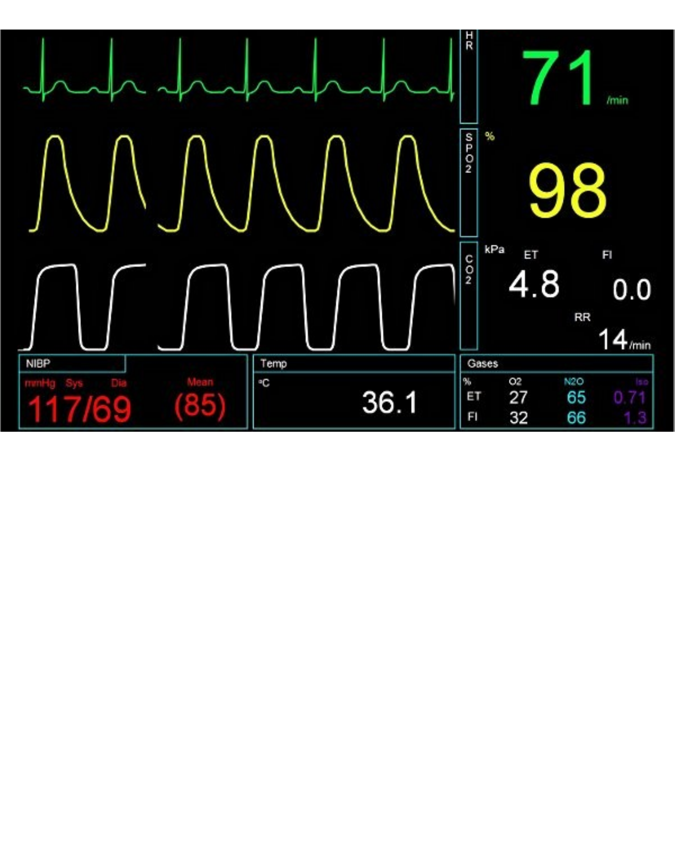
Standard monitoring recommended by ASA

Slide 31
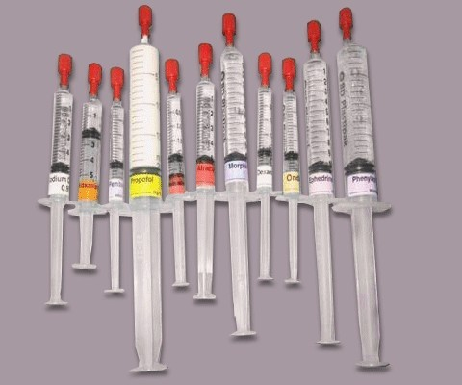
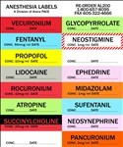
Medication
λ
Human error: most common
All drugs should be clearly labelled; cross check before administering
λ

Slide 32
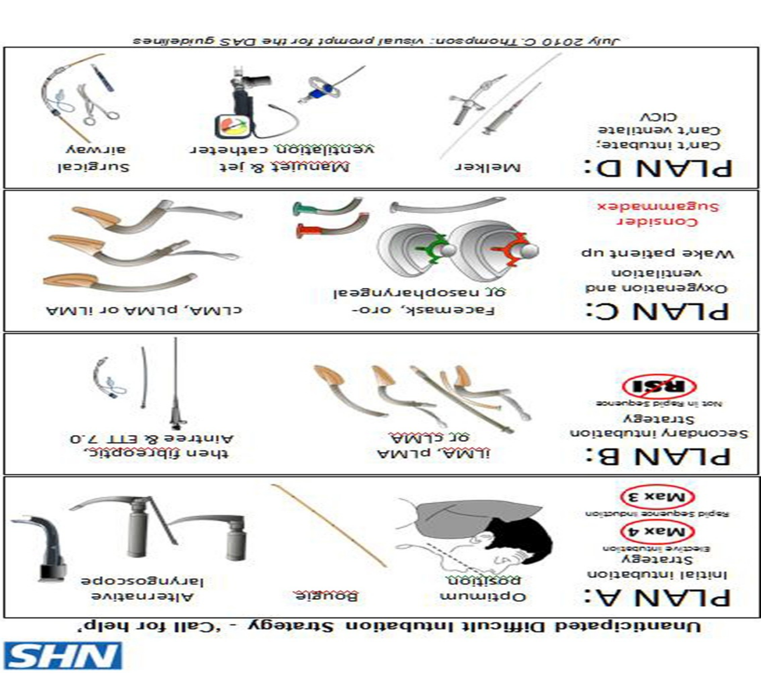
^{U}U^{na}na^{n}n^{t}t^{i}i^{c}c^{i}i^{p}pªa^{t}t^{ed}ed ^{Di}Di^{ff}ff^{ic}ic^{u}u^{lt}lt ^{A}A^{i}ir
^{way}

Slide 33
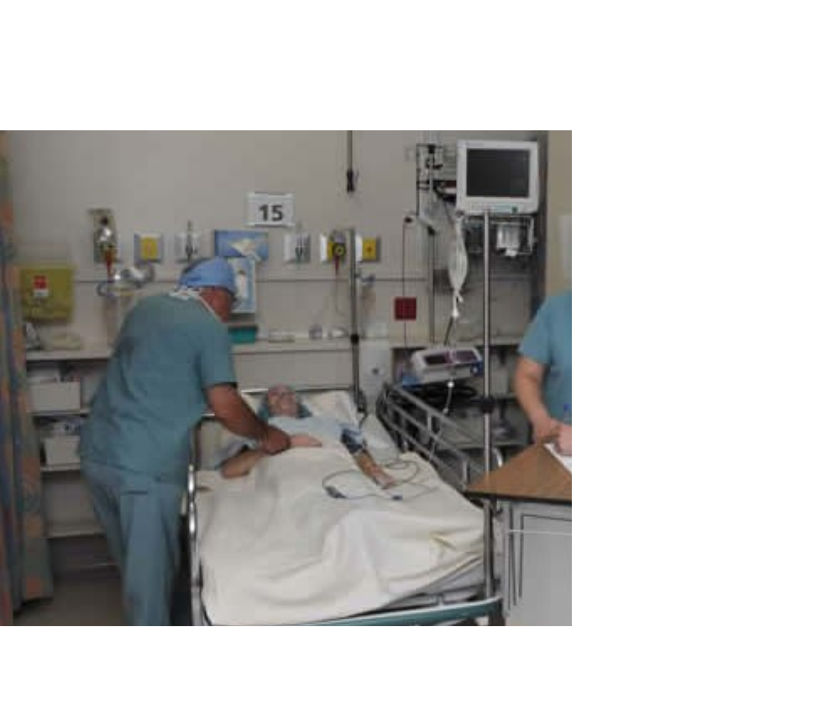
Post-anaesthesia Care
λ
Facilities and personnels
Monitoring Pain relief Discharged criteria
λ
λ
λ

Slide 34
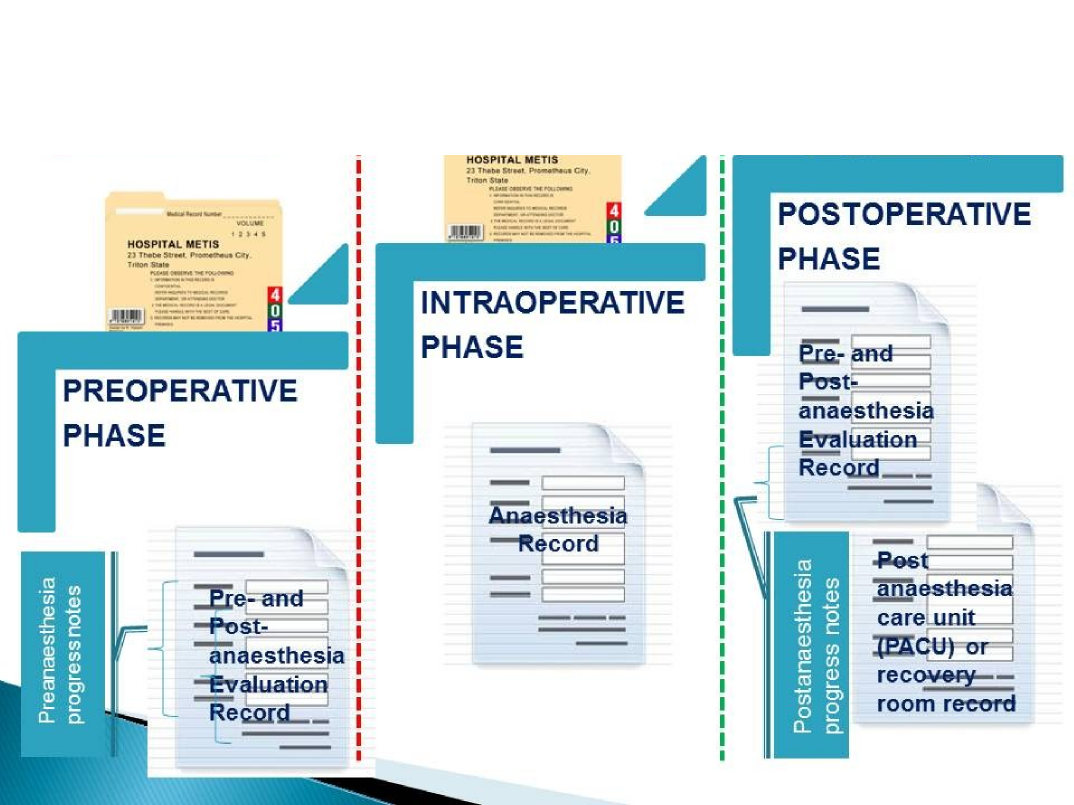
Documenta ion: Legal aspects

Slide 35
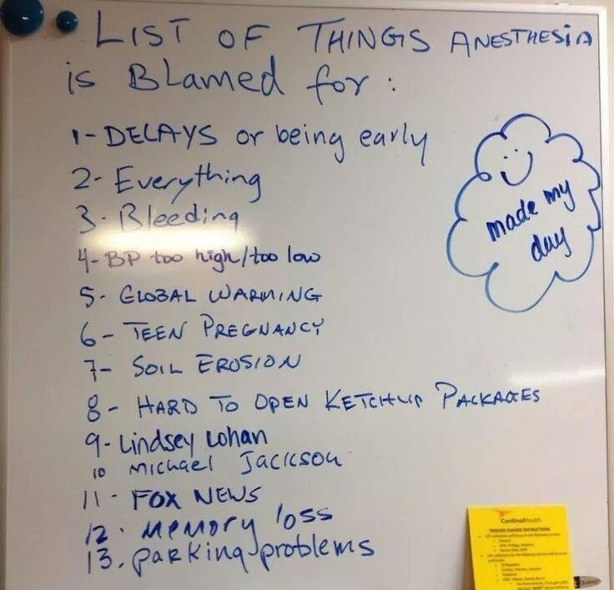
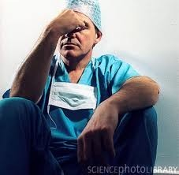
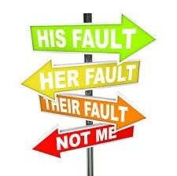
P_{P}o_{o}st_{st} Cri_{Cri}s_{s}i_{i}s_{s}
Avoid blame culture
_{Develop Help Culture}

Slide 36
Post Crisis: Recommendations for colleagues
λ
Be aware that such an adverse event could happen to you also
Discuss with your colleague or seniors. This is not weakness. This represents appropriate professional behaviour
λ
Listen to what your colleague wants to tell and support him/her with your professional expertise
λ
A professional work-up of that case based on fact is important for analysis and learning out of medical error.
λ
Senior/ colleague should offer support in discussing and briefing with patient/relative after an medical error.
λ

Slide 37
Changing definition of Anesthesia
λ
Word anaesthesia was coined from two greek words: “an”
meaning without and “aesthesis” meaning sensation.
λ
Traditionally the goal of anaesthesia were described as
Amnesia, analgesia, and muscle relaxant.
λ
More recently, Anaesthesia can be considered as a
_{science of reflex management.}

Slide 38
Aims of general anesthesia
In real there are Only 2 aims of GA
  Narcosis: unarousable unconsciousness
  Reflex Depression
Reflexes may
Motor : Movement, coughing
Autonomic reflexes
Cardiovascular: BP, HR changes
Neuro-endocrine: Cortisol, vasopressin

Slide 39
ANAESTHESIA “A Modern Concept”
General Anesthesia can thus be defined as
A reversible iatrogenic state characterised by unarousable unconsciousness and reflex depression

Slide 40
Present global scenario
Anesthesiologist worked in :
Operating theatre
Perioperative physician
Trauma , ICU care , Emergency
Pain physician
Palliative care provider

Slide 41
Reducing aspiration risk (fasting guideline)
Infant and children:
All Trauma patients; Pregnant Patient in labour: Considered to be full stomach
λ
formula milk- 6 hrs
Breast milk: 4 hrs
Clear fluid: 2 hrs
λ
λ
Obese
Diabetic
Pt with GERD Hiatus Hernia
Considered to be high risk for aspiration: Gastroprophylaxis even in full fasted state
Adult
λ
Heavy meal: 8 hrs
Light meal 6 hrs
Clear fluid: 2 hrs
λ
λ

Slide 42
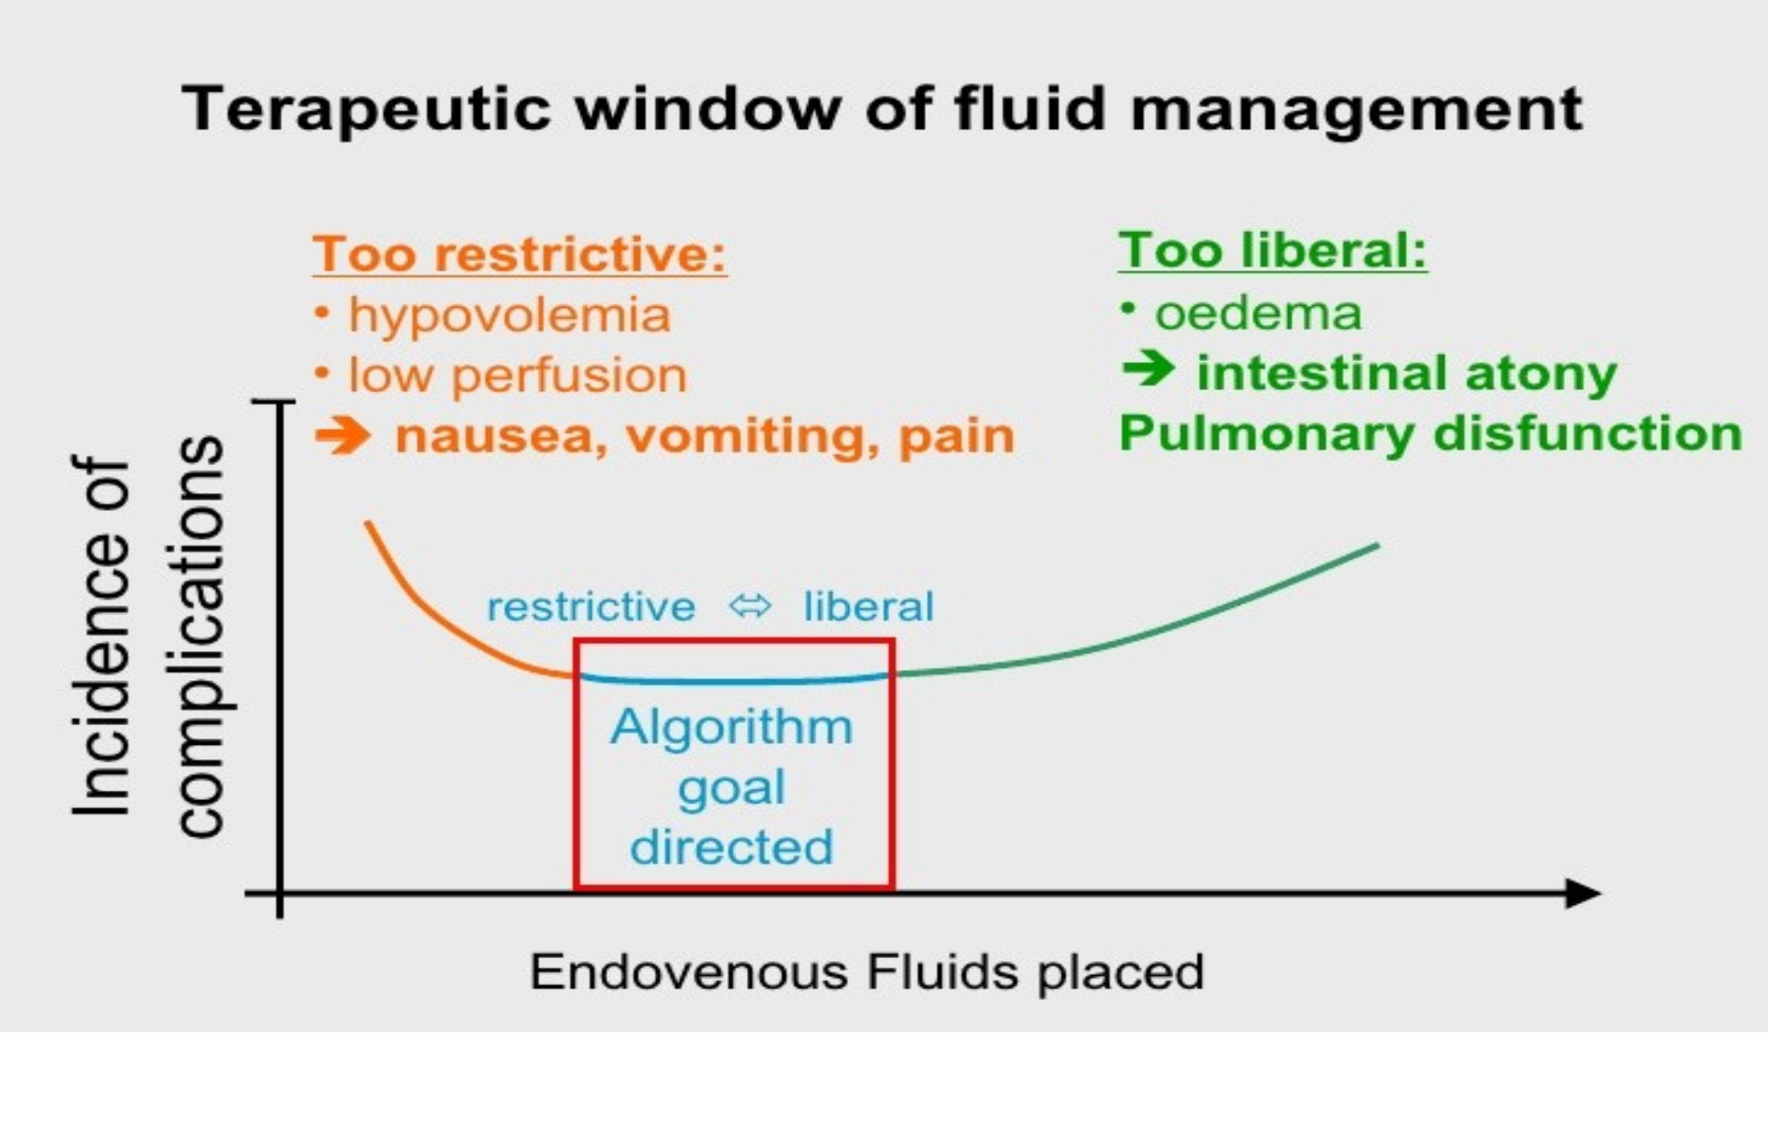
Restrictive Vs liberal fluid

Slide 43
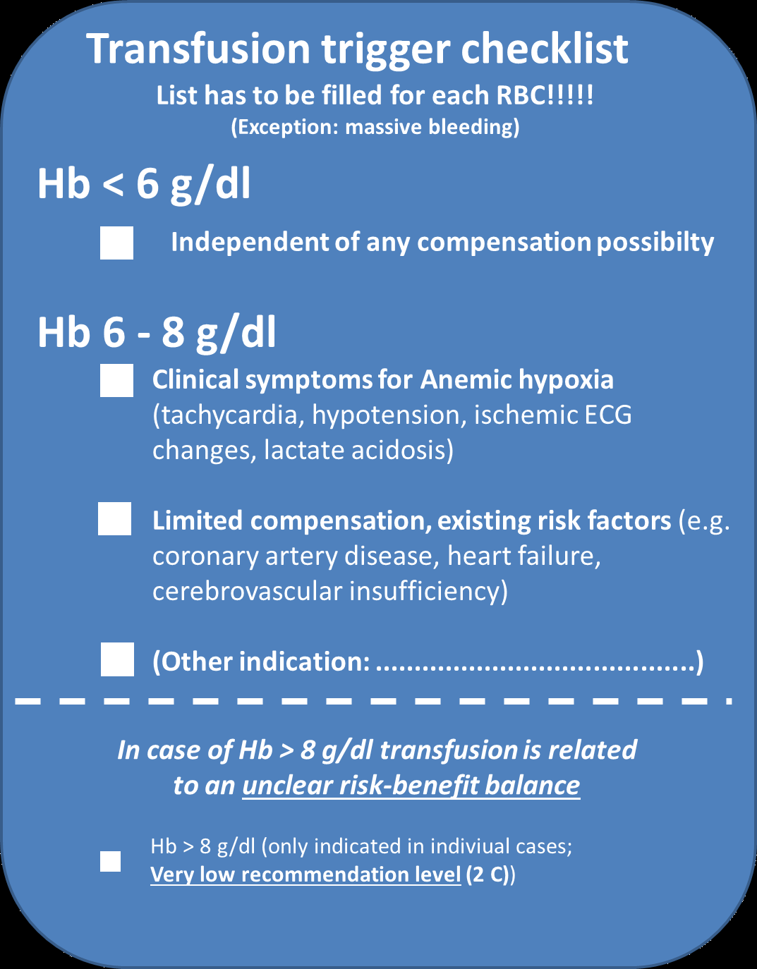
Rational use of Blood

Slide 44
Post operative pain
Multimodal analgesia
Preemptive preventive analgesia
Greater use of regional anesthesia technique
Regular analgesia technique not PRN
Identify problematic patient and formulate management plan

Slide 45
Why opioid free analgesia
Because opioids lead to:
PONV → delay of start feeding
Bladder bowel function
Sedation delay mobilization , patient discharge
, Pulmonary complication
immuno-suppressive effects infection cancer recurrent /mets
Inadequate analgesia persistence post-op pain into chronic pain

Slide 46
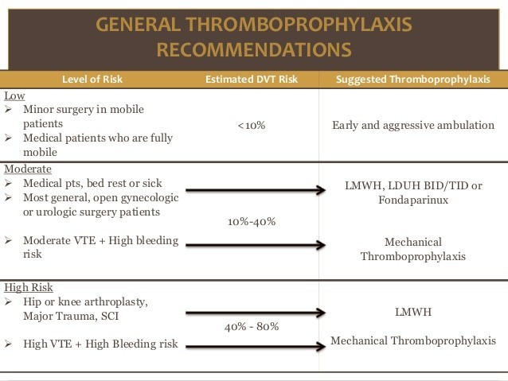

Slide 47
Hypothermia:peri-operative morbidity/mortality
Consequences of hypothermia
Shivering/oxygen requirement increased: myocardial oxygen
supply / demand
λ
Infection: Directly depress immune function, Vasoconstriction-
reduced tissue oxygen- predispose to infection
λ
Delay would healing
λ
Bleeding / transfusion: Depressed platelet and coagulation
λ
Depressed Cardiac function and risk for arrhythmias
λ
Delay recovery from anesthesia

Slide 48
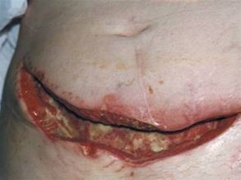
Postoperative infection-Anesthetic role ole
Antibiotic prophylaxis
Hand hyogein
Aseptic precausion for invasive procedures
Fluid balance , blood transfusion
Oxygen –avoiding hypoxia/hyperoxia

Slide 49

Safety first
λ
Unless Safe Anaesthesia is provided--> Safe Surgery will
not
be
Possible
and
-->Safety
of
Patient
cannot
be
ensured.
λ
So, Safe Anaesthesia-->Safe surgery-->Safe Patient

Slide 50
Thank
you

