Slide 1
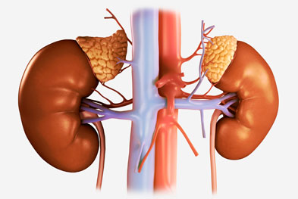
Approach to
Chronic Kidney Disease
Prof. Jamal Al Wakeel
Professor of Internal Medicine, Nephrology Consultant
Nephrology Unit, Department of Medicine

Slide 3
Chronic Kidney Disease
Objective
Epidemiology of CKD
Definition of CKD
Classification
Symptoms, signs and complications
Management of CKD

Slide 4
What is the prevalence of chronic kidney disease?
From 1 % to 3 %
From 10% to 16%
From 5 % to 8%
Age dependent

Slide 5
Prevalence of CKD
CKD in aged ≥20 yrs is >10% -18%
global CKD prevalence of 11-16%
The prevalence of CKD increases with age:
4% at age 29-39 y
47% at age >70 y
The majority of cases are stage 3
mortality in patients with CKD was 56% greater than that in patients without CKD.
For patients with stages 4-5 CKD, the adjusted mortality rate is 76% greater.
The 5-year survival rate for a patient undergoing long-term dialysis in the United States is approximately 35%
Notes:
A systematic review and meta-analysis of observational studies estimating CKD prevalence in general populations worldwide found a consistent estimated global CKD prevalence of 11-13%. The majority of cases are stage 3

Slide 6
Patients in replacement therapy in SA in 2016
8538
Tx. Pts 2016
Total HD
Pts. 2016
16315
Total No 26225 pt
In 2016, Peritoneal Dialysis a total of 1,372 patients
2016 HD Pts. Died
1658
New Pts. in 2016
4150
mean total cost of dialysis per patient per year was 46,332 USD (173,784 SR)
Total 1,215,056,700 SR
A 4.7% increase in new hemodialysis patients. in 2016
audi J Kidney Dis Transpl 2012;23(1):78-82
© 2012 Saudi Center for Organ Transplantation
Kalid Al Saran, Alaa Sabry
Notes:
A 4.7% increase in new hemodialysis patients. in 2016
The Dialysis Population Net Annual Increase of 4.6% has in 2016

Slide 7
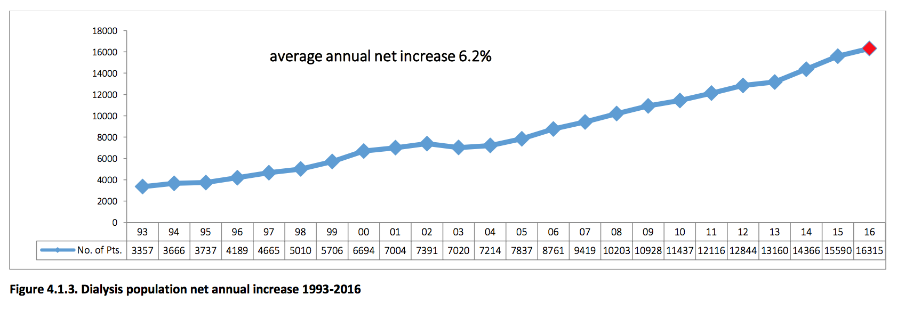

Slide 8
Case Study
55 yrs. old man with previous history of DM & hypertension and CKD came to emergency with repeated nausa & vomiting for 4 weeks. Last week investigation showed his Na 132, K 6.1,urea 28 mmol/L &S Cr 380 μmol/L. The nurse recorded that his vital signs are:
BP – 190/105 mmHg
Pulse rate – 50 beats/min
What will your approach be for this case?

Slide 9
History
History of major complain
History of present illness
{ Site ,Onset , Duration, character, course, frequency, severity, aggravating, reliving factors ,radiation, associated symptoms,symtems of system involve(12) }
History of hypertension(cause, duration, control, medication, complication)
Diabetes Mellitus(type, duration, control, medication, complication)
History of uremia
Systemic review

Slide 10
History of uremia
Manifestations of uremia (Azotemia )in end-stage renal disease (ESRD),
↓ appetite
History of weight loss in 6 months
Nausea and vomiting
Fatigue ,tiredness
Itchiness
Leg cramp
Decrease concentration
Fluid overload
Pericarditis
History of urinary symptom
Notes:
CNC :Encephalopathy: Can progress to coma and death
Peripheral neuropathy
Restless leg syndrome
Gastrointestinal symptoms: Anorexia, nausea, vomiting, diarrhea
Skin manifestations: Dry skin, pruritus, ecchymosis
Fatigue, increased somnolence, failure to thrive
Malnutrition
Pericarditis: Can be complicated by cardiac tamponade, possibly resulting in death
Salt& water retension : edema ,SOB
Platelet dysfunction with tendency to bleed
Erectile dysfunction, decreased libido, amenorrhea

Slide 11
History
Systemic review
Past Medical illness
Surgical
Medication
Family
Social
Allergy
Notes:
Chronic kidney disease has become a serious public health issue. There are currently over 1.4 million patients receiving renal replacement therapy worldwide. One way to reduce the economic burden of chronic kidney disease would be early intervention. In order to achieve this, we should be able to identify individuals with increased risk of renal disease. An individual's genetic and phenotypic make-up puts him/her at risk for kidney disease. Factors such as race, gender, age, and family history are highly important. For instance, being of African-American decent, older age, low birth weight and family history of kidney disease are considered to be strong risk factors for chronic kidney disease. Moreover, smoking, obesity, hypertension, and diabetes mellitus can also lead to kidney disease. An uncontrolled diabetic and/or hypertensive patient can easily and quickly progress to an end-stage kidney disease patient. Exposure to heavy metals, excessive alcohol consumption, smoking, and the use of analgesic medications also constitute risks. Experiencing acute kidney injury, a history of cardiovascular disease, hyperlipidemia, metabolic syndrome, hepatitis C virus, HIV infection, and malignancy are further risk factors. Determination of serum creatinine levels and urinalysis in patients with chronic kidney disease risk will usually be sufficient for initial screening.

Slide 12
Examination

Slide 13
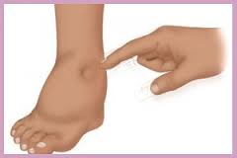
Examination
Posture
Look ill
BMI – 25 kg/m²
BP - 185/80 mmHg sitting both arm
Pulse rate – 50 beats/min
Breathing rate, pattern
Pale
Edema
Mouth
Itching marks
Hand examination

Slide 14
Cardiovascular examination
JVP – 3cm
S1 + S2 + S3
ESM grade II at apex
No pericardial rub

Slide 15
Chest examination
Scratch mark in the back
Right side – stony dullness
↓TVF in right side
Bilateral basal crepitation with vesicular breath
↓breathing sound at right side
↓ Voice Sounds at right side

Slide 16
Abdominal examination
Scratch mark
No organomegaly
Epigastric tenderness
No aortic or renal bruits
No suprapubic mass
No shifting dullness

Slide 17
CNS
Drowsiness
Fundus examination > diabetic retinopathy
No asthraxis
Normal power
Decrease Touch Sensation and vibration & sensation in both legs
Normal Coordination

Slide 18
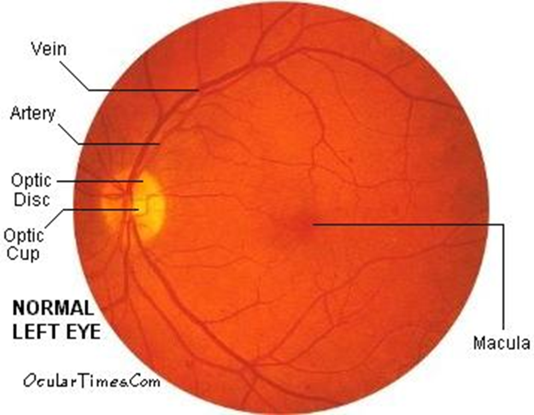
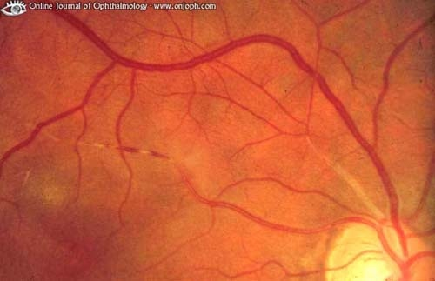
Fundus examination

Slide 20
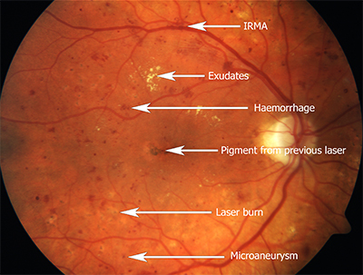
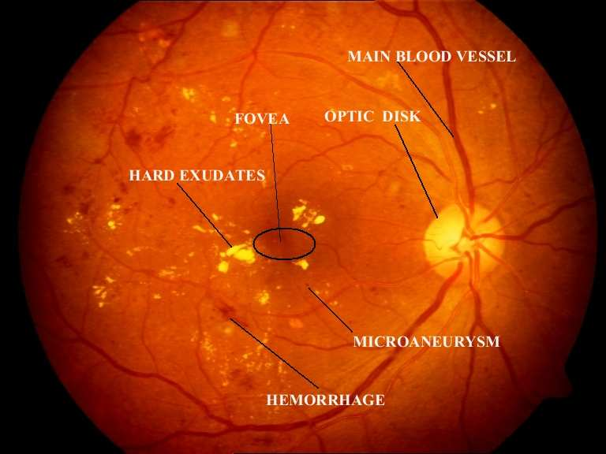
Diabetic Retinopathy
Intraretinal micro vascular abnormalities (IRMA)

Slide 22
Clinical Diagnosis

Slide 23
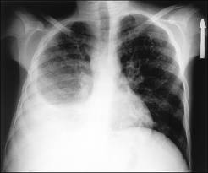
Clinical Diagnosis
CKD due to DM and HTN
Possible AKI
Nausea & vomiting possible due uremia
Diabetic retinopathy
Hypertension uregency(grade3)
Anemia
Functional murmur
Itching
Right pleural effusion
Fluid overload with pulmonary edema
Bradycardia
Diabetic peripheral neuropathy

Slide 24
European Society of Nephrology Classification of Blood Pressure Levels
Category | Systolic blood pressure (mmHg) | Diastolic blood pressure (mmHg)
Optimal blood pressure | <120 | <80
Normal blood pressure | <130 | <85
High-normal blood pressure | 130-139 | 85-89
Grade 1 hypertension (mild) | 140-159 | 90-99
Grade 2 hypertension (moderate) | 160-179 | 100-109
Grade 3 hypertension (severe) | >/= 180 | >/= 110
Isolated systolic hypertension | >140 | <90

Slide 28
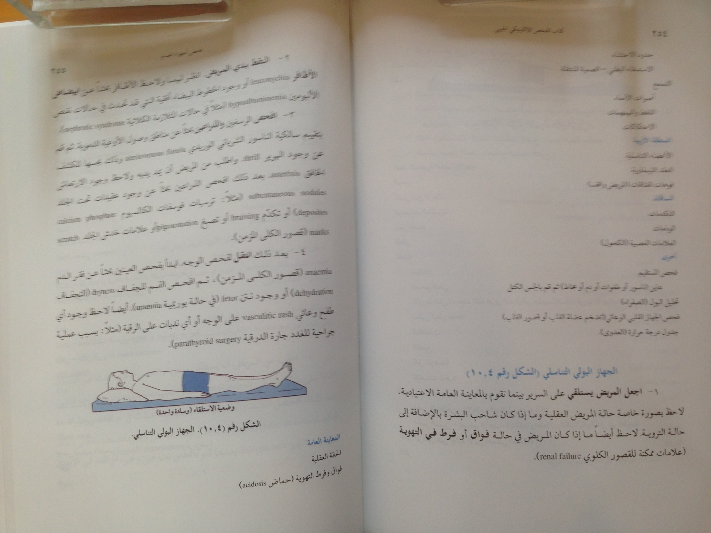

Slide 29
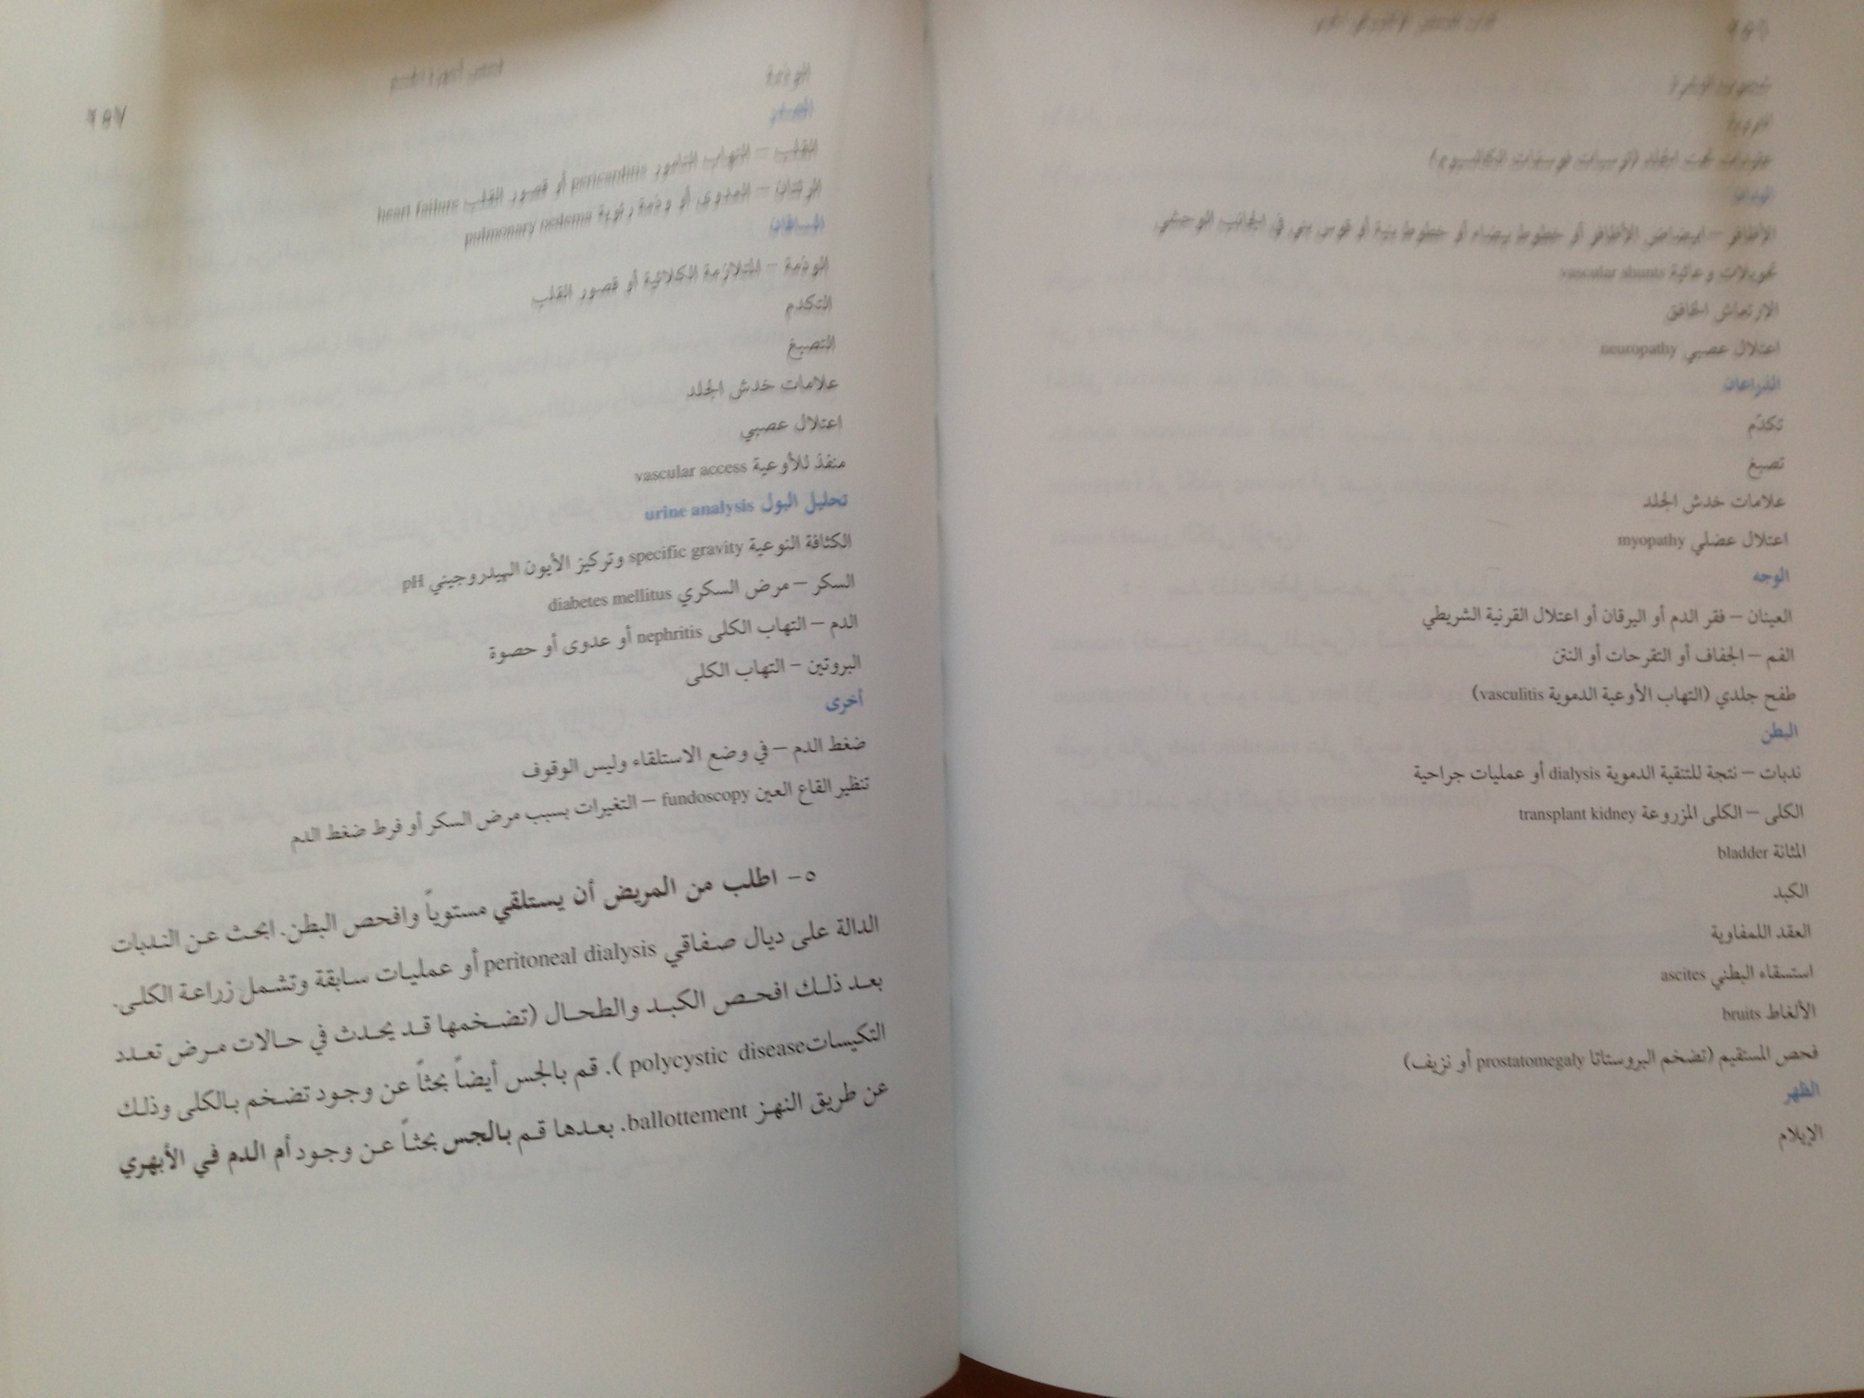

Slide 30
Investigation

Slide 31
Investigation
CBC
Hemoglobin –85g/L
RBCs 3500000/L
WBC – 5,000/L
Platelet – 120,000/L
MCV – 82 fL
Biochemistry (Repeated)
NA – 136 mmol/L
K – 6.4 mmol/L?
Cr – 320 μmol/L- eGFR =18 ml/min ?
Urea – 24 mmol/L

Slide 32
Investigation
Ca – 1.9 mmol/L
PO₄ – 3.9 mmol/L
Albumin – 29 g/L
Uric acid - 690 mmol/L
Bicarbonate 14 mmol/L??
Chloride 102 mmol/L
N= 1.12 to 1.45mmol/L

Slide 33
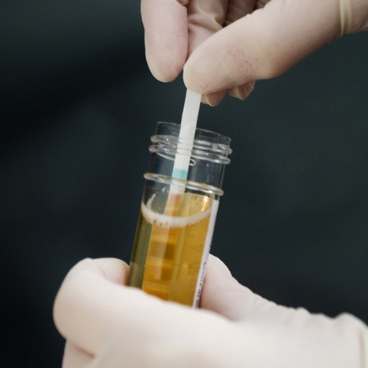
Investigations
Urine Analysis
pH - 6
Urine RBC = negative
WBC – 5 cu/L
Protein = ++ve
Specific gravity – 1010
Broad waxy cast
Urine albumin creatinine ratio
24 hour urine collection
Creatinine clearance
Proteinuria

Slide 34
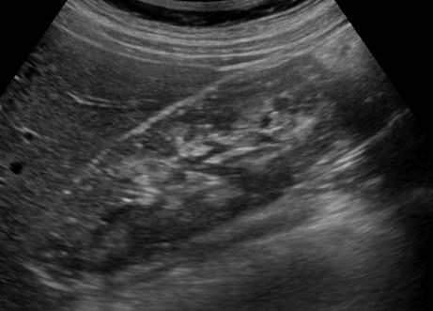
Investigation
Normal size kidneys – 12 cm
Normal Echogenicity

Slide 35
Diagnosis
CKD
- cause possible hypertension & DM Nephropathy
- stage G 4 (eGFR 18 ml/min)
A +3
Hyperkalemia
Metabolic acidosis –high anion gap
Anemia
Hypocalcemia
Hyperphosphatemia
Hyperuricemia
Diabetic Neuropathy and Retinopathy

Slide 36
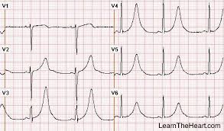
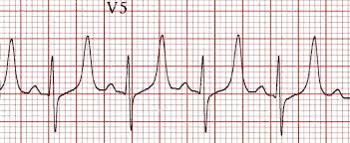
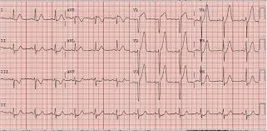
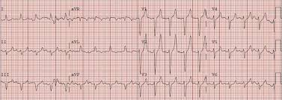
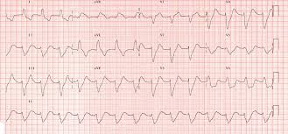
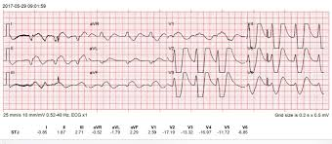

Slide 37
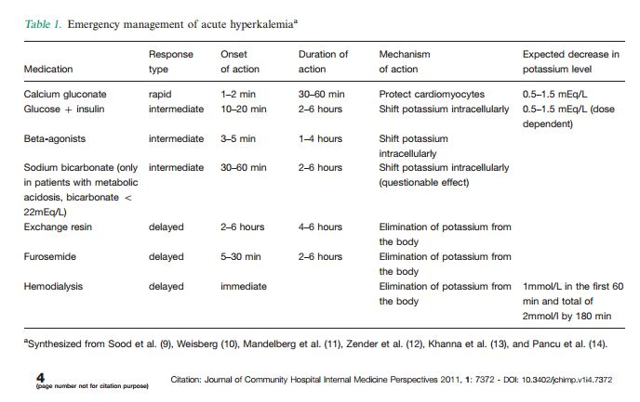

Slide 38
Kidney International Supplements 2017 7, 1-59DOI: (10.1016/j.kisu.2017.04.001)
Kidney International Supplements 2017 7, 1-59DOI: (10.1016/j.kisu.2017.04.001)
Copyright © 2017 KDIGO Terms and Conditions

Slide 39
Staging of chronic kidney disease depend on ?
Measurement of serum creatinine
Measurement creatinine clearance
Estimated GFR
Urine albumin creatinine ratio
Causes of chronic kidney disease

Slide 40
chronic disease can be diagnosed ?
If the patient have ultrasound shows scaring in the kidney should not consider chronic kidney disease.
If patient have proteinuria but normal eGFR should not consider chronic kidney disease
If the patient have high serum creatinine and normal ultrasound you should not consider chronic kidney disease.
If the patient have proteinuria and hematuria with low eGFR you should consider chronic kidney disease

Slide 41
Regarding the symptoms of chronic kidney disease
Patient can be advance renal failure and asymptomatic
Symptoms usually starts in stage 1
Symptoms most commonly appear in stage 3
Stage 5 usually indicate to start dialysis

Slide 42
Kidney damage
Structural abnormalities
GFR < 60 ml/min/1.73 m²
Functional abnormalities
for ≥3 months
Structural abnormalities detected by imaging
Abnormalities detected by histology
History of kidney transplantation
Albuminuria
Electrolyte and other abnormalities
Urine sediment abnormalities
tubular disorders

Slide 43
KDIGO recommendation -classified based on:
Cause
GFR category
Albuminuria category (CGA)

Slide 44
Staging
. The stages of CKD are classified as follows
Stage 1: Kidney damage with normal or increased GFR (>90 mL/min/1.73 m²) Normal or high
Stage 2: Mild reduction in GFR (60-89 mL/min/1.73 m²) Mildly decreased*
Stage 3a: Moderate reduction in GFR (45-59 mL/min/1.73 m²)
Stage 3b: Moderate reduction in GFR (30-44 mL/min/1.73 m²)
Stage 4: Severe reduction in GFR (15-29 mL/min/1.73 m²)
Stage 5: Kidney failure (GFR < 15 mL/min/1.73 m² or dialysis)
The majority of cases are stage 3

Slide 45
Stage 1
Stage 1 and stage 2 CKD, reduced GFR alone does not clinch the diagnosis, except :
Albuminuria (albumin excretion >30 mg/24 hr or albumin: creatinine ratio >30 mg/g [>3 mg/mmol])
Urine sediment abnormalities
Electrolyte and other abnormalities due to tubular disorders
Histologic abnormalities
Structural abnormalities detected by imaging
History of kidney transplantation in such cases
The majority of cases are stage 1&2 asymptomatic

Slide 46
CKD Classification Estimation and Measurement of GFR
Estimate and/or Measure GFR
Filtration Markers (Endogenous)
Creatinine Clearance (CrCl)
eGFR equations
eCKD- EPI cr
eCKD-EPI-cyc
Cystatin C
Polypeptide
chain of 120 amino acids

Slide 47
Calculators
Chronic Kidney Disease Epidemiology Collaboration (CKD-EPI)
Modification of Diet in Renal Disease (MDRD) Study equation

Slide 48
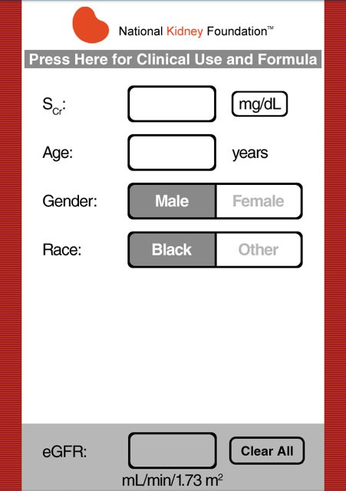
CKD – EPI Calculation

Slide 49
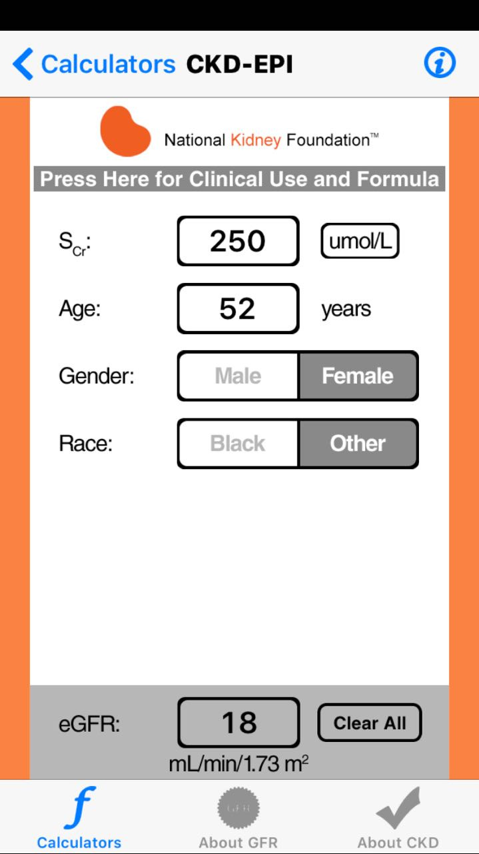

Slide 50
Albuminuria categories as follows:
*note that where albuminuria measurement is not available, urine reagent strip results can be substituted
Albuminuria categories in CKD
Category | AER (mg/24 hours) | ACR (mg/mmol) | ACR (mg/g) | TERMS
 |  | approximate | equivalent
A1 | < 30 | <3 | <30 | Normal to mildly increased
A2 | 30-300 | 3-30 | 30-300 | Moderately increased*
A3 | >300 | >30 | >300 | Severely increased**
*Relative to young adult level
** Including nephrotic syndrome (albumin excretion usually > 2200 mg/24 hours
[ACR .2220/g; >220 mg/mmol])1
Kidney International Supplements (2013) 3, 5-14

Slide 51
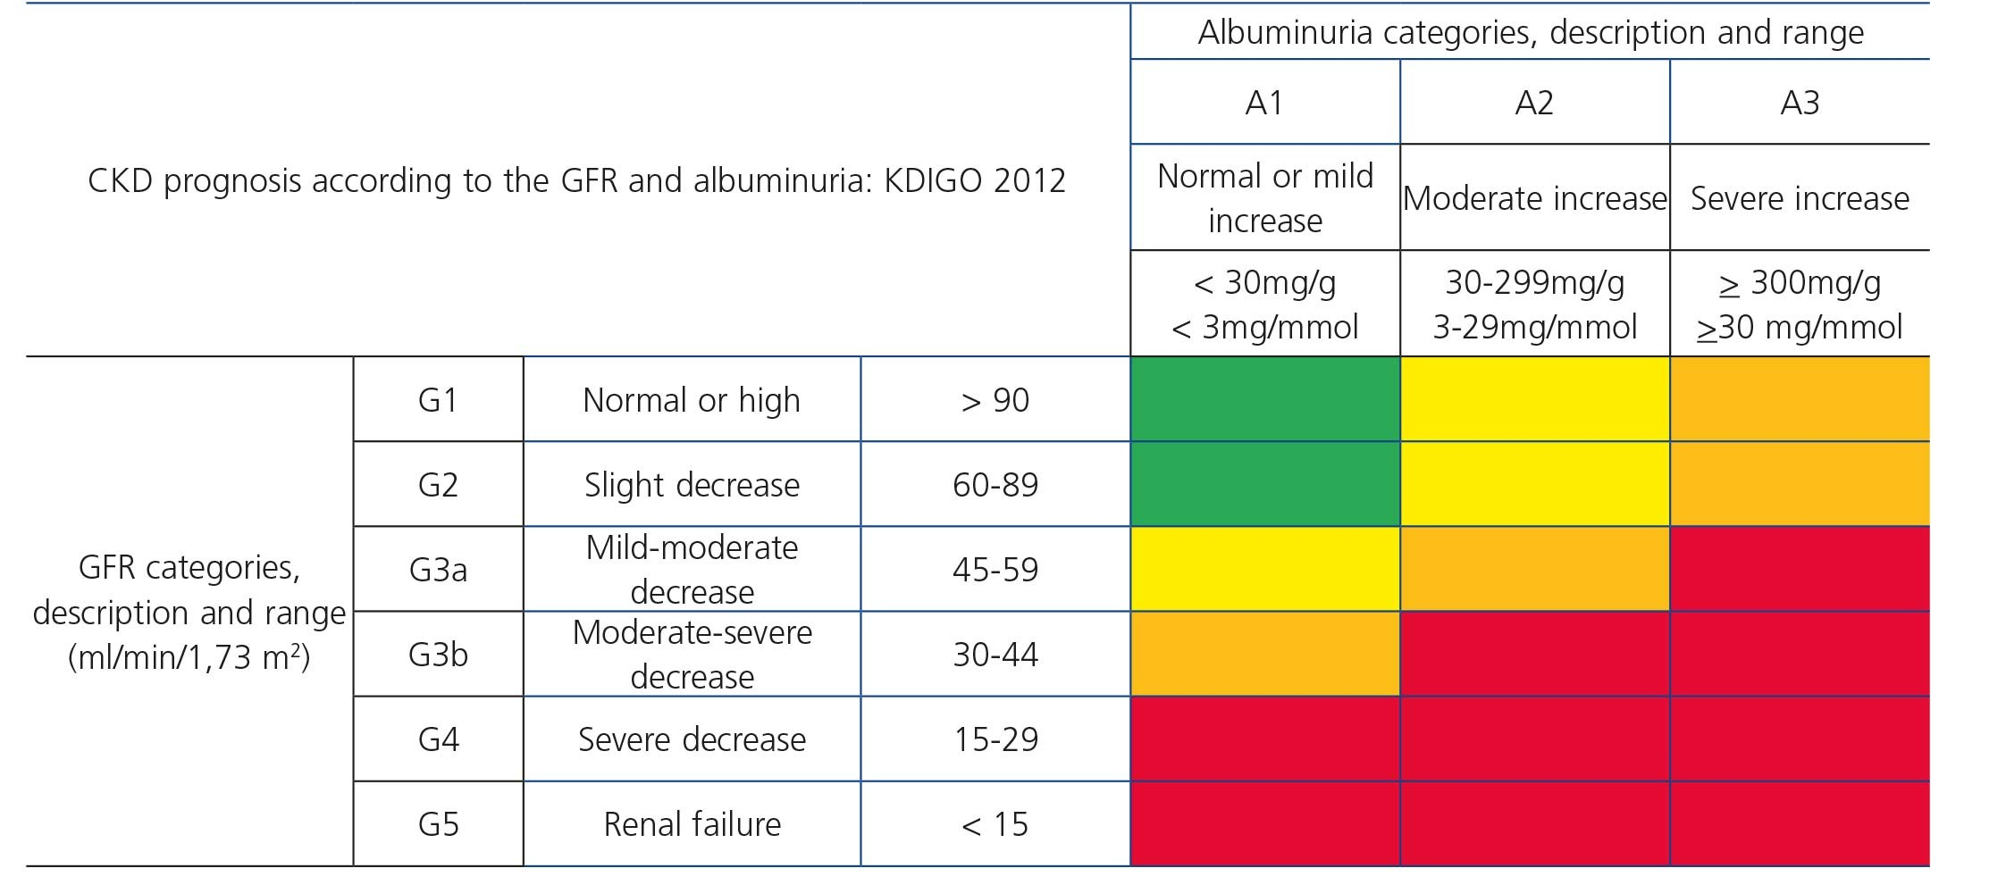

Slide 52
KDIGO recommendation -classified based on:
Cause
GFR category
Albuminuria category (CGA)

Slide 53
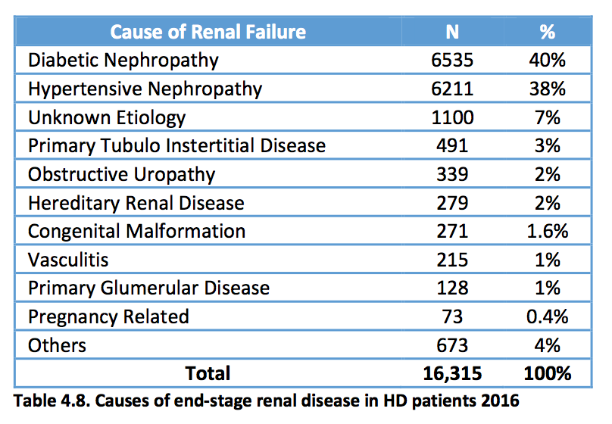

Slide 55
Risk Factors CKD
Diabetes Mellitus 30%
Hypertension 25%
Old age 50%
Low GFR AKI
Obesity
Cardiovascular disease
NSAID
Family History
Smoking

Slide 56
The stage of chronic kidney disease
If the patient have serum creatinine for 6 weeks should consider CKD
If the patient have hematuria and high serum creatinine should be diagnosed with chronic kidney disease
If the patient have EGFR less than 60 should be considered kidney disease

Slide 57
In chronic kidney disease
Hyperkalemia is more common than hypokalemia
Acidosis usually with normal anion gap
Hypercalcemia is common
Phosphate usually low

Slide 58
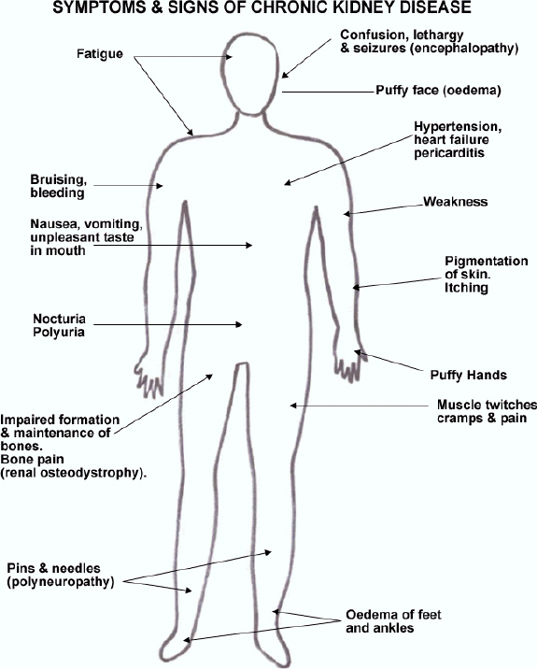
Signs and Symptoms
Hyperparathyrodism
,Epistaxis,
Anemia (Musocal pallor)
Plural effusion, plural edema
Bruising
Amenorrhea
Impotence Infertility
Notes:
metabolic acidosis in stage 5 CKD include the following:
Protein-energy malnutrition
Loss of lean body mass
Muscle weakness
Signs of alterations in the way the kidneys are handling salt and water in stage 5 include the following:
Peripheral edema
Pulmonary edema
Hypertension
Anemia in CKD is associated with the following:
Fatigue
Reduced exercise capacity
Impaired cognitive and immune function
Reduced quality of life
Development of cardiovascular disease
New onset of heart failure or the development of more severe heart failure
Increased cardiovascular mortality
Patients with CKD stages 1-3 are generally asymptomatic
Manifestations of uremia in end-stage renal disease (ESRD),
Pericarditis: Can be complicated by cardiac tamponade, possibly resulting in death if unrecognized
Encephalopathy: Can progress to coma and death
Peripheral neuropathy, usually asymptomatic
Restless leg syndrome
Gastrointestinal symptoms: Anorexia, nausea, vomiting, diarrhea
Skin manifestations: Dry skin, pruritus, ecchymosis
Erectile dysfunction, decreased libido, amenorrhea
Platelet dysfunction with tendency to blee
The medical care of patients with CKD should focus on the following:
Delaying or halting the progression of CKD: Treatment of the underlying condition, if possible, is indicated
Diagnosing and treating the pathologic manifestations of CKD
Timely planning for long-term renal replacement therapy

Slide 59
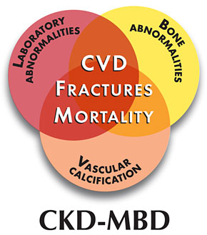
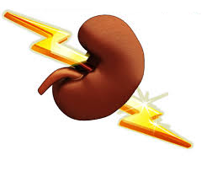
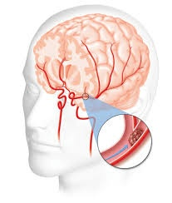
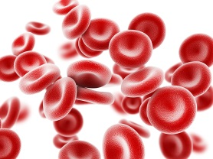
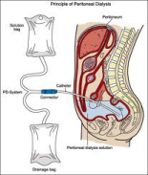
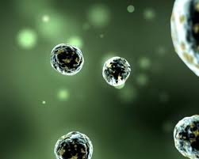
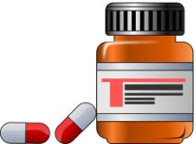
Complications of CKD
Recognized as the 9th leading cause of death in the United States
Mineral
and
Bone Disorder
AAKIKIAKI
Stroke
Cardiovascular Disease
Acute coronary syndrome
Heart failure
Heart rhythm disturbances
Anemia
ESRD
Infection
Drug Dosing
Acidosis
pH

Slide 60
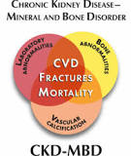
CKD MBD indicate
Change in calcium& phosphate &parathyroid hormone,Vit D
Indicate change in the bone metabolize and mineral
Indicate change in the extra skeletal calcification and vascular,valvular calcification

Slide 61
Mineral abnormalities of Chronic Kidney Disease (CKD)
↓GFR
↓25(OH) Vitamin D
↑Phosphorus
↑ FGF 23
↓1,25(OH) Vitamin D
↓Calcium
↑PTH

Slide 62
Secondary hyperparathyroidism develops in CKD because :
Hyperphosphatemia
Hypocalcemia
Decreased renal synthesis of 1,25-dihydroxycholecalciferol (1,25-dihydroxyvitamin D, or calcitriol)
Intrinsic alteration in the parathyroid glands, which gives rise to increased PTH secretion and increased parathyroid growth
Skeletal resistance to PTH

Slide 63
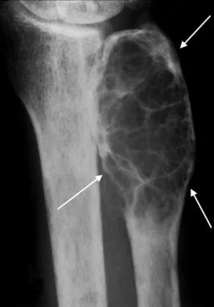
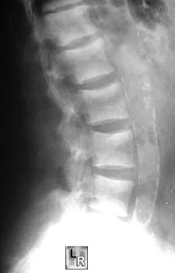
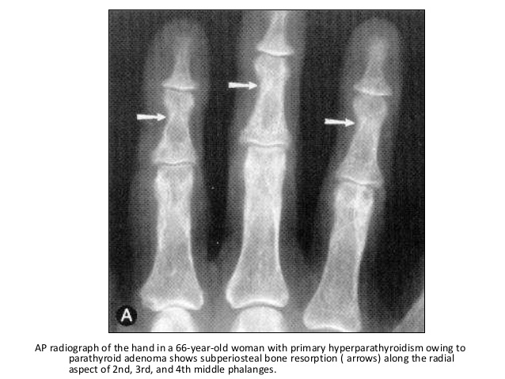
osteitis fibrosa cystica),

Slide 64
Renal osteodystrophy
high bone turnover disease related to secondary hyperparathyroidism (referred to as osteitis fibrosa cystica),
low turnover disease (referred to as adynamic bone disease),
osteomalacia (low turnover disease accompanied by undermineralized bone tissue)
mixed disease where features of both high and low bone turnover disease are present
Notes:
Different types of bone disease occur with CKD, as follows:
High-turnover bone disease from high parathyroid hormone (PTH) levels
Low-turnover bone disease (adynamic bone disease)
Defective mineralization (osteomalacia)
Mixed disease
Beta-2-microglobulin–associated bone disease

Slide 65
Diagnosis of CKD
Basic Laboratory studies used in the diagnosis of CKD can include the following:
Complete blood count (CBC)
Biochemistries(Na, K, Urea, Cr, HCO₃, Ca, PO3, Uric, Albumin, Alk ph)
Urinalysis
24 hour urine collection Creatinine clearance and proteinuria
Urine albumin:creatinine ratio
Glucose
Lipid profile:
increased risk of cardiovascular disease

Slide 66
Diagnosis of CKD
Laboratory studies used in the diagnosis the cause of CKD
HbA1c
ANA
HBsAg
HCV.
C₃,C₄
Investigation used in the diagnosis the complications of CKD
PTH
VIT D₃
ECH
ECG
Renal Biopsy

Slide 67
CT, MRI, and Radionuclide Scans
Renal Ultrasonography:initial imaging
CT, MRI: Intravenous (IV) should be avoided
Radionuclide Scans: quantitates differential renal contribution to total glomerular filtration rate (GFR)

Slide 68
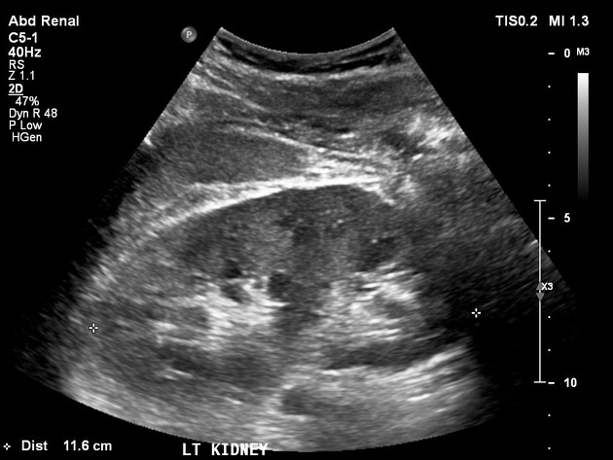
Renal Ultrasonography:initial

Slide 69
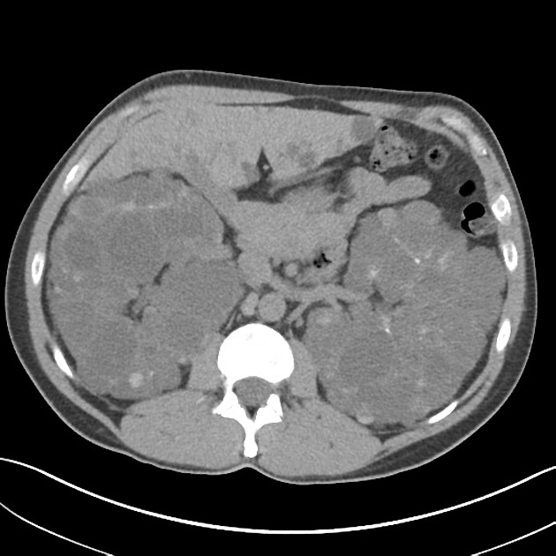

Slide 70
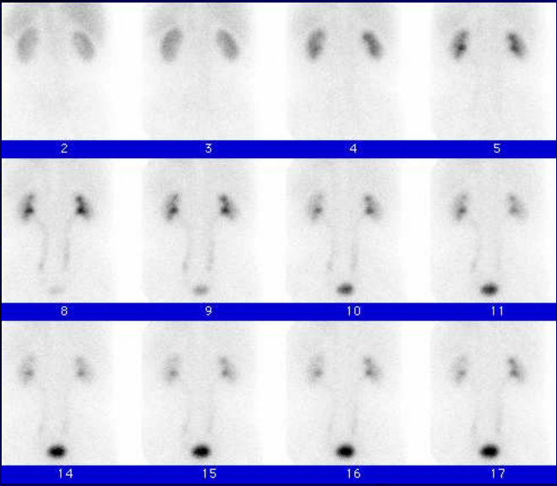

Slide 71
Diagnosis of CKD
Different
Acute Kidney Injury form
CKD
Reversible factors
Differentiating between acute and chronic kidney disease

Slide 72
Treatment of chronic kidney disease??
The treatment usually alable to cure chronic kidney disease
Its slow progressive of chronic kidney disease
It include treatment of hypertension and reduce proteinuria
Acidosis should be treated in chronic kidney disease

Slide 73
Management of CKD
The medical care should:
Prevent CKD
Delaying or halting the progression of CKD
Treatment of the underlying condition
Treating the complications
Timely planning for long-term for RRT

Slide 74
Risk Factors CKD
Diabetes Mellitus 30%
Hypertension 25%
Old age 50%
Low GFR AKI
Obesity
Cardiovascular disease
NSAID
Family History
Smoking
Prevention of CKD
Eary scren

Slide 75
BP control
Hyperlipidemia
Correct Acidosis
Diet
Protein, PO3 & salt
Prevention &Slow progress of CKD
Glycemic Control
Proteinuria & RAAS
Avoid Nephrotoxic Drug

Slide 76
Target Blood Pressure in CKD
≤130/80
Diabetics and Non-diabetics
Albuminuria | Target BP | Drug of choice
A1 <30 mg/d | ≤130/80 | CBC, Diuretic, RAAS
A2 >30 mg/d | ≤ 130/80 | ARB or ACE-I
No B-blocker
NO b-b

Slide 77
Renal Diet
Low salt diet – 3 g/day
Low potassium diet
(2g-2.5 g), half of normal intake
Low protein diet - 0.6 to 0.8 g/kg per day
Low phosphorous diet – 800 – 1000 mg/day
Water intake – daily water intake 1.5-2 L
Restricted Magnesium

Slide 78
Treatment of Complications
Volume overload:
restrict SALT
loop diuretics
Metabolic acidosis:
oral alkali supplementation

Slide 79
Treatment of Complications
Anemia: hemoglobin level ↓10 g/dL –
check iron -iron Tablet or IV
erythropoiesis-stimulating agents (ESAs)
epoetin alfa
darbepoetin alfa
Methoxy polyethylene glycol-epoetin beta(Mircera)
Hyperkalemia
Low K Diet
Resonium Ca ,Na resonium
Patiromer
Zirconium Cyclosilicate
Hyperphosphatemia
dietary phosphate restriction
dietary phosphate binders (Ca Carbonate, Ca Acetate, Sovlomier, lanthium)
Hypocalcemia
calcium supplements with or without calcitriol
Hyperparathyroidism
Calcitriol
vitamin D analogs
Notes:
Patiromer
Zirconium Cyclosilicate

Slide 80
Treatment of Complications
Uremic manifestations:
Long-term renal replacement therapy
hemodialysis
peritoneal dialysis
renal transplantation

Slide 81
Indications for renal replacement therapy
Severe metabolic acidosis
Hyperkalemia
Intractable volume overload
Pericarditis
Uremic Symptoms
Encephalopathy
Failure to thrive and malnutrition
Peripheral neuropathy
Intractable gastrointestinal symptoms
In asymptomatic patients
GFR of 5-8 mL/min/1.73 m²

Slide 82
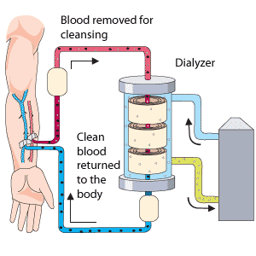
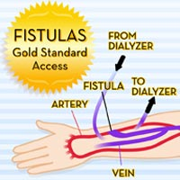
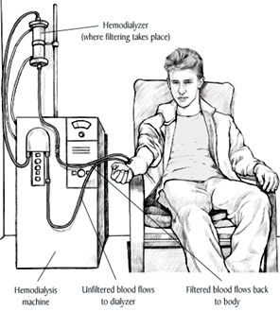
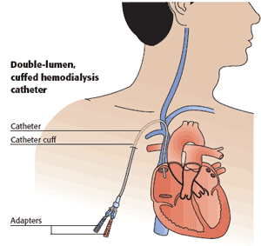
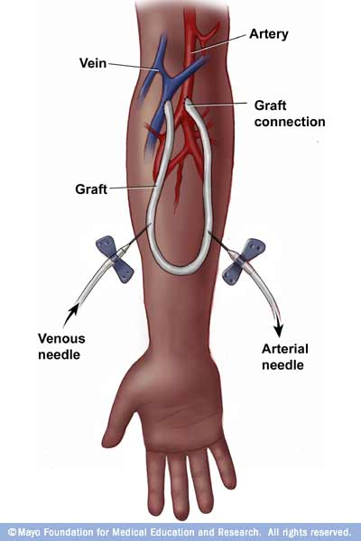
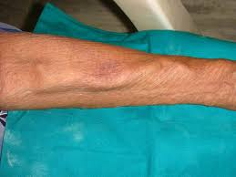
Hemodialysis

Slide 83
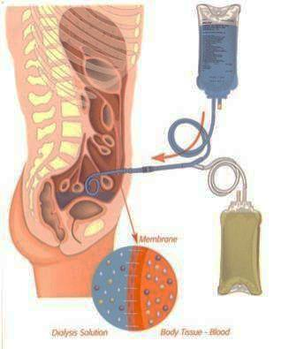
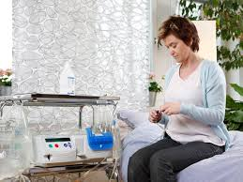
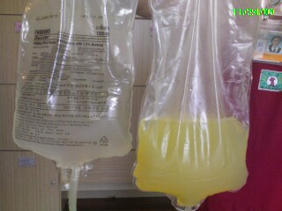
Peritoneal Dialysis

Slide 84
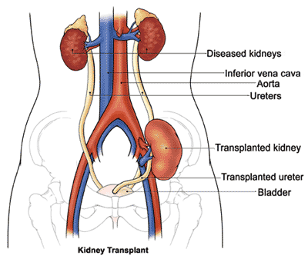
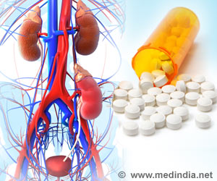
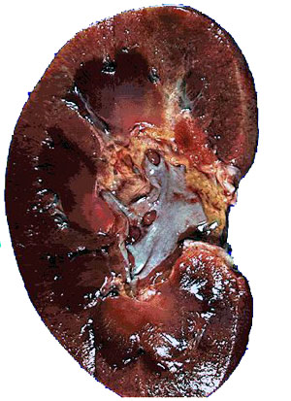
Renal Transplantation
Renal Transplant Medication
Renal Transplant Rejection& infection
Better qulity of live ,less mortality ,can be before HD

