Slide 1

Fifth Year – Introductory Guide

Slide 2

This Presentation will cover:
Course Objectives: Internal Medicine, General Surgery, Pediatrics
Study references
Common scenarios regarding college rules and regulations
Questions and answers

Slide 4
Internal Medicine:
Credit hours: 10 hours
Course duration: 10 weeks
Distribution of grades:
Midterm (Long-case): 20
Final (MCQ): 25
Final (OSCE): 20
Mini-CEX (x4)
Evaluation (x2)
Clerking
DxR

Slide 5
Course activities:
DXR
Clinics
Rounds
Morning meetings
ER on-calls (?)
Cardio/neuro sessions
- BST sessions

Slide 6
Study Sources (Theory):
Step-Up to Medicine
First aid for the USMLE step 2CK
Toronto notes
Master the boards
Davidson’s
Danish
Kumar and Clark’s
Oxford
Churchill’s pocketbook for DDx

Slide 10
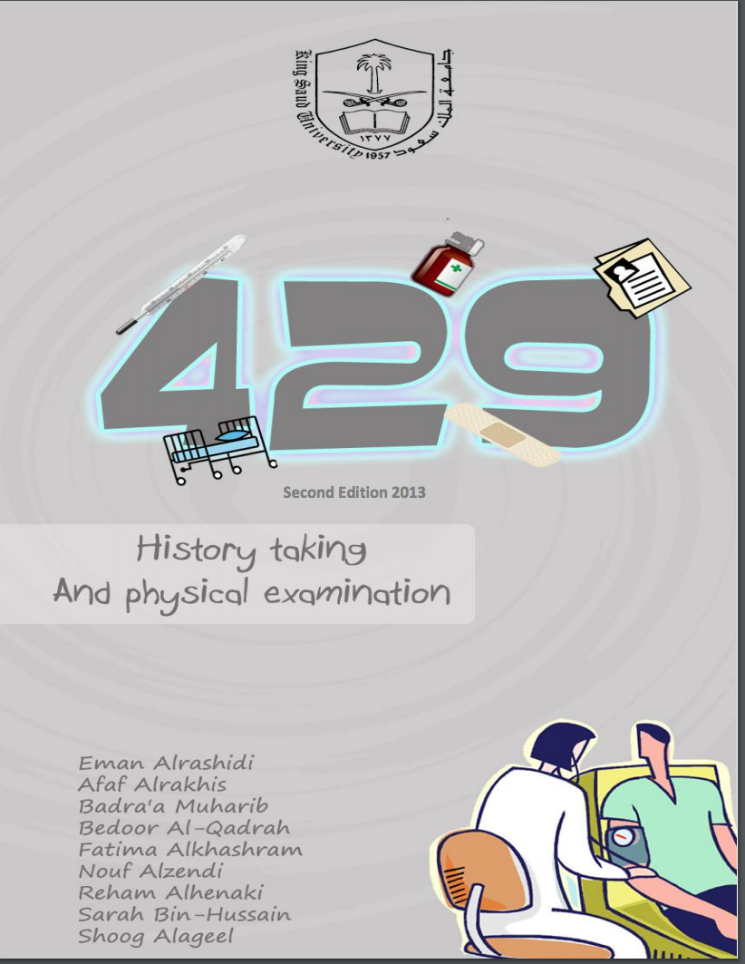
Study Sources (Clinical):
Talley and O’Connor
Talley pocketbook
429 Booklet
434 Booklet
Teamwork

Slide 11
Common Qs:
How to prepare for the long case?
How to divide time?
How you will be distributed across the course?

Slide 12
Tips:
Practice, practice, practice!
Start studying early on.
Stuck to one reference and add to it as needed.

Slide 14
General Surgery:
Credit hours: 10 hours
Course duration: 10 weeks
Distribution of grades:
- Midterm (MCQ)
- Final (MCQ)
- Final (SAQ)
- Final (OSCE)

Slide 15
Course Activities:
BST sessions
OR
Clinics
Rounds
Lectures
Course description:
You will be assigned to groups of 10-15 and will rotate across the different specialties each week.

Slide 16
Study Sources (Theory):
BST notes
431 Booklet
Davidson’s
The Washington Manual – Gen Surg
Toronto Notes – GS
Bailey and Love’s short practice of surgery
Churchills
Surgical Recall
Dr. Pestana’s surgery notes
Podcasts: Burn doc and his ICU Rounds

Slide 18


Slide 20
Study Sources (Clinical):
BST session notes
Dr. Hamad Alqahtani’s Book
Browse’s guide
Churchill’s GS book

Slide 21
Tips:
Study early on, prior to the sessions.
Read, read, read!
Don’t be late for rounds.
Attend ORs (extra ones or stay throughout the procedure, to rule in or rule out GS as a specialty for you)

Slide 23
Pediatrics:
Credit hours: 10h
Couse duration: 10 weeks
Distribution of grades:
Midterm: 25
Final (MCQ+MEQ): 40
Final (OSCE): 20
Continuous assessment 15
DXR: 2
Clerking: 4
Case presentation 4
Clinical skills lab: 4
Professional attitude: 4

Slide 24
Course Activities:
BST sessions
Lectures
Clinics
Rounds
Course description:
Lots of activities and requirements, but a very fun and dynamic course. You will enjoy it and it will be a great finale to your years of medical school.

Slide 25
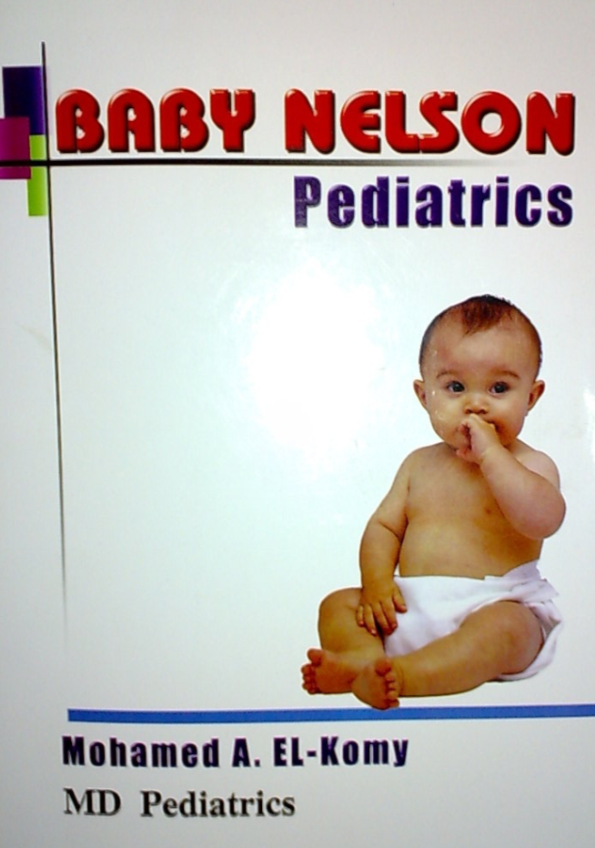
Study Sources (Theory):
Baby Nelson
Neslon’s essentials
Easy pediatrics
Toronto notes
Illustarted
Kaplan
Lectures/431 team
PediaTricks Booklet
Youtube channel: PaulThomasMD

Slide 27
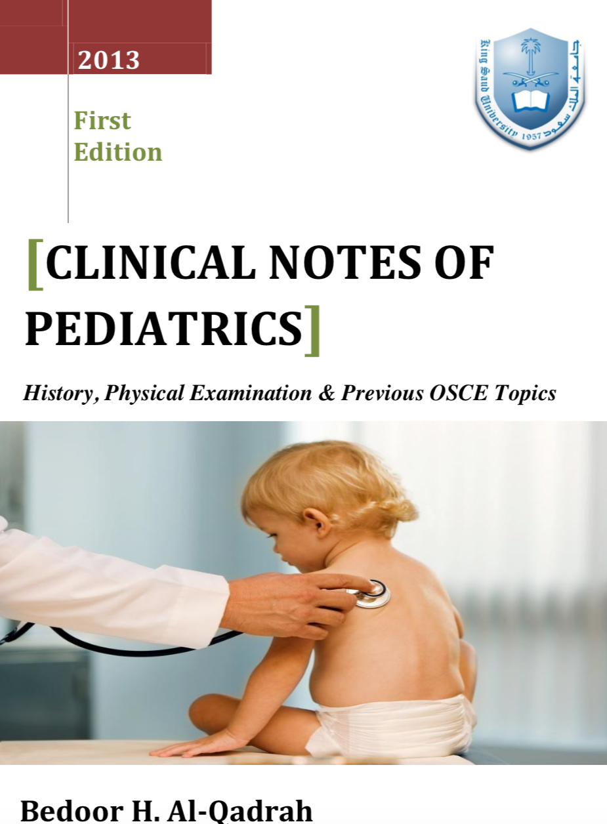
Study Sources (practical):
AlHawasi
Bodour AlQadrah Booklet
Teamwork

Slide 28
Tips:
Study early on, prior to the lectures.
Read, read, read!
Don’t be late for rounds or BST sessions.
Practice your clerking and take them seriously. Some consultants ask you to summarize the case without reading your clerking. This will help you a lot during your internship.
Practice head exam as well as HEENT exam

Slide 30
Rules and Regulations (Case Scenarios):
1- If you have a midterm exam and you had an urgent excuse on the night of the exam (i.e. direct death in the family, acute illness requiring surgery or hospitalization). What should you do?
Inform the academic advisor within 5 days and bring your excuse. You will be able to take the exam within the same or upcoming semester.

Slide 31
Rules and Regulations (Case Scenarios):
2- If you received a grade that you felt you did not deserve. What should you do in this case?
Inform the student affairs in regards to that and fill out the form no more than 7 days after the grade comes out.
You have 3 chances during your university course to ask for a re-correction. Use them wisely.

Slide 32
Rules and Regulations (Case Scenarios):
3- If for some reason, you missed more that 25% of the curriculum, what will happen?
You will banned from entering the final exam and will be a given a grade known as “DN”.

Slide 33
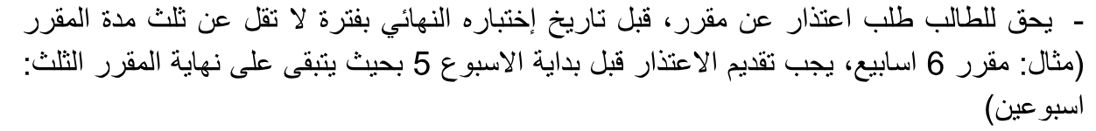
Rules and Regulations (Case Scenarios):
4- If you want to cancel a course, what should you do?
Inform the department prior to the exam by 1/3rd of the course timing.

Slide 34
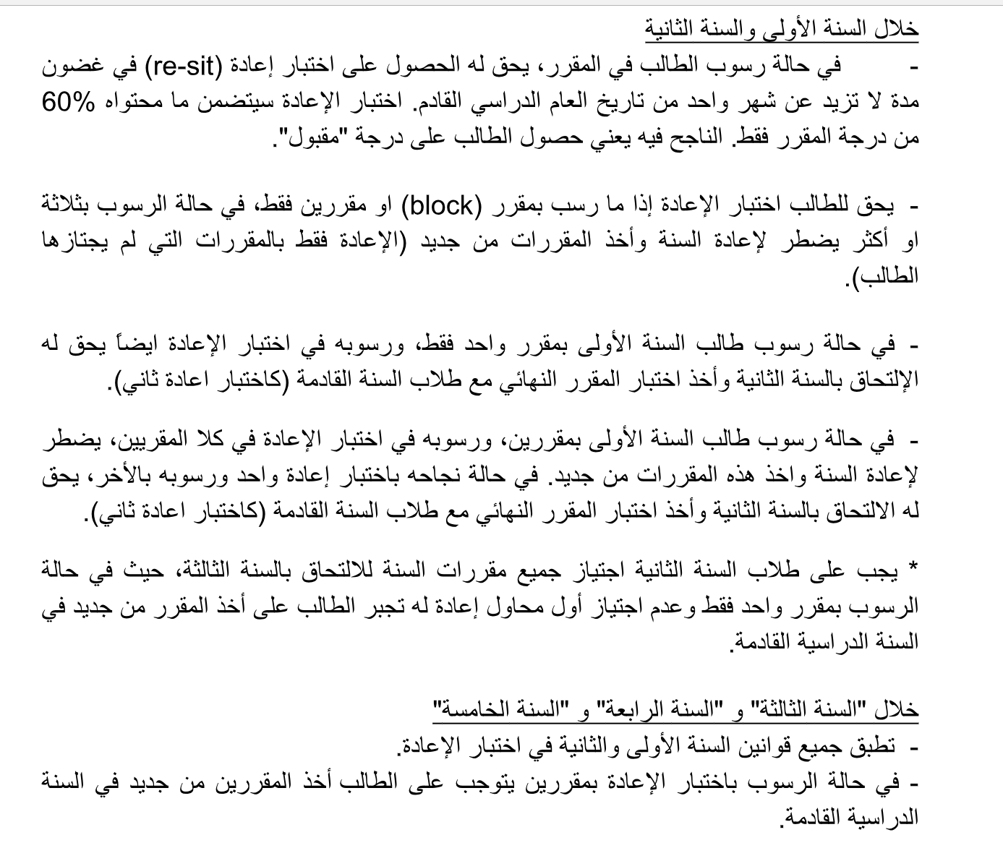

Slide 35
One last word of advice,

Slide 38
عن وحدة الجودة الاكاديمية
رؤية الوحدة:
الوصول إلى مستويات عالمية في الجودة والتميز الأكاديمي لكلية الطب.
رسالة الوحدة:
خلق وتعزيز ثقافة الجودة والتميز الأكاديمي في كلية الطب بجامعة الملك سعود من خلال متابعة جودة و رصد تطور الأنشطة الأكاديمية .
الأهداف العامة للوحدة:
دعم ومتابعة الخطة الاستراتيجية لكلية الطب.
نشر ثقافة الجودة بين منسوبي وطلاب كلية الطب.
متابعة جودة التدريس والتعليم للطلاب الجامعيين وطلاب الدراسات العليا بكلية الطب.
متابعة جودة البحث العلمي والحرص على أن يكون موافقا لأنظمة أخلاقيات البحث العالمية.
قيادة ودعم ومتابعة الاعتماد الأكاديمي لكلية الطب واستثماره كدافع للتطوير.
متابعة جودة الأعمال الإدارية الهامة والمؤثرة بكلية الطب.
اقتراح ودعم وتنظيم وتقييم جميع المبادرات الجديدة لتطوير الجودة الأكاديمية بكلية الطب.

Slide 39
YouTube Video
https://www.youtube.com/watch?v=twIXzPdgIog&t=13s

Slide 40
ليش أقيّم ؟
أقيّم عشان نرفع الجودة الأكاديمية للكلية، ورفع مستوى المقررات وجعلها مميزة، بالإضافة إلى رفع مستوى الكادر الأكاديمي لجميع المقررات وتحسين أو إزالة أي سلبيات متعلقة بالمناهج

Slide 41
ماهي التقييمات المطلوبة؟
١. أعضاء هيئة التدريس
٢. المقرر
٣. الاختبار

Slide 43

Rheema Alfadhil

