Slide 1
Introduction to
Sleep Disordered Breathing

Slide 2
Objectives
Obstructive Sleep Apnea
  List the symptoms and associated comorbid conditions seen with OSA.
  Define the polygraphic patterns associated with obstructive sleep disordered breathing.
  Describe the major treatments used for OSA.

Slide 3
Objectives
Central Sleep Apnea
  Define and identify central sleep apnea.
  Describe the differences between obstructive and central sleep apnea.
  List some treatment options.

Slide 4
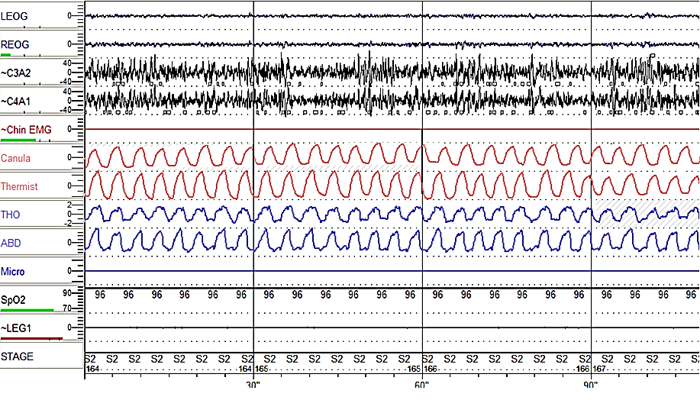
Normal Breathing

Slide 5
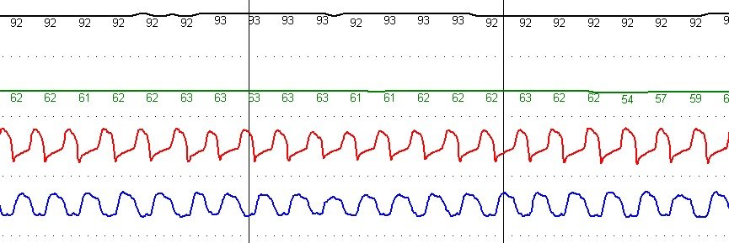
Representative Signal
Normal Breathing
Heart Rate
Nasal Airflow
Effort
← 30 sec epoch →
Oximetry

Slide 6
What is Sleep Disordered Breathing?
Is used to describe a group of disorders characterized by abnormalities of the respiratory pattern or ventilation during sleep.

Slide 7
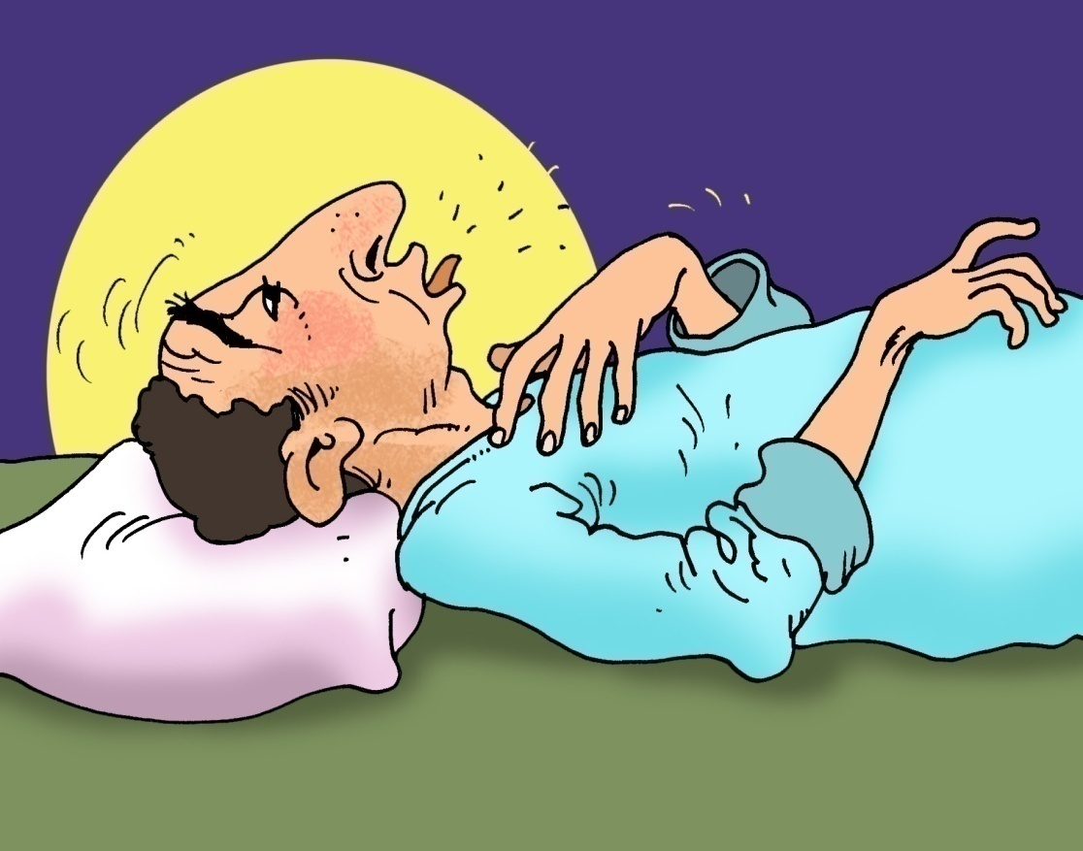
What is Sleep Apnea?
Defined as a cessation of airflow for a minimum of 10 seconds.

Slide 8
Hypopnea

Slide 9
Categories of Sleep Apnea
Obstructive Events
Central Events
Mixed Events

Slide 10
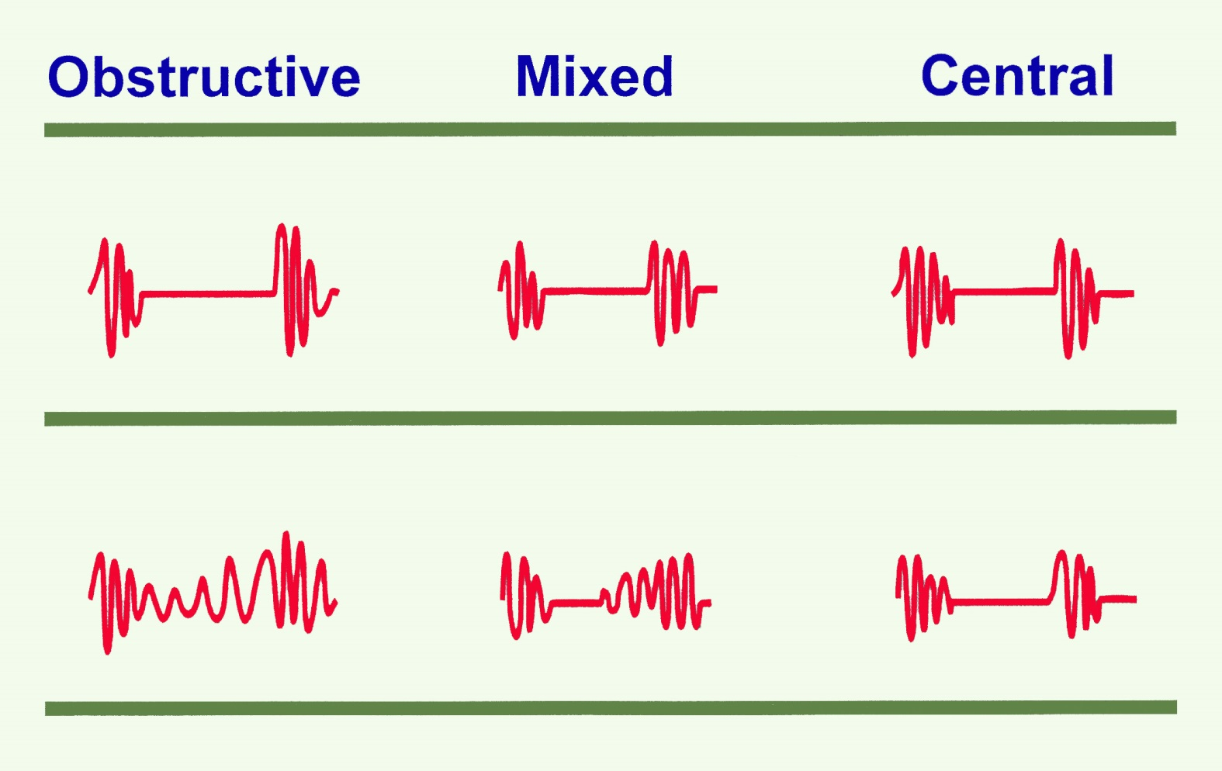
Apnea Patterns
Flow
Effort

Slide 11
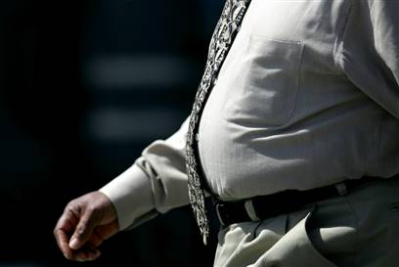
Is it familiar?

Slide 12
A.) What is OSA?
Criteria A & B
Or Criteria C
(ICSD), 3rd ed. 2014

Slide 13
A.) What is OSA?
The presence of one or more of the following:
  The patient complains of sleepiness, nonrestorative sleep, fatigue, or insomnia symptoms.
  The patient wakes with breath holding, gasping, or choking.
  The bed partner or other observer reports habitual snoring, breathing interruptions, or both during the patient’s sleep.
  The patient has been diagnosed with hypertension, a mood disorder, cognitive dysfunction, coronary artery disease, stroke, congestive heart failure, atrial fibrillation, or type 2 diabetes mellitus.
(ICSD), 3rd ed. 2014

Slide 14
A.) What is OSA?
B. Polysomnography (PSG) or OCST¹ demonstrates:
  > 5 predominantly obstructive respiratory events (obstructive and mixed apneas, hypopneas, or respiratory effort related arousals [RERAs]) per hour of sleep during a PSG or per hour of monitoring (OCST).
(ICSD), 3rd ed. 2014

Slide 15
A.) What is OSA?
C. PSG or OCST demonstrates:
  ≥ 15 events predominantly obstructive respiratory events (apneas, hypopneas, or RERAs)³ per hour of sleep during a PSG or per hour of monitoring (OCST).
(ICSD), 3rd ed. 2014

Slide 16
OSA Severity Criteria
AHI /hr
< 5 | Normal
5 - <15 | Mild
15 - 30 | Moderate
> 30 | Severe
Sleep. 1999 Aug 1;22(5):667-89.
Sleep-related breathing disorders in adults: recommendations for syndrome definition and measurement techniques in clinical research. The Report of an AASM Task Force

Slide 17
OSA Severity Criteria
AHI /hr
< 5 | Normal
5 - <15 | Mild
15 - 30 | Moderate
> 30 | Severe
Sleep. 1999 Aug 1;22(5):667-89.
Sleep-related breathing disorders in adults: recommendations for syndrome definition and measurement techniques in clinical research. The Report of an AASM Task Force

Slide 18
OSA Severity Criteria
AHI /hr
< 5 | Normal
5 - <15 | Mild
15 - 30 | Moderate
> 30 | Severe
Sleep. 1999 Aug 1;22(5):667-89.
Sleep-related breathing disorders in adults: recommendations for syndrome definition and measurement techniques in clinical research. The Report of an AASM Task Force

Slide 19
OSA Severity Criteria
AHI /hr
< 5 | Normal
5 - <15 | Mild
15 - 30 | Moderate
> 30 | Severe
Sleep. 1999 Aug 1;22(5):667-89.
Sleep-related breathing disorders in adults: recommendations for syndrome definition and measurement techniques in clinical research. The Report of an AASM Task Force

Slide 20
OSA Severity Criteria
AHI /hr
< 5 | Normal
5 - <15 | Mild
15 - 30 | Moderate
> 30 | Severe
Sleep. 1999 Aug 1;22(5):667-89.
Sleep-related breathing disorders in adults: recommendations for syndrome definition and measurement techniques in clinical research. The Report of an AASM Task Force

Slide 21
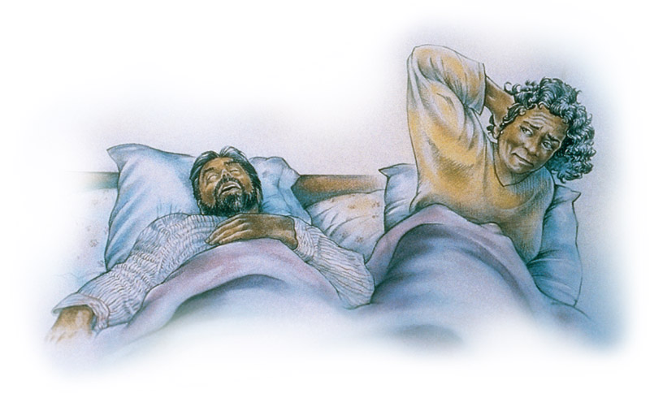
Clinical Features of OSA
Nocturnal Symptoms
Snoring
40% of men, 20% of women report habitual snoring
Associated with considerable social and marital hazard
2006 American Academy of Sleep Medicine

Slide 22
Prevalence of Sleep Apnea
Young 4% Men AHI > 5
  USA 2% Women EDS
  N = 802 Age 36-60
Kripke
  USA
  N = 355
Olson
  Australia
  N = 2,202
Bearpark
  Australia
  N = 400
9% Men
5% Women
5% Men
1.2% Women
10% Men
7% Women
AHI > 15
0₂ sat 4%
Age 40-64
AHI > 15
Age 35-69
AHI > 10
Age 40-85

Slide 23
Prevalence in a Saudi Sample
Sharma et al³ (n=180) 80% Males | Heistand et al² (n=1506) M + F | Netzer et al¹ (n=744) M + F | Middle-aged Saudi Women (n=400) M | Middle-aged Saudi Men (n=578) M
-- | 49 | 48.9 ± 17.5 | 43.74 ― 6.31 | 44.6 ± 9.8 | Mean age
-- | 59.0% | 52.2% | 40.8 | 52.3% | Snoring
-- | 26.0% | 38.8% | 9.5% | 19.3% | Day time fatigue >3 time a week
-- | 32.0% | 19.9% |  | 29.6% | Drowsy driving
53% | 29.0% | 26.0% | 24.0% | 18.0% | HTN (known)
44.4% | Males 31% Females 21% | 37% | 39.0 | 32.8% | High risk
1. BaHammam et al. Saudi Med J 2008; 29: 423-426
2. BaHammam et al. Saudi Med J 2009; 30: 1572-76

Slide 24
Prevalence in a Saudi Sample
Sharma et al³ (n=180) 80% Males | Heistand et al² (n=1506) M + F | Netzer et al¹ (n=744) M + F | Middle-aged Saudi Women (n=400) M | Middle-aged Saudi Men (n=578) M
-- | 49 | 48.9 ± 17.5 | 43.74 ― 6.31 | 44.6 ± 9.8 | Mean age
-- | 59.0% | 52.2% | 40.8% | 52.3% | Snoring
-- | 26.0% | 38.8% | 9.5% | 19.3% | Day time fatigue >3 time a week
-- | 32.0% | 19.9% |  | 29.6% | Drowsy driving
53% | 29.0% | 26.0% | 24.0% | 18.0% | HTN (known)
44.4% | Males 31% Females 21% | 37.0% | 39.0% | 32.8% | High risk
1. BaHammam et al. Saudi Med J 2008; 29: 423-426
2. BaHammam et al. Saudi Med J 2009; 30: 1572-76

Slide 25
Prevalence of Sleep Apnea
Wali et al Saudi Arabia | Men: 11.2%
 | Women: 4%

Slide 26
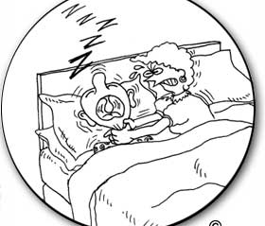
Otherwise snore and this will happen to you….
Or sleep alone….
www.corbett.com.au

Slide 27
Clinical Features of OSA
Daytime Sleepiness
  Differential diagnosis includes:
    Insufficient Sleep
    Medical and psychological disorders
    Medications

Slide 28
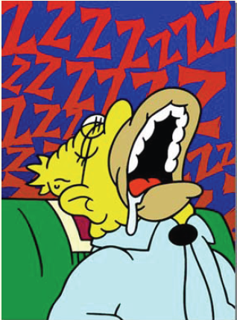
Clinical Features of OSA
Nocturnal Choking / Gasping
  Bed partners may recognize this more commonly than the patient.
Viner et al, Ann Int Med, 1991

Slide 29
Other symptoms
Nocturia
Nocturnal sweating
Morning headache
Dry mouth and throat on awakening
Nocturnal chest pain
Nocturnal reflux symptoms
Unrefreshing sleep
Interrupted sleep
Impotence
↓Memory and concentration
Altered mood

Slide 30
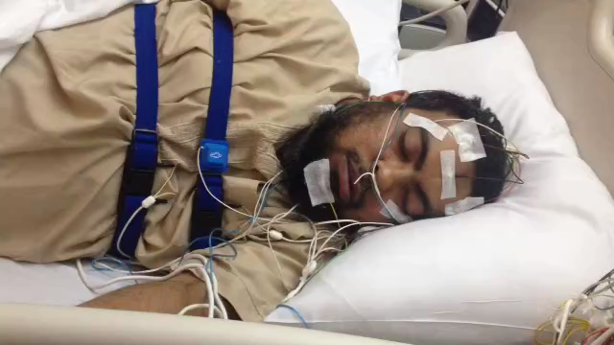
Video

Slide 31
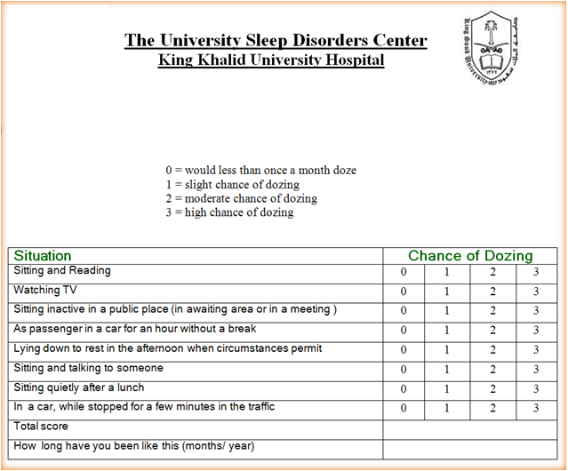

Screening Daytime Sleepiness
Epworth Sleepiness Scale

Slide 32
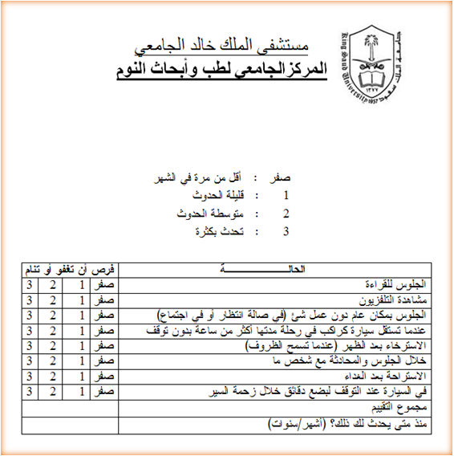
Screening Daytime Sleepiness
Epworth Sleepiness Scale

Slide 33
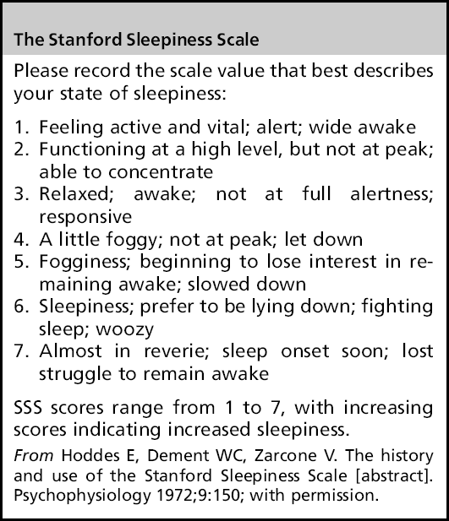
Stanford Sleepiness Scale (SSS)
Notes:
SSS assess the level of sleepiness which is often used in research protocols.
Foggy = confused, not clear, cloudy
Woozy = dizzy, dazed
Reverie = condition of being lost in thought or day dreaming

Slide 34
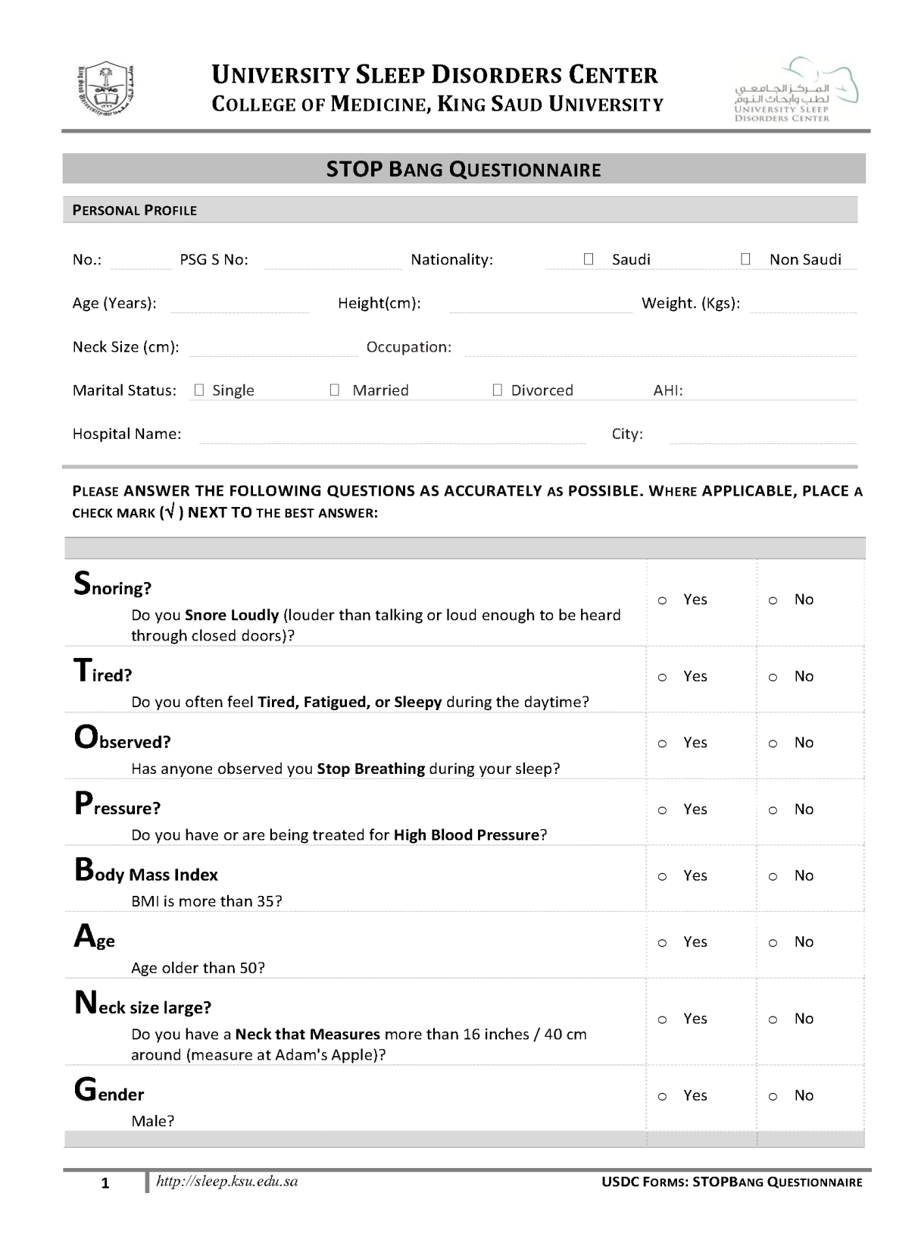

Slide 35
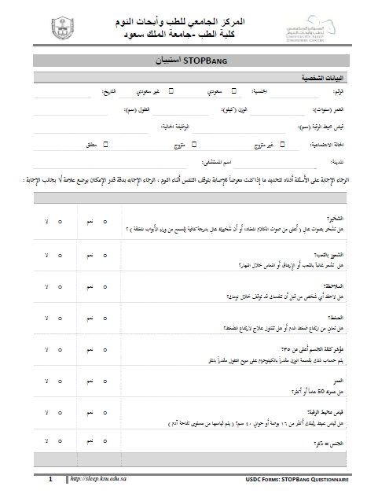

Slide 36
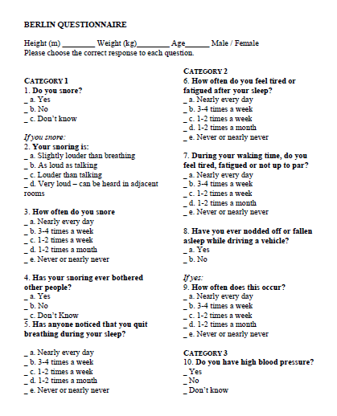

Slide 37
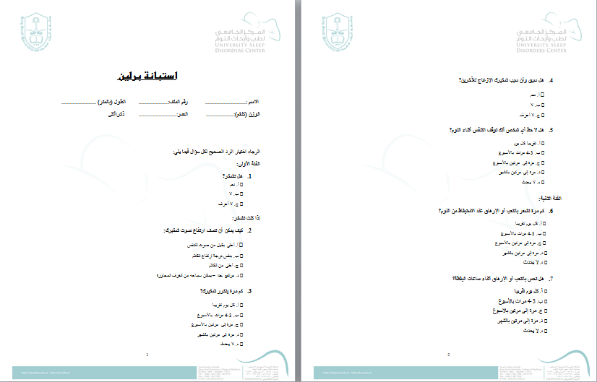

Slide 38
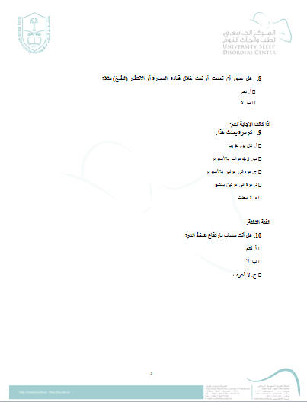

Slide 39
What are the Risk Factors?

Slide 40
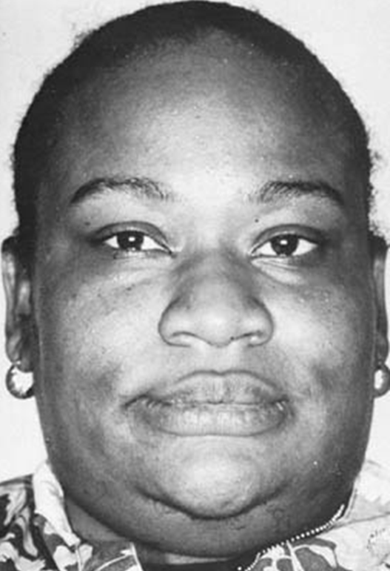
Risk Factors of OSA
Structural Abnormalities:
    Short Fat Neck
    (Neck circumference >17”/16”)

Slide 41
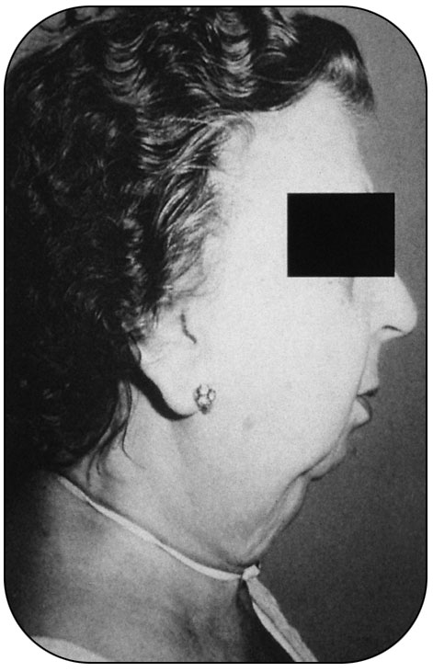
Risk Factors of OSA
Small Mandible
Guilleminault C et al. Sleep apnea Syndromes. New York: Alan R. Liss, 1978.

Slide 42
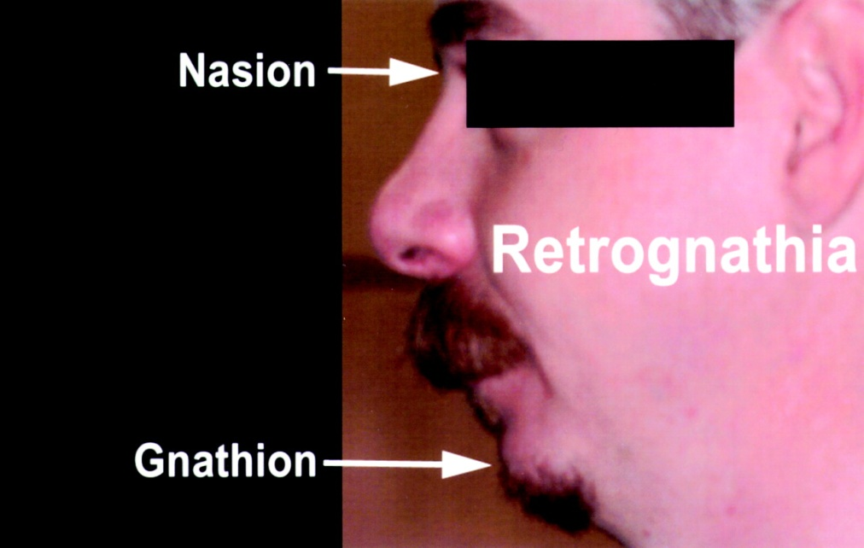
Risk Factors of OSA
Retrognathia

Slide 43
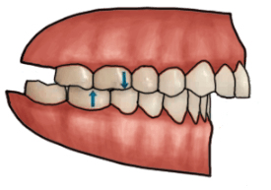
Overbite

Slide 44
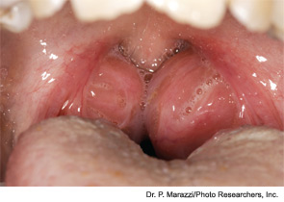
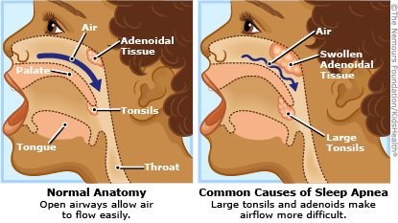
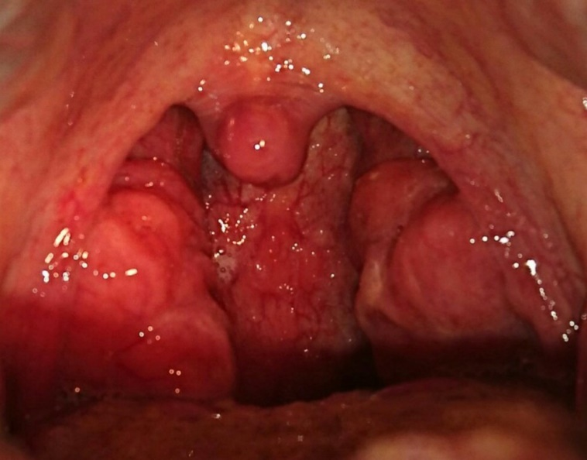
Risk Factors of OSA
Upper airway narrowing:
  Large tonsils / adenoids
Sleep apnea and children
www.dcsmiles.com/services/sleep-apnea/sleep-and-children/

Slide 45
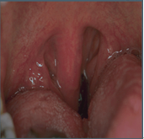
Cont..
(Upper airway narrowing)
Long uvula
Sleep Disorders & Sleep Apnea with Dr. Kushner, DDS
http://www.brownkushner.com/Sleep Apnea.pdf

Slide 46
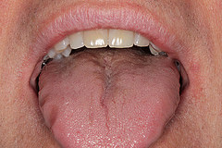
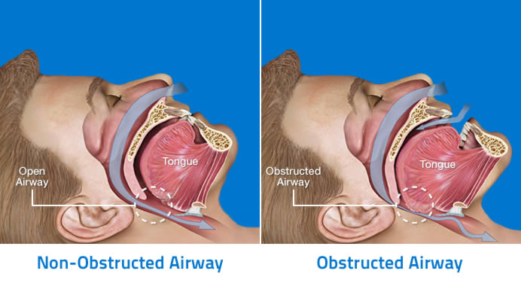
Large tongue
Science-based Medicine https://sciencebasedmedicine.org/dental-management-of-obstructive-sleep-apnea/

Slide 47
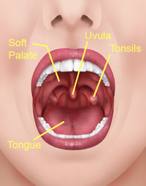
Cont..
(Upper airway narrowing)
Academy for Respiratory Medicine 2014
Notes:
Mallampati Score to Help Predict Obstructive Sleep Apnea
As part of the initial exam is to look into your mouth to evaluate you for obstructive sleep apnea. One of the things for evaluation is the opening of your airway. This is also an assessment done by anesthesiologists when they evaluate your airway prior to any surgery that involves intubation to add or remove fluids to or from your stomach during surgergy. When you open your mouth, there are certain structures that can cause the airway to narrow or be constricted. These structures are:
Soft palate - The soft palate is so named since it does not contain any bone. The area in front of the soft palate is the hard palate since it does contain bone. One of the functions of the soft palate it to close off the nasal passages during swallowing.
Tongue -The tongue is mostly muscle and it is the primary organ of taste.
Tonsils - The tonsils are a collection of lymphoid tissue, and can become enlarged when they get infected, which is known as tonsilitis. When they become enlarged, it can become more difficult to breath through the mouth since the airway becomes smaller.
Uvula - Uvula means "little grape" in Latin, and it is the small piece of tissue that hangs down from the edge of the soft palate.

Slide 48
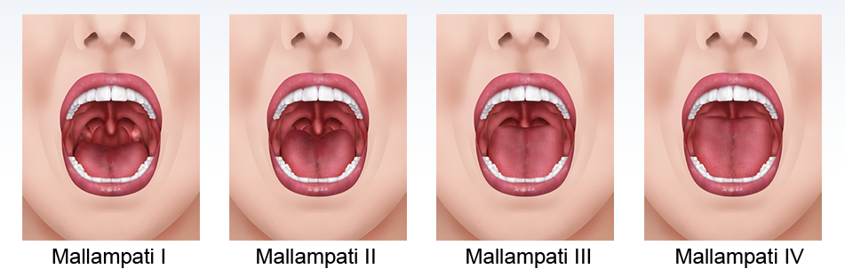
Cont..
(Upper airway narrowing)
Mallampati Score to Help Predict Obstructive Sleep Apnea
Academy for Respiratory Medicine 2014
Notes:
Mallampati I
When we look inside, if we can see the bottom of the uvula, we score that as Mallampati I since the airway is very open.
Mallampati II
When we look inside, if the tongue is covering part of the uvula, we score that as Mallampati II since the airway is mostly open.
Mallampati III
When we look inside, if the tongue is covering most but not all of the uvula, we score that as Mallampati III since the airway is mostly closed.
Mallampati IV
When we look inside, if the tongue is covering all of the uvula, we score that as Mallampati IV since the airway is very closed.

Slide 49
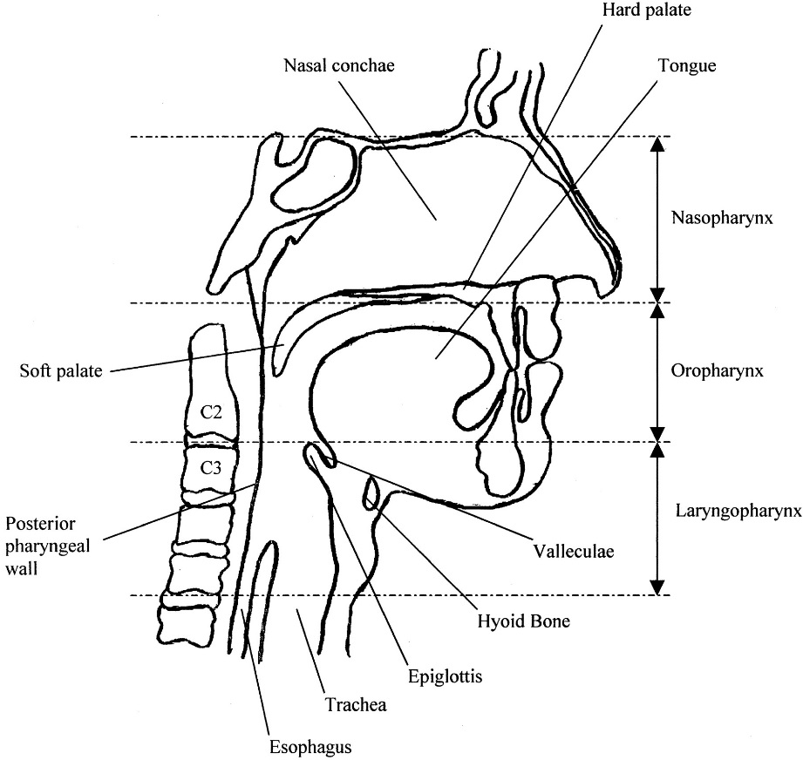
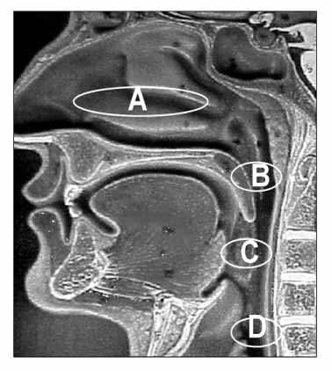
Levels of airway obstruction

Slide 50
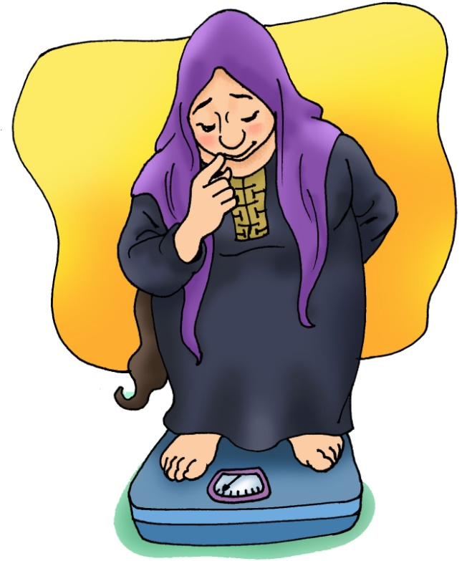
Risk Factors of OSA
Obesity
  Strongest risk factor for OSA.
  Present in >60% of patients referred for a diagnostic sleep evaluation.

Slide 51
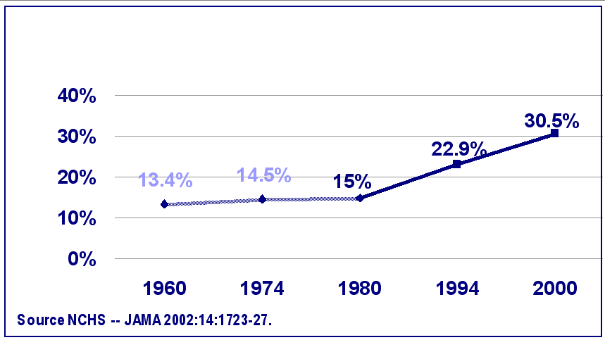
Twenty Years of Increasing Obesity
% Obesity

Slide 52
PREVALENCE OF OBESITY
IN SAUDI ARABIA
% of Subjects
(BMI ≥ 30 kg/m²)
Al-Nozha et al. SMJ 2005;26:824-829

Slide 53
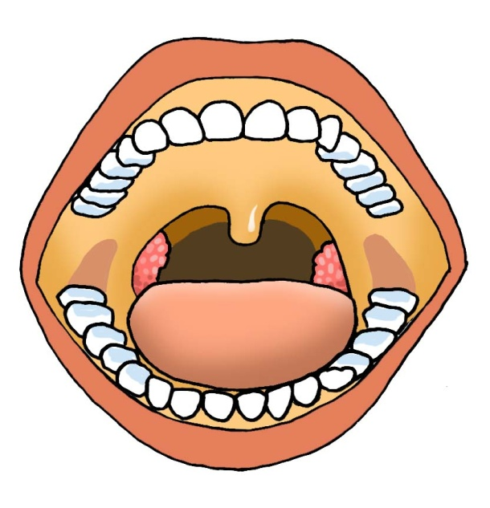
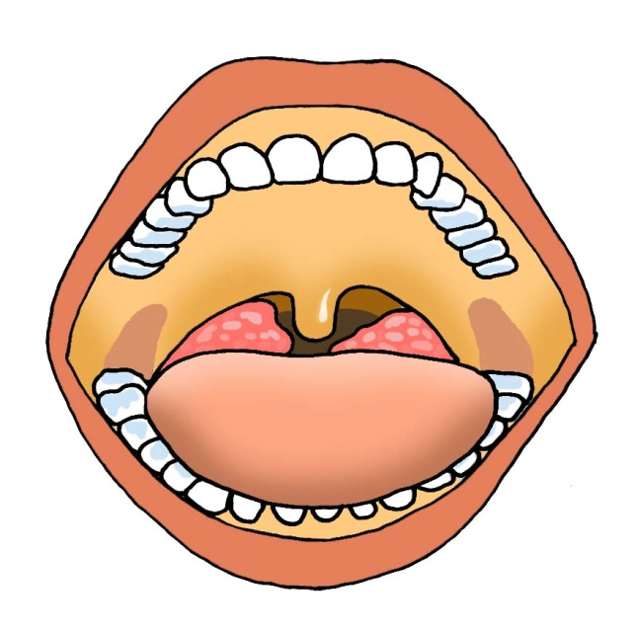
Patient Evaluation
Normal Airway
Obstructed Airway
Sleep Disorders & Sleep Apnea with Dr. Kushner, DDS
http://www.brownkushner.com/Sleep Apnea.pdf

Slide 54
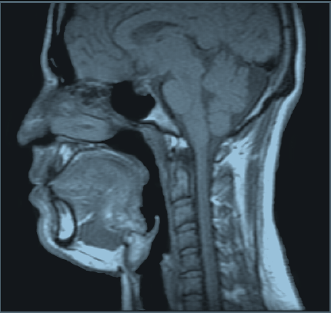
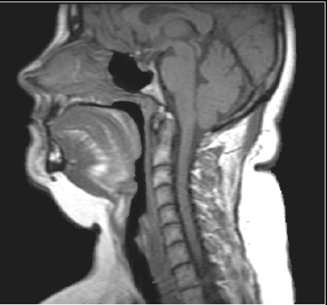
Sagittal Upper Airway
MRI Images
Normal
Apneic
(Schwab et al, Am J Respir Crit Care Med 152:1673, 1995)

Slide 55
OSA and Medical Comorbidity
Obstructive Sleep Apnea
High Blood Pressure
Increased Insulin resistance (event in non diabetic patients)
Increased traffic and workplace accidents
Stroke
Memory problems and inability to think
Cardiac problems, Abnormal heart rhythms, heart attack and heart failure

Slide 56
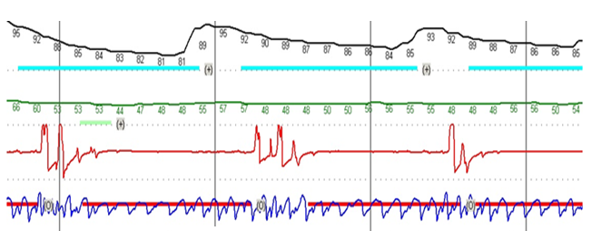
Representative Signals
OSA
Oximetry
Heart Rate
Nasal Airflow
Effort

Slide 58
Treatment
General Measures
These measures should be tried in all patients with OSDB:
    Weight loss
    Avoidance of alcohol & sedatives
    Sleep position
    Driving and operation of heavy machinery

Slide 59
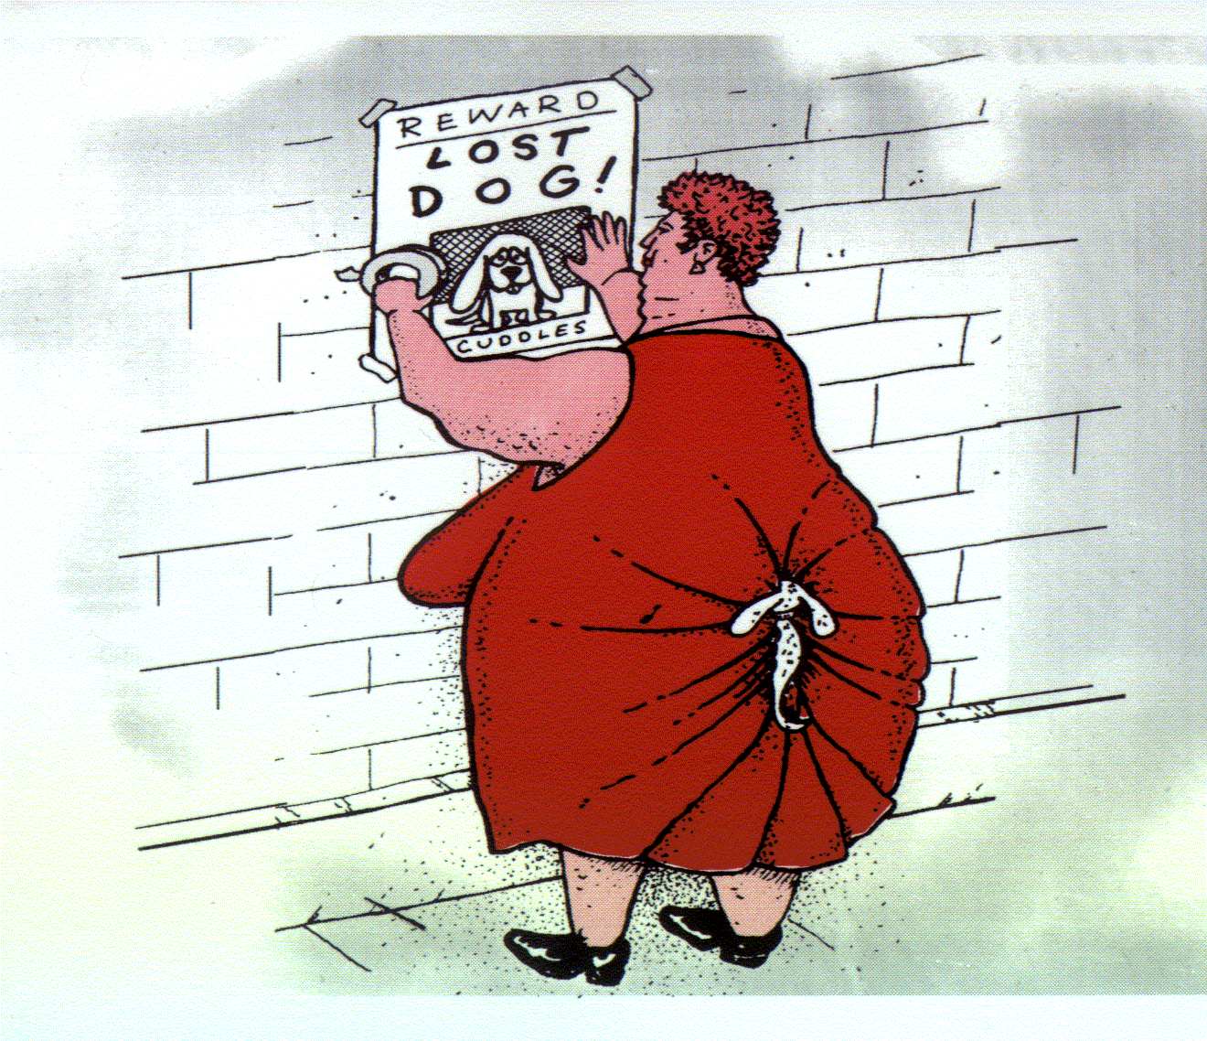
Weight Loss
Weight loss is like getting into heaven….. It is SIMPLE but it is not EASY.
Sleep in Health & Disease
www.sleepsa.com

Slide 60
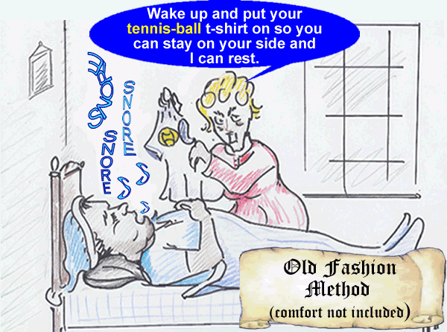
Positional Therapy
Try sleeping on the side.

Slide 61
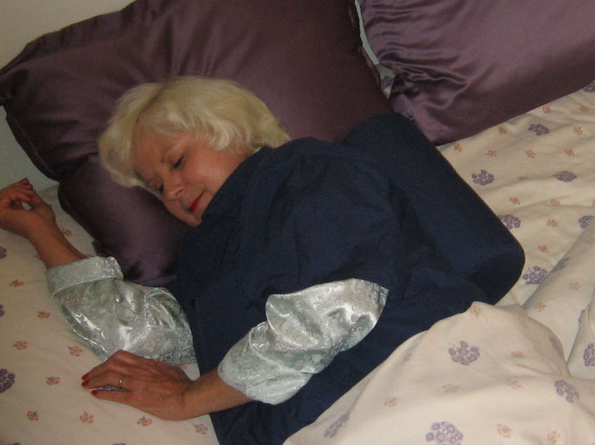
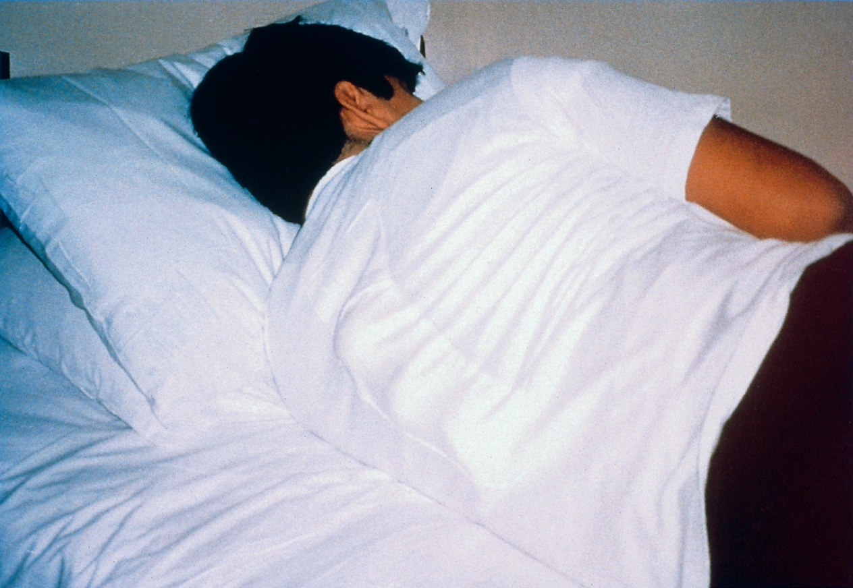
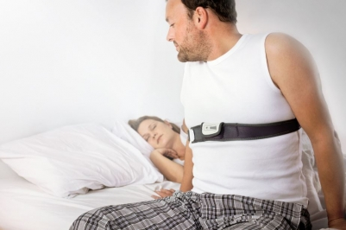
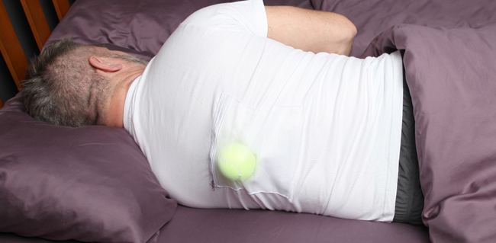

Sleep Position Training

Slide 62
Specific Measures
Continuous Positive Airway Pressure (CPAP)
Intra – Oral Appliances
Surgical Treatment
Hypoglossal Nerve Stimulation

Slide 63
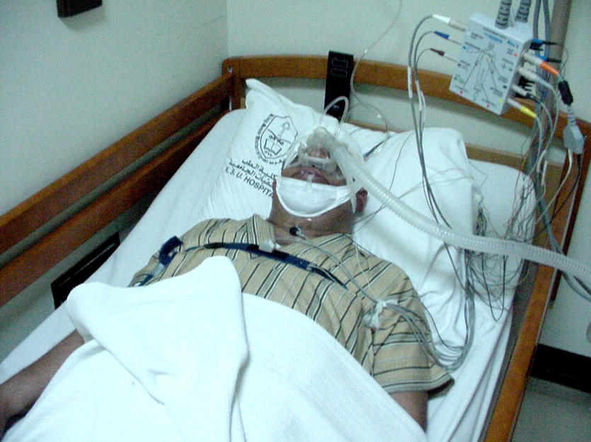
Continuous Positive Airway Pressure (CPAP)
Is the gold standard treatment

Slide 64
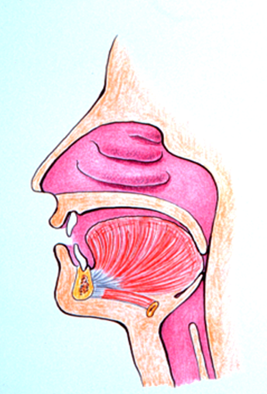
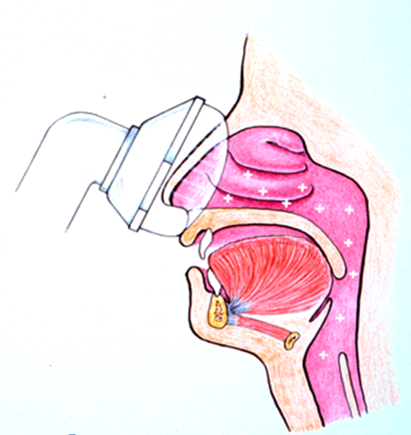
Continuous Positive
Airway Pressure
Before
After

Slide 65
Benefits of CPAP
Improves quality of life even in mild OSA
Improves bed partner sleep
Improves daytime sleepiness
Decreases motor vehicle accident
Improves hypertension

Slide 66
Cont… (Benefits of CPAP)
Increases ejection fraction in systolic CHF
Improves insulin resistance
Decreases inflammatory markers
    CRP (C-reactive protein)

Slide 67
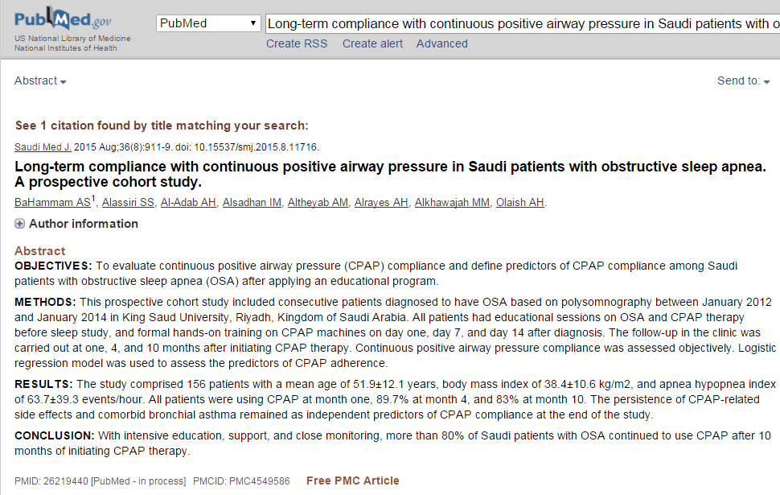

Slide 68
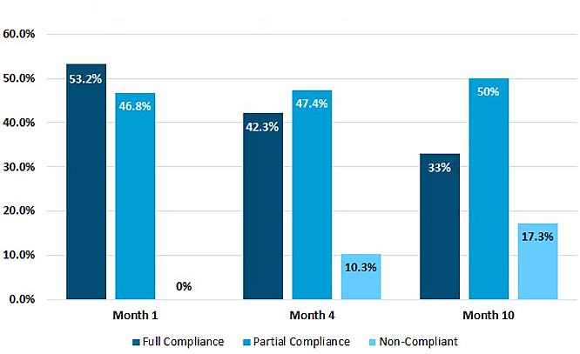
Figure 1-A: CPAP compliance at 1, 4 and 10 months
Saudi Med J. 2015 Aug;36(8):911-9.

Slide 69
Conclusions
Nasal CPAP is the treatment of choice
Successful treatment in 95% of patients
Not as costly as surgery
Long term compliance 60-70%
Improve long term survival
Can re-titrate the pressure if the patient’s clinical condition changes

Slide 70
B.) Obesity Hypoventilation
Syndrome
Is defined by extreme obesity and alveolar hypoventilation during wakefulness.
  Obesity
  PaCO2 >45
  PaO2 <70
  Absence of significant pulmonary disease

Slide 71
Criteria A-C must be met
Presence of hypoventilation during wakefulness (PaCO₂ > 45 mm Hg) as measured by arterial PCO₂, end-tidal PCO₂, or transcutaneous PCO₂.
Presence of obesity (BMI > 30 kg/m²; > 95th percentile for age and sex for children).
Hypoventilation is not primarily due to
    lung diseases,
    medication use,
    neurologic disorder,
    muscle weakness,
    or a known congenital or idiopathic central alveolar hypoventilation syndrome.
(ICSD), 3rd ed. 2014

Slide 72
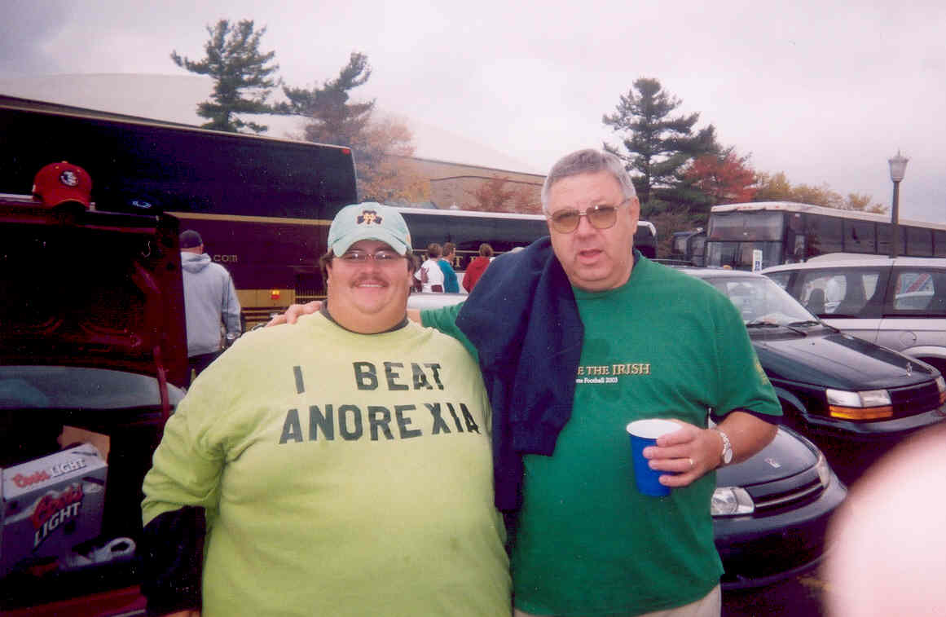
Clinical Features of OHS
Extreme Obesity

Slide 73
Clinical Features of OHS
Middle-aged
Significant sleep-disordered breathing (fatigue, hypersomnolence, snoring, morning headache)
Prone to develop severe pulmonary hypertension

Slide 74
Figure 1
OBESITY
Increased work of breathing and increased needs to augment minute ventilation to maintain adequate alveolar ventilation
Patient can increase ventilatory drive and minute ventilation
Patient cannot increase ventilatory drive and minute ventilation
Normal ventilation and eucapnia
Hypoventilation especially during sleep hypercapnia and hypoxemia
90%
10%
Simple obesity
OSA
OHS + OSA
OHS
AlDabal & BaHammam. ATM 2010

Slide 75


Slide 76
Prevalence of OHS
Out of 1693 OSA patients, OHS was identified in 144 (8.5%) (women 66.7%).
Saudi Med J 2015; Vol. 36 (2)

Slide 77
Prevalence of OHS in OSA
Authors | Number | Study Design | Country | Age | BMI | AHI | OHS %
Mokhlesi et al²² | 359 | Prospective | USA | 48 | 43 | 62 | 20
Laaban and Chailleux¹⁸ | 1,141 | Retrospective | France | 56 | 34 | 55 | 11
Verin et al²¹ | 218 | Retrospective | France | 55 | 34 | 51 | 10
Kessler et al¹⁷ | 254 | Prospective | France | 54 | 33 | 76 | 13
Resta et al¹⁹ | 219 | Prospective | Italy | 51 | 40 | 42 | 17
Glope et al¹⁶ | 175 | Retrospective | Spain | N/A | 32 | 42 | 14
Akashiba et al¹⁴ | 611 | Retrospective | Japan | 48 | 29 | 52 | 9
Trakada et al²⁰ | 276 | Prospective | Greece | 54.7 | 34.7 | 33.6 | 13.8
Alzaabi et al¹⁵ | 107 | Retrospective | UAE | 45.6 | 33.8 | 48.4 | 16.8
BaHammam | 1693 | Prospective | Saudi Arabia | 46.2 | 35.7 | 41.9 | 8.9
BaHammam AS. SMJ 2015; 36(2):181-9

Slide 78
Prevalence of OHS in OSA
Authors | Number | Study Design | Country | Age | BMI | AHI | OHS %
Mokhlesi et al²² | 359 | Prospective | USA | 48 | 43 | 62 | 20
Laaban and Chailleux¹⁸ | 1,141 | Retrospective | France | 56 | 34 | 55 | 11
Verin et al²¹ | 218 | Retrospective | France | 55 | 34 | 51 | 10
Kessler et al¹⁷ | 254 | Prospective | France | 54 | 33 | 76 | 13
Resta et al¹⁹ | 219 | Prospective | Italy | 51 | 40 | 42 | 17
Glope et al¹⁶ | 175 | Retrospective | Spain | N/A | 32 | 42 | 14
Akashiba et al¹⁴ | 611 | Retrospective | Japan | 48 | 29 | 52 | 9
Trakada et al²⁰ | 276 | Prospective | Greece | 54.7 | 34.7 | 33.6 | 13.8
Alzaabi et al¹⁵ | 107 | Retrospective | UAE | 45.6 | 33.8 | 48.4 | 16.8
BaHammam | 1693 | Prospective | Saudi Arabia | 46.2 | 35.7 | 41.9 | 8.9
BaHammam AS. SMJ 2015; 36(2):181-9

Slide 79
Patient with OHS

Slide 80
Therapeutic Algorithm during PAP Titration
Start with CPAP and build up pressure to eliminate obstructive events
Switch to Bi-Level PAP if:
Patients cannot tolerate CPAP due to persistent air leak or discomfort
exhaling against high pressure
Frequent episodes of hypoventilation and desaturation without
obstructive events
↑ IPAP over the last CPAP until SaO₂ > 90%
Add O₂, if the patient continues to desaturate < 88% despite elimination of apneas and hypoventilation
Al Dabal L, BaHammam AS. Obesity hypoventilation syndrome. Annals of Thoracic Medicine.
2009;4(2):41-49. doi:10.4103/1817-1737.49411.
Notes:
This algorithm is applicable only to elective or stable patients; otherwise if the patient is having acute hypercapnic respiratory failure that’s a different scenario.

Slide 81
C.) Central Sleep Apnea
Is a disorder of decreased breathing rate or depth, particularly during sleep due to a transient reduction or withdrawal of central output to the respiratory muscles (the diaphragm and intercostal muscles).

Slide 82
Central Apnea
Absent inspiratory effort throughout the entire period of absent airflow.
Nasal / Oral Airflow
Respiratory Effort - chest
Respiratory Effort - abdomen

Slide 83

Central Apnea

Slide 84
Central Apnea
Notes:
During Central apnea, ETCO2 also going up.

Slide 85
Cheyne Stokes Respiration
Diagnostic Criteria
(A or B) + C + D satisfy the criteria
  The presence of one or more of symptoms
  The presence of
      atrial fibrillation/flutter,
      congestive heart failure,
      or a neurological disorder.
(ICSD), 3rd ed. 2014

Slide 86
Diagnostic Criteria
PSG shows all of the following:
  ≥ 5 central apneas and/or central hypopneas per hour of sleep.
  The total number of central apneas and/or central hypopneas is > 50% of the total number of apneas and hypopneas.
  The pattern of ventilation meets criteria for Cheyne-Stokes breathing (CSB).
(ICSD), 3rd ed. 2014

Slide 87
Cheyne Stokes Respiration
(Periodic Breathing)
A breathing pattern characterized by regular “crescendo-decrescendo” fluctuations in respiratory rate and tidal volume.
More common among patients with heart failure and low ejection fraction.
Associated with poor prognosis in patients with heart failure.

Slide 88

Representative Signal
CSA - CSR
Oximetry
Heart Rate
Nasal Airflow
Effort

Slide 91


Slide 92
D.) Mixed Apnea
Begins as central apnea followed by obstructive apnea
Seen in patients with OSA
Often found in Down’s Syndrome

Slide 93
Mixed Apnea
Absent inspiratory effort in the initial portion of the event, followed by resumption of inspiratory effort in the second portion of the event.
Nasal / Oral Airflow
Respiratory Effort - chest
Respiratory Effort - abdomen

Slide 94
Mixed Apnea

Slide 95
Key Points
Sleep Disordered Breathing is an important medical disorder that warrants active investigation by means of a clinical evaluation and polysomnographic sleep studies.
Treatment is essential, not only to improve the symptoms that include sleepiness, but also to prevent the development of cardiovascular complications.
Effective treatments exist that include behavioral, medical and surgical means; dramatic improvements in patient’s well being can be achieved.

Slide 96
Question:
A breathing pattern characterized by regular “crescendo-decrescendo” fluctuations in respiratory rate and tidal volume.
  a. Obstructive Apnea
  b. Hypopnea
  c. Cheyne Stokes Respiration
  d. OHS (Obesity Hypoventilation Syndrome)

