Slide 1
polyarthritis –clinical approach
By
Dr.afsar sayeeda
frcp
Consultant & head ,ctu,
Dept of medicine,ksumc

Slide 2
DEFINITION-
ARTHRITIS- INFLAMMATION OF JOINT MARKED BY PAIN , SWELLING ,REDNESS ,WARMTH ,TENDERNES .,DECREASED MOVEMENT
POLY - OF 4 OR MORE JOINT INVOLVEMENT

Slide 3
classification
Inflammatory
noninflammatory
Acute
chronic

Slide 4
DIFFERENTIAL DIAGNOSIS OF POLYARTICULAR JOINT PAIN
INFLAMMATORY INFECTIIONS - Viral infection: human parvovirus (especially B19), enterovirus, adenovirus, EBV, coxsackievirus (A9, B2, B3, B4, B6), CMV,, rubella, mumps, hepatitis B, VZV (HHV3), HIV
BACTERIAL – Indirect bacterial infection (reactive arthritis): N.gonorrhoeae, bacterial endocarditis, Campylobacter , Chlamydia , Salmonella , Shigella , Yersinia , Tropheryma whippelii (Whipple's disease), group A strept (rheumatic fever)
Direct bacterial infection:(SEPTIC) N. gonorrhoeae, Staph aureus, gram-negative bacilli, bacterial endocarditis
Other infections: Borrelia burgdorferi (Lyme disease), Mycobacterium tuberculosis (tuberculosis), fungi
CRYSTAL INDUCED ARTHRITIS : GOUT,PSEUDOGOUT(CPPD), hydroxyapatite
IMMUNE MEDIATED --Systemic rheumatic disease: RA,SLE,PM/DM, JIA , SJOGRENS, PMR, BEHCETS, SCLERODERMA . Systemic vasculitS: -HSP, LCV, PAN,WG,GCA
Spondyloarthropathies: ankylosing spondylitis, psoriatic arthritis, IBD RELATED( ENTEROPATHIC), reactive arthritis (Reiter's syndrome)
Endocrine disorders: hyperparathyroidism, hyperthyroidism, hypothyroidism.ACROMEGALY .CUSHINGS DISEASE,AMYLOIDOSIS, WILSONS DISEASE
Malignancy: PARANEOPLASTIC SYNDROMES,HPOA
NONINFLAMMATORY -- DEGENERATIVE ; osteoarthritis OTHERS : hypermobility syndromes, sarcoidosis, fibromyalgia, osteomalacia, Sweet's syndrome, serum sickness

Slide 6
What you need to know -- General principles of management
Consider inflammatory arthritis in anyone with acute or subacute onset of joint pain, early morning stiffness, and soft tissue swelling.
Early diagnosis and treatment of all pts of RA with DMARDS for a better radiographic outcome
.Use of anti-inflammatory therapy ,including NSAIDS & GLUCOCORTICOIDS to help control the symptoms & improve function until DMARDS take effect.
Patients need rapid access to specialist advice during flares.
Specialists are best placed to guide changes in DMARDS or steroid treatment.
Achievement and maintenance of tight control of disease activity ,defined as remission or a state of low disease activity.
.

Slide 7
RHEUMATOID ARTHRITIS
INCIDENCE – 1.4 / 10000 male , 3.6/10000 females
Prevalence – 0.5 -2%
Male: female 1:3
Onset – any age but max 40 – 60 yrs. in women , 60-70 yrs. in men

Slide 8
I

Slide 11
clinical features
symmetrical deforming polyarthritis
Affects synovial lining of joints ,bursae & tendons
More than just a joint disease
Progression of joint involvement
Almost any joint ( large & small) can be involved
Spread occurs to other joints (over months to years) additive pattern
Spontaneous remissions can occur

Slide 12
Poor prognostic factors
High disease activity,
the early presence of erosions,
autoantibody positivity ( rf & acpa ) in high titres
Hla dr4 genotype
Age less than 30 years
Female sex
Large number of joints involved at presentation
functional disability,
extraarticular disease,
Systemic symotoms
or multibiomarkers,

Slide 13
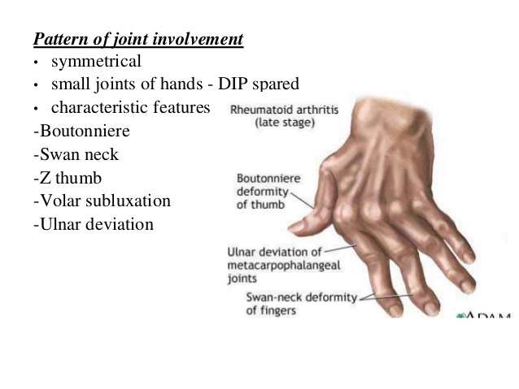

Slide 17
Predictive factors for persistent ra
Ems > 1 hour
Arthritis in more than 3 joints
Igm rf high positive

Slide 21
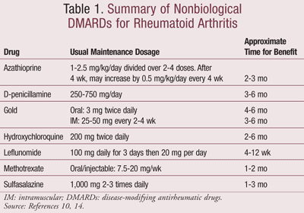

Slide 25
SYSTEMIC LUPUS ERYTHEMATOSUS
Management depends on disease severity and disease manifestations.
Hydroxychloroquine has a central role for long-term treatment in all patients.
a decrease in flares and prolonged life in patients given hydroxychloroquine, makes it the cornerstone of SLE management.
SLE with arthritis – NSAIDS, HCC, short courses of steroids.

Slide 26
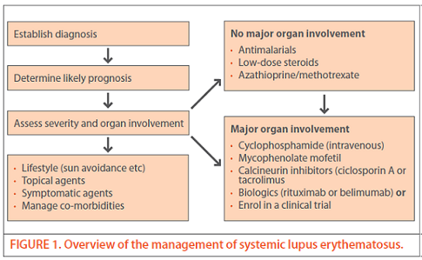

Slide 27
Adult onset stills disease

Slide 30
Ankylosing spondylitis
Spondyloarthropathy
Onset –late adolescence & early childhood
Spine , si & large joints
Leads to fibrosis & bony bridging
Paraarticular calcification and ossification , bamboo spine
Male predisposition
90% association with hla b27

Slide 31
Clinical features
Back pain( inflammatory)
Ems
Muscle spasm( flexed posture)
Decreased chest expansion)
ankylosis

Slide 32
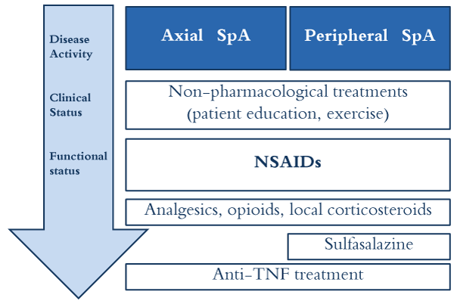

Slide 35
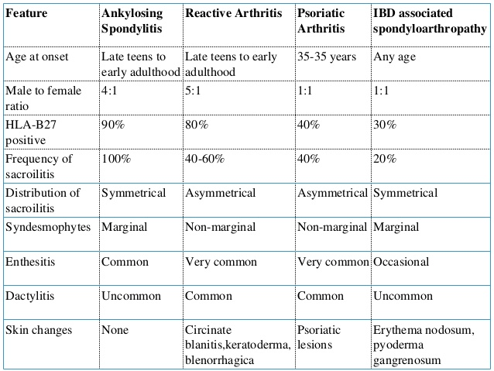

Slide 36
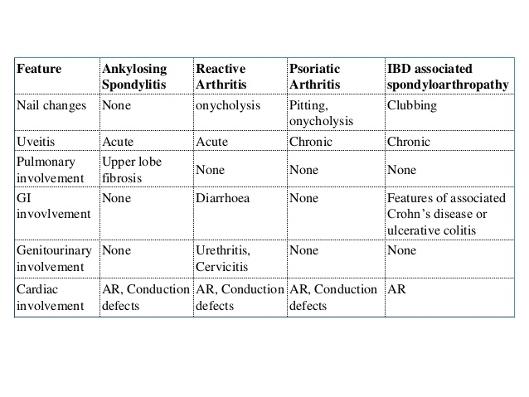

Slide 37
Crystal arthropathies
Gout
pseudogout

Slide 38
Gout-types
Primary –
Heriditary –overproduction
-- underexcretion
Secondary –myeloproliferative disease
--ckd
---psoriasis
--- drugs

Slide 53
investigation
treatment

Slide 54
Thank you

