Slide 1



Introduction to Emergency POCUS
Eyad Khattab MD, MPH
Assistant Professor
College of Medicine
King Saud University
April 2020

Slide 2



Objectives
History
Understand the basic physics of ultrasound
Types of Transducers
Ultrasound Imaging Modes
Common Artifacts
2

Slide 3
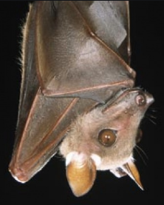
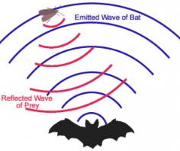
Objectives
2

Slide 4
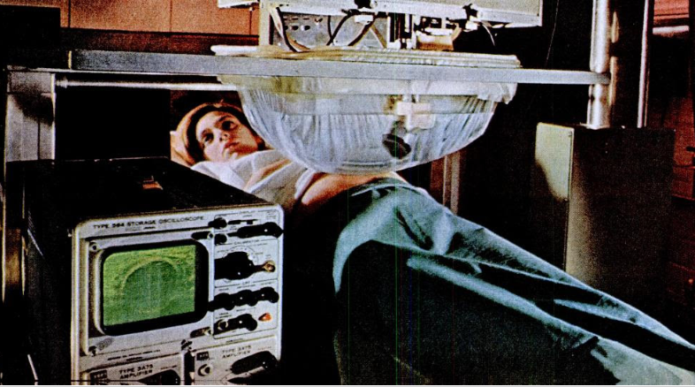
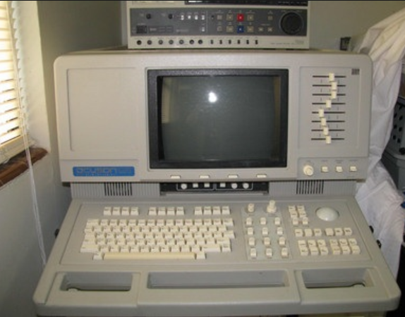
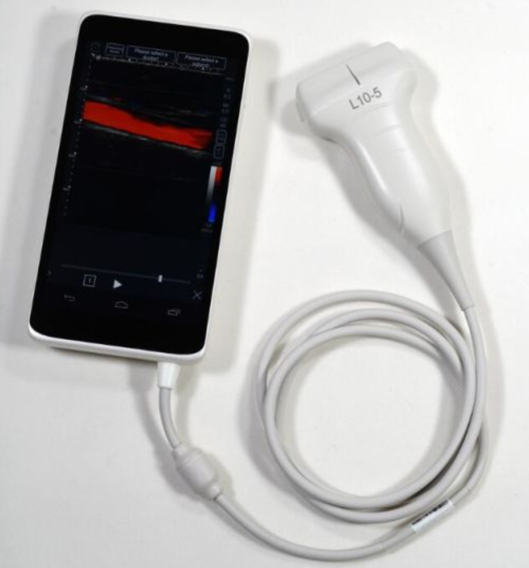
History
Ultrasound
Advancement
1956 1990 2018
2

Slide 5
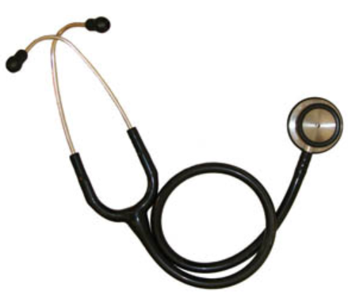
History
Traditional vs. Modern
2

Slide 6

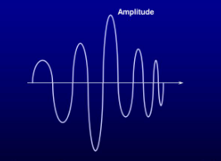
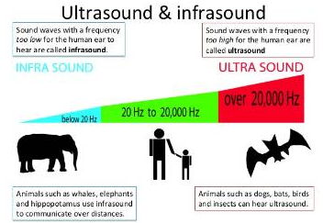
Basic Physics
“Health needs assessment is a systematic method for reviewing the health issues facing a population, leading to agreed priorities and resource allocation that will improve health and reduce inequalities (Cavanagh & Chadwick, 2005).”
6

Slide 7
Basic Physics
Diagnostic US utilizes sound waves in the range of
1 MHz to 20 MHz
7

Slide 8
Basic Physics
Many factors influence the ultrasound waves
transmitted through the human body
8

Slide 9
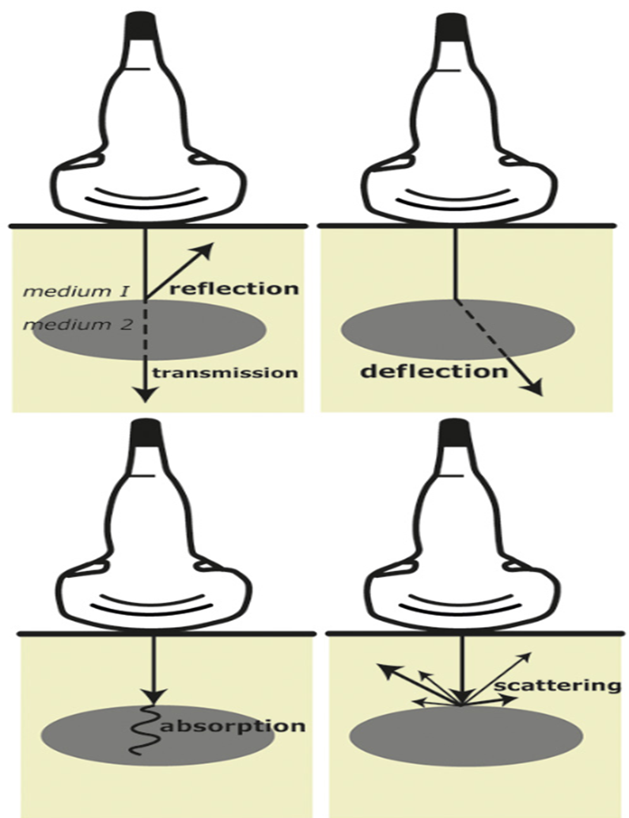
Basic Physics
Reflection & Refraction & Scatter
At interfaces between different medium
9

Slide 10
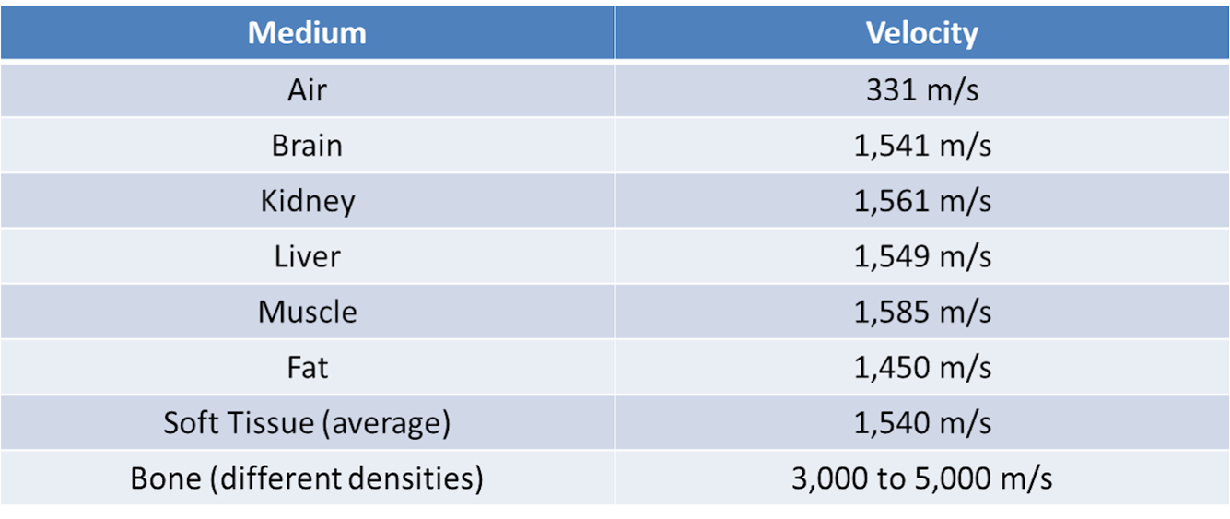
Basic Physics
High stiffness = high speed
High density = low speed
10

Slide 11
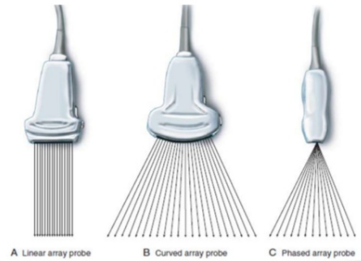
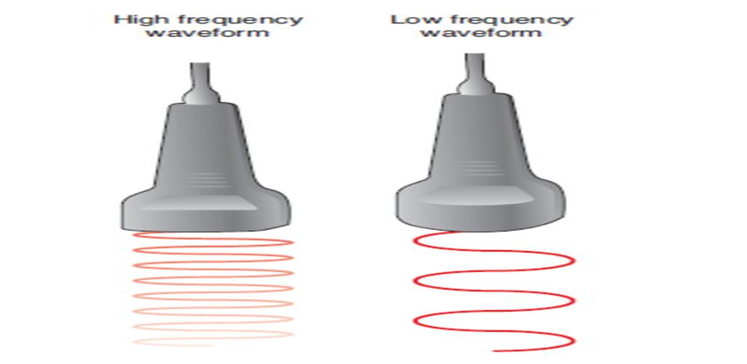
Transducers
11

Slide 12
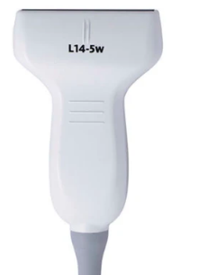
Linear
High frequency (5-18) MHz
Flat surface
High resolution
Does not allow deep penetration
Maximum depth (6-8) cm
12

Slide 13
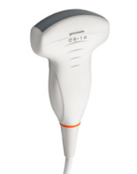
Curvilinear
Low frequency (1 – 5) MHz
Curved surface
Allow deep penetration into the body.
13

Slide 14
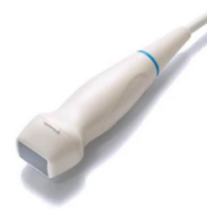
Phased-array
Low frequency (1 – 5) MHz
Allow deep penetration into the body.
Smaller footprint and flat surface.
Poor resolution in the far field when comparing with curvilinear probe.
14

Slide 15
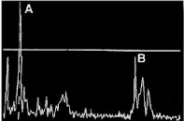
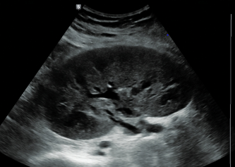
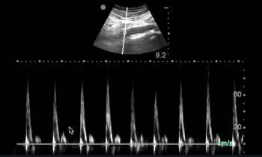
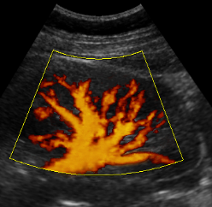
Ultrasound Imaging Modes
A-Mode = Amplitude
B-Mode = Brightness
C-Mode = Color Doppler
D-Mode = Pulse Wave Doppler
P-Mode = Power Doppler
M-Mode = Motion
15

Slide 16
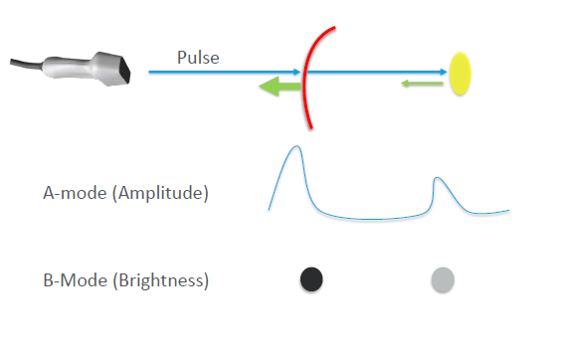
Ultrasound Imaging Modes
16

Slide 17
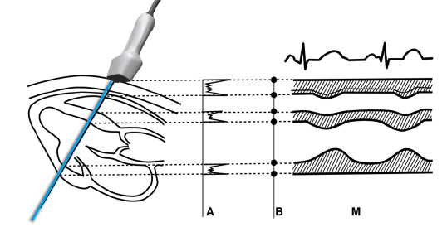
Ultrasound Imaging Modes
M-Mode
17

Slide 18
Ultrasound Imaging Modes
18

Slide 19
Ultrasound Imaging Modes
19

Slide 20
Ultrasound Imaging Modes
20

Slide 21
Ultrasound Imaging Modes
21

Slide 22
Ultrasound Imaging Modes
22

Slide 23
Ultrasound Imaging Modes
23

Slide 24
Gain
24

Slide 25
Depth
25

Slide 26
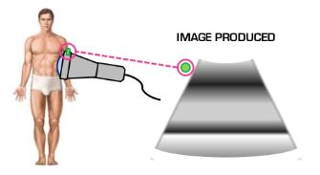
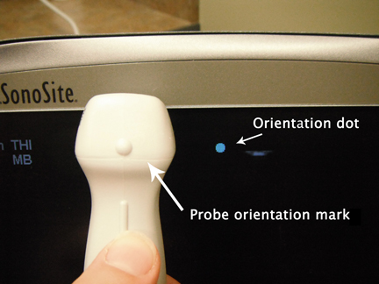
Probe Orientation
26

Slide 27

Common Artifacts
Reverberation
Mirroring
Acoustic Enhancement
Shadowing
27

Slide 28
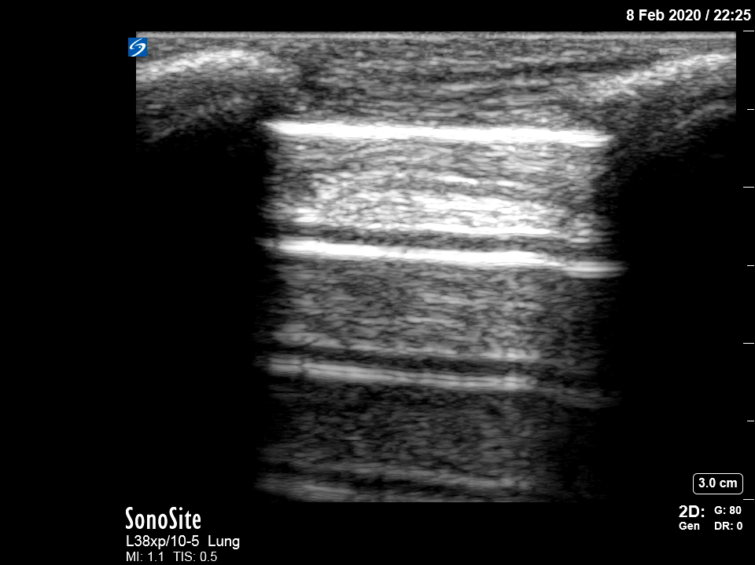




Reverberation
28

Slide 29
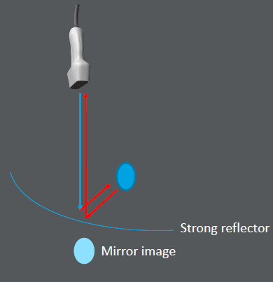
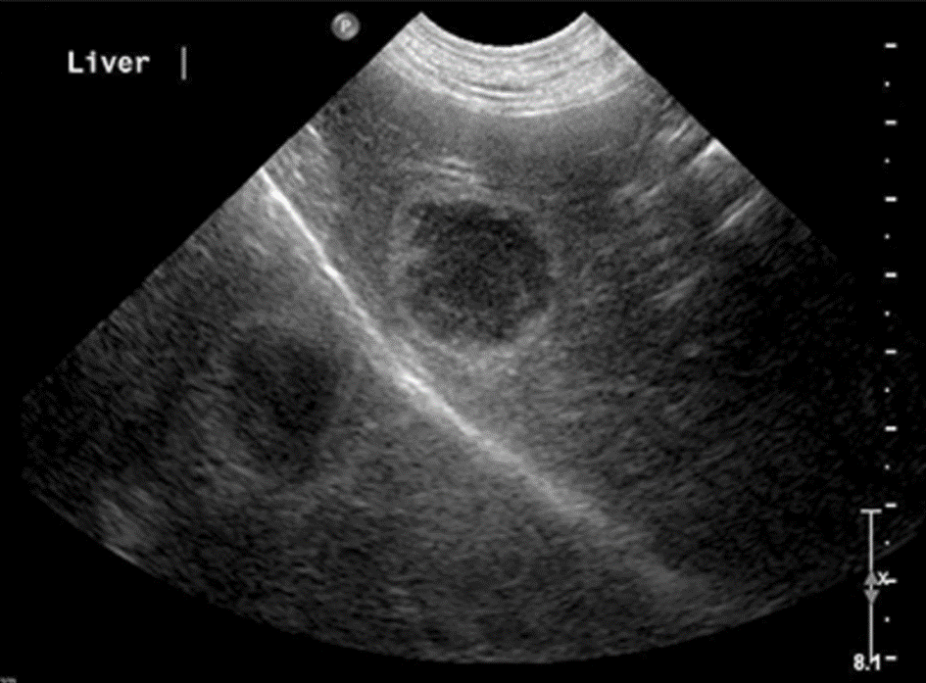
Mirroring
29

Slide 30
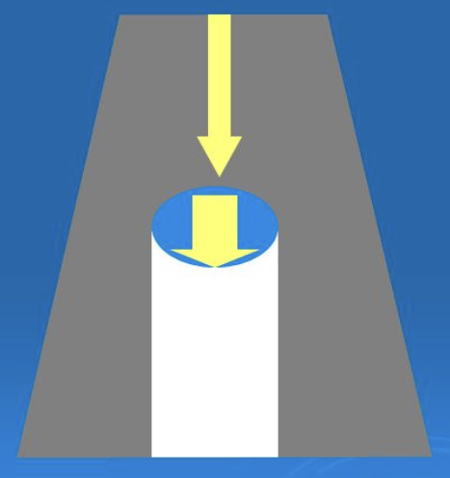
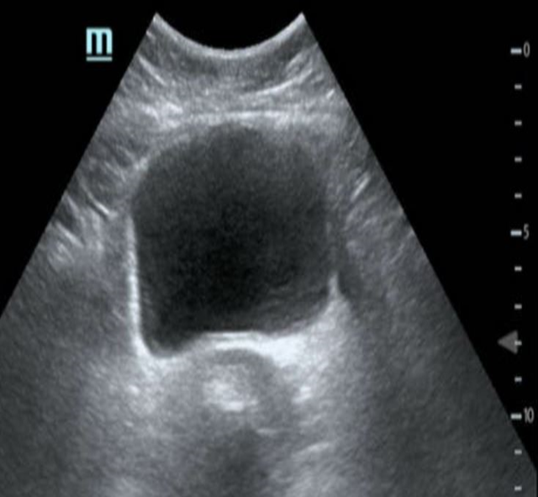
Acoustic Enhancement
30

Slide 31
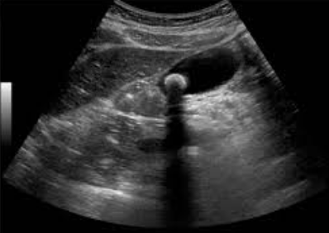
Shadowing
31

Slide 32
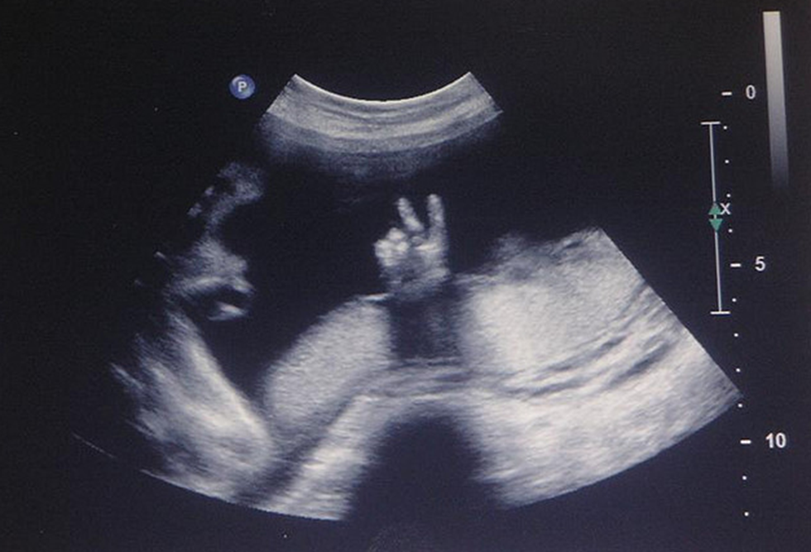
Thank You

