Slide 1
Intraosseous Infusion Workshop
Dr Tariq Al thobaiti ,MBBS
Clinical Assistant Professor
Consultant EM/PEM
KSU- College of medicine &Medical City
Notes:
© Copyright PresentationGO.com – The free PowerPoint template library

Slide 2
IO

Slide 3
EZ-IO Device

Slide 4
Bone Injection Gun

Slide 5
Various intraosseous needles

Slide 6
IO INDICATION
1- Emergency intravascular access when other methods have failed
2- Cardiac arrest in infant and young children
3- Military applications

Slide 7
IO CONTRAINDICATIONS
1- Osteoporosis and osteogenesis
2- Fractured bone
3- Prior use of same bone for io infusion
4- Cellulitis or burn overlaying insertion site

Slide 8
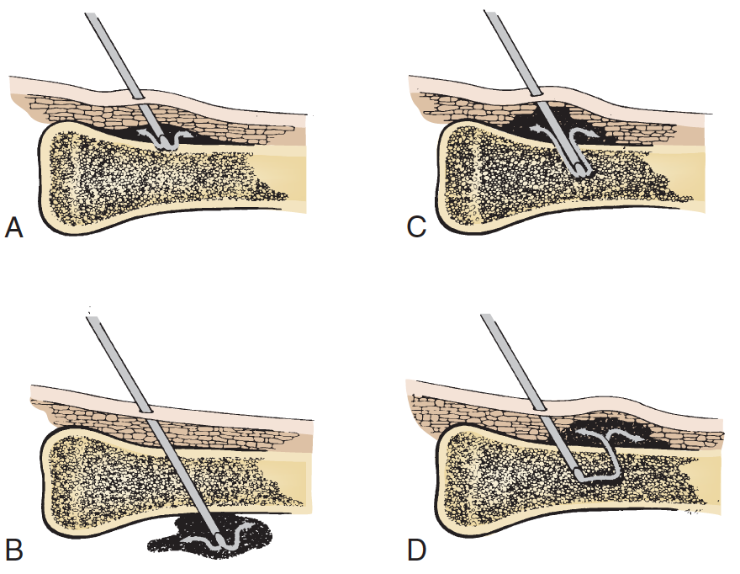
IO Complications
A- TECHNICAL DIFFICULTIES
1- Over penetration
2- Incomplete penetration
3- Needle obstruction
4- Fluid extravasation

Slide 9
IO Complications
B- SOFT TISSUE AND BONY COMPLICATIONS
1- Infection
2- Bony inflammatory
3- Skin sloughing
4- Compartment syndrome
5- Epiphyseal injury
6- Fat embolism
7- Pain with infusion

Slide 10
MEDICATIONS AND FLUIDS BY IO

Slide 11
LABORATORY TESTING

Slide 13
IO HOW ?
https://youtu.be/DB_Jly2jEDY
https://youtu.be/KHXSfh2ZRDM

Slide 14
Tube Thoracostomy Workshop
Dr Tariq Al thobaiti ,MBBS
Clinical Assistant Professor
Consultant EM/PEM
KSU- College of medicine &Medical City

Slide 15
How?

Slide 16
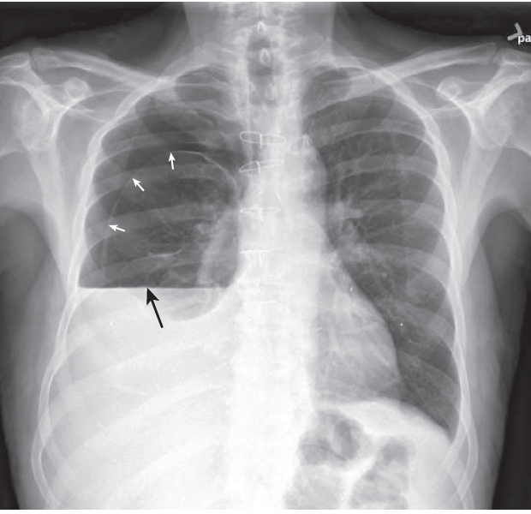
?

Slide 17
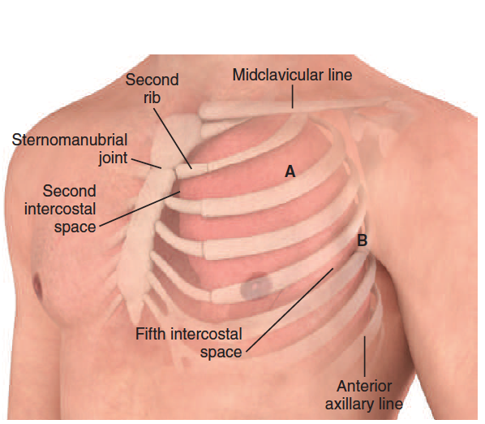
indication
1- Spontaneous and traumatic pneumothorax
2- Hemothorax
3- Empyema
4- Patients with penetrating chest trauma undergoing positive pressure ventilation or long- distance transport

Slide 18
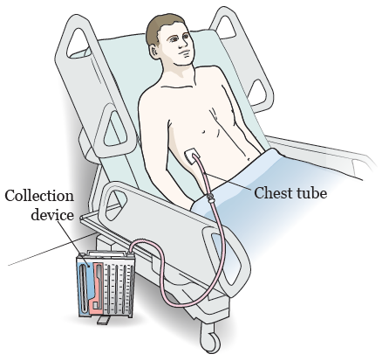
Contraindication
A- absolute
none
B- RELATIVE
1- Presence of multiple pleural adhesions
2- Presence of emphysematous blebs
3- Coagulopathy

Slide 19
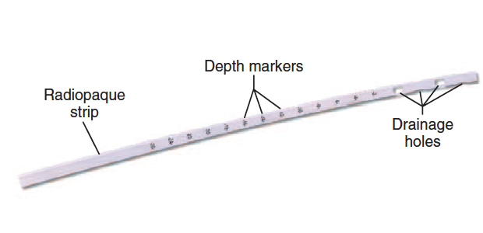
Complications
1- Infection
2- laceration of an intercostal vessel
3- Pulmonary injury
4- Intraabdominal or solid organ tube placement
5- Failure of reexpantion of pneumothorax
6- Reexpansion pulmonary edema

Slide 20
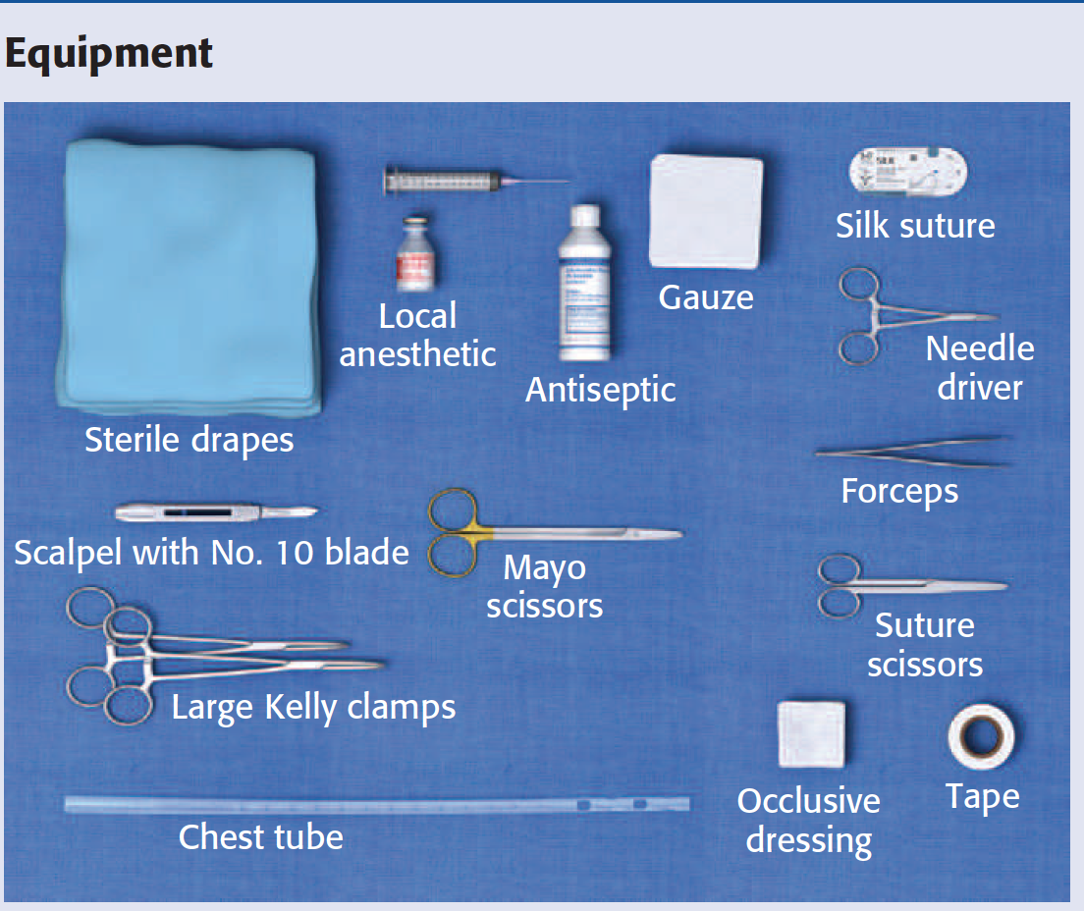
What You Need?

Slide 21
Drainage and Suction Systems

Slide 22
OTHER TECHNIQUES

Slide 23
HOW?
https://youtu.be/qR3VcueqBgc

Slide 24
QUESTION ?

