Slide 1
Approach to Chest Pain
Adel Altamimi, MD
EM Consultant
KSU-MC

Slide 2
Chest pain is one of the highest risk chief complaints you will see in the Emergency Department (ED).
Approximately 6 million patients visit the emergency department (ED) each year with complaints of chest pain, constituting 9% of all patients seen in ED in USA.

Slide 3
Definition of Acute Chest Pain:
It is the recent onset of pain, pressure, or tightness in the anterior thorax between the xiphoid, supra sternal notch, and both midaxillary lines.

Slide 4
Chest pain challenges:
It can caused by several life-threatening as well as non–life-threatening diseases and has a broad differential diagnosis.
The diagnosis of chest pain in ED can be difficult because neither the quality nor intensity of the pain is specific to any organ or diagnosis.
The presentations can vary significantly even amongst the most common life-threatening diseases.

Slide 5
Life Threatening Causes of Chest Pain
Acute Coronary Syndrome (ACS)
Acute Aortic Dissection (AAD)
Pulmonary Embolism (PE)
Cardiac Tamponade
Esophageal Rupture
Tension Pneumothorax

Slide 6
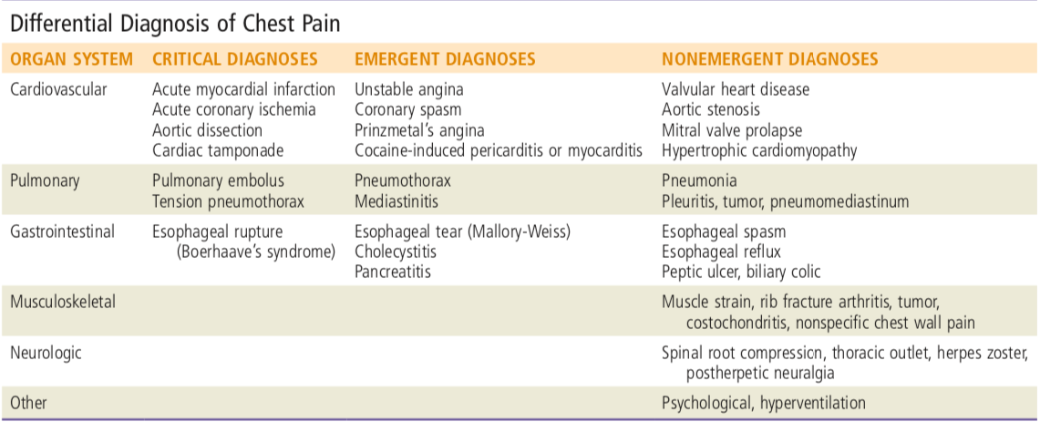

Slide 8
Pathophysiology:
Afferent fibers from the heart, lungs, great vessels, and esophagus enter the same thoracic dorsal ganglia.
Through these visceral fibers, each organ produces the same indistinct quality and location of pain.
Because dorsal segments overlap three segments above and below a level, disease of a thoracic origin can produce pain anywhere from the jaw to the epigastrium.

Slide 9
Chest pain evaluation is challenging but very manageable.
Most patients who present with chest pain are actually not that sick and many can be safely discharged from the ED.

Slide 10
Initial Evaluation:
Determine “Sick vs “Not Sick”.
Assesses primary survey: ABC’s and vital signs (Stable vs unstable)
Obtain focused history and exam.
Obtain ECG.

Slide 11
History:
Character of the pain:
Squeezing.
Crushing
Pressure like
Think of ACS
Sharp or stabbing more in pulmonary

Slide 12
relation to exercise.
onset.
relation to food.
severity.
location.
radiation

Slide 13
Duration .
aggravation factors.
associated symptoms ( diaphoresis).
PMHx
Risk Factors.

Slide 14
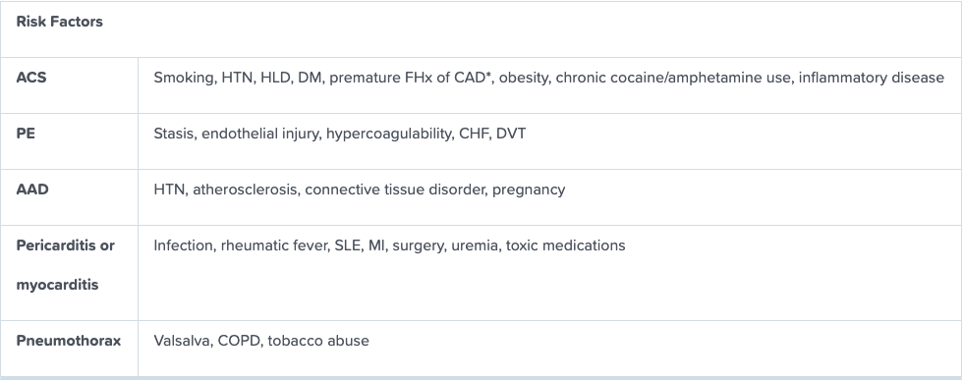

Slide 15
Classical cardiac chest pain:
Retrosternal left anterior chest crushing, squeezing, tightness, or pressure.
Aggravated by exertion and relieved by rest.
Radiation.
Diaphoresis.

Slide 16
Examination:
General appearance .
V/S.
Cardiac exam.
Pulmonary exam.
Abdominal exam.
Extremities exam.
Neurologic exam.

Slide 17
Diagnostic Testing:
Electrocardiogram (ECG):
ECG within 10 minutes of arriving to ED.
It can gives the clinician a lot of information.
A rapid screen is done to look for STEMI/ ischemia and arrthymia.
Serial ECGs.

Slide 18
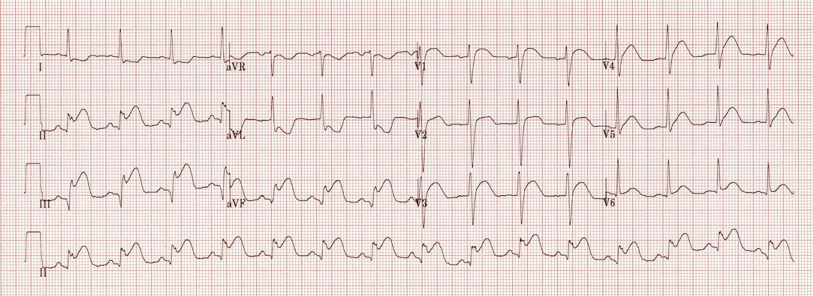

Slide 19
ST-segment elevation also occurs in patients with pericarditis, myocarditis, early repolarization, left ventricular hypertrophy, and ventricular aneurysms.
A normal ECG lacks the sensitivity to exclude ACS.

Slide 21
Imaging:
CXR is commonly performed in the evaluation of ED patients with chest pain.
Most patients with ACS have a normal CXR.
Useful to exclude other conditions such as pneumonia and pneumothorax.

Slide 24
Laboratory Studies:
Cardiac troponins (cTn):
They are regulatory proteins that control the calcium-mediated interaction of actin and myosin, producing myocardial contraction.
Myocardial injury, including but not limited to ischemia, causes release of these proteins into blood.
There are numerous non- ischemic causes of cTn elevations.

Slide 25
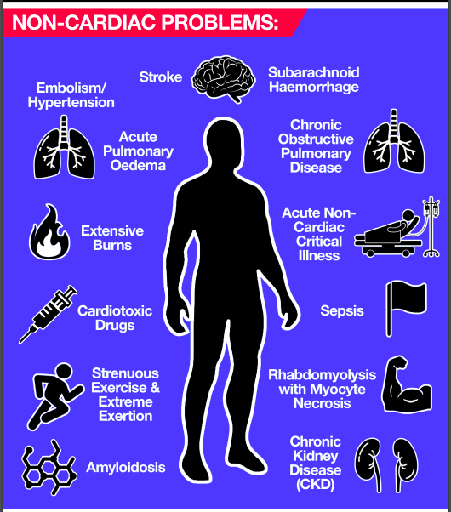

Slide 26
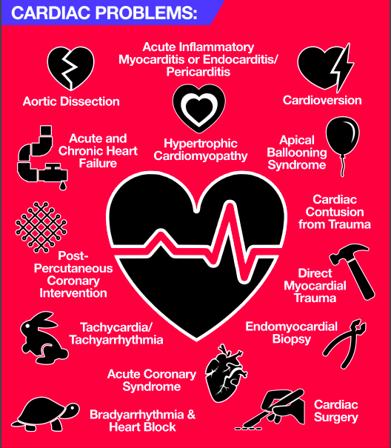

Slide 27
Point of Care Ultrasound (POCUS):
The ultrasound can assess for pericardial effusion as well as tamponade.
It can assess the cardiac contractility to assess the left ventricular function.
It can determined the t presence of right ventricular strain.

Slide 28
ACS
Incidence: ~12% of ED patients with Chest pain have ACS.
ACS is comprised of ST-elevation myocardial infarction (STEMI), non-ST-elevation myocardial infarction (NSTEMI), and unstable angina (UA).

Slide 29
History:
Classically associated with shortness of breath (SOB), nausea/vomiting, diaphoresis, and radiation to neck/arm/shoulder.
Pain worsens upon exertion.
Response to nitroglycerin has no predictive value for ACS.

Slide 30
Non-classic presentations of ACS occur more frequently in women, black race, diabetics, the elderly, and patients with psychiatric disease or altered mental status

Slide 31
Chest pain that significantly decreases the likelihood of ACS include:
Pleuritic in nature.
Positional pain.
Pain described as sharp.
Pain that is fully reproducible with palpation.
Non-exertional

Slide 32
Diagnosis:
In the absence of left ventricular hypertrophy (LVH) or left bundle branch block (LBBB), ST elevation (STE) is defined as follows:
≥1 mm STE in at least 2 contiguous leads except for V2-V3. If V2-V3, STE must be ≥2 mm in men ≥40 y old, ≥2.5 mm in men <40 y old, or ≥1.5 mm in women.
In AMI, initial ECGs are often non-specific (40%-70%) or normal (<10%).

Slide 33
Troponin is the test of choice for diagnosing MI. Along with the history and ECG, troponin plays an essential role in diagnosing MI.
Elevated troponin is proportional to increased mortality in ACS.

Slide 34
Time course of Troponin:
Rise 4-8 hours post onset of symptoms in MI
Peaks at 18-24 hours.
Levels stay elevated for 10 days.

Slide 35
Therapeutic Interventions:
Address ABC.
Start an IV, oxygen to maintain SpO2 >90% and start cardiac monitoring.
Aspirin 162-325 mg chewed. If the patient is unable to tolerate aspirin, clopidogrel 75 mg PO is an alternative.
Nitroglycerin 0.4 mg SL q5min × 3 as needed for CP.

Slide 36
Contraindication to Nitroglycerin:
Hypotension
Inferior STEMI
History of use phosphodiesterase inhibitors.

Slide 37
STEMI Patients:
Percutaneous intervention (PCI).
Fibrinolytics.

Slide 38
PE
Incidence is 0.5% of ED patients with Chest pain.
Presentation varies greatly, ranging from asymptomatic to shock.

Slide 39
Massive PE:
Accounts for only 5% of acute PE.
Mortality rate 25-65%
Hypotension: SBP <90 mm Hg or decrease >40 mm Hg for 15 min.
Signs of shock secondary to PE.

Slide 40
Submassive PE:
PE without hypotension but with either of the following:
Myocardial necrosis defined by elevation of troponin or
Right ventricular (RV) dysfunction defined by RV dilation on imaging (echocardiographic or CT) and elevation of B-type natriuretic peptide (BNP) or ECG criteria.

Slide 41
Presentation:
SOB is the most common symptoms followed by pleuritic chest pain.
Look for risk factors.
Tachypnea is the most common sign.
Risk stratification by clinical rules ,e.g Wells Criteria.

Slide 42
Diagnosis:
ECG and CXR: Often non-specific.
Low to moderate risk of having PE → D-dimer.
High risk of having PE → send directly to imaging.
CT pulmonary angiogram is the test of choice.

Slide 43
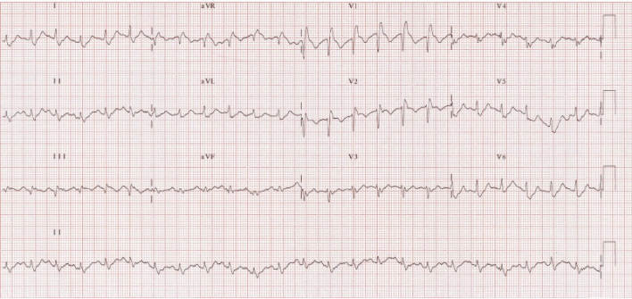

Slide 44
Therapy:
Anticoagulation is the main step of treatment.
For massive PE, thrombolytics can be used if there is no contraindication.

Slide 45
AAD
Incidence is approximately 5 cases/million population/y.
Risk factors: HTN, atherosclerosis and connective tissue disease.

Slide 46
History:
Classic presentation is severe tearing or ripping pain radiating to the back with severe distress and diaphoresis.
May cause signs of infarction/ischemia anywhere along the aorta (arms, legs, bowels, kidneys, brain, spinal cord).
Approximately a third of patients have neurologic complaints/findings.

Slide 47
Exam:
Pulse deficit, caused by a hematoma or intimal flap, may unilaterally obstruct flow. This is observed in fewer than one-third of patients.
Diastolic murmur may be due to aortic regurgitation.
Abnormal neurologic exam may be due to stroke from cervical artery dissection or infarct of the spinal cord.

Slide 48
Diagnosis:
ECG mostly non specific or may show a STEMI as a result of dissection of coronary ostia.
CXR may shows widened mediastinum (61%) or abnormal aortic contour (50%).
Normal x-ray does not rule out the diagnosis.
CTA is the test of choice.

Slide 49
Therapy:
Pain control.
BP control
Surgical consultation

Slide 50
Esophageal Rupture
Boerhaave’s syndrome.
Severe CP, usually following forceful vomiting.
Often associated with subcutaneous crepitus.
Think of this diagnosis in alcoholics or with history of recent procedures.

Slide 51
Diagnosis:
Ill appearing, septic and febrile.
CXR may show left side pleural effusion and mediastinal air.
CT Chest will help in defining injury.

Slide 52
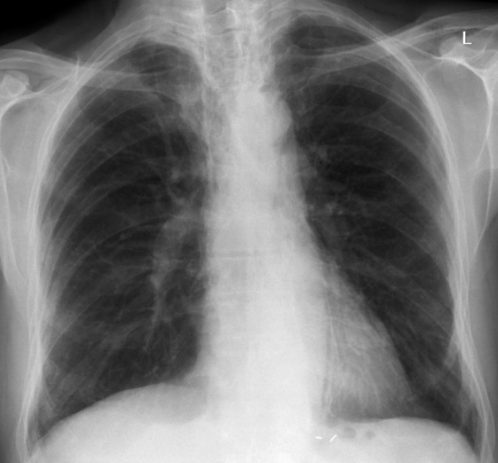

Slide 54
Therapy:
IV antibiotics.
Emergent surgical consultation

Slide 55
Pericardial Tamponade
Can present acutely from trauma or aortic injury, or slowly from cancer and infection.
Consider this diagnosis if the patient is in shock.

Slide 56
Diagnosis:
Tachycardia.
Pericardial rub.
Muffled heart sounds.
Jugular venous distention.
POCUS is the test of choice and it usually show diastolic collapse of the cardiac chambers.

Slide 57
ECG can show low voltage, tachycardia or electrical alternans.
POCUS is the test of choice and it usually show diastolic collapse of the cardiac chambers.

Slide 59
Therapy:
The treatment is pericardiocentesis.

Slide 60
Tension Pneumothorax
Can occur for many reasons including iatrogenic (e.g. from central lines).
Shock and respiratory symptoms due to pneumothorax compressing the mediastinum, resulting in decreased venous return to the heart.
Often secondary to thoracic trauma.

Slide 61
It can also caused by caused by a simple spontaneous pneumothorax progressing to tension pneumothorax.
Diagnosis is clinical, Don’t wait for the X-ray to make the diagnosis .
Treat with needle decompression while preparing for ED Thoracostomy.

Slide 62
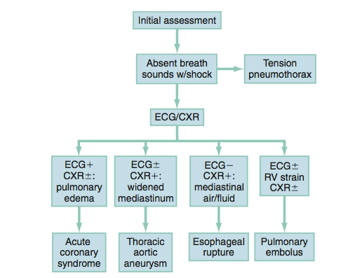

Slide 63
