Slide 1
Common Drugs Ingestion
Hashim Bin Salleeh
Associate Professor of Paediatrics
Consultant Paediatric Emergency Medicine
King Khalid University Hospital

Slide 2
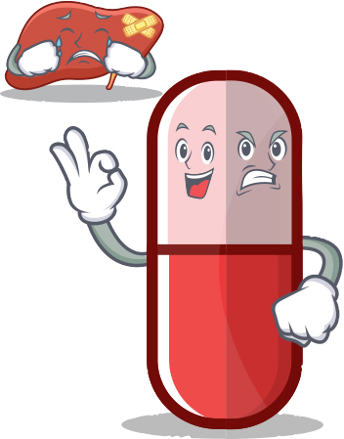
Acetaminophen overdose N -acetyl-p-aminophenol (APAP)

Slide 3
Objectives
By the end of this lecture, participants should be able to:
Know the potential toxic dose of APAP according to age
Understand the pathophysiology of APAP OD
Know the symptoms and signs of APAP OD
Know the indications of NAC therapy

Slide 4
APAP
Acetaminophen has been approved for OTC use since 1960
1st cases of hepatic damage after APAP OD 1966
Therapeutic dose of acetaminophen is 10-15 mg/kg/dose in children and 325-1000 mg/dose every 4-6 hours in adults, with a maximum of 4g/day

Slide 5
Toxic dose of APAP
Children:
< 12 months 150 mg/kg
1 – 6 y 200 mg/kg
1 – 6 y with risk factors 150 mg/kg
7 – 12 y 150 mg/kg
Youth & Adult
7.5 - 10 g

Slide 6
Metabolic Pathways
Hepatic glucuronide conjugation(40-65%)
Hepatic sulfate conjugation(20-45%)
→ inactive metabolites excreted in the urine.
Excretion of unchanged APAP in the urine (5%).
Oxidation by P450 cytochromes (CYP 2E1, 1A2, and 3A4) to NAPQI (5-15%)
→ GSH combines with NAPQI
→ nontoxic cysteine/mercaptate conjugates
→ excreted in urine.
90%

Slide 7
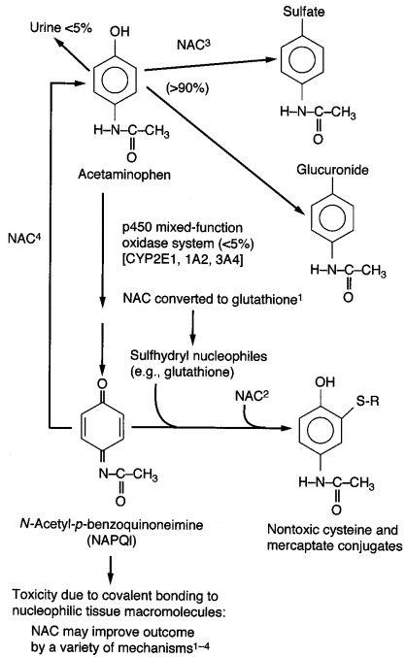

Slide 8
What happens in OD ?

Slide 9
Saturation of glucuronidation and sulfation pathways
Amount of APAP metabolized by p450 cytochromes to NAPQI increases
Normally NAPQI is detoxified by reduced GSH (glutathione) and thiol-containing substances
In OD: rate and quantity of NAPQI formation overwhelms GSH supply and regeneration:
→ elimination of NAPQI prolonged
→ free NAPQI binds critical cell proteins with sulfhydryl groups
→ cellular dysfunction and cell death.
Animal models: hepatotoxicity when GSH stores fall <30% of baseline

Slide 11
Factors which adversely affect APAP metabolism
Up regulation (i.e. induction) of CYP 2E1 enzyme activity
Decreased glutathione stores
Eating
NAC
Frequent dosing interval of APAP
Prolonged duration of excessive dosing
(Kuffner et al. 2001)

Slide 12
Clinical manifestation
I 0.5-24h n/v, anorexia, asymptomatic
II 24-48 h resolution of stage I sxs
RUQ pain, elevation of PTT, INR, bili + enzymes (at the latest by 36h)
III 48-96h coagulopathy, peaking of enzymes, acidosis, hypoglycemia, bleeding diathesis, jaundice, anuria, cerebral edema, coma. ARF in 25% of pts with hepatotoxicity
IV 4-14d resolution

Slide 13
Diagnosis
In the patient with a history of APAP overdose, a serum APAP level should be measured between 4 and 24 hours after ingestion
The value obtained should be evaluated according to the Rumack-Matthew nomogram for determining the risk of hepatotoxicity and the need for NAC therapy

Slide 14
Toxicological History
Often incomplete, unreliable or unobtainable
Sources – Patient, friends, family, EMS,or pill containers
PMHx, liver/renal disease, concurrent medications, previous overdoses, PΨHx, substance abuse

Slide 15
The 5W’s of toxicology
Who – pt’s age, weight, relation to others
What – name and dose of medication, coingestants and amount ingested
When – time of ingestion, single vs. multiple ingestions
Where – route of ingestion, geographical location
Why – intentional vs. unintentional

Slide 16
Which lab test is the most sensitive for early detection of hepatotoxicity.?
AST

Slide 17
Management Guidelines
Airway
Breathing
Circulation
Decontamination
AC
Find antidote
NAC

Slide 18
NAC
Early → Prevents binding of NAPQI to hepatocytes
GSH precursor → increases GSH stores
Increases sulfation metabolism of APAP → less NAPQI formed
Reduces NAPQI back to APAP (at least in animal models)
Sulfur group of NAC binds and detoxifies NAPQI to cysteine and mercaptate conjugate (= GSH substitute)

Slide 19
NAC
Late (12-24h) → Modulates the inflammatory response
Antioxidant, free radical scavenger
Reservoir for thiol groups (i.e. GSH)
Impairs WBC migration and function → antiinflammatory
Positive inotropic and vasodilating effects (NO) → improves microcirculatory blood flow and O2 delivery to tissues
Decreases cerebral edema formation, prevents progression of hepatic encephalopathy and improves survival

Slide 21
NAC
NAC should optimally be given within 8 to 10 hours after ingestion
More delayed therapy is associated with a progressive increase in hepatic toxicity
some benefit may still be seen 24 hours or later after ingestion

Slide 22
What is the Rumack-Matthew nomogram?

Slide 23
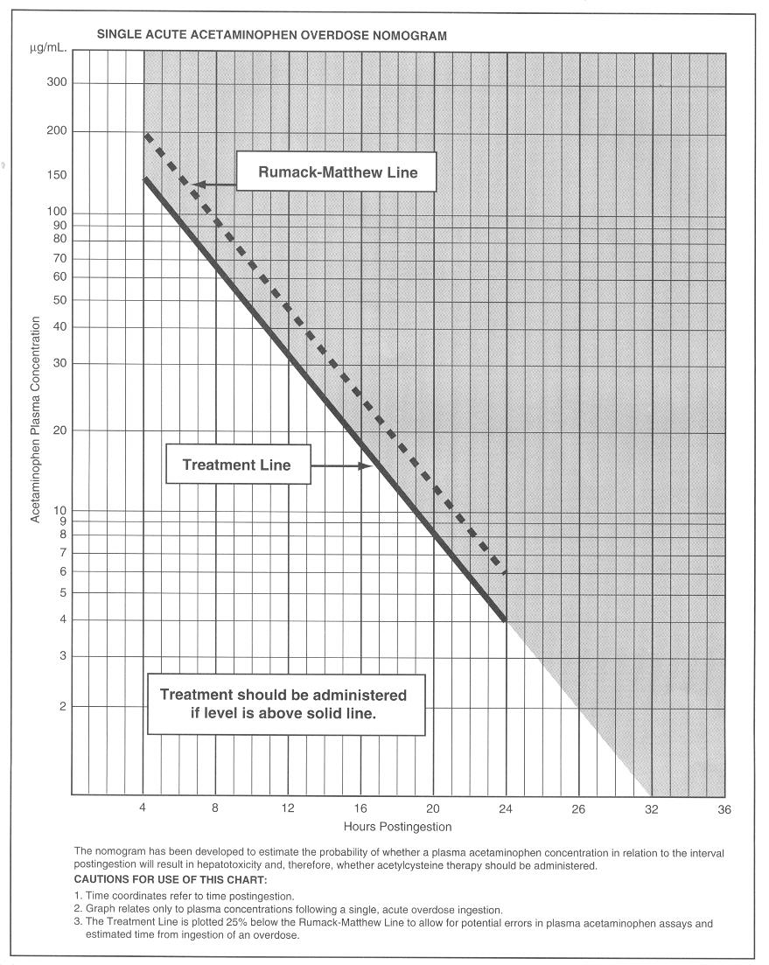

Slide 24
Rumack-Matthew nomogram
APAP level to predict which patients will develop an AST elevation >1000 IU/L with out antidotal treatment
Derived from acute ingestion of immediate release acetaminophen
Begins at 4 h post ingestion
Recommended line of treatment has been lowered by 25% to increase its sensitivity

Slide 25
What percent of pts whose APAP level falls above the upper line of the Rumack-Matthew normogram will develop hepatotoxicity? (defined as elevation of the plasma transaminases above 1,000 U/L)
60%

Slide 26
When to give NAC?

Slide 27
Indication for NAC
APAP level above the treatment line
Hx of significant APAP ingestion presenting close to 8h (give while waiting for level)
All APAP ingestions who present late>24h with either detectable APAP or elevated transaminases
Chronic ingestions (>4g/day in adult, >120mg/d in child) with elevated transaminases
Hx of exposure and FHF

Slide 28
XR tablets
Several studies show that elimination of extended and immediate-release acetaminophen are nearly identical after 4 hours.
some case reports APAP levels falling above the treatment normogram line as late as 11-14 hours post ingestion of the extended-release preparation

Slide 30
Short cases

Slide 31
15 month old child (wt. 10 kg) accidentally took full bottle of Tylenol 60cc(120mg/5cc) 30 min ago. Clinically looked well. What will be your treatment plan:
Give Ipecac STAT
Give 1g/kg activated charcoal
Insert OGT and perform gastric lavage
Should be observed for 4h then to do drug level
None of the above

Slide 32
15 month old child accidentally took full bottle of Tylenol 60cc(120mg/5cc) 30 mint ago. Clinically looked well. What will be your treatment plan:
Give Ipecac STAT
Give 1g/kg activated charcoal
Insert OGT and perform gastric lavage
Should be observed for 4h then to do drug level
None of the above

Slide 33
19 y old girl brought to ED with GCS 8 following drug ingestion (empty bottle of Tylenol was found in her room). What will be your first response
1g/kg activated charcoal STAT
Orotracheal intubation
Observation for 4 h
Do CBC, CBG, PT, PTT, INR, Drug level
NAC loading dose followed by infusion over 24 h

Slide 34
19 y old girl brought to ED with GCS 8 following drug ingestion (empty bottle of Tylenol was found in her room). What will be your first response
1g/kg activated charcoal STAT
Orotracheal intubation
Observation for 4 h
Do CBC, CBG, PT, PTT, INR, Drug level
NAC loading dose followed by infusion over 24 h

Slide 35
3 y old boy with accidental Tylenol ingestion on NAC for high drug level, after 48 h course LFT ,INR are high. What will be your recommendation:
D/C NAC if drug level undetectable
D/C NAC and repeat LFT, INR, drug level after 4h
Continue on NAC until all his labs become normal
D/C NAC, most likely it is secondary to concurrent viral illness

Slide 36
3 y old boy with accidental Tylenol ingestion on NAC for high drug level, after 48 h course LFT ,INR are high. What will be your recommendation:
D/C NAC if drug level undetectable
D/C NAC and repeat LFT, INR, drug level after 4h
Continue on NAC until all his labs become normal
D/C NAC, most likely it is secondary to concurrent viral illness

Slide 37
20 yr old pregnant girl ingested 20g of Tylenol in a suicidal gesture 36h ago. Her APAP is <10 and her AST is 90
How will you manage her medically?
She asks you whether her baby will have any defects?

Slide 38
Questions ??

Slide 40
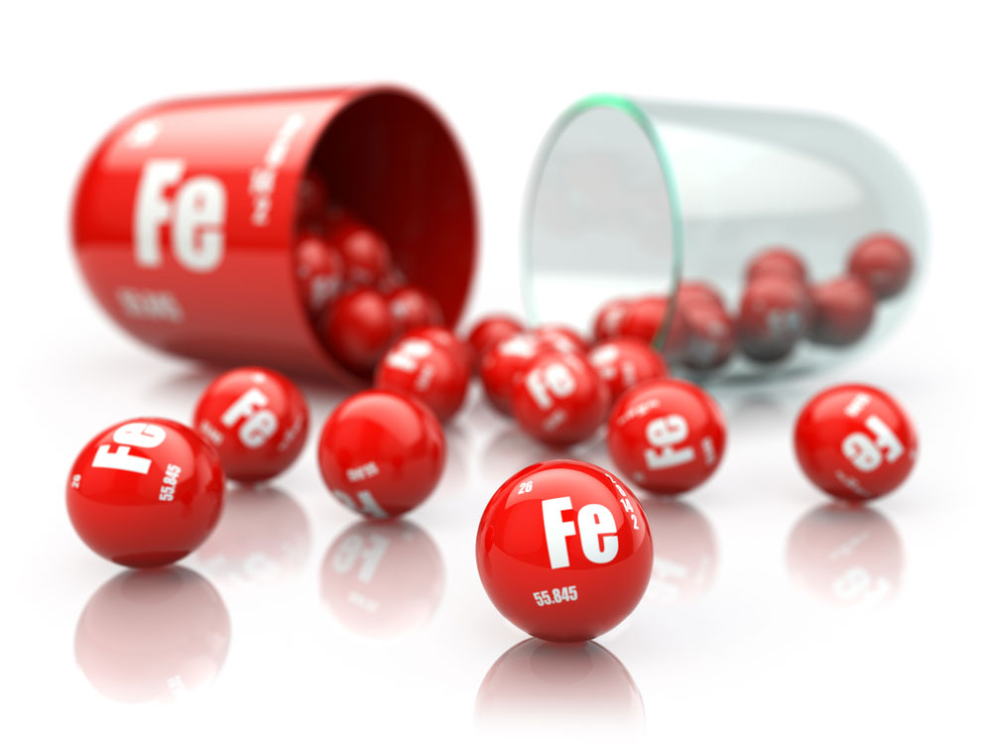
Iron overdose

Slide 41
Common
availability & routinely prescribed
candy like appearance
Chronic overdose
Multiple blood transfusions
Thalasemia
Oncology patients
Acute overdose:
Iron Preparations
Contents | Elemental Fe (%)
Ferrous chloride | 28
Ferrous fumarate | 33
Ferrous gluconate | 12
Ferrous lactate | 19
Ferrous sulfate | 20

Slide 42
Pathophysiology
@ Therapeutic /daily requirement:
absorption of iron is normally very tightly controlled by the GI system
@ overdose:
Iron exerts both local and systemic effects
Corrosive to the GIT (bleeding, perforation, peritonitis)
local damage to the GI mucosa allows unregulated absorption, which leads to potentially toxic serum levels
Excess free iron is a mitochondrial toxin that leads to derangements in energy metabolism
Metabolic acidosis and its effect on multiple organ (heart, lungs, and liver)

Slide 43
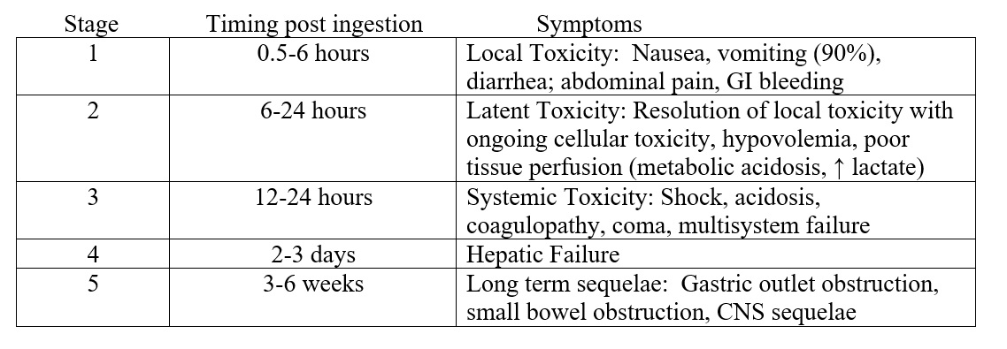
Phases of IRON toxicity

Slide 44
Management
Toxicological History
Unintentional
Timing is important
Number of pills
Formulation
e.g. a 10-kg child who consumed 10 tablets of 320 mg ferrous gluconate (12% elemental iron per tablet), 10 tablets × 38.4 mg elemental iron per tablet = 384 mg/10 kg = 38.4 mg/kg
Physical Examination
5 phases
Patients may not always demonstrate each of the phases.

Slide 45
Management
Serum iron levels peak 4-6 hours post ingestion
peak level predicts severity
Iron is rapidly cleared from serum and deposited in the liver
A measured level after the peak can be deceptively low
Serum iron levels generally correlate with clinical severity
TIBC, glucose, and WBC counts are unreliable in predicting toxicity
Abdominal X-ray can be used to confirm ingestion

Slide 46
Management
Airway
Breathing
Circulation
Fluid
Decontamination
No charcoal
No gastric lavage
WBI
Elimination
None
Finding Antidote
Deferoxamine

Slide 47
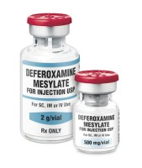
Management
Deferoxamine
Fe level > 500 mcg/dl
Presence of metabolic acidosis
Lethargy/coma
Shock
Toxic appearance
Chelates free iron in the plasma resulting in water soluble complexes that can be renally excreted

Slide 48
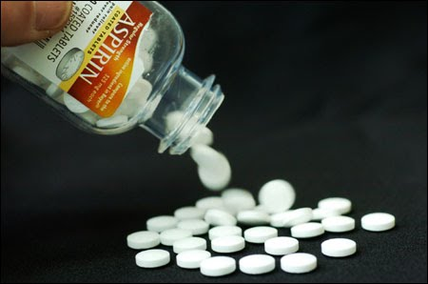
Salicylates overdose

Slide 49
SALICYLATES OVERDOSE
Found in hundreds of OTC medications
important cause of morbidity and mortality
Antipyretic, antiplatelet, and an anti-inflammatory agent
Formulation
Tabs
Baby Aspirin 80mg
Adult Aspirin 325mg
Topical
Oil of wintergreen
Pepto-Bismol
toxicity more & severe
elderly
infants

Slide 50
Range of toxicity
>150 mg/kg
no toxicity- mild toxicity
150-300 mg/kg
Mild-Moderate toxicity
301-500 mg/kg
Serious toxicity
<500 mg/kg
lethal toxicity
Large amount of salicylate
Saturates the body’s protein-binding capacity
Leaves free salicylate in the serum

Slide 51
Pathophysiology
Direct stimulation of respiratory center
Kussmaul Respirations
Respiratory alkalosis
Uncoupling oxidative phosphorylation
Generation of lactate (organ damage, metabolic acidosis)
Hypoglycemia
Hyperthermia from inefficient attempt at ATP production
Electrolyte abnormalities

Slide 52
Presentations
EARLY
LATE
Hyperpnea
Tachypnea
Tachycardia
Nausea
Vomiting
Tinnitus
Vertigo
Diaphoresis
Hypotension
Pulmonary edema
Oliguria
Brain edema
LOC
Seizure
Coma
Death

Slide 53
Diagnosis
High index od suspicion
Acute
Chronic ingestion
anxiety
difficulty concentrating
Hallucinations
agitated delirium
Laboratory
ASA level q2h
VBG
U/E
LFT
CBC
Coagulations
ECG

Slide 54
Treatment
Airway
Breathing
Circulation
Fluid & Electrolytes
Decontamination
Charcoal
No gastric lavage
WBI for bezoar
Elimination
Alkalinize urine
Hemodialysis
Finding Antidote
None

Slide 55
