Slide 1
Burn and thermal injuries
Hossam hassan

Slide 2
Objectives
Thermal Burns
pathophysiology
Zones of burns.
Classification for burn injuries.
Rule of 9’s.
Upper airway and lower airway burns.
Intubation in the burn patient.
Formulas of fluid resuscitation.
Escharotomy.
Burn unit criteria.
Basic burn dressing management.
Burn prevention strategies.

Slide 3
Pathophysiology
Skin function as a semipermeable barrier to evaporate water
Other function of the skin include protection from adversities of the environment, control of body temperature , sensation and excretion
Partial thickness thermal injuries can result in disruption of barrier function and contribute to free water deficits. The effect may be significant in moderate to severe burns

Slide 4
pathophysiology
Thermal injuries result in spectrum of local and systemic homeostatic derangement that contribute to burn shock
Fluid and electrolytes abnormalities are largely due to alteration of cellular membrane potentials with intracellular influx of water and sodium and extracellular migration of potassium secondary to dysfunction of sodium pump

Slide 5
MCQ 1-
In burns Fluid and electrolytes abnormalities are largely due to alteration of cellular membrane function with
A. influx of sodium *
B. efflux of water
C. influx of potassium
D. perfect sodium pump

Slide 6
pathophysiology
In burns greater than 60% of body surface area, depression of cardiac output is frequently observed with lack of response to aggressive volume resuscitation due to increased systemic vascular resistance and circulating myocardial depressants and significant metabolic acidosis
Thermal injuries is progressive injury . Local effects include liberation of vasoactive substances, disruption of cellular function and edema formation
Cell damage occur at a temperature more than 45’c owing to denaturation of cellular protein

Slide 7
pathophysiology
Burn wound is described as having three zones
Zone of coagulation where tissue is irreversibly destroyed with thrombosis of blood vessels
Zone of stasis where there is stagnation of the microcirculation
Zone of hyperemia where there is increased blood flow
Zone of stasis can become progressively more hypoxemic and ischemic if resuscitation is not adequate
In the zone of hyperemia there is minimal damage and spontaneous recovery is likely

Slide 8
MCQ 2-
Regarding zones of skin burn which one is correct
A. Zone of coagulation where tissue is irreversibly destroyed with thrombosis of blood vessels *
B. Zone of hyperemia where there is stagnation of the microcirculation
C. Zone of stasis there is minimal damage and spontaneous recovery is likely
D. Zone of hyperemia there is maximum damage and spontaneous recovery is unlikely

Slide 9
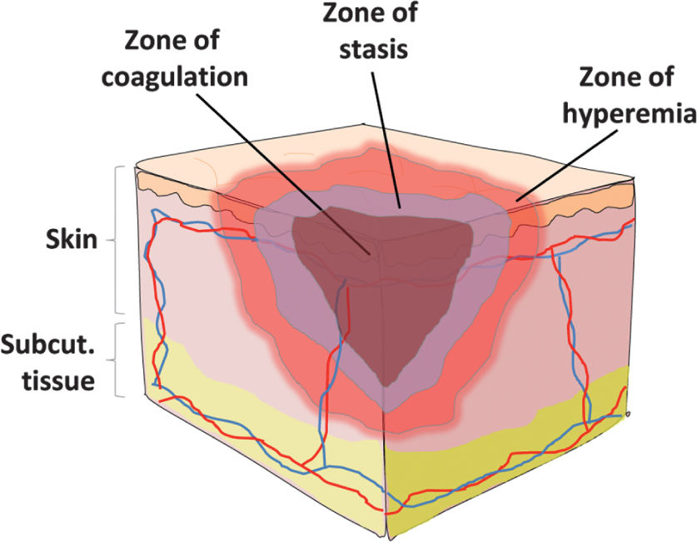
zones of burns

Slide 10
Highlights
Five percent to 35% of patients hospitalized with burns will have inhalational injury
44% of thermal burns due to flame exposure, 33% from scalding, 9% direct conductive burns from hot objects, 4% electrical burns, and 3% chemical burns.
Most commonly affected are upper extremities (41%), then lower extremities (26%), and head and neck (17%)
Overall survival rate 95%.

Slide 11
MCQ 3-
Most commonly affected part of the body is
Head and neck
trunk
upper extremity
lower extremety

Slide 12
Highlights
70% of burn victims are male, risk is highest 18-35 years.
Risk of death from burn increases with:
Larger burn size.
Older age.
Female.
Presence of inhalation injury.

Slide 13
MCQ 4-
Risk of death from burn increases with:
A. smaller burn size.
B. middle age.
C. male.
D. Presence of inhalation injury.

Slide 14
Skin and its function
Skin functions as a semipermeable barrier to evaporative water loss, protects against environmental assault and infections, and aids in the control of body temperature, sensation, and excretion.

Slide 15
Pathophysiology
First 3 will cause the acid base and fluid deficits
Depression of myocardium because of overwhelming circulating inflammatory mediators.
Increase in metabolic rate up to 3 times, so early initiation of feeding is helpful.

Slide 16
Prehospital evaluation
Stop the burning process.
Secure airway if indicated.
Initiate fluid resuscitation.
Relieve pain.
Protect wound.
Transfer.
Primary and secondary survey.
The patient must be extricated from the burning environment
burning clothing must be immediately removed.
Rings, Belts, watches, and jewelry should be removed because they retain heat.
Notes:
Primary and secondary survey.
The patient must be extricated from the burning environment, and burning clothing must be immediately removed. Rings, Belts, watches, and jewelry should be removed because they retain heat.

Slide 17
classification of burn injuries
Notes:
First Degree Limited to epidermis Painful, erythematous, dry surface Heal in days
Second Degree: “moist, painful”
Involves epidermis and extends into dermis
Superficial Second Degree
Involve only the papillary dermis
Painful, erythematous, blisters, blanches with pressure, moist surface
Heal in 2-3 weeks
Deep Second Degree
Extends into reticular dermis
Painful, white or only mild erythema, hemorrhagic blisters, minimal blanching, dry or moist surface
Heal in 3+ weeks, or can progress to 3rd degree burns
In Kids: these can lead to severe scarring and contractures – and need excision and skin grafting if not healed by day 21.
Third Degree
Full-thickness – extend through entire dermis
Stiff, white or tan colour, dry, leathery and insensate
Require excision +/- grafting
Fourth Degree
Extend full-thickness and through subcutaneous fat to involve muscle or bone
Stiff, charred skin
****Accuracy in ED of establishing burn depth is 50-75%. Patients need serial exam and monitoring.****
Burn progression is dynamic and can worsen.

Slide 18
MCQ 5
In secodery degree burn there is
A. only there is hyperemia
B. there is blisters
C. heals without scaring
D. involve skin and subcutaneous tissue and muscles

Slide 19
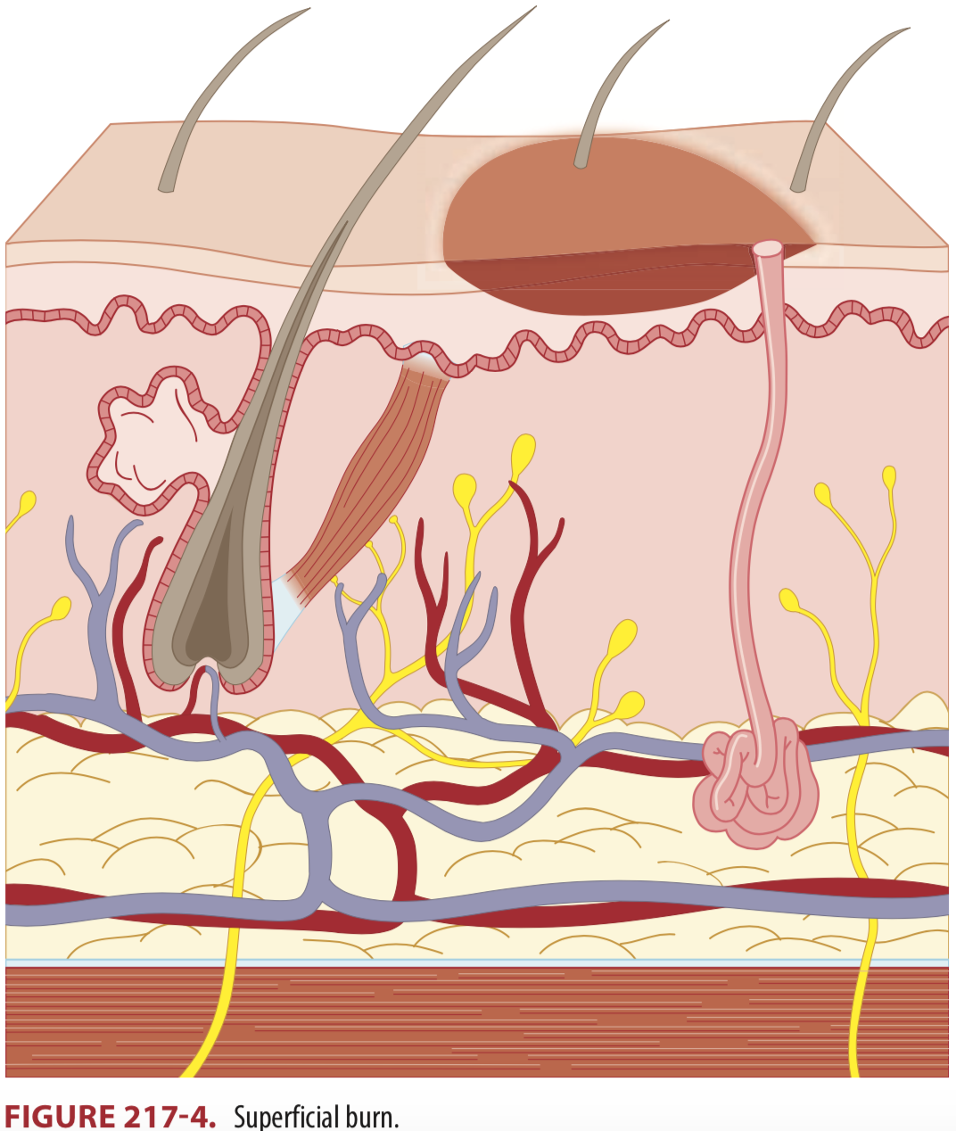

Slide 20
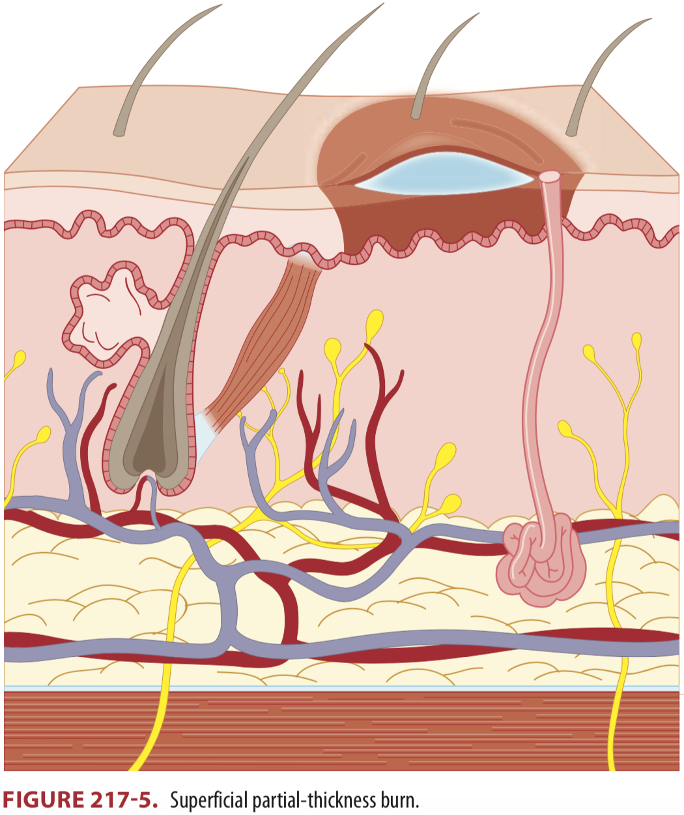

Slide 21
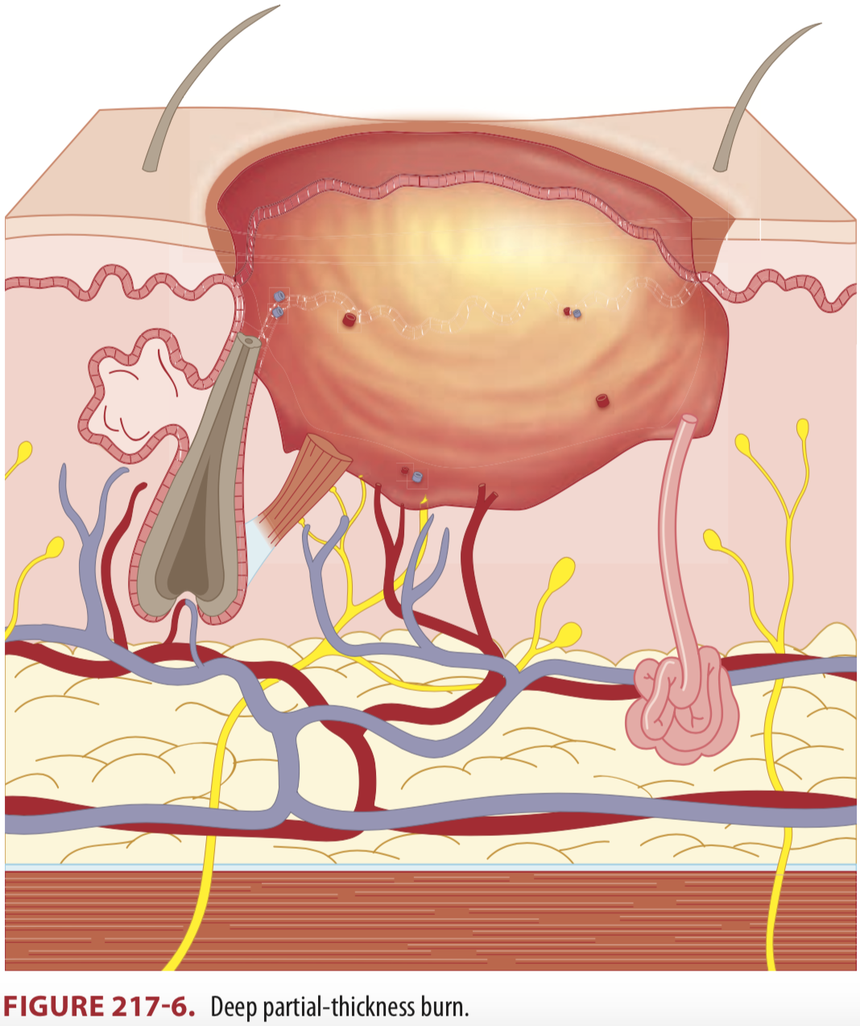

Slide 22
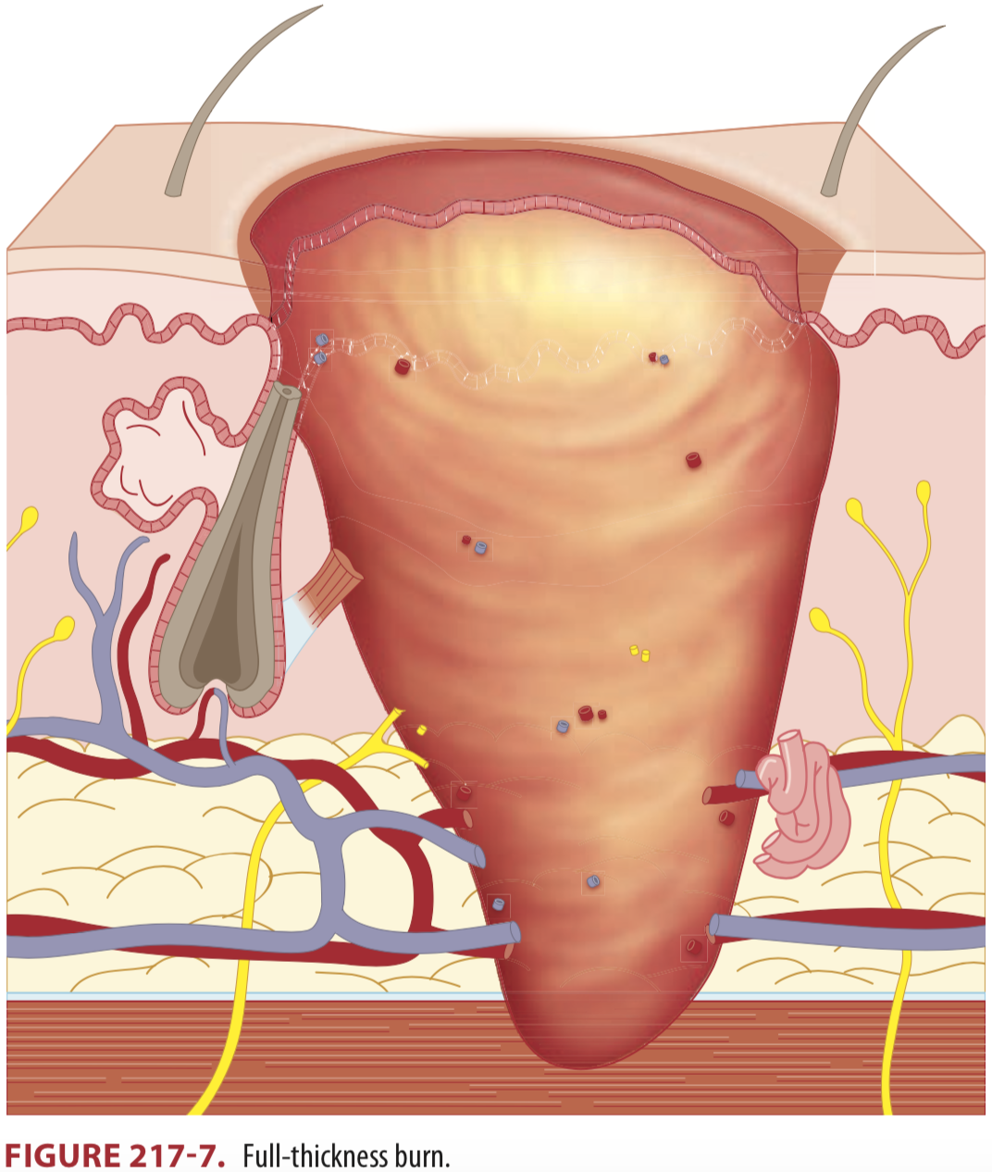

Slide 23
Rule of 9’s

Slide 24
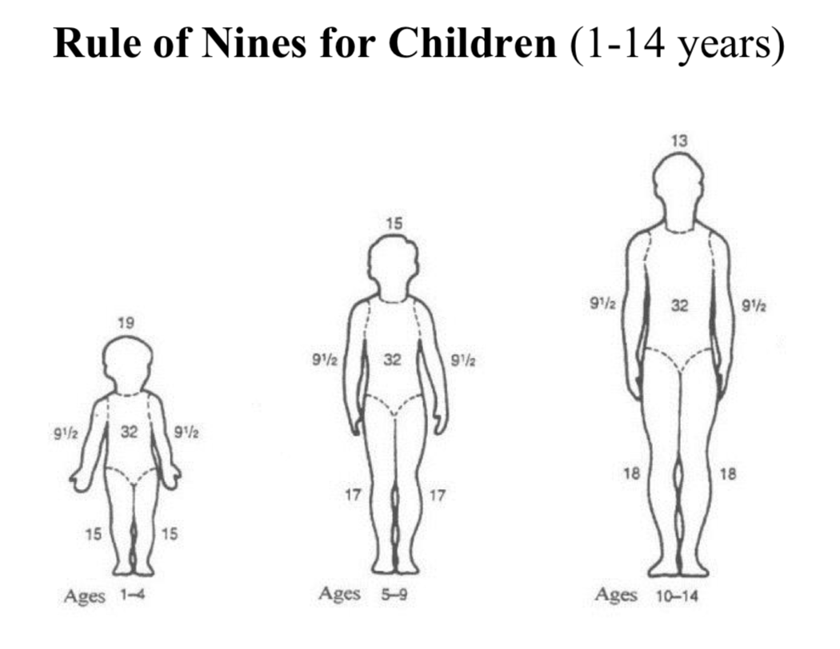
Rule of 9’s in pediatrics
Notes:
Children have relatively larger heads, smaller thighs, and smaller lower legs

Slide 25
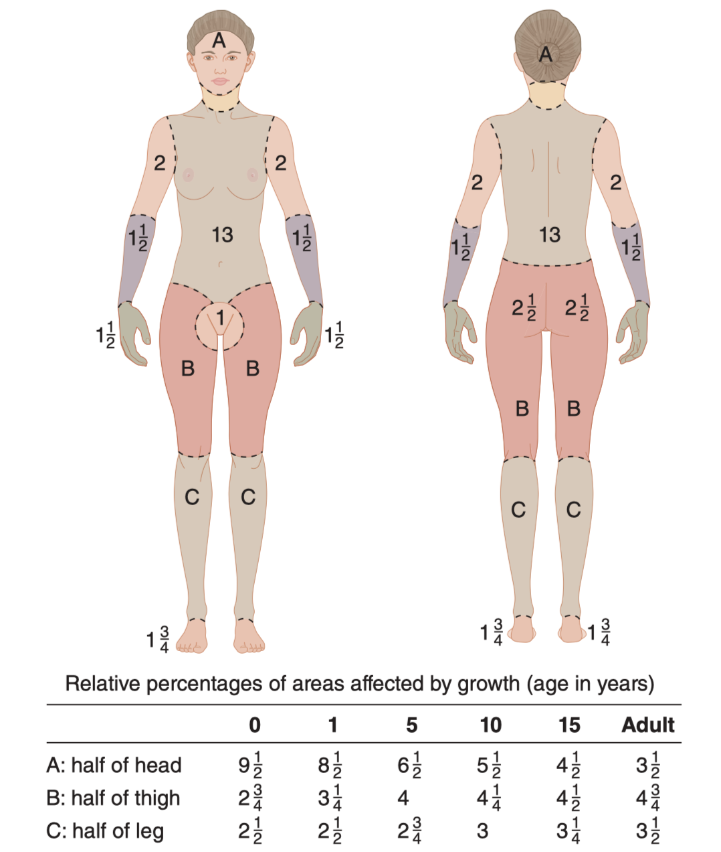
Lund-Browder diagram
Notes:
Small patchy burn ?

Slide 26
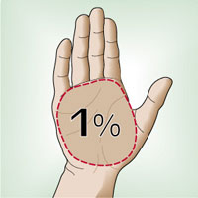
Rule of hand
Notes:
Small patchy burn ?

Slide 27
upper and lower airway burns
Upper airway (supra-glottic):
Soot in and around nose/mouth
Charring
Mucosal inflammation or necrosis
Edema
Lower airway (subglottic):
Wheezing
Crepitations
Hypoxemia
Abnormalities on chest x-ray
V/Q mismatch, decreased lung compliance, microatelectasis, and eventually ARDS
Notes:
Be aware, these signs are only moderately sensitive or specific.
The true dx requires: direct visualization with fibroscopy before / after intubation….showing:
Soot, charring, mucosal inflammation, edema, necrosis
thermal injuries below the level of the vocal cords are less likely, but can occur in cases of steam inhalation.
Watch out for carbon monoxide and hydrogen cyanide tox.

Slide 28
Note:::
Be aware, these signs are only moderately sensitive or specific.
The true dx requires: direct visualization with fibroscopy before / after intubation….showing:
Soot, charring, mucosal inflammation, edema, necrosis
thermal injuries below the level of the vocal cords are less likely, but can occur in cases of steam inhalation.
Watch out for carbon monoxide and cyanide toxicity

Slide 29
Indications for Intubation and Mechanical Ventilation
Full thickness burn of the face or perioral region
Circumferential neck burn
Acute respiratory distress
Progressive hoarseness or air hunger
Respiratory depression or Altered mental state
Supraglottic edema and inflammation on bronchoscopy

Slide 30
fluid resuscitation
Parkland
Evans
Galveston
Modified Parkland
Brooke
Rule of ten
Monafo
Modified Brooke
Notes:
8 different formulas!
maintain urine output of 0.5-1.0 cc/kg/hr (target 1.0 cc/kg/hr in children)
The modified parkland uses the same formula, but gives the fluid over a 24 hr period
Galveston formula – preferred for pediatrics
Lactated Ringers at 5000 cc / m² TBSA burned + 2000 cc/m² BSA
g. 10% TBSA burns in a 100 cm child, weighing 15 kg has a body surface area of: 0.64 m²
5000 cc/m² TBSA burned x 0.64 m² TBSA x 10% burned = 320 cc 2000 cc/m² TBSA x 0.64 m² = 1280 cc So give LR 320 cc + 1280 cc = LR 1600 cc total
Give ½ of the fluid in the first 8 hours, remainder in the next 16 hours
800 cc in 8 hrs = 100 cc / hr for 8 hours THEN 800 cc in 16 hrs = 50 cc / hr for 16 hours
Use a tool to estimate skin surface area
Over the following 24 hours, 3750 cc/m² TBSA burned + 1500 cc/m² TBSA
Pearls:
Infants should also receive 5% glucose in their maintenance fluid as the lack carbohydrate reserves.
Colloids are usually started after the initial 12-24 hrs
Some studies suggest that non-shocky adult patients with < 20% TBSA can be treated with oral fluids only
Inhalational injuries need 30-60% more fluid
Remember that the goal is: organ perfusion!
This can be indirectly assessed by vital signs, level of consciousness, cap refill, urine output goal of 1 ml/kg/hr

Slide 31
fluid resuscitation
Modified Parkland
2 to 4 x Weight (Kg) x BSA%

Slide 32
Indications for an escharotomy
Circumferential chest or neck burns with:
Increased airway pressures
Hypoxemia
Difficulty with ventilation
Circumferential extremity burn with:
Pain, loss of sensation, delayed cap refill (early signs)
Pulse oximetry of less than 90% distally in the limb (one study)
Decreased doppler signal distally
distal vascular status of such patients must be monitored closely, including pulses, capillary refill, pulse oximetry, and skin temperature. Doppler flow testing may likewise be useful.

Slide 33
criteria for transfer to burn unit

Slide 34
basic burn dressing management
ABC’s
Analgesia, analgesia, analgesia
Prevent hypothermia!
Assume burns are contaminated: clean and debride gently
Tetanus toxoid booster if eligible (>5 years since last)
If the patient did not complete primary series, TIG
Leave blisters intact, debride ruptured blisters
Notes:
superficial partial-thickness burns are the most painful.

Slide 35
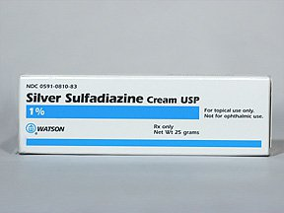
basic burn dressing management
Dressings for partial-thickness burns
Clearly infected, purulent wounds should be managed in an ‘open’ manner
Topical antimicrobials (e.g. neomycin, mupirocin, silver sulfadiazine)
Nonadherent dressing
Daily dressing exchange and gentle cleansing with water and soap

Slide 36
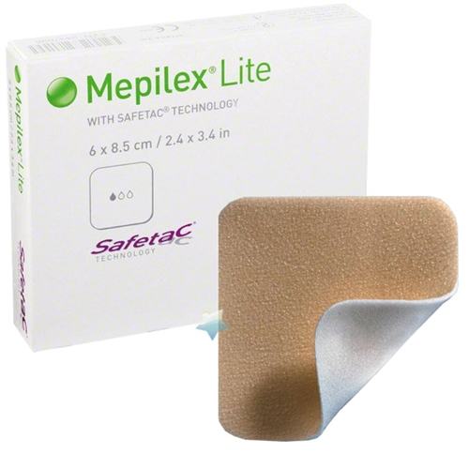
basic burn dressing management
The second method for burn management is with occlusive dressings
Dressing such as Mepilex or silver-containing occlusive dressing should be applied and left in place for approximately 1 week

Slide 37
burn prevention strategies.
Flame burn prevention
Secure matches and lighters where they are inaccessible to children
Safety device around fireplace
Create home escape plan and practice with family
Check that smoke detectors are functional
Scald prevention
Use splash guards on stove
Use thermometer on bathwater
Lower hot water heater maximum temperature to 49-54 C

Slide 38
Thank you

