Slide 1
APPROACH TO THE TREATMENT OF INFLAMMATORY POLYARTHRITIS
DR.AFSAR SAYEEDA
FRCP
CONSULTANT INTERNIST & RHEUMATOLOGIST
HEAD, CLINICAL TEACHING UNIT .
KING KHALID UNIVERSITY HOSPITAL
KSUMC, RIYADH, KSA .

Slide 2
CAUSES OF INFLAMMATORY POLYARTHRITIS
INFECTIONS - VIRAL/ BACTERIAL (H PARVOVIRUS B19, CMV,CSV.HEPB.HIV,EBV,MUMPS,VZV ,ADENO.ENTERO.HHV)
STAPH AUREUS, GONORRHOEA,GRAM NEGATIVE BACILLI
DIRECT/INDIRECT( REACTIVE ARTHRITIS-SHIGELLA,SALMONELLA,CHLAMYDIA, YERSINIA,CAMPYLOBACTER,GROUP A STREPTOCOCCI, TROPHEREMA WHIPPELI ,WHIPPLES, INFECTIVE ENDOCARDITIS )
SYSTEMIC RHEUMATIC DISEASE –RA/SLE/AOSD/JRA
CRYSTAL INDUCED ARTHRITIS -Gout / Pseudogout
SYSTEMIC VASCULITIDES –HSP/PAN/WG
SERONEGATIVE SPONDYLOARTHROPATHEIS - Psoriatic arthritis ,
IBD related (enteropathic) ,
Reactive arthritis &
Ankylosing Spondylitis

Slide 3
INFLAMMATORY VS NONINFLAMMATORY
INFLAMMATORY
NONINFLAMMATORY
MORNING STIFFNESS OF MORE THAN AN HOUR
LOW GRADE TEMPERATURE, FATIGUE, SKIN RASH
SIGNS OF INFLAMMATION- RUBOR ( REDNESS)
WARMTH( CALOR). SWELLING( EFFUSION-TUMOUR), TENDERNESS( DOLOR) LOSS OF FUNCTION.
LABS –ESR, CRP ,ANAEMIA OF CHRONIC DISEASE, RF, ANTICCP, ANA….
X RAYS- EROSIONS, UNIFORM JOINT SPACE NARROWING.
SYNOVIAL FLUID ANALYSIS -> 2000(NONINFECTIOUS), > 50000( INFECTIOUS)PREDOMINANTLY NEUTROPHILS.
LESS THAN AN HOUR
BONY PROLIFERATION – HEBERDENS NODES, BOUCHARDS NODES)
NORMAL LABS
JOINT SPACE NARROWING, SUBCHONDRAL SCLEROSIS,OSTEOPHYTES .
SYNOVIAL FLUID < 200 CELLS 50% NEUTROPHILS

Slide 4
RHEUMATOID ARTHRITIS
ACUTE AND CHRONIC INFLAMMATION IN SYNOVIUM CAUSING PROLIFERATION AND DESTRUCTION OF JOINT TISSUES.
TO ACHIEVE THE BENEFITS OF INTERVENTION WITH EARLY DMARDS DEPENDS THE DIAGNOSIS OF RA AS EARLY AS POSSIBLE.
RECOGNISE RA EARLY BEFORE IRREVERSIBLE JOINT INJURY OCCURS.

Slide 5
THE GOALS OF RA TREATMENT ARE TO:
STOP INFLAMMATION(PUT DISEASE IN REMISION)
RELEIVE SYMPTOMS
PREVENT JOINT AND ORGAN DAMAGE
IMPROVE PHYSICAL FUNCTION AND OVERALL WELLBEING
REDUCE LONG TERM COMPLICATIONS

Slide 6
NONPHARMACOLOGIC THERAPIES
PATIENT EDUCATION
REST,EXERCISE,PHYSICAL AND OCCUPATIONAL THERAPY
NUTRITIONAL AND DIETARY COUNSELLING
INTERVENTIONS TO DECREASE THE CV RISKS, eg: SMOKING CESSATION
IMMUNISATIONS TO DECREASE THE INFECTIOUS COMPLICATIONS OF IMMUNOSUPPRESSIVE THERAPIES.

Slide 9
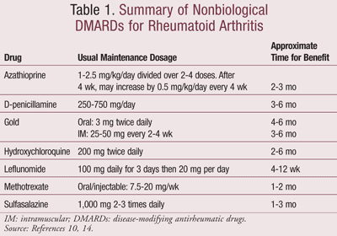

Slide 15
USE OF ANTIINFLAMMATORY THERAPY,INCLUDING NSAIDS & GLUCOCORTICOIDS TO HELP CONTROL THE SYMPTOMS & IMPROVE FUNCTION UNTIL DMARDS TAKE EFFECT.
ACHEIVEMENT AND MAINTENANCE OF TGHT CONTROL OF DISEASE ACTIVITY , DEFINED AS REMISSION OR A STATE OF LOW DISEASE ACTIVITY.

Slide 18
2016 EULAR Recommendations -12
Patients with active disease should be monitored every 3 months, and treatment should be adjusted if there is no improvement at 6 months
Methotrexate (MTX) is recommended as first-line therapy; sulfasalazine (SSZ) or leflunomide can be substituted if there are contraindications to MTX
Tumor necrosis factor (TNF) inhibitors are no longer the only biologics recommended for patients with an insufficient response to MTX; all biologics are considered to be similarly effective
Biologics should be combined with disease-modifying antirheumatic drugs (DMARDs)

Slide 19
Disease Activity | Recommendations
Early RA (<6 months) (Notable change from 2012 to 2015 guidelines: The 2015 guidelines do not recommend initial combination DMARD therapy in early RA with moderate to high disease activity) | Administer DMARD monotherapy in patient with low-high disease activity If disease activity remains moderate /high despite DMARD monotherapy, use combination DMARDs or a TNF inhibitoror a non-TNF biologic
Established RA (=6 month or meets 1987 ACR RA classification criteria) | If disease activity remains moderate or high despite DMARD monotherapy, ACR guidelines recommend one of the following: Combination DMARDs Add an anti-TNF biologic Non-TNF biologic Tofacitinib
If disease activity remains moderate or high despite use of a single anti-TNF biologic: | Switch to a non-TNF biologic with or without MTX over another anti-TNFi or Tofacitinib
If disease activity remains moderate or high despite use of one anti-TNF biologic and one non-TNF biologic: | Use another non-TNF biologic with or without MTX over Tofacitinib If still uncontrolled use Tofacitinib
(Notable change from 2012 to 2015 guidelines: Instead of switching from one anti-TNF biologic to another anti-TNF biologic because of continued activity, it is recommended to change first to a non-TNF biologic)

Slide 20
2015 ACR Guideline for the Treatment of RA
Monotherapy: Methotrexate or leflunomide recommended for all patients regardless of disease duration or severity
Dual-DMARD combinations: Methotrexate and hydrcosychloroquine recommended for moderate-to-high disease activity; Methotrexate or leflunomide with longer disease duration.
Triple-DMARD combinations: Methotrexate,sulfasalazine and hydrcosychloroquine recommended for patients with poor prognostic features and moderate-to-high levels of disease activity.
Anti-TNF-alpha agents: Etanercept, infliximad, adalimumab plus methotrexate recommended for patients with early RA(symptoms <3 months) with high disease activity and no history of ever being treated with DMARD. TNF blockers are recommended fo a long disease duration and for those patients who failed to obtain a satisfactory response from methotrexate therapy.
Abatacept or rituximab recommended for patients with at least moderate disease activity and poor prognostic indicators following treatment with methotrexate or other DMARDs resulting in inadequate treatment response
ACR-American College of Rheumatology; DMARDs- Disease-modifying antirheumatic drugs; RA – rheumatoid arthiritis; TNF – Tumor necrosis factor -Poor prognosis features include high number of affected joints, pra--- of bonyerosioes, elevated theumatoid factor for C-reactive protein, anticycle

Slide 21
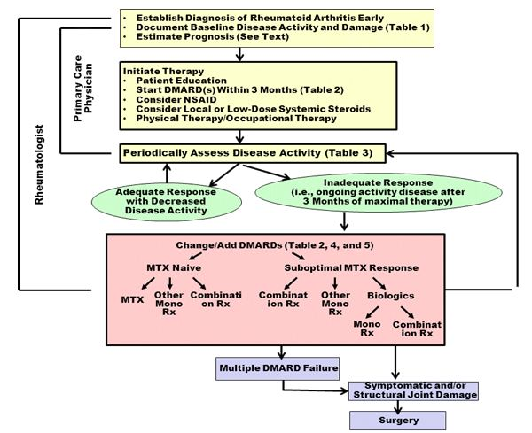

Slide 22
PROGNOSIS
OUTCOME IN RA IS COMPROMISED WHEN DIAGNOSIS AND TREATMENT ARE DELAYED.
OUTCOMES ARE HIGHLY VARIABLE.SOME PATIENTS EXPERIENCE A RELATIVELY SELF LIMITING DISEASE WHILE OTHERS HAVE A CHRONIC PROGRESSIVE ILLNESS.
40% OF THE PATIENTS BECOME DISABLED AFTER 10 YEARS.
INTERVENTIONS WITH DMARDS IN VERY EARLY RA( SYMPTOM DURATION OF LESS THAN 12 WEEKS AT THE TIME OF FIRST TREATMENT) GIVES THE BEST OPPURTUNITY FOR ATTEMPTING TO ACHIEVE DISEASE REMISSION.

Slide 23
UNFAVOURABLE PROGNOSTIC FACTORS
HLA DR4 GENOTYPE
HIGH SERUM TITER OF AUTOANTIBODIES(RF & ACPA)
PRESENCE OF EXTRAARTICULAR MANIFESTATIONS
LARGE NUMBER OF INVOLVED JOINTS
AGE YOUNGER THAN 30 YEARS
FEMALE SEX
PRESENCE OF SYSTEMIC SYMPTOMS

Slide 24
SYSTEMIC LUPUS ERYTHEMATOSUS
MANAGEMENT DEPENDS ON DISEASE SEVERITY AND DISEASE MANIFESTATIONS.
HYDROXYCHLOROQUINE HAS A CENTRAL ROLE FOR LONG TERM TREATMENT IN ALL PATIENTS.
DECREASES NUMBER OF FLARES AND PROLONGS LIFE
CORNERSTONE OF SLE MANAGEMENT
SLE WITH ARTHRITIS – NSAIDS, HCC, short courses of STEROIDS.

Slide 25
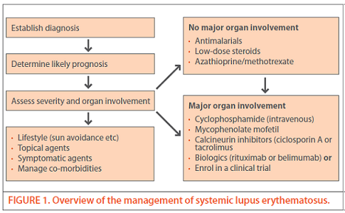

Slide 26
AOSD

Slide 29
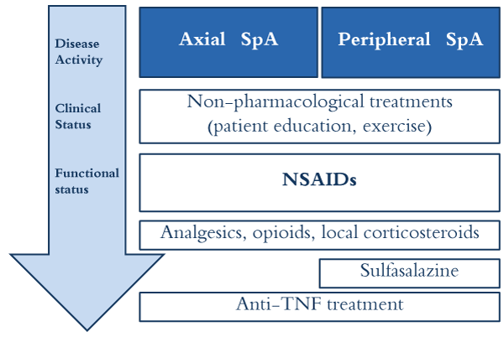

Slide 32
THANK YOU

