Slide 1
Acute Stroke Diagnosis and management
Yousef Mohammad MD., MSC.
Associate Professor of Neurology

Slide 2
The High Socioeconomic Cost of Stroke
Morbidity and Mortality
A leading cause of serious, long­term disability
A second to only heart disease in causing death world-wide
According to the WHO 15 million people worldwide suffer a stroke each year
30-day mortality is 8-12%
Notes:
2

Slide 3
The High Socioeconomic Cost of Stroke
For survivors aged > 65 years:
50% have hemiparesis
30% are unable to ambulate
19% are aphasic
35% are depressed
26% resides in nursing home

Slide 4
The High Socioeconomic Cost of Stroke
Stroke risk and mortality increase with age
The increase in life expectancy will increase the incidence of stroke
In the US, total direct and indirect costs are $56.8 billion annually
The mean lifetime cost of ischemic stroke is estimated at $140,048

Slide 5
Stroke Impact
The economic, social, and psychological costs of stroke are enormous.
Many important leaders in science, medicine, and politics had their productivity end prematurely short by stroke:
- Marcello Malpighi
- Louis Pateur (at age 46)
- Vladamir Lenin
- Woodrow Wilson
- Dwight Eisenhower
- Richard Nixon

Slide 6
Ischemic Stroke
Low blood flow to focal part of brain
Usually caused by thromboembolism
Acute therapy includes thrombolysis
2° prevention depends on source of thromboembolus
Accounts for ∼ 85% of strokes

Slide 7
Transient Ischemic Attack (TIA)
Reversible focal dysfunction, usually lasts minutes
Among TIA pts who go to ED:
5% have stroke in next 2 days
25% have recurrent event in next 3 months
Stroke risk decreased with proper therapy

Slide 8
Five Major Stroke Syndromes for Rapid Recognition in the ED
All Occur Suddenly in Stroke Patients
Left (dominant) cerebral hemisphere
Right (nondominant) cerebral hemisphere
Brainstem
Cerebellum
Hemorrhage
Note: The dominant cerebral hemisphere is the side that controls language function.

Slide 9
Left (Dominant) Cerebral Hemisphere
Aphasia
L gaze preference
R visual field deficit
R hemiparesis
R hemisensory loss

Slide 10
Right (Nondominant) Cerebral Hemisphere
Neglect (= L hemi-inattention)
R gaze preference
L visual field deficit
L hemiparesis
L hemisensory loss

Slide 11
Brainstem
Hemi- or quadriparesis
Sensory loss in hemibody or all 4 limbs
Crossed signs (face 1 side, body other side)
Diplopia, dysconjugate gaze, gaze palsy
Vertigo, tinnitus
Nausea, vomiting
Hiccups, abnormal respirations
Decreased consciousness

Slide 12
Cerebellum
Truncal = gait ataxia
Limb ataxia

Slide 19
Major sites and sources of ischemic stroke

Slide 20
Thrombolytic Treatment of Acute Ischemic Stroke
Prior to two decades ago, no treatment was offered for acute stroke victims because of the misconception that arterial occlusion in the brain leads to irreversible necrosis and dead tissue within minutes
Stroke was wrongly named Cerebrovascular Accident (CVA)
Stroke care was focused on supportive care, stroke prevention and rehabilitation

Slide 21
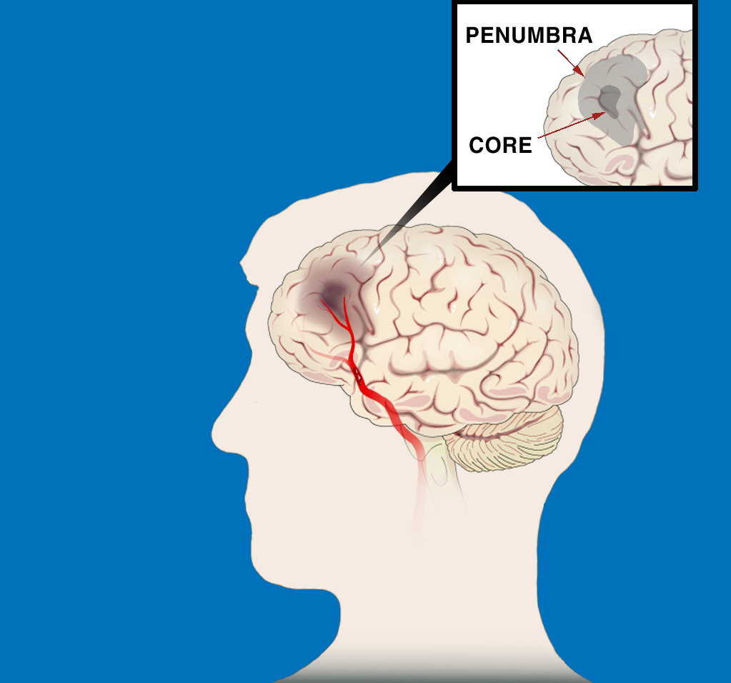
ISCHEMIC STROKE PATHOPHYSIOLOGY The First Few Hours
“TIME IS BRAIN:
SAVE THE PENUMBRA”
Penumbra is zone of reversible ischemia around core of irreversible infarction—salvageable in first few hours after
ischemic stroke onset
Penumbra
Core
Clot in Artery

Slide 22
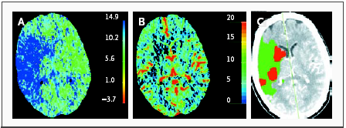
Perfusion CT Scans Obtained 1 Hour 45 Minutes after the Onset of Ischemia in the Territory of the Right Middle Cerebral Artery
A large area shows prolongation of the mean transit time (in seconds) (Panel A), and a smaller area shows a reduction in cerebral blood volume (in ml per 100 g) (Panel B). These two maps suggest a large penumbra and a small infarct core (Panel C, with the penumbra shown in green and the suggested infarct core in red).

Slide 24
Perfusion/Diffusion MRI
Diffusion rCBV MTT

Slide 25
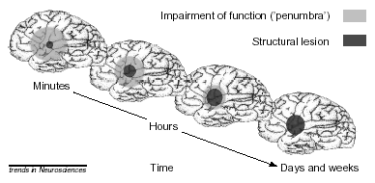
Penumbra
In every ischemic stroke there is ischemic core and penumbra
Penumbra is the region of tissue at risk of being recruited into the ischemic core
Ischemic Penumbra presents a Window of Opportunity

Slide 26
National Institute of Neurological Disorders and Stroke (NINDS) Trial
624 acute stroke patients were randomized to either Placebo or 0.9mg/kg of IV rt-PA within 3 hours from the stroke onset.
Primary outcome: complete or nearly complete neurological recovery at 3 months after stroke

Slide 27
National Institute of Neurological Disorders and Stroke (NINDS) Trial
Outcome | IV t-PA | Placebo
MRS < 1 | 39% | 26% (P=.019)
Mortality | 21% | 17%
ICH | 6.4% | 0.6%

Slide 28
National Institute of Neurological Disorders and Stroke (NINDS) Trial:
Those treated with IV rt-PA were 30% more likely to have no or only minor disability at 3 months post stroke
Absolute risk reduction of poor outcome in the t-PA patients is 13%
OR for favorable outcome (MRS 0-1) in the t-PA patients 1.9
No difference in mortality between the two groups
6.4% symptomatic hemorrhage in the t-PA group compared to 0.6% in the Placebo group

Slide 29
National Institute of Neurological Disorders and Stroke (NINDS) Trial
Based on the NINDS trial results, the FDA in 1996 approved IV t-PA for the treatment of acute ischemic stroke within 3 hours from stroke onset.

Slide 30
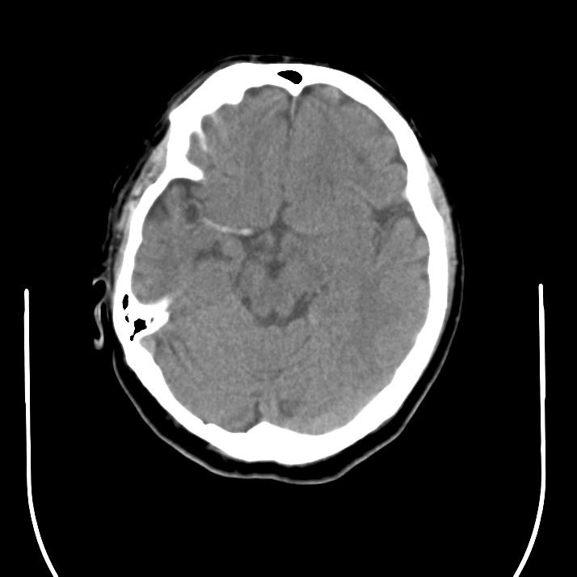
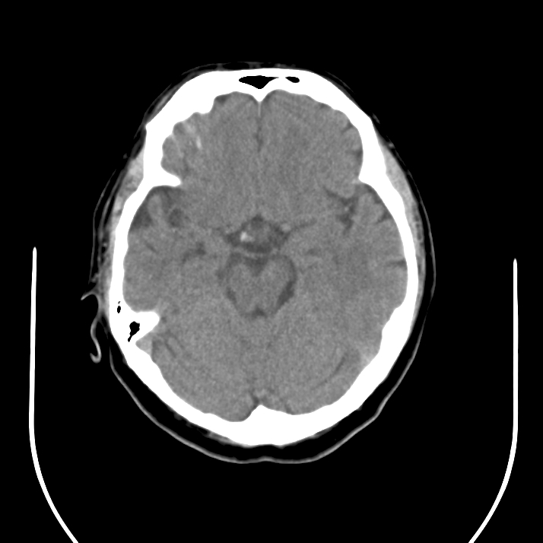
CT Prior to IV t-PA
CT Post IV t-PA

Slide 31
Pharmacological re-canalization
European Cooperative Acute Stroke Study (ECASS II):
Acute stroke patients were treated with either 0.9 mg/kg rt-PA or Placebo within 6 hours after stroke onset
Results showed increase intracerebral hemorrhage in the t-PA group

Slide 32
European Cooperative Acute Stroke Study (ECASS III)
A total of 821 acute stroke patients were treated with either 0.9 mg/kg rt-PA or Placebo within 4.5 hours of the stroke symptoms onset
Additional exclusion criteria to the NINDS trial include age >80, oral anticoagulant, NIHSS > 25, CT showing > 1/3 MCA infarct, and history of both stroke and diabetes

Slide 33
European Cooperative Acute Stroke Study (ECASS III)
Outcome | t--PA | Placebo
MRS < 2 | 54.4% | 45.2% P=0.04
Mortality | 7.7% | 8.4% P=0.68
Hemorrhage | 2.4% | 0.2% P=0.008

Slide 34
European Cooperative Acute Stroke Study (ECASS III)
Absolute risk reduction of poor outcome is 7%
A second pooled analysis including ECASS and EPITHET showed consistent results
The AHA,ASA, and ESA endorsed the use of alteplase within 4.5 hours of the symptoms onset

Slide 35
Outcome with IV-t-PA:
Odds Ratios for Favorable Outcome
Time Odds Ratio 95% (CI) Interval
0-90 2.8 1.8 - 4.5
91-180 1.5 1.1 - 2.1
181-270 1.4 1.1 - 1.9
271-360 1.2 0.9 - 1.5

Slide 36
Tissue Plasminogen Activator (t-PA)
The introduction of t-PA 2 decades ago marked the end of one era dominated by nihilism, in which stroke was considered untreatable and the beginning of another

Slide 37
After the microcatheter transverses the thrombus, the first loops of the Merci Retriever are delivered distal to the occlusion site
Pierre Gobin, Y. et al. Stroke 2004;35:2848-2854
Copyright ©2004 American Heart Association

Slide 38
The Merci Retriever is pulled back at the contact of the thrombus, additional loops are delivered within the thrombus, and the Merci Retriever is torqued to ensnare the thrombus
Pierre Gobin, Y. et al. Stroke 2004;35:2848-2854
Copyright ©2004 American Heart Association

Slide 39
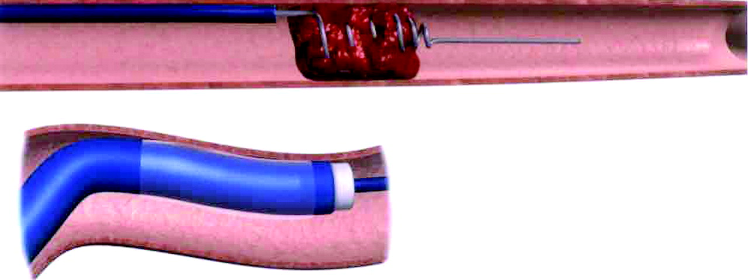
The balloon of the balloon guide catheter (BGC) (insert) is inflated to control antegrade flow, and the Merci Retriever is pulled back with the ensnared thrombus toward the tip of the BGC where it is aspirated
Pierre Gobin, Y. et al. Stroke 2004;35:2848-2854
Copyright ©2004 American Heart Association

Slide 40
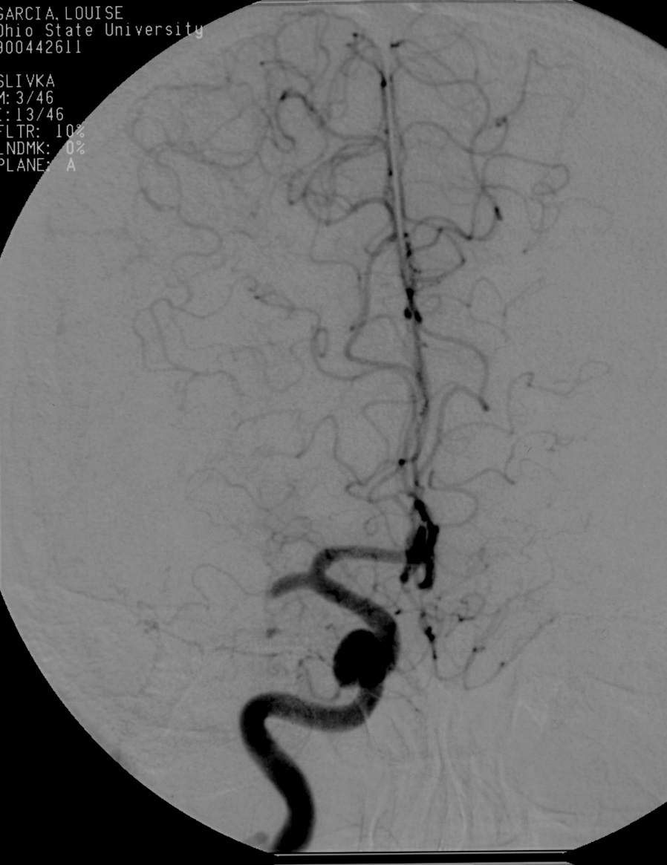
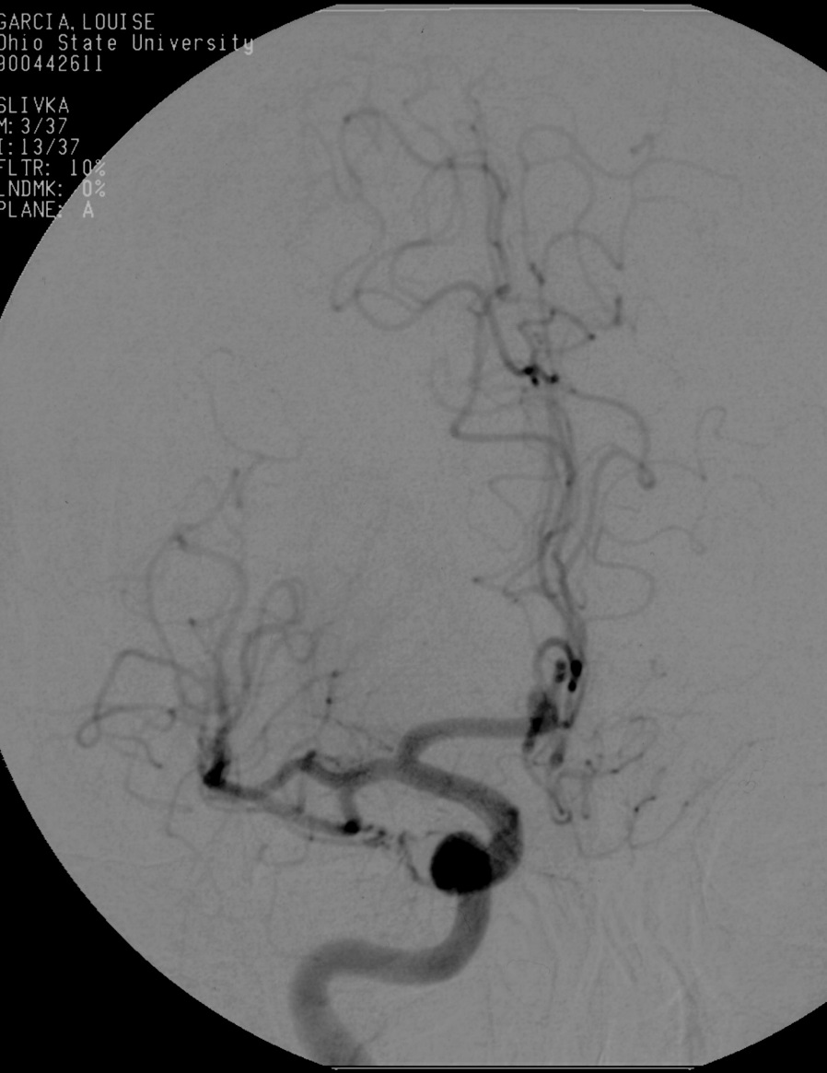
Thrombolysis

Slide 41
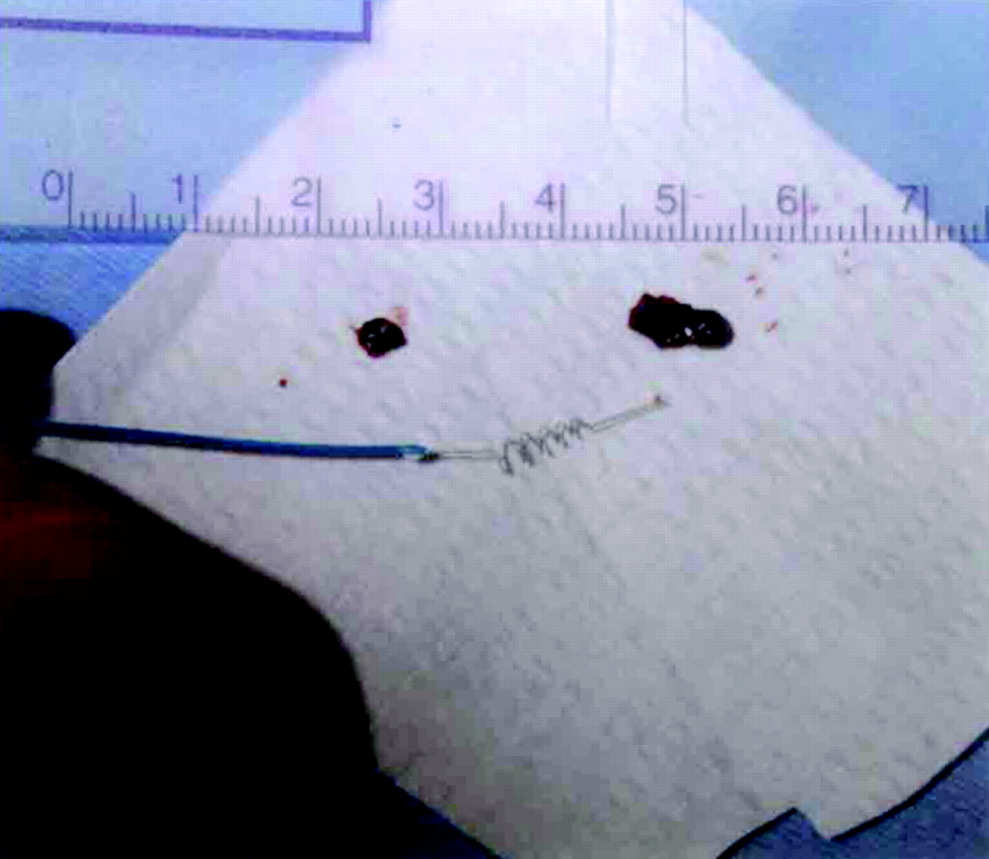
Photograph showing the Merci Retriever and the 2 thrombi, which were retrieved in case 9
Pierre Gobin, Y. et al. Stroke 2004;35:2848-2854
Copyright ©2004 American Heart Association

Slide 42
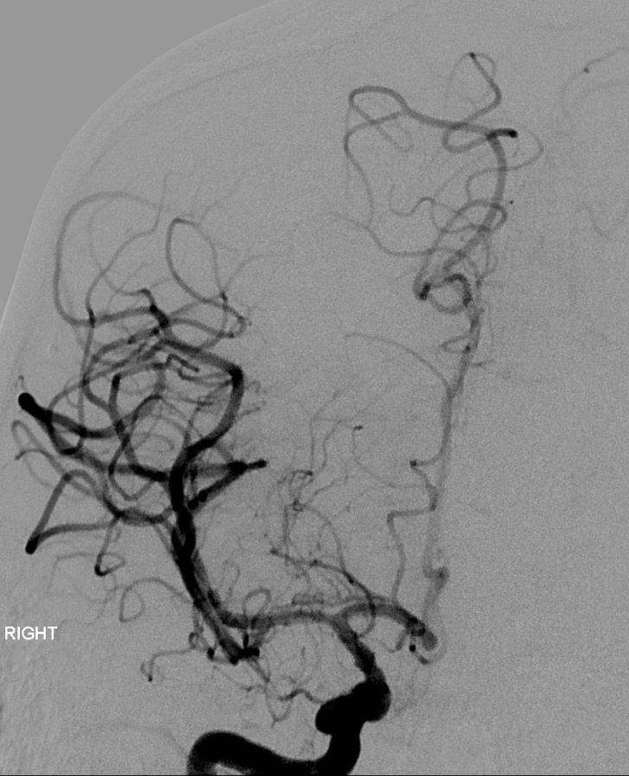
MERCI retriever
Embolectomy performed using a MERCI retriever device can also result in successful recanalization. The patient presented here had significant clinical improvement following MERCI assisted embolectomy.
MERCI retriever in MCA
LICA angiogram showing MCA occlusion (arrow)
Tip of MERCI device with removed thrombus (arrows)
Complete recanalization

Slide 43
Acute Stroke Treatment: Mechanical Thrombolysis
Mechanical Embolus Removal in Cerebral Ischemia (MERCI) Trial:
Recanalization: 48% (19% PROACT control)
Complications: 7% (emboli, dissection, SAH)
Good outcome: 28% (46% recanalized, 10% occluded)
Mortality: 43% (32 recanalized, 54% occluded)
Symptomatic hemorrhage occurred in 5%.

Slide 44
Mechanical Recanalization
Mechanical Embolus Removal in Cerebral Ischemia (MERCI) Trial:
Based on the MERCI trial results, the FDA in 2005 approved the MERCI retriever for removing clot within 8 hours of stroke symptoms.

Slide 45
Penumbra

Slide 46
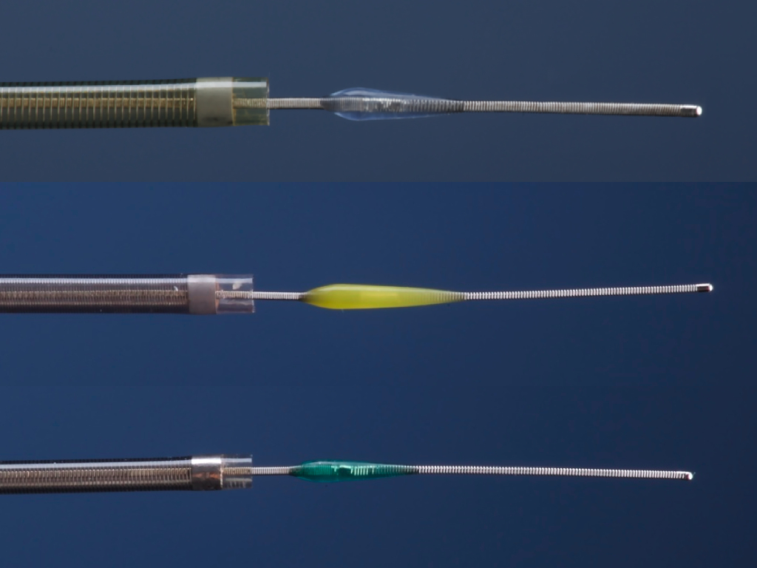
Penumbra microcatheters, shown here with separator wires, are available in sizes ranging from 2.3 French to 4 French. This device uses aspiration assisted by a separator wire to suction out thrombus.
ADVANTAGES
Can be used in some patients with contraindications to thrombolysis
8-hour window
Initial data indicates higher revasculariztion rates relative to other methods.
Preliminary data shows better outcome at 90 days relative to other devices show
DISADVANTAGES
Vessel tortuosity precludes use
Distal vessels not reachable
Operator experience
Higher rate of symptomatic intra-cerebral hemorrhage

Slide 47
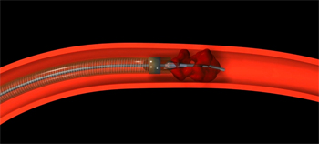
Penumbra

Slide 48
Penumbra
Trial Design
Prospective, single arm, multi-center
Enrolled 125 patients at 24 international centers
Patients in the trial presented within 8 hours from symptoms onset, had an NIHSS >8 and had complete occlusion of a large intracranial vessel

Slide 49
Penumbra
Recanal | Hemorr | >4 NIHSS Imp | MRS<2 | Mortal
81.6% | 11.2% | 57.8% | 25% | 26%

Slide 50
Endovascular Thrombolysis vs IV t-PA
Randomized Phase 3 trial:
IMS III
Synthesis Expansion
MR Rescue

Slide 51
Endovascular Thrombolysis vs IV t-PA
IMS III
A randomized study to assess the efficacy and safety of IV t-PA combined with mechanical thrombolysis compared with IV t-PA alone, in acute stroke patients presenting within 3 hours of the symptoms onset
The primary outcome was a MRS of <2 (indicating functional independence) at 90 days

Slide 52
Endovascular Thrombolysis vs IV t-PA
IMS III
Outcome | IV t-PA | IV t-PA/MT
MRS <2 | 38.7% | 40.8%
Mortality | 21.6% | 19.1% P=0.52
sICH | 5.9% | 6.2% P=0.83

Slide 53
Endovascular Thrombolysis vs IV t-PA
Synthesis Expansion
362 patients with acute ischemic stroke within 4.5 hours of symptoms onset, were randomized to endovascular therapy (IA t-PA, mechanical disruption or retrieval or a combination of these approaches) or IV t-PA
Primary outcome is MRS < 0-1 (indicating survival free of disability)

Slide 54
Endovascular Thrombolysis vs IV t-PA
Synthesis Expansion
Outcome | IV t-PA | ET
MRS 0-1 | 34.8% | 30.4% (OR 0.71; 95% CI 0.44-1.41)
Mortality | Same
sICH | 6% | 6%

Slide 55
Endovascular Thrombolysis vs IV t-PA
MR Rescue
A randomized, controlled, open label blinded outcome, multicenter trial in North America.
Patients presenting with 8 hours of symptoms onset and received t-PA for LVO were randomized to mechanical thrombolysis (MERCI or Penumbra) vs. Placebo
Primary outcome MRS <2

Slide 56
Endovascular Thrombolysis vs IV t-PA
MR RESCUE
Outcome | IV t-PA | t-PA/MT
Mean MRS | 3.9 | 3.9 P=0.99
Mortality | Same | NS
sICH | Same | NS

Slide 57
Endovascular Thrombolysis vs IV t-PA
Despite a sound pathophysiologic rationale and promising results from non-randomized studies, treatment of patients with endovascular therapy has not been proven to be superior in improving outcome compared to IV t-PA

Slide 58
Endovascular Thrombolysis
Stent-retriver technology (2nd generation devices for mechanical thrombolysis):
Solitaire Device
Trevo Stent-retrieveer

Slide 59
Perfusion/Diffusion MRI
Diffusion rCBV MTT

Slide 60
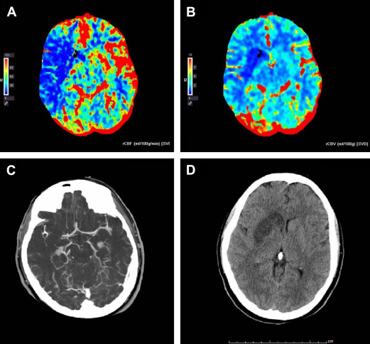
CT perfusion imaging of acute left MCA infarct. Example of radiological findings in a patient with a right hemisphere stroke who underwent successful recanalization: baseline perfusion CT: ( A ) CBF, ( B ) CBV. ( C ) CTA shows right MCA occlusion; ( D ) 24-hour NCCT. The mismatch between the area of reduced CBV and the area of reduced CBF represents the penumbral zone. The infarct at 24 hours correlates with the area of reduced CBV.

Slide 61
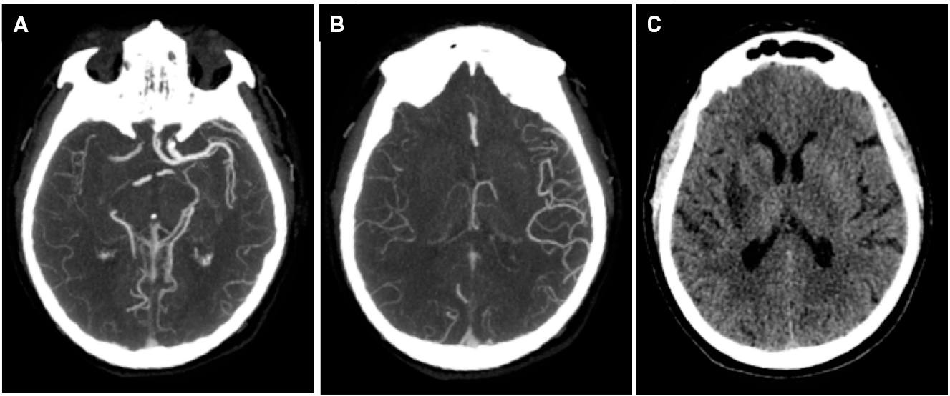
Abundant collaterals

Slide 62
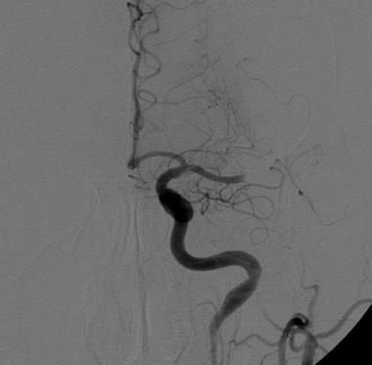
Poor collaterals

Slide 63
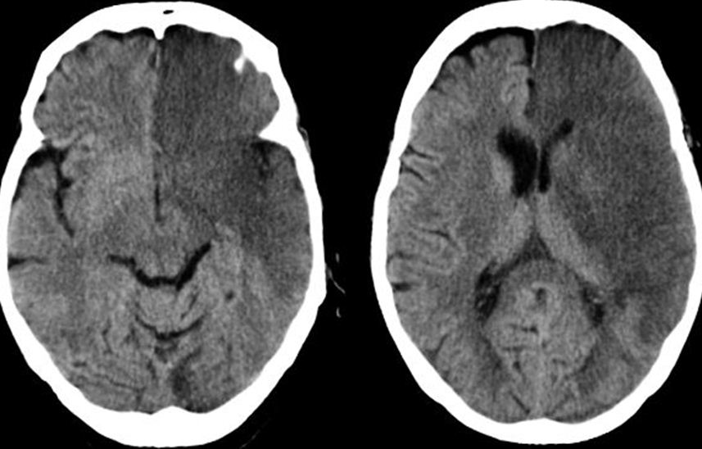

Slide 64
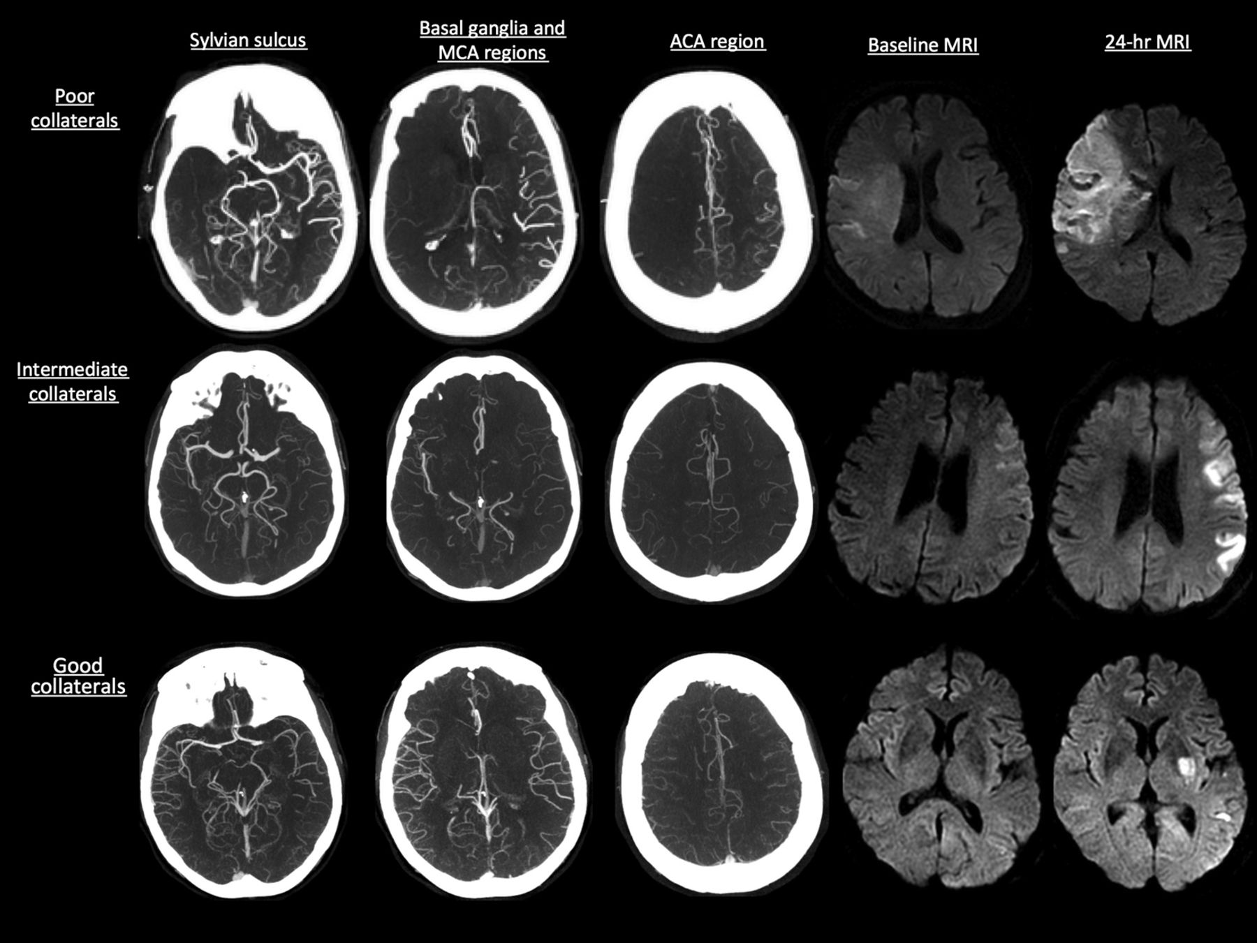
Extent of collaterals

Slide 65
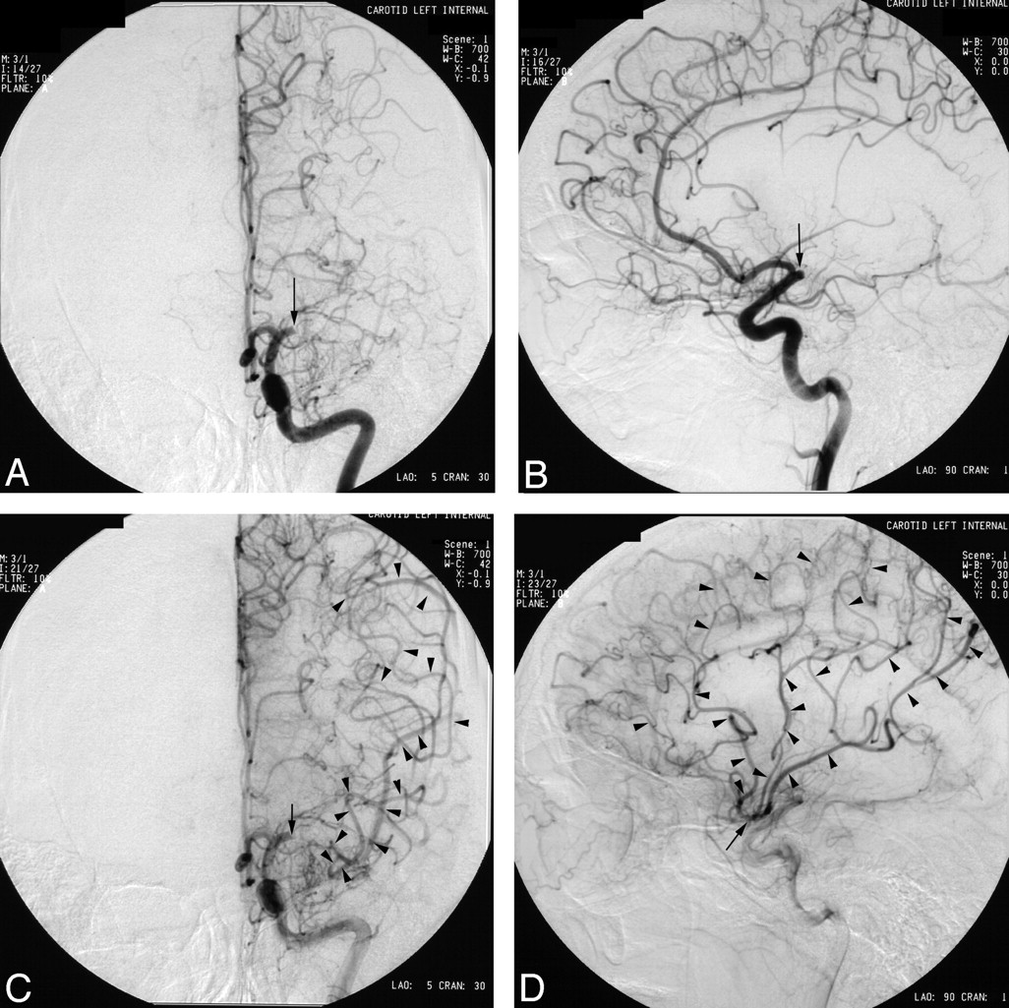
Abundant collaterals

Slide 66
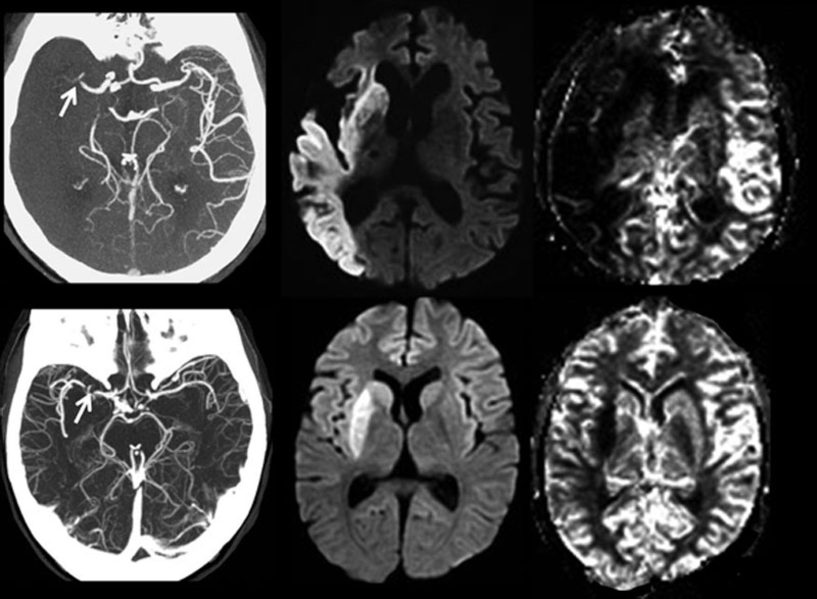
Extent of collaterals

Slide 67
Advance neuro-imaging techniques for acute stroke
Advances in neuroimaging aid in the diagnosis and the treatment decisions in AIS.
In acute stroke patients, Diffusion/perfusion sequence and CTA/CTP head and neck should be performed to assess for LVO and eligibility for endovascular therapy.

Slide 68
Novel Endovascular devices Recently a much more effective and efficient endovascular devices has been introduced

Slide 69
Endovascular Thrombolysis
Stent-retriver technology (2nd generation devices for mechanical thrombolysis):
Solitaire Device
Trevo Stent-retrieveer

Slide 70
Stent-retriever
They work by temporally deploying a stent that captures the thrombus and at the same time instantly restores blood flow to the affected brain territory by displacing the clot peripherally against the artery wall
And theoretically, such flow restoration can enhance the efficacy of systemic thrombolytic drugs if already in the circulation.

Slide 71
Stent retriever
After a period of up to 10 minutes, usually 3 to 5 minutes depending of the location and clot-size, the stent can be retrieved by pulling back the deployed stent into the guide catheter under proximal aspiration through the guide catheter.
The addition of a proximal balloon guide catheter (BGC) can aid aspiration and help thrombus retrieval when the stent retriever is being dragged back into the guide catheter

Slide 72
Solitaire Device

Slide 73
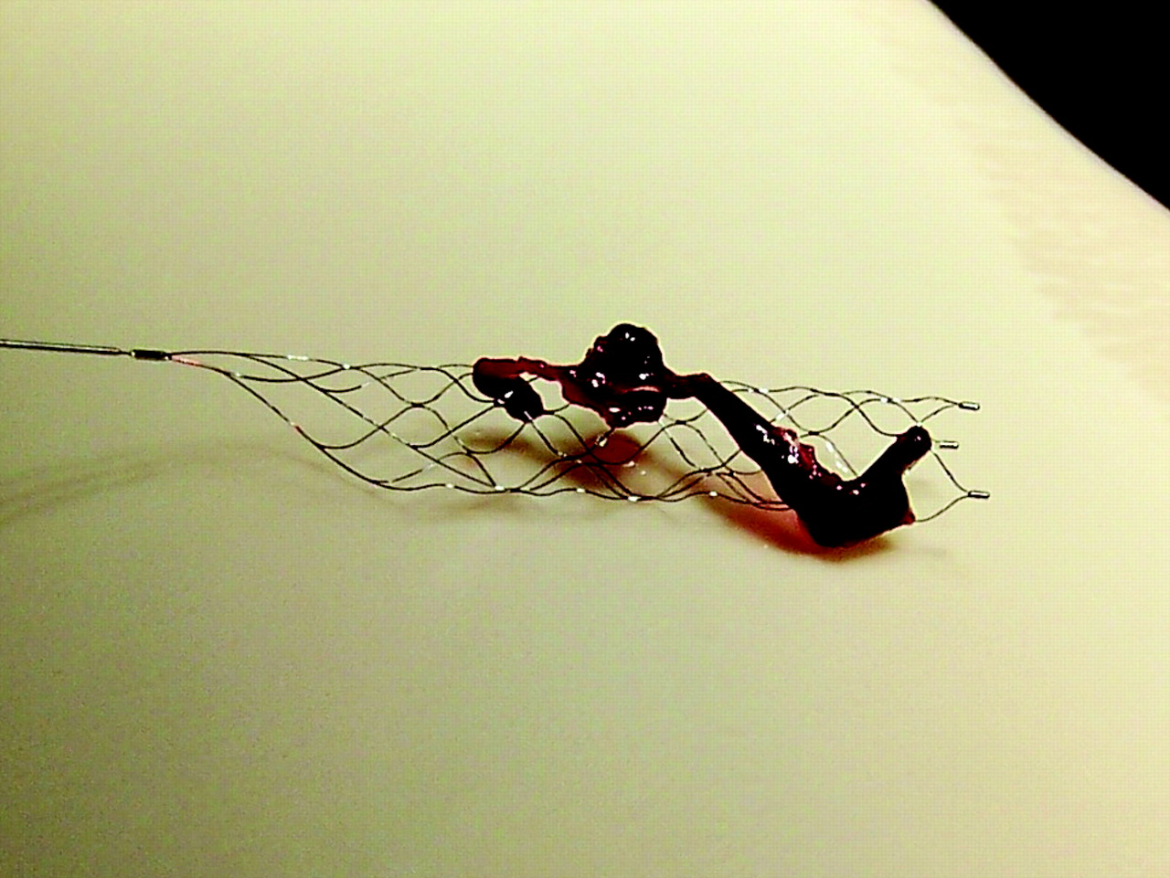
Stent retriever

Slide 74
Trevo Stent-retiever

Slide 75
Stent retrievers or Stentrievers are self-expandable stent for thrombectomy that are deployed past the occlusion site with the use of

Slide 76
Trevo Stent-retiever

Slide 77
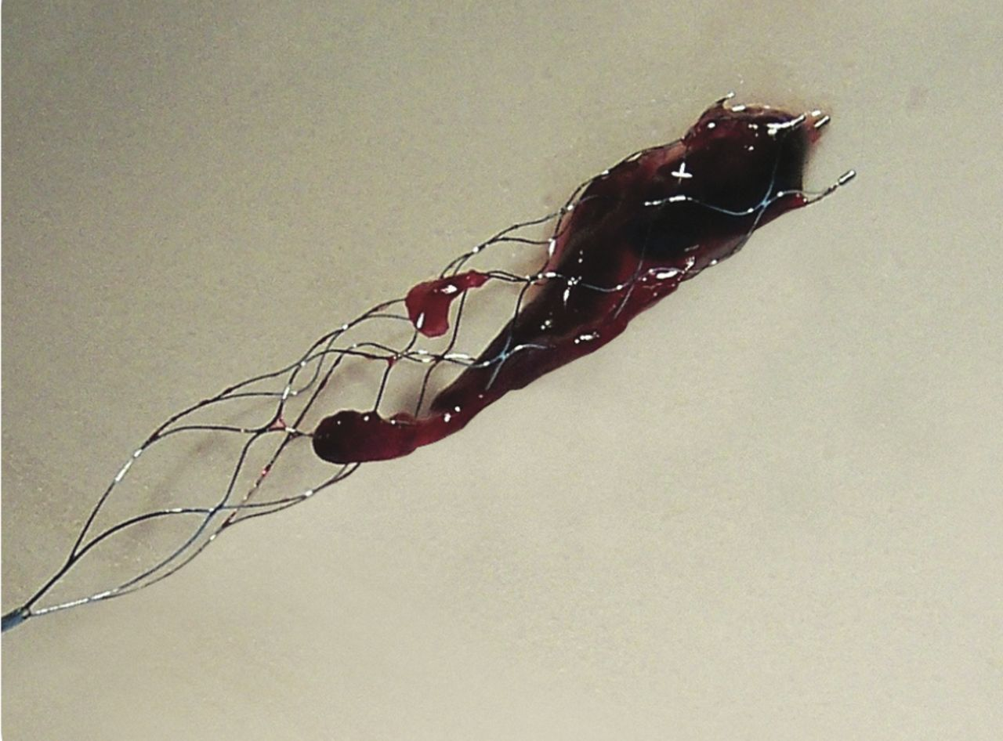
Stent retriever

Slide 78
Stent-retriever
A review of prospective trials related to mechanical thrombolysis since 1999 showed a significant improvement in recanalization over the last 2 decades
Stent-retrievers achieved successful recanalization in around 85% compared 50% in the first generation devices

Slide 79
Outcome with IV-t-PA:
Odds Ratios for Favorable Outcome
Time Odds Ratio 95% (CI) Interval
0-90 2.8 1.8 - 4.5
91-180 1.5 1.1 - 2.1
181-270 1.4 1.1 - 1.9
271-360 1.2 0.9 - 1.5

Slide 80
Mechanical Thrombolysis
Acute strokes with diffusion/perfusion match on presentation to the ED, lacks salvagable brain tissue and hence would not respond to mechanical thrombolysis
Acute strokes with poor collaterals on CT angiogram lacks salvagable brain tissue and hence would not respond to mechanical thrombolysis

Slide 81
New neuro-imaging techniques and endovascular devices
The advanced neuro-imaging techniques reliably identify the extent of salvagable ischemic brain tissues
The novel endovascular devices (stent retriever) achieve a fast and more effective recanalization

Slide 82
Acute Stroke Treatment
5 recent randomized clinical trials assessing the efficacy and safety of stent retriever in acute ischemic stroke:
MR CLEAN
ESCAPE
EXTEND-IA
SWIFT ORIME
REVASCAT

Slide 83
Mechanical Thrombolysis in AIS
The 5 trials demonstrated endovascular (EV) therapy promoted recanalization with significant improvement in modified Rankin scores (mRS) with no increase in sICH or mortality
The number needed to treat for endovascular thrombectomy to reduce disability at least one level of mRS is 2.6

Slide 84
Mechanical Thrombolysis in AIS
ASA recommends that patients should be transported rapidly to primary or comprehensive stroke centers (Class I; Level A evidence), and regional systems of stroke care should be developed to provide access to centers capable of performing endovascular stroke treatment (Class I; Level A evidence)

Slide 85
Mechanical Thrombolysis in AIS
Mechanical thrombectomy is a landmark change in stroke management, and guidelines should recommend mechanical thrombectomy as a level 1 evidence-based treatment worldwide. In terms of technical aspects of mechanical thrombectomy, stent retrievers (Solitaire FR or Trevo device) as the primary method

Slide 86
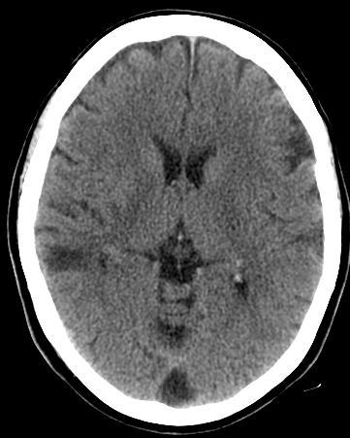
clinical deficit/infarct volume Mismatch
A 61 year old male Presenting with
left arm and leg paralysis, dysarthria, right
gaze deviation and left Visual Field defect.
He was Last seen normal 14 hours from the
time of CT interpretation
The CT predicts only left arm weakness.
However, the exam shows a much more
Severe deficits
Hence, a mismatch between clinical deficit
And infarct volume by imaging

Slide 87
CT Perfusion Scan

Slide 88
CT Perfusion Scan

Slide 89
CT Perfusion Scan

Slide 90
CT Perfusion Scan

Slide 91
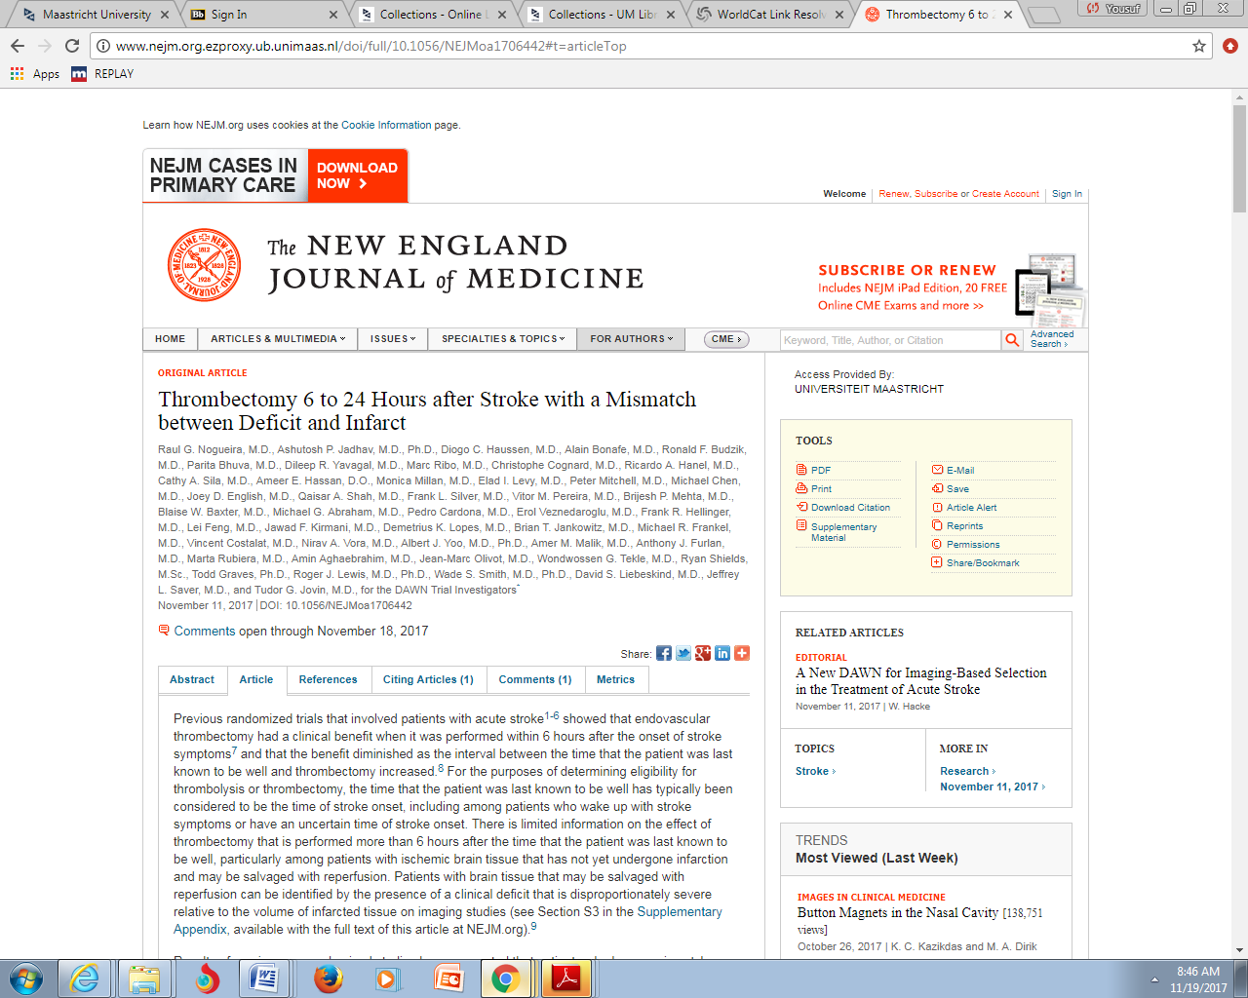
Acute Ischemic Stroke Treatment in 2017
Conclusion
IV t-PA, within 4.5 hours from the symptoms onset of acute ischemic stroke, is affective and the standard of care
Endovascular treatment using stent retriever ± t-PA within 6 hours from the onset of stroke symptoms, is effective and the standard of care

Slide 92
DAWN Trial
Background:
The effect of endovascular thrombectomy that is performed more than 6 hours after the onset of ischemic stroke is uncertain
Brain tissue that has not yet undergone infarction may be salvaged with perfusion
Brain tissue that may be salvageable can be identified by the presence of a clinical deficit that is disproportionately severe relative to the volume of infarct tissue on imaging studies

Slide 93
DAWN Trial
Methods:
Multi-center, prospective, randomized, open label trial with blinded assessment of end points
Patients must have occlusion of the intracranial internal carotid artery or proximal middle cerebral artery who had last been known to be well 6 to 24 hours earlier
Exclusion include >1/3 infarct volume of MCA territory by initial CT or MRI
Patients are allowed, if indicated, to receive t-PA within 4.5 hours

Slide 94
DAWN Trial
Methods:
There must be a mismatch between the severity of the clinical deficit and the infarct volume (mismatch between NIHSS and infarct volume)
Infarct volume was assessed with the use of DW MRI/CT perfusion and was measured with automated software (RAPID)
Patients were randomly assigned in a 1:1 ratio to thrombectomy plus standard care (the thrombectomy group) or to standard care alone (the control group).

Slide 95
DAWN Trial
Methods:
Randomization was performed with the use of a central web based procedure
26 centers randomized patients in the USA, Canada, Europe, and Australia
At least 40 mechanical thrombectomy procedure had to be performed at each center annually

Slide 96
DAWN Trial
Methods:
Thrombectomy was performed with the use of Trevo device: a retrievable self-expanding stent that is used to remove occlusive thrombi and restore blood flow
The end points (MRS) was obtained by a local certified assessor, who were unaware of the treatment assignment

Slide 97
DAWN Trial
Methods:
The coprimary end points were the mean score for disability on the utility-weighted modified Rankin scale (which ranges from 0 [death] to 10 [no symptoms or disability]) and
The rate of functional independence (a score of 0, 1, or 2 on the modified Rankin scale, which ranges from 0 to 6, with higher scores indicating more severe disability) at 90 days.

Slide 98
DAWN Trial
Results:
At 31 months, enrollment was halted because the results of an interim analysis met the pre-specified criterion for trial discontinuation
From Sept. 2014 to Feb. 2017, 206 patients were enrolled in the study: 107 assigned to thrombectomy and 90 to control

Slide 100
Results

Slide 101
Results

Slide 104
DAWN Trial
Results:
Symptomatic hemorrhage was the same in the 2 groups: 6% vs. 3% in the Thromb and Cont respectively (P=0.50)
Mortality was the same in the two groups: 19 and 18% (P=1.00)

Slide 105
DAWN Trial
Conclusion:
Among patients with acute stroke who had last been known to be well 6 to 24 hours earlier and who had a mismatch between clinical deficit and infarct, outcomes for disability and functional independence at 90 days were better with thrombectomy plus standard care than with standard care alone.

Slide 106
DAWN Trial
Conclusion:
For every 2 patients who underwent thrombectomy, 1 additional patient had a better score for disability at 3 months
For 2.8 patients who underwent thrombectomy, 1 additional patient had functional independence at 3 months

Slide 108
DEFUSE 3 Trial
Background:
CT perfusion and MRI D/P sequence can estimate the volume of irreversibly injured ischemic tissue and the volume of brain that is ischemic but not yet infracted
These techniques may identify patients who will have a favorable response to ET even when therapy is initiated beyond 6 hours

Slide 109
DEFUSE 3 Trial
Background:
DEFUSE 3 trial was designed to test the hypothesis that patients who were likely to have salvageable ischemic brain tissue as defined by perfusion imaging and who underwent ET therapy 6 to 16 hours after they were last known normal, would have better functional outcome than patients treated with standard medical therapy

Slide 110
DEFUSE 3 Trial
Methods:
A multi-center, randomized, open-label, with blinded outcome assessment of thrombectomy within 6-16 hours from the symptoms onset
Neurointerventionists were preapproved to participate on the basis of training and experience

Slide 111
DEFUSE 3 Trial
Methods:
Patients were assigned in a 1:1 ratio to ET or Standard medical treatment with the use of web-based dynamic randomization system
Randomization was stratified according to age, core infarct volume, time from symptoms onset to enrolment, baseline score of NIHSS and trial site

Slide 112
DEFUSE 3 Trial
Methods:
ET was performed with any FDA approved thrombectomy device at the discretion of the NI
GA was discouraged
IV t-PA within 4.5 hours was allowed

Slide 113
DEFUSE 3 Trial
Inclusion criteria include:
Proximal MCA or ICA occlusion
Infarct volume (ischemic core)< 70ml, a ratio of volume of ischemic tissue to infarct core of >1.8 and an absolute volume of penumbra of> 15 ml [RAPID software was used to calculate the volume of ischemic core and penumbra regions from CT perfusion and MRI D/P scans]

Slide 115
DEFUSE 3 Trial
Methods:
The primary outcome was the MRS (range 0-6, with higher score indicating greater disabilty) at day 90
Primary outcome was assessed by a certified rater who was unaware of the trial group assignment

Slide 116
DEFUSE 3 Trial
Results:
38 US centers participated in the study
The NIH, induced by the DAWN trial results, asked the investigators to hold enrollment and perform early interim analysis
The results of interim analysis dictated early termination of enrollment
From May 2016 to May 2017, a total of 182 patients underwent enrollment; 92 to the ET and 90 to the SMT

Slide 117
DEFUSE 3 trial

Slide 118
DEFUSE 3 Trial

Slide 119
DEFUSE 3 Trial

Slide 120
DEFUSE 3 Trial

Slide 121
Acute Ischemic Stroke Treatment in 2017
Conclusion
IV t-PA, within 4.5 hours from the symptoms onset of acute ischemic stroke, is affective and the standard of care
Endovascular treatment using stent retriever ± t-PA within 6 hours from the onset of stroke symptoms, is effective and the standard of care

Slide 122
In selected acute stroke patients within 6-16 hours of last known normal who have a large vessel occlusion in the anterior circulation and meet other DAWN or DEFUSE 3 eligibility criteria, mechanical thrombectomy is recommended.

Slide 123
In selected acute stroke patients within 6-24 hours of last known normal who have large vessel occlusion in the anterior circulation and meet other DAWN eligibility criteria, mechanical thrombectomy with a stent retriever is reasonable.

