Slide 1
ECG med 442
Dr. Ahmad S. Hersi, MBBS. MSc. FRCPC
Professor of Cardiac Sciences
Consultant Electrophysiologist

Slide 2
Outlines
EKG : waves, intervals, and segments.
EKG leads
How to read an EKG

Slide 3
EKG : waves, intervals, and segments.

Slide 4
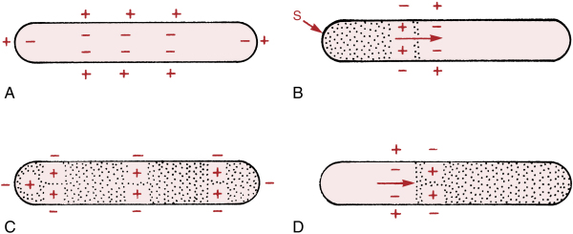
Depolarization and Repolarization

Slide 6
The conduction system

Slide 8
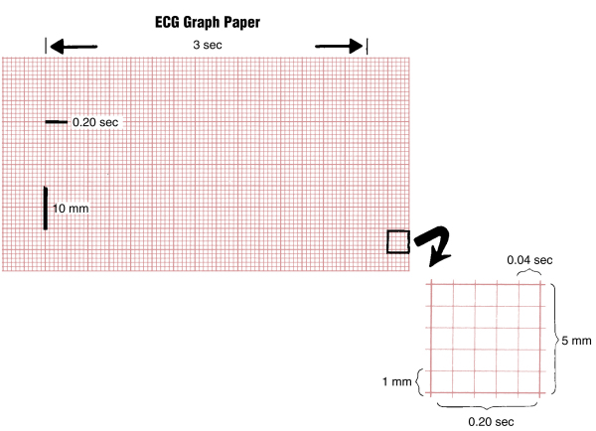

Slide 9
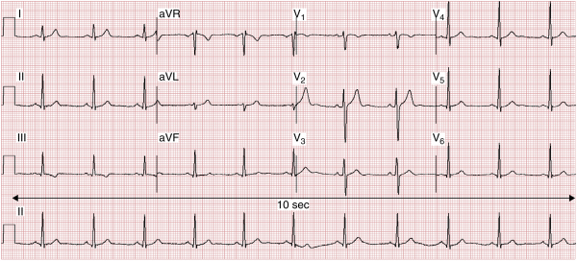
12 Leads EKG

Slide 10
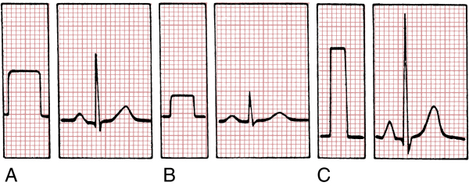

Slide 11
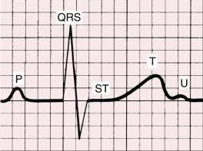
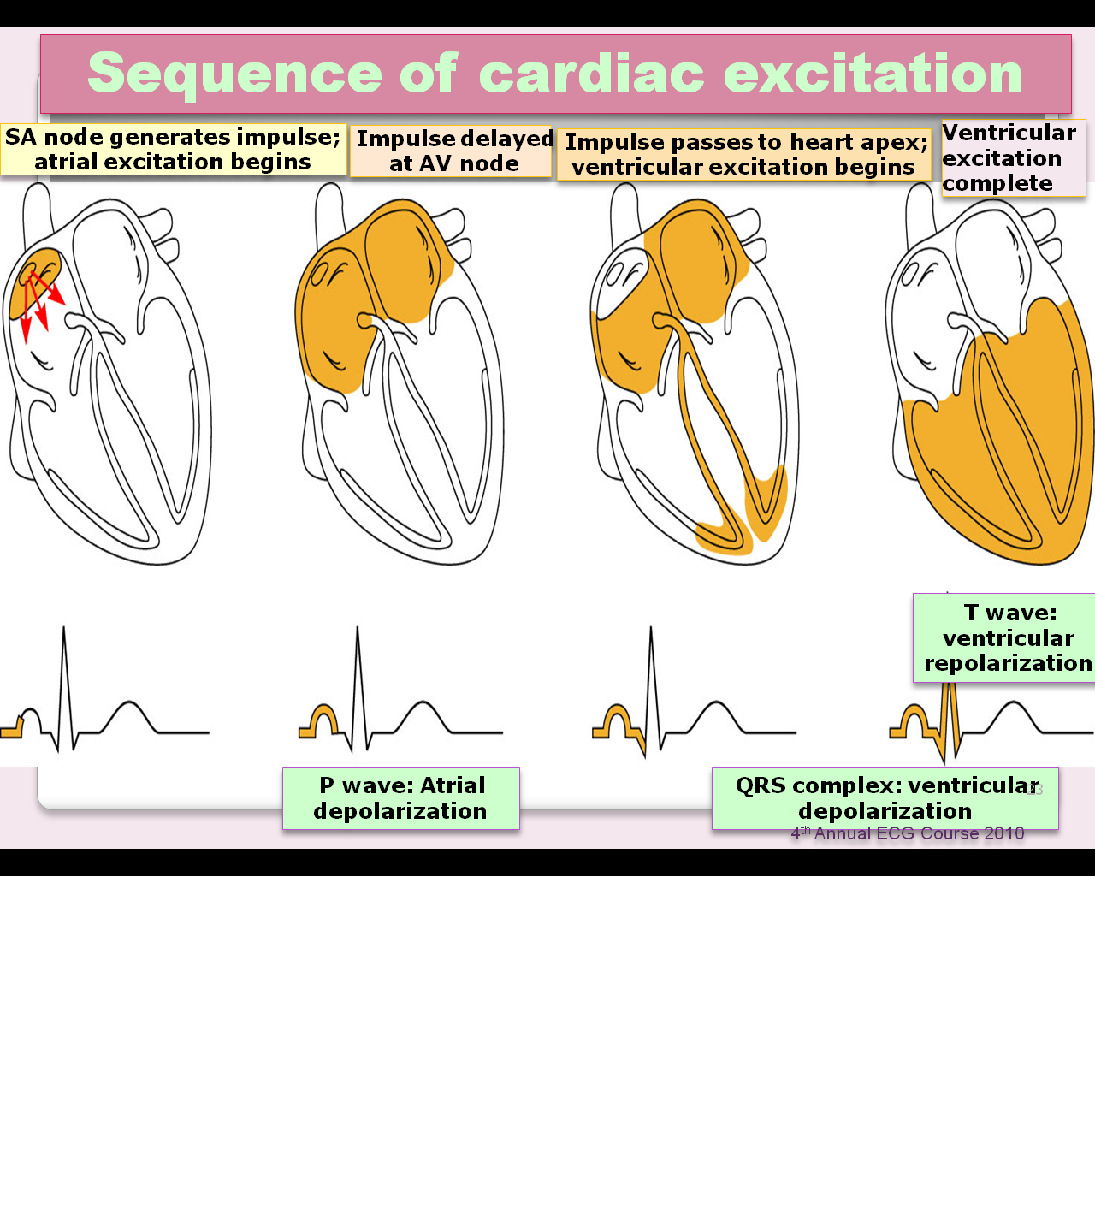
Waves

Slide 12
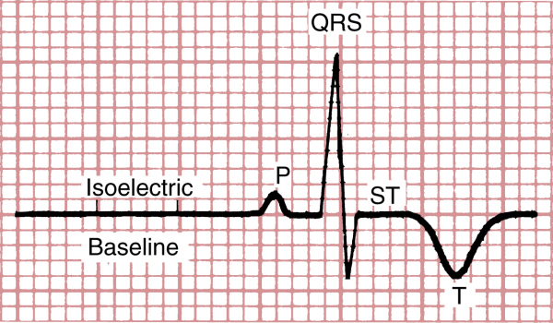
Waves

Slide 13
Waves

Slide 14
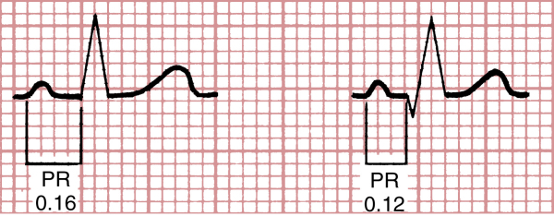
P-wave

Slide 15
QRS complex

Slide 16
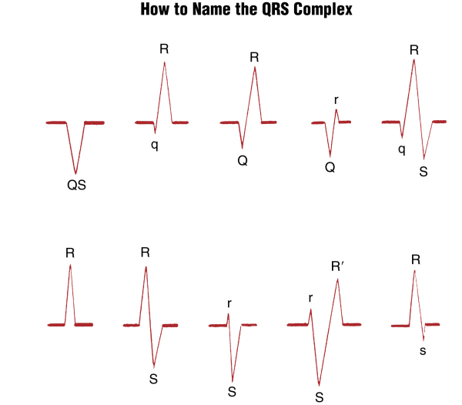
QRS complex
QRS

Slide 17
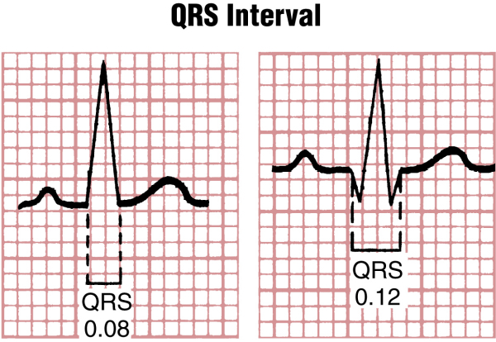
QRS complex

Slide 18
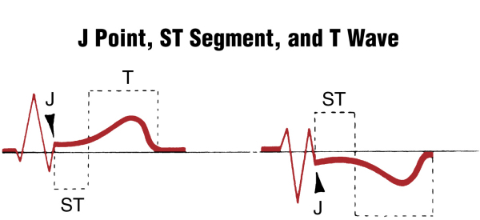
ST segment and T wave

Slide 19
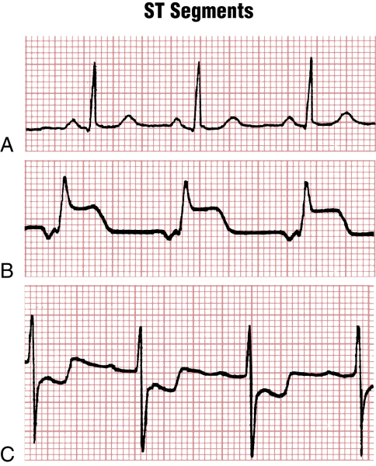
ST segment and T wave

Slide 20
QT interval

Slide 21
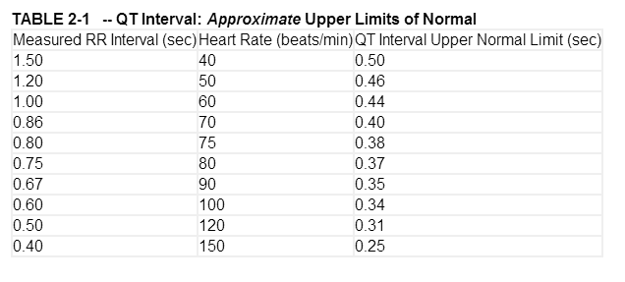

Slide 22
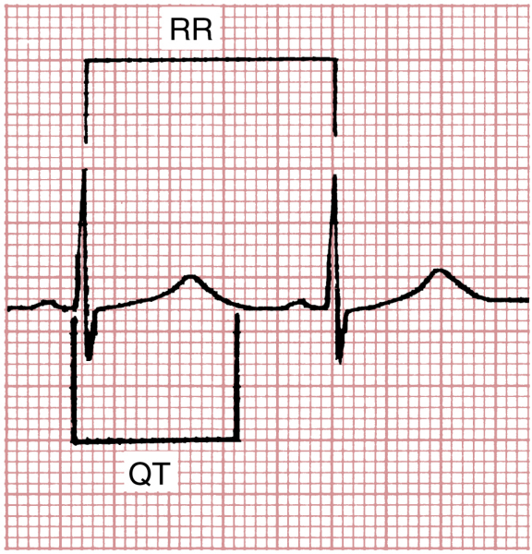
Prolonged QT interval

Slide 23
EKG leads

Slide 24
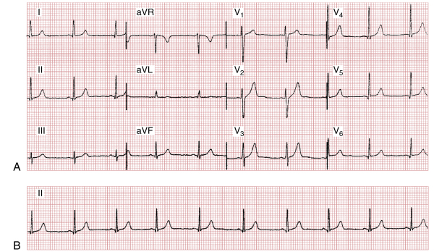
EKG

Slide 25
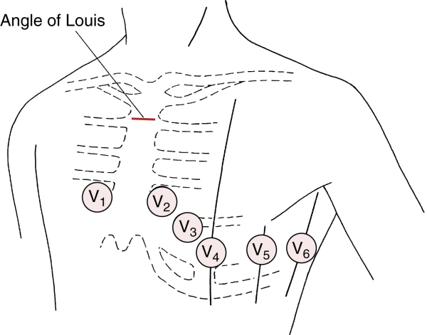
Chest leads

Slide 26
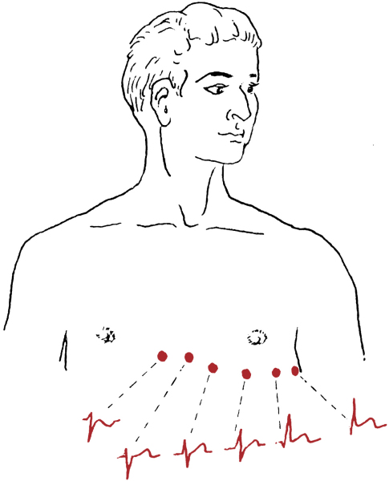
Chest leads

Slide 28
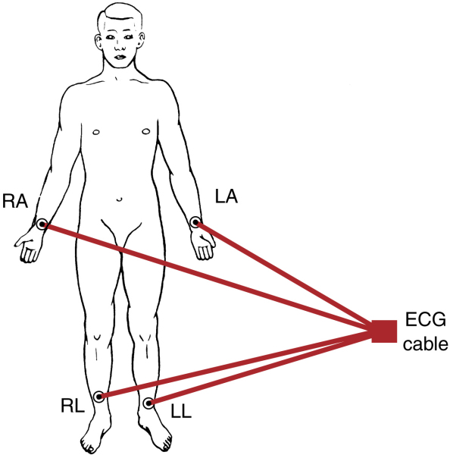
Limb leads

Slide 29
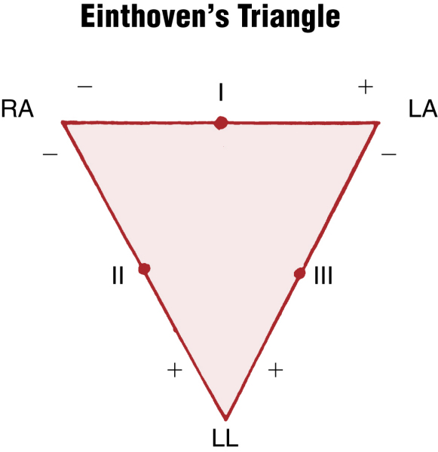

Slide 30
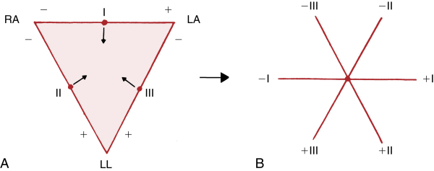

Slide 31
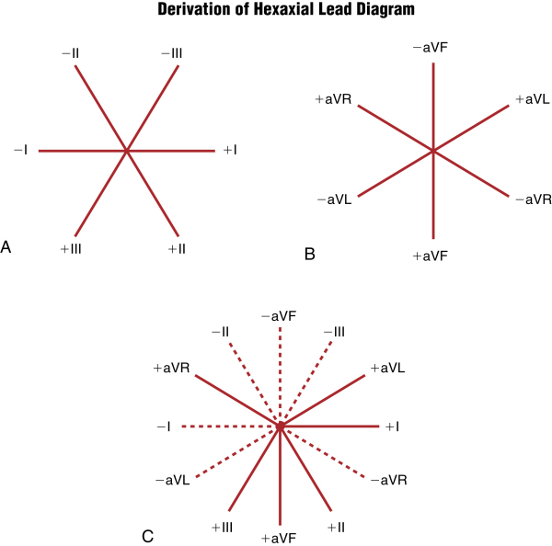

Slide 32
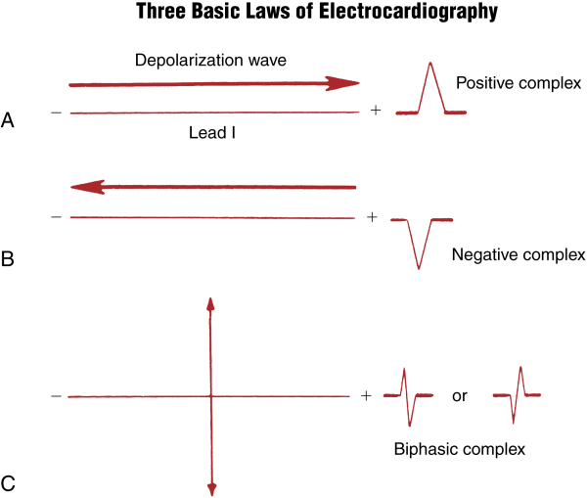

Slide 33
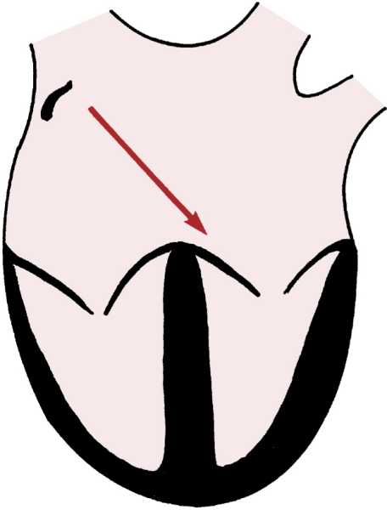

Slide 34
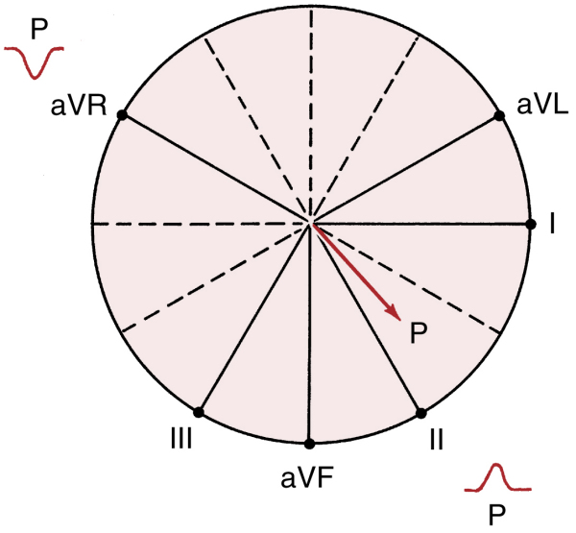
P-wave axis

Slide 35
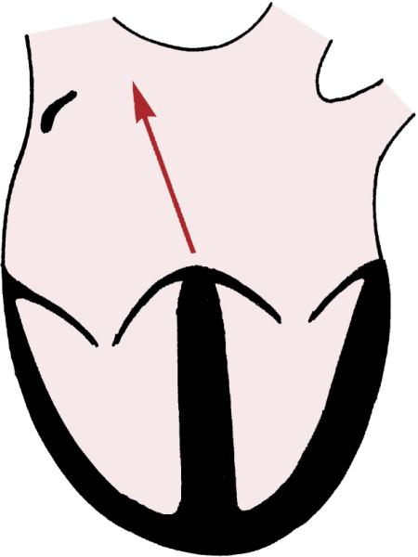

Slide 36
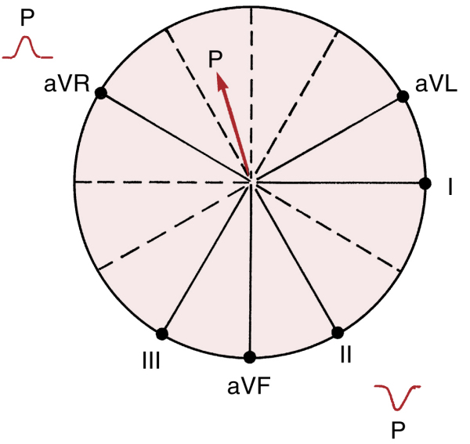

Slide 37
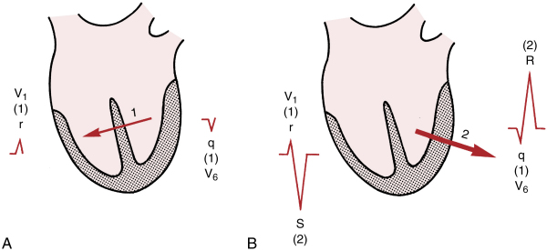
Chest leads

Slide 38
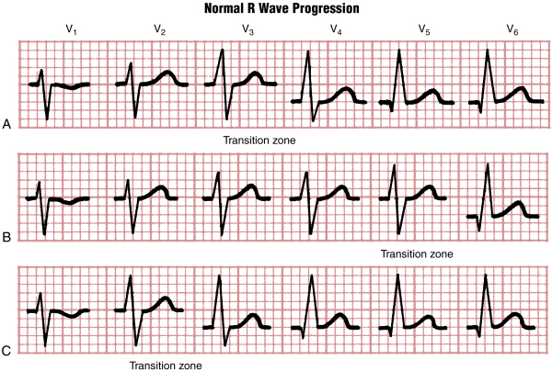
Chest leads

Slide 39
aVR

Slide 40
How to read an EKG

Slide 41
How to read an EKG
Rate
Rhythm
Axis
Waves and intervals

Slide 42
Rate
Normal sinus rate: (60-100).
Tachycardia: >100.
Bradycardia: <60.

Slide 43
How to Calculate Rate
300/No. of large squares R-R.
1500/No. of small squares R-R.
No. of (R) waves in the strip×6.
300›››150 ›››75 ›››60 ›››55

Slide 44
Rate

Slide 45
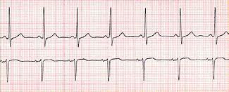
Rhythm
LEDA II: Positive P wave preceding each QRS.
V1: Biphasic P wave.
Lead II
V1

Slide 46
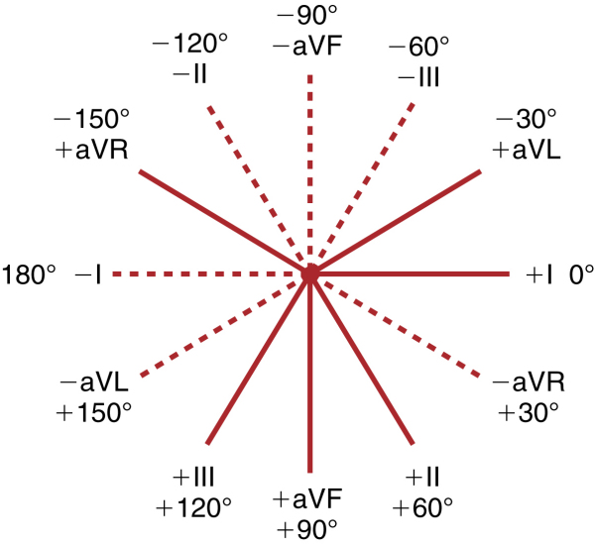
AXIS

Slide 47
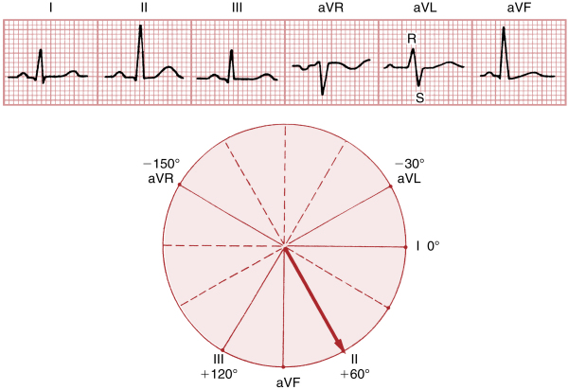
AXIS

Slide 48
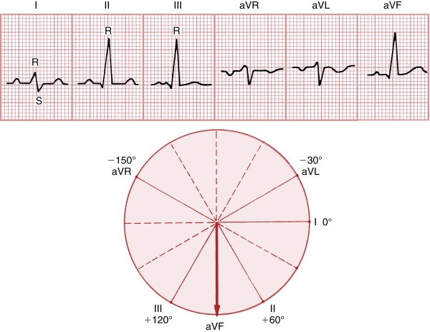
AXIS

Slide 49
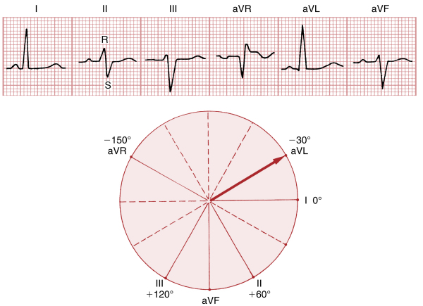
AXIS

Slide 50
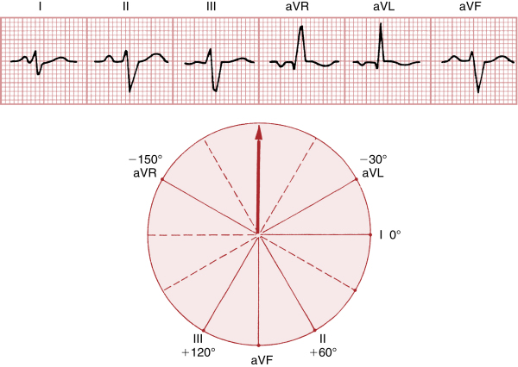
AXIS

Slide 51
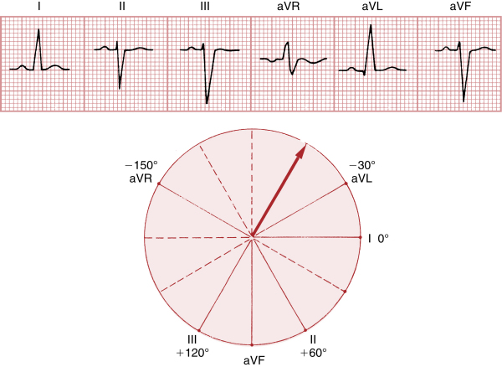
AXIS

Slide 52
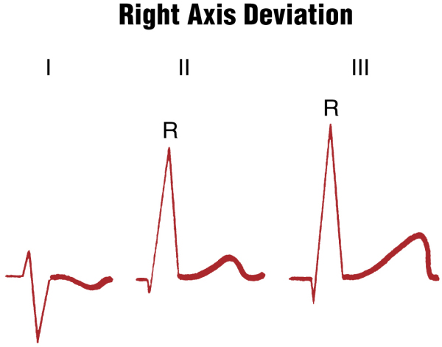
AXIS

Slide 53
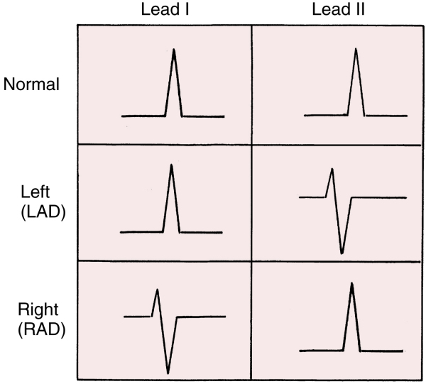
AXIS

Slide 54
Right Atrial Enlargement

Slide 55
Left Atrial Enlargement

Slide 56
Left Ventricular Hypertrophy
*
*
*
*

Slide 57
Right Ventricular Hypertrophy

Slide 58
LBBB

Slide 59
RBBB

Slide 60
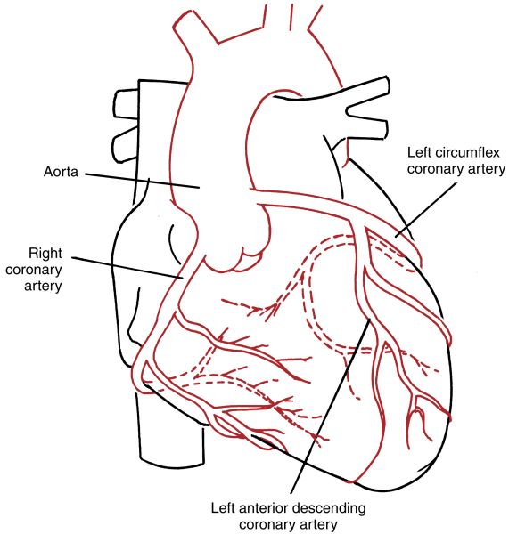

Slide 61
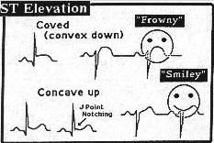
Morphology of STE
Concave shape STE – non AMI causes
AMI causes – usually demonstrate convex/straight STE

Slide 62
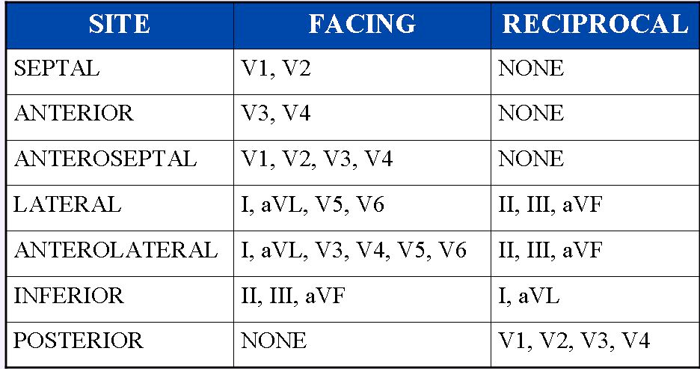
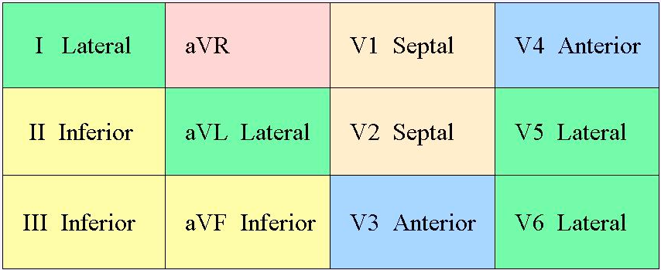
Distribution

Slide 64
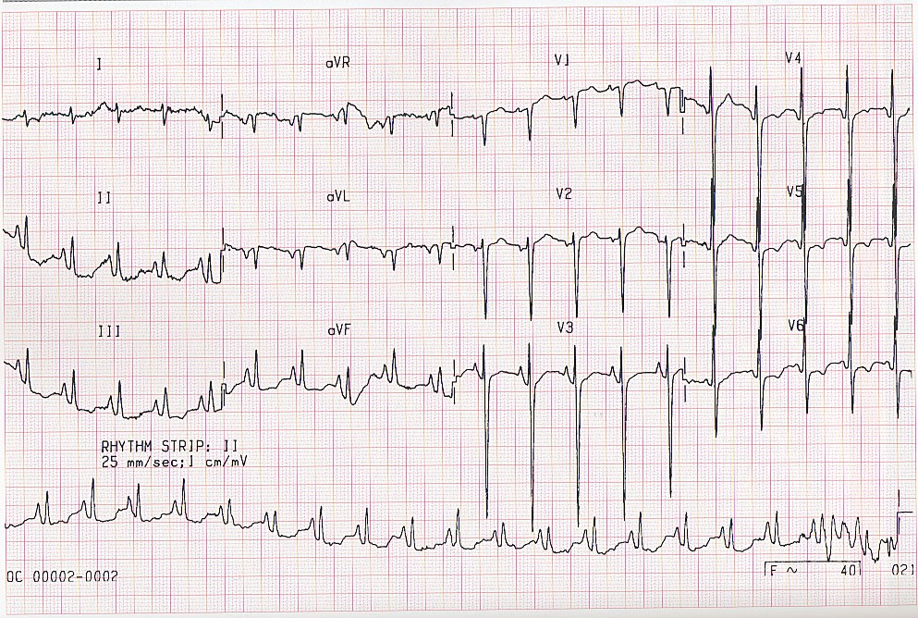
Realty check

Slide 65
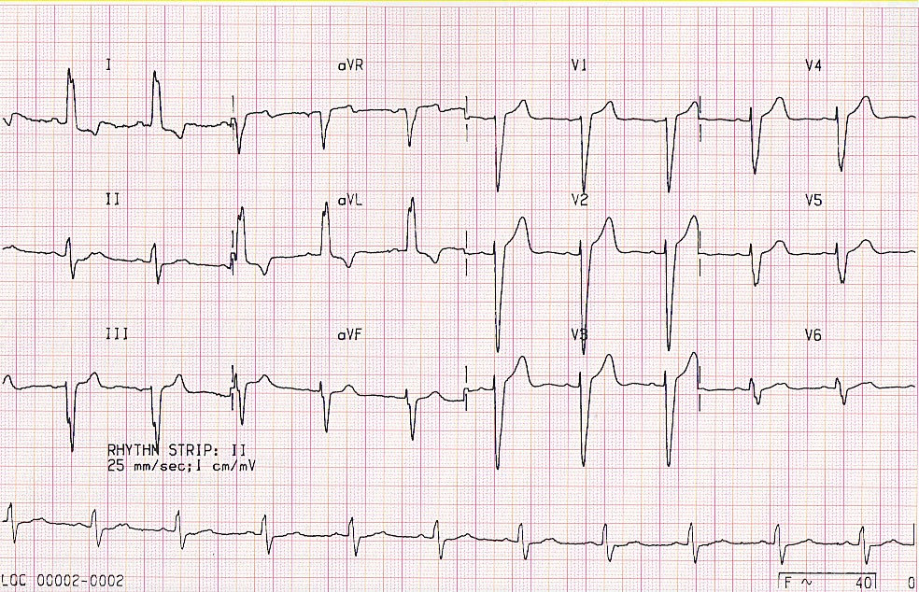
Realty check

