Slide 1
The High Blood Pressure
Dr. Talal Alfaadhel

Slide 2
Outline
Presentations
Introduction
Definitions
Evidence
Summary

Slide 3
Case 1
35 year old female was referred to your clinic after undergoing screening for employment. Her blood pressure was found to be high (149/93 mmHg). She has no complaints and is otherwise healthy.
PMH: nil
Meds: nil
FHx: High BP in father and brother
SHx: Single, works as a nurse, smokes shisha once weekly, no illicit drug use.

Slide 4
Case 1
On physical exam: BMI 25, looks healthy, not in distress
BP: 145/93, HR: 78
CVS: S1 + S2 + 0
Chest: clear
Abd: Soft, Lax, no bruit
Rheum and Neuro: normal

Slide 5
Question 1. Is this hypertension?
A. Yes
B. No
C. I don’t know
D. Other

Slide 7
Question 2. What is the next step in management?
A. Repeat blood pressure in 2 weeks
B. Do a 24 hour ambulatory BP recording
C. Check electrolytes, urea and creatinine
D. US kidneys

Slide 8
Epidemiology
1 in 3 adults (>20 years old) have high blood pressure
Incidence goes up with age
5 – 10% of all hypertension is secondary
Searching for secondary hypertension is expensive and cumbersome
Need better selection of who to screen and offer specific treatments

Slide 9
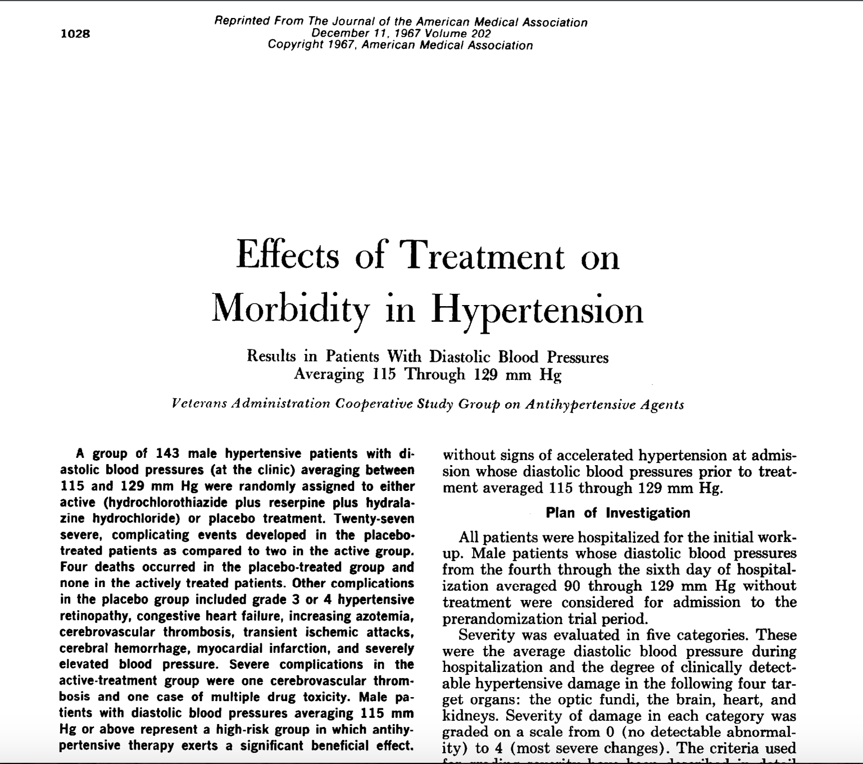

Slide 14
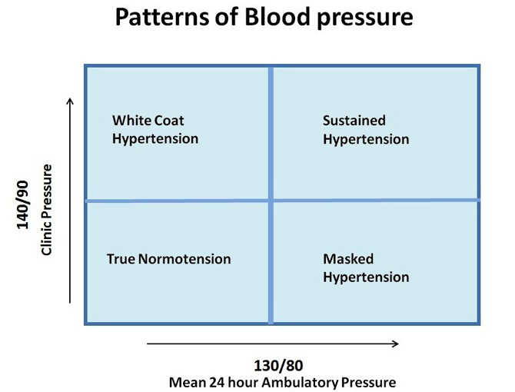
Hypertension definitions
Prehypertension
Hypertension
Stages
Urgency
Emergency
White Coat syndrome
Masked Hypertension

Slide 15
Criteria for HTN diagnosis

Slide 16
Ambulatory BP measurement
NICE

Slide 17
Ambulatory BP measurement
Australian

Slide 18
Ambulatory BP

Slide 20
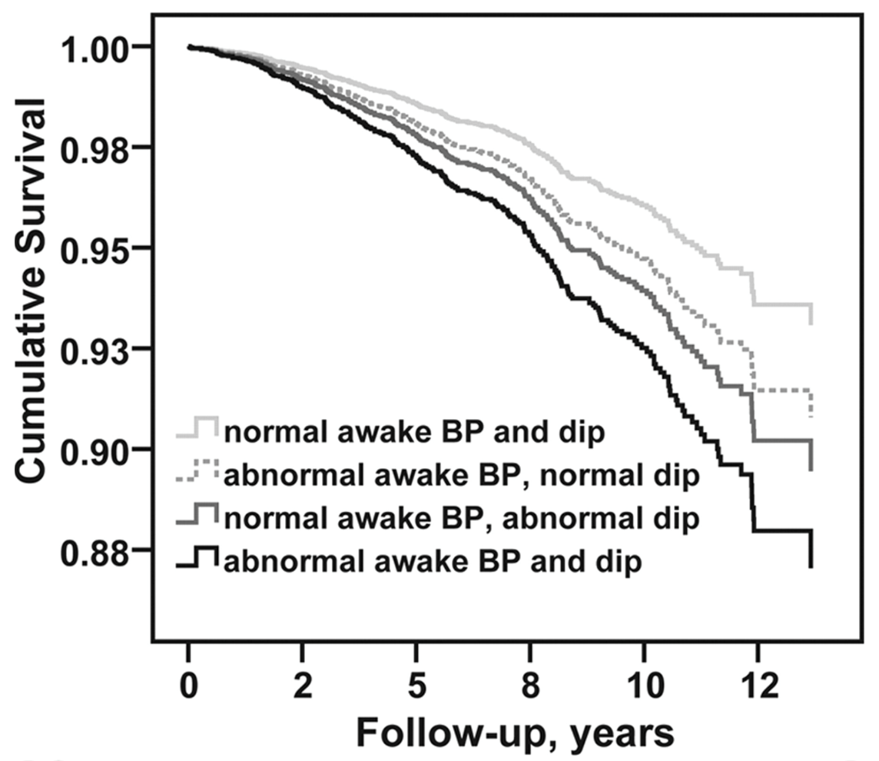
Nocturnal Blood pressure

Slide 21
Secondary HTN

Slide 22
This is not her image

Slide 24
Case 1
35 F, BP 149/98 mmHg, FHx father, brother. No significant PMHx
Labs: CBC normal, Urea 4, Cr 56, Na 143, K 3.1, Cl 89, HCO3 30
LFT Normal, TSH Normal
US Kidneys: R kidney 11.2 cm, L kidney 12 cm, Dopplers Normal renal artery flow

Slide 25
ARR

Slide 26
ARR

Slide 27
PA Confirmatory tests
Try to inhibit Aldosterone (demonstrate that it is regulated)
Oral salt loading (1 g po od x3days)
NS infusion (500 ml)
Captopril challenge
Fludrocortisone + Na

Slide 28
PA testing
Imaging
Venous sampling

Slide 29
Case 1
Results:
Low Aldosterone
Low Renin
CT Abdomen: No adenoma, normal adrenal glands
What to do next?

Slide 30
Case 1
24 hour K excretion: high

Slide 33
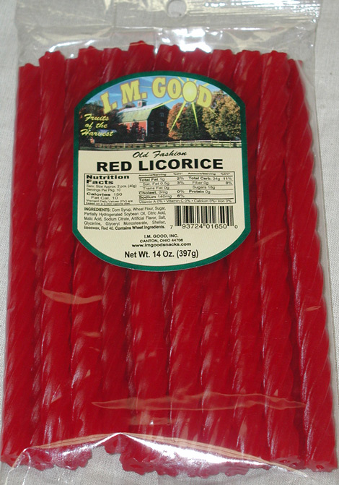
Liqorice

Slide 34
Treatment?
Block ENaC

Slide 35
Summary

Slide 36
Summary

