Slide 1
BY RUBANA BAABBAD, MD
CONSULTANT NEONATOLOGIEST
KING KHALID UNIVERSITY HOSPITAL

Slide 2
Formula=Breast milk?!
Do you really believe it?
Notes:
2

Slide 3
A crucial question
Is infant formula really very near to, or almost like breastmilk?
No!
Even now, formula is only superficially similar to breastmilk
There is no question about this!
Notes:
3

Slide 4
Is formula almost like breast milk?
How can it possibly be?
We don’t really know what is in breastmilk
There is no such thing as a standard breastmilk
Even the formula companies admit that not all babies need exactly the same stuff and, of course, will use this notion to market their formulas (special formulas for special babies)
At the same time convincing us that their formula is virtually the same as breastmilk
But different and better than the formulas of their competitors, which are also virtually the same as breastmilk
Notes:
4

Slide 5
Breast milk varies
From woman to woman
Depending on the baby’s gestational age
With the mother’s diet
With the time of day
With the length of time after birth
During a single feeding
With which breast is offered first
With the time of the mother’s menstrual cycle
With the number of previous pregnancies
Depending on how the milk is obtained
Notes:
5

Slide 6
Human Milk
The defining characteristic of the class Mammalia is the ability to produce milk, an externally secreted fluid designed specifically to nourish the young.
It is a unique complex fluid with a composition that is species specific.
It is the most appropriate source of nutrition for the infant up to the age of 6 months.
It is rich in nutrients needed for the growth of the newborn, and in non-nutritional bioactive components such as the maternal antibodies, chemical mediators, vitamins, enzymes and some types of white blood cells in breast milk (particularly in colostrum) augment the action of the baby’s immune system.
This unique fluid evolves to meet the changing needs of the baby during growth and maturation.

Slide 7
Breast Anatomy

Slide 9
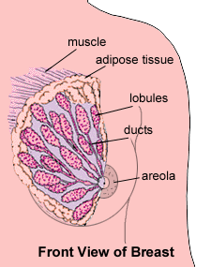
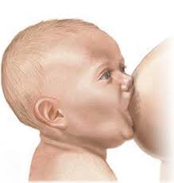

Slide 14
Types of Breast Milk
There are broadly three types of breast milk :
1- Colostrum;
It is the first stage of breast milk that is produced after birth and lasts for several day after child birth.
It has a yellowish to cream colored thick appearance.
It is high in protein especially antibodies( that provide protection to the newborn against infection) , vitamins( especially fat soluble vitamins) , minerals but very low in fat compared to mature breast milk .
2- Transitional milk;
It occurs after colostrum stage and lasts for approximately two weeks until it is replaced by mature milk.
The transitional milk contains high levels of fat, lactose, and vitamins to help the baby regain any weight lost after birth .
- It contains more fat and lactose than colostrum and has water-soluble vitamins.
3- Mature milk ; - It is the final milk that is produced and lasts throughout lactation.
-Ninety percent is water, which is necessary to maintain hydration of the infant. The other 10% is made up of carbohydrates, proteins, and fats, which are necessary for both growth and energy.
-There are two types of mature milk: foremilk and hind milk.

Slide 15
Types of Mature Breast Milk
During each breastfeeding session, the baby should receive two types of mature milk, the foremilk and the hind milk to ensure that the baby is receiving adequate nutrition to grow and develop properly.
The foremilk (the milk "in front"); is produced at the beginning of each feeding. It contains water, vitamins, and protein.
The hind milk ; is pushed out latter , it is heavier , richer in lipid and CHO.

Slide 16
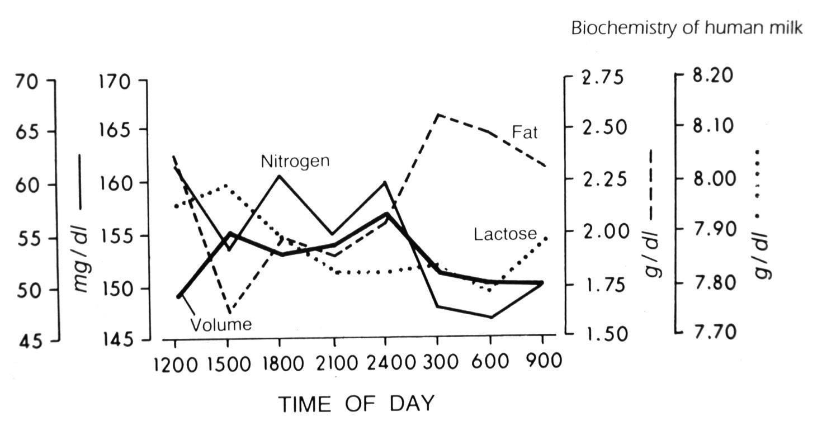
Diurnal variation of breast milk
Notes:
16

Slide 17
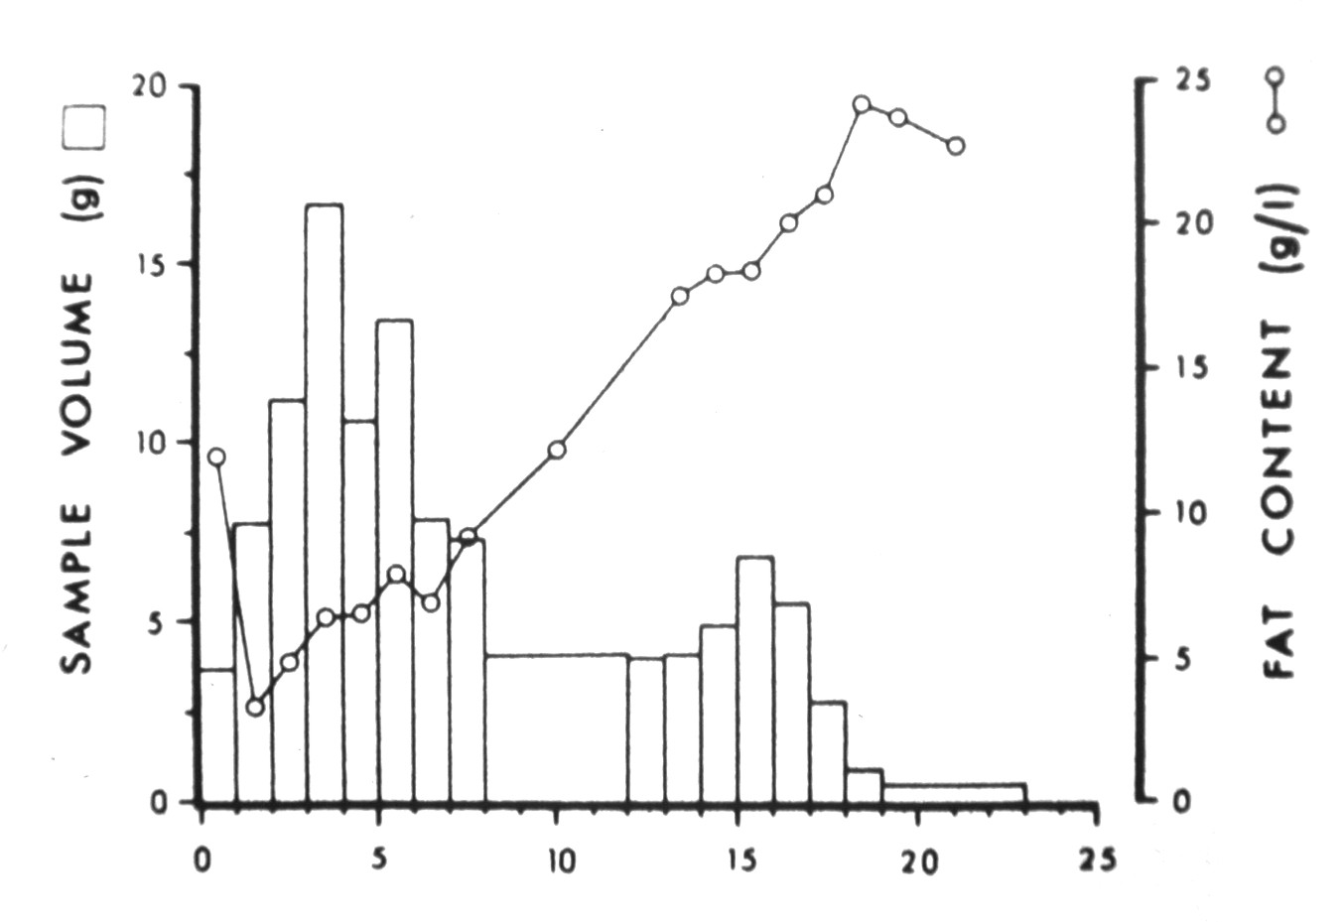
Variation in fat content during a single feeding
Notes:
17

Slide 18
Composition of Mature Milk
Mature milk contains on average:
Energy; (670-750 kcal / liter) .
Lipids (38 g / liter) - The main lipids found in human breast milk are the triacyl-glycerols, phospholipids, and fatty acids including essential fatty acids. Maternal diet does not affect the amount of fat in milk but does affect the types of fat. Cholesterol is present in breast milk but not in formulas.
Casein (2.5 g / liter) - protein - Casein or curds are proteins with low solubility which complex with calcium. These are present in breast milk in much lower concentration than in cow's milk.
Whey (0.64 g / liter) - protein - the whey proteins are located in the clear liquid left behind when clotted milk stands. The largest components are alpha-lactalbumen, lactoferrin, lyzozyme, albumen and immunoglobulins.

Slide 19
CONT.
Nonprotein Nitrogen is used in amino acid synthesis and includes the nitrogen in urea, creatine, creatinine, uric acid and ammonia. Peptides, such as epidermal growth factor, somatomedin - C and insulin are also present in this fraction. Nucleotides such as cytidine monophosphate are derived from nucleic acids and play an important role in the immune system and protein synthesis.
Lactose (70 g / liter) carbohydrate - Lactose is the major carbohydrate in breast milk. It is composed of galactose and glucose. Lactose concentration in breast milk increases over the duration of breastfeeding.

Slide 20
Composition of Mature Milk

Slide 21
The immunologic components of mature milk
While awaiting endogenous maturation of the baby's own immunologic systems, various immunologic and bioactive milk components act synergistically to provide a passive immunologic support system from the mother to her infant in the first days to months after birth.
The immunologic components include ;
Immunoglobulins ; Human milk contains all of the different antibodies (M, A, D, G, E), but secretory immunoglobulin A (sIgA) is the most abundant .
lactoferrin,; which binds to iron, thus making it unavailable to pathogenic bacteria;
lysozyme , which enhances sIgA bactericidal activity against gram-negative organisms;
Mucins adhere to bacteria and viruses and help eliminate them from the body.
Leukocytes; with the transition from colostrum to mature milk, the percentage of macrophages increases from 40-60% of the cells to 80-90% .

Slide 22
Enzymes in mature milk
Human milk contains various enzymes ;
- Some are specific for the biosynthesis of milk in the mammary gland (eg, lactose synthetase, fatty acid synthetase, thioesterase),
Others are specific for the digestion of proteins, fats, and carbohydrates that facilitate the infant's ability to break down food and to absorb human milk (such as lipase, and protease, amylase)
Certain enzymes also serve as transport moieties for other substances, such as zinc, selenium, and magnesium.
Some have antimicrobial activity such as lysozyme.
the enzyme lysozyme which inhibits the growth of many bacterial species by
disrupting the bacterial cell wall, more specifically, the proteoglycan layer

Slide 23
Cont.
In addition,
casein may inhibit the adhesion of various bacteria at different epithelial sites.
Lactalbumin is part of an enzyme complex that:
1-synthesizes lactose, and
2- upon modification seems to contribute to the apoptosis of malignant cells.

Slide 24
Vitamins & Minerals
Fat soluble vitamin A, D, E & K
Water soluble vitamins in general are present ,their
content reflective of the mother’s diet .
Low vitamin B₁₂ is seen in women who are vegetarians, malnourished or have had gastric bypass .
Minerals ; The most important salts are calcium, sodium, potassium and magnesium, representing the predominating mineral.
Notes:
Vitamin A: Content in colostrum is ~double that of mature milk
Yellow color from beta-carotene
Vitamin D: Most as 25-OH₂ vitamin D
Content reflective of mother’s exposure to sun
Needs to be supplemented to 400 IU beginning at 2 mos as per AAP.
Vitamin E: Level linked to milk’s fat content
Level not adequate to meet needs of preterm infants
Vitamin K: ~5% of breastfed infants at risk for K deficiency based on clotting factors
Infants who did not receive K injection at birth may be deficient
Water soluble in general: Content reflective of mother’s diet
Vitamin most likely to be deficient is B₆
Vitamin B₁₂ and folate: Bound to whey proteins
Low B₁₂ seen in women who:
have hypothyroidism or latent pernicious anemia
are vegans or malnourished
have had gastric bypass
Minerals contribute to osmolality (solute concentration per kg or solvent).
Content related to growth of infant
Concentration decreases over 1st 4 months, except for magnesium
Bioavailability: Most have high bioavailability. Good b/c required less from mom.
Exclusively breastfed infants have very low risk of anemia despite low iron content of human milk
Zinc: Bound to protein & highly available
Rare defect in mammary gland uptake of zinc may cause zinc deficiency that appears as diaper rash
Other trace minerals: Fluoride is only mineral not affected by mother’s diet. As per ADA, baby may need fluoride supp.

Slide 25
Milk Carbohydrates
Lactose;
Is the principal carbohydrate of human milk .
Oligosaccharides;
Second dominant CHO
Prevent binding of pathogenic microorganisms to gut, which prevents infection & diarrhea.
Notes:
Other CHO include: glucose, polysaccharides, oligosacchrides, protein-bound CHO.
Oligo: A medium-length CHO containing lactose on one end. low osmolality, stimulates bifidus bacteria, inhibits e. coli. (FOS).

Slide 26
Lipid
More than 98% of the fat in breastmilk is in the form of triglycerides.
Short-chain fatty acids (carbon chain length � 8) are only present in trace amounts.
Oleic acid (18:1) and palmitic acid (16:0) are the most abundant fatty acids in breastmilk .
cholesterol
(LCP) fatty acids(18- to 22-carbon length) are needed for brain and retinal development of the infant.

Slide 27
Triglycerides
Triglycerides are fat. They are the main lipid found in breast milk, and they make up 98% of breast milk fat. Triglycerides are responsible for the storage of energy. The bonds that hold the triglyceride molecules together contain the energy. When the triglycerides are broken down, the bonds break and release the energy.

Slide 28
Cholesterol
Cholesterol is a steroid, and it's essential for brain and nerve development. Cholesterol is also needed to make hormones which regulate the functions of the body. Studies show that children exposed to cholesterol in breast milk appear to have better heart health as they grow. It seems that adults who were breastfed as children have lower levels of bad (LDL) cholesterol and a lower risk of heart disease
Human milk contains 90 to 150 mg/L cholesterol ⁽⁸⁾, in contrast to
no appreciable cholesterol content in vegetable oil–based infant formulae and
to approximately 40 mg/L in dairy fat–based infant formulae.

Slide 29
Docosahexaenoic Acid (DHA)
DHA is an essential fatty acid that contributes to the development of the central nervous system and the brain. It's also important for vision and the development of the eyes, especially for premature infants. Role of DHA
Arachidonic Acid (ARA)
The importance of the essential fatty acid ARA in breast milk is not entirely understood. It may play a role in infant growth, or it may be necessary to balance the DHA.

Slide 30
Complex Lipids
Complex lipids are believed to be important for the brain, stomach, intestines, and skin. They are found in a baby's brain, they help to fight infection, and they are believed to help reduce inflammation in the intestines to protect a baby against a serious intestinal condition called necrotizing enterocolitis (NEC).

Slide 31
Amount of Fat in Breast Milk
The amount of fat in breast milk is not constant.
It changes throughout the day and over time as your baby grows. It even changes during each feeding. The longer your baby breastfeeds on the same breast and the closer she gets to emptying that breast, the more fat she will receive.
Breast milk produced for premature infants is also very high in fat. It has about 30% more fat than the breast milk that's made for full-term babies.

Slide 32
Mother's Diet, Fat in Breast Milk
The levels of DHA are very different among different populations of women depending on their diet and where they live.
examples of how diet can influence lipids, especially DHA in breast milk:
Supplements During Pregnancy: When pregnant women take omega-3 supplements, they have higher levels of DHA, IgA, and other immune properties in their early breast milk.

Slide 33
Vegetarian and Vegan Diets: Since vegetarians do not get dietary fat from animal products, the level of DHA in their breast milk is lower. But, they tend to have very high levels of linoleic acid, a plant-based fatty acid. DHA supplements may be necessary for those who follow a strict vegetarian or vegan diet.
Diets High in Carbohydrates: When women have diets high in carbohydrates with little or no fat, their breast milk has higher levels of medium-chain fatty acids such as lauric acid and linoleic acid.
Coastal Fish Eating Diets: Women who live in areas where seafood is abundant and a large part of their diet, have higher levels of DHA in their breast milk.

Slide 34
Cont.
studies indicate that the major portion of milk PUFA is not derived directly from the maternal diet, but stems from endogenous body stores. Thus, not only the woman's current but also her long-term dietary intake is of marked relevance for milk fat composition.
breastfeeding providing DHA and ARA improves cognitive development and reduces asthma risk at school age particularly in those children with a genetically determined lower activity of DHA and ARA
Ann Nutr Metab 2016;69(suppl 2):28-40

Slide 35
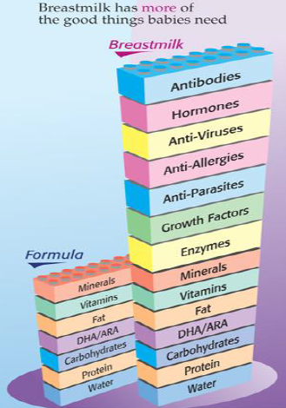

Slide 36
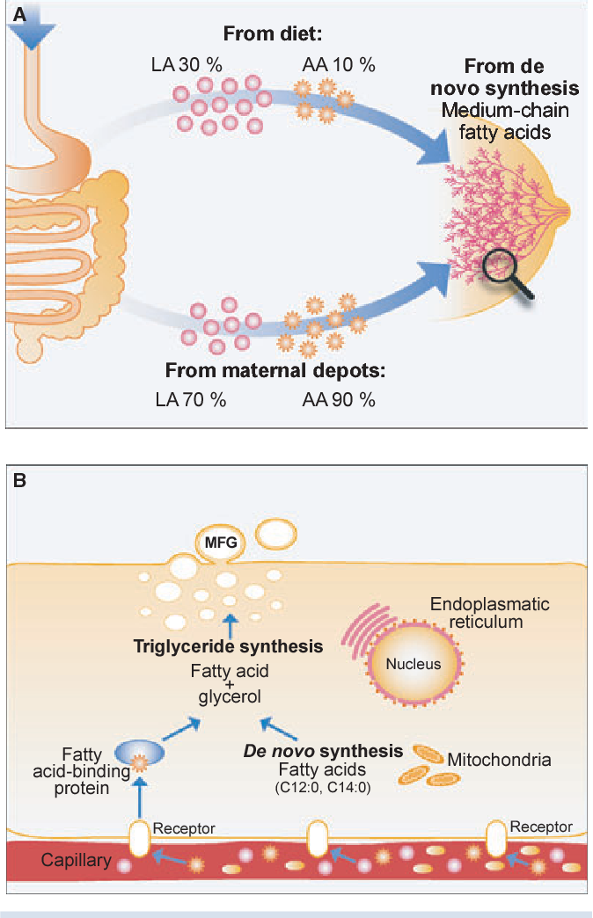

Slide 37
Colostrum is a wonderful fluid
More Na, K, Cl, protein, fat-soluble vitamins
More minerals
Rich in immunoglobulins, especially SIgA
Rich in cells (100,000-5,000,000 leukocytes per ml)
Higher percentage of fat is docosahexaenoic (DHA), arachidonic and linolenic acids
Notes:
37

Slide 38
Notes:
38

Slide 39
In addition, colostrum…
Facilitates establishment of L. bifidus flora in GI tract
Facilitates expulsion of meconium
Is the best “treatment” for preventing and treating hypoglycaemia and hyperbilirubinaemia
Notes:
39

Slide 40
What’s missing in breastmilk?
Iron?
No, there is just the right amount of iron in breastmilk
Together with the stores the baby gets during pregnancy, at birth especially with delayed clamping of the cord, probably there is enough to keep the baby iron sufficient for up to 6 to 9 months
Bean counters, be careful (amounts of breastmilk babies get, the amount of protein, iron etc)
Vitamin D?
Breastmilk does not need to supply vitamin D
Notes:
40

Slide 41
What about iron?
The following is the abstract of an article that was published in the American Journal of Human Biology 2014:26;10-17
It questions the basic assumption that what might be "normal" for the artificially fed baby should be considered normal for the breastfed baby

Slide 42
Here is the abstract
Recently, there has been considerable debate regarding the appropriate amount of iron fortification for commercial infant formula. Globally, there is considerable variation in formula iron content, from 4 to 12 mg iron/L. However, how much fortification is necessary is unclear. Human milk is low in iron (0.2–0.5 mg/L), with the majority of infant iron stores accumulated during gestation. Over the first few months of life, these stores are depleted in breastfeeding infants.

Slide 43
Here is the abstract (continued)
This decline has been previously largely perceived as pathological; it may be instead an adaptive mechanism to minimize iron availability to pathogens coinciding with complementary feeding. Many of the pathogens involved in infantile illnesses require iron for growth and replication. By reducing infant iron stores at the onset of complementary feeding, infant physiology may limit its availability to these pathogens, decreasing frequency and severity of infection.

Slide 44
vitamin D.
All babies need vitamin D. Artificially fed babies have vitamin D already added artificially to the milk at the factory. Breastfed babies unable to get adequate sunshine exposure should receive supplementation

Slide 45
What’s missing from formula?
What about colostrum?
Where do I buy Similostrum?
Enfalostrum?
Good Startostrum?
Notes:
45

Slide 46
Which formula is closest to which colostrum?
Notes:
46

Slide 47
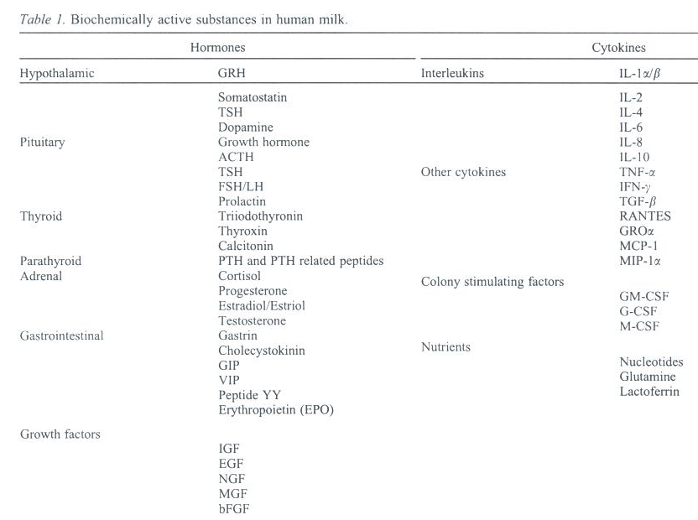
Notes:
47

Slide 48
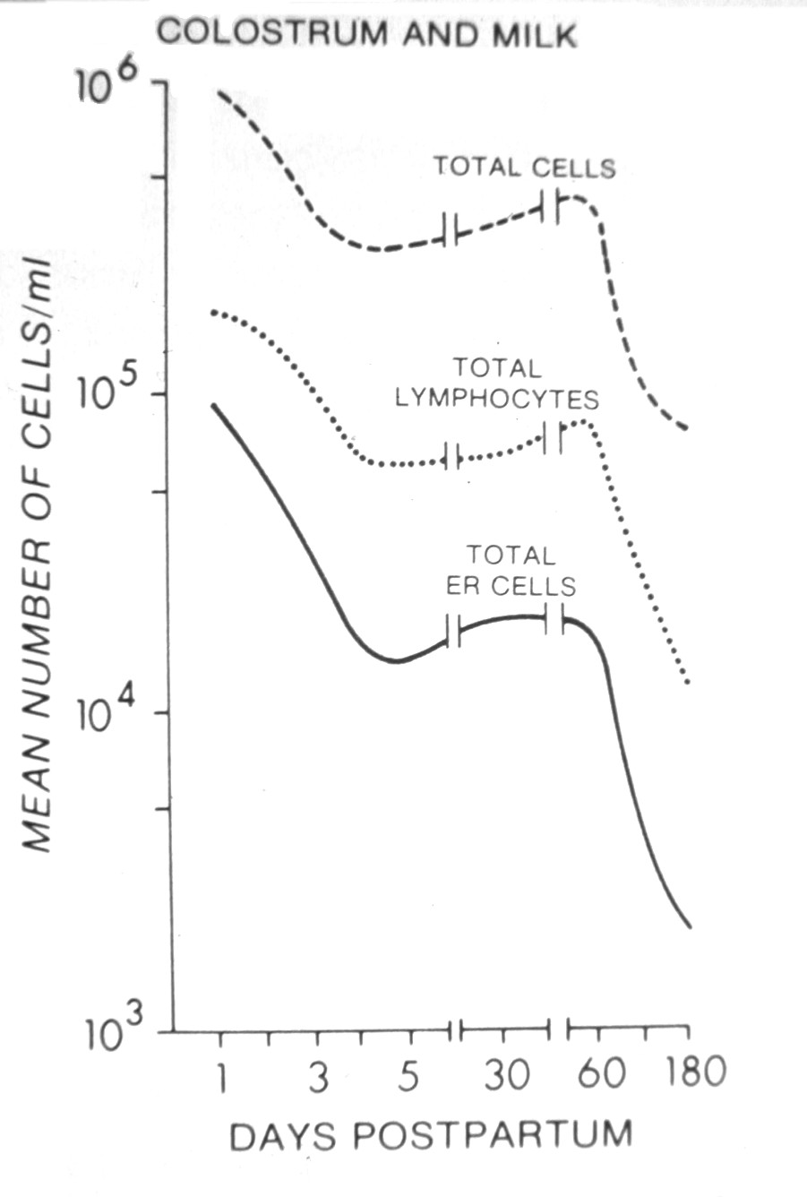
Notes:
48

Slide 49
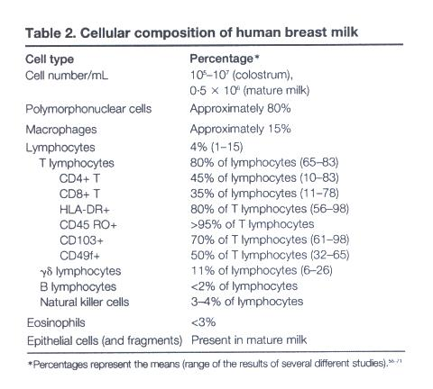
Notes:
49

Slide 50
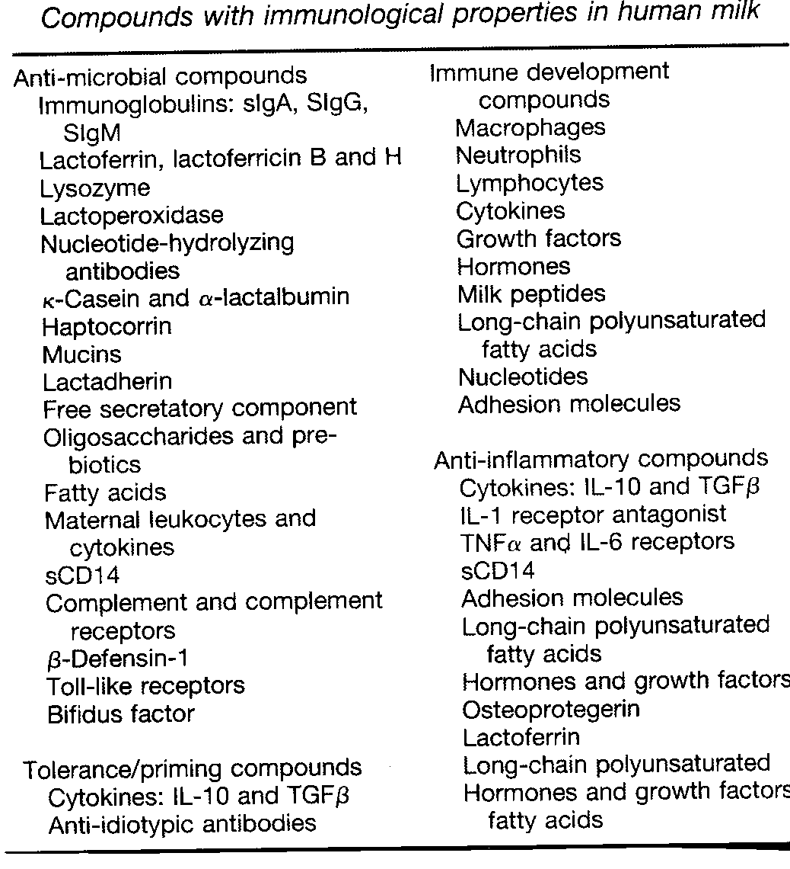
Immune Factors in Breastmilk
Comparison of Human Milk and Formula
August 8, 2013 in Why Breast is BestNo Comments
Notes:
50

Slide 51
And these are not even all of the immune factors which are present in breastmilk, but absent from formulas
Notes:
51

Slide 52
STEM CELLS.

Slide 53
It was discovered seven years ago that human breast milk also contains a kind of stem cell. The question was whether The above now demonstrate that as in humans, mouse milk contains cells that express stem cell markers. These studies in mice provide the first evidence of migration and integration of breastmilk stem cells to organs of the neonate.
April 2014 The FASEB Journal vol. 28 no. 1 Supplement 216.4

Slide 54
Breastmilk made to measure
Notes:
54

Slide 55
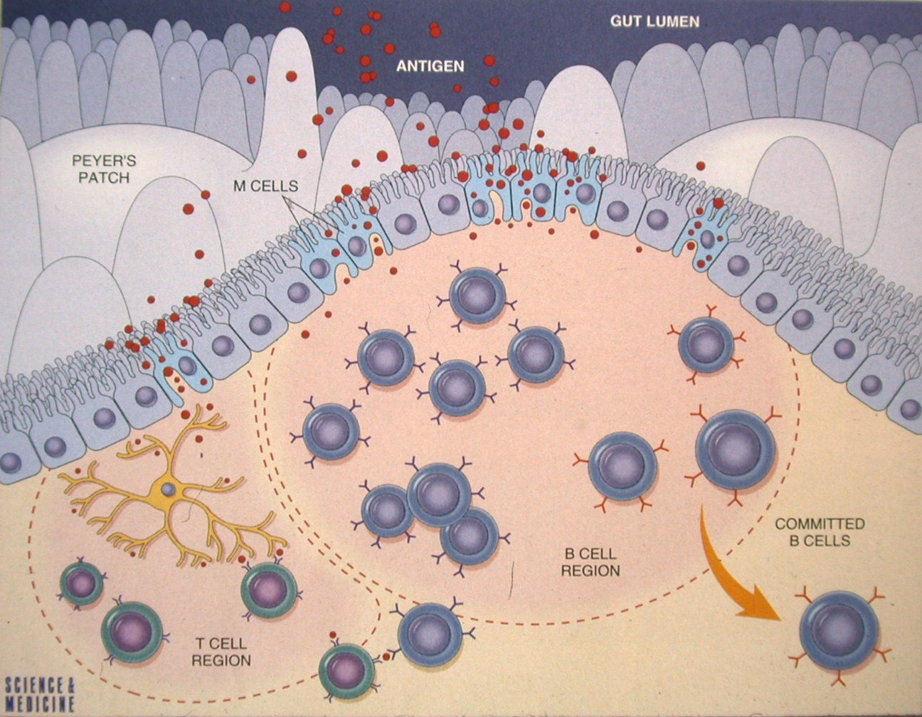
Notes:
55

Slide 56
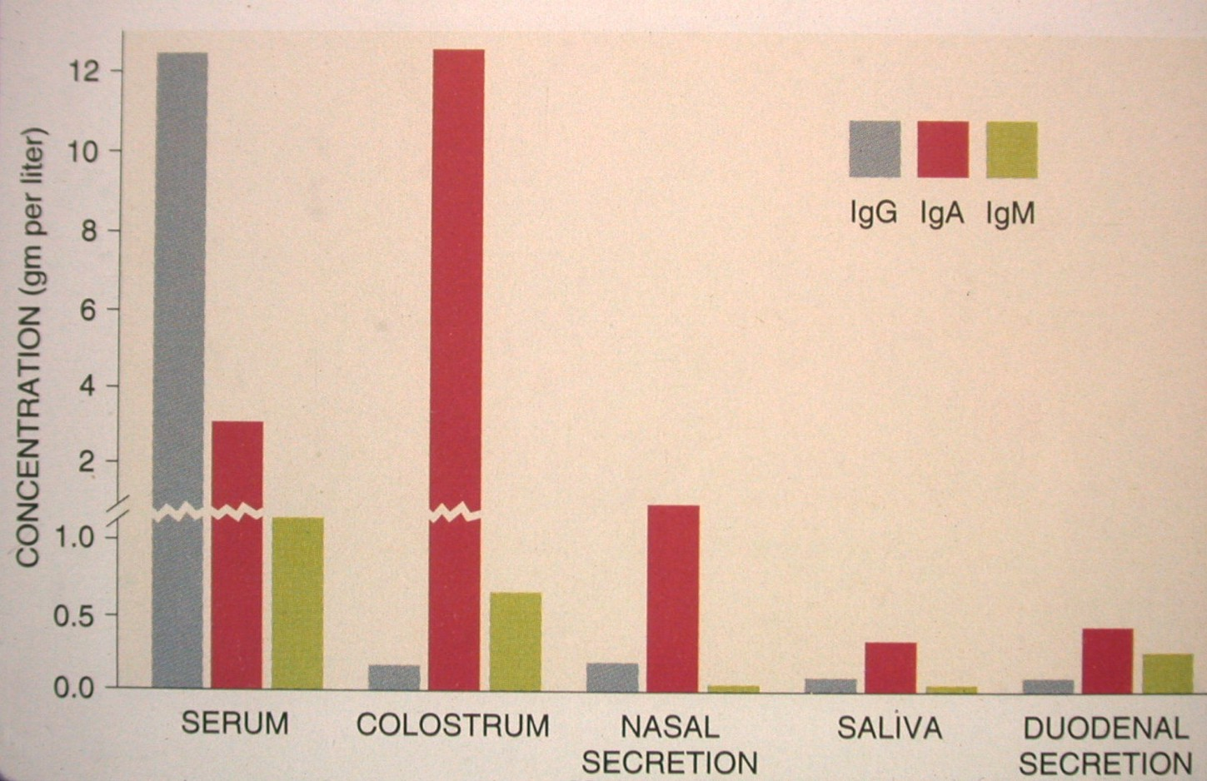
Notes:
56

Slide 57
Do maternal antibodies pass on auto-immune disease to the baby?
The predominant immunoglobulin in human milk is secretory IgA, but there is no evidence that secretory IgA is a pathogenic antibody in autoimmune disease
In any case, secretory IgA is not absorbed via the gastrointestinal tract
There is no evidence that IgG in human milk is absorbed into the circulation of the infant
IgM is also excluded from the infant’s circulatory system

Slide 58
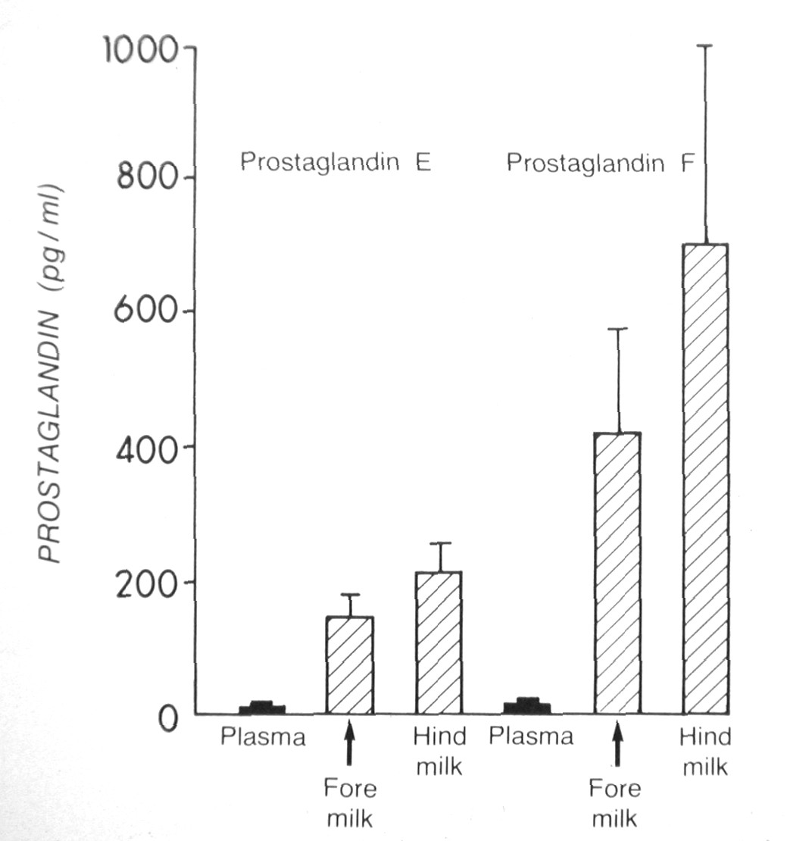
Notes:
58

Slide 59
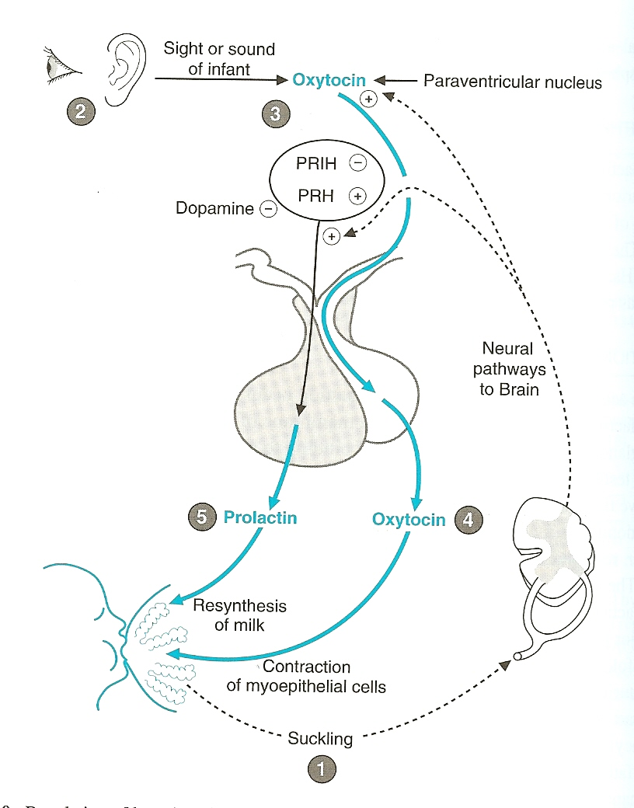
Stimulation of milk production
Milk ejection is promoted by ;
1-neurogenic stimulant (stimulated by suckling)
2-hormonal reflex (oxytocin)

Slide 60
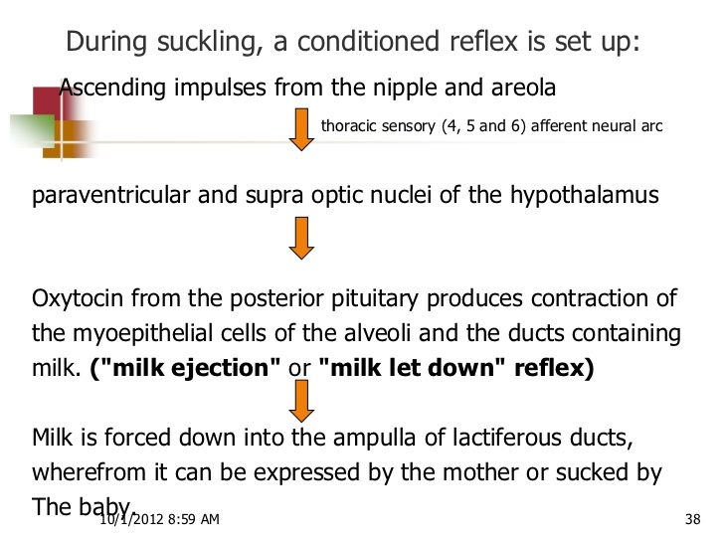
Physiology of lactation

Slide 61
Formula contains the same amount of protein as breastmilk, really?
Breastmilk contains at about 3 months after birth, 8 to 10 g/L of protein
This is somewhat less than most formulas (most contain 12-15 g/L or more)
But:
Up to 60-65% (about 5 g/L) of the protein in breastmilk is lactoferrin, which is not absorbed from the gut!
About 6% (0.5 g/L) of the protein is immunoglobulin, which is also not absorbed from the gut!
So only at most, 4.5 g/L of protein
→Babies can’t grow on this amount, but they do!
→formula contains way too much protein (3.5x more)
Notes:
61

Slide 62
What about S100B protein?
S100B is an acidic calcium-binding protein of the EF-hand family, characterized by the most common calcium binding motif of a helix-loop-helix structure
The protein encoded by this gene is a member of the S100 family of proteins containing 2 EF-hand calcium-binding motifs. S100 proteins are localized in the cytoplasm and/or nucleus of a wide range of cells, and involved in the regulation of a number of cellular processes such as cell cycle progression and differentiation. It may be important to brain development
Notes:
62

Slide 63
altered expression of this gene have been implicated in several neurological, neoplastic, and other types of diseases, including Alzheimer's disease, Down's syndrome, epilepsy, amyotrophic lateral sclerosis, melanoma, and type I diabetes. [provided by RefSeq, Jul 2008]
Present in much higher concentrations in breastmilk than in formula (and higher in mature breastmilk than in colostrum)

Slide 64
Stem cells in breastmilk
See:
Cregan MD, Fan Y, Applebee, A, et al. Identification of nestin-positive putative mammary stem cells in human breastmilk Cell Tissue Res (2007) 329:129–136
Notes:
64

Slide 65
Is it good or bad?
Breastmilk is full of immune factors
Immune factors in breastmilk work by lining the mucous membranes of the baby’s body and prevent pathologic bacteria from entering the baby’s body
When the baby spits up, immune factors line the babies upper respiratory tract and upper gut twice, once on the way down, again on the way up
So if the baby aspirates breastmilk?
formula=breastmilk?
Notes:
65

Slide 66
All this is very nice, but does it make a difference to the baby?
You bet it does!
The studies are all there, but so many people prefer not to believe them because they don’t want to believe them (my baby was formula fed and he’s a PhD)
As soon as one study comes out doubting the results of many studies, we hear “You see? Formula is just as good!”
Studies showing risks of formula are never as well done as studies showing no risk…
Remember, if studies showing risks of formula feeding are not perfect, the burden of proof that there is no risk to formula is on those who say it’s okay
Notes:
66

Slide 67
Formula: a heavy metal cocktail
Notes:
67

Slide 68
Too much…
Too much aluminum
Cow milk formula 100x
Soy formula up to 2000x
Too much manganese
Too much lead
Too much cadmium
Too much iron
Notes:
68

Slide 69
Errors in infant formulas
Notes:
69

Slide 70
Recalls of infant formulas
1978
Enfamil contaminated with E. coli
1979
SMA recalled (improper homogenization)
Neomulsoy and CHO free caused hypochloremic alkalosis
1980
Soyalac contained too much Vitamin D
Enfamil recalled (sour, green, curdled)
Notes:
70

Slide 71
Just one study
CONCLUSIONS: Breastfeeding is protective against SIDS, and this effect is stronger when breastfeeding is exclusive. The recommendation to breastfeed infants should be included with other SIDS risk-reduction messages to both reduce the risk of SIDS and promote breastfeeding for its many other infant and maternal health benefits. Pediatrics 2011;128:103–110
A study completely ignored it seems

Slide 72
In fact…
No evidence that simply adding DHA and ARA to formula gives the benefit it’s supposed to
These PUFA’s need to be added in correct proportions, and they are not absorbed from formula in the same way as they are from breastmilk
Studies do not support any benefit when added to formula
See http://cornucopia.org/DHA/DHA_FullReport.pdf
Notes:
72

Slide 73
Notes:
73

Slide 74
FDA ALERTS PUBLIC REGARDING RECALL OF POWDERED INFANT FORMULA (November 1, 2002): see http://www.fda.gov/bbs/topics/NEWS/2002/NEW00849.html
Notes:
74

Slide 75
Aside from many recalls of formulas over the years…
For those who are fond of exotic foods…
Interesting food that has been found in infant formulas:
Rat hair
Beetle parts and beetle larvae
Pieces of glass
Melamine—due to adulteration of milk by greedy people
Notes:
75

Slide 76
Risks for the mother
Ovarian cancer
Endometrial cancer
Breast cancer
Osteoporosis
Iron deficiency
Delayed involution of the uterus
Notes:
76

Slide 77
Breast cancer
Women who breastfeed are less likely to develop breast cancer
Collaborative Group on Hormonal Factors in Breast Cancer. Breast cancer and breastfeeding: collaborative reanalysis of individual data from 47 epidemiological studies in 30 countries, including 50,302 women with breast cancer and 96, 973 women without the disease Lancet 2002;360:187-195
This study brings together >80% of the worldwide epidemiological data on breast cancer and breastfeeding
Notes:
77

Slide 78
More maternal risks
Difficulty with weight loss
Disempowerment
Increased difficulty in attachment with baby
Cost
Notes:
78

Slide 79
Type 2 diabetes
Stuebe AM, Rich-Edwards JW, Willett WC, et al. Duration of lactation and incidence of type 2 diabetes J Am Med Assoc 2005;294:2601-2610
“Longer duration of breastfeeding was associated with reduced incidence of type 2 diabetes in 2 large cohorts of women”
Notes:
79

Slide 80
Metabolic syndrome
Ram K, Bobby P, Hailpern S, et al. Duration of lactation is associated with lower prevalence of the metabolic syndrome in midlife—SWAN, the study of women’s health across the nation Am J Obstet Gynecol 2008;198:268.e1-268.e6
“Duration of lactation is associated with lower prevalence of MetSyn in a dose-response manner in midlife, parous women”
Notes:
80

Slide 81
What is metabolic syndrome?
The metabolic syndrome is a clustering of the metabolic abnormalities:
Insulin resistance, dyslipidemia, hypertension, and obesity
Women with metabolic syndrome are at increased risk of diabetes mellitus, major cardiovascular events, and increased all-cause mortality
Notes:
81

Slide 82
Risks to society
Formula as an environmental hazard
Loss of contraceptive effect
Loss of security, stable beginning for the child
Notes:
82

Slide 83
Notes:
83

Slide 84
Notes:
84

Slide 85
Notes:
85

Slide 86
Notes:
86

Slide 87
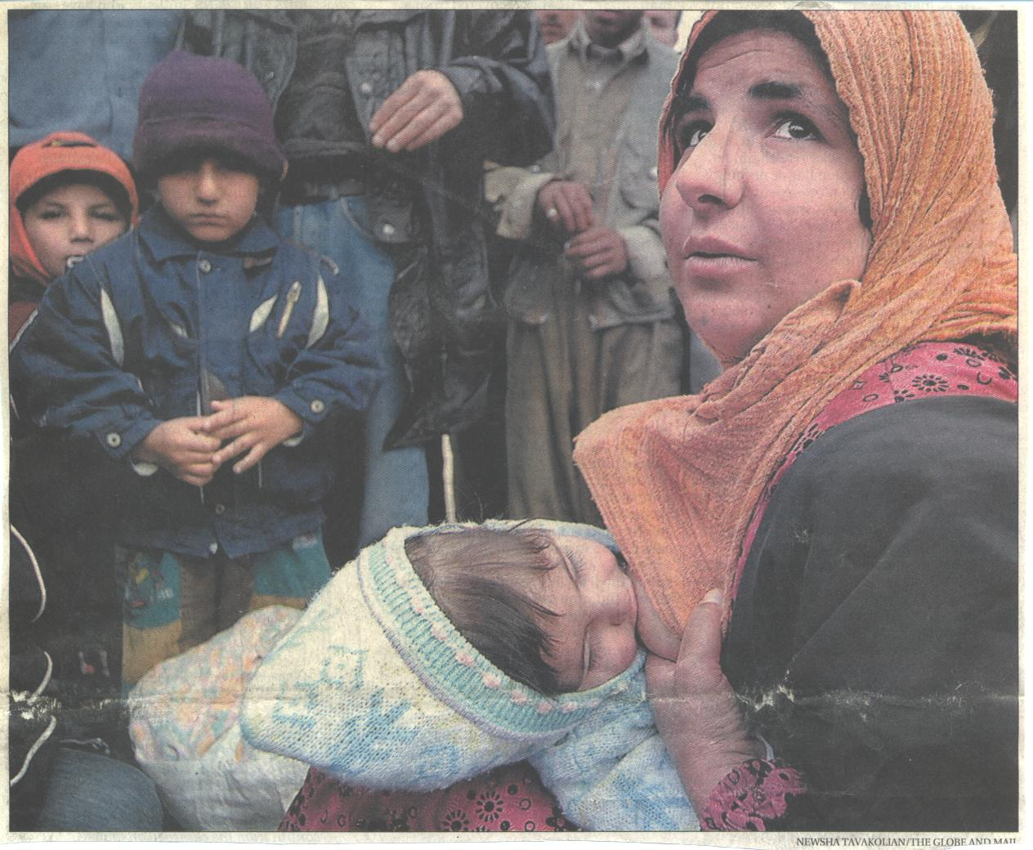
Notes:
87

Slide 88
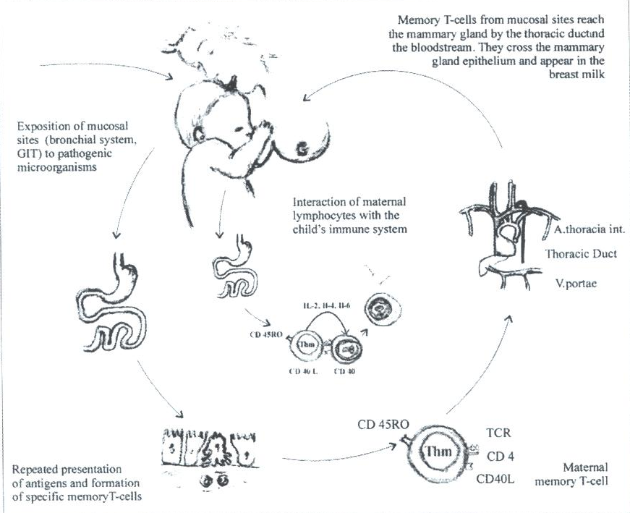
Notes:
88

Slide 89
Notes:
89

Slide 90
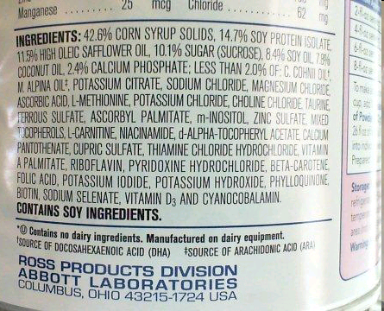
Notes:
90

Slide 91
إلى متى المتاجرة بأرواح أطفالنا؟؟

