Slide 1
Examination of The Newborn Infant
2019
Khalid Altirkawi, MD, FAAP
Assistant Professor, Pediatrics
King Saud University

Slide 2
Objectives
By the end of this presentation, student should be able to:
Recognize the physical differences between the newborn infant and the older children.
Recognize the importance of maternal factors in neonatal health.
Recognize the most important components of the examination and their proper interpretation

Slide 3
How The Newborn Infant Differs
Developmental considerations:
Varying degree of immaturity in many systems
Higher basal metabolic rate (BMR)
Larger body surface area
Lower glomerular filtration rate (GFR)
Children are NOT small adults
Neonates are NOT small children

Slide 4
Maternal Factors
Examples of maternal health issues and its effects on the newborn:
Hypertension and small for gestational age (SGA) infants
Myasthenia Gravis and neonatal hypotonia
DM and macrosomic infants
SLE and neonatal lupus

Slide 5
Why To Examine a Newborn Infant
To discover abnormalities and problems
To explore the difficulties parents face in taking care of their baby.
To answer the parents’ questions

Slide 6
Before You Start…
Remember to:
Introduce yourself
Wash your hands
Explain to the caregiver the purpose of your visit and the procedure of examination

Slide 7
Steps of the Examination
Verify the newborn demographics (ID)
Review maternal history, pregnancy and perinatal details
Examine thoroughly from head to toe
Inform the caregiver about findings and the next step if needed
Document your findings

Slide 8
Start With….
Assess nutritional/hydration status
Weight gain
Adipose tissue
Mucus membranes
Check the vital signs
Obtain growth measurements

Slide 9
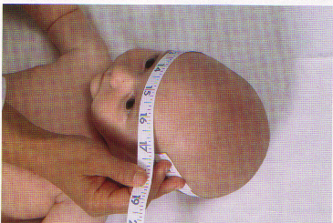
Growth Parameters
Weight
Weigh infant directly on infant scale.
Length
Place the baby supine on measuring board.
Measure the distance between marks made on the table paper indicating the crown and heel.
Head circumference
Place the tape over occipital, parietal and frontal prominences for the greatest circumference.

Slide 10
Skin
Inspect and search for:
Color: Plethora, Pallor, Cyanosis, Jaundice
Mottling
Bruises
Rashes

Slide 12
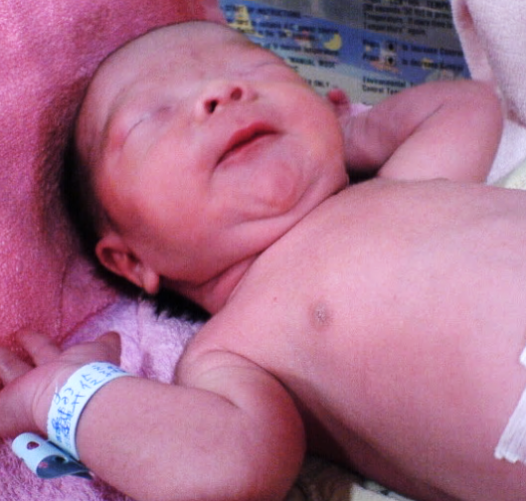
Skin Colors
Jaundice
Mottling
Pallor

Slide 13
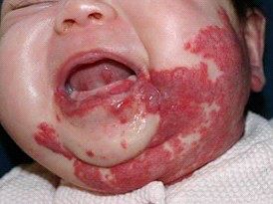
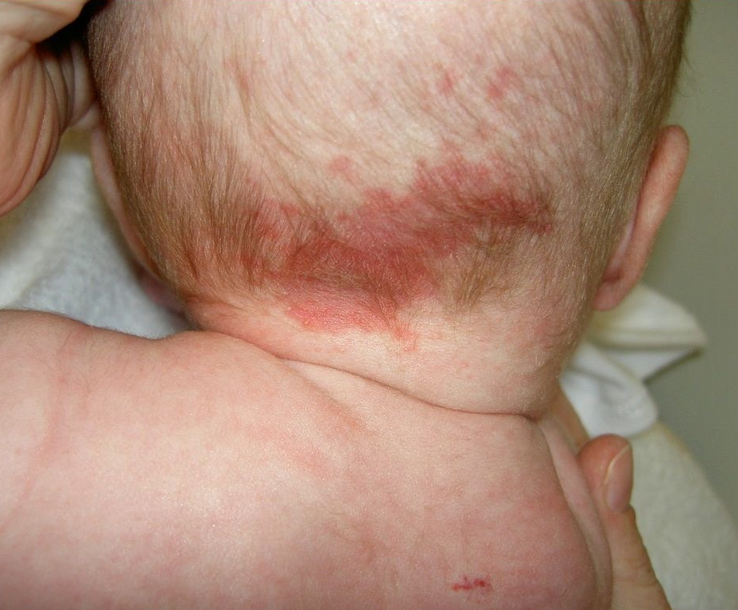
Hemangiomas
Salmon patch
PHACE syndrome
"Stork bite" mark
Notes:
PHACE syndrome
A large Hemangioma with abnormality in one or more of the following:
Structures of the Posterior fossa
Arterial and cerebral vasculature
Cardiac anatomy
Eye
‘S' may be added because Sternal clefting and Supra-umbilical raphe are commonly present
PHACE syndrome is NOT rare (20% of all facial hemangiomas & 2% to 3% of all hemangiomas) with Female: male ratio of 4:1
Posterior fossa abnormalities may be associated with developmental and motor delays, and pituitary dysfunction
“Beard" distribution lesions may involve the upper airway
Renal USS is unlikely to detect a structural abnormality
Sturge-Weber syndrome
PHACES is more common than Sturge-Weber syndrome, (facial nevus flammeus, unilateral meningeal angiomatosis, and vascular abnormalities of the choroid of the eye)
Salmon patches may also be found on the nape of the neck in newborns. Nicknamed "Stork Bite Marks", these lesions become less intense with time, but are frequently visible into adulthood.

Slide 14
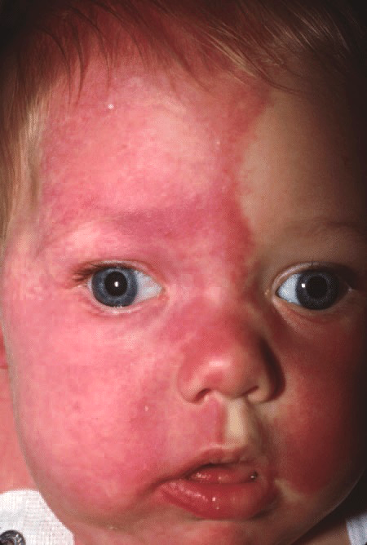
Hemangiomas
Port Wine Stain
Nevus flammeus
Notes:
Port Wine Stain
They are typically more intense and purple-red in color than salmon patches. In some cases, as seen here, a port wine stain may affect a large surface area. The discoloration is not, of itself, a problem, but it may be a clue to an underlying condition.
Port wine stains on the face may be associated with Sturge-Weber syndrome, and those on the extremities may be associated with Klippel-Trenaunay-Weber syndrome, in which overgrowth of an extremity may occur.

Slide 15
Hemangioma
Natural History
At 1 month
At 2 years
At 7 years
Notes:
A. at one month
B. At 2 years
C. At 7 years

Slide 16
Skin Lesions
Gray slate (mongolian) spots
Pigmented areas mostly over the lumbar region and buttocks.
Become less prominent and may eventually disappear during childhood
Notes:
Slate Grey Patches (Mongolian Spots)
These dark blue-grey lesions are most commonly seen in darker-skinned infants. The sacrum is the most commonly affected area. These lesions tend to fade over several years but may not completely disappear. No evaluation is needed. They can be easily differentiated from bruises by the absence of other colors associated with bruises -- red, purple, green, brown or yellow.

Slide 17
Skin Lesions
Erythema Toxicum
Erythematous flares with central pin point vesicles or papules.
May appear and disappear over several hours to days during the first week of life
Erythema Toxicum

Slide 18
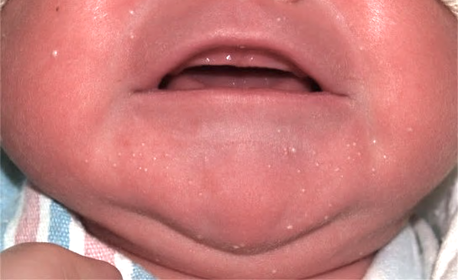
Skin Lesions
Milia
Tiny white papules on the nose, cheeks, fore-head and the trunk
They are keratin filled epithethial cysts
Spontaneous resolution is expected within a few weeks.
Milia
Sebaceous Hyperplasia
Notes:
Milia
The white papules on this baby's chin and cheeks are milia. Milia are keratin filled epithethial cysts which occur in up to 40% of newborns. Spontaneous exfoliation and resolution is expected within a few weeks.
Parents will occasionally mistake these lesion for neonatal acne, but milia are present at birth and have no inflammatory component. Acne, even though caused by maternal hormones, does not generally appear until after 2 weeks of age.
Sebaceous Hyperplasia
In contrast to milia, the raised lesions on the nose in this newborn are sebaceous hyperplasia. The lesions are more yellow than milia and are the result of maternal androgen exposure in utero.
Sometimes referred to as "the miniature puberty of the newborn," maternal hormone exposure may also cause vaginal withdrawl bleeding in infant girls and neonatal acne.
Sebaceous hyperplasia is a benign finding and spontaneously resolves with time. No evaluation is needed.

Slide 19
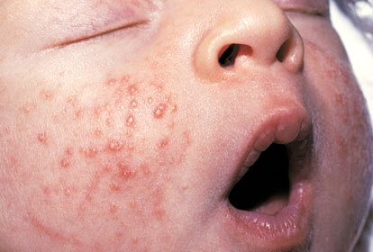
Skin Lesions
Miliaria (heat rash)
Pin-point vesicles with or without surrounding erythema caused by plugging of sweat glands
Miliaria
Neonatal acne

Slide 20
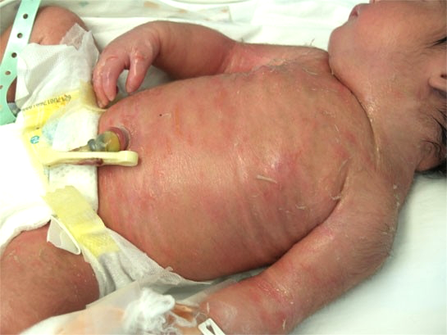
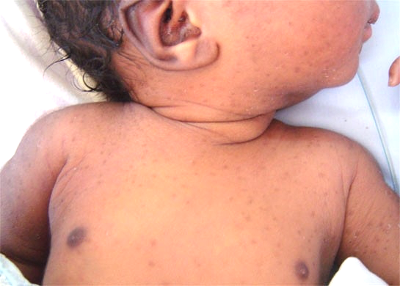
Skin Lesions
Peeling and cracking
Icthyosis
Postmature infant
Pustular melanosis of the newborn
Notes:
Icthyosis
Notice how the skin uder the peeled areas is red and fissured and how the fingers on the right hand appear edematous. This newborn had an uncomplicated pregnancy and delivery, but this skin appearance in the delivery room prompted transfer to the NICU for further evaluation. For this baby, Aquaphor was liberally applied to the skin, and the infant was kept in an isolette to minimize fluid losses.

Slide 21
Skin Lesions
Diaper rash
Mainly due to irritation by urinary urates.
Maybe due to Candida skin infection
Contact dermatitis
Candida

Slide 22
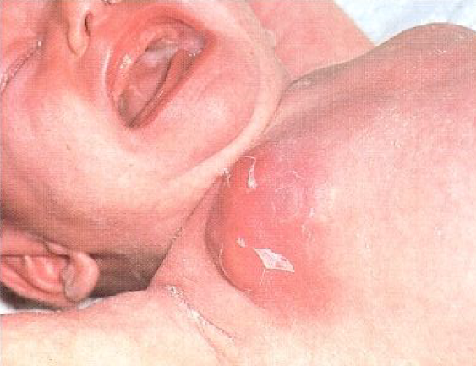
Skin lesions
Swollen Breasts
Occur in both sexes.
Occasionally lactate (under effect of the maternal hormones)
Subsides gradually with no treatment
Mastitis

Slide 23
Head & Neck examination
Remember
The newborn's neck muscles are not strong; therefore, whenever lifting a baby, you should always support the head separately with one hand
Notes:
Most newborn necks are quite short, but if they are abnormally so or not mobile, this may be a result of bony abnormalities as in Klippel-Feil syndrome. Check the neck for sinuses and tags in the postauricular region and along the anterior sternocleidomastoid border.
A mass in the body of the sternocleidomastoid muscle indicates a possible bleed and may produce subsequent torticollis. Midline masses should bring to mind thyroid disorders such as thyroglossal duct cyst. Neck masses may compromise respiration and require immediate evaluation, and may be dermoid cysts, hemangiomas, cystic hygromas, teratomas, or reactive lymph nodes. Webbed necks should bring to mind Turner syndrome, sometimes associated with generalized edema, or other collagen disorders that cause skin laxity such as Ehlers-Danlos syndrome. Observe and auscultate carefully to localize areas of upper airway compromise as a result of any of these lesions.

Slide 24
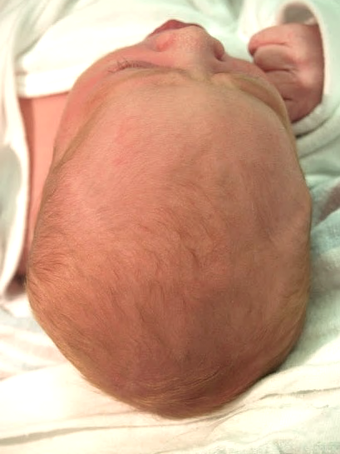
Head
Circumference
Fontanels
Caput Succedaneum
Hematomas
Molding
Molding

Slide 25
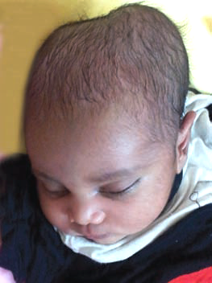
Head
Circumference
Fontanels
Caput Succedaneum
Hematomas
Molding
Caput Succedaneum
Cephalhematoma

Slide 26
Caput Succedanum vs. Cephalhematoma
Caput succedaneum
(scalp edema)
Cephalohematoma
(subperiosteal hemorrhage)

Slide 27
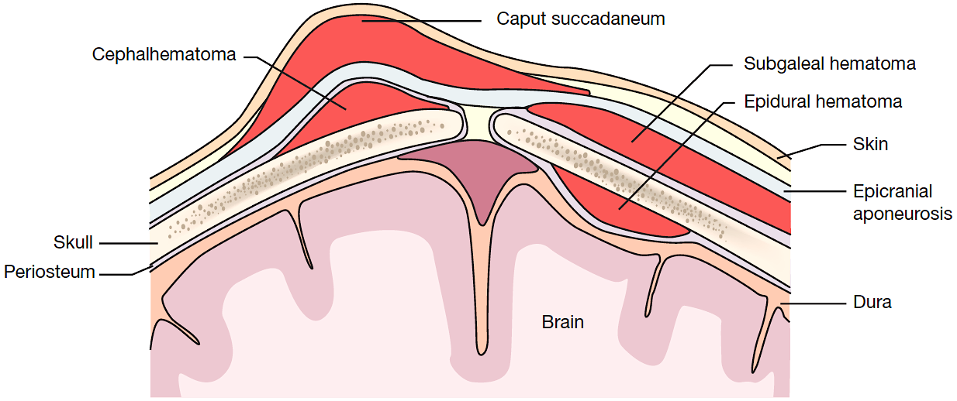
Other Scalp Hemorrhages

Slide 28
Fontanels and Sutures

Slide 29
Fontanels
Anterior one closes by 18 to 24 months
Posterior by birth to 2 months
If anterior Fontanel is
Closed at birth → microcephaly or molding
Tense/bulge → increased ICP
Sunken → dehydration

Slide 30
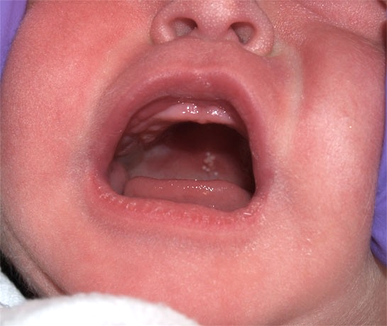
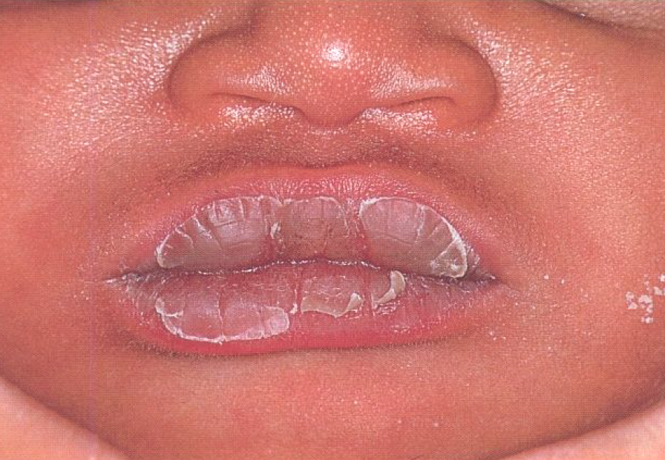
Mouth
Insert finger to test for intact palate, mandible, gums, lips, size of the tongue and sucking.
Shut the mouth to test choanal atresia
Epstein pearl
Sucking pads
Ankyloglossia

Slide 31
Mouth
Cleft palate

Slide 32
Mouth
Natal teeth
Micrognathia
Notes:
Pierre Robin sequence

Slide 33
Mouth
Facial nerve palsy

Slide 34
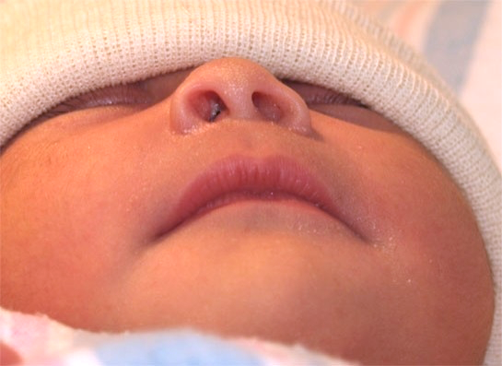
Nose
Septum dislocation
Shape and size
Race and family determined
Patency
Infant is an “obligate nasal breather”
Deformities
Trauma or syndromic
Pressure deformity

Slide 35
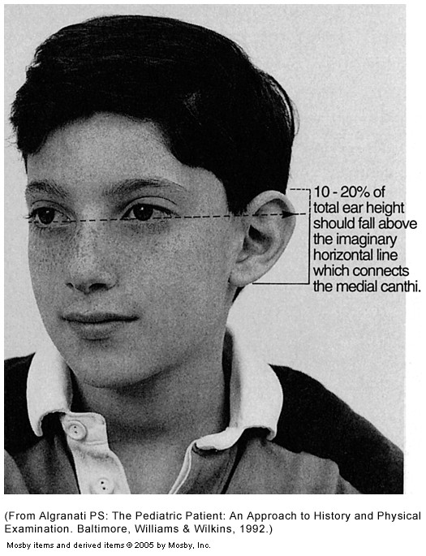
Ears
Normal ear
Low-set,
posteriorly rotated

Slide 36
Ears
Low-set ear
Preauricular sinus
Preauricular tag
Microtia
Notes:
Preauricular tag

Slide 37
Eyes
Look for
Red reflex
Corneal opacities
Conjunctivitis/discharge
Hypertelorism / hypotelorism
Microophthalmia
Brushfield spots – Down’s syndrome
Sticky eyes are common, mostly due to lacrimal duct stenosis

Slide 38
Red Reflex
Normal, symmetric red reflex.
Red reflex is normal in the right eye, and diminished in the left one, this is most commonly caused by refractive error between the eyes, but can also be caused by a more serious patho-logy (e.g., retinoblastoma).
Red reflex is normal in the right eye and no reflex in the left eye, this occurs when the reflection is blocked by an opacity such as a cataract.
From Bell AL, Rodes ME, Collier Kellar L. Childhood eye examination. Am Fam Physician. 2013;88(4):246.

Slide 39
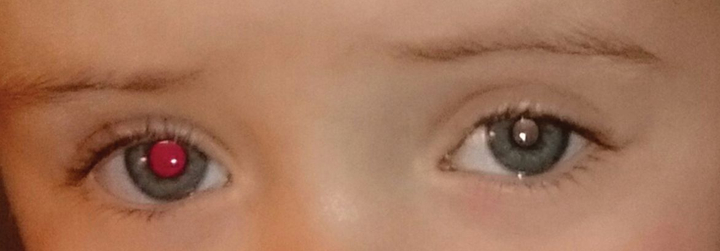
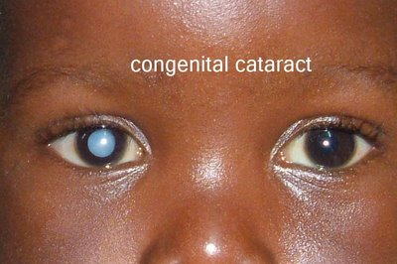
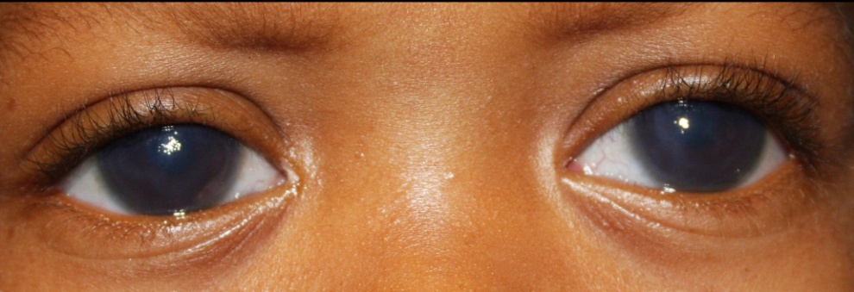
Eyes
Notes:
L abnormal red reflex
L Leucocoria
R leucocoria
Strabismus and megalocornia
L Horner Syndrome
Bilateral corneal haziness

Slide 40
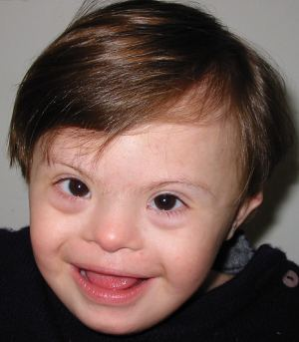
Eyes
Dacrocystitis
Brushfield nodules
Epicanthal folds
Coloboma
Subconjunctival hemorrhage

Slide 41
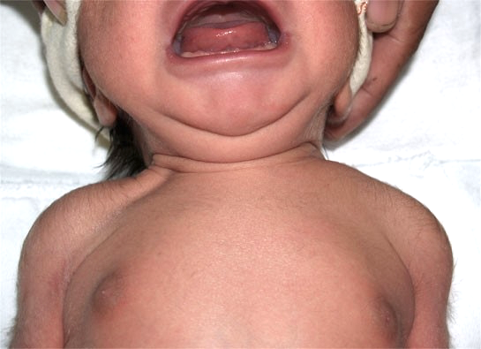
Neck
Clavicle fracture
Redundant skin
Neck webbing

Slide 42
Thorax
The shape
The movement
Heart sounds
Breathing sounds
Pectus excavatum
(Concave )
Pectus carinatum
(Convex)

Slide 43
Thorax
Cardiovascular system
Palpate precordium, apex beat
Auscultate for the rate, rhythm and murmurs
Normal heart rate at birth is about 140 (90-175) bpm.
Do not forget to check for peripheral pulses (Radio-femoral delay)
Lungs
Respiratory movements, Rate, grunting or recessions
Abnormal breath sounds
Normal RR at birth = 40-60 bpm (count 1 full minute)

Slide 44
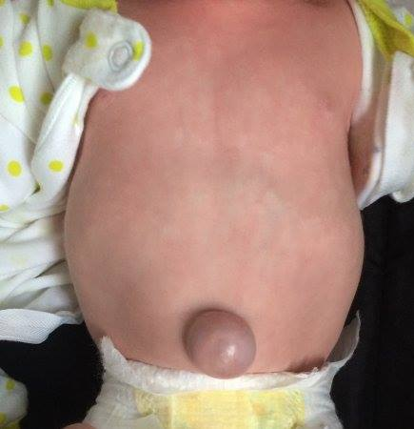
Abdomen and Perineum
Abdomen
Normally feel liver, spleen and kidneys
Umbilical Cord
Signs of infection: Odor/pus/redness/ tenderness
Separates through a moist base at about day 7
Genitalia
Identify gender, hypospadias, testes, orifice patency, bleeding
Anus
Orifices patency, tone

Slide 45
Trunk and Extremities
Trunk & Spine
Spina bifida/deformities
Extremities / Hip Joints
Compare both upper and lower limbs
Look for “dislocation”
Number of fingers (polydactyly, syndactyly)
Club foot (Talipes equinus varus)
Palmer creases (e.g. single palmer crease)

Slide 46
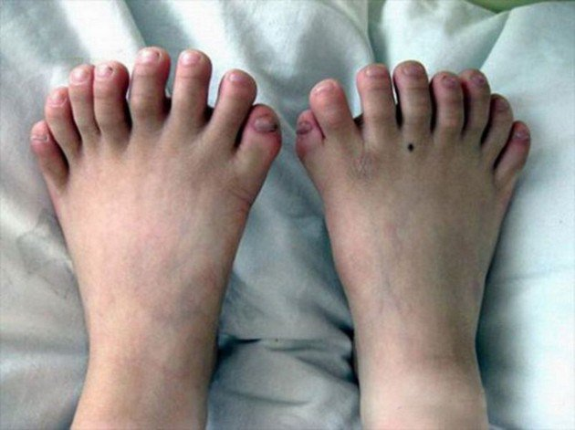
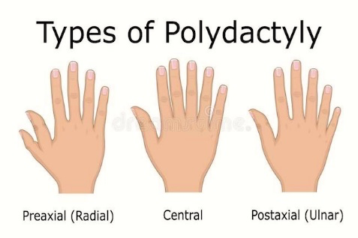
Skeletal Anomalies
Syndactyly
Polydactyly

Slide 47
Skeletal Anomalies

Slide 48
Developmental Dysplasia of the Hip (DDH)
Barlow
Ortolani
Notes:
Techniques to evaluate for hip dysplasia in newborns. (A) The Barlow maneuver involves adducting the hip while pushing the thigh posteriorly to see if can be dislocated. (B) The Ortolani maneuver involves abducting the hips while pushing the thigh anteriorly and relocates reducible hips dislocated by the Barlow maneuver creating a clunk.
Procedure
Place baby in supine, legs pointing towards examiner. Flex legs to right angles at hips and knees.
Note: Look for symmetry of the leg/thigh length. The thigh may appear short on affected side. Thigh skin folds may be asymmetric. Hip may have limited abduction on the affected side.
2. To detect an unstable hip by placing thumb medially over lesser trochanter and examiner middle/index finger laterally over greater trochanter. Abduct both hips simultaneously until lateral aspect of each knee touches examining table.The pelvis is steadied by the hand & the flexed thigh is abducted & adducted & any clunk or jerk is noted ( ortolani’s sign). With the hip abducted about 45 degree, the femur is gently rocked backwards & forwards on the pelvis & again any jerk or clunk(dull sound) is noted as the head of the femur slips out on to the posterior lip of the acetabulum.
3. with the help of index/middle finger, press greater trochanter forward and inward. Feel for a sudden movement of femoral head inward as it returns to hip socket.

Slide 49
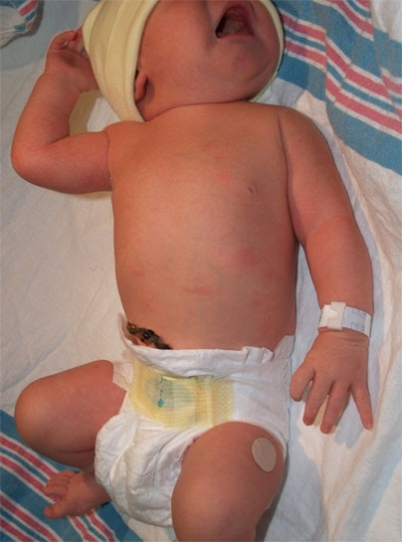
Erb’s Palsy
C5-C6 Injury
Paralysis of deltoid, supraspinitus, biceps and teres major.
Loss of sensation over deltoid, lateral forearm and hand.
External rotation of arm is absent, biceps paralysis prevents flexion, & arm is held internally rotated. When adducted posteriorly it adopts – Porter’s Tip Position)

Slide 50
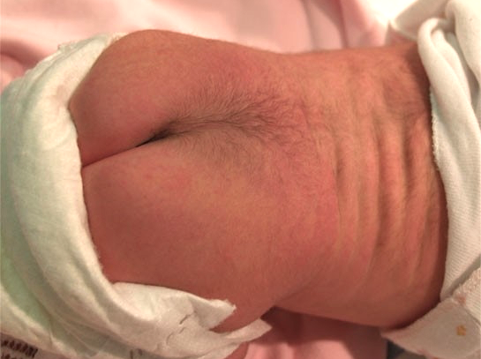
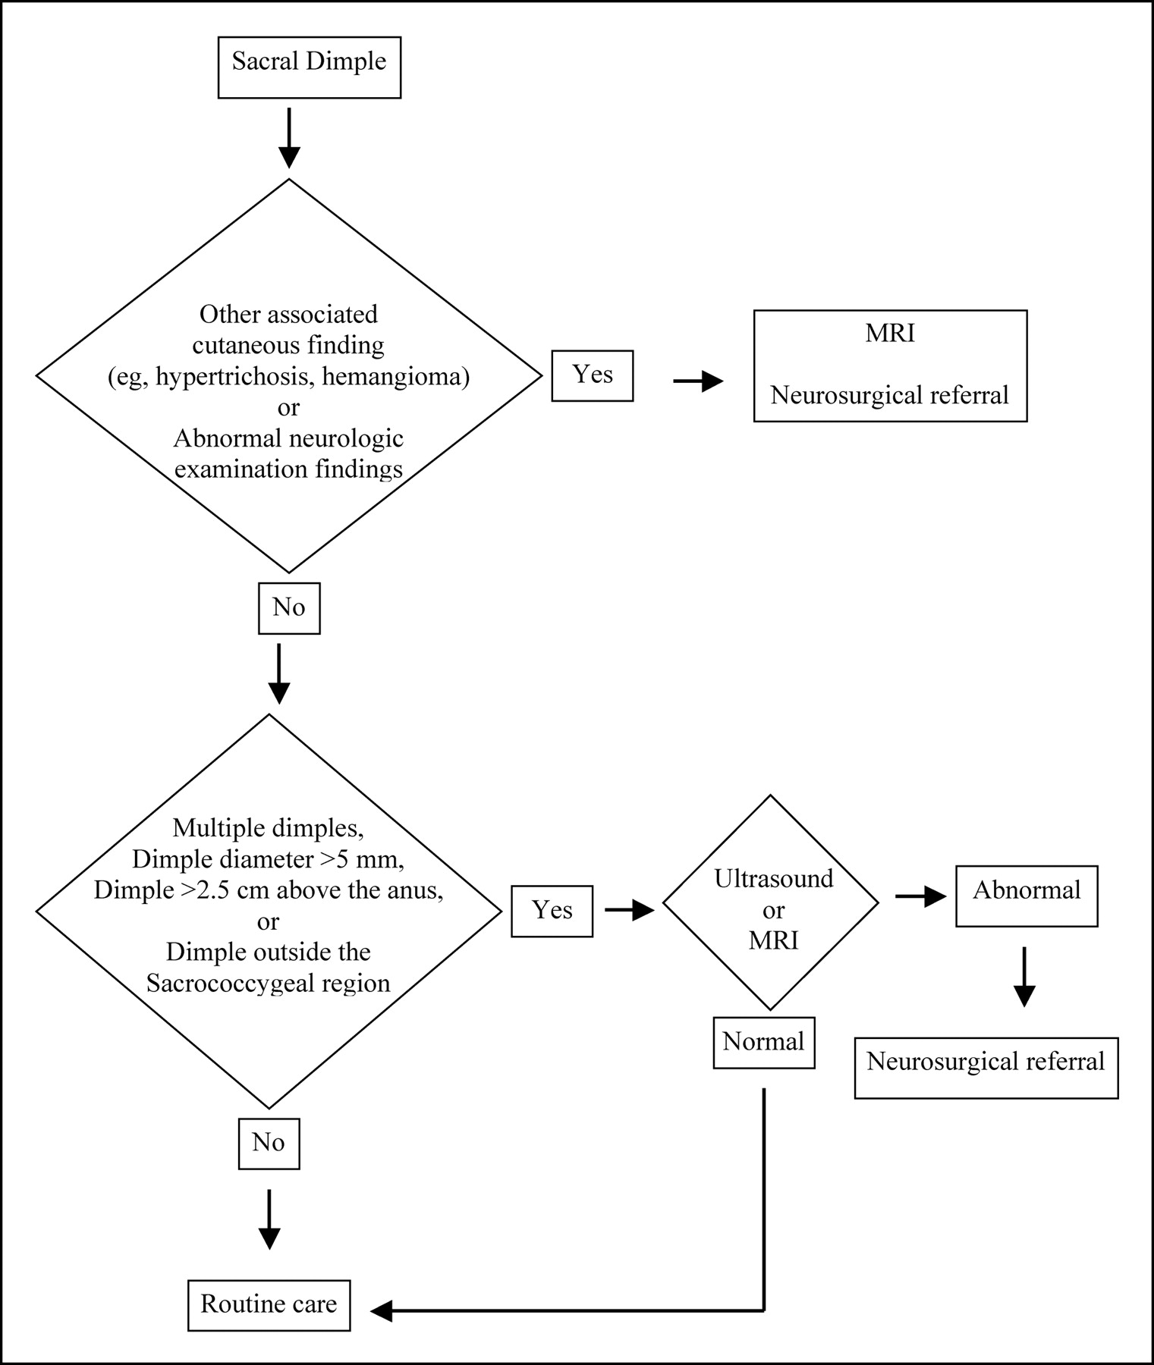
The Back
Notes:
Inspect the back for obvious masses or deformities. Spina bifida may present either covered with skin or open.
Other causes of midline masses include sacrococcygeal teratomas and lipomas.
Check the entire posterior midline for dimples or sinuses. If they occur further than 2 cm away from the anus, they may well communicate with the central nervous system (CNS); refer them immediately.
Abnormal tufts of hair in the sacral region may bespeak spina bifida, tethered cord, or other CNS abnormalities.
Pilonidal sinuses and cysts occur within 2 cm of the anus and are benign if the examiner sees the floor of the dimple. If not, ultrasound may be necessary to delineate the anatomy.
Check the anus for patency. Ninety-nine percent of normal newborns should pass meconium within the first 48 hours of life.
Congenital scoliosis is not normal, and it is necessary to image the spine for abnormalities.

Slide 51
Neurological Examination
General appearance
CNS is under developed
Functions at subcortical levels
Normal subcortical functioning in early infancy does not mean an intact cortical system
Positioning
Persistent asymmetries, predominant extension of extremities, constant turning of head to one side indicates severe intracranial disease (Opisthotunus).
Notes:
Opisthotunus (extension of head, stiffness of neck with extension of arms and legs) indicates meningeal or brainstem irritation due to infection or hemorrhage.

Slide 52
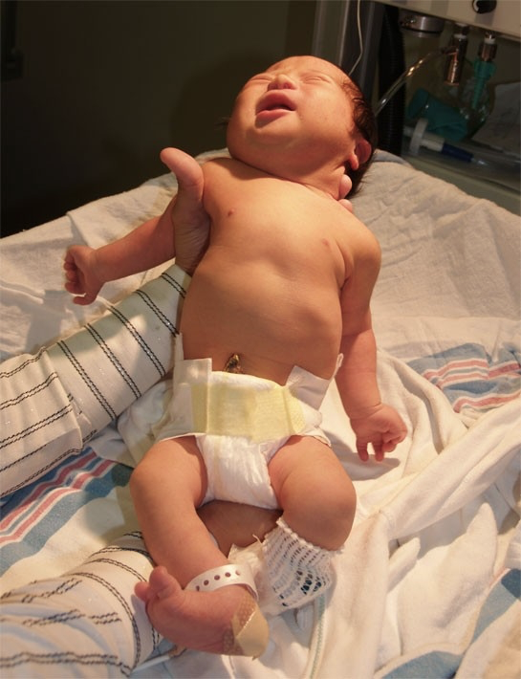
Hypotonia

Slide 53
Neurological Examination
Unconsciousness
Activity
Spontaneous and induced movement, cry and alertness
Motor Function
Put each major joint through its range of motion
Determine muscle tone – spasticity or flaccidity
Abnormal movement/Seizures

Slide 54
Primary Reflexes
Blinking (Dazzle Reflex)
Disappears after first year. Eyelids close in response to bright light. Absence indicates blindness
Acoustic Blink (Chleco-palpebral reflex)
Both eyes blink in response to a sharp loud noise. Disappearance variable.
Notes:
Note: Have prognostic value in CNS integrity. Absence of this in neonate or the persistence of some beyond their expected time indicate severe CNS dysfunction Eliciting anyone of them except rooting, grasp, tonic neck and moro should be attempted only when CNS function is questionable.
Note: All babies clinch their hand during first month of life. Persistence of clench hand beyond two months also suggests CNS/frontal lobe damage

Slide 55
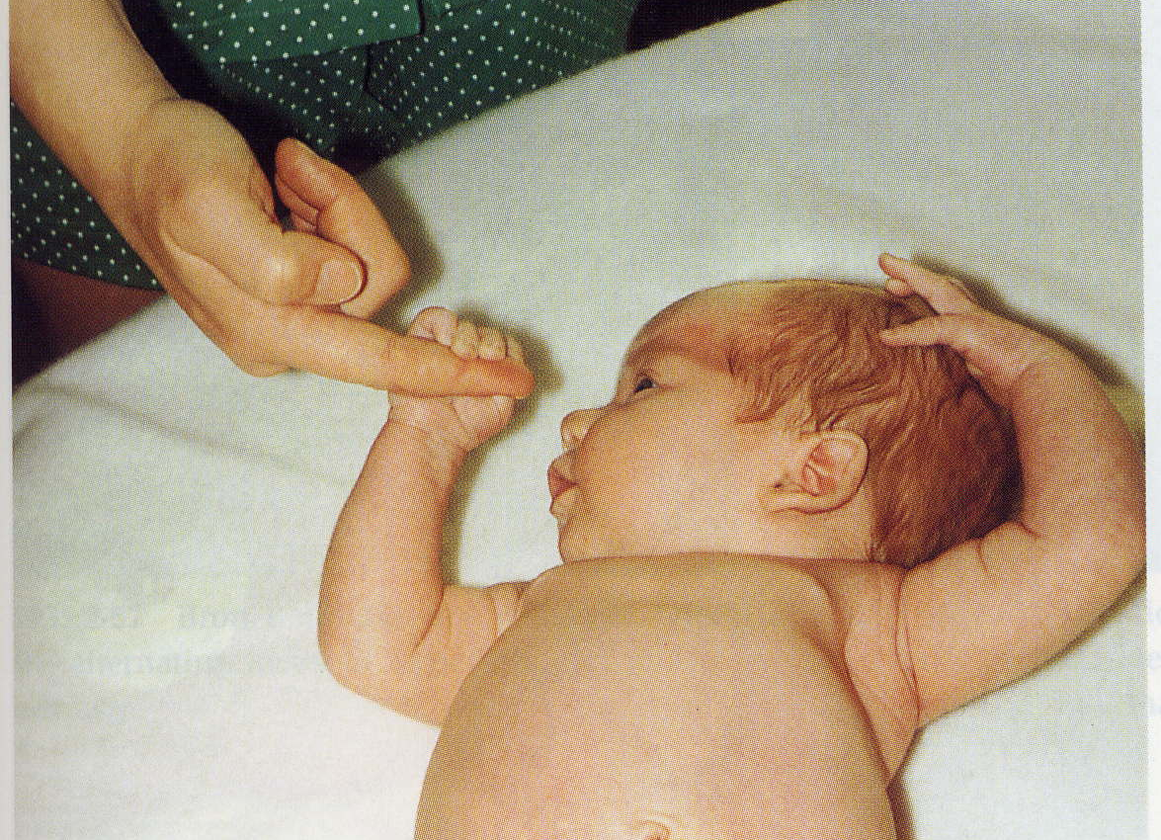
Grasp Reflex
Head positioned in mid-line, arms semi-flexed, stroke ulnar side of baby’s palm or fingers with examiner index finger. Flexion of all fingers to grasp.
Check for symmetry.
Disappears within 3-4 months.

Slide 56
Moro’s Reflex
Hold baby in supine, support back and pelvis with one hand, and arm and head with other hand. Allow the head to drop several cm with a sudden rapid movement.
OR
Baby in supine, produce a large noise, by striking examination table with hands on both side of baby’s head.
Notes:
Response to reflex:
Arms briskly abduct, and extend with hands open, fingers are extended and legs flex slightly and abduct less than arms. Arms then return over the body in a clasping manoeuvre with a simultaneous cry
Persistence beyond four months indicate neurological disease.
An asymmetrical response in upper extremities suggest hemi-paresis, injury to brachial plexus, or fracture of clavicle or humerus.
Absence of response in one or both legs indicate lower spinal injury and congenital dislocation of hip

Slide 57
Rooting Reflex
Disappear at three to four months.
Absence indicates severe/generalized CNS disorder.
How to elicit:
Baby’s head in midline, hands held against anterior chest, stroke with index finger the perioral skin at the corner of baby’s mouth and at the midline of upper and lower lips. Mouth will open and turn to simulated side
Notes:
How to elicit:
Baby’s head in midline, hands held against anterior chest, stroke with index finger the perioral skin at the corner of baby’s mouth and at the midline of upper and lower lips. Mouth will open and turn to simulated side.
When upper lip is stimulated, the head with extend and when the lower lip is stimulated the jaw will drop. Sometimes this reflex occurs when the infant’s cheek is stimulated some distance from corner of mouth.

Slide 58
Placing Reflex
Best elicited after first four days.
Disappears after one year.
Notes:
How to elicit:
Hold baby up right from behind by placing examiner’s hands under baby’s arm with your thumbs supporting the back of the head. Allow dorsal surface of one foot to touch or brush against the under surface of table top edge and is followed normally by simultaneous flexion of knees and hips and placement of foot on the table edge. The opposite leg steps forward and a series of alternate stepping movement occurs as you move the baby gently forward. This response is absent when paresis is present.

Slide 59
Sucking Reflex

Slide 60
Non-Primary Reflexes
Abdominal reflex
Absent in newborn but appear within six months.
Anal reflex
This is normally present in newborns
Absent reflex strongly suggests loss of innervation to external sphincter muscle due to spinal cord injury, spina bifida or tumour at lower sacral segment
Notes:
How to elicit anal reflex: Baby supine, straighten and raise lower legs. Stroke perianal region with paper clip. Observe external anal sphincter contraction.

Slide 61
Non-Primary Reflexes
Deep tendon reflex and planter response
These whether exaggerated or absent has little diagnostic significance as cortico-spinal pathways are not fully developed.

Slide 62
Sensory Examination
Sensory examination for neonate is rather limited
Threshold of touch, pain and temperature are higher in older children and reaction to these stimuli are relatively slow.
Notes:
.

Slide 63
Examination of The Newborn Infant
Comments? …
Please email them to:
kaltirkawi@ksu.edu.sa
Khalid Altirkawi, MD, FAAP
Assistant Professor, Pediatrics
King Saud University
2019

