Slide 1
Neuro Exam
Ali H Alwadei. MD, FRCPC, CSCN
Consultant, pediatric neurologist

Slide 2
Objectives
Organize Exam into the 6 Subsets of Function
Concept of Screening Examination
Understand Afferent and Efferent Pathways for Brainstem Reflexes
Differentiate Between Upper and Lower Motor Neuron Findings

Slide 3
Six Subsets of the Neuro Exam
Mental Status
Cranial nerves
Motor
Sensory
Coordination
Gait
* Always write or present the exam in this format regardless of the order in which the information is obtained

Slide 4
Concept of a Screening Exam
Screen each of the subsets. This allows one to check on the entire neuroaxis (Cortex, Subcortical White Matter, Basal Ganglia/Thalamus, Brainstem, Cerebellum, Spinal Cord, Peripheral Nerves, NMJ, and Muscles)
Expand evaluation of a given subset to either
Answer questions generated from the History
Confirm or refute expected or unexpected findings on Exam

Slide 5
The “Complete” Neuro Exam
This is never done given the amount of time and effort that it would take.
The Neurological Exam is Long and Redundant
Take advantage of this to confirm or refute abnormal findings

Slide 6
Mental Status
Level of Alertness
Subjective view of Examiner
Definition of Consciousness
Terminology for Depressed Level of Consciousness
Concept of Coma
Delirium
Degree of Orientation
To what?
“A and O x 3”

Slide 7
Mental Status
Concentration
Serial 7’s or 3’s
“WORLD” backwards
Months of the Year Backwards
Try to quantify degree of impairment
* A and O and Concentration need to be intact for other aspects of the Mental Status Exam to have localizing value!

Slide 8
Mental Status Memory
Immediate Recall
A task of concentration
Short-Term Memory
“3/3 objects after 5 minutes”
Long-Term Memory
Last thing to go

Slide 9
Mental Status Language
Aphasia vs Dysarthria
Receptive Language
Command Following
Expressive Language
Fluency
Word Finding
Repetition
Screens for Receptive, Expressive, and Conductive Aphasias

Slide 10
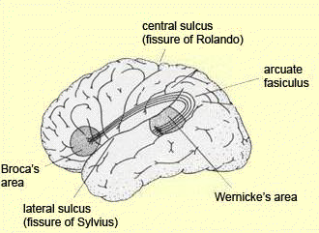
Language

Slide 11
Mental Status
Calculations, R-L confusion, finger agnosia, agraphia
Gerstmann’s Syndrome (Dominant Parietal Lobe)
Hemineglect
Non-Dominant Parietal Lobe
Delusional Thinking, Abstract Reasoning, Mood, Judgement, Fund of Knowledge, etc
Important for Psychiatry
Does not localize well to one region of the cortex
Neurocognitive Testing required to get at more specific deficits

Slide 12
Cranial Nerves Olfactory Nerve

Slide 13
Cranial Nerves Olfactory Nerve
Distinguish Coffee from Cinnamon
Smelling Salts irritate nasal mucosa and test V2 Trigemminal Sense
Disorders of Smell result from closed head injuries

Slide 14
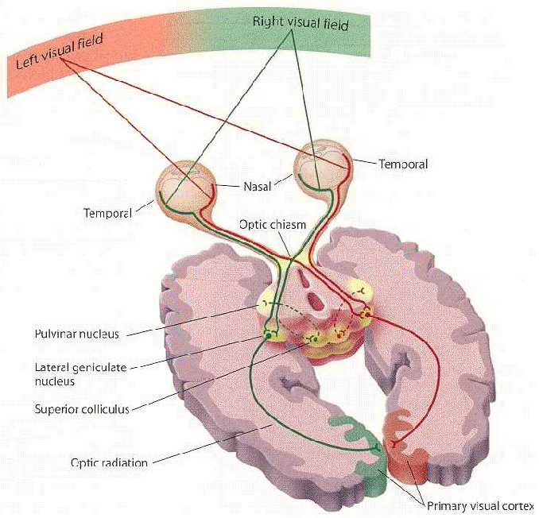
Cranial Nerves Optic Nerve Cranial nerve II

Slide 15
Cranial Nerves Optic Nerve
Visual Acuity
Visual Fields
Afferent input to Pupillary Light Reflex
APD
Look at the Nerve (Fundoscopic Exam)
“VA equals 20/20 OU at near”
“PEERLA”

Slide 16
Cranial Nerves
Abducens Nerve
Cn VI
Oculomotor Nerve
Cn III
Trochlear Nerve
c.n. IV

Slide 17
Cranial Nerves Cranial Nerves III, IV, VI
Extra-Ocular Muscles
Efferent limb of pupillary light reflex (III)
Edinger-Westphal nucleus in tegmentum of midbrain
Ptosis
Oculomotor Nerve Palsy
Part of Horner’s Syndrome
Cardinal Directions of Gaze
Efferent output for Oculocephalic Reflex
Look for Nystagmus
“EOMI without nystagmus”

Slide 18
Cranial Nerves Trigeminal Nerve C.N. V

Slide 19
Cranial Nerves Trigeminal Nerve
Motor Component
Opthalmic (V1), Maxillary (V2), and Mandibular (V3) Distributions
All modes of Primary Sensation Modalities can be tested
Afferent input for the Corneal Blink Reflex
“Facial sensation intact in all distributions”

Slide 20
Cranial Nerves Facial Nerve C.N. VII

Slide 21
Cranial Nerves Facial Nerve
Motor innervation to facial muscles
UMN versus LMN Facial Weakness
Efferent output to Corneal Blink Reflex
Other Functions
Parasympathetic input to lacrimal, sublingual, and submandibular glands, taste to anterior 2/3 of tongue, general sensation to concha of earlobe and small part of scalp, motor input to stapedius muscle
“Facial motor intact”

Slide 22
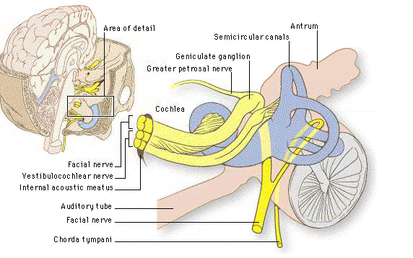
Cranial Nerves Vestibulocochlear Nerve C.N. VIII

Slide 23
Cranial Nerves Vestibulocochlear Nerve
Hearing and Balance
Patients will complain of tinnitus, hearing loss, and/or vertigo
Weber and Renee Test
Differentiates Conductive vs Sensorineural hearing loss
Afferent input to the Oculocephalic Reflex
Doll’s Eye Maneuver
Cold Calorics
Not “COWS”
“Hearing grossly intact AU”

Slide 24
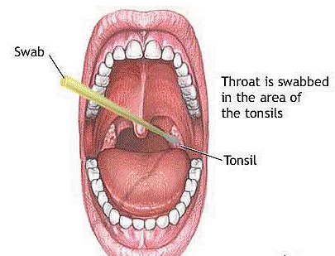
Cranial Nerves Glossopharyngeal and Vagus Nerves C.N’s IX and X

Slide 25
Cranial Nerves Glossopharyngeal and Vagus Nerves
Afferent (IX) and Efferent (X) components for the Gag Reflex
Vagus Nerve also does all parasympathetics from the neck down until the mid-transverse colon

Slide 26
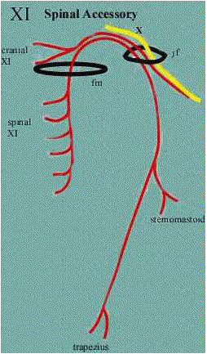
Cranial Nerves Spinal Accessory Nerve C.N. XI
Sternocleido-
Mastoid
strength
Trapezius
strength

Slide 27
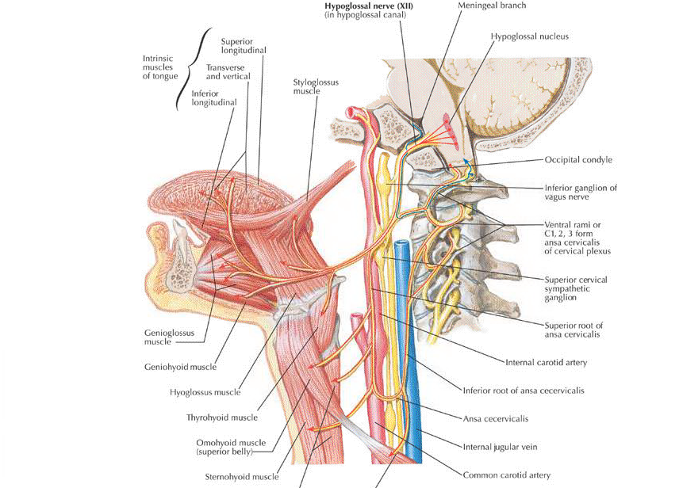
Cranial Nerves Hypoglossal Nerve C.N. XII

Slide 28
Cranial Nerves Hypoglossal Nerve
Protrudes the tongue to the opposite side
Tongue in cheek (strength)
Hemi-atrophy and fasiculations (LMN)

Slide 29
The Neurological Examination Motor Examination
Strength
Tone
DTR’s
Plantar Responses
Involuntary Movements

Slide 30
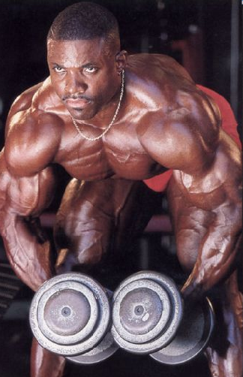
The Neurological Examination Motor Examination
Strength

Slide 31
The Neurological Examination Motor Examination
Strength
Medical Research Council Scale
5/5 = Full Strength
4/5 = Weakness with Resistance
3/5 = Can Overcome Gravity Only
2/5 = Can Move Limb without Gravity
1/5 = Can Activate Muscle without Moving Limb
0/5 = Cannot Activate Muscle

Slide 32
The Neurological Examination Motor Examination
Weakness
Describe the Distribution of Weakness
Upper Motor Neuron Pattern
Peripheral neuropathy Pattern
Myopathic Pattern

Slide 33
The Neurological Examination Motor Examination
 | Upper Motor Neuron | Lower Motor Neuron
Strength
Tone | Spasticity | Hypotonia
DTR’s | Brisk DTR’s | Diminished or Absent DTR’s
Plantar Responses | Upgoing Toes | Downgoing Toes
Atrophy/Fasiculations | None | +/-

Slide 34
The Neurological Examination Motor Examination
Tone
Tone is the resistance appreciated when moving a limb passively
“Normal Tone”
Hypotonia
“Central Hypotonia”
“Peripheral Hypotonia”
Increased Tone
Spasticity (Corticospinal Tract)
Rigidity (Basal Ganglia, Parkinson’s Disease)
Dystonia (Basal Ganglia)

Slide 35
The Neurological Examination Motor Examination
DTR’s
0/4 = Absent
1-2/4 = Normal Range
3/4 = Pathologically Brisk
4/4 = Clonus

Slide 36
The Neurological Examination Motor Examination
2
2+
2
3
4
4

Slide 37
The Neurological Examination Motor Examination
Involuntary Movements
Hyperkinetic Movements
Chorea
Athetosis
Tics
Myoclonus
Bradykinetic Movements
Parkinsonism (Bradykinesia, Rigidity, Postural Instability, Resting Tremor)
Dystonia

Slide 38
The Neurological Examination Sensory Examination
Primary Sensory Modalities
Light Touch (Multiple Pathways)
Pain/Temperature Sensation (Spinothalamic Tract)
Vibration/Position Sensation (Posterior Columns)
Cortical Sensory Modalities
Stereognosis
Graphesthesia
Two-Point Discrimination
Double Simultaneous Extinction

Slide 39
The Neurological Examination Sensory Examination
Primary Sensory Modalities
Reflect Input from sensory receptors, sensory nerves, spinal cord, brainstem, through to the level of the Thalamus.
Cortical Sensory Modalities
Reflect Processing by the Somatosensory Cortex (post-central gyrus)

Slide 40
The Neurological Examination Sensory Examination
Pain and Temperature
A-δ and small-unmyelinated fibres provide pain and temperature input which travels through the dorsal roots, then up and down a few segments in Lissauer’s tract then synapse with neurons in Lamina II (Substantia Gelatinosa)
Second-order neurons cross midline at the anterior commissure and travel up the lateral spinothalamic tract to synapse on VPL nucleus of Thalamus

Slide 41
The Neurological Examination Sensory Examination
Joint Position and Vibration
Larger myelinated A-α and A-β fibres bring sensory information concerning vibration and joint position sense up through the Fasiculus Gracilis (legs) and Fasiculus Cuneatus (arms) to synapse on the ipsilateral Nucleus Gracilis and Cuneatus respectively.
Second-order neurons cross at the medial lemniscus to synapse on VPL nucleus of the Thalamus

Slide 42
The Neurological Examination Sensory Examination

Slide 43
The Neurological Examination Sensory Examination
Pain and Temperature
Pinprick (One pin per patient!)
Sensation of Cold
Look for Sensory Nerve or
Dermatomal Distribution
Vibration Sensation
C-128 Hz Tuning Fork (check great toe)
Joint Position Sensation
Check great toe
Romberg Sign

Slide 44
The Neurological Examination Sensory Examination
Higher Cortical Sensory Function
Graphesthesia
Stereognosis
Two-Point Discrimination
Double Simultaneous Extinction
Gerstmann’s Syndrome (acalculia, right-left confusion, finger agnosia, agraphia)
Usually seen in Dominant Parietal Lobe lesions

Slide 45
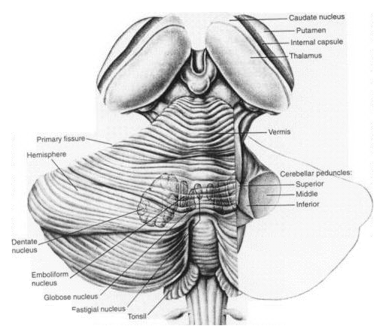
The Neurological Examination Coordination
Outputs
Inputs
Cerebellum

Slide 46
The Neurological Examination Coordination
Hemisphere Dysfunction
Dysmetria on Finger-Nose-Finger Testing*
Irregularly-Irregular Tapping Rhythm*
Dysdiadochokinesis*
Impaired Check*
Hypotonia*
Impaired Heel-Knee-Shin*
Falls to Side of Lesion*
Nystagmus (Variable Directions)
* All Deficits are Ipsilateral to the side of the lesion

Slide 47
The Neurological Examination Coordination
Midline Dysfunction
Truncal Ataxia
Titubation
Ataxic Speech
Gait Ataxia
Acute Ataxia (unsteady Gait)
Chronic Ataxia (wide-based, steady Gait)

Slide 48
The Neurological Examination Gait
A normal Gait requires multiple levels of the neuroaxis to be intact
Vision
Strength
Balance/Coordination
Joint Position

Slide 49
The Neurological Examination Gait
Observe Different Aspects of Gait
Arm Swing
Base of Gait
Heel Strike
Time Spent on Each Leg
Posture of Trunk
Toe Walking
Heel Walking
Tandem Walking

Slide 50
The Neurological Examination Gait
Classical Patterns of Abnormal Gait
Parkinsonism Gait
Hemiparetic Gait
Spastic Diplegia Gait
Acute Ataxia Gait
Chronic Ataxia Gait
Waddling Gait (Hip Girdle Weakness)
High Stepping Gait

Slide 51
The Neurological Examination
Questions?

