Slide 1

Approach to Child with Lymphadenopathy

Slide 2
Outline
Introduction
Anatomy
Pathophysiology
Generalized lymphadenopathy
Regional lymphadenopathy
Investigation
Management

Slide 3
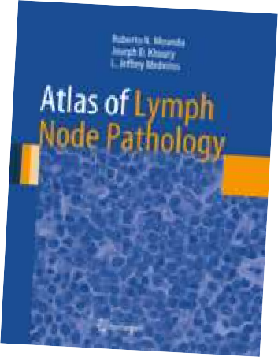
Introduction
Lymphatic system
  Network of organs, lymph nodes, lymph ducts and lymph vessel that make and drain lymph from tissues to the bloodstream.
  This lymphoid tissue concerned with immune function in defending body
against antigen.
Primary lymphoid organ (thymus & bone marrow)
Secondary lymphoid organ (lymph nodes, tonsil & others)
Lymphoid tissue enlarges until puberty & progressively atrophy throughout life
Functions
  Removal of interstitial fluid from tissues, collection of lymph plasma
  Absorption & transport of fatty acids and fats
  Formation of a defense mechanism for the body

Slide 4
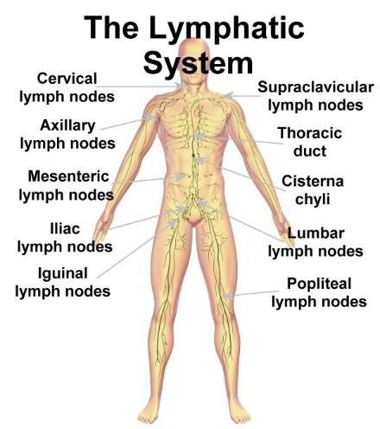
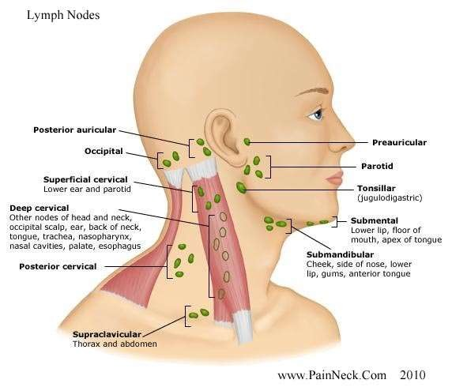
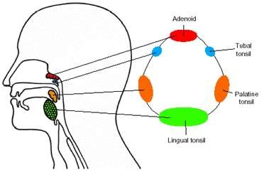
Groups of Lymph Nodes

Slide 5
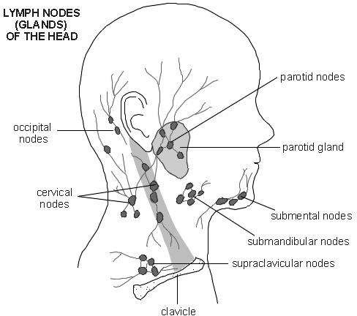
Lymphadenopathy
Enlargement of lymph node
Normal lymph nodes are discrete, non tender, and mobile without fixation to underlying tissues.
Significant enlarged:
  >1 cm in cervical and axillary,
  >1.5cm in inguinal nodes

Slide 6
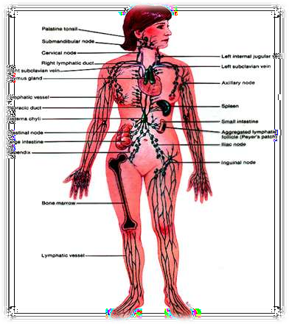
Pathophysiology
Localized response from lymphocyte and macrophage – viral/ bacterial infection
Localized infiltration by inflammatory cells in response to infection of nodes- lymphadenitis
Proliferation of neoplastic lymphocyte or macrophages- neoplasm

Slide 7
Lymphadenopathy
Generalized lymphadenopathy (enlargement of >2 noncontiguous node regions) is caused by systemic disease
Regional lymphadenopathy is most frequently the result of infection in the involved node and/or its drainage area

Slide 8
Generalized adenopathy
Infant: Syphilis, Toxoplasmosis, CMV, HIV
Infective
Child: Viral infection, EBV, CMV, Toxoplasmosis
Inflammation
Autoimmune
Child: SLE, JRA, Sarcoidosis, Fungal infection, Plaque, Chronic granulomatous disease
Generalized
Primary
Malignancy
Secondary

Slide 9
Generalized
enlargement of more than 2 noncontiguous lymph node groups
Infectious
Viral (most common): URTI, measles, varicella, rubella, hepatitis, HIV, EBV, CMV, adenovirus
Bacterial: syphilis, brucellosis, tuberculosis, typhoid fever, septicemia
Fungal: histoplasmosis, coccidioidomycosis
Protozoal: toxoplasmosis
Non-infectious inflammatory diseases
Rheumatologic diseases: Sarcoidosis, rheumatoid arthritis, SLE
Storage diseases: Neimenn-Pick disease, Gaucher disease
Serum sickness
Rosai-Dorfman disease
Malignant: leukemia, lymphoma, neuroblastoma
Drug reaction: phenytoin, allopurinol
Hyperthyroidism

Slide 10
Infectious Mononucleosis (Glandular Fever)
Caused by Epstein Barr Virus
Signs/Symptoms
  Prolong fever
  Exudative pharyngitis
  Painless generalized lymphadenopathy
  Splenomegaly
Diagnosis
o 50% lymphocytosis with >10% Atypical lymphocytes on peripheral blood smear
Positive monospot test (Paul Bunnell test)
Serum heterophile Antibody definitive (positive at 2-6weeks)
Complication: splenic rupture, respiratory obstruction, encephalitis, lymphoma
Treatment
o Mainly supportive
Tonsillar hypertrophy → produce airway obstruction: need to place nasopharyngeal tube and start high dose steroids
Do not give amoxicillin → develop an iatrogenic rash in 80% of patients.

Slide 11
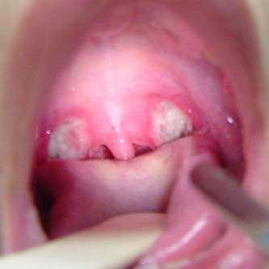
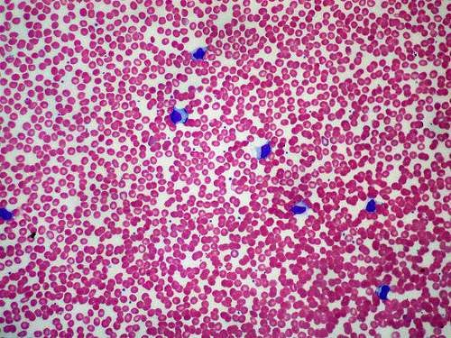
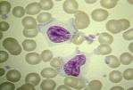
Infectious Mononucleosis Findings

Slide 12
Cytomegalovirus
From Herpesviridae family
Infectious mononucleosis like syndrome
CF: fatigue, malaise, myalgia, headache, fever, hepatosplenomegaly, elevated liver enzymes
Ix: atypical lymphocytosis in peripheral blood smear, CMV DNA PCR
Tx: not indicated for immunocompetent persons

Slide 13
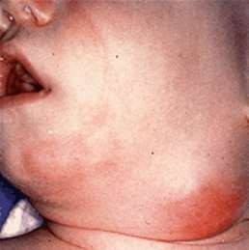
Suppurative Bacterial Lymphadenitis
Staphylococcus aureus and Group A Streptococcus
Common history reveals recent
  URI
  Earache
  Sore Throat/Toothache
  Skin Lesions: erythema and tender of overlying skin
Tx: Oral or IV antibiotics depending on severity of
infection
If not resolving or getting worse Ultrasound or CT scan to evaluate for phlegmon/abscess
Surgical I&D vs Surgical Excision if abscess

Slide 14
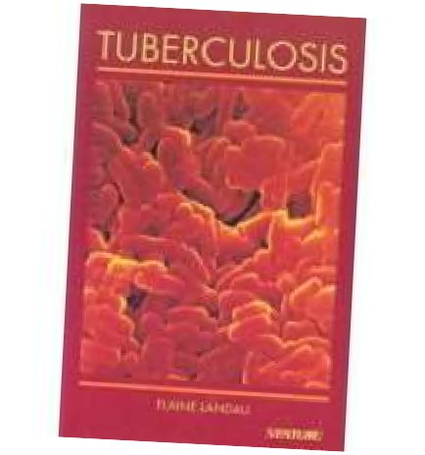
TB Lymphadenitis
Most commonest form of extrapulmonary manifestation of TB in children
Tonsillar, anterior cervical, submandibular, and supraclavicular nodes secondary to extension of the primary lesion of TB (lung/abdomen)
Inguinal, epitrochlear, or axillary regions result from regional lymphadenitis associated with tuberculosis of the skin or skeletal system.
Characteristic: firm, discrete and nontender – often feel fixed to overlying tissue→ disease progress, multiple node infected (matted)
Unilateral
Reactive tuberculin test
Dx: fine – needle aspiration of node (through histologic and bacterial conformation)
Response well to anti – TB therapy

Slide 15
Syphilis
Treponema pallidum
Vertical transmission, sexual contact with infectious lesion, blood product
4 stages: primary, secondary, latent and tertiary
Primary:
  glands of penis, vulva or cervix
  Other: anus, fingers, oropharynx, tongue
  Regional lymphadenopathy
2nd: localized or diffuse mucocutaneous rash, patch alopecia condylomata with generalized non tender lymphadenopathy
3rd: CNS involvement or CVS
Ix: VDRL
Tx: IM Benzathine Penincillin

Slide 16
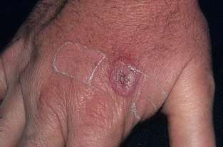
Cat Scratch Disease
Bartonella Henselae
o Commonest cause of chronic lymphadenitis
90% have had exposure to cat bite or scratch
  CF: Red papules over scratch area + lymphadenopathy
  Nodes involved: tender, overlying erythema, enlarged, (10-40%) suppurative
  Axillary nodes are most frequently affected, followed by cervical, submandibular, and preauricular nodes.
Diagnosis with serology for antibodies or PCR
Management: supportive
**Other less common zoonotic causes are tularemia, brucellosis, and anthracosis.

Slide 17
Toxoplasmosis
Toxoplasma gondii
Mechanism
  Consumption of undercooked meat
  Ingestion of oocytes from cat feces
Symptoms
  Malaise, fever, sore throat, myalgias
  90% have cervical lymphadenitis
Diagnosis by serologic testing
Complications
  myocarditis
  pneumonitis
Risk of TORCH infection to fetus
Treatment with pyrimethamine or sulfonamides

Slide 18

Storage diseases
Gaucher disease
multisystemic lipidosis characterized by hematologic problems, hepatosplenomegaly, and skeletal involvement
results from the deficient activity of the lysosomal hydrolase, acid β-glucosidase
CFx:
  easily bruising owing to thrombocytopenia
  chronic fatigue secondary to anemia
  hepatomegaly with or without elevated liver function test results
  splenomegaly
  bone pain
Niemann-Pick disease
3 types:
  Type A & B deficient activity of acid sphingomyelinase
  Type C is defective cholesterol transport
Characterized by a normal appearance at birth. Hepatosplenomegaly, moderate lymphadenopathy, and psychomotor retardation are evident by 6 mo of age, followed by neurodevelopmental regression.
With advancing age, the loss of motor function and the deterioration of intellectual capabilities are progressively debilitating; and in later stages, spasticity and rigidity are evident.
Affected infants lose contact with their environment - DEATH

Slide 19
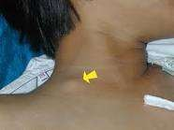
Localized
enlargement of a single node or multiple contiguous nodal regions
a) Cervical (most common adenopathy in children, often INFECTIOUS cause):
Infectious
 Viral upper respiratory infection
 Infectious mononucleosis (EBV, CMV)
 Group A Streptococcal pharyngitis
 Acute bacterial lymphadenitis (eg: Staphylococcus aureus)
 Kawasaki disease (unilateral cervical lymph node > 1.5 cm)
 Rubella
 Cat scratch disease
 Toxoplasmosis
 Tuberculosis, atypical mycobacteria
Neoplastic (malignant childhood tumours develop in the head and neck in ¼ of
cases)
Neuroblastoma, Leukemia, non-Hodgkins, and Rhabdomyosarcoma are most common in those < 6 years old.
In older children, Hodgkin’s and non-Hodgkin’s lymphoma are more common.
  Acute leukemia, Neuroblastoma, Rhabdomyosarcoma

Slide 20
Localized
enlargement of a single node or multiple contiguous nodal regions
Cervical (most common adenopathy in children, often INFECTIOUS cause):
Infectious
  Viral upper respiratory infection
  Infectious mononucleosis (EBV, CMV)
  Group A Streptococcal pharyngitis
  Acute bacterial lymphadenitis (eg: Staphylococcus aureus)
  Kawasaki disease (unilateral cervical lymph node > 1.5 cm)
  Rubella
  Cat scratch disease
  Toxoplasmosis
  Tuberculosis, atypical mycobacteria
Neoplastic (malignant childhood tumours develop in the head and neck in ¼ of cases)
  Neuroblastoma, Leukemia, non-Hodgkins, and Rhabdomyosarcoma are most common in
those < 6 years old.
  In older children, Hodgkin’s and non-Hodgkin’s lymphoma are more common.
    Acute leukemia, Neuroblastoma, Rhabdomyosarcoma

Slide 21
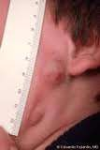
Differential Diagnosis
Submaxillary and submental
Oral and dental infections
Acute lymphadenitis
Pediculosis capitis (lice)
Tinea capitis/local skin infection
Rubella
Roseola
Occipital
Preauricular (rarely palpable in children)
Local skin infection
Chronic ophthalmic infection

Slide 22
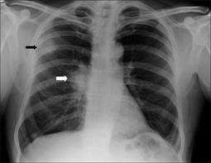
Differential Diagnosis
Mediastinal (not directly palpable; assess indirectly via presence of supraclavicular adenopathy.
May manifest as cough, dysphagia, hemoptysis, or SVC syndrome
  ALL
  Lymphoma
  Sarcoidosis
  Cystic fibrosis
  Granulomatous disease (tuberculosis, histoplasmosis, coccidioidomycosis)

Slide 23
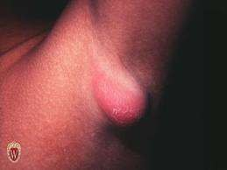

Local infection
Cat scratch disease
Brucellosis
Reactions to immunizations
Non Hodgkin lymphoma
Juvenile rheumatoid
arthritis
Hidradenitis suppurativa
Axillary

Slide 24
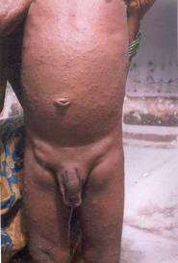
Differential Diagnosis
(may manifest as abdominal pain, backache, urinary frequency, constipation, or intestinal obstruction due to intussuception)
Acute mesenteric adenitis
Lymphoma
Abdominal
Local infection
Diaper dermatitis
Syphilis
Genital herpes
Inguinal

Slide 25
History
Characteristic of LN: onset, size, duration, is it painful or erythematous? Generalized or local? Associated symptom?
Recent infection? URT symptom? Rashes? Changes in bowel movement or voiding patterns? Bone and joint pain?
Constitutional sx? Fever, night sweat, weight loss?
Skin lesion or trauma? Cat scratch? Animal/ insect
bites? Open wounds? Dental abscess?

Slide 26
History
Any ongoing medical condition? Surgery?
Recent travel and exposures? Contact with infected person? Viral respiratory exposures such as EBV/ CMV? TB exposure?
Immunization status? MMR? DTaP?
Medication? Isnoniazide, Allopurinol, Phenylbutazone, Pyrimethamine? Carbemazepine or phenytoin?
Allergies
Adolescence: IVDU or sexual history
Cats: Toxoplasmosis and Bartonella
Foods: Unpasteurized milk (Brucellosis), Undercooked meats (Toxoplasmosis, Tularemia)

Slide 27
Kawasaki Disease
Lymphomucocutaneous Disease
Five Characteristics of Disease (4/5 for diagnosis)
 Fever >5 days
 Cervical lymphadenopathy (usually unilateral)
 Erythema and edema of palms and soles with desquamation of skin
 Nonpurulent Bilateral Conjunctivitis
 Strawberry Tongue
Complications
 Coronary artery aneurysms
 Coronary artery thromboses
 Myocardial infarction
Treatment
o IVIG and Aspirin
**Be sure to get Echo and EKG is Kawasaki disease is suspected

Slide 28

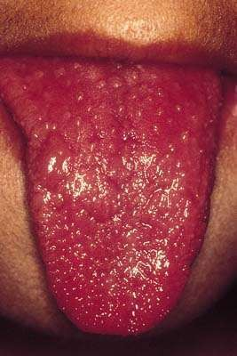
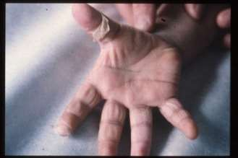
Systemic Manifestations of Kawasaki Disease

Slide 29
Investigations
Complete blood count, peripheral blood smear
Erythrocyte sedimentation rate (non-specific)
Rule out infectious causes: Monospot, CMV, EBV, & toxoplasma, Bartonella titres, TB skin test, Anti-HIV test, CRP, ESR
Hepatic and renal function + urinalysis (systemic disorders that can cause lymphadenopathy)
Lactate dehydrogenase, uric acid, calcium, phosphate, magnesium if malignancy suspected
US guided lymph node biopsy

Slide 30
Imaging Studies
Chest X-ray. This study will help determine the presence of mediastinal adenopathy and underlying pulmonary diseases including tuberculosis, coccidioidomycosis, lymphomas, and neuroblastoma.
CT of the chest and/or abdomen. Supraclavicular adenopathy is highly associated with serious disease in the chest and abdomen.
Bone marrow, liver biopsies,
Nuclear medicine scanning is helpful in the evaluation of
lymphomas.

Slide 31
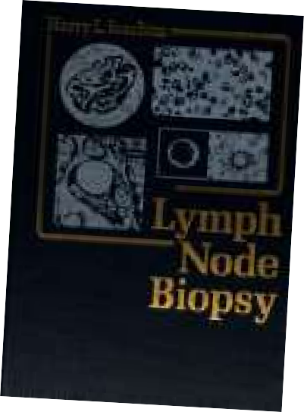
Biopsy indications
1. + constitutional sx
Very large LN
Persistent growing > 2 wk
Constant for 6 wks
Fixed lymph nodes
Non responsive after 2 course of antibiotic therapy

Slide 32
Management
Treatment with antibiotics. Bacterial infection results in large nodes that are warm, erythematous, and tender. Start on antibiotics that cover the bacterial pathogens frequently implicated in lymphadenitis, including staphylococcus aureus and streptococcus pyogenes. Reevaluate in 2-4 weeks. Biopsy if unchanged or larger.
If malignancy is a strong possibility excisional biopsy should be considered immediately.
If lymphadenitis is present, aspirate may be needed for culture.

Slide 33
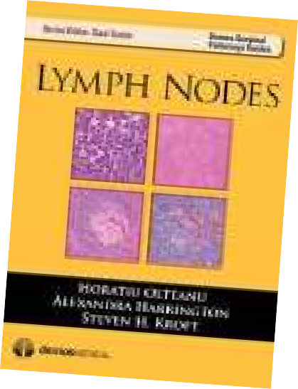
Management
Treat the underlying cause.
If no specific cause – Antibiotic (10day course), if still persist- give another course of other antibiotic
Antifungal, anti-TB
Chemotherapy- for malignancy
HAART- for HIV
Incision & drainage – nodes with suppuration

Slide 34
Conclusion
In summary, lymphadenopathy is a sign of a variety of underlying disorders, most of which are benign in children.
Less commonly, there is a more serious cause of lymphadenopathy and thus it is extremely important to think of and rule out malignancy through a thorough history and physical exam.

Slide 35
Viral Lymphadenitis
Most common form of reactive lymphadenopathy
Common virus’ involved:
  Adenovirus
  Rhinovirus
  Coxsackie virus A and B
  EBV
Lymphadenopathy often bilateral, diffuse, non-tender
Other Signs/Symptoms are consistent with URI
Management is expectant but they are often biopsied due to slow regression
Nodal architecture and hilar vascularity are normal on pathologic
examination

