Slide 1
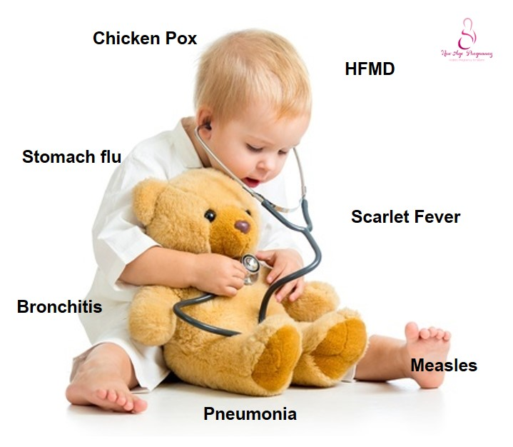
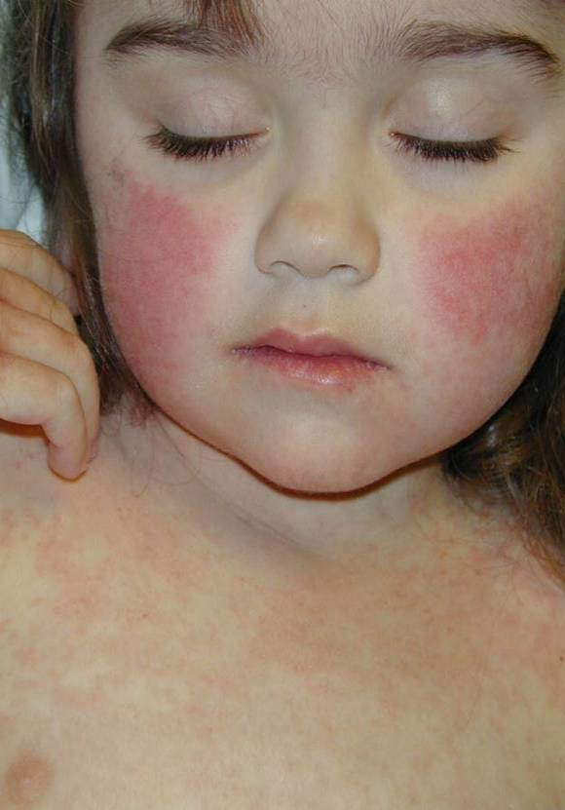
Common Childhood Infectious Diseases
Dr. Sarah Alsubaie
Associate Professor & Consultant
Pediatric Infectious Diseases and Infection Control
King Saud University Medical City
King Saud University

Slide 2
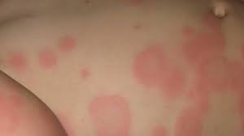
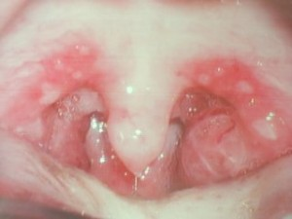
Definitions
Exanthem: A skin eruption occurring as a symptom
of a general disease.
Enanthem: Eruptive lesions on the mucous mb

Slide 3
Causes of fever and rash

Slide 4
Classic Childhood Exanthems
Measles (Rubeola)
Scarlet Fever
Rubella (German measles)
Erythema Infectiosum (fifith disease, Parvovirus B19)
Roseola Infantum

Slide 5
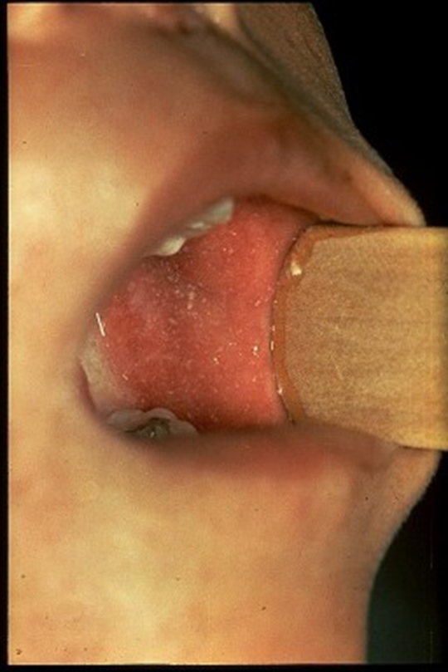
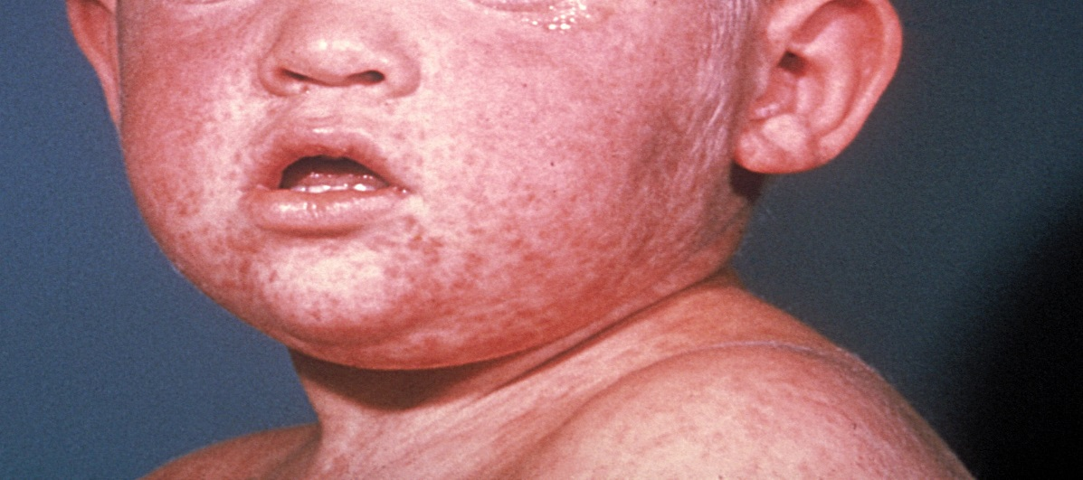
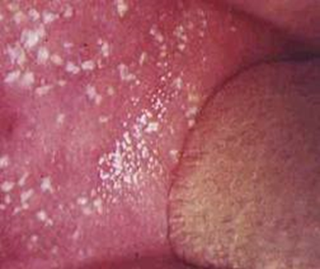

Slide 6
Measles
•Paramyxovirus
•At risk: children who are not yet vaccinated or
who miss vaccination
•Incubation period: 10-14 days
•Infectious period: 1-2d before prodrome to 4 days after onset of rash

Slide 7
Measles clinical features

Slide 8
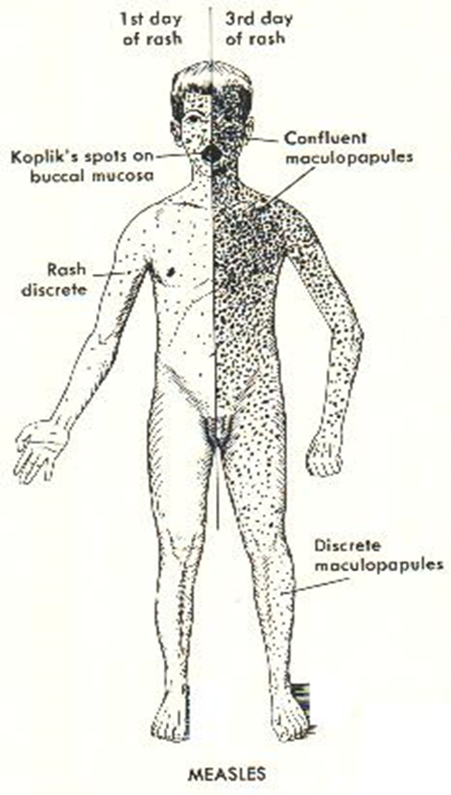

Slide 9
Symptoms
Prodrome: day 7-11 after exposure
- Fever, cough, coryza, conjunctivitis
- Enanthem: Koplik’s spots appear 2 days before
the rash, last 2 days into the rash
rash spread downwards from face
Highly contagious
Treatment: symptomatic, Vitamin A
Prevention 2 doses of measles vaccine
Immunize susceptible contacts, Immune globulin

Slide 10
Measles: complications
•Otitis media
•Bronchopneumonia
•Encephalitis
•Myocarditis
•Pericarditis
•Subacute sclerosing panencephalitis SSPE—late sequelae due to persistent infx of the CNS

Slide 11
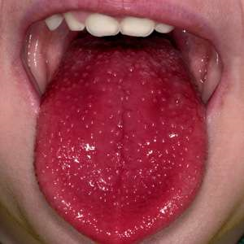

Slide 12
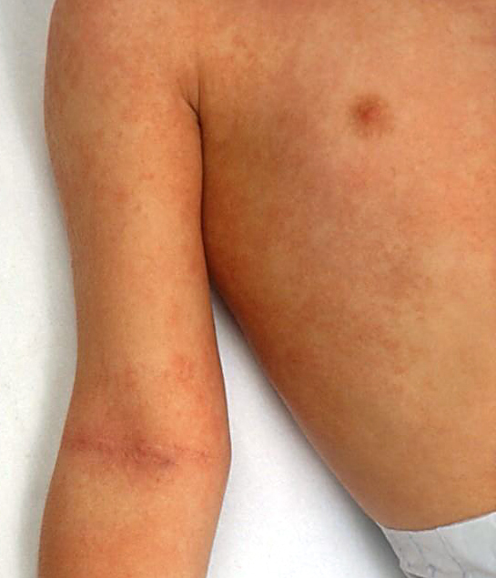
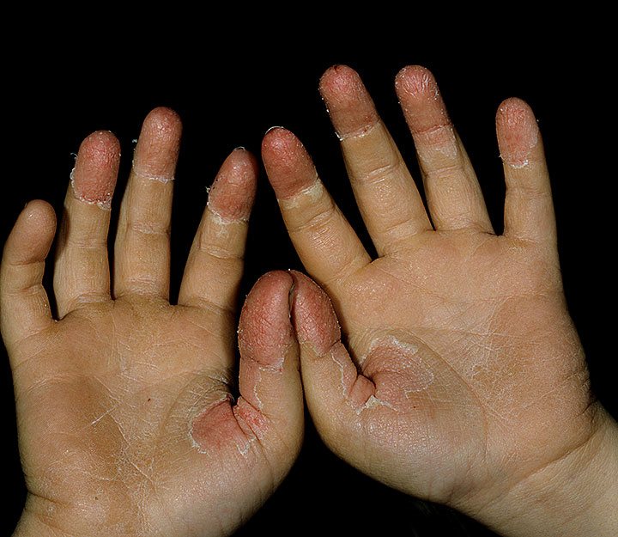
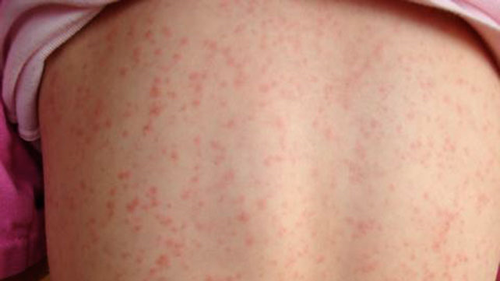
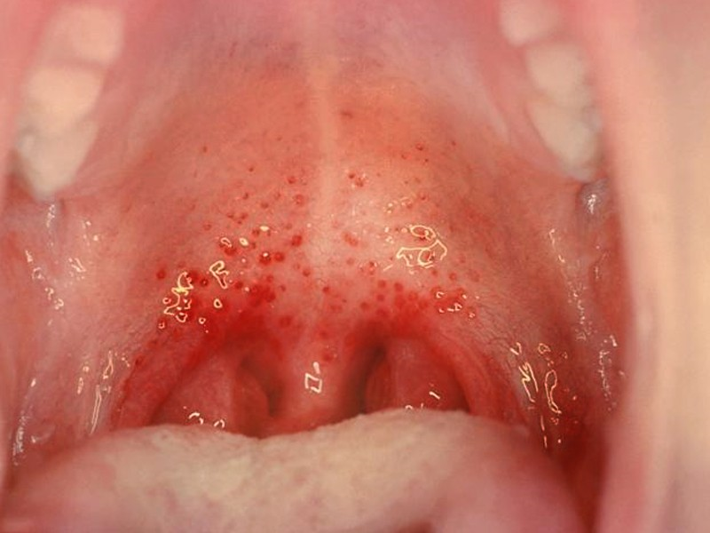

Slide 13
Scarlet Fever
•Due to erythrogenic exotoxin-producing
Group A beta-hemolytic streptococci
•Peak age: 4-8 yr
•Incubation period: 2-5 days

Slide 14
Scarlet Fever
Abrupt onset fever, headache, vomiting, malaise, sore throat
Bright red oral mucosa
Palatal petechiae
Tongue change

Slide 15
  Rash appears 1-2 days after the onset of illness
  Described as "sandpapery" in quality
  Can last for over a week
  As the rash fades, peeling (desquamation) may occur (finger tips, toes, and groin area)
Treatment: penicillin
or erythromycin if there is penicillin allergy
for 10 days

Slide 16
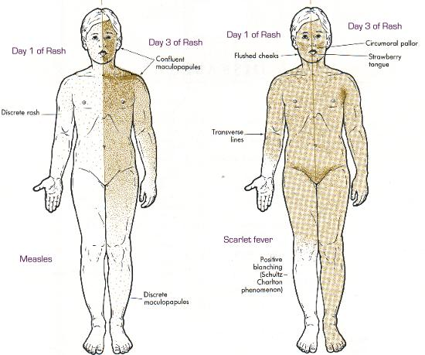
Measles versus Scarlet fever

Slide 17
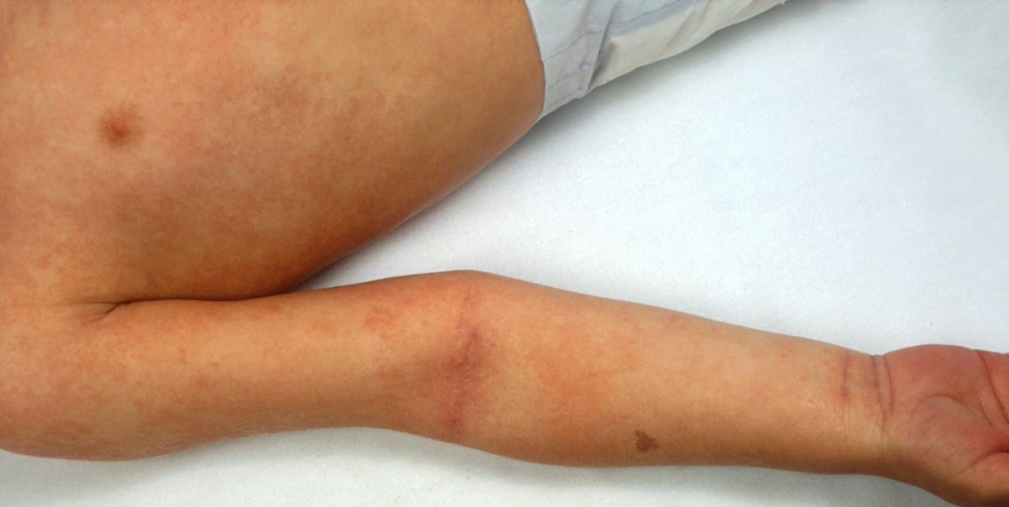
Pastia lines

Slide 18
Scarlet Fever: complications
Purulent complications:
Otitismedia
Sinusitis
Peritonsillar/retro-pharyngeal abscesses
Cervical adenitis
Nonsuppurative sequalae:
Rheumatic fever
Acute glomerulonephritis

Slide 19
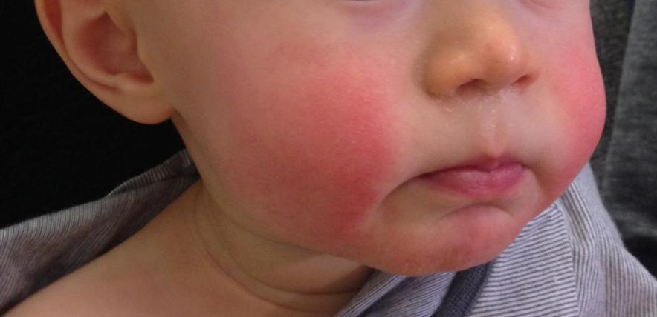

Slide 20
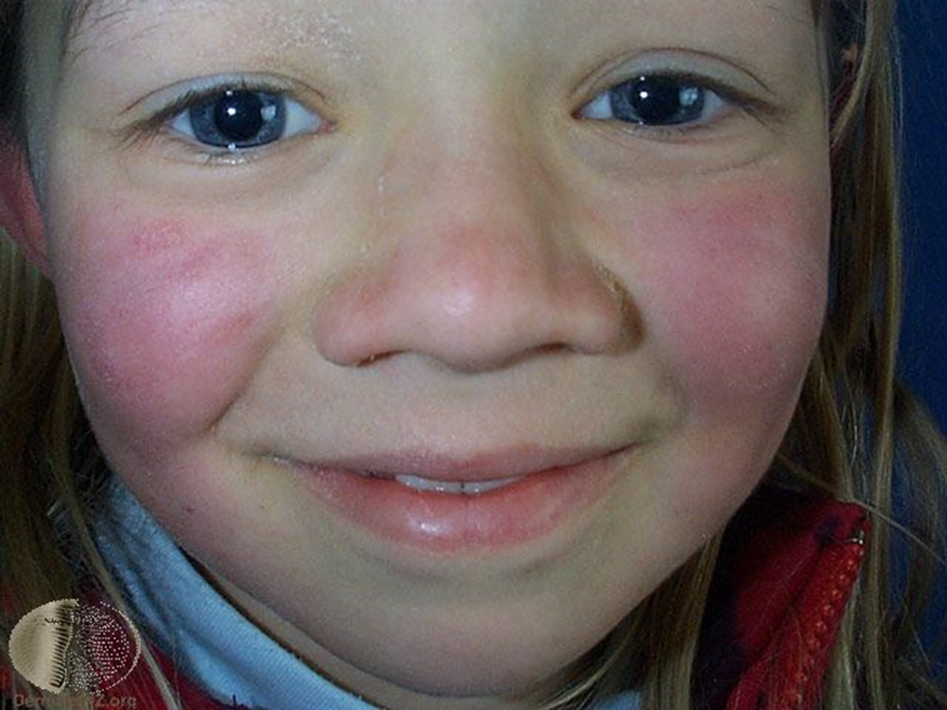
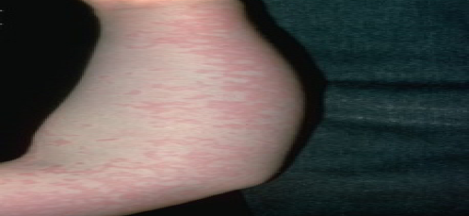

Slide 21
Fifth Disease Erythema Infectiosum
(Human Parvovirus)
Raised, red, warm rash, first appearing on cheeks
(slapped cheek appearance).
After 1 - 4 days, a lace-like rash spreads to the rest
of the body.
Infectiousness greatest before onset of the rash and not after the rash.
Control In school outbreaks, alert pregnant staff.
In pts hemolytic anaemia (e.g SCA)
Treatment: supportive

Slide 22
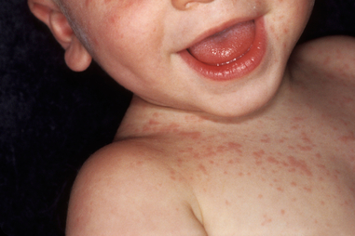
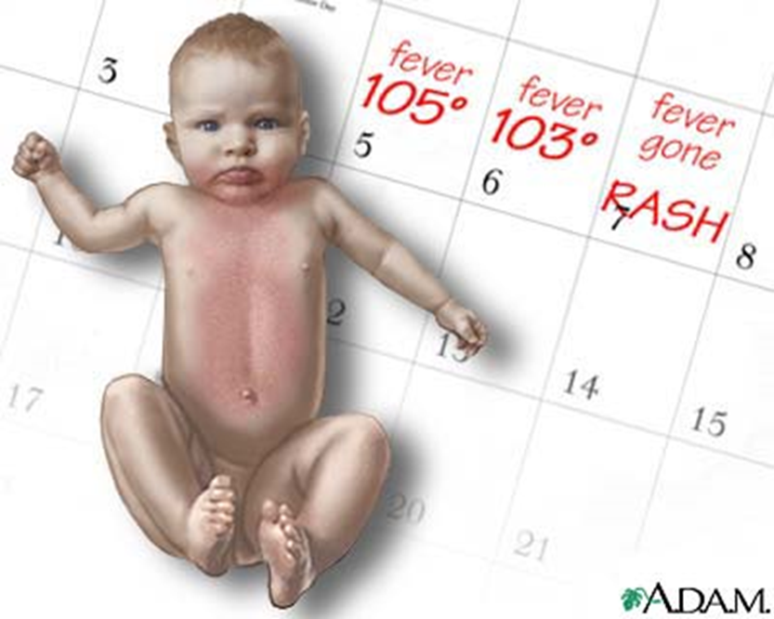
Roseola infantum (exanthema subitum)
Human Herpesvirus-6

Slide 23
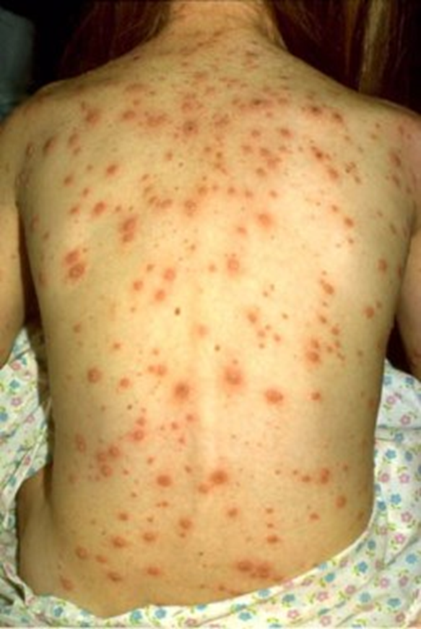
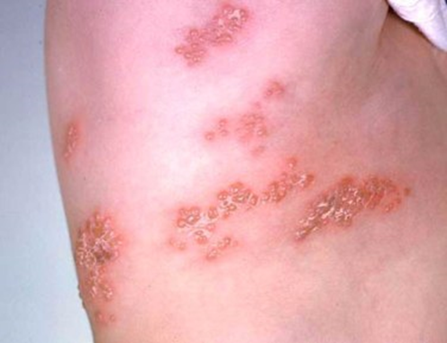

Slide 24
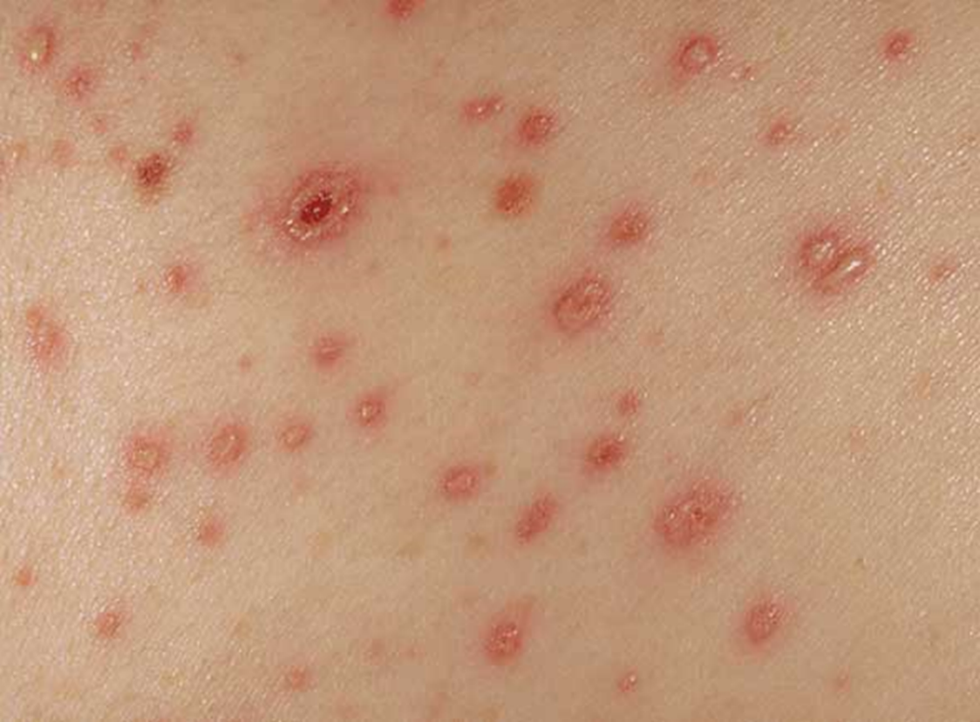

Slide 25
Chicken Pox (Varicella)
DNA Virus
Incubation Period: 10 – 21 days
Very contagious; can be spread by direct contact, airborne transmission
Infectivity: 1-2 days before rash till all skin lesions have crusted (~ 6th day of rash)
Vaccine

Slide 26
Varicella

Slide 27
Complications
Secondary infection of the blisters may occur
pneumonia, myocarditis
Cerebellar ataxia may appear during the recovery phase or later
Encephalitis (rare)
Congenital infection
Newborns are at risk for severe infection (if mother is not immune)
Disseminated dis: immunocompromised
Treatment: Acyclovir

Slide 28
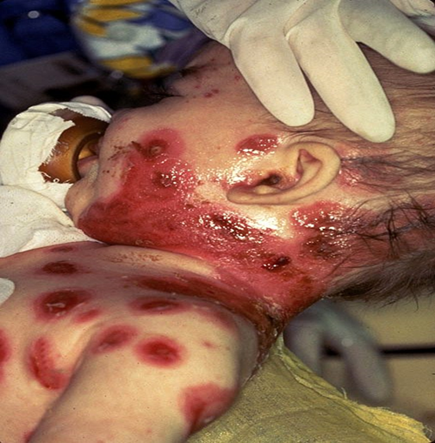
Neonatal varicella with secondary bacterial infection

Slide 29
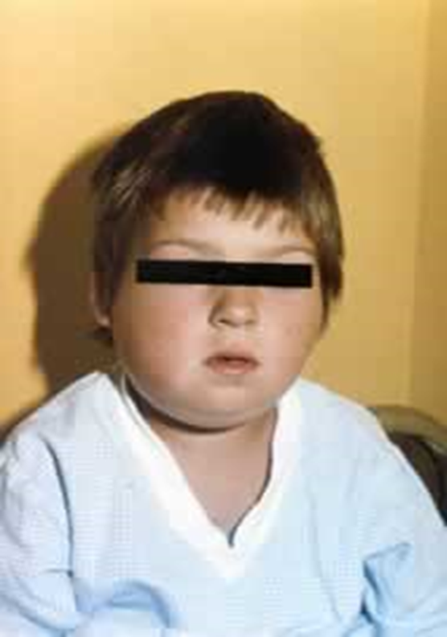
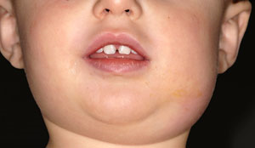

Slide 30
Mumps
RNA Virus
Incubation Period: 15 – 24 days
Clinical Features: fever, parotitis, may be subclinical
Complications: meningitis, encephalitis, orchitis
Treatment
Isolation & Infectivity: 7 days after onset of parotid swelling.
Vaccine

Slide 31
Rubella
RNA Virus
Incubation Period: 15 – 20 days
Spread by respiratory droplet.
generally a mild disease in childhood, Lymphadenopathy particularly the occipital and postauricular nodes, is prominent, arthralgia and arthritis.
Serious in pregnancy: cong. infection
Treatment
Isolation & Infectivity: 7 days from onset of rash
  Congenital Rubella: until 1 year of age
Vaccine

Slide 32
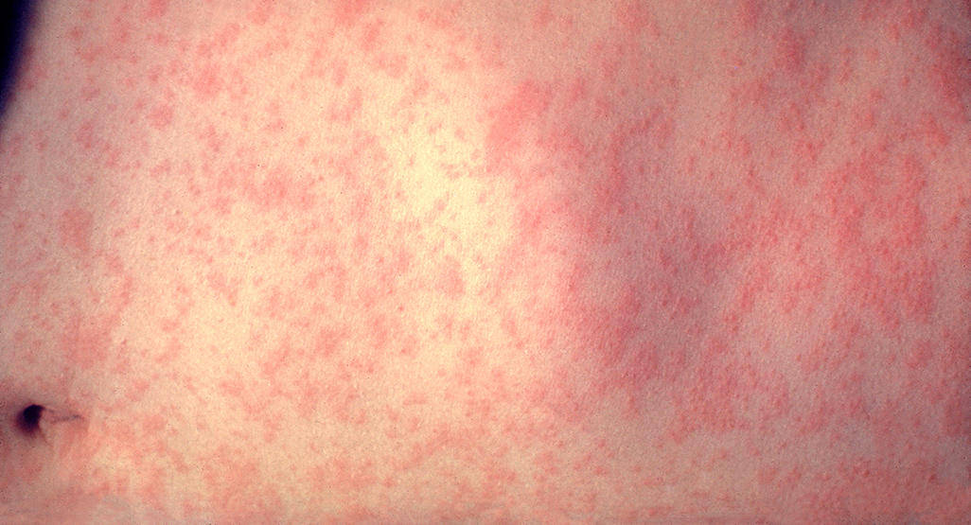

Slide 33
Congenital rubella syndrome
Infection of seronegative mother during pregnancy
Risk of fetal infection
First trimester : 75-90%

Slide 34
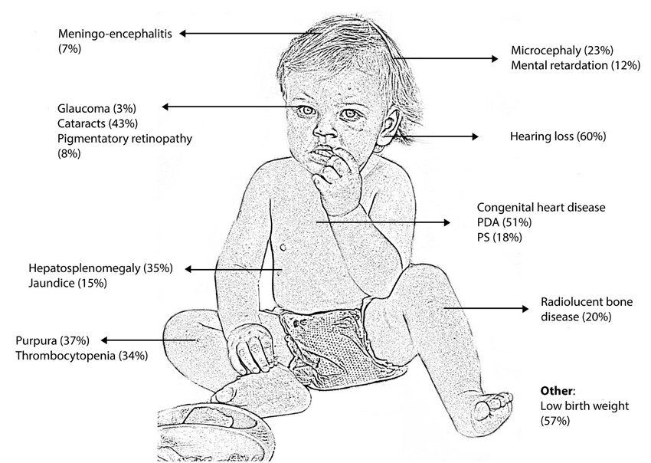

Slide 35
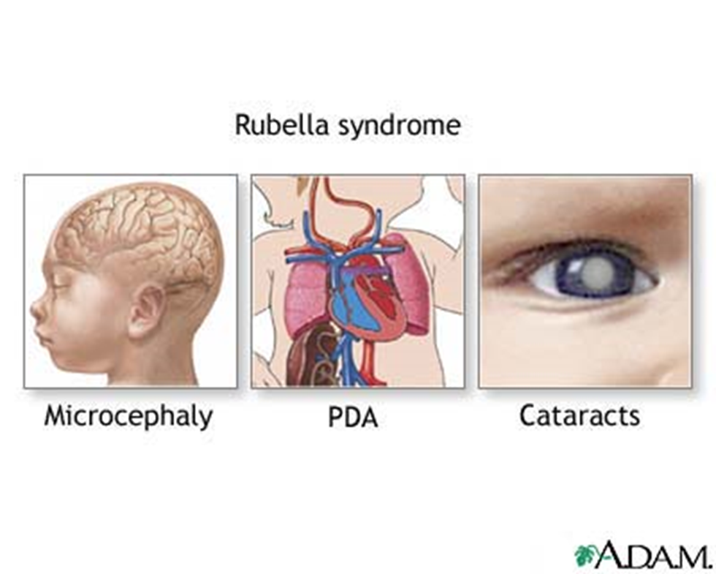
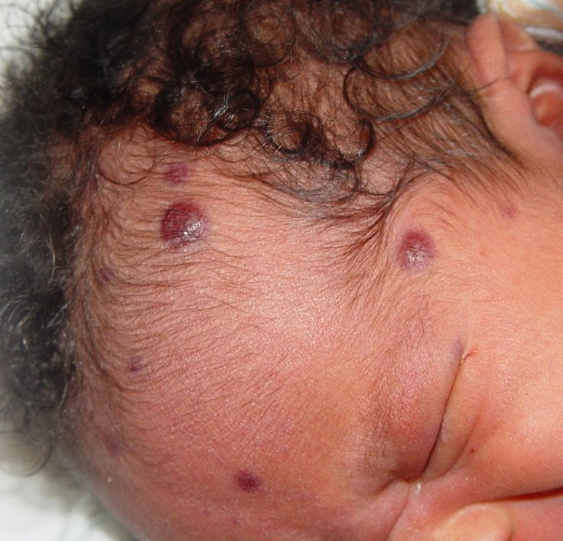

Slide 36
MCQ
14-year-old girl,unvaccinated, presented with sore throat, low-grade fever,
and a diffuse maculopapular rash. During the next 24 hours, she develops
tender swelling of her wrists. In addition, her physician notes mild tenderness and marked swelling of her posterior cervical and occipital lymph nodes. Four days after the onset of her illness, the rash has vanished. Which of the following is the most likely diagnosis?
a. Rubella
b. Rubeola
c. Roseola
d. Erythema infectiosum
e. Erythema multiforme

Slide 37
Enterovirus infection
Nonpoliovirus)
and Parechovirus Infections
(Group A and B Coxsackieviruses, Echoviruses,
Numbered Enteroviruses, and Human
Parechoviruses)

Slide 38
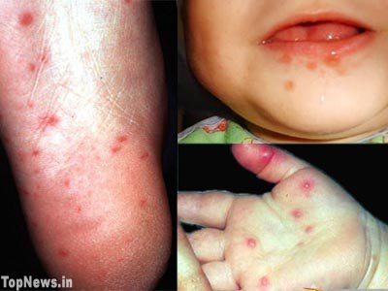

Slide 40
The most common manifestation of enteroviruses is nonspecific febrile illness
Other manifestations can include the following:
(1) respiratory: coryza, pharyngitis, herpangina, stomatitis, bronchiolitis, pneumonia.
(2) skin: handfoot-and-mouth disease, and nonspecific exanthems.
(3) neurologic: aseptic meningitis, encephalitis, and motor paralysis
(4) gastrointestinal: vomiting, diarrhea, abdominal pain, hepatitis, pancreatitis.
(5) eye: acute hemorrhagic conjunctivitis and uveitis
(6) heart: myocarditis
(7) muscle: myositis

Slide 41
Hand-Foot-and-Mouth Disease
Coxsackievirus infection
Usually a mild illness
Generally complete recovery occurs in 5-7 days
Complications:
Dehydration may occur
  mouth lesions cause pain with swallowing

Slide 42
Herpes simplex virus 1
  most common sites are lips and fingers or thumbs (herpes whitlow)

Slide 43
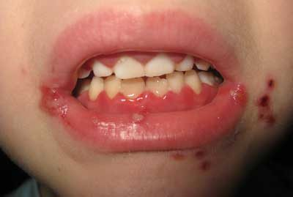

Slide 44
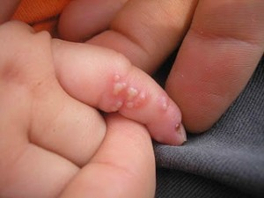

Slide 45
Herpes simplex virus infection
Herpes “cold sores”
Symptoms Superficial clear vesicles (blisters) with red base, usually on face or lips, which crust and heal within days.
Method of Direct contact
avoid contact with children with eczema or burns and the immunocompromised.

Slide 46
Herpes simplex virus infection
Gingivostomatitis – may necessitate, intravenous fluids and aciclovir
Eczema herpeticum – may result in secondary
bacterial infection and septicaemia
Herpetic whitlows – painful pustules on the fingers
Eye disease – blepharitis, conjunctivitis, corneal
ulceration and scarring
CNS – aseptic meningitis, encephalitis
Pneumonia and disseminated infection in the
immunocompromised.

Slide 47
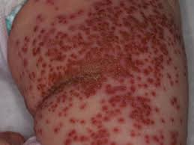
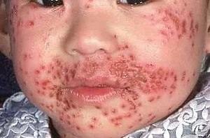

Slide 49
Eczema herpeticum
(kaposi varicelliform eruption)
serious condition, emergency care
Widespread vesicular lesions develop on eczematous skin
This may be complicated by secondary bacterial
infection, which may result in septicaemia
high fever, irritability, lesionsthen rupture and crust over the course of a couple of days
Lesions can become hemorrhagic
If area of involvement is large, can be lots of fluid loss and potentially fatal
Treat promptly with acyclovir

Slide 50
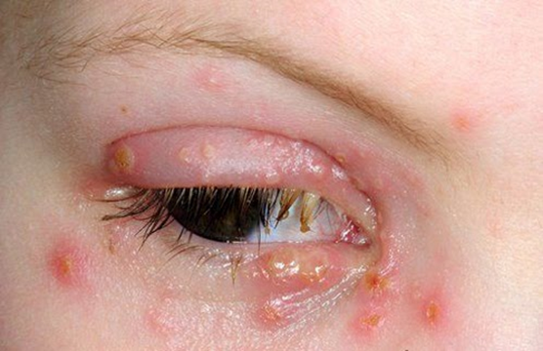
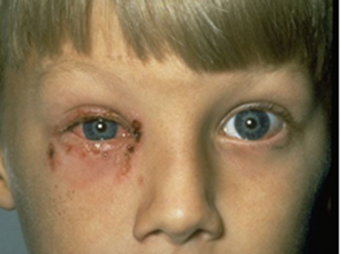
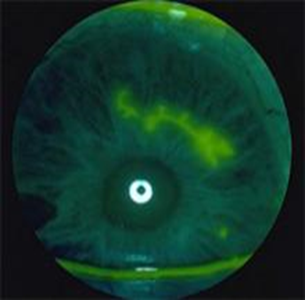

Slide 51
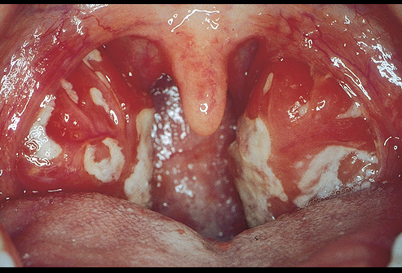
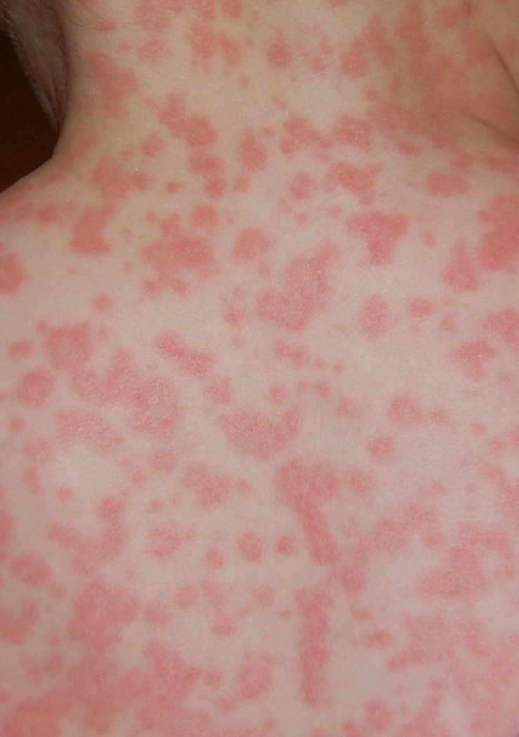
Infectious Mononucleosis
Cause: Epstein-Barr virus and Cytomegalovirus

Slide 53
Enlarged lymph nodes
Rash
  Pink, measles-like rash
    more common if given amoxicillin for throat infection
Enlarged spleen & liver
transmitted by saliva and close contact
Diagnosis: serology, PCR
Treatment is usually supportive, unless immunocompromised, where antiviral is indicated.

Slide 54
ADENOVIRUSES
Incubation period is 2-14 days.
Clinical syndromes:
EyeEpidemic keratoconjunctivitis, acute follicular conjunctivitis, pharyngoconjunctival fever.
Respiratory systemCommon cold (rhinitis), pharyngitis, tonsillitis, bronchitis, pneumonia.
GenitourinaryAcute hemorrhagic cystitis, orchitis, nephritis.
GastrointestinalGastroenteritis, mesenteric adenitis, appendicitis.
Rare results of adenovirus infections: Meningitis, encephalitis, arthritis, myocarditis, hepatitis.
Fatal disease may occur in immunocompromised patients, as a result of a new infection or reactivation of latent virus

Slide 55
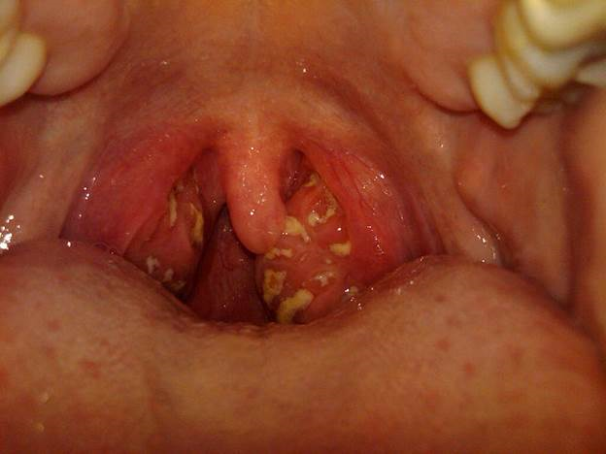
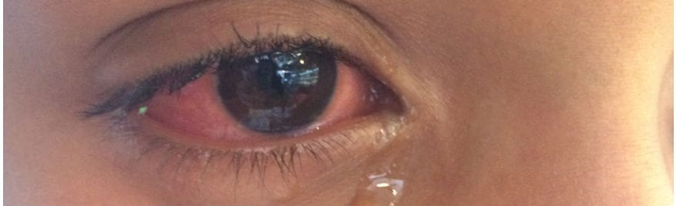

Slide 56
MCQ
An 8-year-old sickle-cell patient seen at the emergency room (ER) for fever. Over the previous several days, the child has become progressively tired and pale. The hemoglobin concentration in the ER is 3.1 mg/dL.
Which of the following viruses commonly causes such
a clinical picture?
a. Roseola
b. Parvovirus B19
c. Coxsackie A16
d. Echovirus 11
e. Cytomegalovirus

Slide 57
case
a six month old male, had the acute onset of fever to 39º c and irritability.
He was seen in your office and examination of the tympanic membranes revealed the physical findings noted.

Slide 58
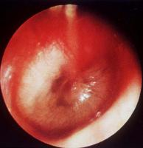

Slide 59
Risk factors for OM
Children cared for in group settings
Children who live with adults who smoke
Infants who nurse from a bottle while lying down
Children who are not breast-fed

Slide 60
Strep. Pneumoniae
H. influenzae
M. catarrhalis
Strep. pyogenes
Staph. Aureus
No growth

Slide 61
OM treatment
  Amoxicillin

Slide 62
Complications of OM
chronic effusion, hearing loss
Mastoiditis
intracranial extension (brain abscess, subdural empyema, or venous thrombosis).
cholesteatoma (mass-like keratinized epithelial growth)

Slide 63
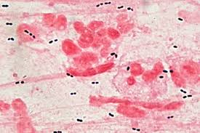
Pneumococcal infections
Often carried in nasopharynx of healthy children
transmission is by respiratory droplets.
the incidence of invasive disease has declined.
Susceptibility is increased in hyposplenism (e.g.
SCD, nephrotic syndrome, spleenectomy)
May cause pharyngitis, otitis media, conjunctivitis, sinusitis, invasive disease (pneumonia, bacterial sepsis and meningitis).
Prevention: Vaccine (PCV13, PPV23)
Prophylaxis for high risk.

Slide 64
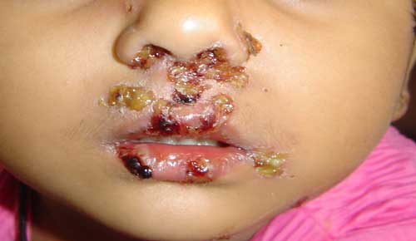

Slide 65
Impetigo
Impetigo is a bacterial skin infection
Staphylococcus aureus / streptococcus pyogenes.
honey-coloured crusted lesions
Lesions are usually on the face, neck and hands
most common in infants and young children.
It is contagious.
Topical antibiotics (e.g. mupirocin)
Systemic: cloxa, augmentin, cephalexin.

Slide 66
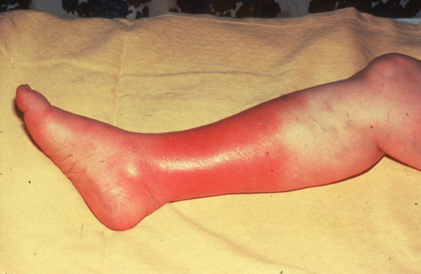

Slide 67
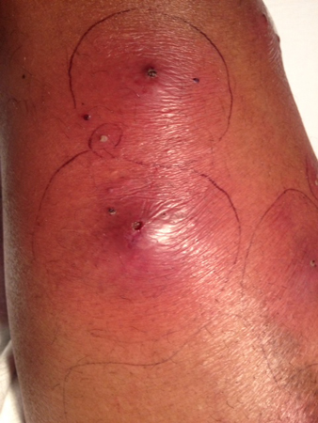

Slide 68
Cellulitis
Inflammation of the subcutaneous connective
tissue – may lead to abscess
Streptococcus pyogenes, Staphylococcus aureus, Haemophilus influenzae (<2 yrs)
Therapy: clindamycin, cefazolin, cloxacillin

Slide 69
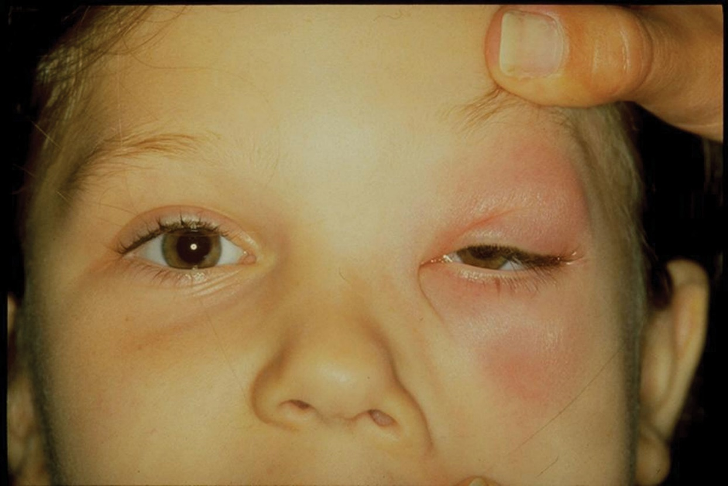

Slide 70
Periorbital cellulitis
fever with erythema, tenderness, oedema of the eyelid.
It is almost always unilateral.
In young, unimmunised children it may also be caused
by Haemophilus influenza type b which may also be accompanied by infection at other sites, e.g. meningitis.
It may follow local trauma to the skin. In older children, it may spread from a paranasal sinus infection or dental abscess
Treatment : i.v antibiotic

Slide 71
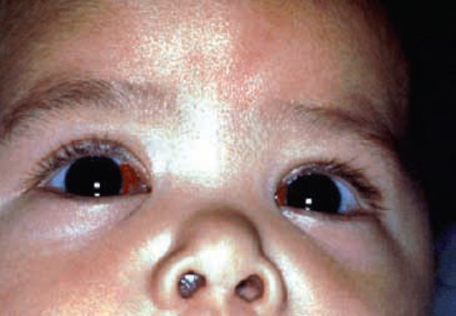
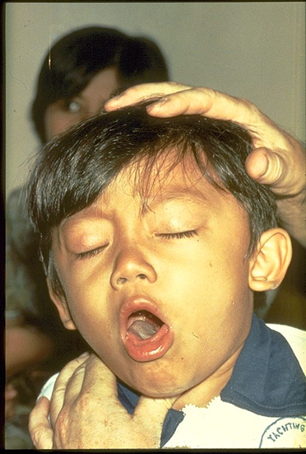

Slide 72
  https://www.youtube.com/watch?v=TIV460AQUWk
  https://www.youtube.com/watch?v=S3oZrMGDMMw

Slide 73
Pertusis (Whooping Cough)
Bordetella Pertusis
Incubation Period: 7 – 14 days
Coughing adults are major reservoirs
Clinical Features:The infection usually lasts 6 wks
  Cold symptoms (~2 weeks)
  Progressively worse cough (~4 weeks)
  Complete resolution (may take months)
Treatment: erythromycin (other macrolids)
Isolation & Infectivity: up to
6 weeks, but with treatment =>
5 days after starting therapy
Vaccine, doesn’t provide lifelong immunity

Slide 74
  Video https://www.youtube.com/watch?v=TIV460AQUWk
  Complication
  OM
  Pneumonia
  apnea
  Convulsions
  Brain damage from lack of oxygen
  cerebral hemorrhage

Slide 75
MCQ
Which of the following is responsible for causing Hand-Foot-and-Mouth Disease?
    Adenovirus
    Coxsackievirus
    Cytomegalovirus
    Echovirus 22
    Epstein-Barr Virus

Slide 77
Tuberculosis
TB affects millions of children worldwide; low but increasing incidence in many developed countries.
Diagnosis of TB in children is even more difficult than
in adults. The clinical features of the disease are nonspecific,
such as prolonged fever, malaise, anorexia, weight loss or
focal signs of infection.
Clinical features follow a sequence – primary infection, then dormancy, which may be followed by reactivation to post-primary TB.
TB disease can present as local disease or may be widely disseminated, miliary TB to sites such as bones, joints, kidneys, pericardium and CNS.
In infants and young children, seeding of the CNS is particularly likely, causing tuberculous meningitis

Slide 78
Diagnosis is often difficult, so decision to treat is usually based on contact history, Mantoux test, interferon-gamma release assays (Quantiferon), chest X-ray and clinical features.
Young children swallow their sputum, so early morning gastric aspirate are required (3 samples)
Contact tracing is important.
TB is more difficult to diagnose and more likely to disseminate in the immunosuppressed.

