Slide 1
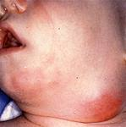
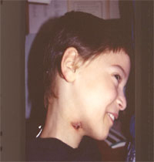
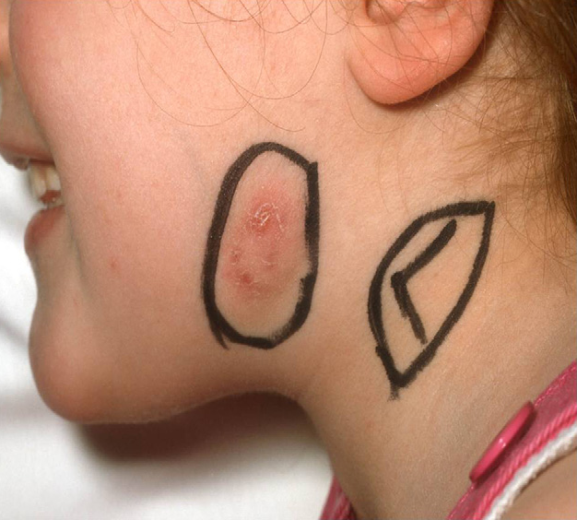
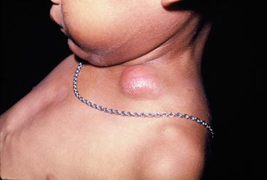
Approach to lymphadenopathy with/without hepatosplenomegaly
By:Prof. Elham Bukhari
Professor, Pediatric Infectious Diseases consultant,
Department of Pediatrics .King saud University.

Slide 2
LN Head and neck

Slide 3
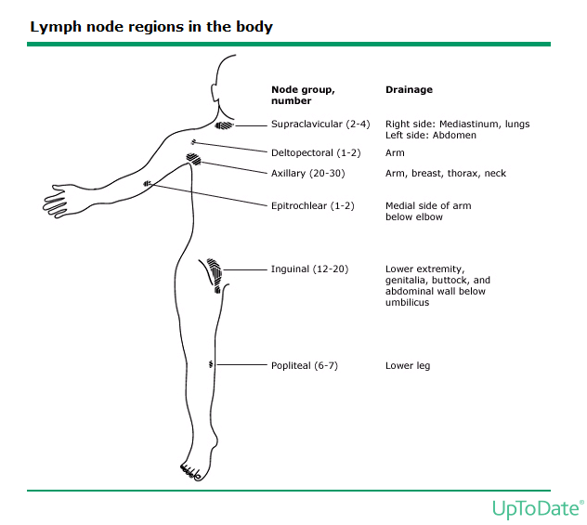

Slide 4
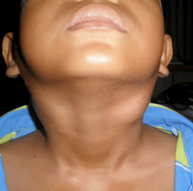

Slide 5
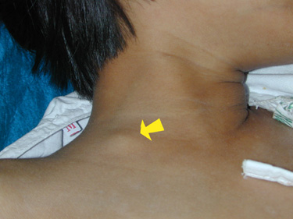

Slide 7
Definitions
Palpable lymph nodes are normal in anterior cervical, axillary and inguinal regions in healthy children
Lymphadenopathy: enlargement of the lymph nodes beyond this normal state. Practically this is any node >1.0 cm in greatest diameter
Certain nodes should be considered enlarged at different sizes (i.e. epitrochlear nodes > 0.5 cm, inguinal nodes >1.5 cm, submandibular nodes > 1.5 cm)

Slide 8
Definitions
Acute Lymphadenopathy
< 2 weeks duration
Subacute Lymphadenopathy
2-6 weeks duration
Chronic Lymphadenopathy
> 6 weeks duration

Slide 9
Causes of Lymphadenopathy: | Examples
Infections
Bacterial
Localized | Streptococcal pharyngitis; skin infections; tularemia; cat scratch disease; diphtheria;
Generalized | Brucellosis; leptospirosis; typhoid fever.
Viral | Epstein-Barr virus; herpes simplex virus; cytomegalovirus; mumps; measles; rubella; HIV, hepatitis B; dengue fever
Mycobacterial | Mycobacterium tuberculosis; atypical mycobacteria
Fungal | Histoplasmosis; coccidioidomycosis; cryptococcosis
Protozoal | Toxoplasmosis; Leishmaniasis
Autoimmune | SLE, JRA, serum sickness
Neoplastic diseases | leukemia metastatic; lymphoma; Hemophagocytic lymphohistiocytosis
Drugs | phenytoin, Hydralazine, Allopurinol, Pyrimethamine, Isoniazide
Miscellaneous | Sarcoidosis; lipid storage diseases; amyloidosis; histiocytosis; chronic granulomatous diseases

Slide 10
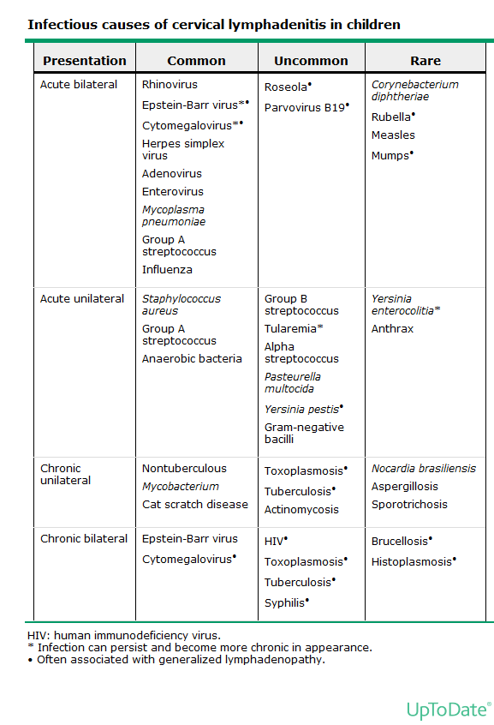

Slide 11
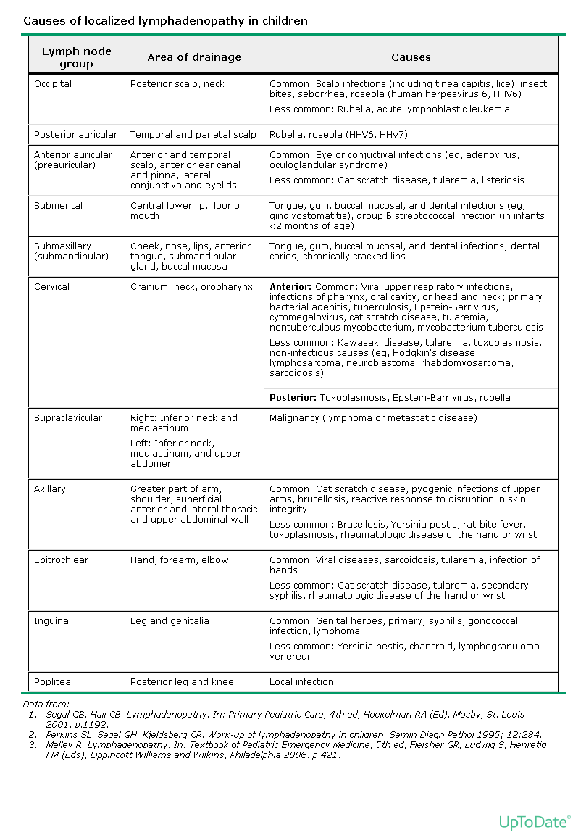

Slide 12
History & Physical Exam
The history and physical examination are particularly important in determining the differential diagnosis and ultimately the timing, workup and treatment of lymphadenopathy.

Slide 13
History
Duration
Short (< 2 weeks) -likely to be infectious
Long (> 2 weeks but < 1 year) -likely to be infectious, malignancy, autoimmune, drug reaction.

Slide 14
Location:
Localized -likely to be infectious
Generalized -more likely pathologic (e.g. malignancy, autoimmune, etc.)
Head and Neck -likely infectious
Mediastinal -likely pathologic
Abdominal -likely pathologic
Inguinal -likely infectious

Slide 15
Associated symptoms-each may be associated with infectious, malignant, autoimmune, or immunodeficiency diseases:
Pain
Sore Throat
URI
Toothache
Ear pain
Fever
Weight loss (> 10% over 6 months)
Night sweats
Pruritis
Myalgia/arthralgia
Rashes
Malaise

Slide 16
Other history
Pets - especially cats for Cat Scratch Disease
Travel - including Tuberculosis exposure
Possible immunodeficiency risk such as HIV
Family history of similar problems
Previous treatments (such as antibiotics and how patient responded)
What do parents think might be going on? What are parents most worried about?

Slide 17
Physical Examination
Nodes
Location -local, regional, generalized
Size
Character- e.g. firm, soft, etc. (may be subjective)
Fixed or non-fixed
Erythema and tenderness

Slide 18
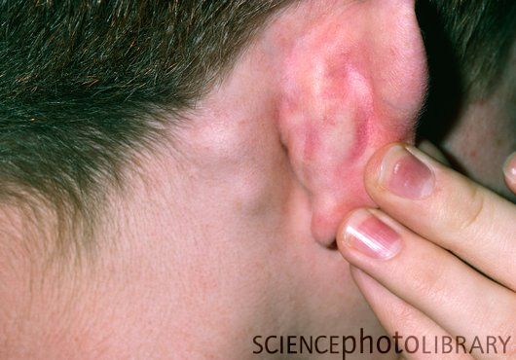
Note:
Generalized, firm, discrete, non-tender, fixed tend to be more ominous causes such as malignancy
Localized, warm, tender, matted, erythematous -tend to be associated with infections

Slide 19
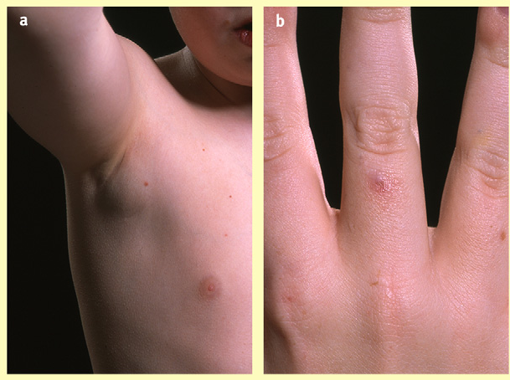
Physical Examination
General
Febrile or toxic appearing
Skin
Cellulitis, impetigo, rash
HEENT
Otitis, pharyngitis, teeth, and nasal cavity
Lungs
Consolidations suggesting TB
Abdomen
Hepatosplenomegaly

Slide 20
Worrying Signs
lymphadenopathy of more than 3 cm in size
more than 4 weeks in duration
supraclavicular, post. cervical involvement
Skin tethering/ulceration
Fixed nodes
Firm/rubbery consistency
abnormal laboratory and radiological findings

Slide 21
Other Signs
Signs of anemia -tachycardia, pale conjunctiva -may be associated with malignancy, autoimmune diseases
Dermatological changes -petechiae, bruising, bleeding -may be associated with malignancy
Weight/growth -poor growth may be associated with malignancy

Slide 24
Facial Papule with Adenopathy
Notes:
Cat scratch disease

Slide 25
Mimickers of lymphadenopathy
Thyroglossal duct cyst :Moves with tongue protrusion and is midline.
Dermoid Cyst : Midline and often has calcifications on plain films.
Branchial Cyst :Smooth and fluctuant along SCM border.
Hemangioma : Mass is presents after birth, rapidly grows,
plateaus, and is red or bluish in color

Slide 26
Cystic Hygroma :Transilluminates and is compressible
Sternocleidomastoid Tumor : Presents with torticollis,
Mumps : Mass palpated superior to jaw line, not just inferior to it.

Slide 27
When to Investigate ?
Patients generally should be considered for investigation and/or referral if:
Unexplained generalized lymphadenopathy
Any palpable supraclavicular or popliteal node
Significant constitutional symptoms
Hepatic or splenic enlargement
Anemia or bleeding
Unresponsiveness to antibiotic treatment
Not decreasing in size after appropriate period of observation

Slide 28
Laboratory Workup
CBC with Differential
ESR/CRP
Throat swab
Serology
EBV
Bartonella
CMV
Toxoplasmosis
PPD (Mantoux test)
LDH
Uric acid
LFT

Slide 29
Imaging Workup
CXR
To look for mediastinal lymphadenopathy
Ultrasound
To evaluate for or follow progress of an abscess
To assess the consistency
CT- scan
Biopsy
FNA or Excisional
Early biopsy is indicated in children with supraclavicular, mediastinal, or massively enlarged nodes or groups of nodes >3 cm.

Slide 30
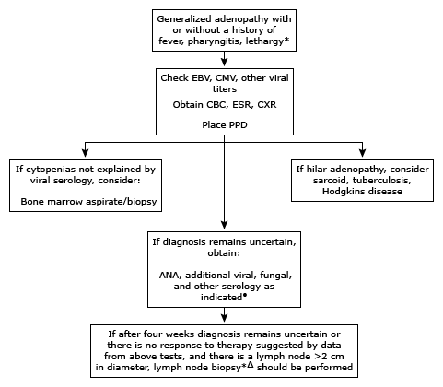
Suggested approach to generalized adenopathy in children.

Slide 31
Case #1
A 2- year- old boy brought to the clinic with fever and ® sided neck swelling for 3 days.
What are the likely etiologies? (mention at least 3)
What points in history will be suggestive of each etiology?
What points in physical examination relevant to each possible etiology?
What are the appropriate investigations helpful in reaching a diagnosis?

Slide 32
Case #2
An 8 – year – old patient with left cervical lymphadenopathy for the past 4 weeks.
What are the likely etiologies? (mention at least 3)
What points in history will be suggestive of each etiology?
What points in physical examination relevant to each possible etiology?
What are the appropriate investigations helpful in reaching a diagnosis?

Slide 33
Case #3
10 years old girl presented with history of fever, pallor, cervical and axillary lymphadenopathy for the past 8 weeks.
What are the likely etiologies? (mention at least 3)
What points in history will be suggestive of each etiology?
What points in physical examination relevant to each possible etiology?
What are the appropriate investigations helpful in reaching a diagnosis?

