Slide 1
The Approach to the
Acute Abdomen
Thamer Nouh MD, FRCSC,FACS
Assistant Professor of Surgery
Trauma & Acute Care Surgery
King Saud University

Slide 2
Approach to the Acute Abdomen
Acute abdomen represents the rapid onset of severe symptoms that may indicate potentially life-threatening intra-abdominal pathology that requires urgent surgical intervention

Slide 3
Approach to the Acute Abdomen
Anatomy
Physiology

Slide 4
Approach to the Acute Abdomen
History
  Detailed pain history
  Complete systematic review
  Past history
Physical Examination
  Abdominal exam
  Digital rectal exam
  Special signs

Slide 5
Approach to the Acute Abdomen
Presentation
  Abdominal pain is usually a feature
  Pain may be located in any quadrant of the abdomen and may be intermittent, sharp or dull, achy or piercing; it may radiate from a focal site and there may be associated symptoms such as nausea and vomiting.

Slide 6
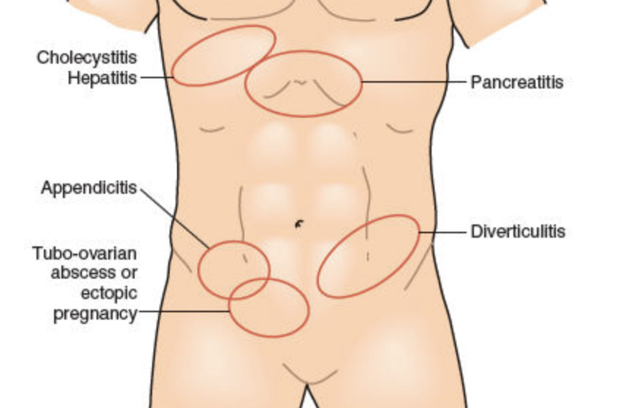
Character of the pain
Gradual, Progressive Pain

Slide 7
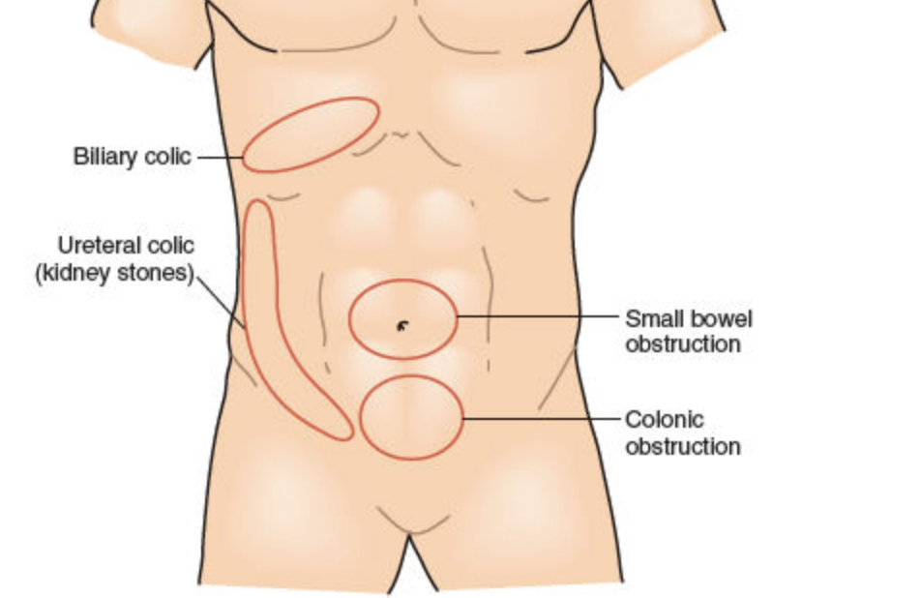
Character of the pain
Colicky, Crampy Intermittent Pain

Slide 8
Approach to the Acute Abdomen
Presentation
  Abdominal pain is usually a feature
  Immediate assessment should focus on distinguishing those cases of true acute abdomen that require urgent surgical intervention from those that do not, which can initially be managed conservatively

Slide 9
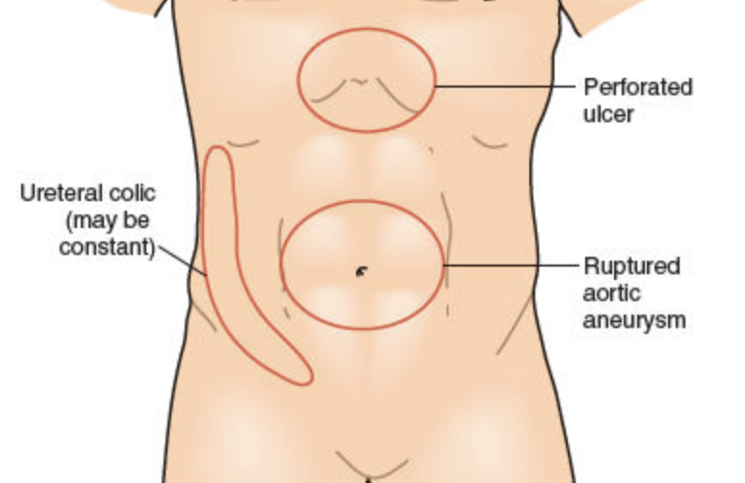
Character of the pain
Sudden, Severe Pain

Slide 10
Approach to the Acute Abdomen
Presentation
  Abdominal pain is usually a feature
  Pain-free acute abdomen can occur, particularly in older people, in children, in the immunocompromised, and in the last trimester of pregnancy.

Slide 11
Approach to the Acute Abdomen
Diagnosis
  An acute abdomen is diagnosed by a combination of history, physical examination, radiography, and laboratory results.

Slide 12
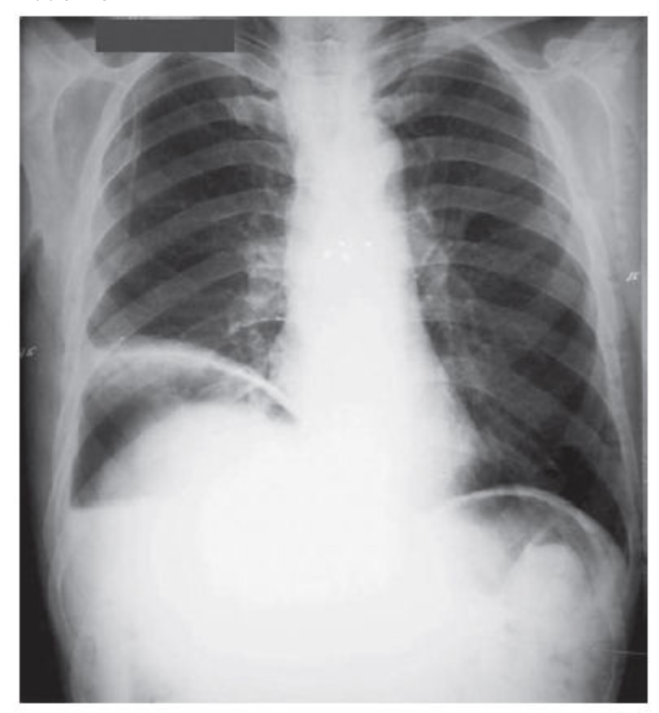

Slide 13
Approach to the Acute Abdomen
Diagnosis
  An acute abdomen is diagnosed by a combination of history, physical examination, radiography, and laboratory results.
  CT Scan
  Experienced Surgeon
  Diagnostic Laparoscopy

Slide 14
Approach to the Acute Abdomen
Management
  Pain Management.
  Surgical Intervention
  “Conservative” / “Non operative Management” of Acute Abdomen
  Elderly patients
  ICU patients
  Pregnancy
  Immunosuppressed patients

Slide 15
Thank You!

