Slide 1
Acute abdomen
Surgery Team
MED437
Team Leader: Rawan Mishal
Team Members: Hadeel awrtani & Dimah Alaraifi
Revised By: Arwa aljohany

Slide 2
Basic definition and principles
Signs and symptoms of intra-abdominal disease that is usually best treated by surgery
Despite improvements in labs and imaging, history and physical examination remain the mainstays of determining the correct diagnosis!
Proper evaluation and management requires one to recognize:
Does this patient need surgery ?
Is it emergent, urgent, or can wait ?
• Remember medical “non-surgical” causes of abdominal pain
Medical Causes of Acute Abdomen
(3 broad categories)
Surgical Causes of Acute Abdomen
You need to act fast
If no? look for non-surgical causes If yes? Answer question 2
Emergent = Category I , Class A (act within 1Hr)
Urgent = we’ve 6-8 Hrs to medically optimize the patient (resuscitate, give Abx, check electrolytes, PT, PTT and correct things)
Endocrine and Metabolic Causes
Uremia Diabetic crisis Addisonian Crisis Acute intermittent porphyuria Hereditary Mediterranean fever
Hematologic Causes | Toxins and Drugs
Sickle cell crises Acute leukemia Other blood dyscrasias | Lead poisoning Other heavy metal poisoning Narcotic withdrawal Black widow spider poisoning
They present with severe acute abdomen if you don’t work them up well you may take them wrongly to the OR and find nothing
Spleen infarction
Hemorrhage
Solid organ trauma Leaking/ruptured arterial aneurysm Ruptured ectopic pregnancy Bleeding gastrointestinal diverticulum Arteriovenous malformation of gastrointestinal tract Intestinal ulceration | Aortoduodenal fistula after aortic vascular graft Hemorrhagic pancreatitis Mallory–Weiss syndrome Spontaneous rupture of spleen
AAA

Slide 3
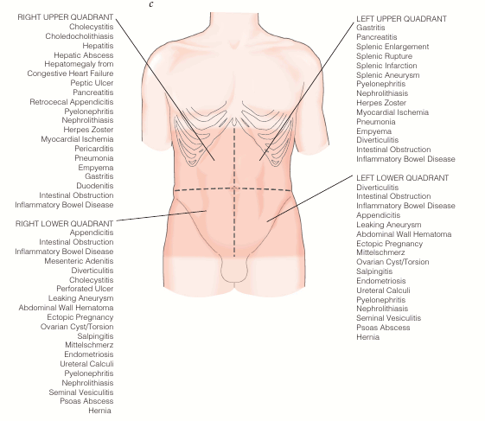
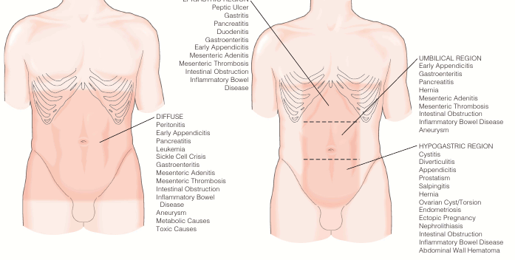
Surgical Causes of Acute Abdomen
Clinical Diagnosis
Characterizing the pain is the key
Onset, duration, location, character:
Visceral pain → dull & poorly localized Can’t pinpoint it
i.e. distension, inflammation or ischemia
Parietal pain → sharper, better localized
Inflammation of parietal peritoneum Or skin or muscle
Infection | Blockage
Appendicitis Cholecystitis Meckel’s diverticulitis Hepatic abscess Diverticular abscess Psoas abscess | Adhesion induction small/large bowel obstruction Sigmoid volvulus Cecal volvulus Incarcerated hernias Inflammatory bowel disease Gastrointestinal malignant neoplasm Intussusception
Perforation | Ischemia
Perforated gastrointestinal ulcer Perforated gastrointestinal cancer Boerhaave’s syndrome Perforated diverticulum | Buerger's disease Mesenteric thrombosis/embolism Ovarian torsion Ischemic colitis Testicular torsion Strangulated hernias
Most of surgical diseases are caused by blockage
Which is blockage but in a different way
What is the most common perforation? PUD
EPIGASTRIC REGION
Notes:
*Visceral V.S. Parietal
- The nerve conduction for pain sensation is different when it’s come from visceral or parietal
- Visceral pain is either diffuse like peritonitis or regional (epigastric, umbilical, hypogastric)

Slide 4
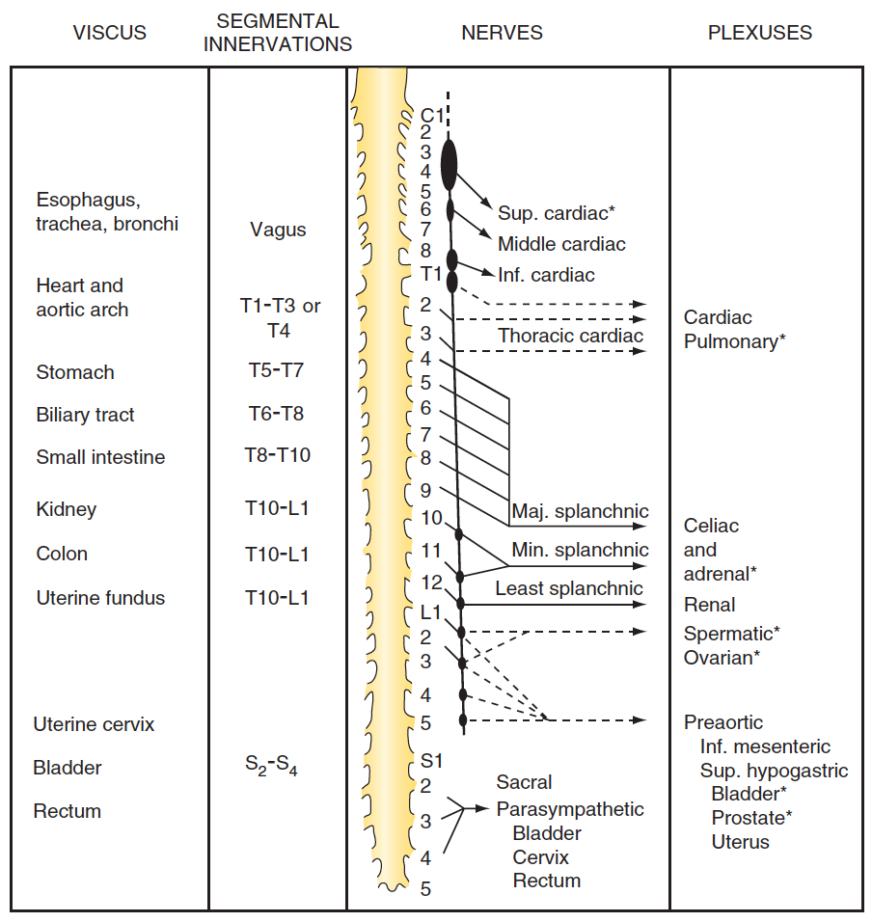
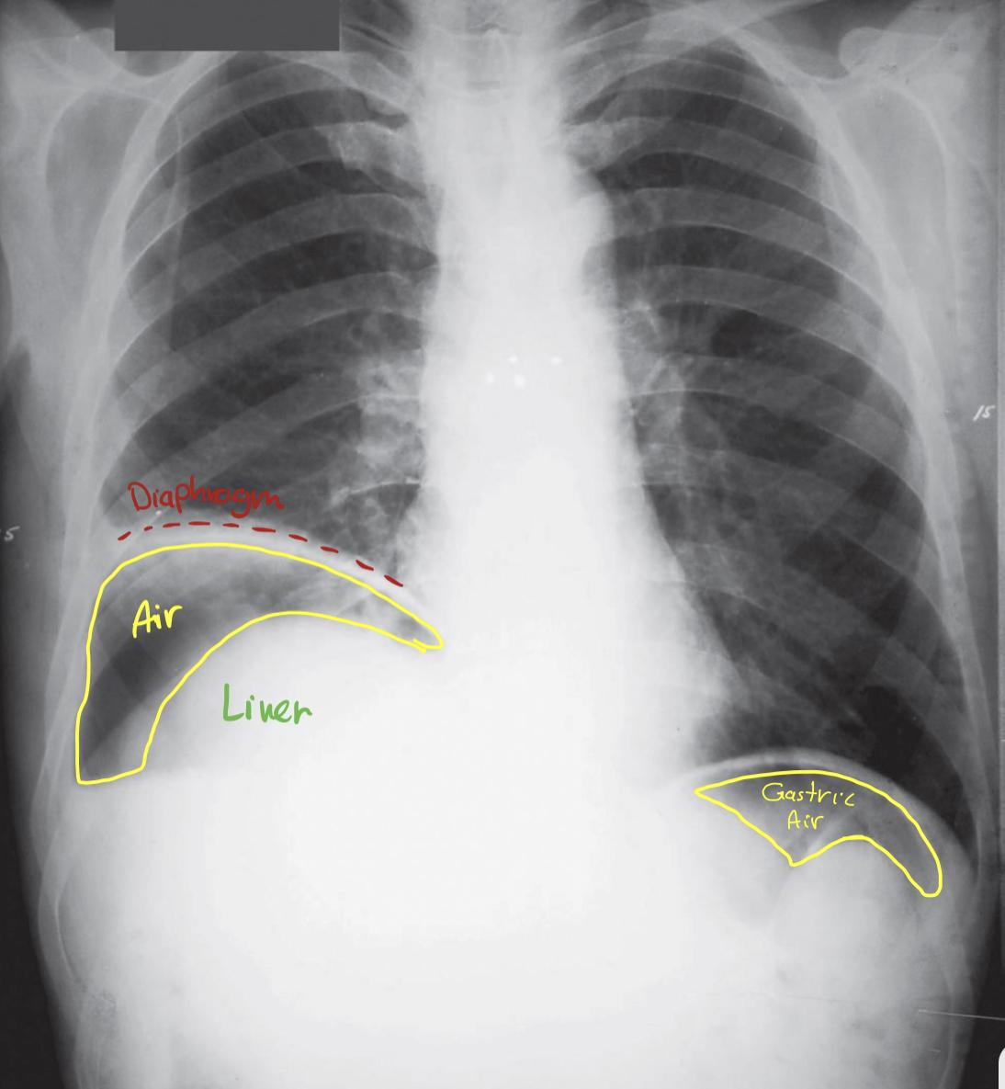
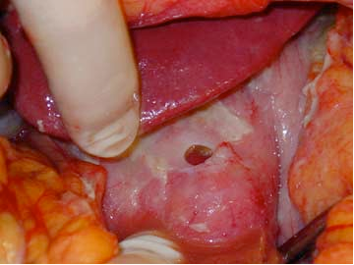
Sensory Innervation of the Viscera
Case
83 yo F presented to the ED Inability to stand for daily activities
Progressive weakness & functional decline over past 5 days
Initially vague abdominal complaints
Past Medical History: Arthritis NSAIDS!!
P/E generalized tenderness maximum over RUQ
• In visceral pain the pain can be conducted
through segmental innervation or through the
plexuses sending it to the nerve
• It can follows a dermatomal pattern, and each
level make you think of some diagnosis
Celiac trunk
You lift up the liver and you can clearly see the perforation
Notes:
• Free air under the diaphragm > perforated PUD > H.pylori
• Most common perforated part is duodenal ulcers; it has thinner wall + it’s the first part that receives gastric juices
• Definitive management? Surgical

Slide 5
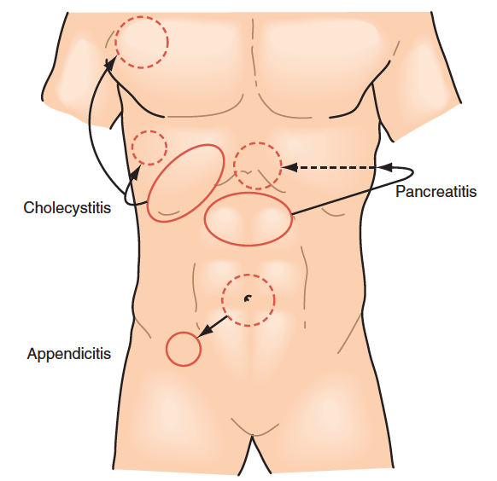
Clinical Diagnosis
“Referred pain”
Biliary disease → R shoulder or back
Sub-left diaphragm abscess → L shoulder Basal abscess on the lung could be felt in the shoulder too, Case: peds presented with fever and shoulder pain, do an xray you might find basal pneumonia and abscess
Above diaphragm(lungs) → Neck/shoulder pneumonia can present with shoulder pain. Patient had bad flu & fever and she was complaining of shoulder pain . After x-ray we found that pneumonia and that’s why she was having shoulder pain and she required a course of antibiotic.
Acute onset & unrelenting pain = bad
Other History
GI symptoms
Nausea, emesis (? bilious or bloody)
Constipation, obstipation (last BM or flatus) Obstipation is the extreme constipation, even gas will not pass
Diarrhea (? bloody) Foul smelling?
Change in symptoms with eating? Loss of appetite? Constitutional symptoms?
NSAID use (perforated Duodenal Ulcer)
Jaundice, acholic stools, dark urine Obstructive jaundice Pre-hepatic: normal stool and urine (Because there is no conjugated bilirubin), Hepatic : dark urine, Post-hepatic: dark urine & pale stool
Drinking history (pancreas) Acute/chronic pancreatitis
Prior surgeries (adhesions→ SBO, ?still have gallbladder & appendix)
History of hernias Patient present with obstipation, vomiting, abdominal distention and little bulge in groin > Strangulated (skin erythema) OR Incarcerated. Fibrin formation, when it’s in the abdomen it turns into super glue, the only way to not make it sticky is by cutting it
Urine output (dehydrated)
Constitutional Symptoms
Fevers/chills
Sexual/mesnstrual history Ectopic pregnancy, STD, ruptured cyst
Pain which resolves usually is not acutely surgical ! Surgical diseases get worse with time mostly

Slide 6
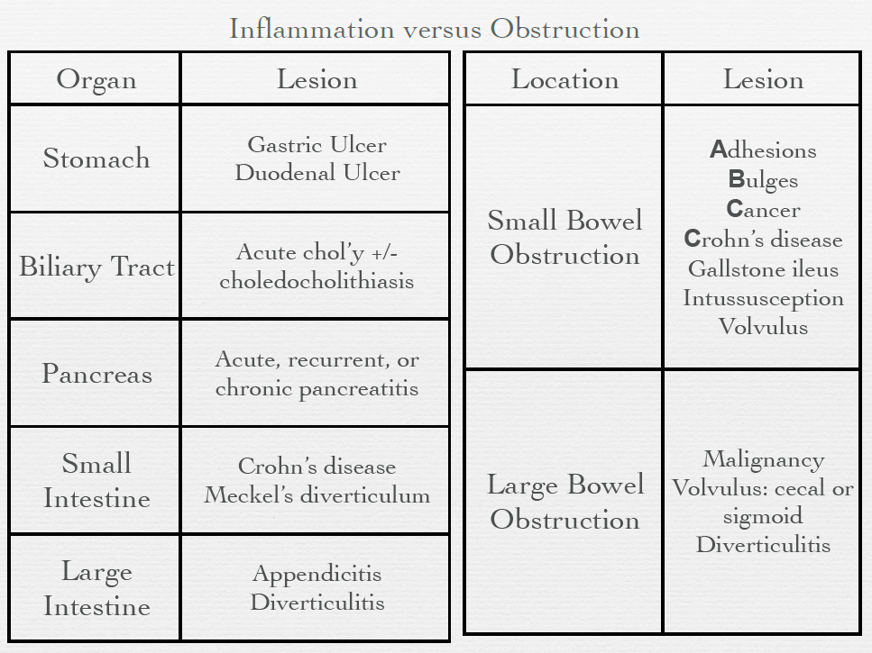
Think BROAD Categories
Inflammation Infection
Obstruction You keep drinking water, producing fluids, swallowing and producing air > increase in the pressure
Ischemia Hx of blood diseases, AFib
Perforation (any of above can end here) Air under the diaphragm, NSAIDs
Offended organ becomes distended
Lymphatic/venous obstruction due to ↑pressure
Arterial pressure exceeded → ischemia
Prolonged ischemia → perforation
Ischemia/Perforation
Acute mesenteric ischemia Usually fatal
Usually acute occlusion of the SMA from thrombus or embolism From AFib usually
Chronic mesenteric ischemia
Typically smoker, vasculopathy with severe atherosclerotic vessel disease
Ischemic colitis
Any inflammation, obstructive, or ischemic process can progress to perforation Inflammation overcome perfusion especially in the inner shed layer of the bowel This is why we intervene as early as possible, to prevent inflammation
Ruptured abdominal aortic aneurysm
The biggest inflammation that kill the patient at the site of trauma / injury, and it could be due to genetic collagen disease
Notes:
This is the classic pathway: the organ distended → this lead to lymphatic
obstruction → which lead to increase in pressure → if arterial pressure is exceeded → there will be an ischemia. Prolonged ischemia → will lead
perforation. The classic example is strangulation like strangulated hernia
Gastritis
Extraluminal
Intraluminal
Intraluminal or extraluminal
Most common
Low fiber diet > stronger power needed > diverticulum
SMA is the main blood supply for 2/3 of the bowel !

Slide 7
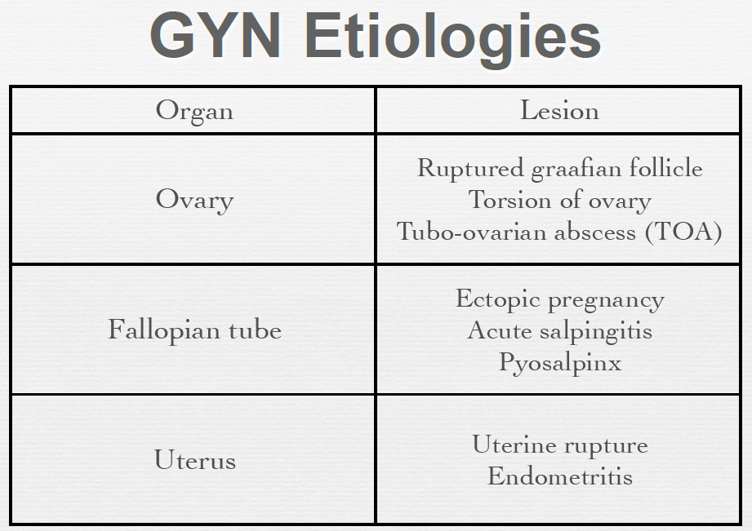
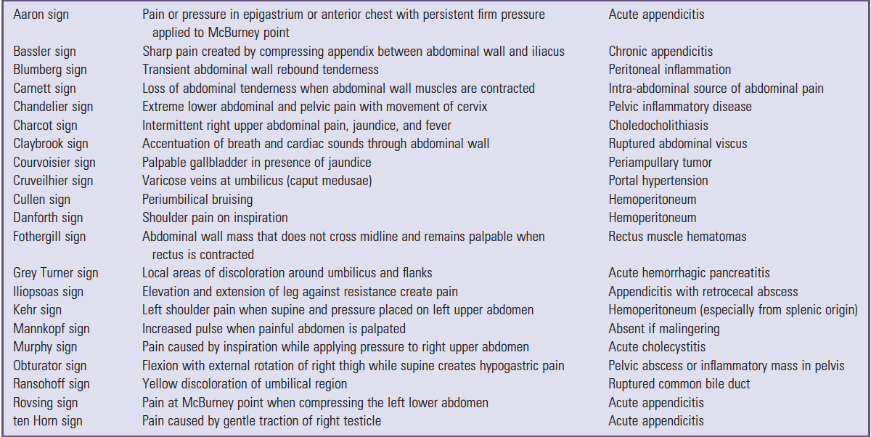
Ovaries can mimic acute abdomen, especially if it’s the right ovary. Sometimes we admit a few patients with RLQ pain that we though that she have appendicitis but after the work up and CT scan and US we only find a small amount of free fluid in the pelvis and prominent ovary. This is a normal physiological changes and can be severe enough to cause a severe pain that bring the patient to the emergency.
Torsion of the ovaries. Means ovary twists around the ligaments that hold it in place. This twisting can cut off blood flow to the ovary and fallopian tube. It’s requires rapid evaluation and management in order to salvage the ovary.
IMPORTANT

Slide 8
Test | Reason
CBC w diff If the WBC is very high this may indicate severe sepsis. Also if it’s low may indicate that the infection is very sever that caused reduction in WBC production. If you look at WBC and it’s normal but you have a left shift (which mean the neutrophils count is higher than the WBC) this indicate acute infection. | - Left shift can be very telling
Basic metabolic panel (BMP) Any situation that cause loss of fluid we need to check the urea and electrolytes to check if there is any metabolic abnormalities | - N/V - Electrolytes - Acidosis - Dehydration
Amylase In past we thought that it’s related only to the pancreas but we understood that it can be produced from the bile it self. So high amylase can come with ischemic bowel, perforated duodenal ulcer as well as pancreatitis . Lipase enzyme is more specific to pancreas | - Pancreatitis - Duodenal ulcer perforation - Bowel ischemia
LFT LFT is a wrong terminology but it’s been used for a long time. The really liver function is related to bilirubin, ammonia, glucose and so on.. But routinely we use terminology LFT to everything related to liver. If you have elevated bilirubin and patient has dark urine and pale stool → obstructed jaundice and what is the cause of obstruction? Is it stone? Is the stone cause inflamed gallbladder (cholecystitis) and compressing the bile duct? Or there is no stone but there is a lesion that cause obstruction and jaundice, so we need to know the cause When do we think about hepatitis? When AST, ALP, ALT Is elevated. In hepatitis you need to do the serology, and ask in the hx about traveling, contact with sick patient. But In emergency we usually think about more serious infections | - Jaundice - Hepatitis
UA Urea electrolytes are imp, because it’s indicate dehydration which is a result of stones | - GU-UTI - Stones - Hematuria
Beta-hCG Pregnancy test should be performed in all women of childbearing age (14-50 years old) coming to ER before any imaging. Not only is this important if x-rays are to be taken, but it will also raise the possibility of an ectopic pregnancy if positive. | - Ectopic
KUB Flat & Upright. There is also three views x-ray which is flat, upright and lateral decubitus You want to look for free air and signs of bowel obstruction. Air fluid level is the most common sign of bowel obstruction The high the number = high obstruction The upright chest x-ray (CXR) is the most appropriate first investigation for the detection of free intraperitoneal gas and should be carried out in any patient who might have a perforation. If the condition of the patient prevents an upright being taken, then a left lateral abdominal decubitus film might be helpful. | - Small bowel obstruction (SBO) - Free air - Stones

Slide 9
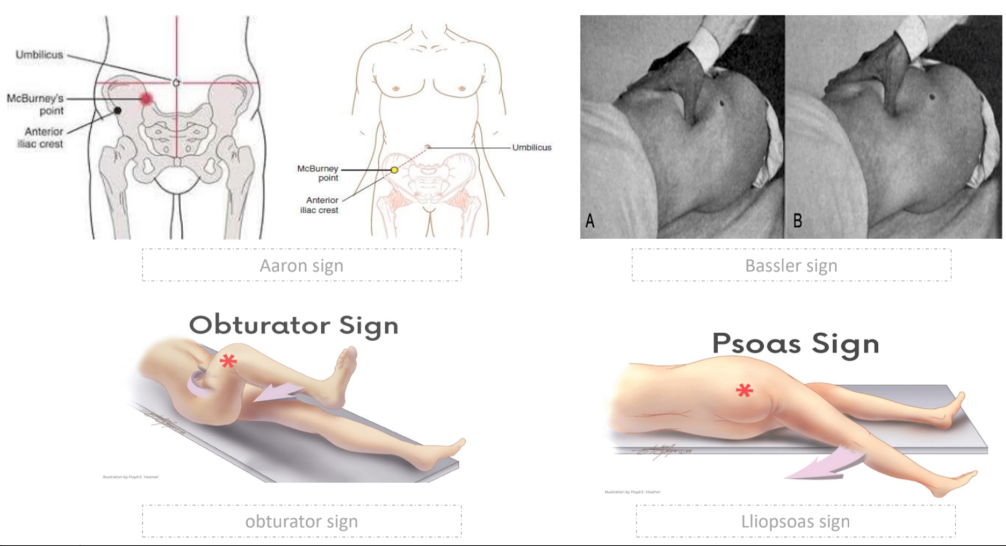
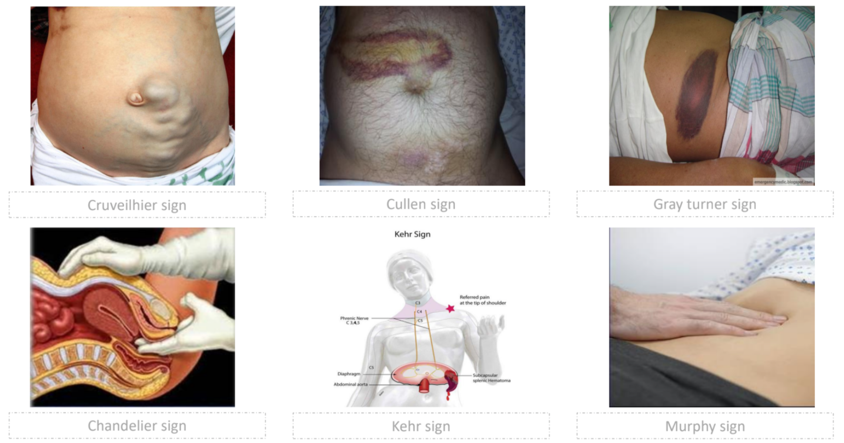
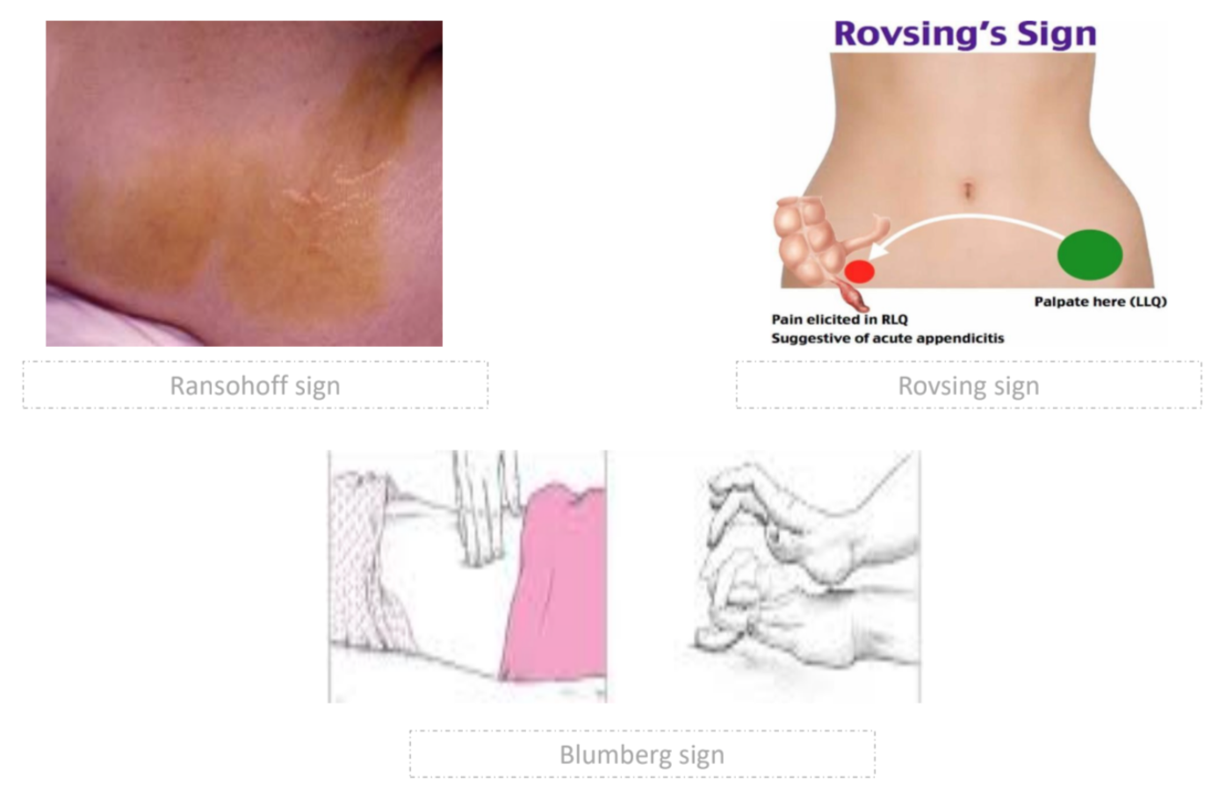
Test | Reason
US US: one of the main modality in assessing the genitourinary system, biliary system. US is most commonly used to assess acute abdominal pain. As a general investigation it might reveal small amounts of intraperitoneal fluid in conditions such as perforation and infection, whereas in specific conditions such as acute cholecystitis, biliary obstruction, aortic aneurysms and ovarian cysts it can be diagnostic. Although some studies have reported high levels of sensitivity and specificity in the diagnosis of acute appendicitis, ultrasonography is highly operator dependent and a negative result cannot be relied upon, particularly if the clinical picture suggests otherwise. | - Chol’y - Jaundice - Gynecological pathology
CT scan (diagnostic accuracy) CT is most modality using in ER. Mostly all patient will get an CT , it could be replaced by MRI in some situation but CT is 95% accurate. When you are not sure but you have a an Initial diagnosis and you can’t localized the problem exactly, the CT scan can shows you where is the problem exactly (anatomical localization), but you need to have an initial diagnosis by hx and exam and that your diagnosis is not relies on CT. | - Anatomical dx - case not straightforward
Diagnostic Laparoscopy It’s a microscopic assisting of intra abdomen. Flexible sigmoidoscopy is performed on patients who present with an acute abdomen associated with rectal bleeding and in those patients with large bowel obstruction to evaluate the anorectum. Additional information can be obtained from a colonoscopy. Both flexible sigmoidoscopy and colonoscopy can be therapeutic in the management of sigmoid volvulus and pseudo-obstruction. Upper endoscopy is used to investigate patients with acute upper abdominal pain in whom a perforated peptic ulcer has been excluded. | - Anatomical dx - Case not straightforward
Notes:
- US is the screening of choice for trauma, gallbladder, GYN and hernia
- CT accuracy reach up to 95% for certain diseases
- CT answer all Qs that not clear
We go for laparoscopy when the imaging and tests fails
Extra pictures

Slide 10
IMPORTANT
Clinical Findings Associated with Surgical Disease in the of Acute Abdominal Pain
Physical Examination and Laboratory Findings
Abdominal compartment pressures >30 mm Hg measured by foley catheter Worsening distention after gastric decompression NGT Involuntary guarding or rebound tenderness Peritonitis Gastrointestinal hemorrhage requiring >4 units of blood without stabilization Unexplained systemic sepsis High WBC with no good reason or infection Signs of hypoperfusion (acidosis, pain out of proportion to examination findings, rising liver function test results)
Radiographic Findings
Massive dilation of intestine Progressive dilation of stationary loop of intestine (sentinel loop) Pneumoperitoneum Extravasation of contrast material from bowel lumen Vascular occlusion on angiography Fat stranding or thickened bowel wall with systemic sepsis Signs of inflammation (appendix, gallbladder, diverticulum)
Diagnostic Peritoneal Lavage (1000 mL)
>250 white blood cells per milliliter of aspirate >300,000 red blood cells per milliliter of aspirate Bilirubin level higher than plasma level (bile leak) within aspirate Presence of particulate matter (stool) Creatinine level higher than plasma level in aspirate (urine leak)
Not done anymore, you may be asked about it

Slide 11
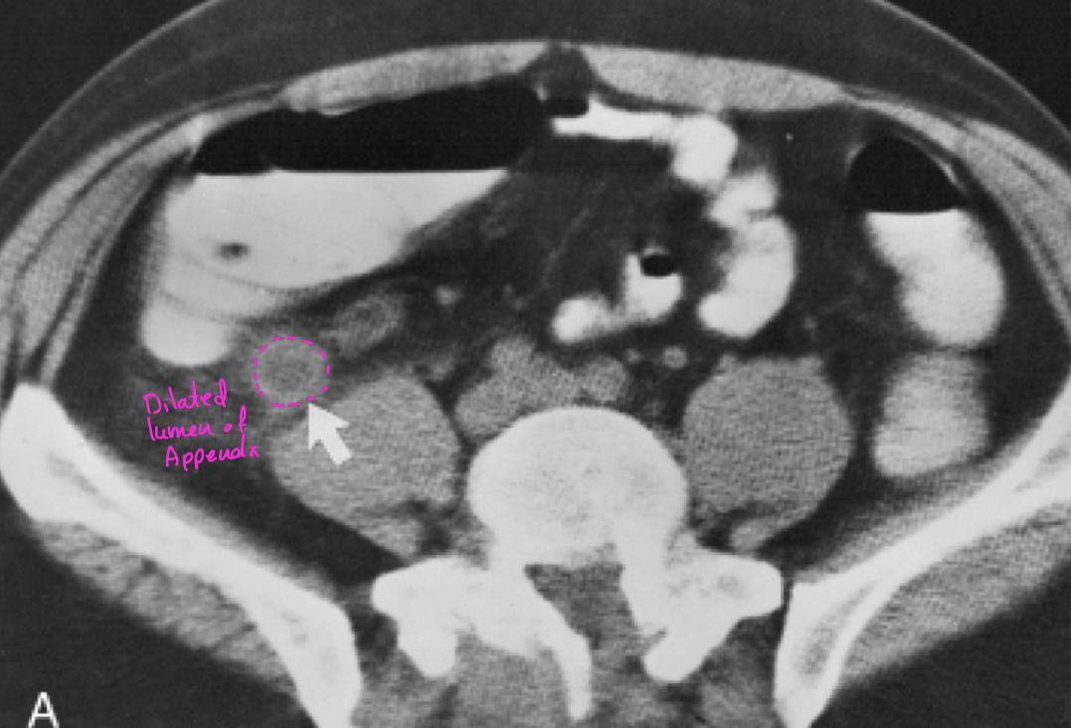
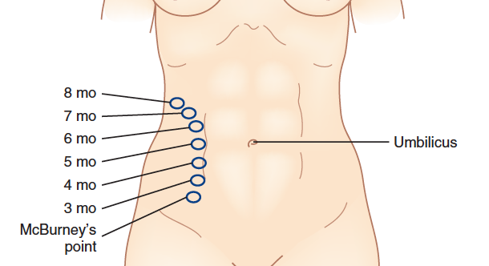
Case
19 year old man with periumbilical pain that shifted to RLQ
On exam febrile, sick and tender RLQ
CT scan These days having CT is one of the standard care to confirm the diagnosing. Or at least to have an US
What is the diagnosis? Appendicitis
There is non compressible lumen in the RLQ (arrow) with fast stranding around it. Fat stranding is a common finding on CT of the abdomen, when present, it directs the radiologist's to the site of pathology. It refers to an abnormal increased attenuation in fat.
The Atypical Patient
Pregnancy (physiological changes, management concerns) U/S Pregnant uterus will pus the appendix up
Pediatrics (Common is common, congenital causes, conservative) U/S US modality of choice
The Critically ill (ICU setting) CT Difficult to take Hx from intubated patient or patient with dementia
Immunocompromised (Not only HIV) CT Chemo/immunotherapy or any disease will impair the immune system
Morbid obesity (atypical, late) D/L Difficult to exam
Special Circumstances
Situations making diagnosis difficult
Stroke or spinal cord injury
Influence of drugs or alcohol
Severity of disease can be masked by:
Steroids
Immunosuppression (i.e. AIDS)
Beta blockers
Threshold to operate must be even lower!

Slide 12
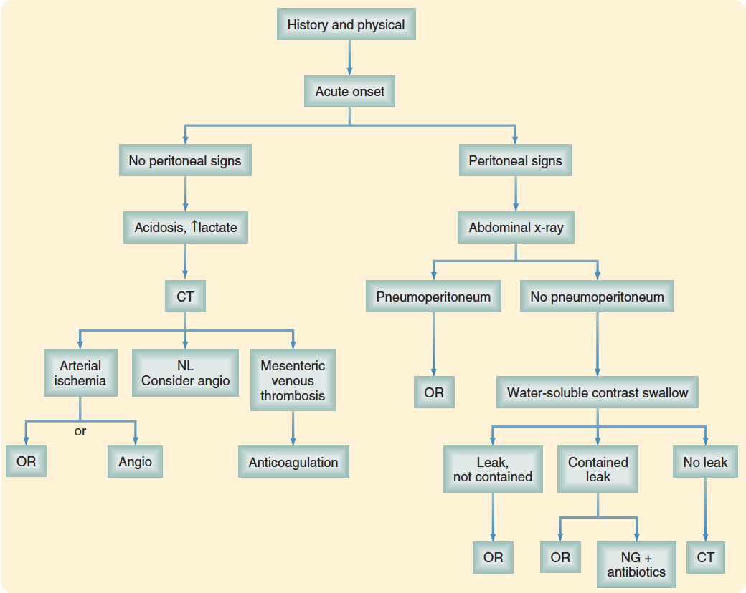
Emergency OR!!!
Peritonitis
Tenderness w/ rebound, involuntary guarding
“Unstable” (hemodynamically, or septic)
Tachycardic, hypotensive, white count Elevation
Intestinal ischemia, including
Strangulation
Closed loop obstruction Bowel is obstructed in two points, proximal and distal
Pneumoperitoneum
Complete or “high grade” obstruction
Radiological term = dilated then narrow than normal
Think about medical causes
Normal lactate up to 2
Heparin then warfarin
depend in your clinical judgment.

Slide 13
*Important guides*
Failure to thoroughly examine and document findings
Failure to perform a rectal or vaginal examination when appropriate
Failure to evaluate for hernias, including the scrotal region
Failure to conduct a pregnancy test or to consider pregnancy in the diagnosis
Failure to reassess the patient frequently while developing a differential diagnosis
Failure to reconsider an established diagnosis when the clinical situation changes
Failure to recognize immune compromise and to appreciate its masking effect on the historical and examination findings
Allowing a normal laboratory value to dissuade a diagnosis when there is cause for clinical concern
Failure to consult colleagues when appropriate
Failure to take age- and situation-specific diagnoses into consideration
Failure to make specific and concrete follow-up arrangements when monitoring a clinical situation on an outpatient basis
Hesitancy to go to the operating room without a firm diagnosis when the clinical situation suggests surgical disease
Take Home Points
Careful history (pain, other GI symptoms)
Remember DDx in broad categories
Narrow DDx based on hx, exam, labs, imaging
Always perform ABCs, Resuscitate before diagnosis
Don’t forget GYN/medical causes, special situations
Common things are common in acute abdomen

