Slide 1
Critical care and small bowel obstruction
Surgery Team
MED437
Team Leader: Rawan Mishal
Team Members: Majd Albarrak & Rawan alharbi
Revised By: Arwa aljohany

Slide 2
Critical
Care

Slide 3
Critical Care
Historically, we recognized that the needs of patients with acute, life threatening illness or injury could be better treated if they were grouped into specific areas of the hospital. Intensive care began in the United States in 1920’s, when W.E. Dandy established the first 3-bed neurosurgical ICU at Johns Hopkins Hospital in Baltimore.
Critical Illness
Acute life threatening conditions that require close and frequent assessment
and multidisciplinary care.
Trauma | Sepsis | Respiratory failure | ACE (acute coronary events) | ETC.
Critical Care Unit
A section in the hospital that is equipped to deal with critically ill patients.
General ICU | Surgical ICU | Medical ICU | Neuro ICU | ETC.
Advantages/ Disadvantages of Critical Care Unit
The chief advantage is that it provides better and more organized care.
The main disadvantage is of a hostile environment contributing to anxiety, emotional stress, loneliness, fear and a greater risk of developing nosocomial
infections.
ICU Multidisciplinary Team
ICU medical team, (consultant, assistants, residents, etc.)
Nursing, (specialized in critical care, 1:1 - 2:1 ratio ideally) every nurse has 1-2 patients only
Respiratory therapy.
Dieticians
Clinical pharmacists
Physiotherapy
Occupational therapy.
Social worker
Consultation services, (Radiology, ENT, Surgery, Nephrology, etc.

Slide 4
ICU Multidisciplinary Team
Provide advanced care to ICU patients
Multi-disciplinary management plan.
Advanced and tight monitoring of vital signs.
Resuscitation and maintaining vital functions during critical illness.
Provision of life-saving treatment modalities.
Hemodynamic Monitoring
Monitoring provides an early warning of adverse changes or trends before
irreversible damage occurs.
Monitoring reflects physiologic homeostasis, allows prompt recognition of responses to therapeutic interventions, allows prompt recognition of adverse changes.
What is the most important monitor?
– Vigilance!
Monitoring Modalities
Vigilant Physicians (Subjective data)
Monitors
(Visual, Tactile, Auditory, Olfactory)
Standard Monitoring Equipment (Objective Data) every monitor should have these five:
Pulse Oximetry
Capnography
Body Temperature
ECG
Systemic Blood Pressure
Monitoring That Requires No Instrumentation
Inspection
Skin (Is there normal capillary refill? Delayed return suggests abnormality in regional or systemic circulation) capillary refill is better way to assessing response to fluid
Palpation
Skin (Is the patient warm or cold and clammy)
Pulse (Presence/Absence of pulse)
Skeletal muscle (Are muscles fasciculating)
Auscultation
Chest (Listen for breath sounds over both lung field, is there paradoxical breathing)
Heart (Are sounds muffled, or murmurs present)

Slide 5
Non-Invasive Hemodynamic Monitoring
Noninvasive BP
Heart Rate, pulses
Mental Status
Skin Temperature
Capillary Refill
Urine Output
Minimal Monitoring Standards
Oxygenation (inspired gas and saturation of arterial blood (SpO2))
Ventilation (capnography and clinical assessment)
Circulation (ECG, arterial blood pressure)
Temperature
Neuro-vitals (GCS, mental status)
Pulse Oximetry
Assess the oxygenation of blood
Reduced (or deoxygenated) hemoglobin (Bluish)
Oxygenated hemoglobin (Red)
How it works?
A probe send light impulses into a finger and collects the light that pass through it.
The units estimates the proportion of oxyhemoglobin to reduced Hb
SpO2 – the saturation based on pulse oximetry
SaO2 – the saturation obtained from direct arterial blood sample
Pulse Oximetry
Acceptable readings depend on the clinical condition, and trends must be considered.
Limitations:
Cannot differentiate between different forms of hemoglobin.
Environmental interference: vibration at 0.5-3.5 Hz, excessive movement and perhaps high level of ambient light, including infrared heat lamps.
Cold hands -Poor perfusion.
Nail polish.
Intravascular dyes
Can't give PCO2 (need ABG)
Electrocardiogram (ECG)
Provides information on
cardiac arrhythmias | myocardial ischemia/infarction
electrolyte changes, particularly potassium
ECG is not a measure of heart function
ECG reflects only the electrical activities occurring in the heart

Slide 6
ECG
Lead V5 is the most sensitive lead for detecting ischemia
Lead II is the most sensitive lead for detecting arrhythmias
P waves are best seen on Lead II (lead II best to detect arrhythmia)
best to observe the cardiac rhythm.
Blood Pressure (Bp) Monitoring
BP monitoring is commonly performed either:
Indirectly – noninvasive cuff around extremity
Directly – inserting catheter into artery
Blood Pressure (Bp) Monitoring
Systolic Blood Pressure (SBP)
Pressure which ejected blood will overcome to perfuse vessels distally
Diastolic Blood Pressure (DBP)
Pressure under which the blood flow will be laminar
Pulse Pressure = SBP – DBP
Mean Arterial Blood Pressure (MAP) = 65
Time weighted average of arterial pressures during a pulse cycle
MAP = [SBP + (2 x DBP)] / 3
Non-Invasive Bp Monitoring
Mechanical deformation from the blood pressure cuff of an artery leads to the creation of Korotkoff sounds result from turbulent flow
The appearance of the first Korotkoff sound is the systolic blood pressure
The disappearance of the Korotkoff sound signals the diastolic blood pressure.
American Heart Association recommends
Bladder width: approximately 40% of the circumference of the extremity
Bladder Length: sufficient to circle at least 60% of the extremity
Falsely low estimates occur:
after quick deflation
when the extremity is above the heart
when cuffs are too large
Falsely high estimates occur when:
cuffs are applied too loosely
when the extremity is below heart level
when cuffs are too small
Complications: (non invasive not mean very safe)
Hematomas results due to increase venous pressure after failure to deflate the cuff
Delayed cuff deflation can result from shivering and tremors
Ulnar neuropathy can occur due to compression of the ulnar nerve

Slide 7
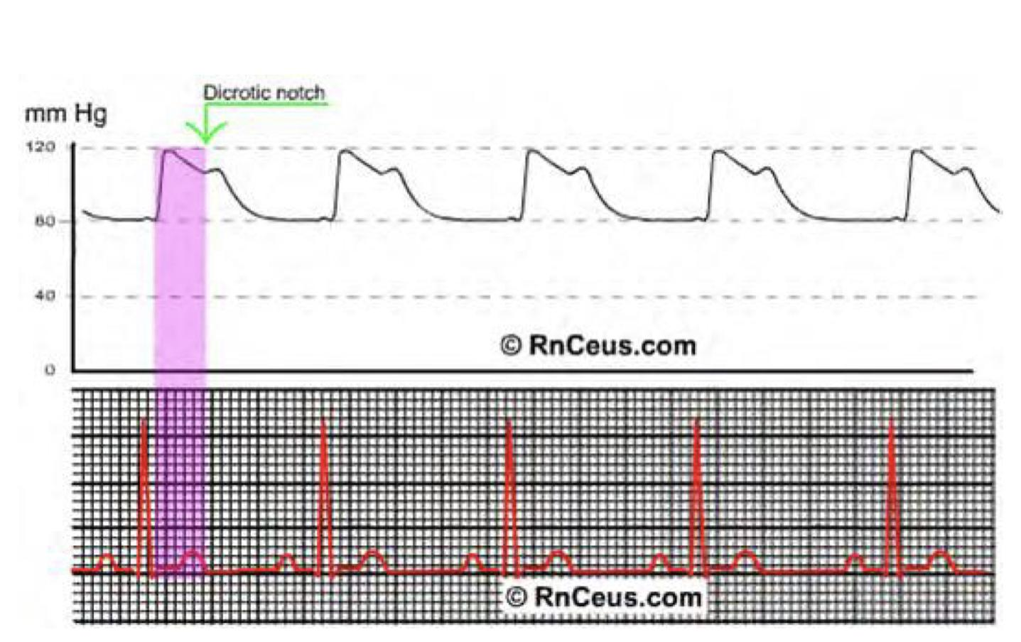
Invasive BP Monitoring best in sick patient & very accurate
Provide beat to beat blood pressure reading (real time) while in non invasive BP monitoring can repeat after 2 minutes at least
Reliable access for analysis of arterial blood gases, pH, and/or electrolytes Usually we put 2 lines: Central line → to give medications | Arterial line → ABG + BP monitor
New technologies enable cardiac output estimation from invasive BP monitoring
Indications: Expected rapid changes in hemodynamic stability (shock)
Induced hypotension, acute hypotension
Inability to achieve noninvasive monitoring
Use of Vasoactive drugs
Frequent blood gas monitoring. examples: respiratory failure & covid patients
Site: Radial artery is the most frequent site easy access
Can be at femoral artery or brachial artery more complications
Dorsalis pedis rarely.
Rate of upstroke indicates contractility
Rate of downstroke indicates peripheral vascular resistance
Dicrotic notch reflects the closure of the aortic valve
The farther out the dicrotic notch the lower the SVR or peripheral vascular resistance
Complications
Hematoma & Bleeding
Vasospasm
Arterial Thrombosis
Distal Emboli
Central Venous Access
Monitoring central venous pressure (CVP)
Rapid administration of fluid to treat hypovolemia and shock (i.e. acute hemorrhaging)
Infusions of drugs (a lot of medications can't give to patient by peripheral vein especially epinephrine & Norepinephrine bc it cause vasospasm → ischemia)
Long-term IV Feeding (i.e. Hyperalimentation)
Insertion of Transcutaneous pacing leads
Venous Access in patients with poor peripheral veins
Infection and Necrosis
Air embolism
Unintentional intraarterial drug injection
Pseudoaneurysm
Damage to adjacent nerves

Slide 8
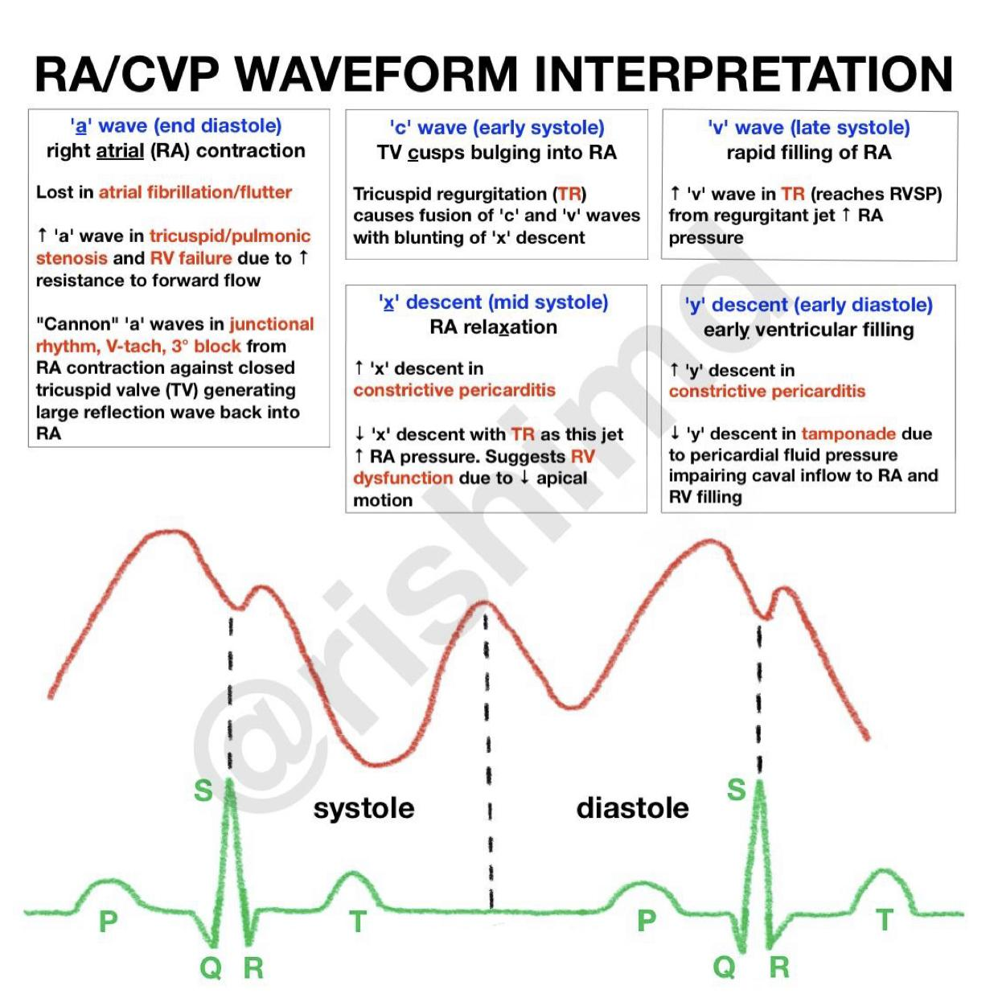
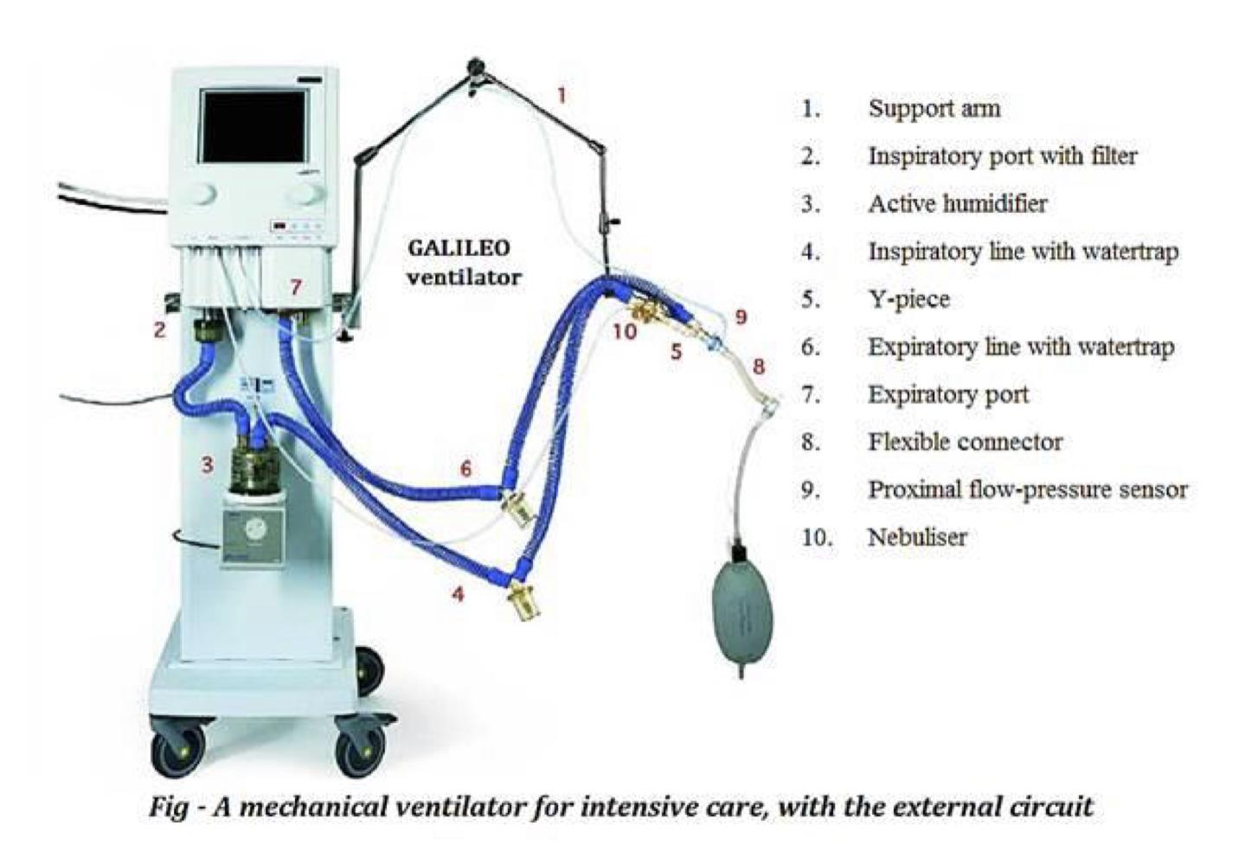
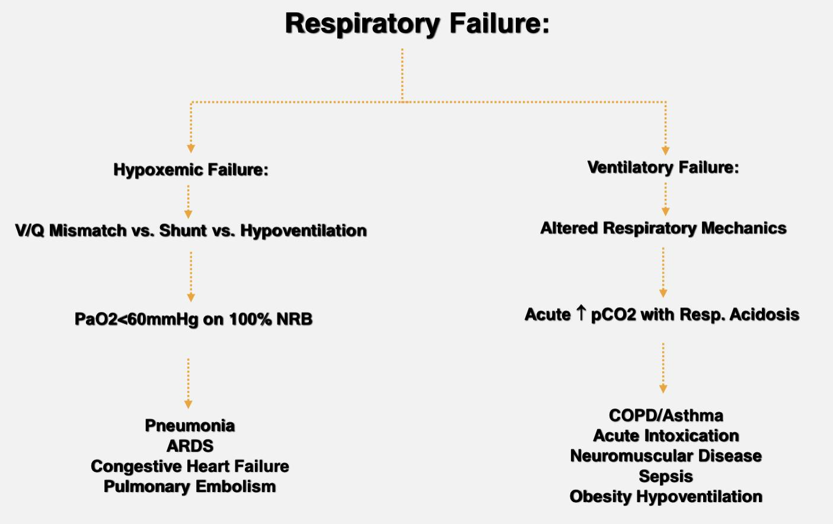
Central Venous Pressure rarely used nowadays
Central venous pressure parallels right atrial pressure.
Normal pressures might range from -2 to 12 mmHg in a spontaneously breathing patient.
Pressures of 6 to 15 mmHg (or more with high peak inspiratory pressures) can be expected on mechanical ventilation.
The shape of the central venous waveform corresponds to the events of the cardiac contractions.
Elevated Central Venous Pressure (a lot of false elevations)
Tricuspid Stenosis
Tricuspid Regurgitation
Pulmonary Hypertension
Mitral Stenosis
Mitral Regurgitation
Mechanical Ventilation
Mechanical Ventilation
Indications
Three peak (a,c, and v waves) and two descents (x,y) can be seen in a normal CVP waveform.
LV Failure
Volume Overload
Cardiac Tamponade
Arrhythmias
Increased PVR (Anxiety, Pain)
Delivery of ventilation and supplemental Oxygen with a mechanical ventilator to support a patient experiencing Respiratory Failure.

Slide 9
Respiratory Failure
Arterial Blood Gas Abnormalities:
Hypoxemia:
PaO2<60mmHg or O2 sat < 90% on 100% NRB
Hypercapnea:
Acute: pH 0.08 for pCO2 10mmHg
Chronic: pH 0.03 for pCO2 10mmHg
Clinical Impression:
Use of Accessory Muscles
Inability to Speak in Full Sentences
Paradoxical Respirations
Altered Mentation
Cardiopulmonary Arrest: When Respirations and Pulse Cease
Starting Mechanical Ventilation
Need a Conduit:
Endotracheal Tube: Invasive Mechanical Ventilation
Face Mask: Noninvasive Mechanical Ventilation (NPPV)
Deliver Cyclical Positive-Pressure ‘Breaths’.
Provide Supplemental Oxygen.
Minimize Complications.
Assessment Of A Patient In The ICU (Hourly)
The Flow Sheet: Recording round the clock information of different organ systems.
Vital signs
Neurological Status
Haemodynamic Parameters
Ventilation settings
Respiratory parameters
Input/output
Laboratory Data
Medications
Systematic daily oriented team rounds with accurate transmission and discussion of all clinical information from head to toe.
Identification/problem list
Major events during the last 24 hrs
By system approach; CNS, Cardiovascular, Respiratory, GI, Renal/metabolic, Heme/ID, tubes, etc.
Documented note containing problem list and plan for all of the above.
PO2 < 60 → Respiratory failure
PCO2 (High) → Respiratory failure (HYPERcapnia)

Slide 10
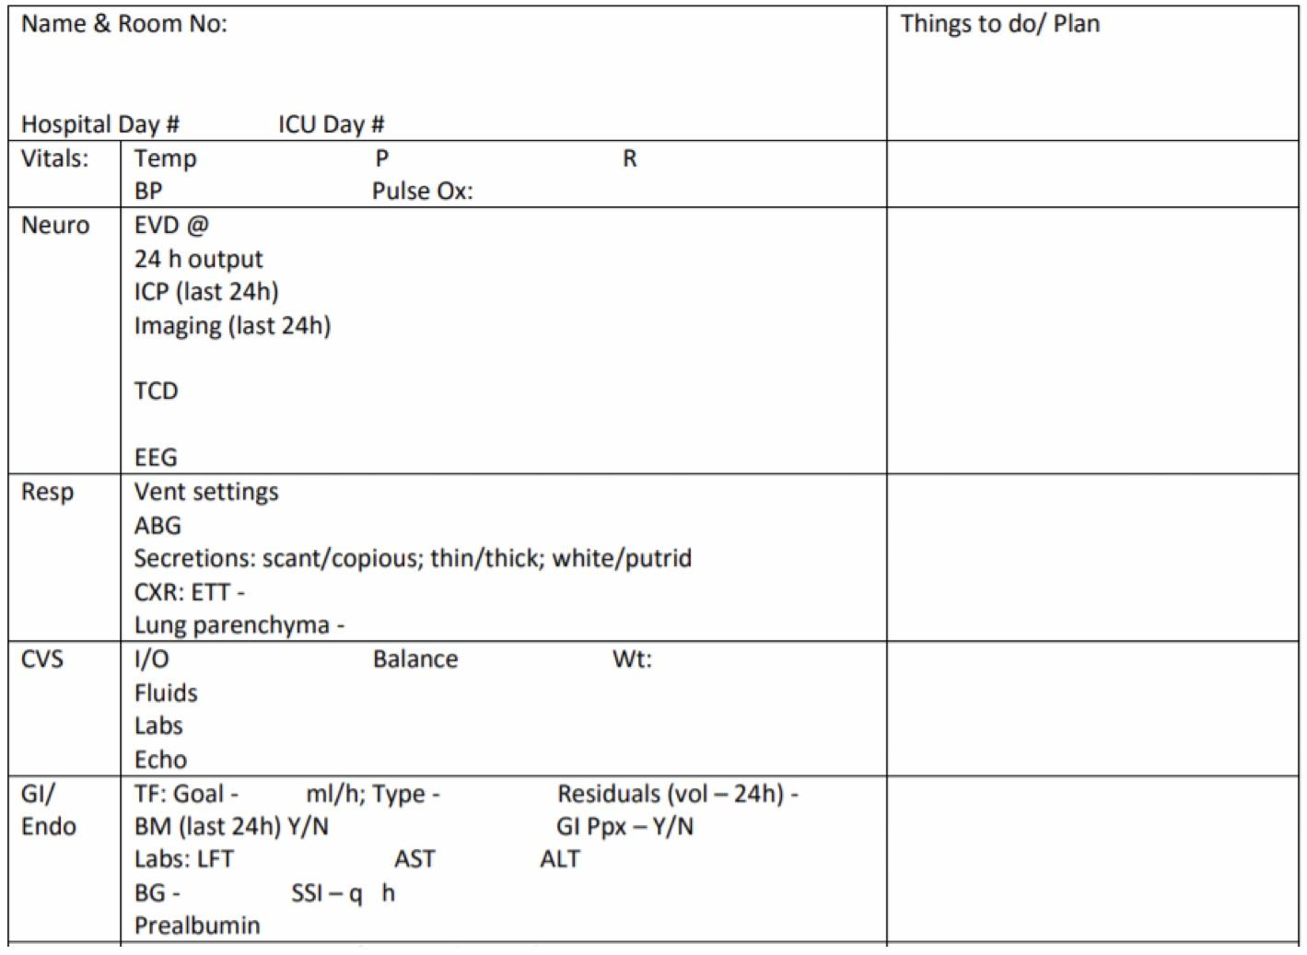
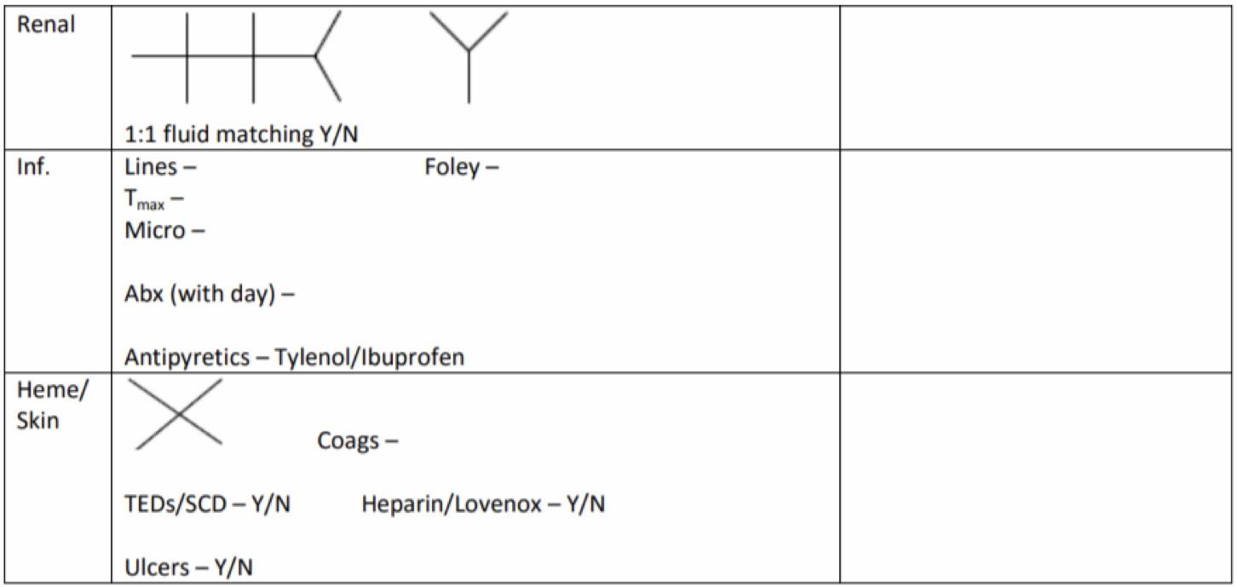
ICU Note
Who Get Icu Admission
Acute life-threatening illnesses which are potentially reversible
Acute illnesses with potential and likely to occur life-threatening complications
Monitoring of vital parameters of patients with symptoms/signs that suggest the possibility of an evolving life-threatening illness.
Common Scenarios In ICU
A 73 year old lady with a history of ischemic heart disease, HTN, DM II
presents to the ED with altered mental status. She is febrile to 39.4,
hypotensive (BP 80/40) with a widened pulse pressure, tachycardic (HR 121),
with warm extremities and decreased urine output.
How would you manage this patient?
SEPTIC SHOCK
ICU admission
Hemodynamic monitoring.
Resuscitation with fluids, vasopressors.
Pan cultures, looking for source of sepsis
Treatment and reversal of condition. ( antibiotics, drainage, etc.)
Monitoring and prevention of complications. ( respiratory failure, ARDS,
multiorgan failure, etc.)

Slide 11
A 71 year old gentleman with a history of ischemic heart disease, HTN, DM II
presents to the ED with altered mental status and slurred speech since
morning. His BP is 190/90, HR 111/min. On exam he has right facial drop,
slurred speech and left sided arm weakness.
How would you manage this patient?
STROKE
ICU admission
Hemodynamic and neurovitals monitoring.
Blood pressure control.
Workup of possible stroke, type, risk factors etc.
Monitoring and prevention of complications. ( hemorrhage, re stroke, seizures, respiratory failure, etc)
A 63 year old lady with a history of DM, IHD and previous stroke with no
deficit has just had a Whipple procedure for pancreatic carcinoma. The surgery
lasted for 6 hours and was complicated with major bleeding requiring multiple
transfusions.
How would you manage this patient?
BLEEDING
ICU admission
Hemodynamic monitoring.
Resuscitation with fluids, blood products, and vasopressors.
Monitoring and prevention of complications.
recurrent bleeding.
leak
compartment syndrome
fluid overload
Post op acute coronary syndrome.
Seven ‘C’s Of Critical Care
Compassion
Communication (with patient and family).
Consideration (to patients, relatives and colleagues) and avoidance of Conflict.
Comfort : prevention of suffering
Carefulness (avoidance of injury)
Consistency
Closure (ethics and withdrawal of care).

Slide 12
Small Bowel Obstruction

Slide 13
Intestinal Obstruction
One of the common cause of acute abdomen. May lead to high morbidity and mortality if not treated correctly. It can be classified according to:
(1) Pathology (types): Dynamic (mechanical) & Adynamic
(2) Pathological changes: simple, strangulation & closed loop
(3) Onset: acute, chronic, acute on chronic & subacute
1. Pathology (types):
Dynamic (mechanical): where peristalsis is working against a mechanical obstruction. Something physical causing obstruction
It can be classified according to:
(A) Anatomy:
Small bowel obstruction (SBO) proximal
high -> early profuse vomiting rapid dehydration
low-> predominant pain, and central distention, Vomiting delayed, multiple central air-fluid levels seen on AXR
Large bowel obstruction (LBO) distal
early pronounced distension, mild pain vomiting, late dehydration e.g. carcinoma common, diverticulitis or volvulus
If obstruction proximal (close early) the space is so small , so it will filled up quickly, and cause vomiting > dehydration, while in distal obstruction the space is larger therefore it can be easily filled with bowel content and causes distension
(B) Site (lumin):
Intraluminal inside: impacted faeces, foreign bodies, gallstones, Bezoars. Rare
Intramural bowel wall : tumors, inflammatory strictures. Common
Extramural outside: adhesion, hernias, volvulus (loop of intestine twists around itself), intussusception, tumors
Adynamic: mechanical element is absent. Functioning as obstruction
- Peristalsis my be absent (paralytic ileus)
- May be present in non propulsive form. (mesenteric vascular occlusion or pseudo-obstruction)
2. Pathological changes:
Simple: blockage without interfering with vascular supply patient stable
Strangulation: significant impairment of blood supply most commonly associated with hernia, volvulus, intussusception, mesenteric infarction, adhesions/Bands surgical emergency patient sick Tachy, signs of acute abdomen, rebound tenderness
Closed loop obstruction: bowel is obstructed at both the proximal & distal end (This is worse because this loop will get dilated then ischemic then it will perforate)

Slide 14
3. Onset:
Acute obstruction:- usually in small bowel
obstruction with severe colicky central abdominal pain, distension, early vomiting and constipation.
Chronic obstruction: -usually in large bowel
lower abdominal colic & constipation followed by distension.
Acute on chronic: usually masses (cancer) short history of distension & vomiting against background of pain & constipation, masses narrowing the lumen (without close it) then suddenly enlarged cause obstruction
Subacute obstruction: incomplete obstruction.
Causes
Adhesions- 40%
Tumors -15%
Inflammatory- 15%
Obstructed hernia-12%
Intraluminal-10%
Miscellaneous -8%
Pathophysiology
Proximal to obstruction
Increased fluid secretion abdominal distention, Accumulation of gas abdominal distention, Increased intraluminal pressure (may lead to venous congestion → ischemia), Vomiting, Dehydration, Dilatation of bowel, Reflex contraction of smooth muscle → colicky pain, Increased peristalsis to overcome obstruction → increased bowel sounds, If obstruction not overcome → bowel atony, Decreased reabsorption with time and flaccidity to prevent vascular damage from high pressure
Distal to obstruction: nothing is passed & bowel collapse → constipation
Symptoms
The four cardinal features of intestinal obstruction:
Abdominal pain
Vomiting
Distension
Constipation (diarrhea 1-2 days then constipation)
Vary according to:-
location of obstruction
Duration of obstruction
underlying pathology
intestinal ischemia (complication)
60 years old, virgin abdomen, distention, “chronic symptoms” vomiting & constipation → malignancy
Many surgeries before, previous obstruction, presents with obstruction → Adhesions

Slide 15
Abdominal pain
- colicky not peritonitis in nature, around the umbilicus in SBO while in the lower abdomen in LBO
- if it becomes continuous, think about perforation or strangulation.
- does not usually occurs in paralytic ileus.
Pain in abdomen unless there is itis (peri, cholycy, appendicitis) they will have visceral pain
Vomiting
- starts early in SBO and late in LBO
- As obstruction progresses vomitus alters from digested food to faeculent due to enteric bacterial overgrowth
Distension
-more with large bowel obstruction (LBO)
In strangulation: You need to know how sick the patient is How? By these signs
severe constant abdominal pain
fever
tachycardia (if not responding to fluids)
tenderness with rigidity/rebound tenderness (signs of peritonitis)
shock
Signs
1. General examination (OSCE station usually)
Vital signs
Signs of dehydration –tachycardia, hypotension, dry mucus membrane, decreased skin turgor, decreased urine output
2. Inspection
distension, scars (adhesion), peristalsis, masses, hernial orifices (very imp to mention in OSCE)
3. Palpation
tenderness, masses, rigidity
4. Percussion
tympanitic abdomen
5. Auscultation (if absent sound = ileus)
high pitched bowel sound or silent abdomen
*You should mention I will complete my examination with digital rectal examination
*Examine rectum for mass, blood, feces or it may be empty in case of complete obstruction

Slide 16
Investigations
If patient unstable → OR
CBC, High WBC (neutrophilia with strangulation) every patient
Hyperkalemia, hyperamylasemia & raised LDH may be associated with strangulation every patient
Plain AXR every patient , best initial
Sigmoidoscopy (only in carcinoma, volvulus , contraindicated in SBO)
Contrast x-ray
CT abdomen If stable patient , this is gold standard for non sick pt
Adhesions = CT with contrast
Peritonitis , guarding = laparotomy
Strangulation + hernia + discoloration = surgery, no imaging
Management
NPO
NG tube decompression to removes fluids, gas & helps relieve pain & pressure, sometimes this is enough for adhesions
IV rehydration
Monitoring In’s and Out’s
IV antibiotics usually not need except in certain cases i.e peritonitis
Frequent clinical assessments
Some cases (adhesive small bowel obstruction without complications like strangulation or ischemia ) will settle by using this conservative regimen, (you can wait till 3 days “ 72 “ then go for surgery) other need surgical intervention.
Surgery should be delayed till resuscitation is complete unless signs of strangulation and evidence of closed- loop obstruction.
Cases that show reasons for delay should be monitored continuously for 72 hours in hope of spontaneous resolution e.g. adhesions with radiological findings but no pain or tenderness
“The sun should not both rise and set” in cases of unrelieved obstruction.
Surgery
Assess bowel viability (If healthy → treat | if not healthy “dead” → remove)
Then treat the cause:
Adhesions → Adhesiolysis
Mass → Resection
Hernia → Repair
Etc
Indication for surgery:
- Virgin abdomen. (No previous surgery)
- Failure of conservative management
- Complications: (tender, irreducible hernia & strangulation)

