Slide 1
Patient Safety & invasive procedures
Surgery Team
MED437
Team Leader: Rawan Mishal
Team Members: Aseel Badukhon
Revised By: Arwa aljohany

Slide 2
Patient Safety Incidents
Definition:
[
[
These are preventable events that may cause unnecessary harm to the patient
Patient safety has become a well established healthcare discipline with structured approaches which guarantee that all affected patients are cared for and informed
Classification of patient safety incidents:
Adverse event | Near miss | No-harm event
This is an incident that leads to patient harm. such as injury to an organ intraoperatively. | This is an incident which could have caused unaccepted consequences but did not occur, either by chance or by preventing the occurrence of the event in appropriate time. Such as prophylactic antibiotics or prophylactic medications for the DVT or PE | This is an incident which occurs but did not harm the patient
Common causes of adverse events in healthcare:
The most common factors that result in patient safety incidents are inadequate communication between:
The members of medical staff¹
The medical staff and the patients or the members of the patient family²
Notes:
1.Such as the communication between the junior residents with the registrars or consultants and nurses. (Very common)
2.Such as taking consent from the patient, what is an informed consent? It is when you explain to the patient the procedure possible complications, the outcome of the procedure and the alternative treatment options. You should know the components of informed consent:Diagnosis, procedure, adverse events, benefit, alternative options and consequences of refusing taking treatment / doing the procedures

Slide 3
Patient Safety Incidents
Causes of patient safety incidents:
Human Factors | System Failures | Medical Complexity
-Inadequate patient evaluation. History and physical examination (common). Your investigations depend on this assessment -Delay or error in the diagnosis. In case of peritonitis you should know that you need xray not CT -Inappropriate use or interpretation of investigations. It is very common -Error in doing an investigation, procedure. or treatment. -Inappropriate follow up or monitoring of the treatment. Pt underwent major procedure and you didn’t monitor them post operatively -Lack of experience -Work overload and pressure of time. Like when you are on-call and you have a lot of patients error and adverse events occur more commonly. Also, in ICU OR and emergency -Psychological or personal reasons (e.g. depression or drug abuse) -Variation in patient and environment of the workplace. ICU & emergency vs general wards vs OR | -Inadequate communication between the medical staff. especially during handover -Inadequate levels of medical staff. Junior staff doing a complicated procedure -Shut down of the reporting systems -Inadequate coordination between the staff at the handovers -Similarities between drugs. Like cephalosporins and penicillin -Environment infrastructure and design -Failure of the equipment, due to the lack of parts or skilled expertise. When you plan a procedure, you should make sure that all instruments are there in the OR. -Policies of cost-cutting taken by the health institute. Health institute want to reduce the cost so they end up not preparing the adequate facilities for surgical procedures or service -Inappropriate reporting systems of the incidents in patient safety. Such as OVR, morbidity and mortality that reflects the quality of the work | -A new advanced technologies (e.g robotic surgery, laparoscopic surgery). It needs experience -Side effects and interactions of medications -Place of work (emergency room, operating theaters, intensive care unit). More complicated place of work than general wards.

Slide 4
The Real Working Conditions, beyond your lectures
Patient safety in the real working conditions:
Communication opnely with patients and obtaining consent
As mentioned before, it has to be an informed consent. If the patient does not understand you, explain it to one of the family members
The required information when obtaining the consent
Details and accuracy of the diagnosis.
The goals and details of the planned procedure.
The possible complications of the planned procedure.
The possible prognosis.
Other treatment options, including the not to treat option.
Explanation of the advantages and possibility of success for each option.
The name of the responsible surgeon.
At any time, the patient can change his or her mind. Document this!!
Professional behaviour
This is very important as patient trusts the physicians based on their behaviour and the way they take history and perform the examination
Communication between the medical staff
Reporting adverse events and near misses
Prescribing safely. One of the most common problems on every hospital: Error in prescription
Inadequate clinical evaluation.
Inadequate information about the drugs.
Errors in the calculation of the dose.
Unclear handwriting. This is very common
Confusion in the name of the patient or mixing up of drugs. Mistake the dose or duration or frequency & this is the most common in hospitals when the drugs are prescribed by junior staff

Slide 5
The Real Working Conditions, beyond your lectures
Patient safety and the surgeon:
More than one cause of adverse events can be applied to many aspects of patient care during the perioperative period. The adverse events in the surgical practice that can potentially be committed by the treating surgeons in the patients care includes:
Prophylaxis errors. Common prophylaxis that we give the patients, antibiotics and anti thrombotics for PE. More common
Prescription errors.
Parenteral administration errors. Such as blood transfusions
Awareness of situation, and teamwork errors.
Diagnostic and management errors.
Resuscitation errors.
Procedure technique and operative errors.
Situation awareness - identifying teamwork errors:
The wrong patient was taken to the OR
Wrong site or side of surgery¹
Wrong procedure or surgery
Communication failure about changes in the condition of the patient²
Retained swabs or instruments³
Notes:
1.Most common surgery for this to happen is hernia
2.Such as if the patient has chest pains the night prior to surgery it could be an MI so the patient needs to be re-evaluated for surgery and the procedure postponed (common).
3.nurse responsibility. This is now avoided by counting them (sign in, sign out; always count)

Slide 6
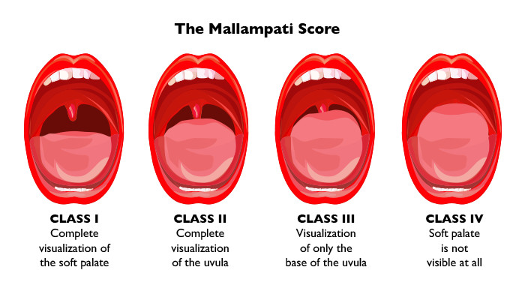
Checklists (IMP)
Sign in | Time out | Sign out
Before induction of anaesthesia, this includes: 1. Confirmation of patient identity Name and number 2. Site and nature of procedure 3. Obtaining consent 4. Marking the site of procedure very imp 5. Complete anaesthesia safety check: • Functioning pulse oximeter on patient •Check for known allergy • Risk for difficult airway or aspiration with available equipment and assistance. Mallampati score* •Risk of blood loss more than 500ml with adequate intravenous access and fluids are available. Common concern for the surgeon in an operation is bleeding and the anesthesiologist a difficult airway. | Before skin incision. This includes: 1. All team members must introduce themselves by name and role. 2. Nurse verbally confirm: -The identity of the patient -Site and nature of the procedure -Anticipated critical events This is very important, for example I’m doing a whipple procedure the critical event is bleeding. Surgeon should mention what are the critical steps, duration of the procedure, expected blood loss Anesthesia team should mention any patient-specific concerns Nursing team should review the sterility been confirmed, equipment is available, any issues or any concerns, antibiotic prophylaxis has been given within the last 60 minutes, essential imaging is displayed. Antibiotics are usually given before the skin incision by 30-60 mins | Before the patient leaves the OR. This includes: 1. Nurse should confirm verbally with the team: •The name of the procedure recorded •The instrument, sponge and needle counts are correct • Any equipment problems to be addressed. 2. The surgeon, anesthesia, and nurse review: • The concerns for recovery and management of the patient. If the pt became hypotensive intraoperatively or they have a critical situation and stability or the management of the pt if he needs to be admitted to the ICU and it wasn’t planned before the surgery •The specimen is labeled including the patient name. Very important to do
*Good to recall:

Slide 7
Others
Technical and operative errors:
During the conduct of the operation Example: Laparoscopic cholecystectomy they injure the bile duct
Judgement errors (e.g. failure or late decision making to convert difficult laparoscopic into an open surgery).
Technical errors (steps of surgical procedure are not followed or omitted) Sigmoidectomy we injure the ureter
Aggressive handling of tissues that result in tissues damage.
Misinterpretation (this is unique to minimally invasive surgery due to the misreading of a two dimensional image) We injure the bile duct most commonly
Misuse of surgical instruments (e.g. diathermy) Might cause cautery of the blood supply of the bowl or perforation of the bowl that might cause post-op complications like peritonitis.
Missed iatrogenic injury (e.g. bile duct injury or bowel perforation)
Ethical aspect of surgery:
Informed Consent
The surgical problem and the reasons why it needs surgery.
The proposed surgical procedure and how it might treat the surgical problem.
The expected complications of the proposed surgery.
The anticipated prognosis.
The alternative and potentially successful treatments.
The consequences of no treatment at all.
Confidentiality
Nobody should know anything about the patient even his family.

