Slide 1
Principles of Laparoscopic surgery
Surgery Team
MED437
Team Leader: Rawan Mishal
Team Members: Aseel Badukhon
Revised By: Arwa aljohany

Slide 2
Overview of Laparoscopic Surgery (LS)
Definition:
Laparoscopy is a type of surgical procedure that allows a surgeon to access the inside of the abdomen and pelvis without having to make large incisions in the skin. This procedure is also known as:
Keyhole surgery
Or
Minimally invasive surgery
It is an operation performed in the abdomen or pelvis using small incisions (usually 0.5 - 1.5 cm) with the aid of a camera. 1.5 cm is the largest we can do, and even spleen and liver can be removed through this small incision!
Get your facts right, Laparoscopy VS Endoscopy:
Laparoscopy | Endoscopy
It is an operation performed in the abdomen or pelvis using small incisions with the aid of a camera. The laparoscopy aids diagnosis or therapeutic interventions with a few small cuts in abdomen | An endoscope is an illuminated optical, typically slender and tubular instrument used to look deep into the body by way of openings such as the mouth or anus, and used in procedures called an endoscopy. No incision! Endoscopes use tubes which are only a few millimeters thick to transfer in one direction

Slide 3
Overview of Laparoscopic Surgery
Get your facts right, Laparoscopy VS Endoscopy:
Laparoscopy
Endoscope
Advantages of minimally invasive surgery:
Notes:
Notes about advantages part:
-So in general laparoscopic procedures has a smaller incision (small scar 1 cm), therefore less pain (less nerve involvement) and earlier recovery and discharge, but because of the gas there will be more stress on respiratory and cardiac systems.
-Most important advantages are in red
Notes about limitations:
-IT support is important because it can impact the outcomes of surgery
Notes about Contraindications:
-Inability to get GA is an absolute contraindication while frozen abdomen (a lot of adhesions; know what can cause adhesion such as multiple laparotomies) and large tumor size are relative.
-Which tumor size is contraindicated? > 12 cm and you can not morcellate it
-A gasless approach can be done when lungs can’t ventilate the gas but it is too painful (we do it by separating the muscles)
-We can do it with epidural or spinal anesthesia but this is an advanced topic
Less pain
Less adhesion formation
Early recovery
Early return to work
Better cosmetic
Can get same outcome of standard approach
Limitations of laparoscopic approach:
Loss of tactile sensation
Need brain training
Need further training
Hospital administration and IT support
Contraindications of laparoscopy:
Others
Such as facility problems
Patient can not get general anesthesia
Number 1 contraindication
Tumor size limitations
Number 2 contraindication
Frozen abdomen
Number 3 contraindication

Slide 4
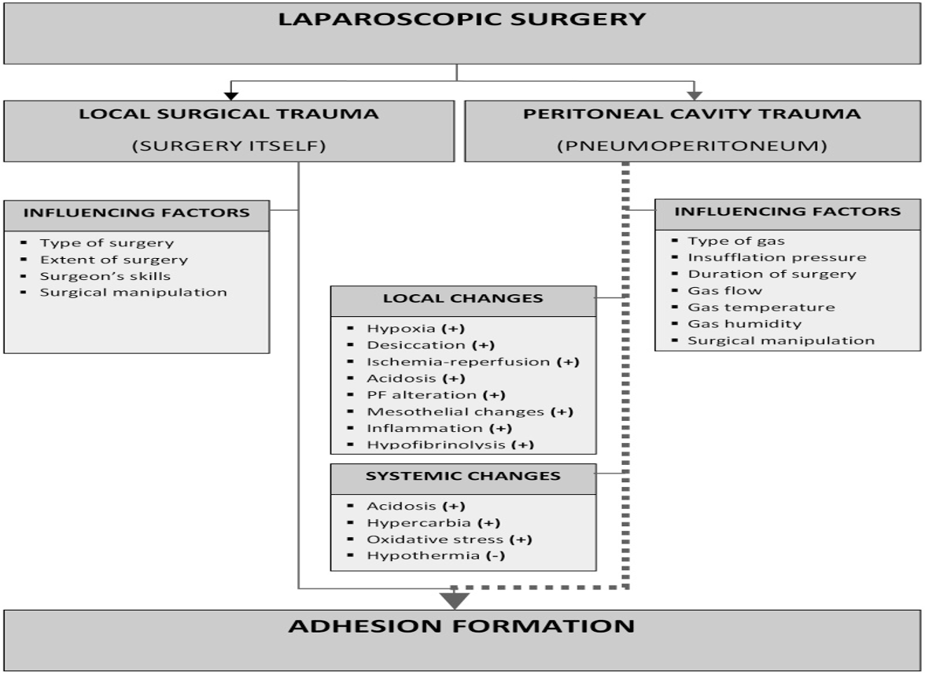
Overview of Laparoscopic Surgery
Trauma in Laparoscopic approach:
Surgical Trauma, Open VS Laparoscopic:
Both has same surgery stress response
More wound stress with open
More respiratory and cardiac with laparoscopic
Notes:
-Stress response means: Cortisol and aldosterone will increase and immunity will be stimulated but the difference the pain will be less.
-All types of stress are the same in both ways (open and laparoscopic) because there is a wound eventually no matter how big is it.
-Why more respiratory (particularly on diaphragm) and cardiac complications with the laparoscopic? CO2 insufflation causes increased intraabdominal pressure and hypercarbia. (HIGHLY RECOMMENDED ARTICLE ABOUT CARDIAC AND PULMONARY CONSEQUENCES OF LS)

Slide 5
Laparoscopic Tower
Main Principles of LS:
Same anatomy and surgical steps as open.
Recognize the content of laparoscopic tower
Update yourself about laparoscopic instruments (Disposable vs non-disposable, size and length..). Very important!!. All instruments are longer than opening procedures
Standard roles for applying trocars: First do the skin incision then use the trocar, finally use your instruments (if we don’t use trocars, muscle will contract every time you remove an instrument to the use the other. Also, leakage and contamination)
First principle of LS,
Never introduce or violate known anatomy
Do the scientific approved surgical steps
Only difference is the approach! (other things are same for the opening procedures)
Main pillars of any LS (content):
Gas
Light
Camera
To create space (air, water, non)
To illuminate the space
To transmit the picture to the screen
Notes:
-Open appendectomy incision is 3 cm while laparoscopic will be 1 cm, and with the help of magnification the view will be as if we are operating in a larger incision
-In LS we can use water if we are doing cystoscopy
-In OSCE they may ask you about the tower / content of LS

Slide 6
Laparoscopic Tower Content
Gas
The gas must have 10 features to be used in the procedure; ColorLess, odorless.. (see below for further details; VERY IMP)
There are 11 gases available: O, F, N, H, Cl, HE, NE, AR, KR, XE, RN
Air, oxygen, CO2, nitrous oxide, inert gases
Insufflator:
Flow 40 L/min
Set your pressure at 15 mmHg (12-15 is normal)
Observe recording pressure
Troubleshooting: No space and high pressure OR No space and high flow
Insufflator:
Odorless. It is inactive at room temperature and doesn’t react chemically with ordinary metals and any body structures
Nitrate can’t be used because is inflamable so we can’t use cautery , Helium is diffusible and can’t be used (it can cause subcutaneous emphysema) . Air has nitrogen so it doesn’t dissolve that is why we don’t use it because it may cause air embolism

Slide 7
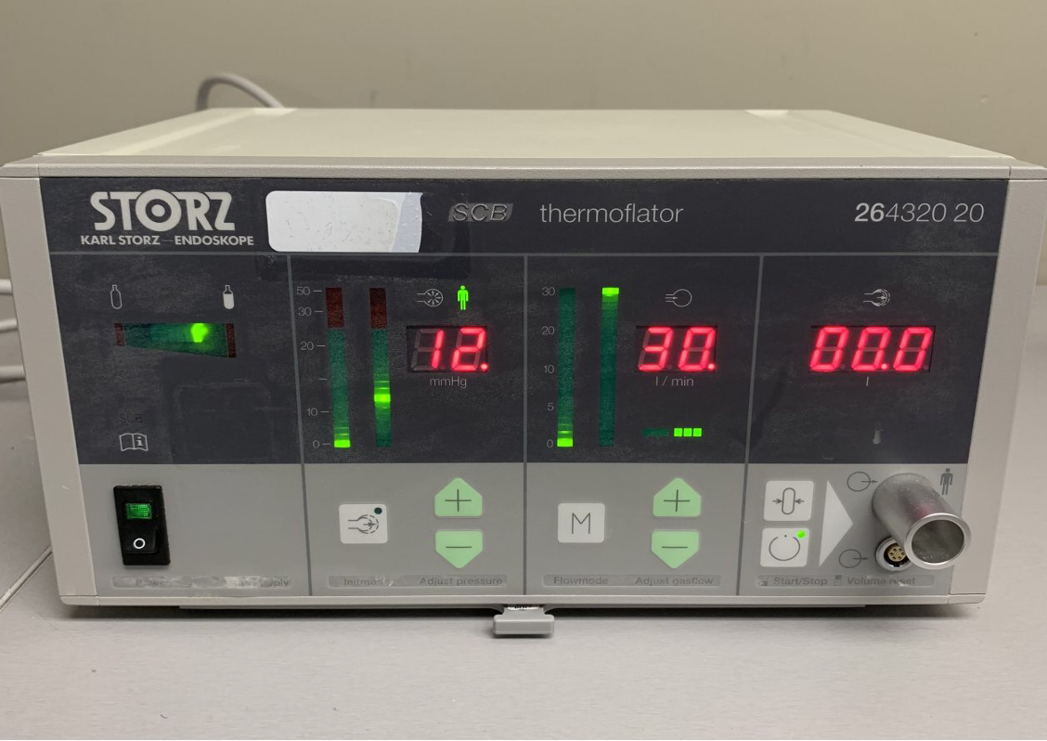
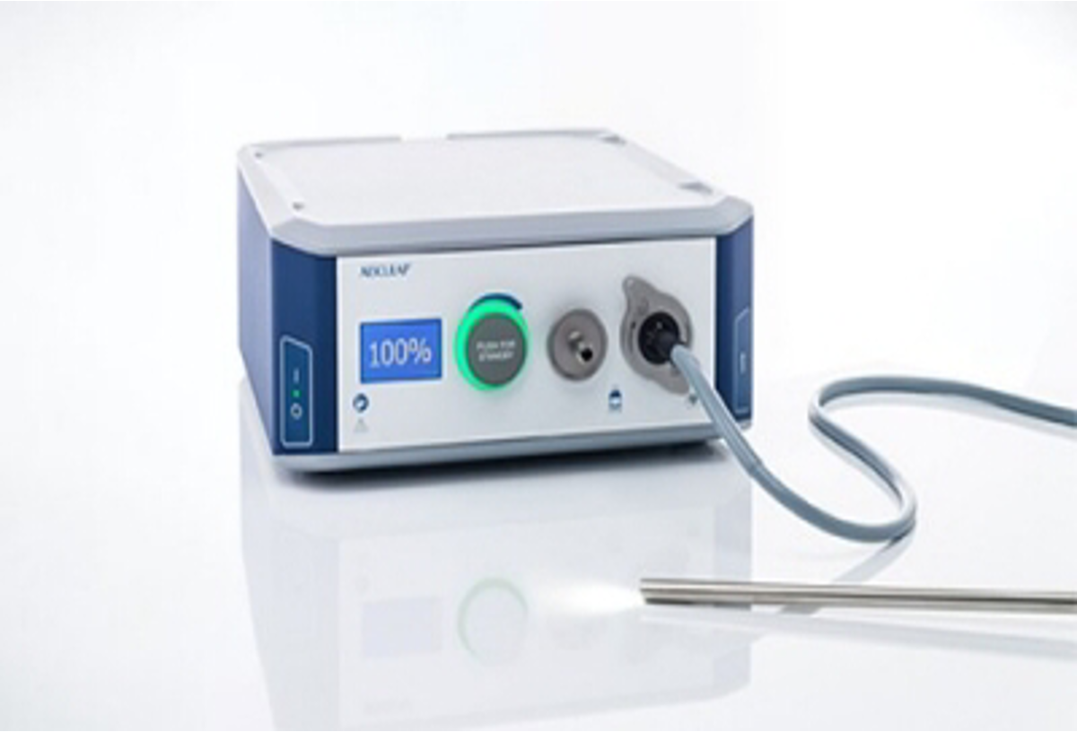
Laparoscopic Tower Content
Gas
Insufflator:
Notes:
1.The direction of green dot indicates the amount of gas in the cylinder; full (to the right) or empty (to the left)
2.Represents the amount of pressure inside the abdomen (mmHg). You can set the pressure. Green: This is actual pressure
Limit in peds is 10-12
Limit in adults is 12-15
Obese is 20
3.Insufflator (flow rate): If the pressure column is not moving then the flow rate will become zero. Higher flow is better to keep space intact not collapsed (best at 40 L/min)
4.Total amount used: with increasing time > this is increasing 200 is toxic to patient (it can cause acidosis)
-If you inflate abdomen to 20 you will have high pressure on IVC so venous return stops, and blood pressure drops down
1
2
3
4
Light
High intensity bulbs, Xenon,mercury, halogen
175-300 watt
Troubleshooting: Dark field
Turn on the light before white balance (You bring white object to the camera to recognize it as white not the light)
Notes:
Green: Where light comes out

Slide 8
Laparoscopic Tower Content
Camera
Imaging system: (Most important part)
Camera | It magnifies the endoscopic view 15 fold
Laparoscope | It is a rigid rod-lens and light conducting cable. Length (32 “for normal weight people” - 42 “For obese people” cm) Diameter (2,5,10 “For complicated cases where wider view is desired” mm) 5 mm and 10 mm are the commonly used Degree (0º, 30º, 45º)
Monitor | It has to be 19 inches or larger, same site of the operated organ
Troubleshooting: No picture
Types of laparscope:
There are two types of laparoscope:
Telescope rod lens (the standard)
Usually it is connected to a video camera (single or three chip)
Digital laparoscope
Where a miniature digital video camera is placed at the end of the laparoscope, eliminating the rod lens system
Telescope:
There are three important structural differences in telescope available:
6 to 18 rod lens system telescopes are available
0 to 120 degree telescopes are available
1.5 mm to 15 mm of telescopes are available

Slide 9
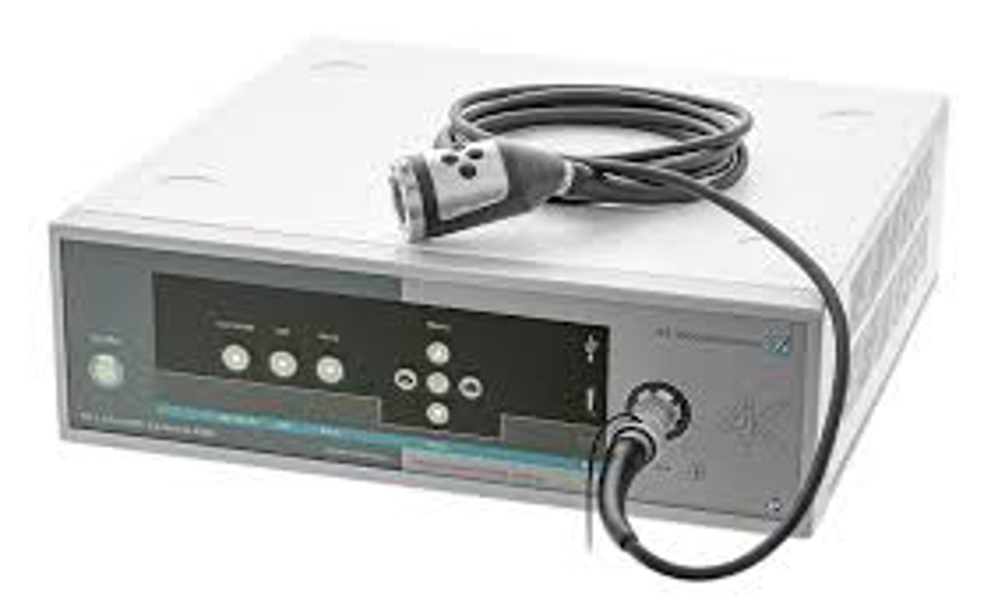
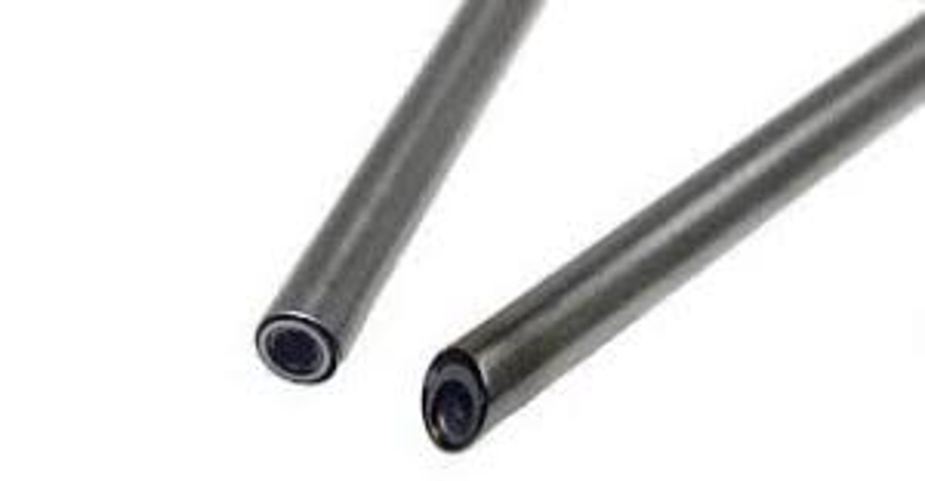
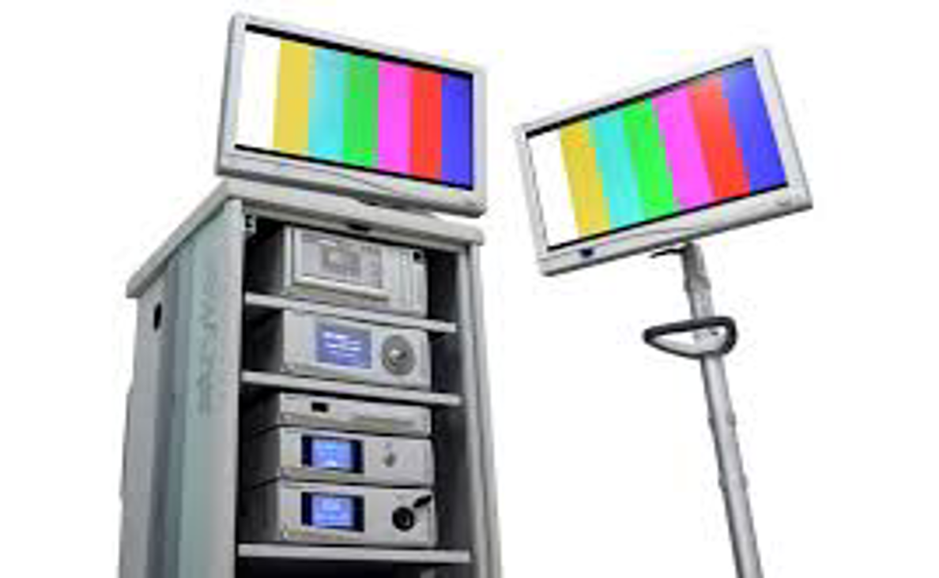
Laparoscopic Tower Content
Camera
Imaging system:
Length: 42 cm
Degree: 0
2
Length: 36 cm
Degree: 30
3
1
Notes:
1.Camera: the head is bigger and the cord is flexible, connect it to a scope and at the end of the scope there is a lens which opens inside the body (see number two for types of scopes)
2.There are different length and diameter. Green: Connect the camera here, and the image will be transmitted to the other side. Pink: This part is inserted into the abdomen. 30º is the best and most common because it is easy to maneuver and has more light. No angle no corner > zero degree. In abdomen we use with angle (30-40)
3.Pink: 0 angle. Green: angle is either 30 or 45

Slide 10
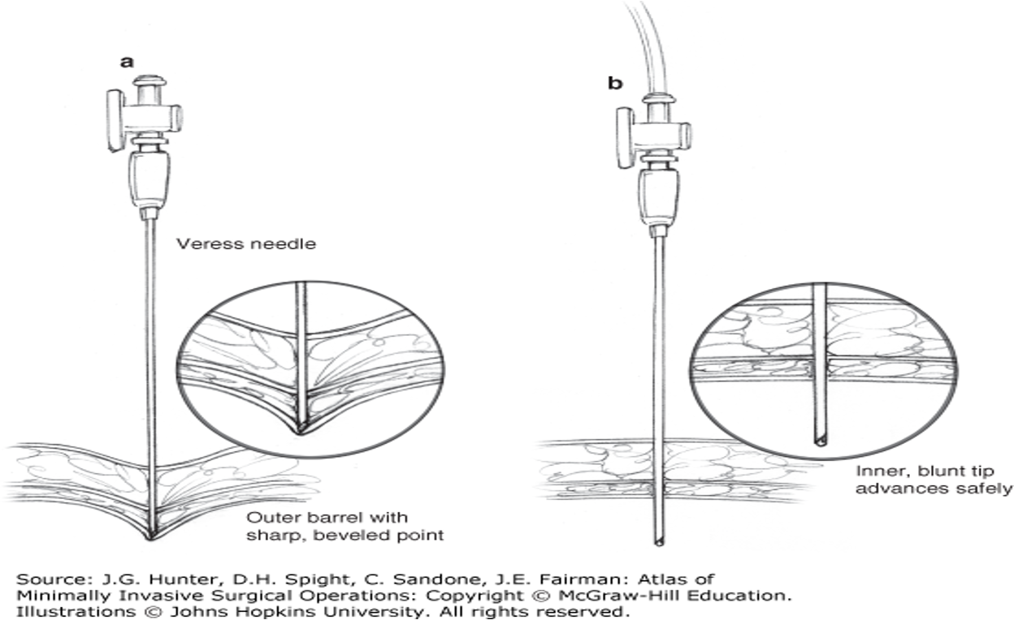
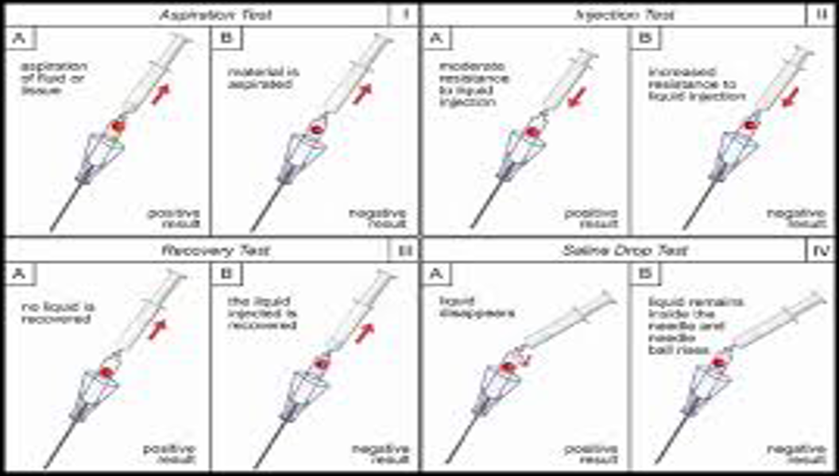
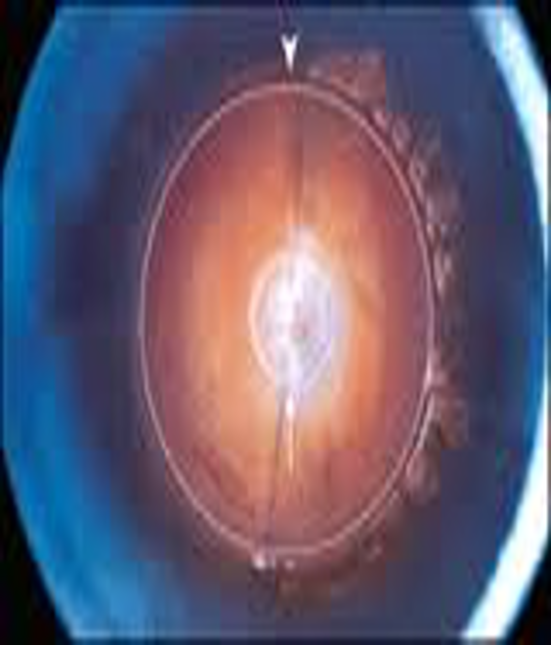
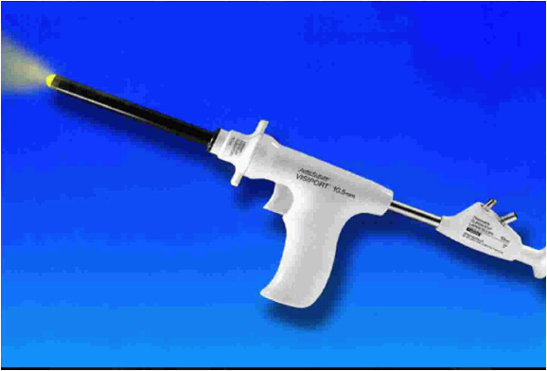
How to introduce pneumoperitoneum: How to create space? Hasson or opti view or veress needle (how we push gas, it has to be with gas!)
Open technique (Hasson) | Use trocar and then insufflate through it. The incision is bigger than the trocar so more leakage
Opti-view | A technique which uses cannula and 0 degree telescope to allow direct visualization of the entry tract. Specialist cannula such as visiport or optiview uses this. Skin incision (trocar size) and put the scope inside without skin retraction.
Veress needle | It has been made in 1938 Three lengths: 80 mm, 100 mm, 120 mm 14 gauge (minimal injury) Maximum flow rate is 2 L/min While with trocar can take up to 15 L/m and new machine up to 50! Percutaneous blind approach, insert a needle and push gas inside. -MCQ: Most common injury by needle or trocar is the small bowel not vascular. -Maneuvers To know you are in the abdomen: 1.Air ball, as soon as you go to negative space it gets sucked down 2.Drop test: put saline and see if it gets sucked (if not then you are in subcutaneous or fat or skin)
Veress needle
Optiview
Notes:
Veress needle parts: Pink (value), Purple (Needle), Yellow (Cannula). Green shows what we call tinting the peritoneum. When it comes in contact with hard tissue it will release a sharp needle to cut it but with soft tissue it won’t; will go bluntly
Optiview: Green (Muscle), Blue (fat), Yellow (Peritoneum)
Trocars & Instruments (Same instruments in open but with shaft to be suitable for laparoscopic approach)
Trocars:
Diameter: 2.5 - 15 mm
Length: 8 - 42 cm
Types: Bladed and Bladeless, Disposable and non. Bladed is not used anymore. Disposable is always used while non is not
How to decide for your trocar?
Size of the trocar depends on diameter of scope (same size) and also the size of the stapler and whether we will use it or not (not all procedures require it)

Slide 11
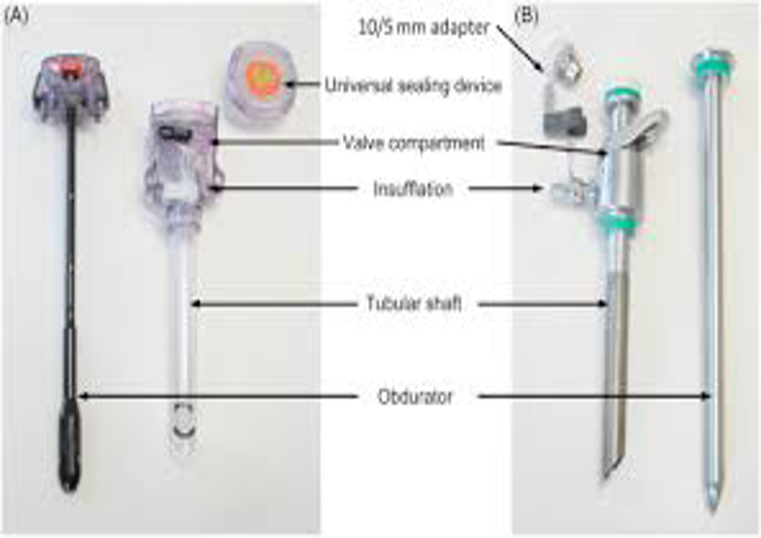
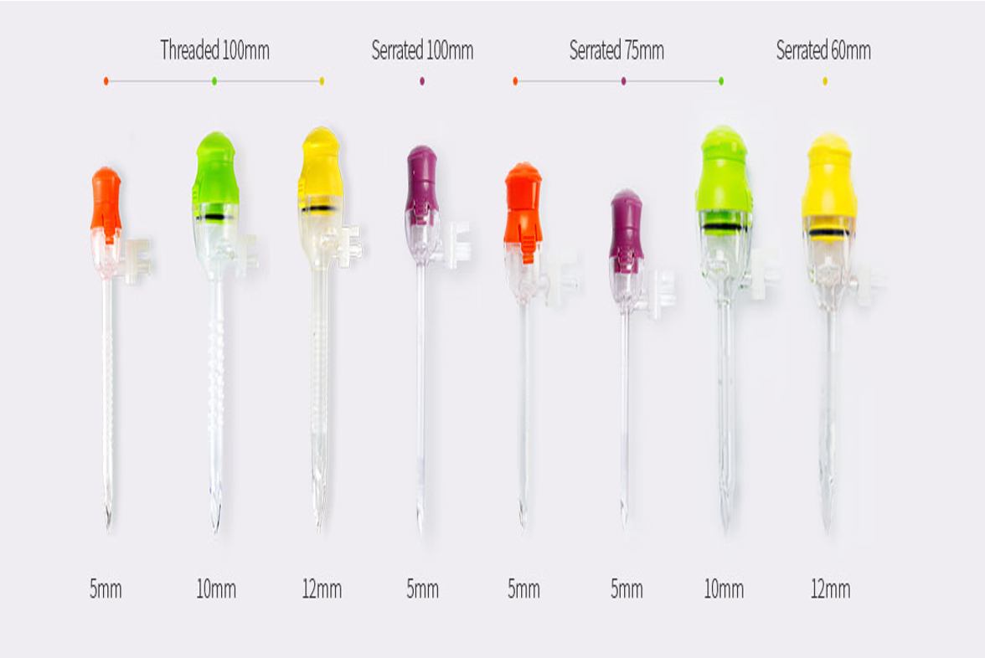
Trocars & Instruments
Trocars:
1
2
3
Notes:
1.Picture A is disposable (one time use). Picture B is reusable (you wash it each time). Trocar parts: Yellow (Head; for diameter), Green (shaft). Purple (obdurator / introducer)
2.Different diameters
3.Very important!! Bladed usually causes injury, it cuts fibers. Bladeless is plastic conical head , it splits the fibers (not cutting). The standard for trocars is to be splitting not cutting.
Other instruments:
Sealing & Cutting & Cautery | -Current waveforms -Cellular effects
Ultracision / Harmonic scalpel | Using electricity by producing ultrasonic wave or harmonic to cut the tissue Ultrasonically activated device that move at an imperceptible 55000 cycles/sec, cutting tissue with a cool blade. It is better because it doesn’t spread. Bipolar The mechanical action denature collagen molecules, forming a coagulant and instantly sealing small vessels with minimal thermal injury.
Ligasure | Electrothermal bipolar tissue sealing system In fact, the heat generated from the bipolar energy determines the fusion of collagen and elastin in the walls of the vessel with the creation of a permanent sealed zone. The system detects the thickness of tissue to be coagulated and automatically defines the amount of energy required and the delivering time. (Dr skipped slide #46)
Laparoscopic staplers | Any sleeve gastrectomy you need 12 trocar because you’ll use stapler. (IMPORTANT) Each staple has different color and this is determined by the length of staple limb; small for vessels, fat and small bowel. Large for thick tissue such as gastric tissue, colon of fibrosis. (MCQ)

Slide 12
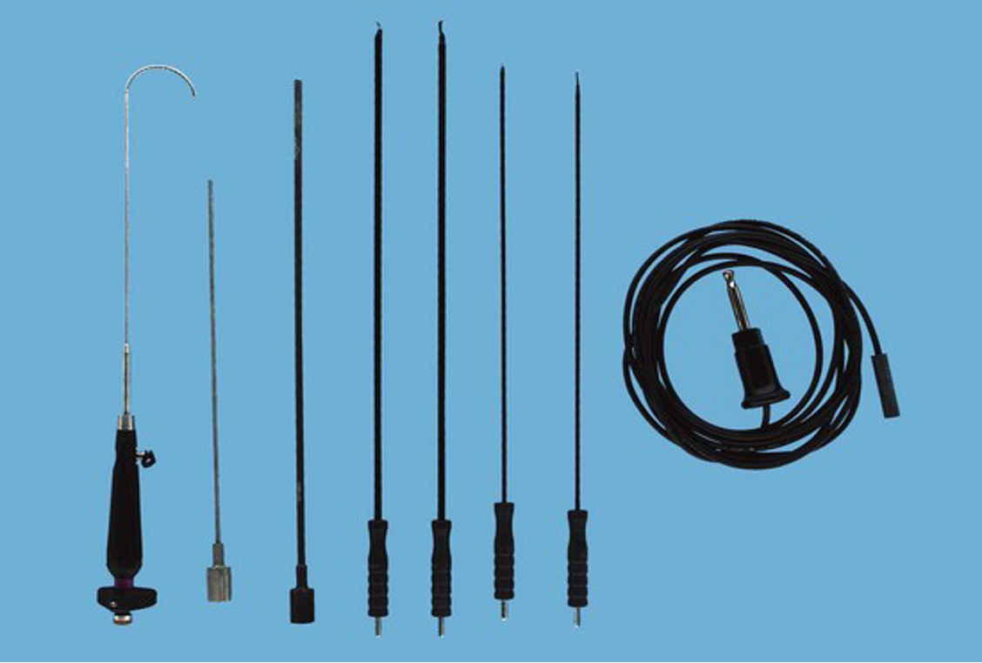
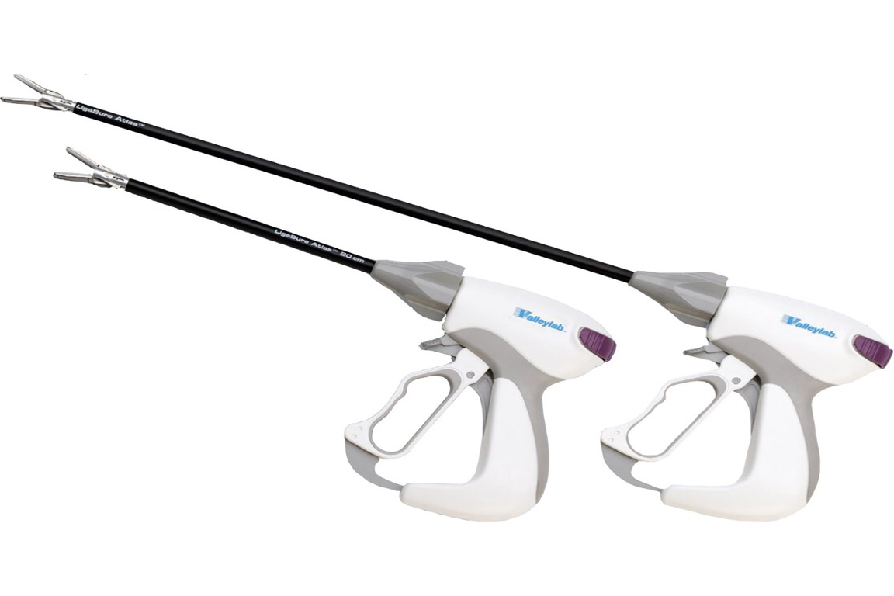
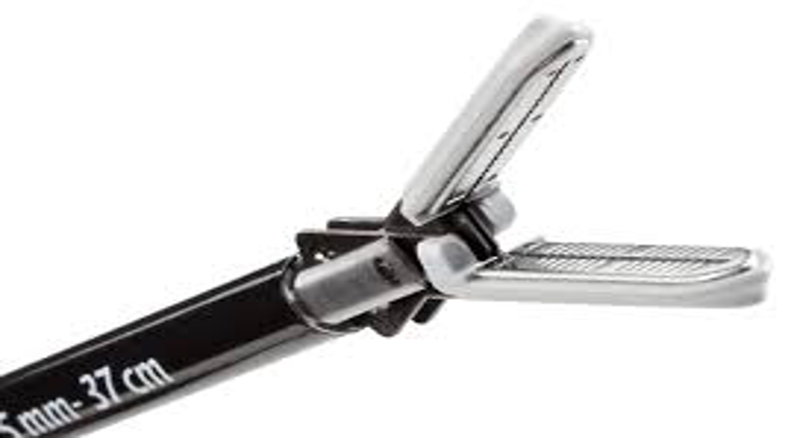
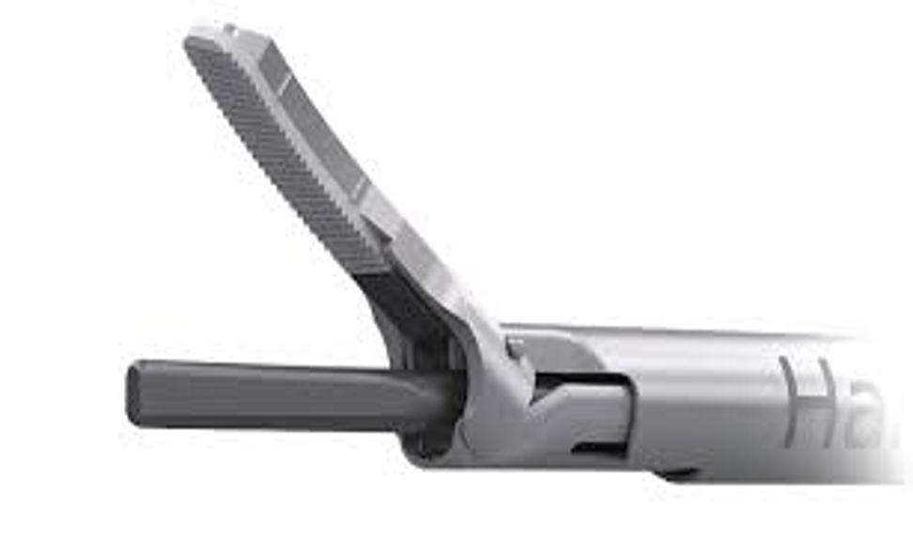
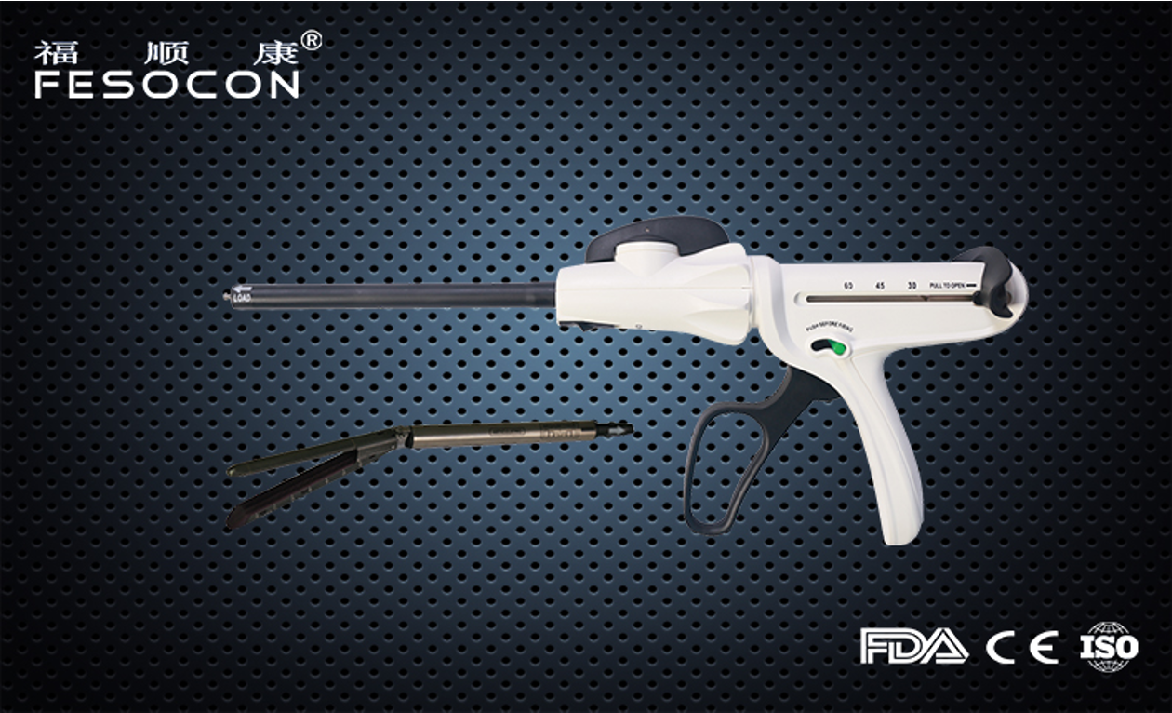
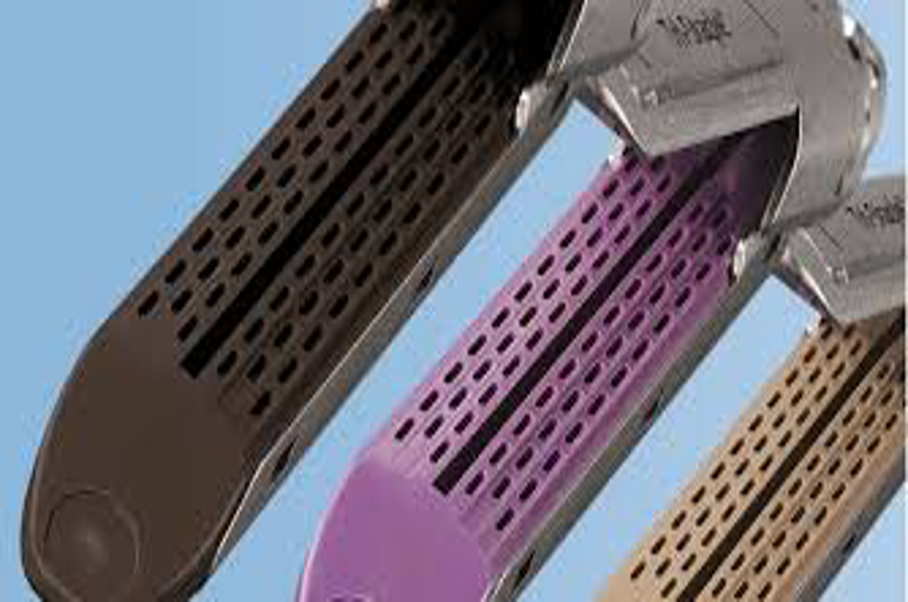
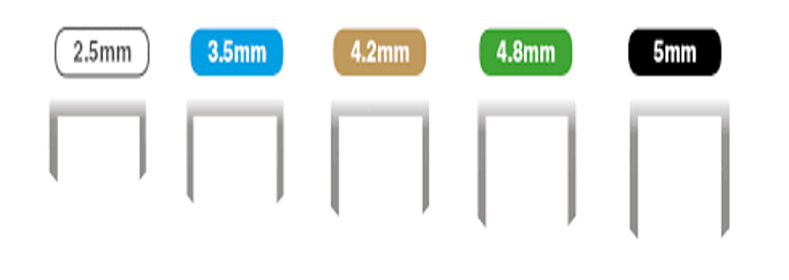
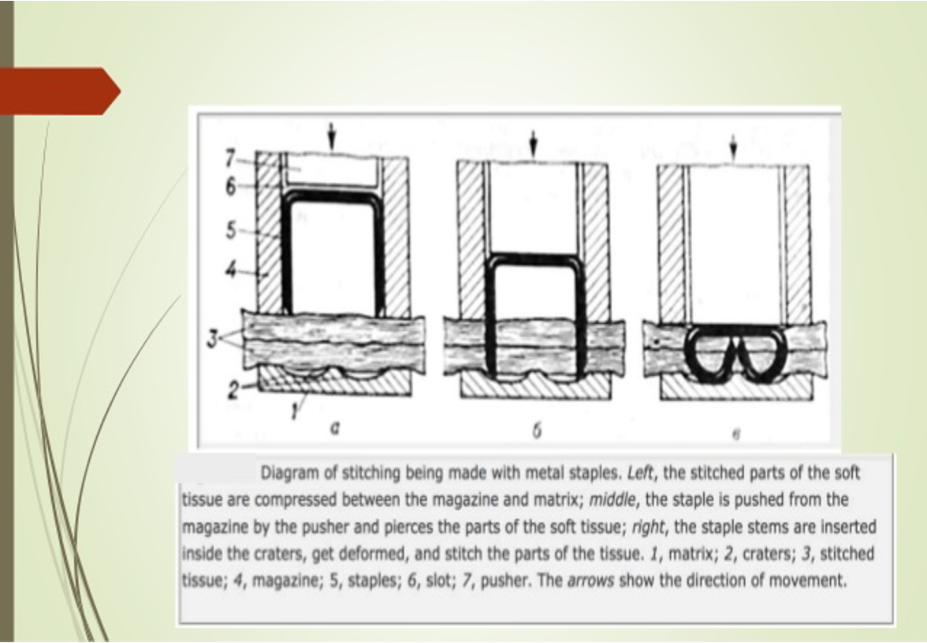
Trocars & Instruments
Other instruments:
1
2
3
4
5
5
5
5
Notes:
1.Blue (Monopolar L Hook: using electricity by producing frequencies to cut the tissue). Pink (Ultrasonic wave 1000 waves per second so coagulated vessel or anything like bowel)
2.The upper part (pink) absorbs the electricity, while lower part (green) produces it. In between two parts there should be a knife.
3.Disadvantages of harmonic scalpel: ???
4.Yellow (shaft), orange (gun), purple (staples)
5.The black (large > 4.5), the purple (medium 3-4.5 ) , the tan (small 2.5 - 3), white (2 mm), blue (3 mm), gold (4 mm), green (4.5 mm), black (5 mm)
L Hook; monopolar
Ligasure; bipolar (2 heads) (The best)
Ultrasonic; hormonal scalpel
What is the difference between monopolar and ultracision?
Monopolar: Electrical currents that causes waves of frequencies that does the cutting
Ultracision: Electrical current that changes to ultrasonic waves that causes the cutting

Slide 13
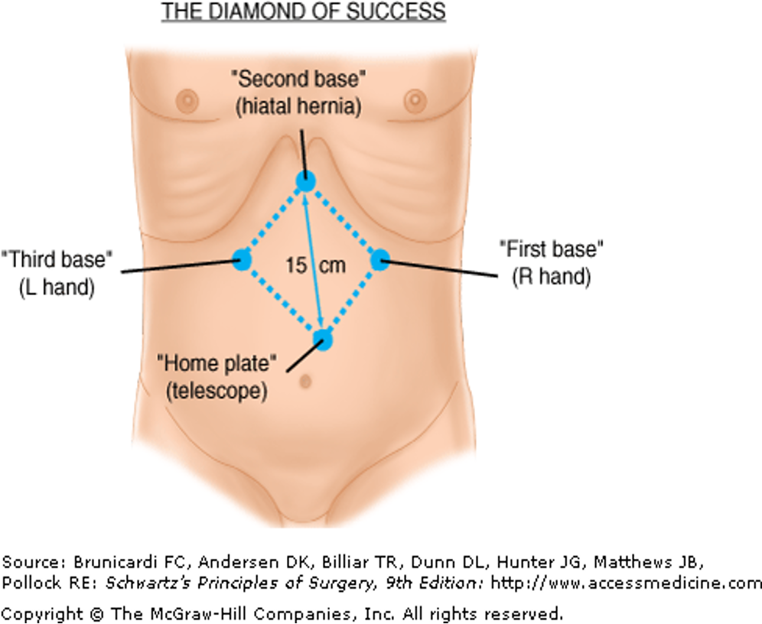
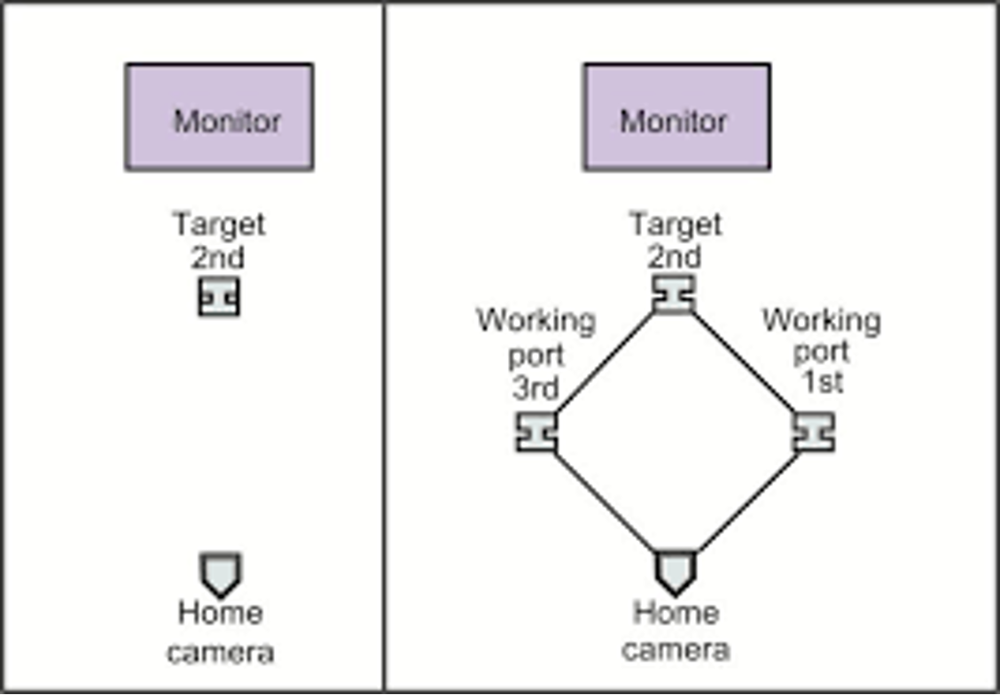
The procedure
Important roles in laparoscopic procedures:
Patient and surgeon position. Screen is above the organ you are working on, you are opposite to the screen as surgeon
Position of the trocator.
Fundoplication (screen at head)
APR*
Splenectomy
Bowel resection
Colostomy
Examples
Distance between trocator. 4-6 cm between each opening, camera and instrument
Size of the trocator. 5 for any instrument. 10 for scope. 12 for staplers. 10 for suture
*
Abdominoperineal resection
Patient Position:
Supine (on his back); intraabdominal
Lateral (Kidney and adrenal)
Prone (retroperitoneal procedures, even kidney and adrenal)
Jak-knife (Prone but legs are down and buttocks are up)
Lithotomy (separating the legs; colon)
Modified lithotomy
Trocars Position:
Notes:
4-6 cm
4-6 cm
-First position the screen and yourself then anything else!
-Scope opposite to organ, screen on the organ. Examples; if I’m going to do right inguinal hernias: put the scope on the left hip, I should stand on left and the screen on right area of hip.

Slide 14
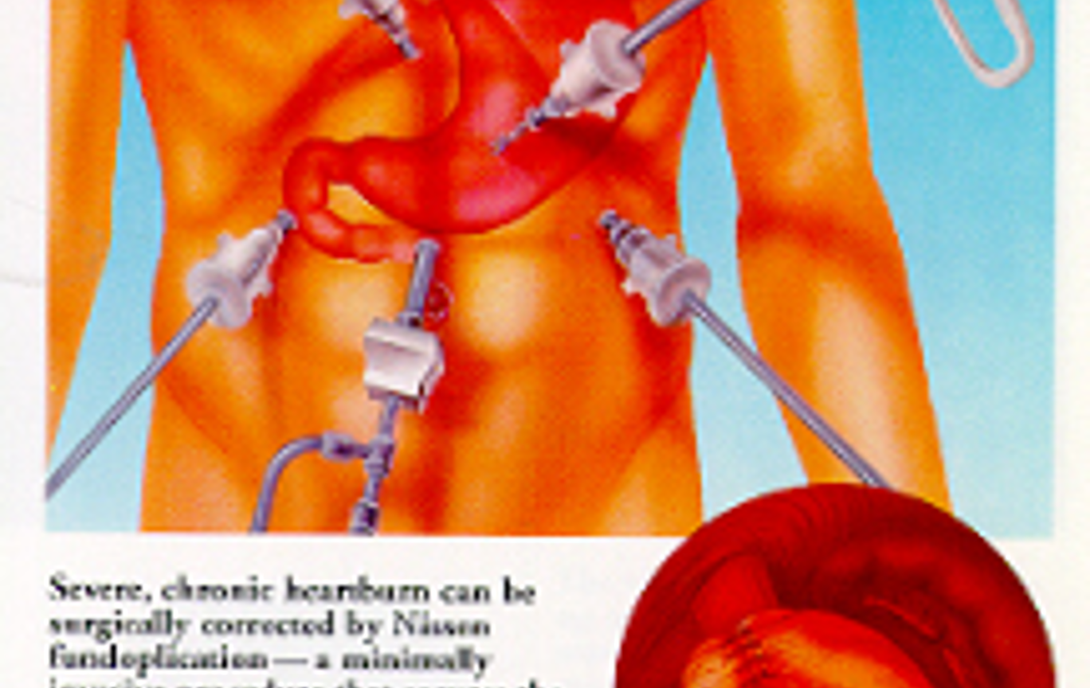
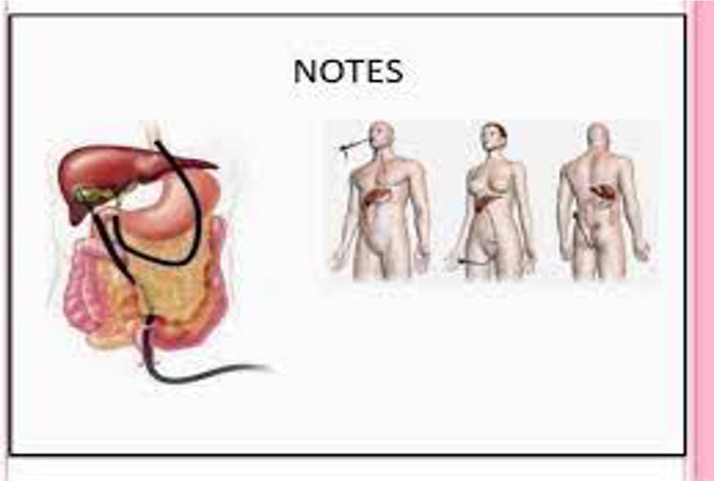
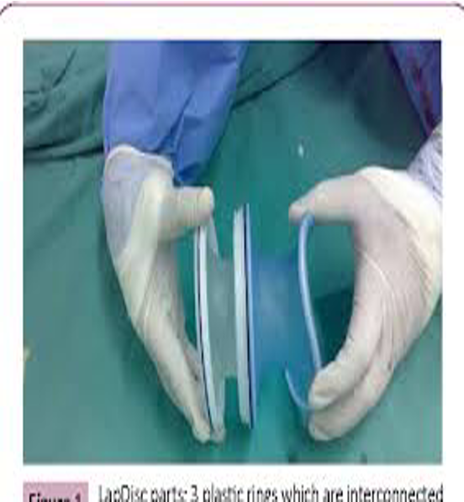
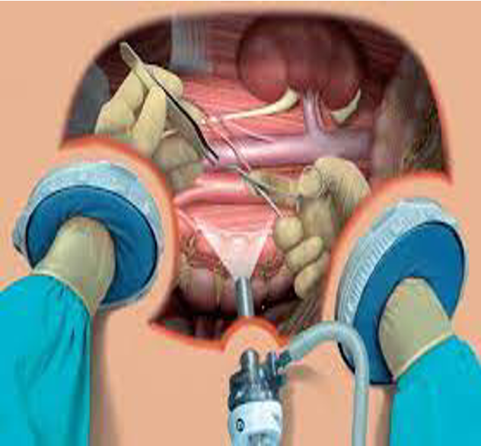
The procedure
Fundoplication, hernia, colon surgery
Fundoplication | -Patient and surgeon position -What is the scope (size and degree)? -How many trocars? -What is the size of the trocar? -Where will be the screen? Fundoplication: Wrapping stomach around esophagus. Esophagus in the upper midline. I have to be between the legs of patient. My screen should be on the left upper shoulder of the patient, my scope should be in the umbilicus. 10-5 trocar size. Hernia and colon depend on the location (previous slide in note section).
Hernia
Colon
How to control bleeder?
Do your best not to have it
Prepare yourself with: strong suction device, other trocars, clip applicator (Ligasure)
Vessels bleeding: Packing, proximal control, electrocautery, clip application, stapler, gray
Raw service oozing: packing, electrocautery, argon beam coagulator, hemostatic agents
Others
NOTES | HALS
Natural Orifice Transluminal Endoscopic Surgery. Mean natural opening orifices; mouth (you go through stomach and take gallbladder), rectum, vagina (through douglas pouch then you can take gallbladder) then going inside the peritoneum. No skin incisions. | Hand-Assisted Laparoscopic Surgery Means you will do all the procedure laparoscopic then you need to use your hand either to take the sample by your hand. If there is too much adhesion or no enough space (like with colon) hand will help you

