Slide 1
Day surgery
Surgery Team
MED437
Team Leader: Rawan Mishal
Team Members: AlHanouf AlJaloud
Revised By: Arwa aljohany

Slide 2
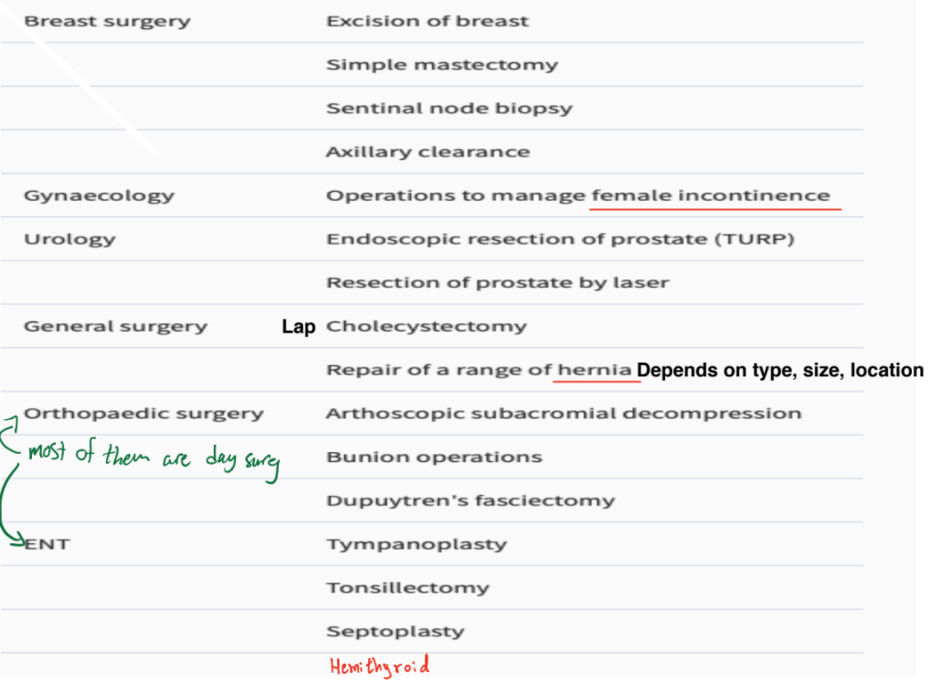
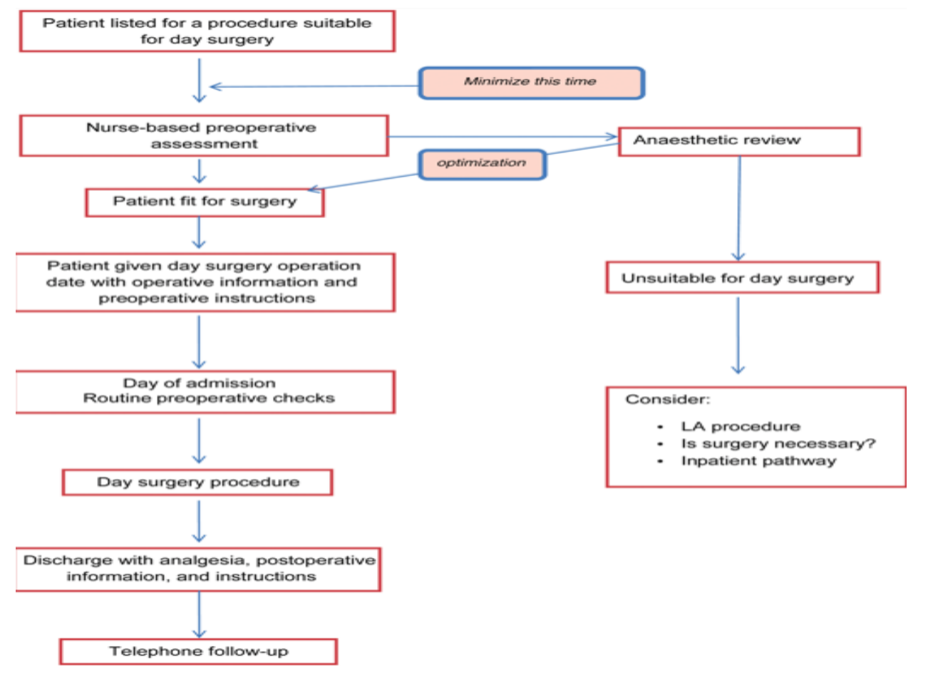
Day surgery
defined as: a patient being admitted to hospital for a planned procedure and discharged home the same calendar day.
The pathway
Successful day surgery outcomes are largely dependent on three key factors: The main aspects of a successful day surgery pathway are shown below
day surgery enthusiasts
a robust day surgery pathway
motivated patients and educated about the concept and the timing of day surgery
1. Patient selection
There are very few absolute contraindications. E.g Uncontrolled HTN or DM, cardiovascular diseases, hematological patients cancer, emergency surgery
To achieve the goals of patient selection, one needs to ask 3 broad questions:
Is the operation an appropriate day-case procedure?
Is there anything we would do for this patient by admitting them overnight which could not be done at home? Like patients with uncontrolled DM to adjust their blood sugar and optimize them before surgery. Also uncontrolled HTN optimize BP before and after surgery
Are the patient's home circumstances adequate for day surgery discharge? E.g Family member at home to take care of them, house close to the hospital
Important
Notes:
Sleeve gastrectomy should not be done as day surgery due to high risk of bleeding because the stomach is highly vascularized
Who decide if the patient is fit for surgery? Anesthesia
Optimization happens by the surgeon, nurse + anesthesia
Notes:
You must discharge the patient with: Analgesia
Post op information & instructions
Follow up appointment or phone follow up

Slide 3
2. Surgical factors
The procedure should not have significant risk of major postoperative complications necessitating immediate medical intervention (haemorrhage, cardiovascular instability).
No prolonged specialist postoperative care or observation required.
Abdominal and thoracic cavities should only be opened with minimally invasive techniques. Like laparoscopy
Postoperative pain should be controllable with oral analgesia ± regional anaesthesia techniques intraoperatively.
Patient should be able to rapidly resume normal functions (oral nutrition, safe mobilization).
Urgent procedures are also appropriate for a semi-elective day-case pathway, for example, drainage of small abscesses, some superficial trauma surgery. Some cases of appendicitis, biliary colic (should not be inflamed cholecystitis)
3. Medical factors
Patient's fitness for day surgery should be judged by functional assessment at the time of preoperative assessment by the surgeon, nurse, anesthesia.
Patients with stable chronic medical conditions such as diabetes, asthma, or epilepsy are often better managed with minimal disruption to their daily routine as facilitated by day surgery.
Patients with unstable medical conditions such as unstable angina or diabetes are unlikely to be appropriate for day surgery.
Obesity: Obese patients benefit from day surgery management with its short-acting anaesthetics and early mobilization. Even morbid obesity is not a contraindication to day surgery. While technically challenging, the majority of complications occur during the procedure or in first-stage recovery and resolve early in the recovery period. An overnight stay is unlikely to confer any benefit and in fact day-case bariatric surgery is a developing area. Obesity is NOT a contraindication for surgery but most obese patients are not fit for surgery due to other comorbidities caused by their obesity.
The elderly: There is no upper age limit for day-case surgery. Increasing age does not lead to adverse day surgery outcomes and being in their familiar home surroundings may reduce postoperative cognitive dysfunction. If the patient is fit we don’t look at the age

Slide 4
4. Social factors
24 h home care: It is generally recommended that after a general anaesthetic, most patients should have a responsible adult to accompany them home and remain with them for 24 h after surgery.
Access to a telephone.
Geographical proximity to hospital; travelling time >1 h may be contraindication for certain procedures (e.g. day-case tonsillectomy). patient should be <1 h away from the hospital
The patient must understand, engage with, and consent to the surgical procedure and for it to be performed as day surgery.
Preoperative preparation
Successful day surgery outcomes require good preoperative preparation.
Education of patients and carers about day surgery pathways. By surgeon, anesthesia, nurse.
Helping patients to make informed decisions by providing verbal and written information regarding planned procedures and postoperative care. Informing the patient of postoperative expectations like pain, outcome, functional expectations
Identification of any medical risk factors and optimizing medical conditions before surgery. e.g Uncontrolled DM, HTN, Asthma
Anaesthetic management
rapid onset and offset of anaesthesia with clear-headed emergence,
minimal postoperative nausea and vomiting (PONV), dizziness, or drowsiness, anesthesia should use short term medication to avoid dizziness and drowsiness which can prevent them from going home that day.
rapid return to full cognitive functions. Before discharge by the anesthesia team
Analgesia
Regular oral analgesia with paracetamol combined with long-acting non-steroidal anti-inflammatory drugs, if not contraindicated.
Supplementation with local or regional anaesthesia where possible.
Avoidance of any long-acting opiates and judicious use of short-acting opiates if required for management of acute pain.

Slide 5
Postoperative nausea and vomiting
PONV should be risk assessed before operation and prophylactic antiemetics given to patient stratified at high risk. Policies should also exist for the rapid management of any postoperative PONV as this can significantly delay discharge. The routine use of i.v. fluids can enhance a patient's feeling of well-being and reducing PONV.
Postoperative recovery and discharge
During the postoperative period, patients should be actively encouraged to return to their preoperative physiological state like being able to walk
Phases of recovery: from anesthesia
Phase I: early recovery, from end of anaesthesia until the return of protective reflexes and motor function.
Phase II. During this time, the patient meets the recovery milestones and achieves the criteria for discharge.
Patients should only remain in phase 1 recovery as long as is necessary to retain full consciousness and have immediate analgesic requirements met.
Discharge from phase 1 recovery should be criteria rather than time based and in the most efficient units, patients may spend no longer than 5–10 min in the phase 1 recovery area.
Discharge
Nurse-led discharge + surgeon is key to day surgery and should include:
Timely discharge once all the recovery milestones have been met
Appropriate analgesia with written instructions given to the patient Most important
A discharge summary should they require medical assistance overnight.
A telephone number where patients can access advice from a senior nurse overnight should they require it. This person must be able to give advice relating to complications of the surgical procedure undertaken.
Any discharged patient should receive: discharge summary, meds and analgesia, post op instructions, Nurse/Doctor Phone number, and follow-up appointment.

Slide 6
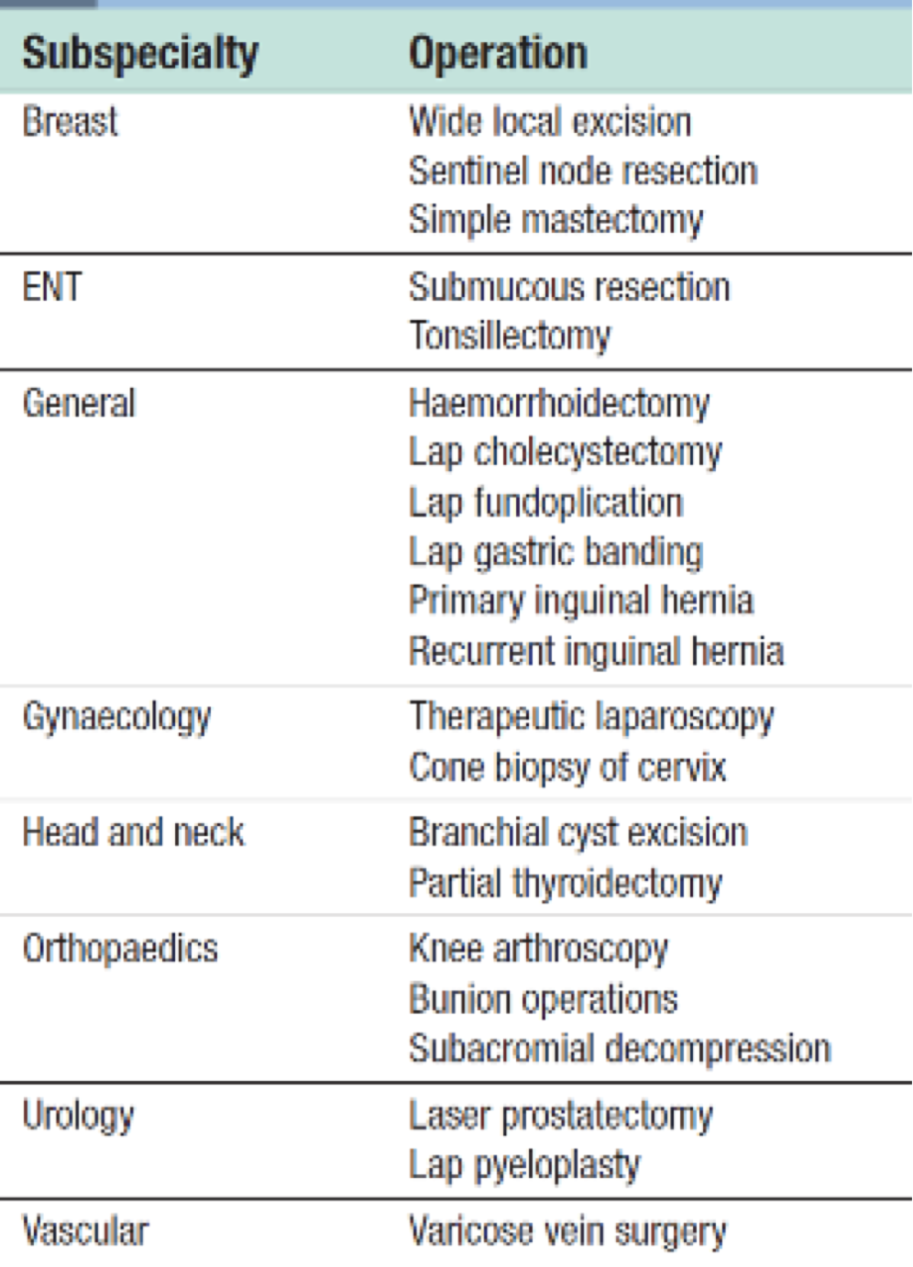
Important notes:
Morbid obesity, they are fit but there are limitations like if they also have OSA (hypoxia, polycythemia, hypercapnia, right sided HF)
Lap cholecystectomy, is elective for day surgery, but if he was bleeding and oozing blood, this will not be fit for day surgery
Simple mastectomy is for day surgery, but if it was bleeding, oozing, hypoxic, this is not fit
You can continue if it was oozing but the BP stabilized easy and fast
Female, for elective cholecystectomy, you cleared her but then you found out she is hypothyroid, what will you do? Postpone the surgery until she becomes euthyroid
Pre Op assessment, if pt was stable but labs were not you will only proceed if it was an emergency surgery, but you will never go through with it for day surgery
Thyroid storm, this pt is not fit for day surgery
BS not good, not fit
Hernia with bilateral wheezing is not fit for Day surgery
MAKE SURE THE PATIENT HAS SOMEONE AT HOME TO TAKE CARE OF THEM, PROVIDE PT WITH TELEPHONE NUMBER
MOST COMMON CAUSE OF LOW GRADE FEVER FIRST 24 Hrs POST OP IS ATELECTASIS
All these tell you dont do say surgery
large hernia
Unstable diabetes or HTN
recurrent disease
Extra
suitable for DSU (Day Surgery)

