Slide 1
Fluid and electrolytes
Surgery Team
MED437
Objectives:
Identify types of intravenous fluids
Revision of fluid compartments (physiology part) (fluid & substance)
Prescribing fluids
Electrolytes abnormalities
Acid-base balance
Team Leader: Rawan Mishal
Team Members: Danah Alkadi, AlHAnouf AlJAloud
Revised By: Arwa aljohany

Slide 2
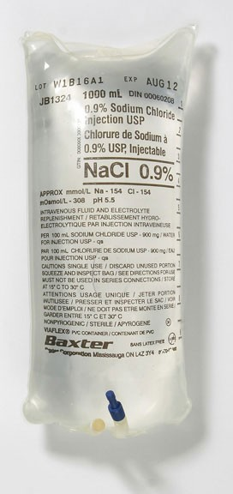
Theory Part
Why is I.V fluids important?
Very basic requirements
Daily basic requirements
done by juniors.
You will be asked to do it as junior staff
To maintain patient life
Definition of Intravenous Fluids:
Any fluid put in the veins
Intravenous (IV) fluids are infused to maintain fluid balance, replace fluid losses, and treat electrolyte imbalances.
They are commonly available in volumes ranging from 25 mL to 1,000 mL
and are dispensed in either plastic bags or glass bottles.
IV fluid is the giving of fluid and substances directly into a vein.
Human Body has fluid and substances
Substances that may be infused intravenously
volume expanders (crystalloids and colloids) important to know that these are the 2 main classifications of fluids
blood-based products (whole blood blood-based products (whole blood, fresh frozen plasma, cryoprecipitate)
blood substitutes,
medications.
First Part is Fluids
Types of IV Fluids
Colloid Solutions | Crystalloid Solutions
No electrolytes. Containing water and large proteins and molecules. The large proteins can’t pass through the pores of the vessels > remain intravascular > increase intravascular volume - tend to stay within the vascular space increase intravascular pressure - very expensive - Examples: Dextran, hetastarch, albumin... | Crystals= Electrolytes. No large proteins. Containing water and electrolytes (e.g.,sodium the main tonic substance in extracellular fluid, potassium, calcium, chloride) - Lack the large proteins and molecules - Come in many preparations and volume - Classified according to their “tonicity”: amount of fluid is constant but % of substance differ Isotonic same as blood: 0.9% NaCl (normal saline), Lactated Ringer's solution. Hypotonic: 2.5% dextrose Hypertonic: D5 NaCl
Tonicity = Osmolarity
Osmolarity = Tonicity in grams
Osmolality = Tonicity in mmol

Slide 3
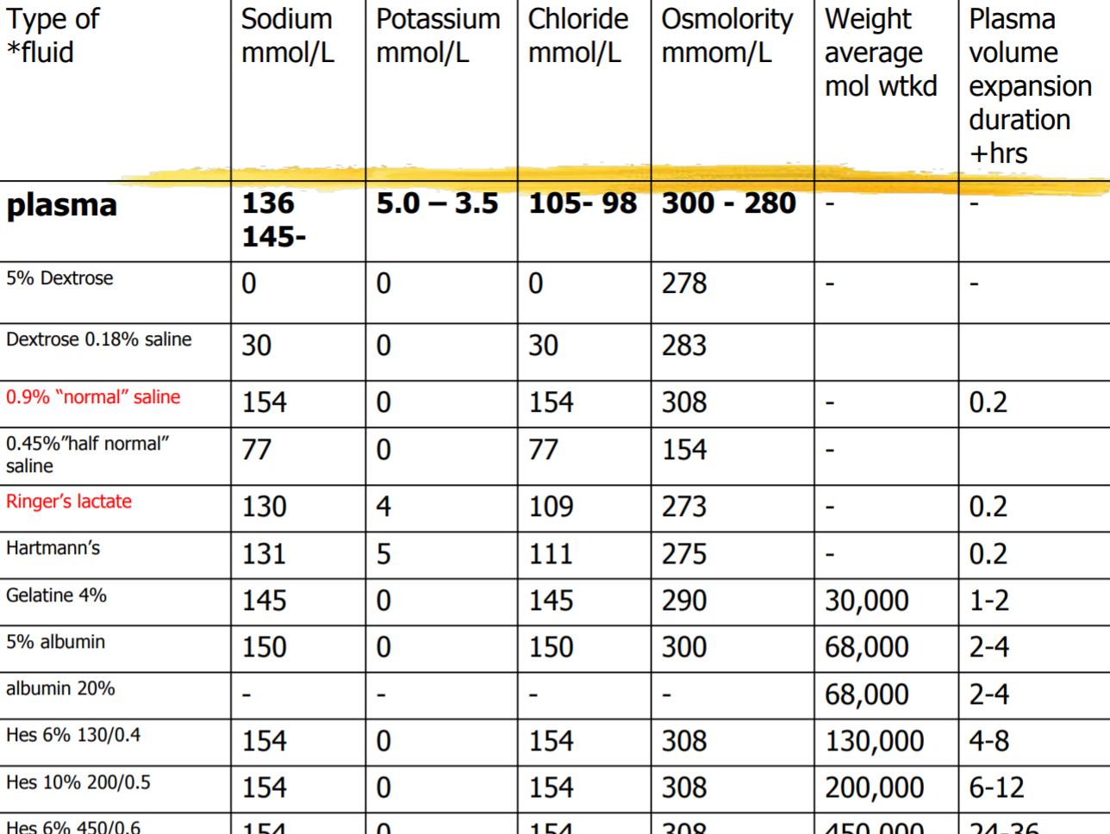
Calculation of osmolality
Difficult: measure & add all active osmoles
Easy = [ sodium x 2 ] + urea + glucose
Normal = 280 - 290 mosm / kg
Very important you must know the content of NS + RL
1- ½ NS means ½ the electrolytes, fluid volume is constant.
2- substance content in the table are for every liter of water.
3- Plasma = extracellular - intracellular
4- NS = Na + Cl only, no K
5- Ringers lactate contain: Na + K + Cl + calcium + lactate (HCO3)
6= Hartmann’s is a variation of RL with same substance but at different %
All are colloids
Normal saline fluid (NS 0.9%)
(NS) — is the commonly-used term for a solution of 0.90% w/v (NS), about 300 mOsm/L or 9.0 g per liter
Na is 154 and only CL 154
No K, NO others
Hartmann’s fluid
The most physiological fluid is Hartmann’s + RL but we use NS because it’s cheaper
One litre of Hartmann's solution contains:
131 mEq131 mEq of sodium131 mEq of sodium ion131 mEq of sodium ion = 131 mmol/L.
111 mEq of chloride ion = 111 mmol/L.
29 mEq of lactate = 29 mmol/L.
5 mEq of potassium ion = 5 mmol/L.
4 mEq of calcium ion = 2 mmol/L .
All but Mg

Slide 4
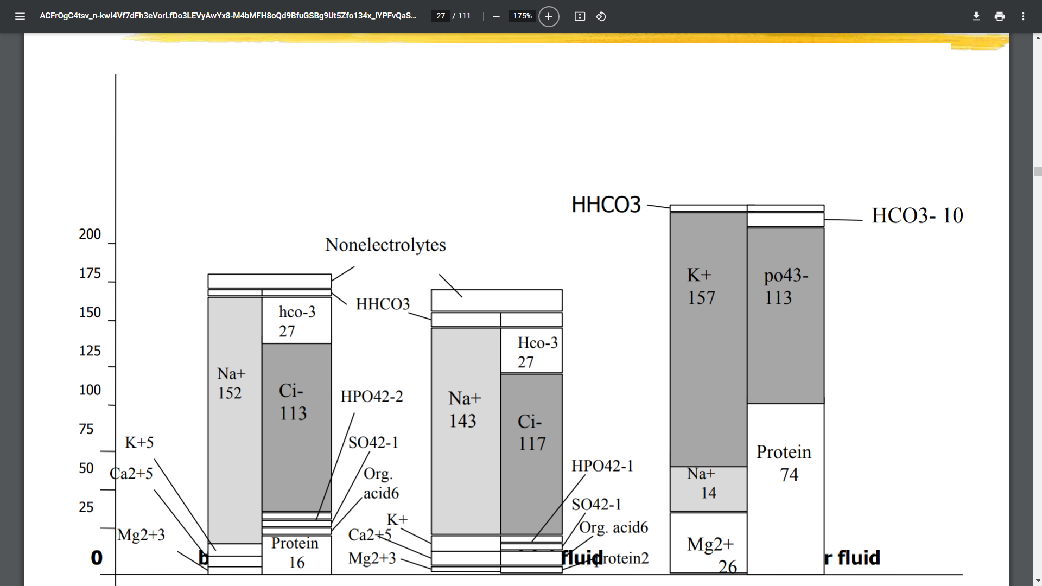
Revision of fluid compartments (physiology part) (fluid & substance)
General Information:
“We are approximately two-thirds water”
Total body water is 60% of body weight
Influenced by age,sex and lean body mass
More fat = less fluid.
More muscle = more fluid
Older age and female sex is less precent
To calculate TBW needed:
Male sex TBW= BW× 0.6
Female sex TBW= BW × 0.5
Fluid shifts / intakes
Body Fluid Compartments:
Intracellular volume (40% of total body weight “66% of total body water”) rich in water
Extracellular volume (20% of total body weight “34% of total body water”) rich in water
15% constitute interstitial space
5% the intravascular space. What we try to replace, most organ to get affected by this loss is the kidneys
Second Part is Electrolytes
Body electrolytes compartments:
Intracellular volume
K+, Mg+, and Phosphate (HPO4 -)
Extracellular volume
Na+, Cl-, Ca++, and Albumin
Important:
Most abundant extracellular cation? Na - Anion? Cl
Most abundant intracellular cation? K - Anion? HPO4
You have to know normal levels of Na, Ka, HCO3, Cl, Mg, Ca, Albumin intracellularly and extracellularly
EXAMPLE 1(How much fluid in your body ? )
Fluid Compartments
70 kg male: (70 x 0.6)
TBW= 42 L
Intracellular volume = .66 “2/3” x 42 = 28 L
Extracellular volume = .34 “1/3” x 42 = 14 L
Interstitial volume = .66 x 14 = 9 L
Intravascular volume = .34 x 14 = 5 L

Slide 5
Daily Requirements of Fluid and Electrolytes
Fluid Requirements
Fluid per day ≠ amount of fluid in your body
Best way is to calculate the Net loss (urine + stool) + insensible loss (you CAN measure the insensible water loss)
Normal adult requires approximately 35cc/kg/d
“4,2,1” Rule l hr most important
First 10 kg= 4cc/kg/hr
Second 10 kg= 2cc/kg/hr
1cc/kg/hr thereafter
Normal daily losses and requirements for fluids and electrolytes
Fluid shifts in disease
Calculate the daily requirement then add any additional loss from the disease. E.g expected urine loss is 1L but patient urinated 3L you add 2 liter to the fluid
Fluid Loss | Fluid Gain
GI: diarrhoea, vomiting, etc. renal: diuresis vascular: haemorrhage skin: burns | Iatrogenic Heart / liver / kidney failure
What is the rate?
In adults remember IVF rate = wt (kg) + 40. ( 70 + 40 = 110cc/hr),
“4,2,1” Rule / hr
Assuming there’s no significant renal or cardiac disease and NPO.
This is the maintenance IVF rate, it must be adjusted for any dehydration or ongoing fluid loss.

Slide 6
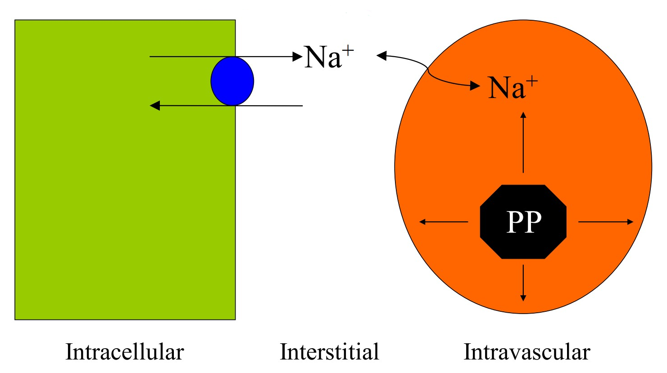
Sodium requirement
Na: 1-3 meq/kg/day
FOR EXAMPLE:
70 kg male requires 70-210 meq NaCl in 2600 cc fluid per day.
Which fluid is the best?
0.45% saline contains 77 meq NaCl per liter.
2.6 x 77 = 200 meq
Thus, 0.45% saline is usually used as MIVF assuming no other volume or electrolyte issues.
Potassium requirement
Potassium: 1 meq/kg/day
K can be added to IV fluids. Remember this increases osm load.
20 meq/L is a common IVF additive.
This will supply basal needs in most pts who are NPO.
If significantly hypokalemia, order separate K supplementation.
Oral potassium supplementation is always preferred when feasible.
Should not be administered at rate greater than 10-20 mmol/hr if more it will burn the vein and cause thrombophlebitis. Only with central line you can go more than 20 mmol/hr
Third Part is Medicine
CASE FOR PRACTICE
Fluid 35/kg/Day,,
Na: 1-3 meq/kg/day.,
K: 1 meq/kg/day
70 kg male requires 2450 cc fluid per day, 70-210 meq Na
0.45% saline contains 77 meq NaCl per liter.
a 2.6 x 77 = 200 meq
Thus, 0.45% saline is usually used as MIVF (Maintenance IV fluid) assuming no other volume or electrolyte issues.
Osmotic / Oncotic pressure Gibbs – Donnan Equilibrium
Gradient:
Passive from high to low
Active from low to high; require ATP

Slide 7
Abnormalities
Hypokalemia: Both hyper/ hypo present with arrythmia
Occurs when serum K+<3 mEq/L.
The most common surgical “post op” electrolyte abnormality
Day 0 post op we shouldn’t give potassium because of cell breakdown during surgery which will cause K to leak > Resume K on day 1 > most drs forget to resume + no oral intake > Hypokalemia
Should not be administered at rate greater than 10-20 mmol/hr
Causes of Hypokalemia
Reduced/inadequate intake most common cause
Gastrointestinal tract losses
Vomiting H+ gets out > K goes intracellular
Gastric aspiration/drainage
Fistulae
Diarrhoea K+ lost with bile
Ileus
Intestinal obstruction
Potassium-secreting villous adenomas
Urinary losses
Metabolic alkalosis
Hyperaldosteronism
Diuretic use
Renal tubular disorders(e.g. bartter’s syndrome, renal tubular acidosis, amphotericin-induced tubular damage)
Treatment of Hypokalemia
Treatment involves KCl i.v. infusion or Orally. If you have 100 K+ per 1 liter at a 200ml/hr rate it will be 20 mmol/hr of potassium > so you should reduce the rate
Hyperkalemia:
Diagnosis is established by ↑ serum K+>6 meq/L and ECG changes. If ECG is abnormal > admit to the ICU > Central line for fast correction
Arrhythmia is the presentation Both hyper/ hypo present with arrythmia
Causes of Hyperkalemia
increased K+ infusion in IVF, tissue injury, metabolic acidosis, renal failure, blood transfusion, and hemodialysis
Haemolysis
Rhabdomyolysis
Massive tissue damage like burn
Acidosis……..ARF
Management of high K
Diagnosis is established by ↑ serum K+>6 meq/L and ECG changes.
Treatment
1 ampule of D50% + 10 IU Insulin intravenously over 15 minutes insulin moves K+ intracellularly, give with dextrose to prevent hypoglycemia calcium exalate enemas binds to K+ in the gut and prevent absorption, Lasix 20-40 mg i.v., and dialysis if needed.

Slide 8
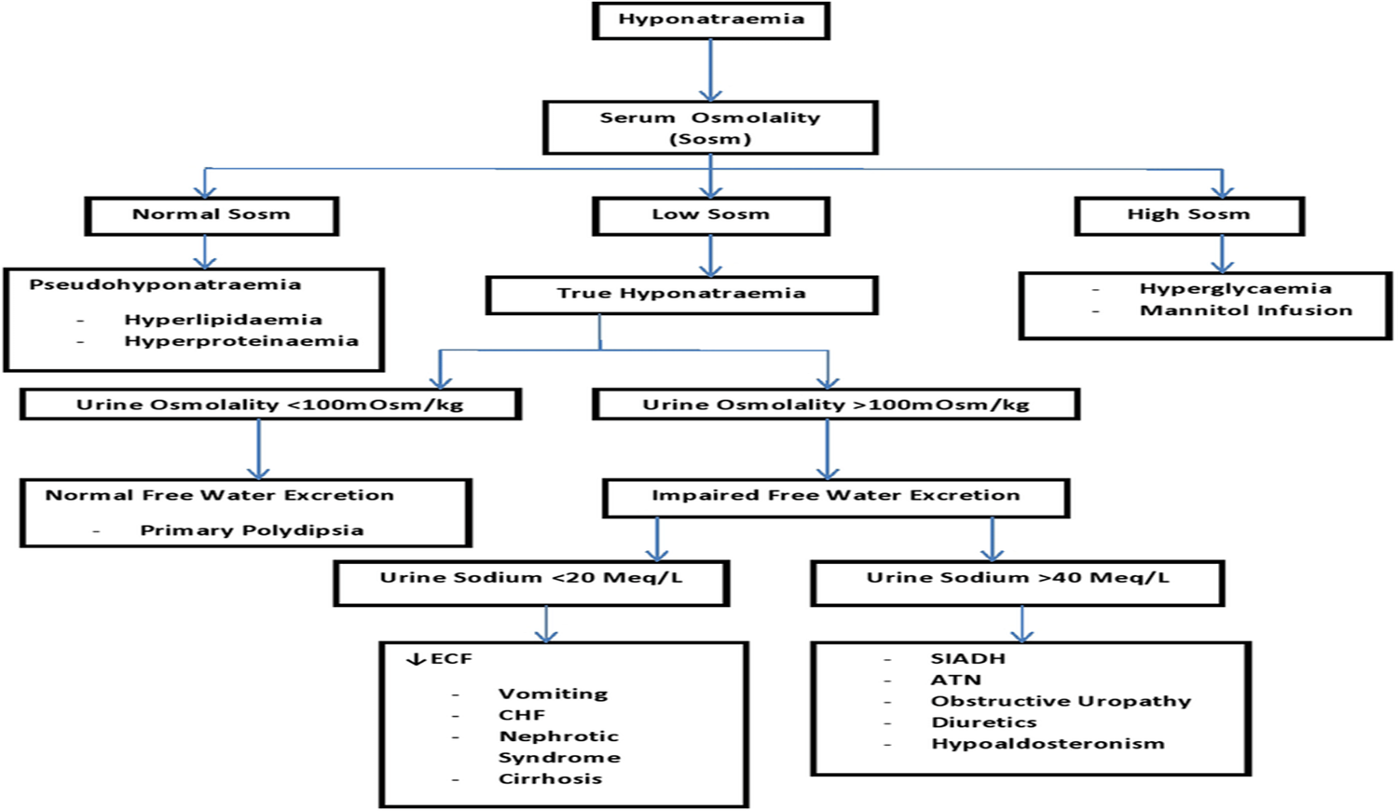
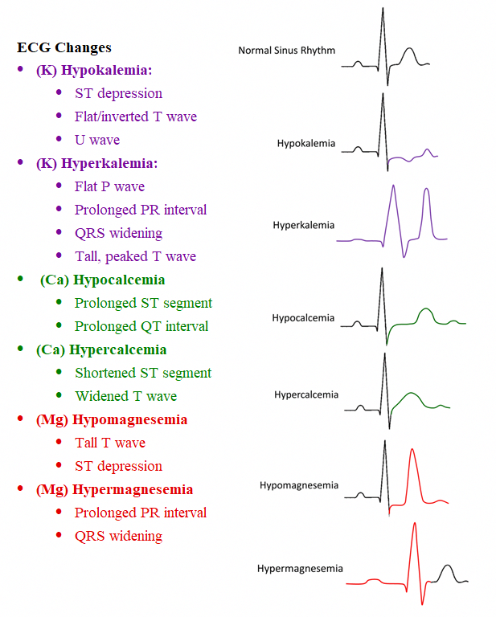
Sodium Deficit (Hyponatremia):
Causes of Hyponatremia
Hyperglycemia , excessive IV sodium-free fluid administration
(Corrected Na= BS mg/dl x 0.016 + P (Na)
can be volume overload, normo, low
Hyponatremia with volume overload usually indicates impaired renal ability to excrete sodium.
Treatment of Hyponatremia
Administering the calculated sodium needs in isotonic solution
In severe hyponatremia ( Na less than 120meq/l): hypertonic sodium solution
Rapid correction may cause permanent brain damage due to the osmotic demyelination syndrome Hyponatremia = low osmolality > fluid is intracellular > correct it quickly fluid will go out and cells will rupture
Serum Na should be increased at a rate not exceed 10-12meq/L/h. Max is 12/day
Extra

Slide 9
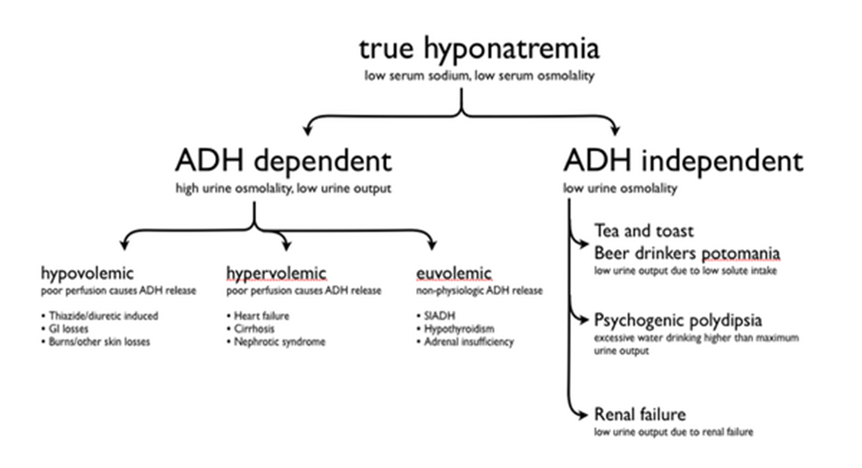
Sodium Excess (Hypernatremia):
Diagnosis is established when serum sodium > 145 mEq/L.
this is primarily caused by high sodium infusion (e.g. 0.9% or 3% NaCl saline solutions).
Another but rare cause is hyperaldosteronism.( What is function?)
Patients with CHF, Cirrhosis, and nephrotic syndrome are prone to this complication
Symptoms and sign are similar to water excess.
Causes of hypernatremia
Reduced intake | Increased loss | Inappropriate urinary water loss
Fasting Nausea and vomiting Ileus Reduced conscious level | Sweating (pyrexia, hot environment) Respiratory tract loss (increased ventilation, administration of dry gases) Burns | Diabetes insipidus (pituitary or nephrogenic) Diabetes mellitus Excessive sodium load (hypertonic fluids, parenteral nutrition)
Treatment of hypernatremia
Treatment include water intake and ↓ sodium infusion in IVF (e.g. 0.45% NaCl or D5%Water). Free water intake is the mainstay of treatment

Slide 10
Comparison Between the Signs and Symptoms of Hypo/Hypervolemia
Volume Depletion | Volume Overload
Postural Hypotension Tachycardia Absence of JVP @ 45 Decreased skin turgor Dry mucosa Supine hypotension Oliguria Organ failure | Hypertension Tachycardia Raised JVP/Gallop rh Oedema Pleural effusion Pulmonary Ascites Organ failure
caused by inappropriate use of hypotonic solutions (e.g. D5%Water) leading to hypo-osmolar hyponatremia, and Syndrome of inappropriate anti-diuretic hormone secretion (SIADH mainly a paraneoplastic syndrome) will present as hypernatremia
Look for SIADH causes :malignant tumors, CNS diseases, pulmonary disorders, medications, and severe stress.
The Role of ADH:
ADH = urinary concentration
ADH = secreted in response to increased osmo;
= secreted in response to decreased volume;
ADH acts on DCT / CD to reabsorb water
Acts via V2 receptors & aquaporin 2
Acts only on WATER
Symptoms of EW
Symptoms of water excess develop slowly and if not recognized and treated promptly, they become evident by convulsions and coma due to cerebral edema
Treatment of EW
water restriction and infusion of isotonic or hypertonic saline solution
In the SIADH secretion. Diagnosis of SIADH secretion is established when urine sodium > 20 mEq/L Normal 2-5 when there is no renal failure, hypotension, and edema. Treatment involves restriction of water intake (<1000 ml/day) and use of ADH- Antagonist (Demeclocycline 300-600 mg b.i.d).
Water Excess (Volume Overload):
IMPORTANT

Slide 11
Water Deficit (Volume Depletion):
the most encountered derangement of fluid balance in surgical patients.
Causes include Bleeding, third spacing, gastrointestinal losses, increased insensible loss (normal ≈ 10ml/kg/day), and increased renal losses (normal ≈ 500-1500 ml/day).
Symptoms and Signs
Symptoms of water deficit include feeling thirsty, dryness, lethargy, and confusion.
Signs include dry tongue and mucous membranes, sunken eyes, dry skin, loss of skin turgor, collapsed veins, depressed level of consciousness, and coma.
Diagnosis
Diagnosis can be confirmed by ↑ serum sodium (>145mEq/L) and ↑ serum osmolality (>300 mOsmol/L)
Treatment
If sodium is > 145mEq/L give 0.45% hypotonic saline solution,
if sodium is >160mEq/L give D5%Water cautiously and slowly (e.g. 1 liter over 2-4 hours) in order not to cause water excess.
Bleeding should be replaced by IVF initially then by whole blood or packed red cells depending on hemoglobin level. Each blood unit will raise the hemoglobin level by 1 g.
Third spacing replacement can be estimated within a range of 4-8 ml/kg/h.
Gastrointestinal and intraoperative losses should be replaced cc/cc.
IVF maintenance can be roughly estimated as a 4/2/1 rule.
Hypercalcemia:
Diagnosis is established by measuring the free Ca⁺⁺ >10 mg/dl.
In surgical patients hypercalcemia is usually caused by hyperparathyroidism and malignancy.
Symptoms of hypercalcemia may include confusion, weakness, lethargy, anorexia, vomiting, epigastric abdominal pain due to pancreatitis, and nephrogenic diabetes insipidus polyuria. Reflexes all absent or reduced
Management of high Ca
Diagnosis is established by measuring the free Ca⁺⁺ >10mg/dl.
Treatment includes normal saline infusion must give first, and if CA⁺⁺>14mg/dl with ECG changes additional diuretics, calcitonin, and mithramycin might be necessary

Slide 12
Hypocalcemia:
Results from low parathyroid hormone after thyroid or parathyroid surgeries,
low vitamin D,
pseudohypocalcemia (low albumin, hyperventilation >Alkalosis >Ionised Ca gets low ).
Other less common causes include pancreatitis, necrotizing fasciitis, high output G.I. fistula, and massive blood transfusion. Bicarb coats the Ca+2
Symptoms and signs of low Ca
may include numbness and tingling sensation circumoral or at the fingertips. Tetany and seizures may occur at a very low calcium level. Signs include tremor, hyperreflexia, carpopedal spasms and positive Chvostek sign. + Trousseau sign (Carpopedal spasm after inflating BP cuff)
Treatment of low Ca
Treatment should start by treating the cause.
Calcium supplementation with calcium gluconate or calcium carbonate i.v. or orally.
Vitamin D supplementation especially in chronic cases.
If you couldn't correct hypocalcemia, check the mg
Hypomagnesaemia:
Very rare to be low, mostly with bony diseases
The majority of magnesium is intracellular with only <1% is in extracellular space.
It happens from inadequate replacement in depleted surgical patients with major GI fistula and those on TPN.
Magnesium is important for neuromuscular activities. (can not correct K nor Ca)
In surgical patients hypomagnesaemia is a frequently missed common electrolyte abnormality as it causes no major alerting symptoms.
Mostly occur in association with renal failure, when Mg+ excretion is impaired.
The use of antacids containing Mg+ may aggravate hypermagnesaemia.
Treatment includes rehydration and renal dialysis.
Hypermagnesaemia:

Slide 13
Mostly is associated with renal failure and hypocalcaemia due to hypoparathyroidism, which reduces renal phosphate excretion.
Hyperphosphataemia:
Hypophosphatemia:
This condition may result from :
-inadequate intestinal absorption,
-increased renal excretion,
-hyperparathyroidism,
- massive liver resection, and
-inadequate replacement after recovery from significant starvation and catabolism.
Management of low phos
Hypophosphatemia causes muscle weakness and inadequate tissue oxygenation due to reduced 2,3- diphosphoglycerate levels.
Early recognition and replacement will improve these symptoms.
Prescribing fluids:
Crystalloids:( iso, hypo, hypertonic)
0.9% saline - not “ normal “ !
5% dextrose
0.18% saline + 0.45% dextrose
Others
Colloids:
Blood if patient lost blood best thing to give is blood but can’t give in the ER because you need cross and type
plasma / albumin
synthetics
The rules of fluid replacement:
Replace blood with blood
Replace plasma with colloid
Resuscitate with colloid (Blood + colloid are the most fluids that stay intravascular)
Replace ECF depletion with saline
Rehydrate with dextrose goes to cell directly

Slide 14
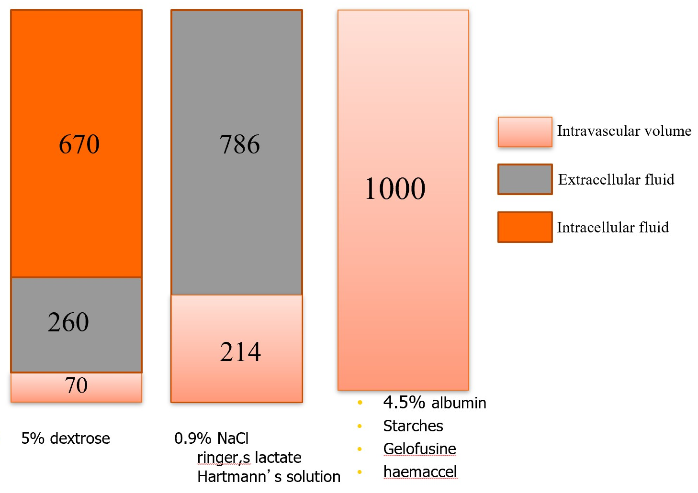
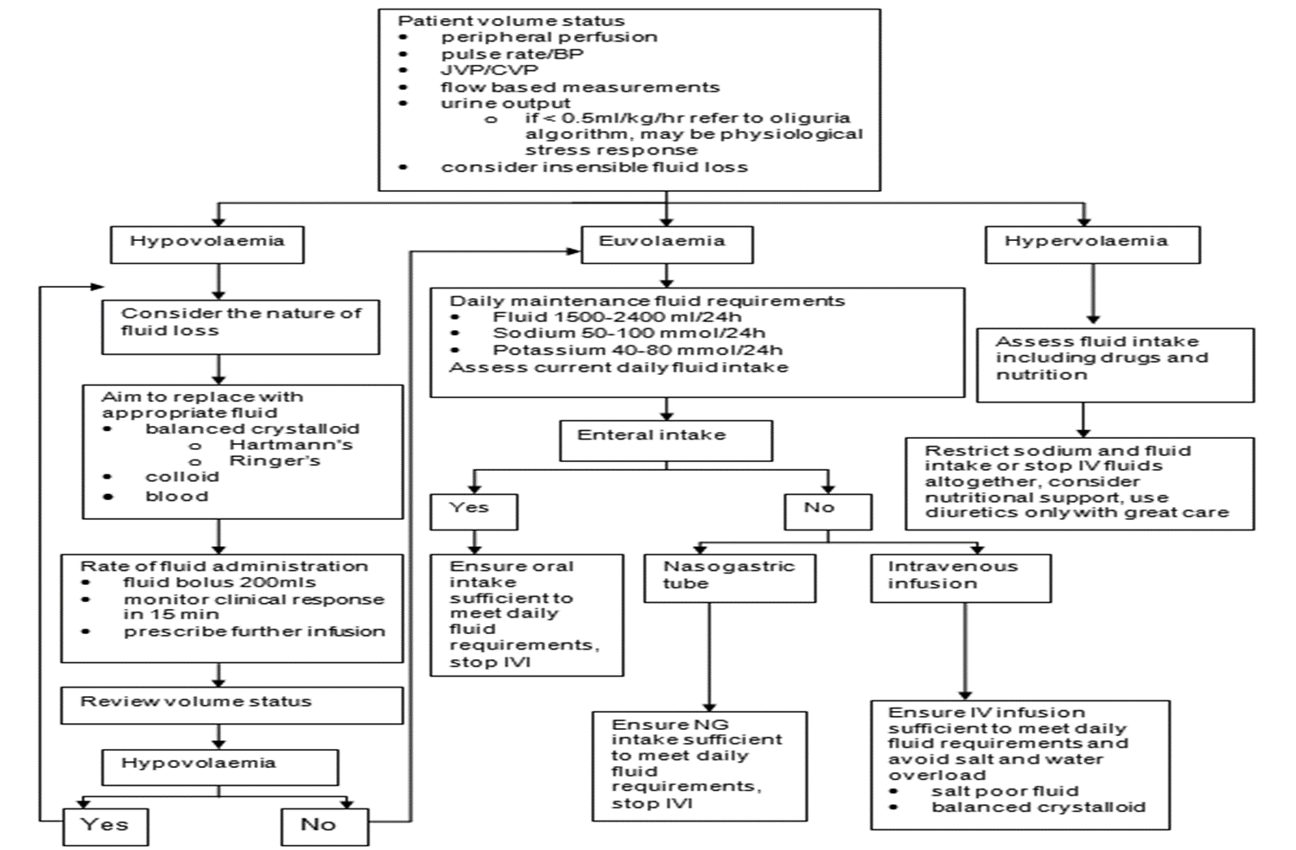
Principles of Surgical Care:
IMPORTANT
Guidelines for Fluid Therapy

Slide 15
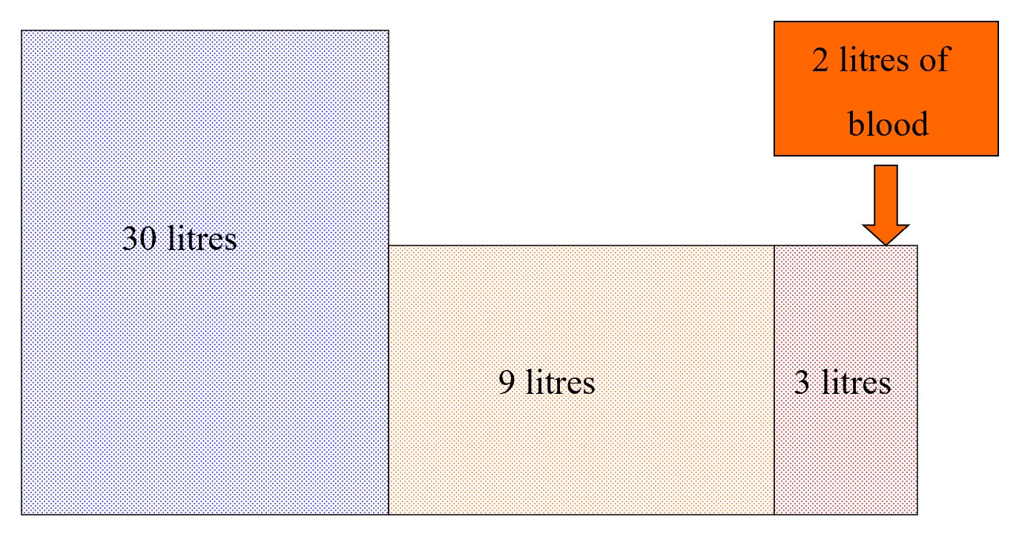
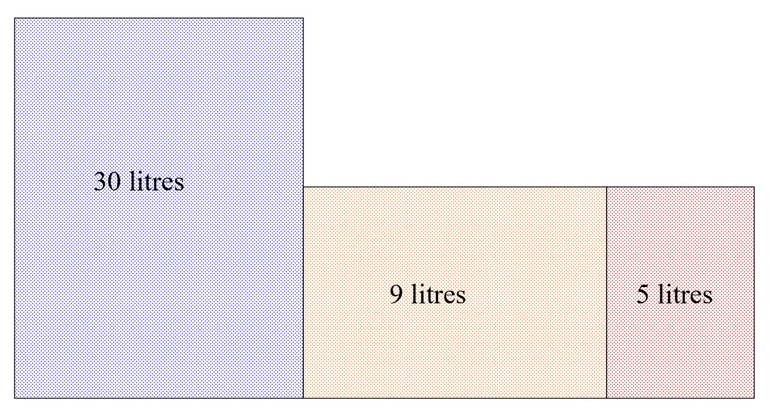
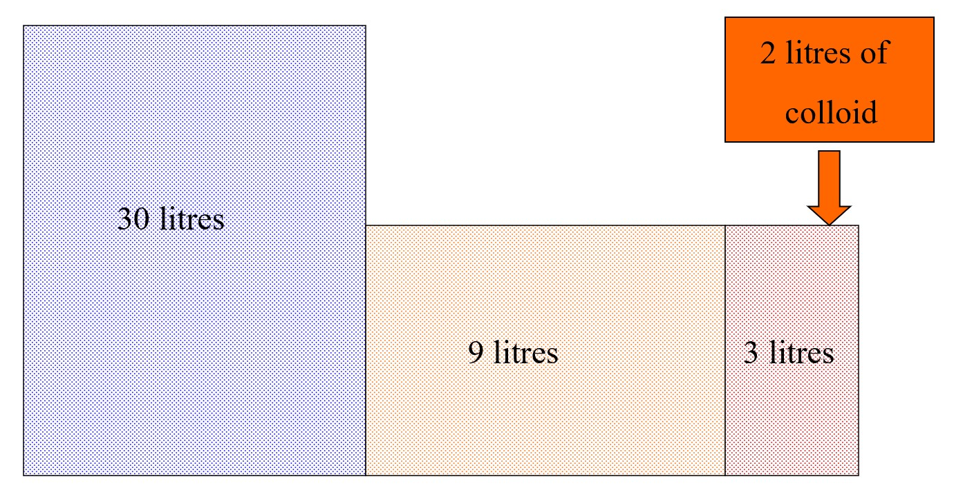
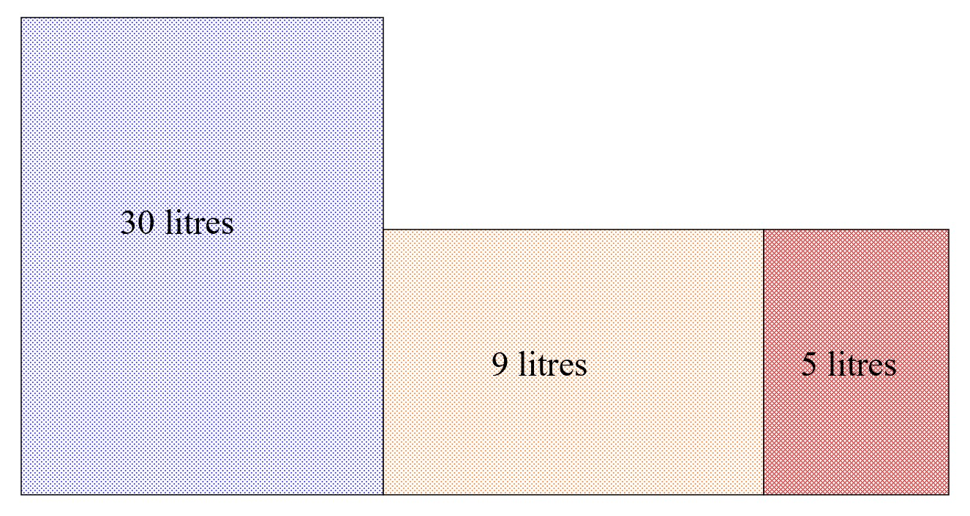
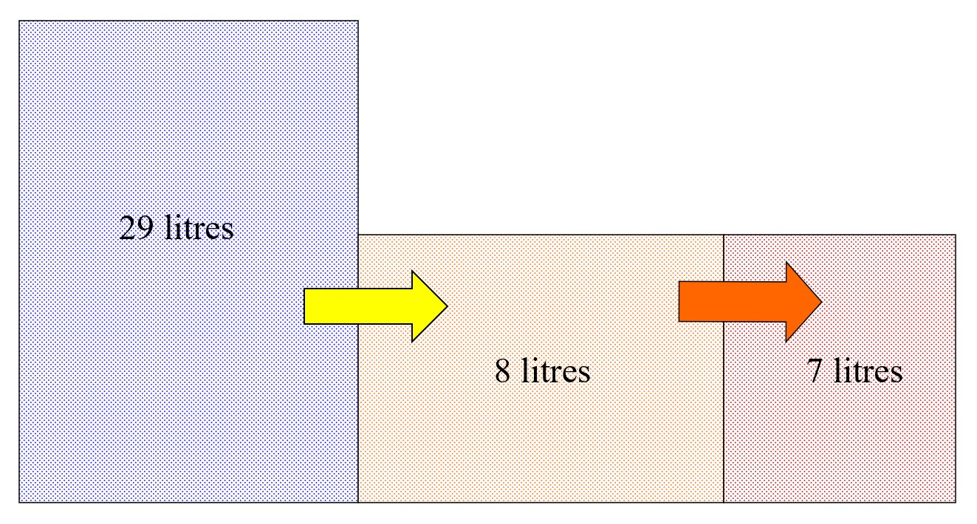
Intravenous Fluids and Fluid Compartments
Blood
Giving 2 litres of blood to someone, will expand their intravascular compartment by 2 litres. None of this fluid will escape across the blood vessel walls ( in the short term at least ) and the other compartments are unaffected.
This is the right treatment for blood loss.
Colloid
Giving colloid into the vascular space results in an immediate expansion of the intravascular compartment by 2 litres, as does blood.
Colloid does not escape from the vascular space, but does increase oncotic pressure markedly causing water to be drawn into the vascular space from the interstitial and intracellular reservoirs. Giving colloid therefore not only expands the vascular space itself, but does so by moving water from other spaces.

Slide 16
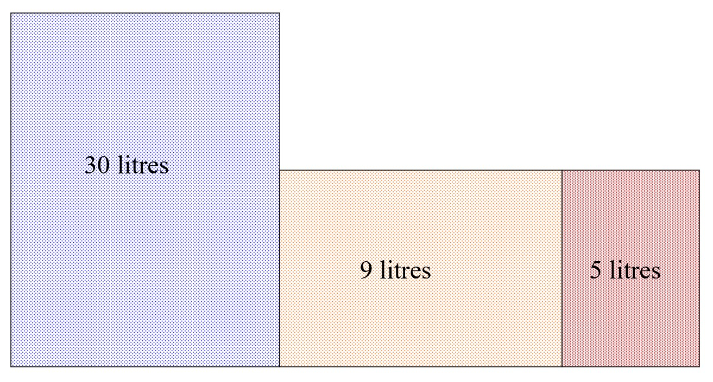
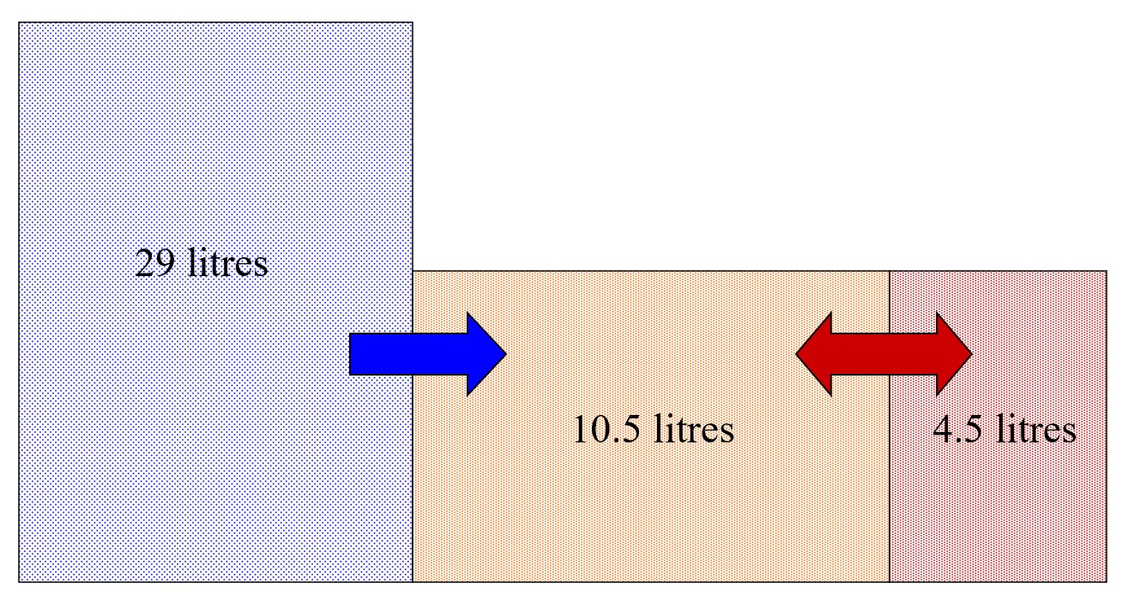
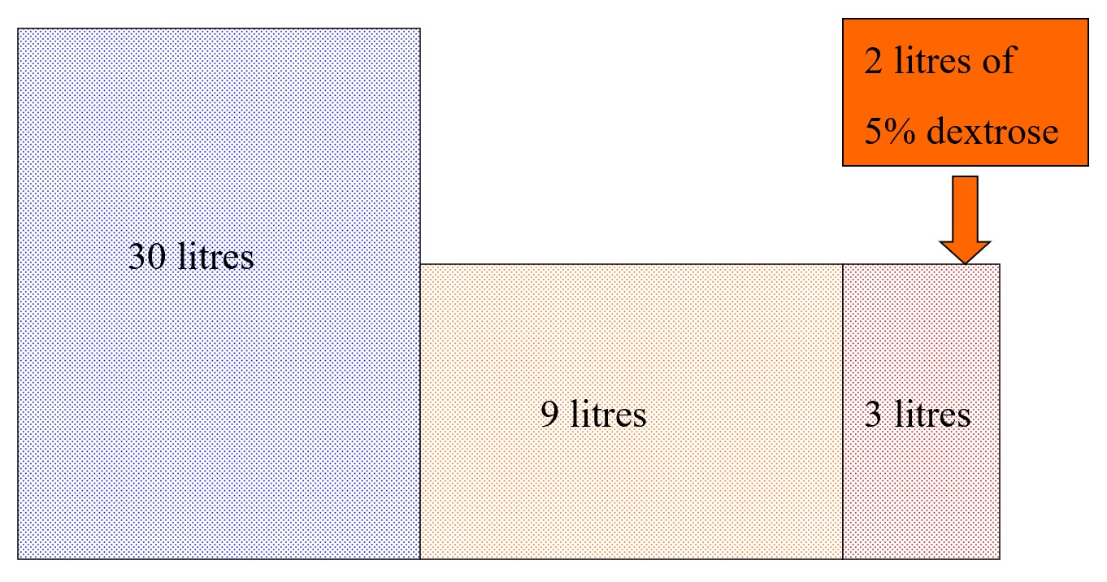
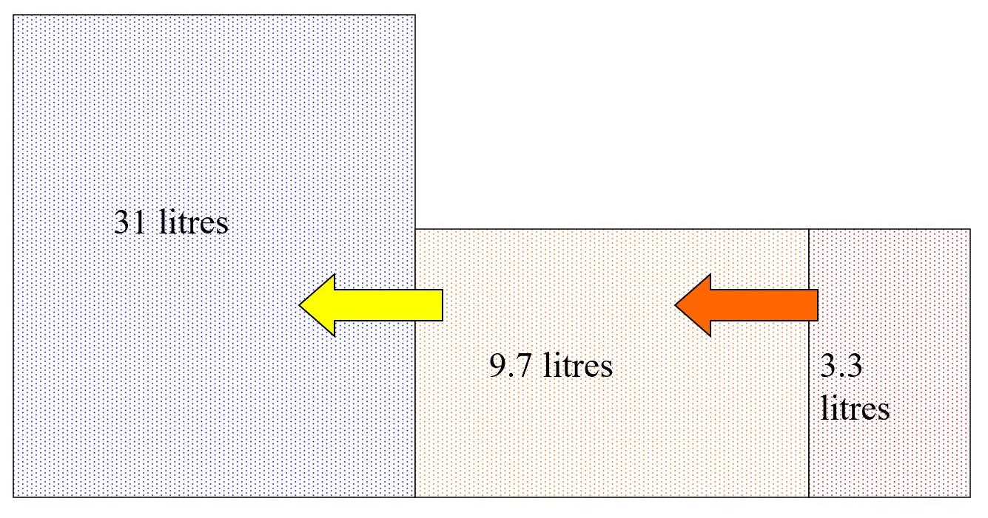
ٍSaline
Saline being a crystalloid, does not remain within the vascular space, but will diffuse into the interstitial space. The sodium it carries will not enter the intracellular space however, because of active sodium extrusion from the cell.
Saline will therefore cause immediate expansion of the intravascular volume, followed by equilibration between the vascular and interstitial spaces, the osmolality of which are equal, but are now slightly greater than that of the intracellular space, due to the increased sodium load. This results in water movement from the intracellular space in order to equalise osmolality throughout all three compartments.
Dextrose
5 Dextrose is isotonic to plasma. Giving 2 litres of 5% dextrose will cause the immediate expansion of the vascular compartment but, as its glucose content is rapidly metabolised, the remaining water will distribute itself between all compartments and very little will remain within the blood space. For this simple reason, dextrose is not a fluid of resuscitation.

Slide 17
How much fluid to give ?
What is your starting point ?
Euvolaemia ? ( normal )
Hypovolaemia ? ( dry )
Hypervolaemia ? ( wet )
What are the expected losses ?
What are the expected gains ?
What are the expected losses ?
Measurable:
urine ( measure hourly if necessary )
GI ( stool, stoma, drains, tubes )
What are the potential gains ?
Oral intake:
fluids
nutritional supplements
bowel preparations
Insensible:
sweat
exhaled
IV intake:
colloids & crystalloids
feeds
drugs

Slide 18
Acid-Base balance
Normal physiology
Hydrogen ion is generated in the body by:
1-Protein and CHO metabolism (1meq/kg of body weight)
2-Predominant CO2 production
It is mainly intracellular
PH depends on HCO3/ CO2
PH = log 1/[H+]
Normal PH range = 7.3 – 7.42
PH<7.3 indicates acidosis
PH>7.42 indicates alkalosis
Buffers
Intracellular
Proteins
Hemoglobin
Phosphate
bicarbonate/carbonic acid system The main MECHANISM
H+ + HCO3↔H2CO3 ↔ H2O + CO2
HOW DO YOU READ A/VBG
PH = 7.3-7.4
Partial pressure of CO2 in plasma (Pco2) = 40 mmHg if 80 it's acidosis
Partial pressure of O2 in plasma (Po2) = 65 mmHg
Bicarbonate concentration (HCO3) = 24 mEq/L
O2 Saturation ≥ 90%
Base Excess 2.5 mEq/L (<2.5 metabolic acidosis, >2.5 metabolic alkalosis)
Anion Gap (Na+ - [HCO3+Cl]) = 12 (>12 met. acidosis, < 12 met. Alkalosis
Anion Gap
AG= Cations (NA+ K) – Anions (CL + HCO3)
Normal value is 12 mmol
Metabolic acidosis with:
1-Normal AG (Diarrhea, Renal tubular acidosis)
2-High AG ,
Endogenous(Renal failure, diabetic acidosis, sepsis)
Exogenous (aspirin, methanol, ethylene glycol )

Slide 19
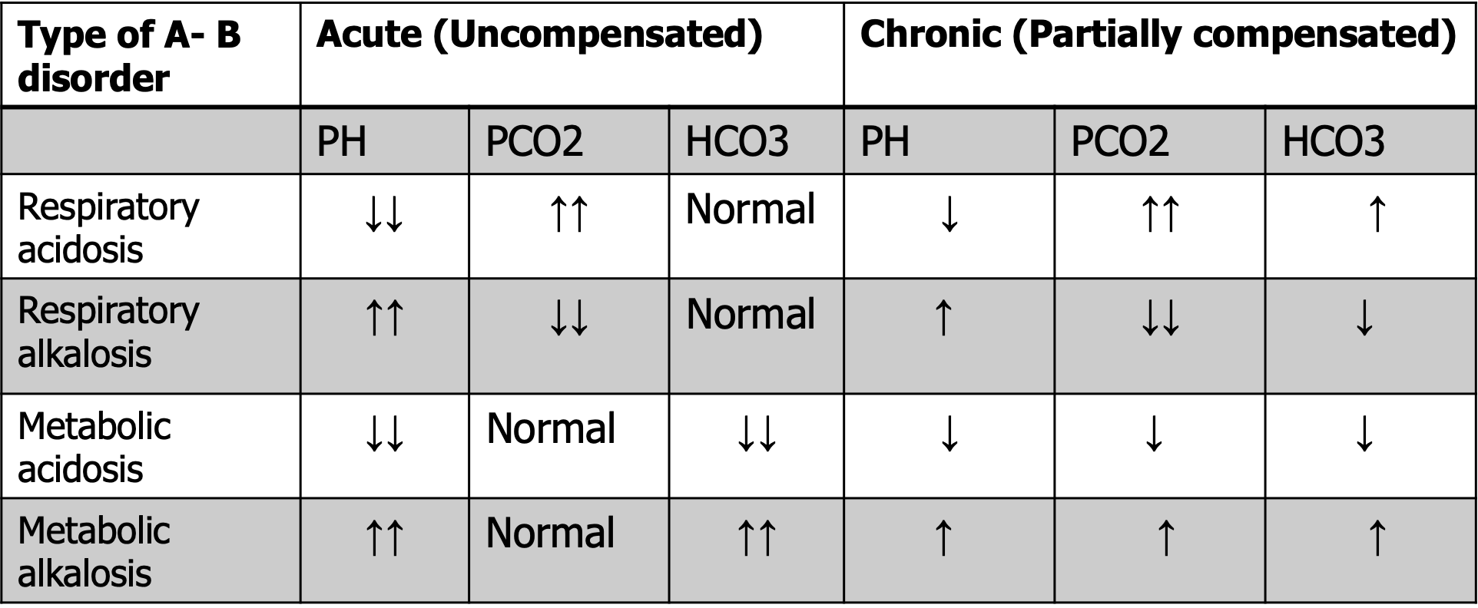
Acid-base disorders
Causes of metabolic acidosis
Lactic acidosis
Shock (any cause)
Severe hypoxaemia
Severe haemorrhage/anaemia
Liver failure
Accumulation of other acids
Diabetic ketoacidosis
Acute or chronic renal failure
Poisoning (ethylene glycol,methanol,salicylates)
Increased bicarbonate loss
Diarrhoea
Intestinal fistula
Causes of metabolic alkalosis
Loss of sodium, chloride, water: vomiting, NGT, LASIX
hypokalaemia
Causes of respiratory acidosis anything that stop
Common surgical causes of respiratory acidosis
Central respiratory depression
Opioid drugs
Head injury or intracranial pathology
Pulmonary disease
Severe asthma
COPD
Severe chest infection
Causes of respiratory alkalosis any cause of hyperventilation
Pain
apprehension/hysterical hyperventilation
Pneumonia Central nervous system disorders(meningitis, encephalopathy)
Pulmonary embolism
Septicaemia
Salicylate poisoning
Liver failure

Slide 20
Examples:
Case 1:
A 62 year old man is 2 days post-colectomy. He is euvolemic, and is allowed to drink 500ml. His urine output is 63 ml/hour:
1. How much IV fluid does he need today ?
2. What type of IV fluid does he need ?
Case 2:
3 days after her admission, a 43 year old woman with diabetic ketoacidosis has a blood pressure of 88/46 mmHg & pulse of 110 bpm. Her charts show that her urine output over the last 3 days was 26.5 litres, whilst her total intake was 18 litres:
1. How much fluid does she need to regain a normal BP ?
2. What fluids would you use ?
Case 3:
An 85 year old man receives IV fluids for 3 days following a stroke; he is not allowed to eat. He has ankle oedema and a JVP of +5 cms; his charts reveal a total input of 9 l and a urine output of 6 litres over these 3 days.
1. How much excess fluid does he carry ?
2. What would you do with his IV fluids ?
Case 4:
5 days after a liver transplant, a 48 year old man has a pyrexia of 40.8oC. His charts for the last 24 hours reveal:
urine output: 2.7 litres
drain output: 525 ml
nasogastric output: 1.475 litres
blood transfusion: 2 units (350 ml each)
IV crystalloid: 2.5 litres
oral fluids: 500 ml
On examination he is tachycardic; his supine BP is OK, but you can’t sit him up to check his erect BP. His serum [ Na+ ] is 140 mmol/l.
How much IV fluid does he need ?
What fluid would you use ?

