Slide 1
Nutritional support for surgical patients
Surgery Team
MED437
Team Leader: Rawan Mishal
Team Members: Sara AlEnezy
Revised By: Arwa aljohany

Slide 2
Aims Of Nutrition In Surgery
Prepare/enhance recovery
Prevent malnutrition or diet-related consequences,(eg,nausea, vomiting, diarrhea,dumping syndrome and dehydration)
Define patient who at risk and who needs for nutrition support
Define special nutrition needs for patients undergoing major surgerys e.g. for cancer, GI surgery and major surgery
Nutrition care for patient undergoing surgery is vary, in related to:
The type of surgery (Minor, Major, Elective, urgent)
The require of extensive nutrition support.
Route of Nutrition, orally or via TF
Postoperative complications such as obstruction, fistula, or anastomotic leaks, delayed recovery.
Malnutrition
Malnutrition is a broad term that can be used to describe any imbalance in nutrition; from over-nutrition to under-nutrition.
Malnutrition seen in hospitalized patients is often a combination of cachexia (disease-related, most commonly) and malnutrition (inadequate consumption of nutrients) as opposed to malnutrition alone.
How To Detect Patient At Risk
Nutritional risk screening in all patients on hospital admission or first contact:
BMI <18kg/m2 (underweight)
Combined: weight loss >10% or >5% over 3 months and reduced BMI or a low fat free mass index (FFMI)
Preoperative serum albumin < 30 g/l (with no evidence of hepatic or renal dysfunction)
Laboratory Measures
Serum proteins such as albumin (nutrition status over a month, most widely used in ICU setting) and prealbumin (nutritional status over a week)
Transferrin
Nitrogen balance
Electrolytes
Total cholesterol
Indicators of inflammation such as (CRP) and total lymphocyte count (TLC)

Slide 3
Enhance Recovery After Surgery
Enhanced recovery of patients after surgery (‘‘ERAS’’) has become an important focus of perioperative management.
From a metabolic and nutritional point of view, the key aspects of perioperative care include:
Avoidance of long periods of pre-operative fasting
Re-establishment of oral feeding as early as possible after surgery if tolerable
Integration of nutrition into the overall management of the patient metabolic control, e.g. of blood glucose
Reduction of factors which exacerbate stress-related catabolism or impair gastrointestinal function
Early mobilization, enhances recovery
Nutrition Support
WHO NEEDS
Patient at Nutrition risk/or Malnourished
Postoperative complications:
Ileus more than 4 days
Sepsis
Fistula formation
Massive bowel resection
Intractable vomiting
OTHER CONDITIONS: Maxillofacial and esophageal surgery (head and neck)
Pre-op:
Fasting from midnight is unnecessary in most patients
Allow clear fluids until two hours before anaesthesia
Nutritional Support prior to major surgery, appropriate period of (7-14 ) days, For patient with severe nutrition risk
POST-op:
Oral intake, including clear liquids, can be initiated within hours after surgery in most patients.
Early tube feeding (within 24 h) shall be initiated in patients in whom early oral nutrition cannot be started, and in whom oral intake will be inadequate (patients undergoing major head and neck surgery or gastrointestinal surgery for cancer, patients with obvious malnutrition at the time of surgery)

Slide 4
Modes Of Administration
Enteral Feeding (tube)
Indications:
Malnourished patient expected to be unable to eat adequately for > 5-7 days
Adequately nourished patient expected to be unable to eat > 7-9 days
(Maxillofacial and esophageal surgery)
Adaptive phase of short bowel syndrome
Parenteral Nutrition
For the surgical patient PN is beneficial in the following ;
Ileus
Intestinal fistula (high-output)
Initial phase in case of short bowel or after small bowel transplant or during periods of rejection
PN should only be initiated if the duration of therapy is anticipated to be >7 days.
IN some cases, Combined EN/PN showed clinical benefits when compared with EN or PN alone.
Assess Nutrition Needs
Most important thing in the entire lecture, practice calculating it
BMI (kg/m2) | Weight (kg) | Caloric Intake (Kcal/kg) | Protein* (gm/kg)
< 30 | Actual BW | 20-25 Kcal/kg (minor) 25-30 Kcal/kg (major) | 1 g/kg/day (minor) 1.5-2.0 g/kg/day (major)
30-50 | Actual BW Ideal BW | 11-14 Kcal/kg 22-25 Kcal/kg | 1.9-2.0 (Ideal BW)
> 50 | Ideal BW | 22-25 Kcal/kg | 2.5 (Ideal BW)

Slide 5
Energy And Protein Needs another calculation based on protein level
Fluids needs
Calculating Fluid Needs for Obese (BMI ≥ 30)
Age (years) | ml/kg | Increased Fluid needs (30-35 ml/kg actual BW): short gut syndrome, high output ileostomy or fistula, excessive diarrhea, high NGT output, large draining wounds, chest tube and JP drain losses.
18-65 | 30-35
65+ | 25 -30
Adjusted Weight | Fluid per day | OR 30-35 ml/kg Adjusted body weight with allowances for extra losses via drains (draining wounds, chest tube and JP drain losses)
40-60 kg | 1500 - 2000 ml
60-80 kg | 2000 - 2500 ml
> 80 kg | 2500 - 3000 ml

Slide 6
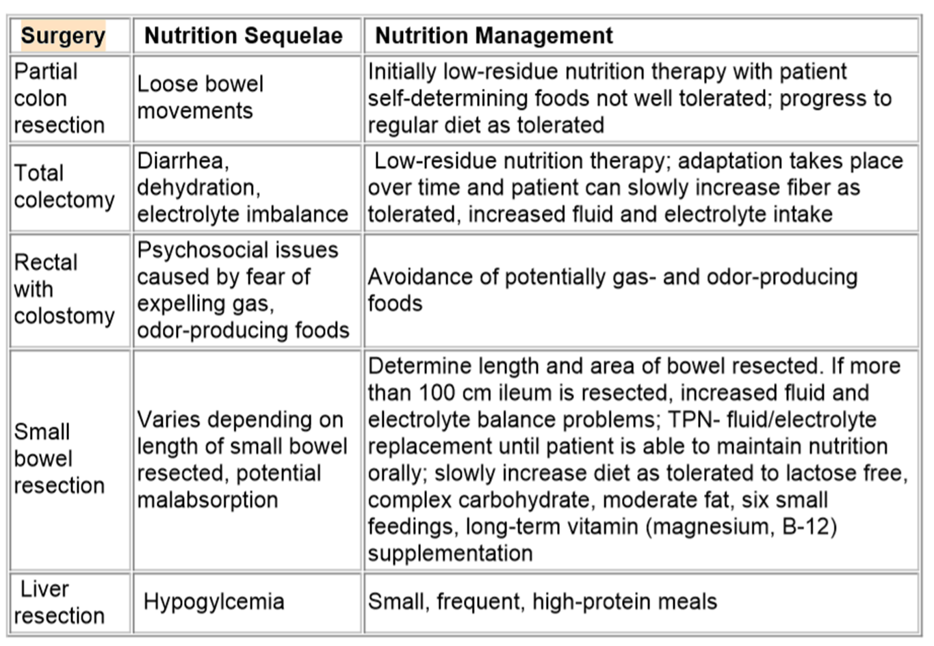
Major surgery nutrition-related challenges
Ostomy (colostomy / ileostomy) a major surgery
Replace Fluid losses via the stoma. (200ml-600ml/day, normal output stoma)
Post Ostomy, low fiber diet for the first 2 weeks, gradually progress to balance diet (avoid beans, peas, corn)
Chew food completely
Small frequents meals
High protein diet, low simple carbohydrate, high sodium. low fat and/or oxalate for the absence of the terminal ileum.
High output stoma
Limit fluids with meals/30min before or after.
Restrict oral fluids to 500ml daily (Meet fluid /electrolyte needs intravenously), low osmolality fluids.
Oral Glucose-electrolyte solution/ORS
Slowing intestinal transit time via loperamide, pectin, and fibers may promote improved absorption
Losses of 2 L to 3 L ostomy output per day can also contribute to losses of magnesium, zinc, bicarbonate, potassium, and sodium.
VERY IMPORTANT
VERY IMPORTANT

Slide 7
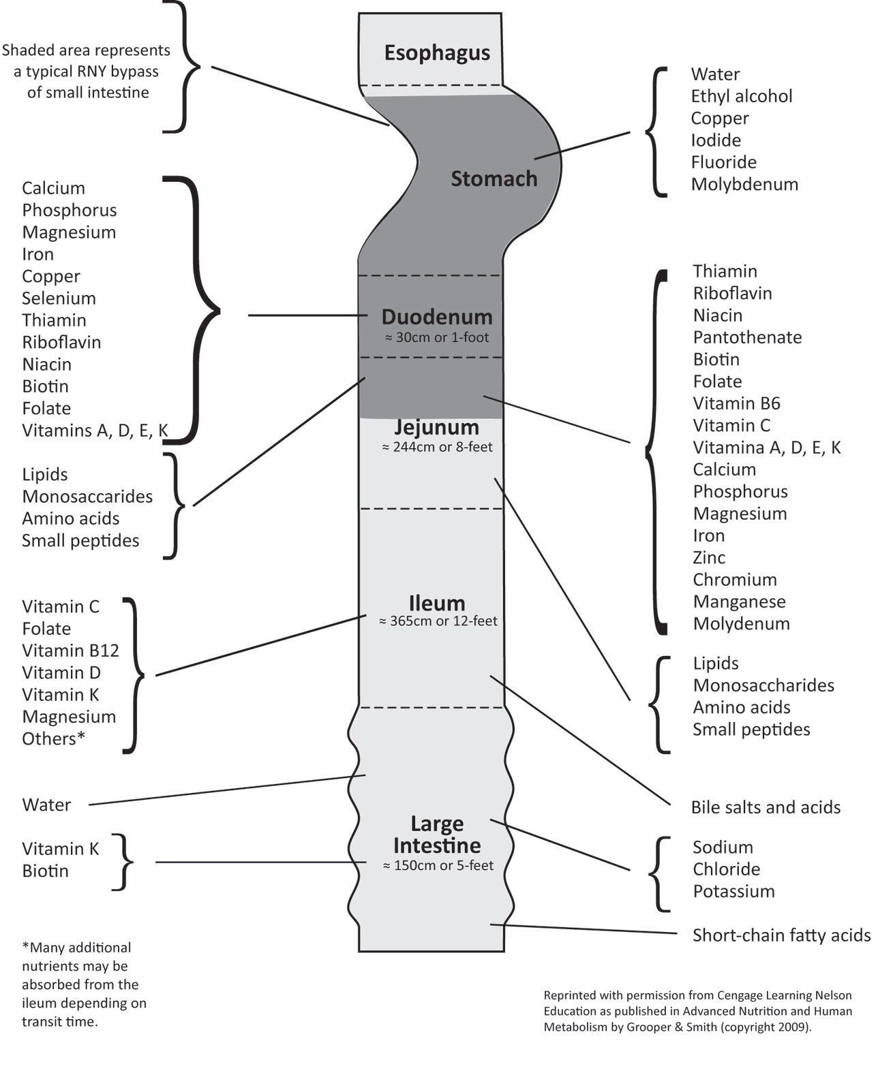
Immunonutrition
In the preoperative phase, formulas enriched with arginine, omega-3 fatty acids have been shown to improve postoperative immune response, gut oxygenation and enhance recovery.
Antioxidants, including vitamins C and E, betacarotene, and selenium are often added in an effort to reduce oxidative stress among patients with acute metabolic stress. (wound healing)
Extra

