Slide 1
practical procedures investigations of surgical patients
Surgery Team
MED437
Team Leader: Rawan Mishal
Team Members: Elham Alami, Sara AlEnezy
Revised By: Arwa aljohany

Slide 2
الحمدلله الذي بنعمته تتم الصالحات
شكرًا لله ثم لكل من ساهم وتعاون على إنجاز هذا العمل، جعله الله عملاً صالحًا متقبلًا تؤجرون عليه
أروى الجهني & روان مشـعل
أسيل بادخن
بتول الرحيمي
مجد البراك
رهف الشمري
خلود الوهيبي
منيره المسعد
ديمة العريفي
رهام الحلبي
رناد الغريبي
الهام علامي
سارة العنزي
ريما العنزي
هديل عورتاني
الهنوف الجلعود
روان الحربي
دانة القاضي

Slide 3
General Consideration:
Every procedure should be preceded by adequate explanation. In any procedure from LP to central line to normal blood studies
Reason for procedure, simplified steps, what is expected during the procedure.
Communication and reassurance throughout the procedure. Helps the pt remain calm.
Counselling regarding the need, the benefit and any alternatives to the procedure. Tell the patient all the options even if you know something is better than the other, because he will choose in the end and will sign a written informed consent.
Written informed consent is required sometimes.
General Precautions:
Needles should not be resheathed. Chances of you pricking yourself with the needle are higher when you resheath it.
Sharp instruments discarded by the operator should be placed in a special ‘sharps’ container. You should discard of them by yourself.
Drapes and other soiled equipment should be placed in appropriate containers.
Gloves and gown should only be removed after all used equipment / drapes have been placed in appropriate containers. Because of a biohazard or a risk of infection. The last step is removing the gloves and gown.
Aseptic Technique:
Using practices and procedures to prevent contamination from pathogens. It involves applying the strictest rules to minimize the risk of infection’.
As a minimum precaution, the skin should be cleansed with an antiseptic solution, and sterile instruments used.
For some procedures, full aseptic technique should be employed. Whenever you bypass the skin.
Means doing surgery without causing infection. The surgeon, the patient and the technique should be sterile.
When the nurse is drawing blood it doesn’t need a full sterile technique. It is done with an aseptic technique using clean (sterile) needles, wearing gloves, cleaning the area with alcohol or chlorhexidine. This is a basic aseptic technique.
Some procedures need to be a full aseptic technique especially if you are entering a sterile medium and it passed the barriers such as lumbar puncture, central lines, chest tubes, catheterization, ascites drain. These procedures you are passing most of the bodies defenses i.e. the skin. And if you introduce an infection the chances of the body defending it are low.

Slide 4
Cont...:
You have dry and wet sterilization, if you need to wear something (mask or protective goggles) wear them before because you cant after that.
When you wash your hands your direction must be away from the hands upwards because we want to remove the pathogens from our hands.
You clean your fingernails the first time you sterilize, the following procedures you’re not required to do it again just resterilize.
Once your done your arms should not be below your waist or above your shoulders.
Key points:
Explain the procedure to the patient.
Take consent
Prepare everything before you start.
Maintain sterility.
You should know how to scrub in and sterilize the site of incision
Central line placement:
This is how you set up for any procedure.
If it were a central line, incision and drainage, lumbar puncture, chest tube, ascites drain it’s all the same.
Local anaesthetic:
Local anaesthetic agents -most of them are sodium channel blockers- inhibit membrane depolarization and hence block the transmission of nerve impulses.
Either topical, or local infiltration.
Local anaesthetic drugs are potentially toxic and care must be taken to avoid inadvertent intravascular injection.
The most common local anesthetic, Lidocaine, comes in a preparation with additional epinephrine to vasoconstrict the area. This prolongs the anesthetic effect (inhibits anesthetic uptake), and decreases bleeding. Do not use Adrenaline in any hand/foot artery as this can lead to ischemia.
Signs of toxicity:
Numbness. “Perioral numbness is the first sign”
Tingling.
Tinnitus.
Lightheadedness.
Symptoms appear gradually, you should stop and monitor the patient and sometimes get a consultation for an antidote.
When you infiltrate you must first withdraw the needle to check for the presence of blood, which indicates you are inside the vein and this might cause earlier toxicity because its injected directly in the blood. If there was no blood when you withdrew then you can go ahead and inject.
Higher doses:
LOC.
Convulsions.
Arrhythmias is the worst.

Slide 5
What is important from these two slides “local anesthesia” ?
Mechanism of action (inhibiting depolarization).
Toxicity (numbness, tingling, tinnitus, arrhythmias).
Duration for each one
None of this was mentioned by dr.Watidy
Cont...:
Esters are old we only use amides now
Esters | Max Dose (mg/kg) | Duration (h)
Chloroprocaine | 12 | 0.5 - 1
Procaine | 12 | 0.5 - 1
Cocaine | 3 | 0.5 - 1
Tetracaine | 3 | 1.5 - 6
Amides | Max Dose (mg/kg) | Duration (h)
Lidocaine -Fast acting with a short duration of action. -Can be mixed with epinephrine which is important because it causes vasoconstriction which means lidocaine will stay in place and not go systemic and will also decrease bleeding. Contraindicated in end arteries like toes or finger because it might lead to ischemia. | 4.5/(7 with epi) | 0.75 - 1.5
Mepivacaine | 4.5/(7 with epi) | 1 - 2
Prilocaine | 8 | 0.5 - 1
Bupivacaine it is the longest acting local anesthesia - Long acting. - If you want something to stay longer. You want to perform a nerve block or apply an epidural then you use it because it lasts longer for 8 hours and more. - Used in epidural catheters. | 3 | 0.5 - 8
Ropivacaine -Used in epidural catheters. | 3 | 1.5 - 8

Slide 6
Suturing:
Whether you are approximating a vessel to prevent rebleeding or the skin for wound healing or for anastomosis.
Suture types
Absorbable
Non-absorbable
Braided | Monofilament (skin)
1- Vicryl. 2- Vicryl rapids. Bowel anastomosis | 1- Monocryl. 2- Fasting absorbing gut. 3- Chromic gut. Face, forearm
Braided (skin if we are not worried about infection +“TR”) | Monofilament (skin if we are not worried about tissue reaction “TR”)
1- Ethibond. 2- Silk. | 1- Ethilon. 2- Prolene. Vascular anastomosis
Absorbable: used in areas where we do not want the stitch to stay forever because we are worried about granulomas, tissue reaction, overgrowth. Like subcuticular under the skin, we use MONOCRYL for it.
If you want to put a suture in the trachea, you want to use an absorbable suture if you put non absorbable it will stay there forever causing a granuloma and tracheal problems. If you want to put it in the skin then it depends: If it is subcutaneous and you don’t want the patient to come back then you put absorbable. In the bowel and the hollow viscus you put an absorbable suture most of the time. Otherwise it will cause ulcerations, granulomas and bleeding.
Non-absorbable: Causes less tissue reaction Can be used in cases where we want the suture to stay forever, or if it was a skin suture and you’re going to cut it off later.
If you want to put it in the skin then it depends:If you want the patient to come back and you cut the stitches the you will most probably choose none absorbable. If you are putting a stitch in the vessel, an artery, do you want the stitch to go away? No. You never want the stitch to go away in vessels because it will cause an aneurysm and there will be a lot of issues. So you put a non absorbable. The back and the buttocks are very tough tissue with a poor blood supply so you need a strong stitch to approximate the tissue. That is why in areas of high tension and low blood supply we use braided non absorbable (Ethibond) or monofilament non absorbable (Ethilon).

Slide 7
Cont…:
EXAMPLE QUESTIONS GIVEN BY THE DOCTOR:
Braided (multifilament): | Monofilament:
More destruction to tissues. More infections. The bacteria might come in between the braids and introduce an infection. Easier to handle. | Usually causes less tissue reaction. Bacteria does not stick to it. More difficult to handle for the surgeon.
1- If we don’t care about infection migration, we are not on the skin or we are in the bowel and we want something easier to handle we use braided. 2- If it were in the subcutaneous tissue or the bowel we use Vicryl which is a braided absorbable suture. 3- Chest tubes and drains we use a silk suture because they will be removed in 5-7 days. | 1- If we were in the skin and we want it subcuticular, cosmetic and gets absorbed then we use monofilament. Most of the time skin in the face we use Monocryl.
Absorbable-Braided: | Absorbable-Monofilament:
Bowel anastomosis: Vicryl or less commonly monocryl (because bowel heals within 3 days, if you use non absorbable it will causes ulcers. Any subcutaneous (muscles, bowel) we use braided absorbable because it is absorbable and you are not worried about infections or tissue reaction. | If you have a skin incision to suture in the face: Monocryl. Close the skin in the forearm: Monocryl If it is subcuticular you have to use (monocryl, no tissue reaction and will go away quickly).
Non-Absorbable-Braided: | Non-Absorbable-Monofilament:
 | Large lipoma in the upper back resected how do you want to close the skin? Ethilon; You can use silk but the problem with silk is that it is natural so more tissue reaction. The doctor recommends using ethilon. Ethilon for the skin if it was a regular suture not-subcuticular. Vascular anastomoses: Ethilon, there is a better one for vessels which is prolene.

Slide 8
Cont...: None of this was mentioned by dr. Watidy
Undesired tissues reactivity is greater with:
Multifilament (compared to monofilament).
Larger suture gauge. Size of the stitch: In the face or the area where there is delicate skin, you choose a smaller size 0.2, 0.3, 0.4 In the back you go for a larger size 0 or 1.
Natural material (compared to synthetic)
Absorbable sutures:
If you had to choose between natural material (gut) or synthetic (Vicryl) vicryl is usually the better option we rarely use natural nowadays.
Obstetrics usually are the ones to use gut stitches, the only benefit to the gut is that they get absorbed very fast. In the perineum where the blood supply is excellent. And the area heals in 4-5 days you want to use the stitch that heals the fastest. But still vicryl is better in my opinion.
Non-Absorbable sutures:
 | Effective wound support | Complete absorption | Comments
Surgical gut | 8 - 9 days | 30 days | Rarely used, high tissue reactivity.
Chromic gut | 10 - 21 days | >90 days | Gut treated with chromium to decrease tissue reactivity and slow absorption.
Fast absorbing gut | 5- 7 days | 14 - 28 days | Gut treated with heat to speed absorption.
Polyglactin(Vicryl) | 21 days | 90 days | Less reactive than gut; synthetic.
Vicryl rapide | 10 days | 42 days | Gamma-irradiated to speed absorption.
 | Tensile strength | Tissue reactivity | Comments
Silk | Low | High | Multifilament, pliable.
Nylon (Ethilon) | High | Low | Monofilament, stiff.
Polypropylene (Prolene) | Moderate | Very low | Monofilament, less knot security because slippery (may need extra throw in knot).

Slide 9
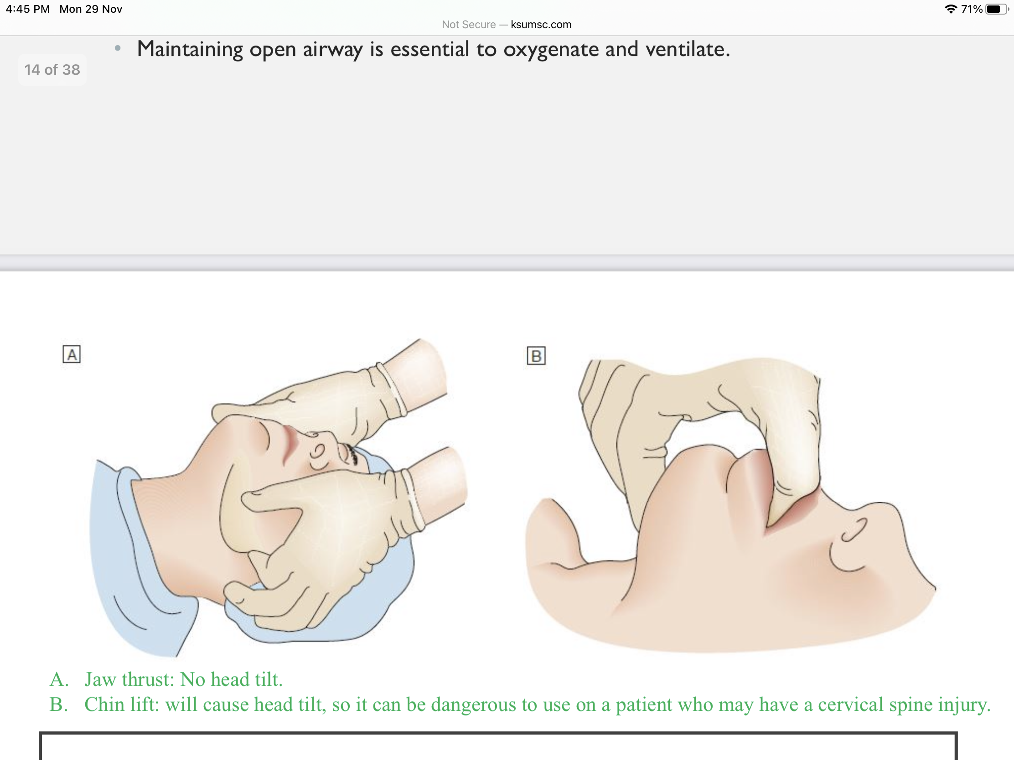
Cont...:
Suture removal time frames: Depends on the blood supply.
If DM or smoker we add time usually.
Airway procedures:
Ability to maintain airway is a basic but essential maneuver.
Hypoxia results in irreversible tissue damage and death quickly. Why is hypoxia dangerous? Because it would kill the brain within minutes
In the unconscious patient, muscles that normally maintain a clear airway become lax.The tongue and soft tissue fall backwards, particularly in the supine patient, occluding the airway. Why do patients lose their airway? Most of the times it is because they lost consciousness and due to jaw muscles relaxation. So sometimes just putting the patient on his left side opens the airway as the jaw does not drop posteriorly but goes laterally
Maintaining open airway is essential to oxygenate and ventilate.
1- Basic airway procedure:
Steps: Jaw thrust/Head tilt chin lift, then suction, then airway. Once you do this the pt starts to breath if he doesn't breath the you supplement the breathing. Sometime you can’t do a head tilt in a trauma patient, cervical spine so the jaw thrust becomes better.
IMPORTANT
Body part | # of days after suturing
Face Great blood supply | 3-5 More than that leads to more discoloration and more reactivity.
Scalp | 7
Chest, Extremities | 7-10
High tension areas = Areas that are always moving like over the joints Back & Buttock | 10-14 The worst area, poor blood supply and the skin is tough.
A- Jaw thrust
No head movement so it is the safest.
B- Chin lift, has a little neck movement

Slide 10
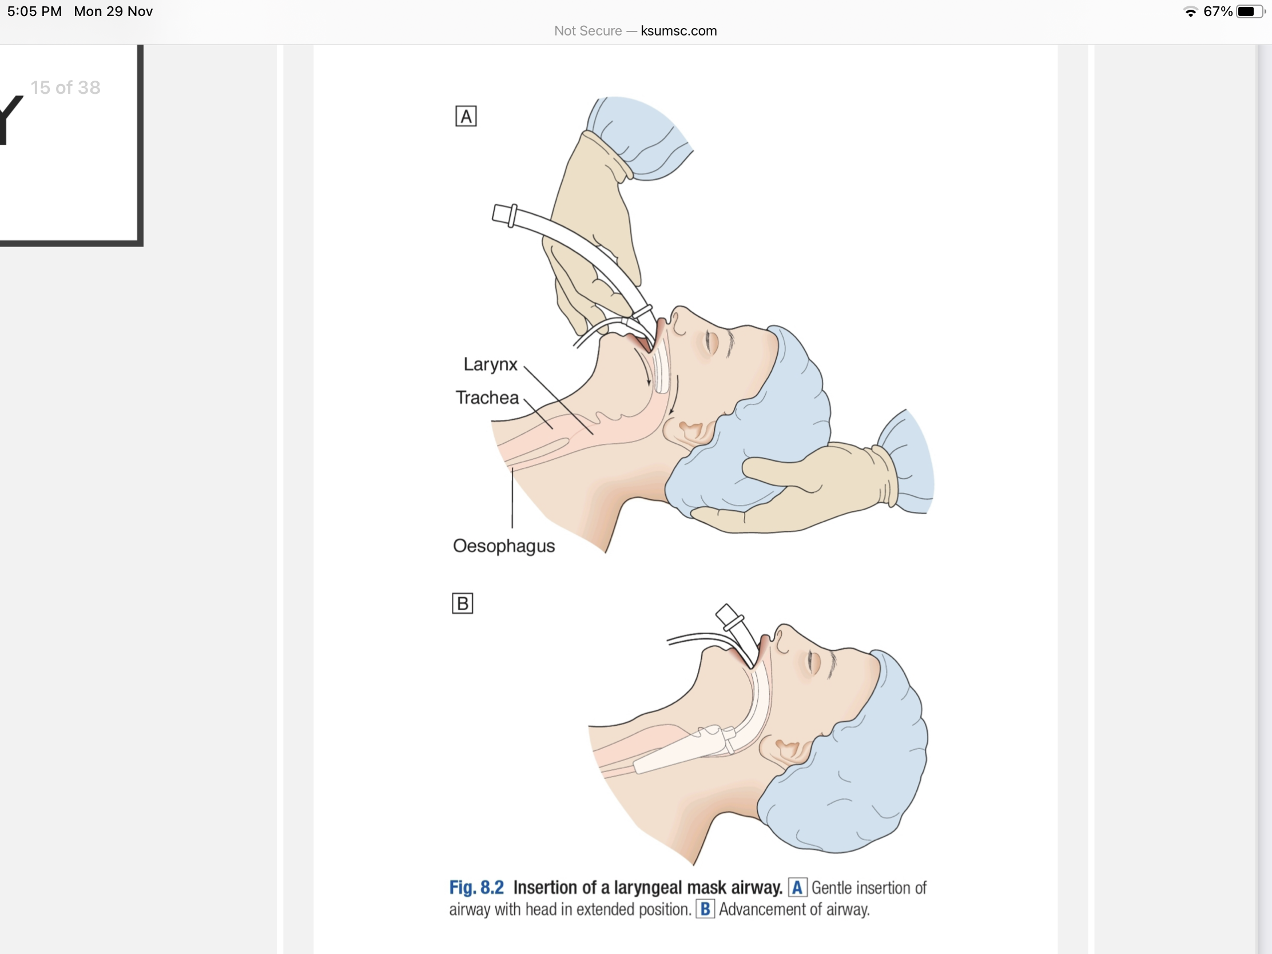
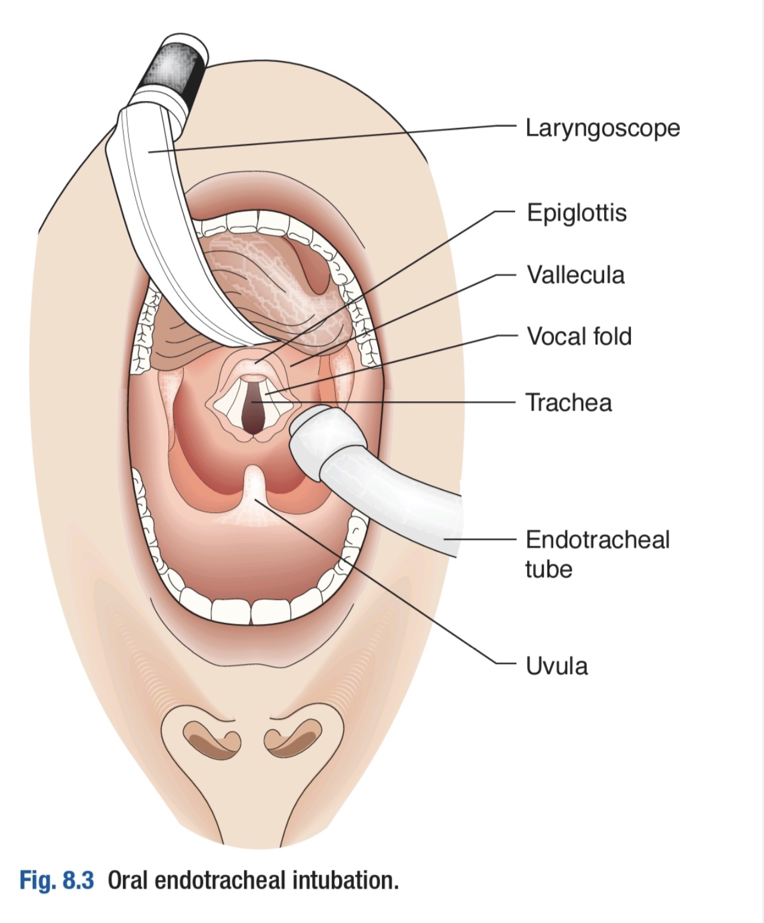
2- Laryngeal mask airway:
Not a replacement for orotracheal intubation.
However, can provide an airway for oxygenation and ventilation for brief periods of time.
Increased risk of aspiration.
One disadvantage to this is that you are also ventilating the stomach so you will get some distension, but at least the pt is still alive.
2- Endotracheal intubation:
A definitive airway.
Life saving.
Protect from aspiration
Every effort should be spent in learning this maneuver.
Complications of prolonged intubation specially in peds is tracheomalacia.
It is the only definitive airway, protects you from aspiration, if failed we go to surgical airways.
3- Surgical airway:
Lifesaving procedures in case of difficult airway or failure to incubate.. (Burns, severe facial trauma, etc.).
Needle Cricothyroidotomy: needle insertion in the cricothyroid membrane and jet ventilation.
Surgical Cricothyroidotomy: incision in the neck and cricothyroid membrane and insertion of tracheostomy tube. - Contraindicated age<12.
It is used when ET is impossible like facial trauma, broken jaw, big hematoma. The landmark here is cricothyroid membrane You can either use a needle or surgical longitudinal incision When is it a bad idea? In children so you just do tracheostomy.
None of the above was mentioned by Watidy
Thoracic procedure:
1- Chest tube insertion:
Indicated for drainage of pleural cavity. (Pneumothorax, hemothorax, effusion, Empyema etc.). anything that fills up the pleural cavity (air or fluid).
For pneumothorax smaller size can be enough (14-16Fr).
For trauma or hemothorax, a larger tube is indicated. In case of fluids or blood use a bigger tube size.
site:
Position as in the opposite figure.
4th or 5th intercostal space, between anterior and mid axillary line.
Nipple line in males. In case of emergency.
Infra-mammary fold in females. In case of emergency.
Chest tube is always the same site but the direction might differ.
The same position for all patients. mark down base of axilla and latissimus dorsi and 5th intercostal space, insert it between middle and anterior axillary lines (never go posterior or inferior or superior)

Slide 11
Equipments:
Sterile gloves and gown.
Skin antiseptics.
Sterile drapes.
Gauze swabs.
Syringes and needles (21–25 gauge).
Local anaesthetic, e.g. lignocaine (lidocaine) 1% or 2%.
Scalpel and 11 no. blade.
Suture (e.g. “1” silk).
Instrument for blunt dissection (e.g. curved Kelly clamps or artery forceps).
Chest tube of appropriate size.
Connecting tubing.
Closed drainage system (including sterile water if underwater seal being used). To balance pressure as when the patient is taking a deep breath and pressure becomes negative we do not want the air to enter from this are so we use this seal.
Dressing.
Technique:
First thing you use anesthesia → Cut the skin → When you reach the cavity then you should insert your finger to check for any adhesions → YOU HAVE TO PALPATE THE LUNG WITH YOUR FINGER → insert above the rib so as not to injure the intercostal bundle (artery, vein, nerve).
After taking the consent, pt preparation , local anesthesia.
Location of the tube:
5th or 4th intercostal space and the best landmark to locate them is the nipple line in males and the infra mammary line in females. And anywhere between the anterior and mid axillary line. If you approach the mid axillary line it will be uncomfortable for the patient when lying down and if you approach the anterior axillary line the rib space will be tight and it will be more painful. So you want anything in between.
Incision is 2-2.5 cm after local anesthesia, you take it down to the ribs. After the rib you want to enter in a space where there are no vessels or nerves (they are usually located below the rib) and you do a controlled push (your other hand is holding the instrument) especially on the left side the heart is right there. You first insert the instrument then your fingers you check if there is a lung or adhesions are you in the space.
Then you put the chest tube.
For air —> Apical
For fluid —> posterior
At the end make sure you secure the chest tube in place. And connect it to pleurovac underwater seal. To avoid tension pneumothorax.
Confirm the chest tube with misting and a chest x ray.

Slide 12
Complications of chest tube:
Infection
Bleeding especially with costal artery injury.
Liver injury, cardiac (atrial) injury depending on the side.
Diaphragmatic injury.
Empyema.
Tension pneumothorax when it gets blocked.
Abdominal procedures:
1- Nasogastric tube insertion:
A tube to drain stomach contents, or administer enteral nutrition.
Usually, a 14–16 Fr single-lumen radio-opaque nasogastric tube with multiple distal openings is sufficient.
Fine bore NG may be used if for enteral nutrition only.
Could be therapeutic or diagnostic.
We use it to drain the stomach like cases of bowel obstruction, bleeding, recurrent vomiting, ingestion of toxic material. Or we use it to feed the patient.
Inspect nose for any deformity.
Patient in sitting position.
Lubricate the tube and measure = from tip of nose behind ears to the stomach.
Insert the tube along the floor of nose.
Once in oropharynx, ask patient to swallow (water may help).
Once in stomach, confirm position by aspiration (bile), or by injecting air and auscultation or CXR.
Indications of NGT:
Bleeding.
Stomach decompression.
Bowel obstruction.
GI bleeding (to rule out an upper GI bleed).
Feeding.
Medication (sometimes the pts cant take meds).
Aspiration (decompression).
Complications of NGT:
Insertion in the lungs.
It closes the sinuses so they develop sinusitis.
Contraindicated in patients with base of skull fracture.
None of the above was mentioned by dr. Watidy. Instead: Abdominal Paracentesis and Abdominal Diagnostic Peritoneal Lavage (open vs closed technique, indications, complications)

Slide 13
Steps for NGT:
consent
Preparation: choose the size of your tube from 16 to18, for bleeding you take a smaller bore (18) for drainage a larger is better so it won’t get blocked (16 gauge).
You have to numb the area topical anesthesia you spray the nostrils and the back of the mouth because it is very uncomfortable.
Try to calculate when the tube will be in the stomach. Usually it is 40 cm.
You need the pt cooperation because at some point you will ask them to swallow. Give them a glass of water because when they swallow the water the NGT also gets swallowed to the esophagus otherwise it will go to the trachea.
Initially you want to sit the patient up, and the direction is towards the head and then after approx 5cm you start pointing towards the back to avoid hitting the roof of the nose, once you are 10 to 15 cm in you are most likely behind the pharynx and now you ask the pt to swallow. With each swallow you push.
Once you go in you check that it is in place by: 1. Aspirating bile or 2. You bring the big tumi syringe and you oscillate for the gas bubble.
Dont forget to secure it in place.
If the pt is in the ICU or they are not awake we usually get an x-ray confirmation especially if we were going to use it for feeding because we dont want it going into the chest.
If you only want it for drainage (i.e. someone with a bowel obstruction) then usually the bile will come out and you confirm and start suctioning. Suction should be intermittent if it were continuous suctioning like the chest tube the mucosa will develop an ulcer.
Vascular procedure:
Central line insertion:
Indications:
Hemodynamic monitoring. (CVP).
Administration of inotropes, vasopressors most imp indication is inotropes and to elevate pressure like epinephrine, remember you cannot administer it peripherally because it is irritating and might cause vasoconstriction most common and ischemia.
Parenteral nutrition.
Sites:
Internal jugular. Most common.
Subclavian.
femoral. High infection.
PICC.
•Should be done under aseptic sterile conditions.
•Should be done with ultrasound guidance.
•Watch for air embolism.
•Always confirm placement by withdrawing blood from the catheter, and by xray.
•All lines should secured in place.
Extra

Slide 14
Complications:
Arterial cannulation.
Hemo or pneumothorax. Check it when withdraw blood.
Hematoma.
Air embolism. Treat it by making the air go to top of the heart by letting pt stay head down until it dissolves.
Infection.
Urinary procedures:
1- Urethral catheterization:
Indications:
Relieve urinary retention.
Accurately measure urine output.
Nursing of incontinent patients.
Long procedures under GA.
Sterile, aseptic technique.
Choose the appropriate catheter, usually 16-18Fr Foley.
Ensure catheter is lubricated.
Avoid using force, catheter should advance gently. if you have resistance uses smaller sizes; if still consult urology.
Complications:
Trauma. Don't Injure the urethra. - False passage. - UTI happen.
2- Suprapubic catheterization:
Indicated for bladder drainage or monitoring of urine output. same indication as foley.
When urethral catheterization has failed, or is contraindicated.
1- Trauma.
2- False passage going through urethra to soft tissue behind urethra & bladder.
3- Obstruction by tumor.
you need to have a full bladder to insert suprapubic cath to avoid injuring adjacent
organs.

Slide 15
Summary
Protect yourself, colleagues and the patient. From infection, Transmission of viruses and diseases
Aseptic technique.
Talk to your patients, and the rest of the team. Get consent, explain the procedure, communicate.
Know indications, alternatives, complications of the procedure you are performing.
procedure | indications | contraindications
PDL | Diagnostic peritoneal lavage (DPL): a diagnostic test used to assess for bleeding or viscus perforation in abdominal trauma. Highly sensitive, but invasive. Performed by placing a catheter into the abdomen, aspirating, then instilling a liter of warm saline. If fecal matter or significant blood are detected, this constitutes a positive test and emergent laparotomy is indicated. Typically performed after the primary survey if hemoperitoneum is suspected and FAST exam is unavailable or equivocal Rarely performed given the greater sensitivity of the FAST exam | An obvious need for laparotomy is the only absolute contraindication for DPL. Lack of training or familiarity with performing DPL, prior abdominal surgery, abdominal-wall infections, coagulopathy, morbid obesity, and second- or third-trimester pregnancy are all relative contraindications.
Venous cut down | Saphenous vein cutdown is indicated for the purpose of emergency venous access (when attempts to gain access via peripheral or percutaneous routes have failed).if percutaneous access cannot be obtained, a surgical cut-down at the saphenofemoral junction is preferable, although more time-consuming. Intraosseous access to long bones in the adult is a viable alternative for initial resuscitation. | Coagulopathy or bleeding diathesis, Vein thrombosis, Overlying, cellulitis.

