Slide 1
Pre-Operative Assessment
Surgery Team
MED437
Team Leader: Rawan Mishal
Team Members: Reema AlEnezy,
Batoul AlRuhaimi
Revised By: Arwa aljohany

Slide 2
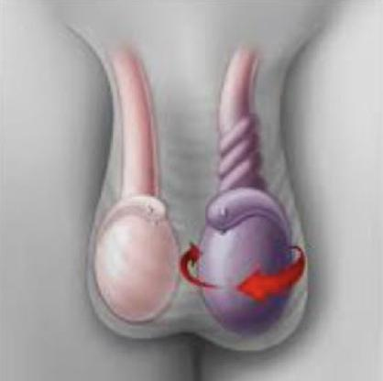
Pre-Operative Assessment:
Disease | Optimizing and risk assessment | Informed consent
Re-assessment of disease before surgery. | Optimization is basically to adjust the patient’s health status, medications and lifestyle. Young, healthy patients do not need it. Needed in more complex cases like in pregnancy, liver diseases and cardiac diseases. Risk assessment is to classify the patient as high or low risk. High risk patients need to be in ICU post-op | Consent does not mean informed consent. Non proper informed consent lead to high percentage of lawsuits.
Notes:
Assessing the risk guide you in management if it’s an elective surgery, for example: Hernia repair in high risk patient > you can abort the surgery (choose not to do the surgery at all)
Surgery + Anesthesia
Alert physiologic and metabolic status
Pre-operative assessment
Estimate the ability to respond to stresses in the post-operative period
Identify the risk or optimize
Remember:
In emergency surgery: pre-operative assessment is altered based on the patient condition.
Like in testicular torsion you do not have enough time to do full assessment, you only have 6 hours.
It can not be done by the surgeon alone but by multiple specialities like cardiology, pulmonology and endocrinology, etc..

Slide 3
How?
History:
Like in patients who are taking corticosteroid, they need a stress dose pre-operatively.
Physical examination:
Routine examination.
Investigations:
Blood tests.
Urine test, only for urology procedures.
ECG and chest X-ray, only for patients >35-40 years old. (Depends on the hospital protocol.
Consultation:
Chest pain > cardiology
Diabetes melitus > endocrinology
Cardiac evaluation:
Pulmonary evaluation:
Screening Tests:
You don’t need to repeat the tests unless there’s a change in patient’s illness
Validity:
4 months
But there’s certain conditions where these tests are mandatory
CBC:
> 500 cc Anticipated blood loss
Anemia
Chronic illnesses
Pregnancy
Renal Profile:
Chronic illnesses
Elderly (dehydration)
Fluid and electrolytes loss (diuretics, vomiting)
Urine tests: (not routinely done)
Urinary symptoms
Urinary procedures
ECG and chest X-ray
In older patients or undergoing a thoracic procedure.
If a surgery was done on a patient with asymptomatic infection, they might develop sepsis.

Slide 4
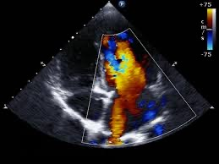
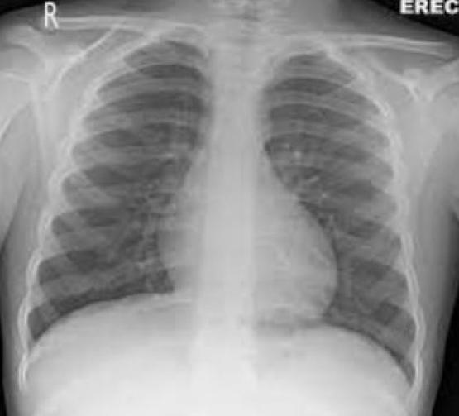
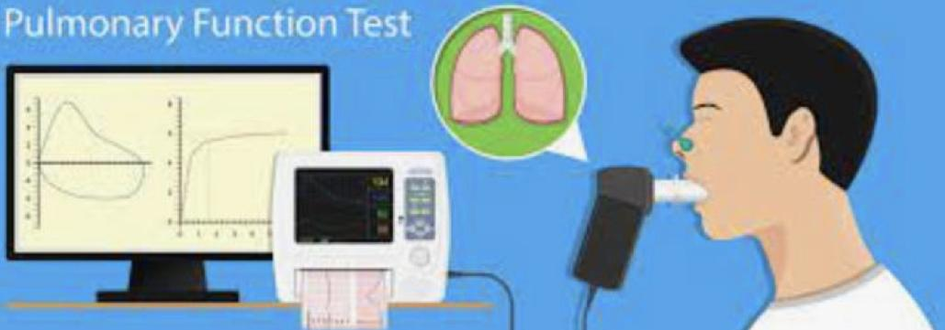
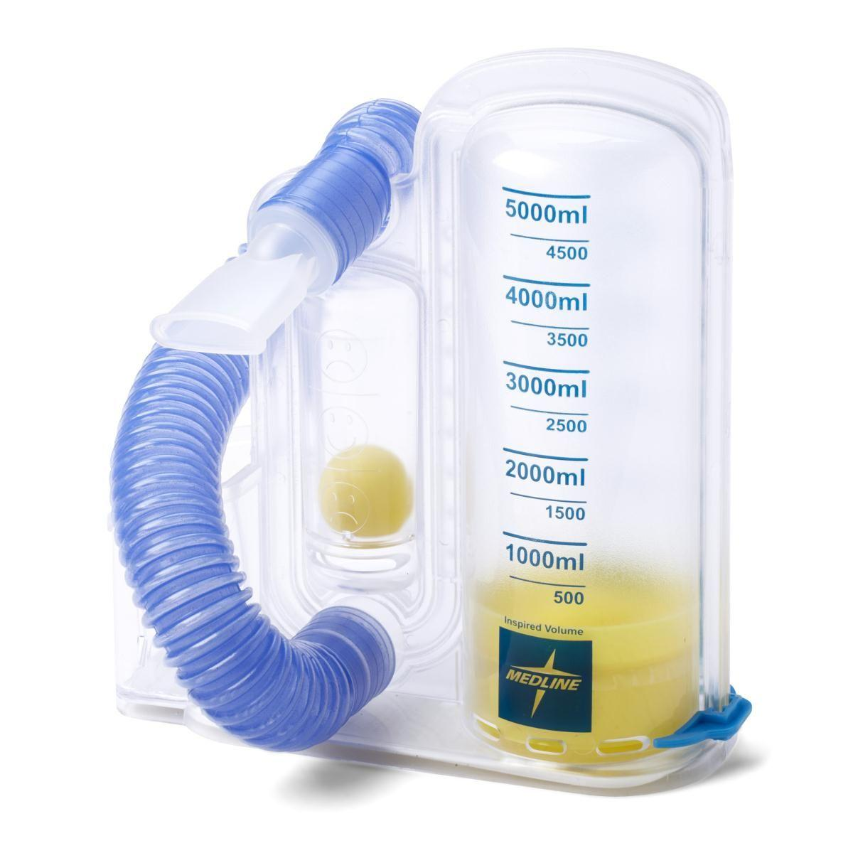
Why? | How?
Cardiac Evaluation
Surgical stress response > catecholamine surge (release) > increase in myocardial oxygen requirement. | ECG
Suppression of the fibrinolytic system > increase thrombosis risk. | Echo.
Coronary artery disease > higher risk for ischemia (post-operatively). Any case of CAD even if the patient is asymptomatic you must refer them to cardiology for Echo. and stress test. | Cardiac stress test
Pulmonary Evaluation
Identify patients at risk for perioperative complications and long-term disability. | Chest X-ray:
Identify modifiable factors: Smoking cessation for at least 6 wk before surgery. Try to stop it early because it decreases the risk by a lot. But if you stop it a couple of days before the surgery then it will increase the risk by a lot. Either stop early or don’t stop at all. Inspiratory muscle training. By incentive spirometer to prevent atelectasis Bronchodilator therapy. Antibiotic therapy for pre-existing infections. Pretreatment of asthmatic patients with steroids. | Pulmonary function test: Consult Pulmonolog.
Incentive Spirometer

Slide 5
Specific conditions might affect surgical outcomes:
1- Renal Dysfunction:
Chronic Kidney Diseases (CKD):
Normochromic, normocytic anemia.
Patients are usually okay but after surgery stress everything changes.
Patients with anemia are more prone to cardiac events.
Immune responses are deficient hence the patients become prone to infections.
Blood-borne pathogens and also develop antibodies because of multiple transfusions.
They might need blood transfusion to avoid hypotension.
Do type and screening before the surgery because the results are usually delayed.
Chronic coagulopathy secondary to heparinization during dialysis, or the coagulopathy associated with uremia.
D-Desamino arginine vasopressin (DDAVP) promotes the release of von Willebrand’s multimers from endothelial cells. Which decrease the chance of bleeding.
Daily weighing.
Accurate intake and output records.
They’re prone to dehydration & fluid overload.
Avoidance of hypotension.
They could develop acute renal failure.
Careful administration of medications.
Analgesic.
They should not receive NSAIDs, opioids or gentamicin.
Electrolytes.
Monitoring renal function.
Risk Factors for Acute Kidney Injury (AKI):
Age. Elderly
Past history of kidney disease.
Left ventricular ejection fraction of <35%.
Cardiac index < 1.7 L/min/m2.
Hypertension.
Peripheral vascular disease.
Diabetes mellitus.
Emergency surgery.
Type of surgery.
Highest Risk Surgeries that could cause AKI:
Cardiac and liver surgeries have the highest risk.
Coronary artery surgery.
Cardiac valve surgery.
Aortic aneurysm surgery.
Liver transplant surgery.

Slide 6
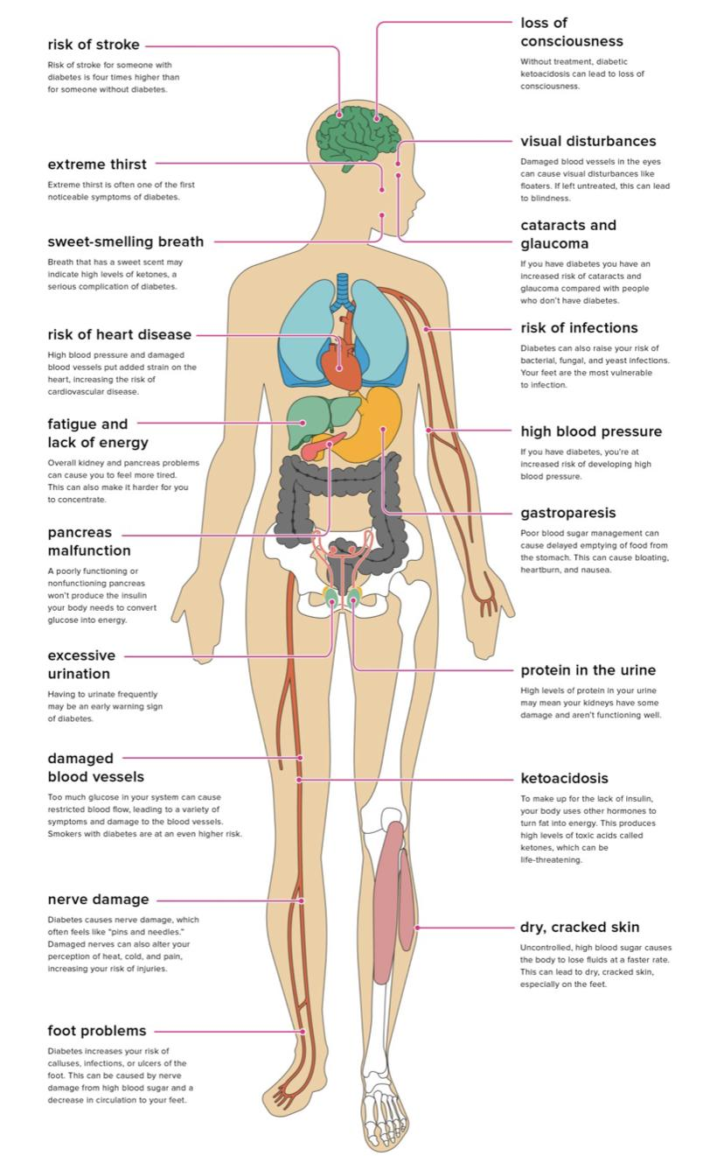
2- Diabetic patients:
Hyperglycemia.
Peripheral insulin resistance.
Increased hepatic glucose production.
Impaired insulin production.
Surgical stress or infections
Neuro-endocrine response (increase surge)
Counter-Regulatory Hormones:
Goal:
Glucagon
Epinephrine
Cortisol
Growth hormone
Achieve euglycemia.
Hyperglycemia is better tolerated than hypoglycemia.
Hypoglycemia can cause starvation and damage the brain which ↑ mortality.
Modest hyperglycemia.
Continuous infusion of insulin.
Complications in Diabetic Patients:
Cardiovascular diseases. ↑ cardiac event after surgery
Autonomic neuropathy.
Nephropathy. They’re more prone to AKI
Gastroparesis.
Prone to infections.
Higher risk of infection. Because of impaired immunity
Wound healing.
In the limbs due to PAD.
Medications Adjustment:
Because the patient will fast before surgery.
Rapid-acting and short-acting insulin: withheld at midnight the day before surgery.
Intermediate-acting and long-acting insulin: two-thirds the normal evening dose the night before surgery and half the normal morning dose the morning of surgery.
Long-acting oral agents: stopped 48 to 72 hours before surgery.
Short-acting agents: withheld the night before or the day of surgery.

Slide 7
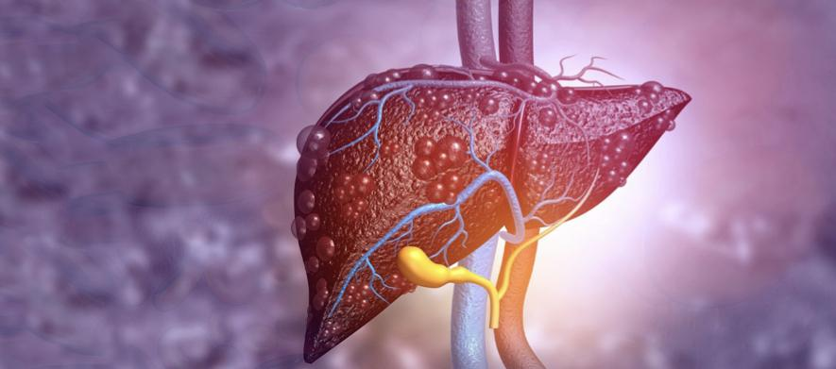
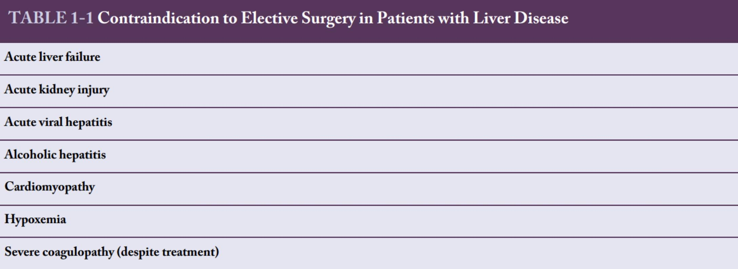
3- Hepatic dysfunction:
Mortality depends on:
Degree of hepatic dysfunction.
Nature of the surgical procedure.
Presence of comorbid conditions.
Cirrhosis: IMP
Class A: Go for surgery.
Class B: Do the surgery but be careful especially in liver or cardiac surgery.
Class C: Do not do the surgery.
Ascites:
Ascites is a risk factor for wound dehiscence and compromised ventilation.
Pre-operative control of ascites with diuretics or transjugular intrahepatic portal caval shunt (TIPS) is recommended.
Medical therapy for ascites includes salt restriction to 2 g/day with the combination of spironolactone and furosemide.
Bleeding:
Decreased production of clotting factors because of hepatic synthetic dysfunction
Depletion of vitamin K.
Platelet abnormalities (number and function).

Slide 8
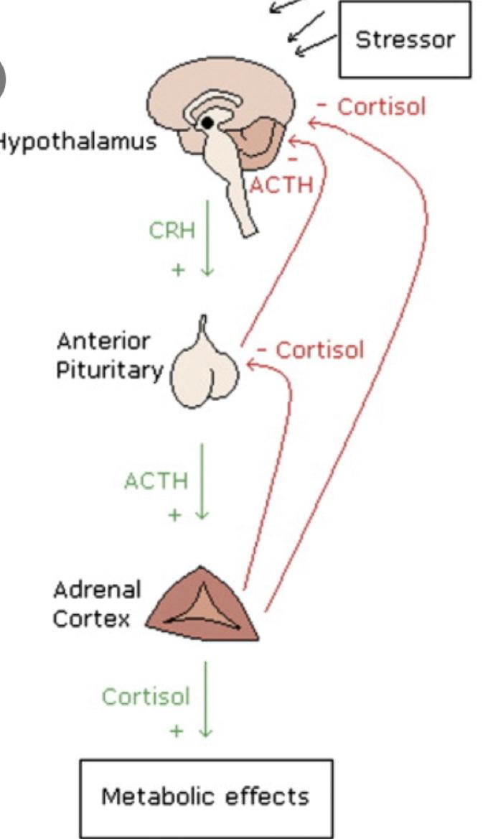
Deficiencies:
liver disease > protein-energy malnutrition.
Cholestatic liver disease > fat-soluble vitamin malabsorption.
Alcohol-induced liver disease > deficient in thiamine and folate and have depleted levels of total body potassium and magnesium.
So give the patients supplements.
4- Adrenal Insufficiency:
These patients are on glucocorticoid (prednisolon).
After the surgery glucosteroid will not increase due to over feedback.
You should give them glucosteroid (stress dose) or they will develop hypotension.
If the patient is taking 20 mg/day of steroids then they need the stress dose before surgery.
Remember that steroids affects the healing process and increase infections.
Glucocorticoid Therapy:
Increased susceptibility to infection.
Impaired tissue healing.
Abnormalities of glucose metabolism.
When?
prednisone-equivalent dose of 20 mg/day for at least 3 weeks.
How?

Slide 9
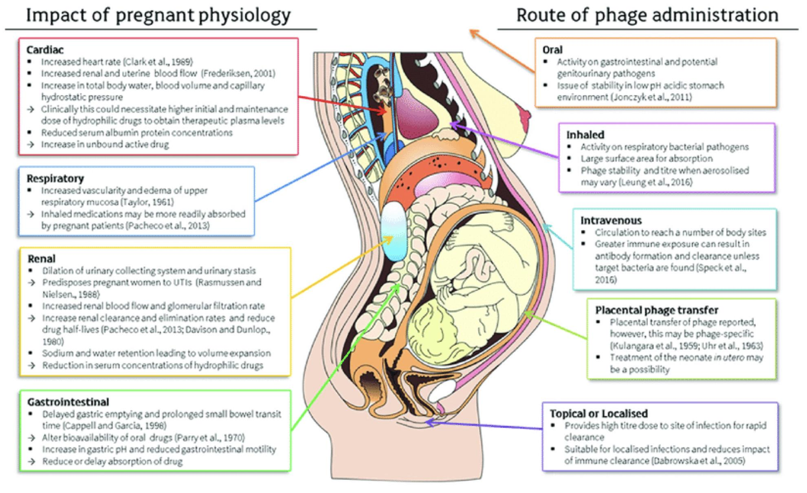
5- Pregnancy:
Surgeons do not like to operate on pregnant women but sometimes they have to.
Changes in Pregnancy:
Increase risk of DVT. (Venous insufficiency)
Uterus alter visceral location > change pain pattern.
Heart rate, stroke volume, Erythrocyte volume and plasma volume are increased > can mask blood loss or delay the classic presentation of hypovolemia.
Leukocytosis > reduces the utility of this laboratory test.
Respiratory rate and tidal volume are increased > lowers the arterial partial pressure of carbon dioxide.
Reduction in functional residual capacity and residual volume imposed by the restriction of diaphragmatic motion > potential for atelectasis and other pulmonary complications is increased.
Increase Gastric acid production and delay in gastric emptying > Nausea and vomiting
Timing:
Avoid a surgical procedure.
If surgery is necessary > second trimester.
Best timing for less abortions.
Most common surgeries done are LAP choly and appendicitis.
If elective then delay it.

Slide 10
Informed Consent:
Informed Consent:
A process.
Does not protect you 100%
Consent:
A legal document.
If you do the procedure and you have explained beforehand that bleeding is a complication of this surgery, and the patient had bleeding, you are still not completely protected. But if you do not let the patient sign on the informed consent you will surely face a litigation.
You will have a litigation if your number is higher than the known percentage.
For example if your infection rate is 20% that means that you’re doing something wrong.
Informed Consent
Diagnosis | Discuss in terms that the patient understands.
Procedure | Does not need to be technical or complicated but he needs to understand what you’re going to do.
Adverse events | That could happen during the surgery.
Benefit | What will the patient gain from the surgery. What is the harm if the surgery was not done.
Alternative options | If there is a laparoscopic option that you don’t do. Even procedures that are not available in your hospital.
Informed consent:
Autonomy
The patient can refuse surgery at any time.
Documentation

