Slide 1
Surgical complications
Surgery Team
MED437
Team Leader: Rawan Mishal
Team Members: Reham alhalabi
Khulood Alwehaibi
Revised By: Arwa aljohany

Slide 2
General complications
Postoperative Nausea and Vomiting
Very common
Can be caused by surgery and/or anaesthesia
Antiemetic can prove useful and can be considered prophylactically
Constant Nausea and Vomiting can be a sign of postoperative ileus or an underlying GI or infectious etiology
For few days , few episodes that’s fine , if its continuous you want to make sure there is no other underlying etiology such as paralytic ileus or underlying infection , so initially give them antiemetics and hydrate them afterwards you need to get CT or X-ray to rule out underlying etiology
NGT tube whenever you see vomiting post op to avoid aspiration pneumonia
N/V Happens in any surgery but very common after GI surgery
Hiccups
Usually, Transient
Can be caused by diaphragmatic irritation, gastric distension or metabolic causes such as renal failure
If no precipitating cause can be found, small doses of chlorpromazine may be helpful
If persistent or delayed presentation, it can indicate an underlying problem (e.g. Abscess under the diaphragm)
Most common causes you will see ; electrolyte imbalances or anything irritate the diaphragm ex; patient did sleeve gastrectomy when he has continuous hiccup make sure no abscess next to diaphragm
Constant Hiccups can be caused by sub-diaphragmatic Abscess
Ileus = gas distention of stomach = irritation to diaphragm = hiccup
2 weeks post op, only hiccups think thoracic pathology or infection
Splenectomy and sub-diaphragmatic hematoma, this could lead to pleural effusion which is a physiological reaction, if asymptomatic don’t do anything
Ileus
Ileus is a temporary lack of the normal muscle contractions of the intestines.
Multiple risk factors including medications, infection and abdominal surgery
Management
NPO
Nasogastric tube for decompression
Decrease opioids or contributing medications
IV hydration
Fix electrolytes
There are many risk factors some of them are medication related such as opioids , Abdominal surgery, prolong surgery, infection ; if there is abscess the bowel next to abscess will be paralytic
Treat it : keep NPO with decompress because if the fluid keep accumulating in the bowel this puts a pressure on the wall of the bowel and compromise the vasculature

Slide 3
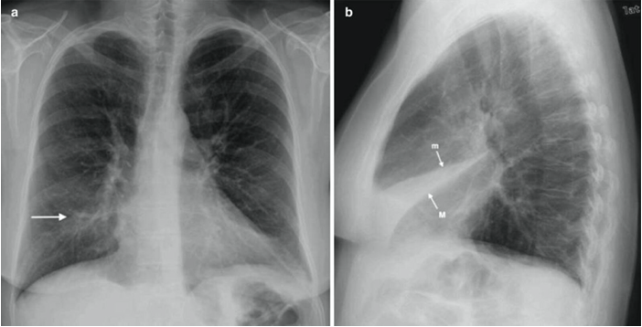
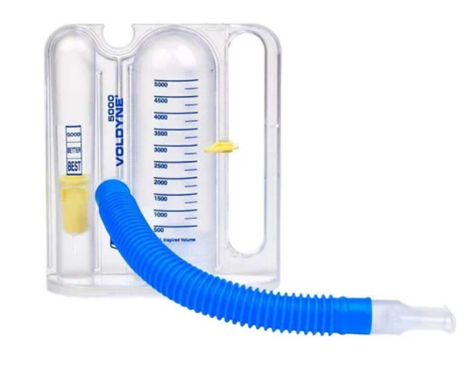
Pulmonary Complications
More common after emergency surgery
Main respiratory problems are:
Pulmonary collapse (atelectasis)
Pulmonary infection (pneumonia)
Pleural effusion and pneumothorax (occur less commonly)
Pulmonary embolism (PE) is a major complication of deep venous thrombosis (DVT)
1) Atelectasis (pulmonary collapse)
Caused by the inability to breathe deeply and cough up bronchial secretions
Contributory factors include:
paralysis of cilia by anaesthetic agents
impairment of diaphragmatic movement
Over-sedation
abdominal distension and/or wound pain
Anything that stops patient from taking a full breath, or remnant from anesthesia
Usually occurs within 24 hours.
It can lead to increased work of breathing and impaired gas exchange; if untreated, secondary bacterial infection will supervene, causing pneumonia.
The clinical signs of pulmonary collapse include:
rapid respiration
Tachycardia and mild fever
Chest x-ray shows areas of increased opacification.
Atelectasis is more common in lower lobe
Usually around costophrenic angle is the most common location, seen by obliterated angle
Preoperative measures to reduce the risk of pulmonary collapse following surgery include:
cessation of smoking
physiotherapy if COPD exists
deferring elective surgery for at least 2 weeks in patients with a chest infection
Postoperatively, pulmonary collapse is prevented by encouraging the patient to breathe deeply, cough and mobilise.
Most common, collapse, SOB, pain, make them cough & give incentive spirometry
Its actually inhalation that matters not blowing
Why doesn’t anesthesia ventilate them enough so they don’t have collapse?
There is something called baro pressure so you want to avoid the ventilator putting
too much air to avoid baro injury

Slide 4
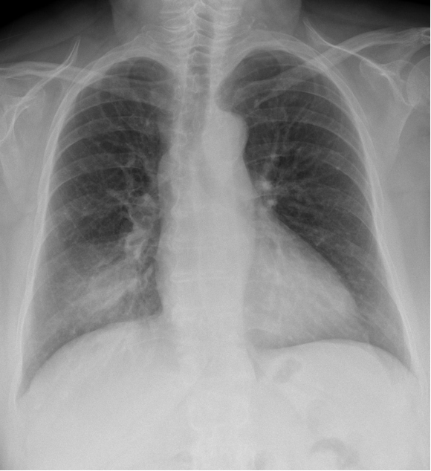
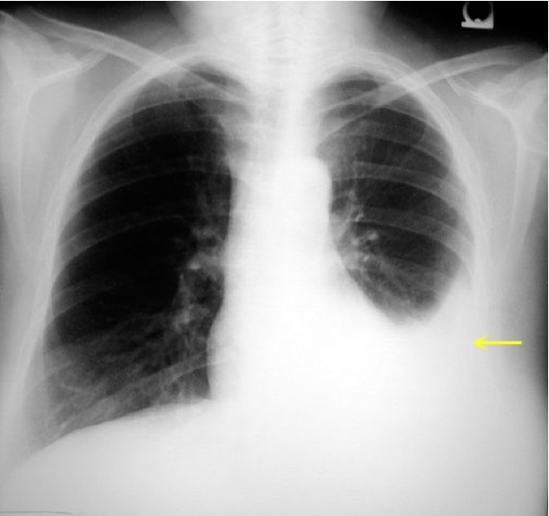
2) Pulmonary Infection
Pulmonary infection commonly follows pulmonary collapse or aspiration of gastric secretions.
Fever, tachypnoea and green sputum are typical.
Chest x-ray usually demonstrates patchy opacities.The patient is encouraged to cough, and antibiotics are prescribed after sputum is sent for bacteriological examination.
Most pulmonary infections are caused by Streptococcus pneumoniae and Haemophilus influenzae
Can be caused by gram-negative bacilli acquired by aspiration of oropharyngeal secretions.
Antibiotics provide the mainstay of treatment. Oxygen is given for hypoxia, and more intensive measures, including bronchoscopy and assisted ventilation, are instituted if respiratory function continues to deteriorate.
3-5 days, productive cough is common, might have sputum without cough
If there is a mucus plug bronchoscopy and suctioning is indicated
Start empirically then change according to culture
In cases of vomiting they get Gram - IMP**** treat them like GI infection
Causes are Aspiration when you induce anesthesia, Post operative N/V > aspiration , Ventilator associated pneumonia
3) Pleural effusion
Small pleural effusions are common following upper abdominal surgery but are usually of no clinical significance.
They may be secondary to other pulmonary pathology, such as collapse/consolidation
The appearance of a pleural effusion 2–3 weeks after an abdominal operation may suggest the presence of a subphrenic abscess.
Small effusions may be left alone to reabsorb if they do not interfere with respiration
Moderate or larger size effusions require pleural aspiration and bacteriological culture of aspirated fluid
Common after upper abdominal surgeries, common after atelectasis too like infections
Can happen if you have abscess under diaphragm, , pneumonia
Abscess = treat by pig tail drainage
You can give them diuretics only if large, smaller do not need anything
If pt gets orthopnea this is an indication for drainage
If you remove colon cancer then they get pleural effusion think mets
Pulmonary infections
Pleural effusion

Slide 5
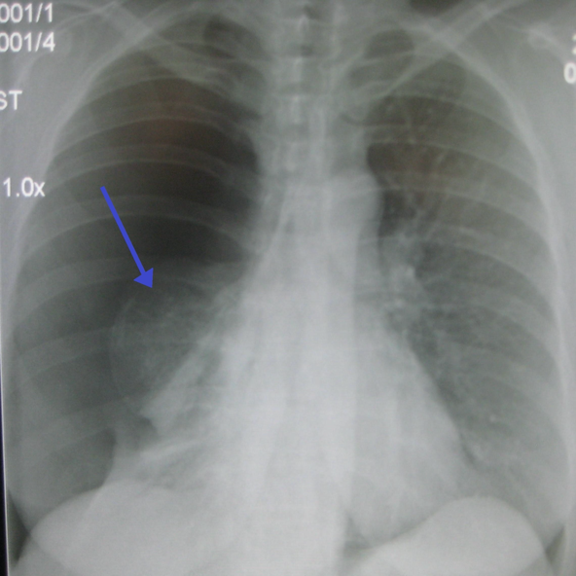
4) Pneumothorax
The most common cause of postoperative pneumothorax is the insertion of a central venous line, and a chest x-ray is necessary after this procedure to exclude this potential complication.
There is also an enhanced risk of pneumothorax in patients on positive-pressure ventilation, presumably owing to rupture of preexisting bullae.
Treatment: The insertion of an underwater seal drain
In general the best answer is chest tube
The most common cause of postoperative pneumothorax is the insertion of a central venous line, And Usually at the right side why? Because most of us are right handed
If you detect it intra op treat it immediately
Injury to diaphragm might cause it

Slide 6
Cardiac Complications
The risks of anaesthesia and surgery are increased in patients suffering from cardiovascular disease.
Whenever possible, arrhythmias, unstable angina, heart failure or hypertension should be corrected before surgery.
Controlled arrhythmia is ok, uncontrolled is a contraindication to surgery
Valvular disease, especially aortic stenosis, impairs the ability of the heart to respond to the increased demand of the postoperative period.
The administration of fluids to patients with severe aortic or mitral valve disease should be carefully monitored.
Electrolytes disturbances > arrhythmia, Hypovolemia: arrhythmia , MI, Surgical stress : MI, Too much fluid : HF
1) Myocardial ischaemia/infarction
Myocardial ischaemia or cardiac arrest can occur in an otherwise fit patients.
Although most commonly present in patients with previous cardiovascular disease
Patients with ischaemia may complain of gripping chest pain, but this is not invariable (particularly in the elderly diabetic patient or in the early postoperative period) and hypotension may be the only sign.
When suspected:
an ECG is performed urgently and arrangements are made for cardiac monitoring.
A sample of blood is withdrawn to estimate concentrations of cardiac enzymes.
Cardiac consultation and appropriate management should follow

Slide 7
2) Heart failure
Clinical manifestations are:
progressive dyspnoea
Hypoxaemia
diffuse pulmonary congestion on chest x-ray
Common cause of acute cardiac failure is excessive administration of fluid in the early postoperative period in patients with limited myocardial reserve Or even intra op
Treatment consists of avoiding further fluid overload, and the administration of diuretics and cardiac inotropes.
3) Arrhythmias
Sinus tachycardia ( Most common )is common and may be a physiological response to hypovolemia or hypotension.
It is also caused by pain, fever, shivering or restlessness.
Sinus bradycardia may be due to vagal stimulation by neostigmine, pharyngeal irritation during suction, or the residual effects of anaesthetic agents.
Atrial fibrillation is the most common postoperative arrhythmia. Fast atrial fibrillation may result in haemodynamic disturbances and may require pharmacological intervention.
Refractory cases may require cardioversion.

Slide 8
Shock
1) Postoperative shock
Shock is defined as a failure to maintain adequate tissue perfusion.
The three main types are hypovolaemic, cardiogenic and septic shock.
Hypovolemic shock may be caused by inadequate replacement of pre- or perioperative fluid losses, or postoperative haemorrhage
Cardiogenic shock is usually secondary to acute myocardial ischaemia/infarction or an arrhythmia.
Hypovolemic and cardiogenic shock are characterised by
Tachycardia
Hypotension
Sweating
Pallor and vasoconstriction
- You can't distinguish between them unless you do an ECG
- Septic and hypovolemic need lots of fluid, With cardiogenic be careful of heart failure
2) Septic Shock
Septic shock is characterised in the early stages by a hyperdynamic circulation with fever, rigors, a warm vasodilated periphery and a bounding pulse.
Later features include hypotension and peripheral vasoconstriction.
Without appropriate management, shock will result in oliguria and the development of multisystem organ failure and may lead to death.
Septicemia screening: Chest x-ray, Sputum, Urine culture, Blood culture

Slide 9
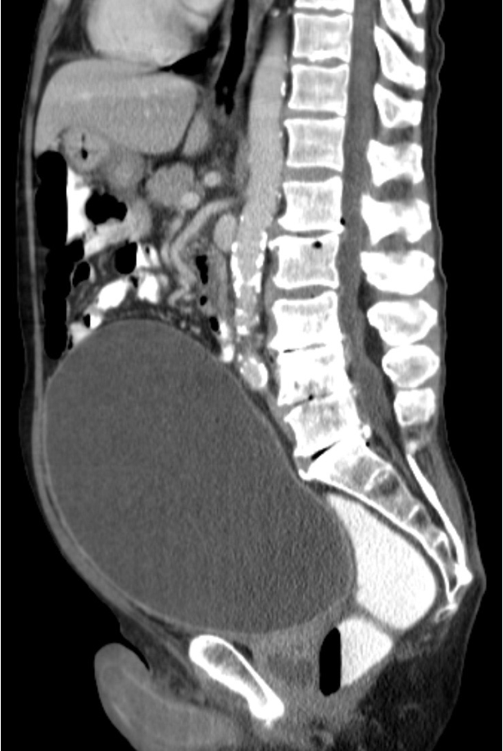
Urinary Complications
Postoperative urinary retention
Inability to void postoperatively is common, especially after groin, pelvic or perineal operations, or operations under spinal/epidural anaesthesia.
Postoperative pain, the effects of anaesthesia and drugs, and difficulties in initiating micturition while lying or sitting in bed may all contribute.
Males tend to be more commonly affected than females.
When its normal capacity of approximately 500 mL is exceeded, the bladder may be unable to contract and empty itself.
Frequent dribbling or the passage of small volumes of urine may indicate overflow incontinence, and examination may reveal a distended bladder.
The management of acute urinary retention is catheterisation of the bladder, with removal of the catheter after 2–3 days
How to differentiate if the patient has no urine or urinary retention ? 1)they can tell you I really want to go but I can’t 2) bladder scan , they put it in suprapubic area and they can measure how much fluid in the bladder
Urinary tract infection
Urinary tract infections are most common after urological or gynaecological operations.
Preexisting contamination of the urinary tract, urinary retention and instrumentation are the principal factors contributing to postoperative urinary infection.
Cystitis is manifested by frequency, dysuria and mild fever, and pyelonephritis by high fever and flank tenderness.
Treatment involves adequate hydration, proper drainage of the bladder and appropriate antibiotics.
100% Exam question :
Patient with urinary retention, how do you manage it ?
In and out catheterization twice and then leave Foley catheter with urology follow up
You don’t give them lasix , you don’t send them home

Slide 10
Venous Thromboembolic Events
Deep venous thrombosis (DVT)
The pathogenesis of venous thrombosis involves stasis, increased blood coagulability and damage to the blood vessel wall (Virchow’s triad).
The incidence of DVT varies with the type of operation and the associated risk factors, which include
Increasing age
Obesity
prolonged operations
pelvic and hip surgery
malignant disease
previous DVT or PE
varicose veins
Pregnancy
use of the oral contraceptive pil
Measures to prevent DVT include:
taking care to avoid prolonged compression of the leg veins during and after the operation
the use of graded compression support stockings (TED stockings)
mechanical or electrical compression of the calf muscles during surgery
low-molecular-weight heparin
DVT is frequently asymptomatic, but may present with a painful, tender swollen calf.
It may be the cause of a postoperative fever.
Duplex ultrasonography is now the investigation of choice for diagnosing DVT.
Treatment with anticoagulation: LMWH, Heparin, warfarin, ….etc
Heparin dose depends on weight, Fat need 3 doses normal need 2
Post operatively depending on the pre operative risk you’ll continue prophylaxis , Certain procedures you give them up to 21 days and certain procedure you don’t need to
100% exam question:
What is the difference between heparin and LMWH ?
Regular Heparin has a reversal agent
Let’s say we need to anticoagulate someone who has risk of bleeding we use heparin because it’s reversible

Slide 11
Venous Thromboembolic Events
Pulmonary embolism
Symptoms of pulmonary embolism include:
Chest pain
Dyspnea
Cough
Palpitation
Hemoptysis
Diagnosis usually with CT Angiography of the chest
Treatment: Anticoagulation
In case of massive PE fibrinolytic agents such as streptokinase can be used
In extreme cases thrombectomy can be performed

Slide 12
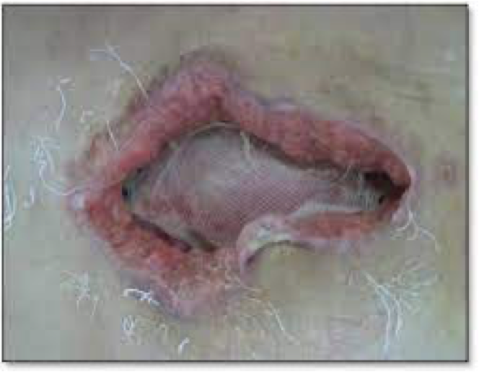
Wound Infection
Wound infection is the most common complication in surgery.
The incidence varies from less than 1% in clean operations ( Lipoma, thyroid) to 20–30% in dirty cases.
Subcutaneous haematoma is a common prelude to a wound infection, and large haematomas may require evacuation.
The onset is usually within 7 days of operation.
If a wound becomes infected, it may be necessary to remove one or more sutures or staples prematurely to allow the egress of infected material.
The wound is then allowed to heal by secondary intention.
Antibiotics are only required if there is evidence of associated cellulitis or septicaemia.
Any abscess need drainage, if hard to access only Abx, Anything more than 5 cm you have to drain
Ingrown toenail just drain no need for Abx
Wound Dehiscence
The incidence of abdominal wound dehiscence should be less than 1%.
Wound dehiscence may be partial (deep layers only) or complete (all layers, including skin). If bowel comes out It is surgical emergency
A serosanguinous discharge is characteristic of partial wound dehiscence.
The extrusion of abdominal viscera through a complete abdominal wound dehiscence is known as evisceration.
Risk factors include obesity, smoking, respiratory disease, obstructive jaundice, nutritional deficiencies, renal failure, malignancy, diabetes and steroid therapy; however, the most important causes are poor surgical technique, persistently increased intra-abdominal pressure, and local tissue necrosis due to infection.
The wound should be re-sutured under general anesthesia.
Skin intact but fascia is dehiscenced, you can wait and treat it later like hernia
Wound Complications

Slide 13
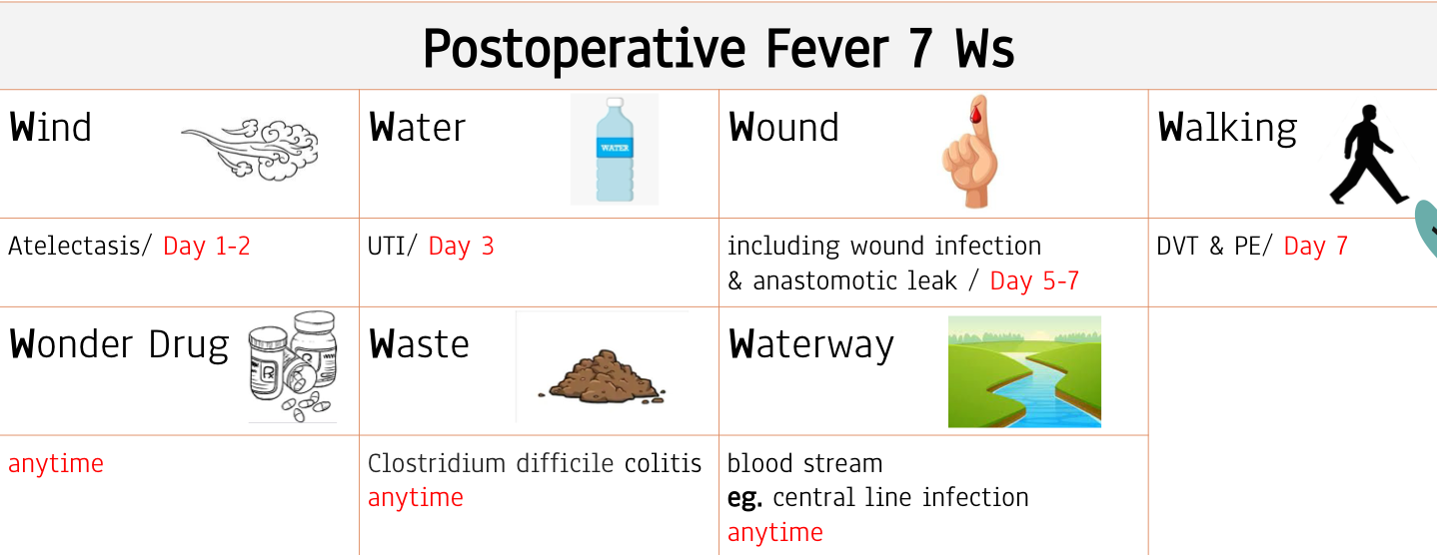
Extra

